Slide 1
Chapter 4
Design of polynomial-time
exact algorithm

Slide 2
Outline
Review of complexity
A case study
  Optimal relay node assignment for cooperative communications

Slide 3
Review of Complexity
Class P
  Exist a polynomial-time complexity algorithm
Class NP
  Exist a non-deterministic polynomial-time complexity algorithm
NP-hard
  Any problem in Class NP can be reduced to it in polynomial-time

Slide 4
Review of Complexity (cont’d)
NP-complete
  If it is in Class NP and is NP-hard
Unless P=NP, no polynomial-time algorithm to solve an NP-hard
or NP-complete problem
Existing a non-polynomial-time algorithm does not mean this
problem is not in P
Notes:
We will show an example in case study.

Slide 5
Outline
Review of complexity
A case study
  Optimal relay node assignment (ORA) for cooperative communications

Slide 6
Outline of Case Study
6
Cooperative communications (CC)
    Amplify and forward (AF)
    Decode and forward (DF)
Relay node assignment problem (RA)
ORA algorithm
Numerical results

Slide 7
CC Network Model
Each node only has a single antenna
Transmission is done on a frame-by-frame basis
  One frame has two time slots
Relay Node
2nd Time Slot
1st Time Slot
Receiver
Sender
1st Time Slot
7
Notes:
1. CC is a recent advance in physical layer technology.
2. Two-slot structure is necessary due to half duplex nature of most wireless transceivers.
3. Antennas on sender and relay node cooperate to achieve spatial diversity

Slide 8
Two Modes of CC
Amplify and forward
  1st time slot: Receives the signal
  2nd time slot: Amplifies and forwards the signal to destination node
Decode and forward
  1st time slot: Receives and decodes the signal
  2nd time slot: Forwards the decoded signal

Slide 9


AF Mode – 1st Time Slot
The signal from s to d is
and the received signal at the relay node r is
Relay Node
1st Time Slot
1st Time Slot
Receiver
Sender

Slide 10
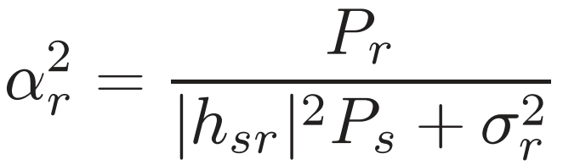
AF Mode – 2nd Time Slot
The signal from r to d is
where
Relay Node
2nd Time Slot
Receiver
Sender

Slide 11

AF Achievable Rate
Achievable rate is
where
and
Notes:
By combining signals from s->d and s->r->d, the achievable rate is …

Slide 12
DF Achievable Rate
Achievable data rate for DF is:
where
12

Slide 13

Direct Transmission Achievable Rate
The achievable rate by direct transmission is
Achievable rate with CC may be higher or lower than direct transmission
13

Slide 14
Outline of Case Study
14
Cooperative communication (CC)
  Amplify and Forward (AF)
  Decode and Forward (DF)
Relay node assignment problem (RA)
ORA algorithm
Numerical results

Slide 15





A Cooperative Ad Hoc Network
s₁
r₁
d₃
d₄
s₃
r₃
s₅
s₂
r₄
d₂
d₅
r₅
r₆
r₇
d₁
r₂
s₄
{ }: the set of source nodes;
  { }: the set of destination nodes;
  { }: the set of relay nodes.
  and
15

Slide 16
Optimal Cooperative RNA Problem
A widely used performance metric: Achievable data rate
Aim to maximize the minimum achievable data rate among all source-destination pairs
    To ensure fairness
Relay node assignment affects achievable rate
  We need to determine optimal relay node assignment
16
Notes:
Other performance metric can also be used

Slide 17
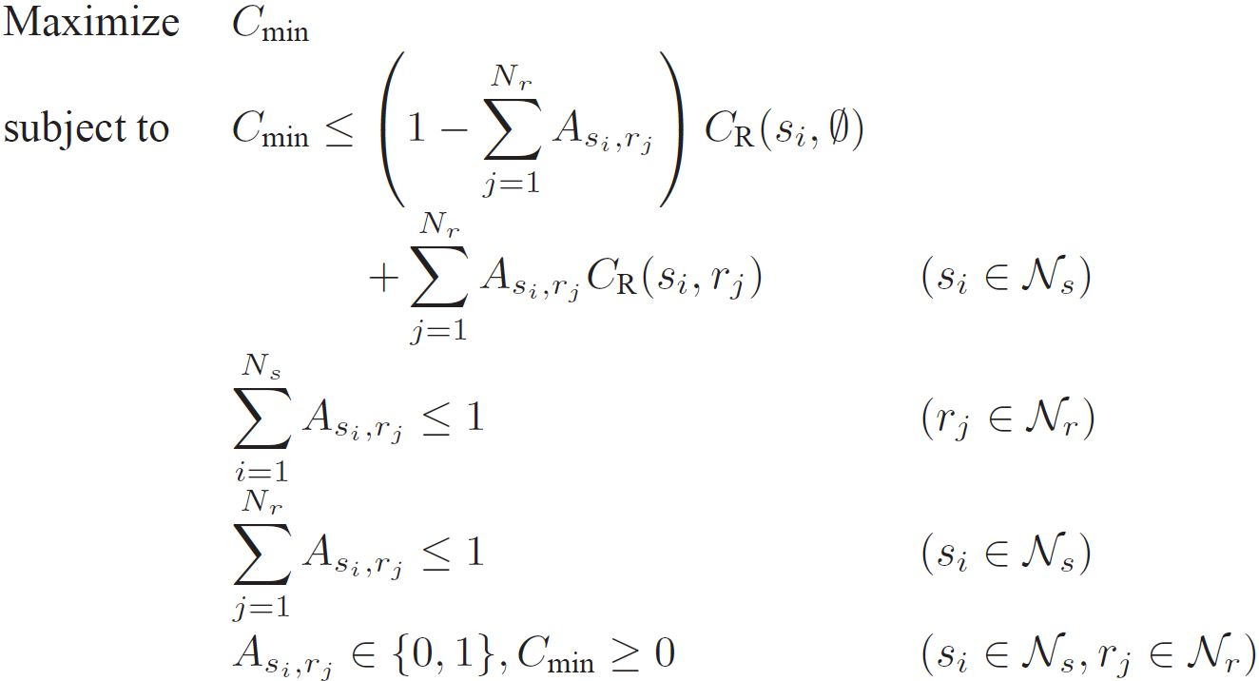

Formulation for RNA
NP hard?
NP-hard formulation is not a proof of a problem’s NP-hardness
Integer variable
where
17
Notes:
A source node s_{i} will be assigned at most one relay node
A relay node r_{j} can be assigned to at most one source node

Slide 18
Outline of Case Study
18
Cooperative communication
  Amplify and forward
  Decode and forward
Relay node assignment problem (RA)
ORA algorithm
Numerical results

Slide 19
Basic Idea
Starting with any feasible relay node assignment
  Different initial relay node assignment can lead to the same optimal solution
  Special case: Use direct transmissions

Slide 20
Basic Idea (cont’d)
Increasing objective C_{min} during each iteration
  Identify the source node corresponding to C_{min} (bottleneck node).
  Make adjustment to increase the achievable rate of this bottleneck node
    Make sure the new achievable rate is strictly greater than C_{min}.
  If no adjustment is possible, the algorithm terminates

Slide 21
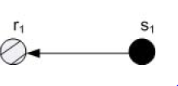

ORA Procedure
Suppose s₁ is the bottleneck node
Then s₁ examines other relays with achievable rate larger than C_{min}
  If no such relay, then ORA terminates.
  Otherwise, consider those relays in non-increasing order of achievable rates.
21

Slide 22
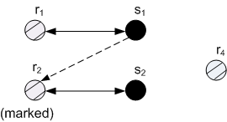


ORA Procedure (cont’d)
Suppose r₂ offers the largest achievable rate for s₁
  If r₂ is not assigned, then r₂ can be assigned to s₁ and current iteration is completed.
Otherwise, assume r₂ is already assigned to s₂. Mark s₂ to indicate r₂ is “under consideration” and check whether r₂ can be released from s₂.
22

Slide 23
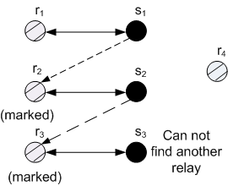
ORA Procedure (cont’d)
To release r₂, s₂ needs to find an unmarked relay node with achievable rate larger than C_{min}
  If r₃ is the only choice and is not assigned, then r₃ can be assigned to s₂ and r₂ can be assigned to s₁. Current iteration is completed.
  Otherwise, mark r₃ and check whether r₃ can be release by s₃
23
Notes:
or direct transmission

Slide 24
ORA Procedure (cont’d)
If s₃ cannot find any unmarked relay that offers a higher achievable rate than C_{min}, then s₂ cannot use r₃ and s₁ cannot use r₂.
24
Notes:
or direct transmission

Slide 25
Clear Marks?
Now s₁ needs to consider other relays. Do we need to clear marks on r₂ and r₃ here?
Naïve approach clears marks such that r₂ and r₃ can be re-considered
in this iteration
ORA does not clear marks
  Each relay node can only be
  considered once in one iteration
  Marks will be cleared at the
  end of the iteration

Slide 26
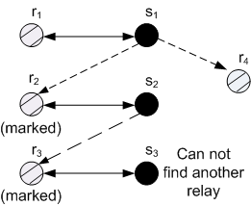
ORA Procedure (cont’d)
s₁ consider another relay r₄
  If r₄ is not assigned, it can be assigned to s₁ immediately and current iteration is completed.
26

Slide 27
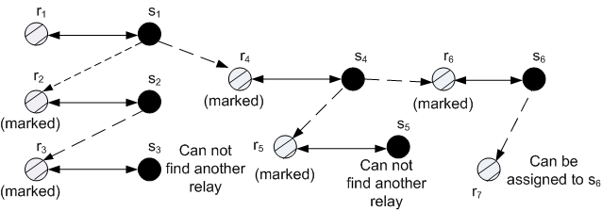
ORA Procedure (cont’d)
  If r₄ is assigned to other source, ORA continues.
s₄ does not check marked nodes r₂ and r₃
27

Slide 28
ORA Procedure (cont’d)
We have two outcomes for each iteration:
  If a better assignment is found, ORA identifies a new bottleneck node for the next iteration.
  If this iteration is non-improving, ORA terminates
28

Slide 29
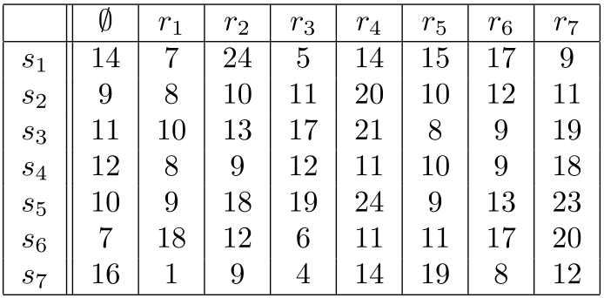
Example - Initial Relay Node Assignment
29

Slide 30

Example - First Iteration of ORA Algorithm
Bottleneck node s₃, C_{min}=13
30
Notes:
s₃ checks r₄, which is used by s₂.
r₄ cannot be released from s_{2,} because all unmarked relay nodes cannot provide a higher achievable rate than C_{min}
(2) s₃ checks r₇, which is used by s₄.
r₇ cannot be released from s₄, because all unmarked relay nodes cannot provide an achievable rate larger than C_{min}
(3) s₃ checks r₃, which is used by s₅
s₅ can use unmarked relay r₂ and has an achievable rate larger than C_{min}. Thus, r₃ can be released from s₅. Therefore, r₂ is assigned to s₅ and r₃ is assigned to s₃
30

Slide 31
Example - Second Iteration of ORA algorithm
Bottleneck node s₁, C_{min}=15
31
Notes:
(1) s₁ checks r₂, which is used by s₅.
(a) s₅ checks r₄, which is used by s₂
r₄ cannot be released from s₂, because all unmarked relay nodes cannot provide an achievable rate larger than C_{min}
(b) s₅ checks r₇, which is used by s₄
r₇ cannot be released from r₄, because all unmarked relay nodes cannot provide an achievable rate larger than C_{min}
(c) s₅ checks r₃, which is used by s₃
r₃ cannot be released from s₃, because all unmarking relay nodes cannot provide an achievable rate larger than C_{min}
Thus, s₂ cannot be released from s₅
(2) s₁ checks r₆, which is used by s₆.
Then, s₆ checks r₁ and finds r₁ is available because r₁ is unmarked and can provide an achievable rate larger than C_{min}. Thus, r₆ can be released from s₆. Therefore, s₁ uses r₆ and s₆ uses r₁
31

Slide 32
Example - Third Iteration of ORA Algorithm
Bottleneck node s₇, C_{min}=16
32
Notes:
s₇ check r₅, which is not assigned and can provide an achievable rate larger than C_{min}
so r₅ can be assigned to s₇ immediately.
32

Slide 33
Example - Last Iteration of ORA Algorithm
Bottleneck node s₃, C_{min}=17
33
Notes:
s₁ and s₃ have the same C_{min}. A tie is broken by taking the node with the largest node index.
s₃ checks r₄, which is used by s₂
r₄ cannot be released from s₂, because all unmarked relay nodes cannot provide an achievable rate larger than C_{min}
(2) s₃ checks r₇, which is used by s₄
r₇ cannot be released from s₄, because all unmarked relay nodes cannot provide an achievable rate larger than C_{min}
(3) s₃ does not have other choice. ORA is complete.
33

Slide 34






Complexity Analysis
  Before first iteration
    Step 1:
    Step 2:
    Step 3:
  Each iteration
    A source node needs to check at most relay nodes
    The number of source nodes is
    The complexity of an iteration is
  Number of iterations
    The number of iteration is
Overall complexity is:
Notes:
Refer to Figure 4.6: A pseudocode for the ORA algorithm
The dominant component in complexity is the recursive process of searching an unmarked relay node and checking its availability.
This process may involve all source nodes, each of which checking its relay nodes’ marking status and availability.

Slide 35
Naïve Approach
Perform both marking and unmarking within an iteration.
It considers all possible assignments
  Guarantee optimal solution
The complexity is exponential
  , if
  , if
35
Notes:
The complexity analysis will be a homework problem.
35

Slide 36
ORA v.s. Naïve Approach
Naïve approach
  Guarantee to find optimal solution
  Exponential time
ORA algorithm
  Polynomial time
  Optimal?
We will prove that ORA can guarantee optimality
36

Slide 37
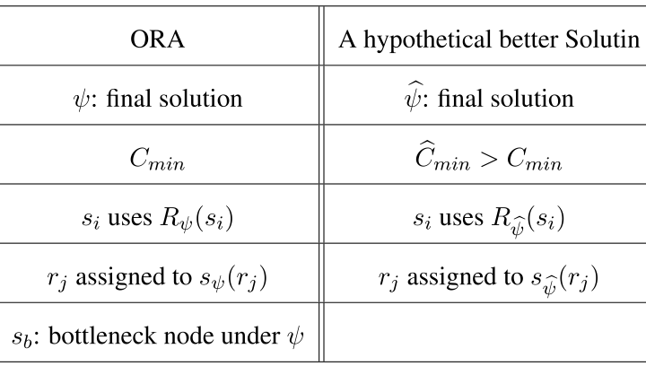
Proof of Optimality - Notation
The proof is based on contradiction
37

Slide 38

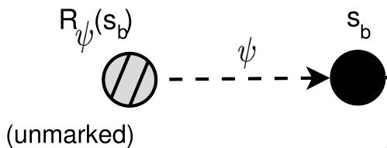

Proof of Optimality - Key Idea
We will prove
  Fact 4.1: is not marked at the end of the last ORA iteration
  If exists, then we will show that is marked at the end of the last ORA iteration
It contradicts with Fact 4.1, so a better solution does not exist.
38
Notes:
In ORA algorithm, a relay node r_{j} is marked only if r_{j} is not the relay node assigned to s_{b}.
Then we have Fact 4.1.

Slide 39
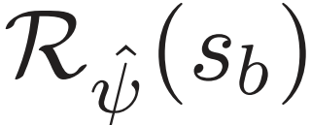


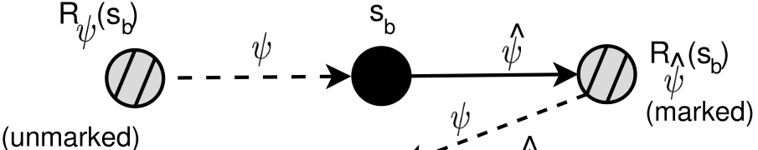


Proof of Optimality - Claim 4.1
Claim 4.1: Relay node must be marked at the end of the last ORA iteration. Further, it cannot be and must be assigned to some source node under .
Proof:
  Prove that must be marked:
    is a better solution, so

Slide 40

Claim 4.1(cont’d)
    ORA should have checked the relay node ’s available and find it is unavailable
    Thus, must be marked and will not be cleared in the last iteration.
  Prove that cannot be :
    If it is , s_{b} will choose direct transmission in the last iteration, since
    This contradicts that the last iteration is non-improving.
  Since is marked, it must be assigned to some relay node.
40

Slide 41




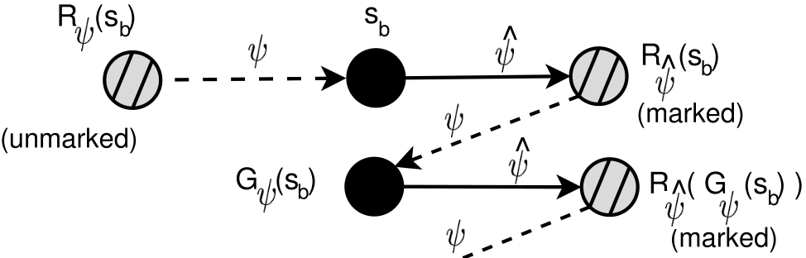
Proof of Optimality
By the definition of , we have that is assigned to source node in .
Define as .
41

Slide 42
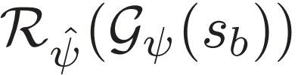
Proof of Optimality - Claim 4.2
Claim 4.2: Relay node must be marked at the end of the last ORA iteration. Further, it cannot be and must be assigned to some source node under .
  The proof follows the same token as that for Claim 4.1

Slide 43





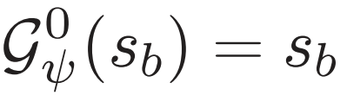
Proof of Optimality
Define
We have two cases:
  If source node is a node in , we terminate our recursive procedure
  Otherwise, we can further consider in
We use following general notations
  and

Slide 44
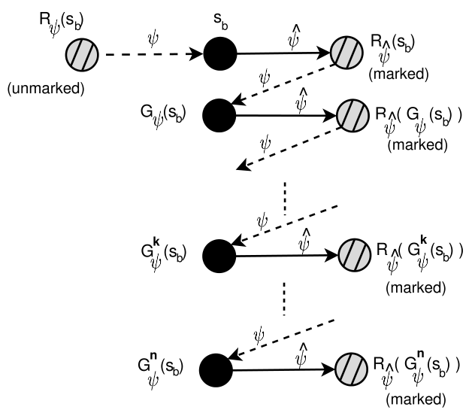
Proof of Optimality
Since the number of source nodes are finite, our recursive procedure will terminate in finite steps. Suppose we terminate at k=n.

Slide 45
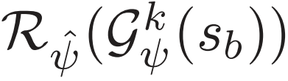
Proof of Optimality - Claim 4.3
Claim 4.3: Relay node must be marked at the end of the last ORA iteration. Further, it cannot be and must be assigned to some source node under solution , k=0, 1, 2, …, n.
45

Slide 46
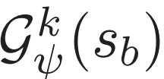

Proof of Optimality - Claim 4.3
Proof:
  Prove that must be marked:
    is a better solution, so
    ORA must have checked ’s availability for
    and find it is unavailable.
    Thus, must be marked at the last iteration.
  Prove that cannot be :
    If it is , will choose in the last iteration, since it can offer
46

Slide 47
Claim 4.3(cont’d)
    s_{b} will be able to get a better relay node. This contradicts with fact last iteration is non-improving.
  Since is marked, it must be assigned to some source node
47

Slide 48
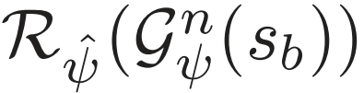

Proof of Theorem 4.1
Theorem 4.1. Upon the termination of ORA algorithm, the obtained solution is optimal.
Proof:
  Under Claim 4.3, we prove relay node is assigned to a source node in .
  Current iteration procedure terminates at , . Its assigned source node in must be in
48

Slide 49


Proof of Theorem 4.1 (cont’d)
But in , source nodes have their relay nodes , respectively
Then can only be assigned to s_{b} under
is assigned to s_{b} under
So

Slide 50
Proof of Theorem 4.1 (cont’d)
Claim 4.3 states that must be marked at the last iteration. But Fact 1 says is not marked.
We reach contradiction, the proof is complete
Thus, does not exit, and is optimal
50

Slide 51
Outline of Case Study
51
Cooperative communication
  Amplify and forward
  Decode and forward
Relay node assignment problem
ORA algorithm
Numerical results

Slide 52
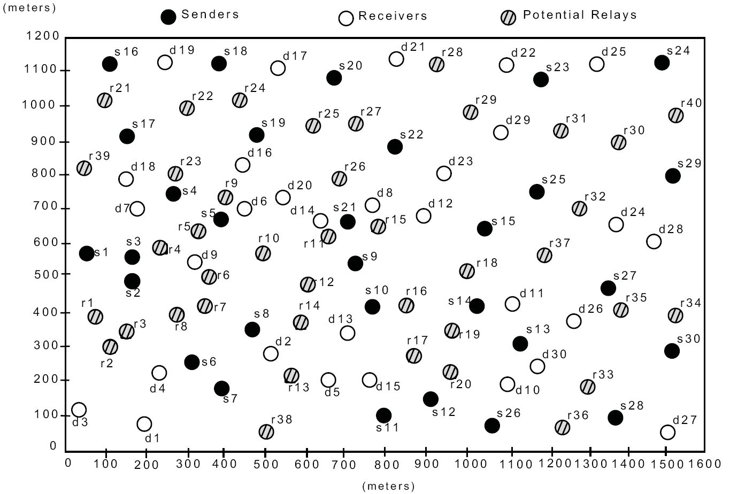
100-node Network Topology: Case 1 (N_{r}>N_{s})
N_{s} =30 and N_{r} =40
52

Slide 53
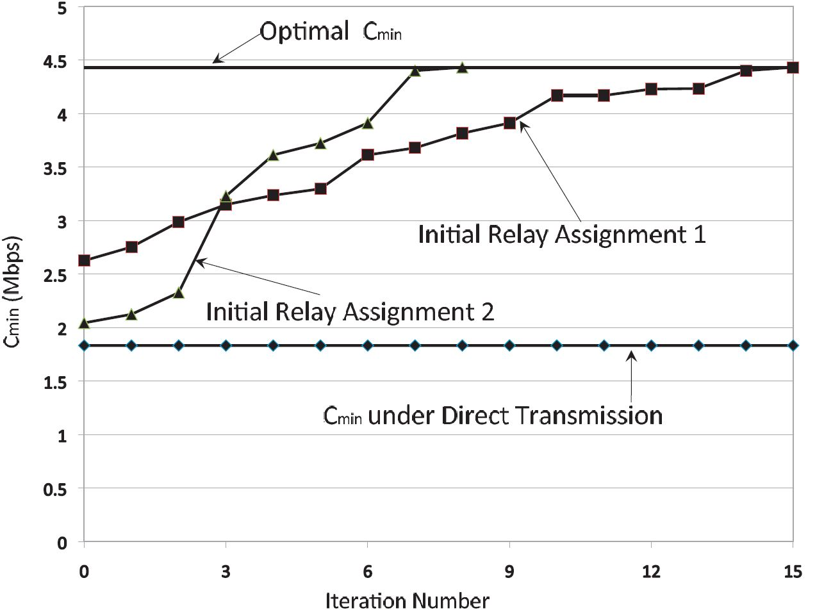
Case 1: Result
53
Notes:
Different initial assignment can lead to an optimal solution.
ORA algorithm can always lead to a better solution than direct transmission.

Slide 54
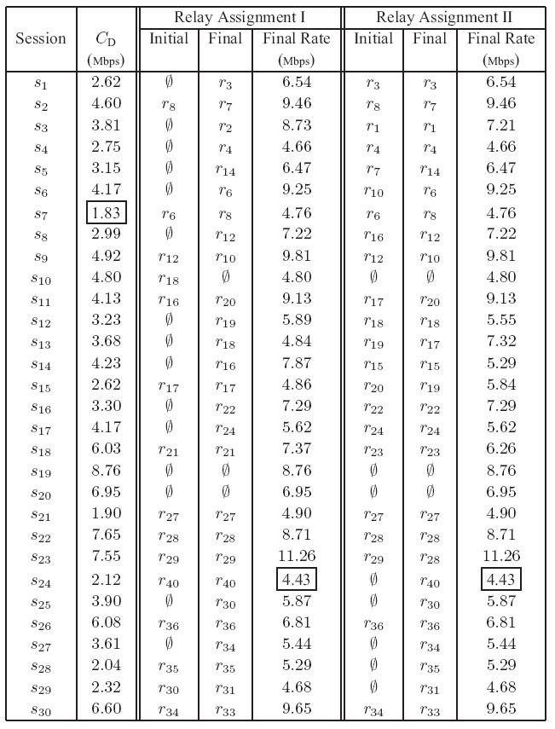
Case 1:
Optimal Assignment
142% improvement
54

Slide 55
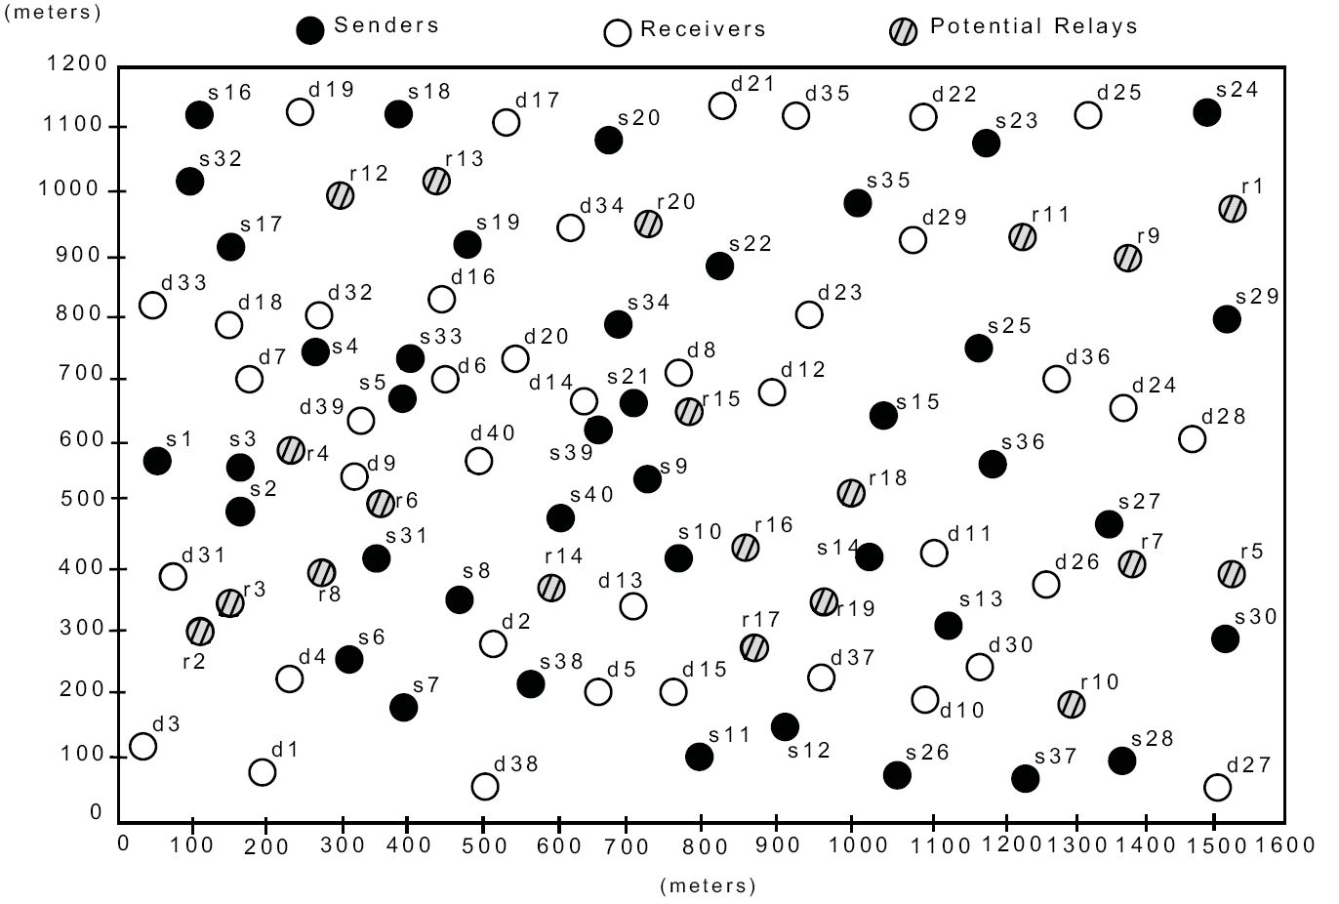
100-node Network Topology: Case 2 (N_{r}<N_{s})
N_{s}=40 and N_{r}=20
55

Slide 56
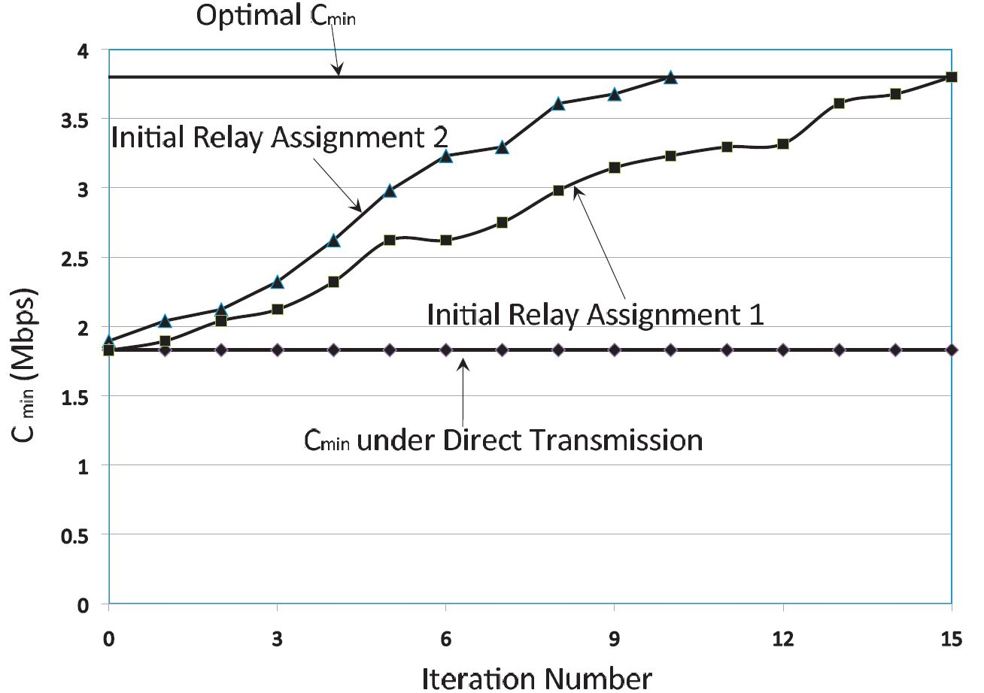
Case 2: Result
56
Notes:
Different initial assignment can lead to an optimal solution
ORA algorithm can always lead to better solution than direct transmission.

Slide 57
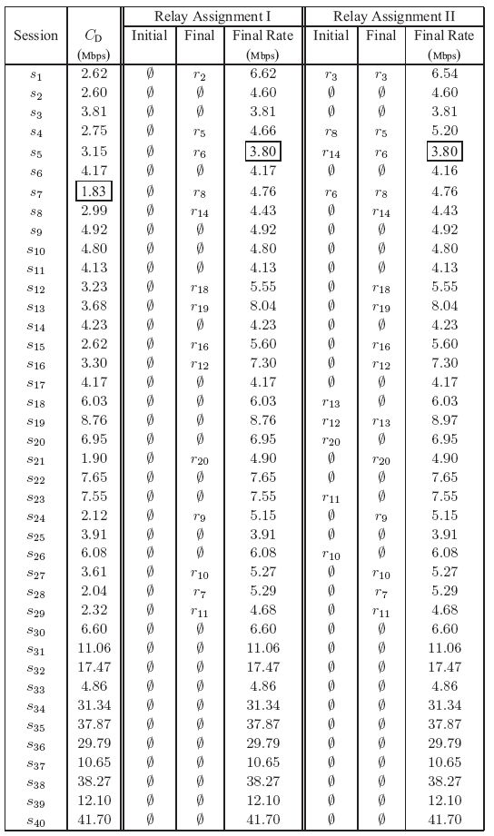
Case 2:
Optimal Assignment
108% improvement
57

Slide 58
Summary
Review of complexity
Case study
  Optimal relay node assignment for cooperative communications
  Developed a polynomial time algorithm (ORA) to solve the problem.
    Key idea: linear marking mechanism
  Offered a proof for optimality
  Numerical results showed significant improvement in network achievable rate.
58

