Slide 1
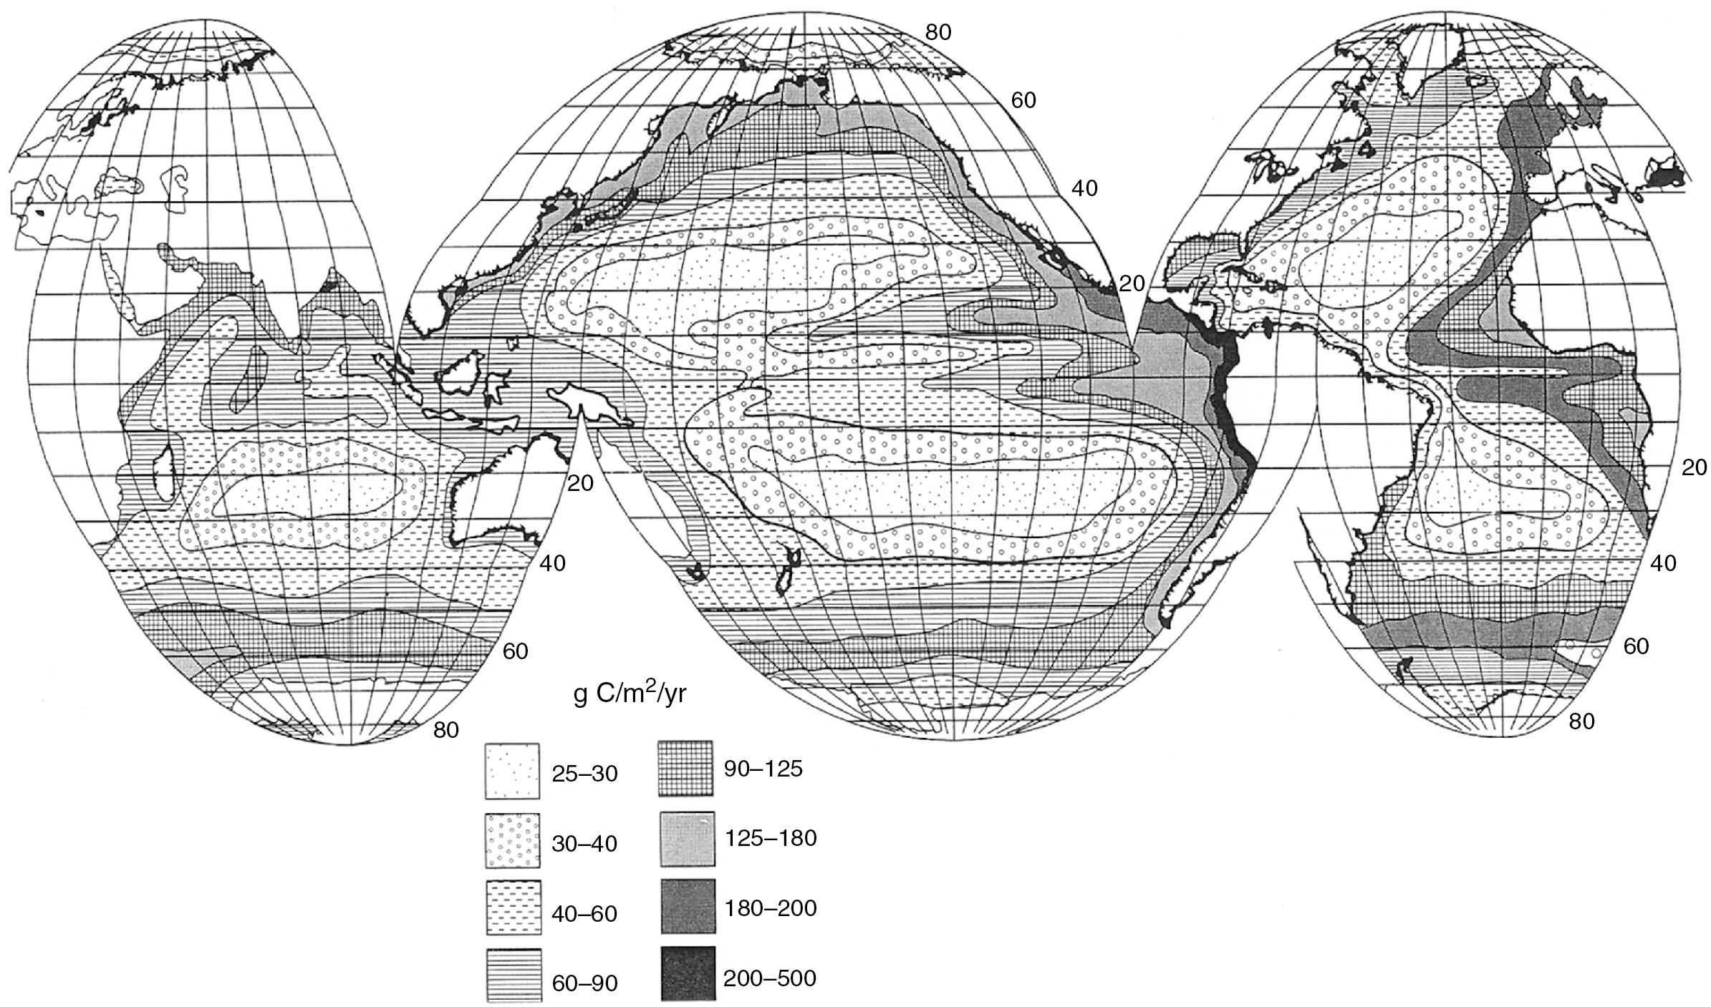
PILSON_Fig 11_01
© Cambridge University Press 2012

Slide 2
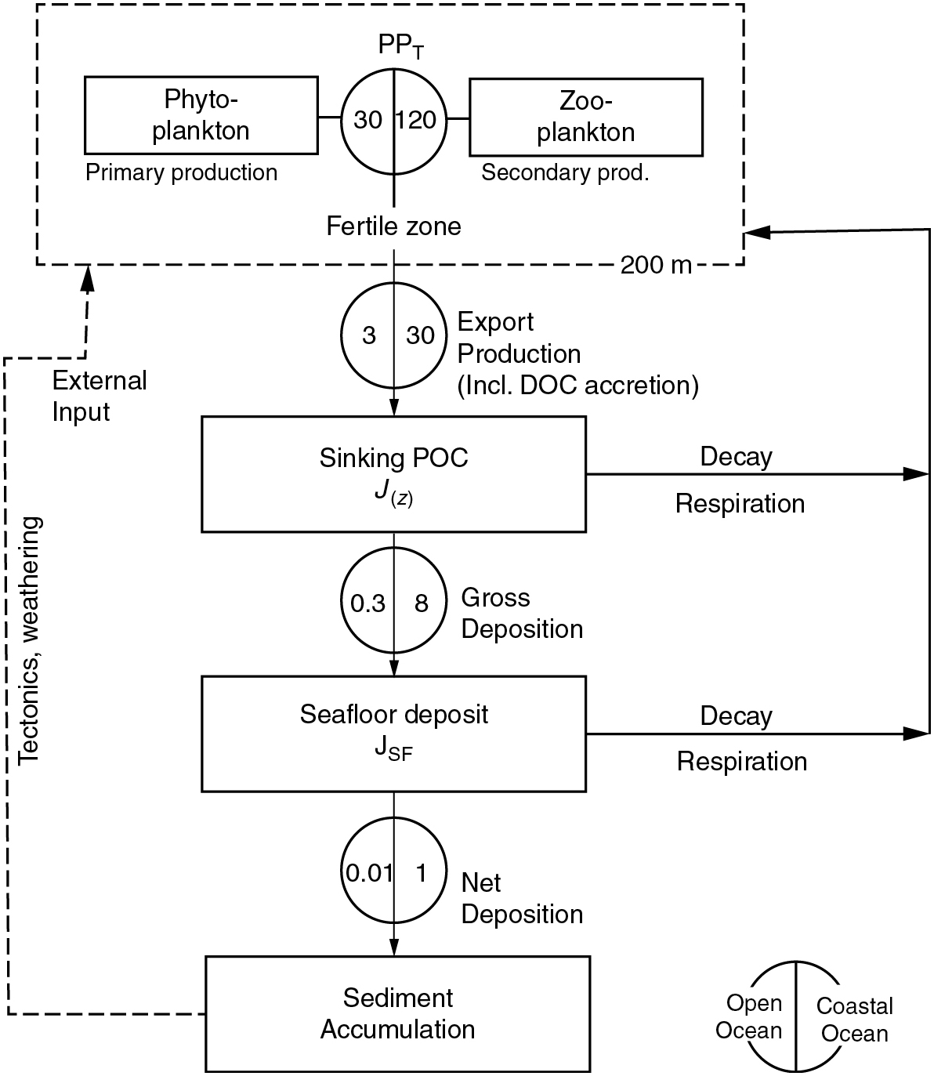
PILSON_Fig 11_02
© Cambridge University Press 2012

Slide 3
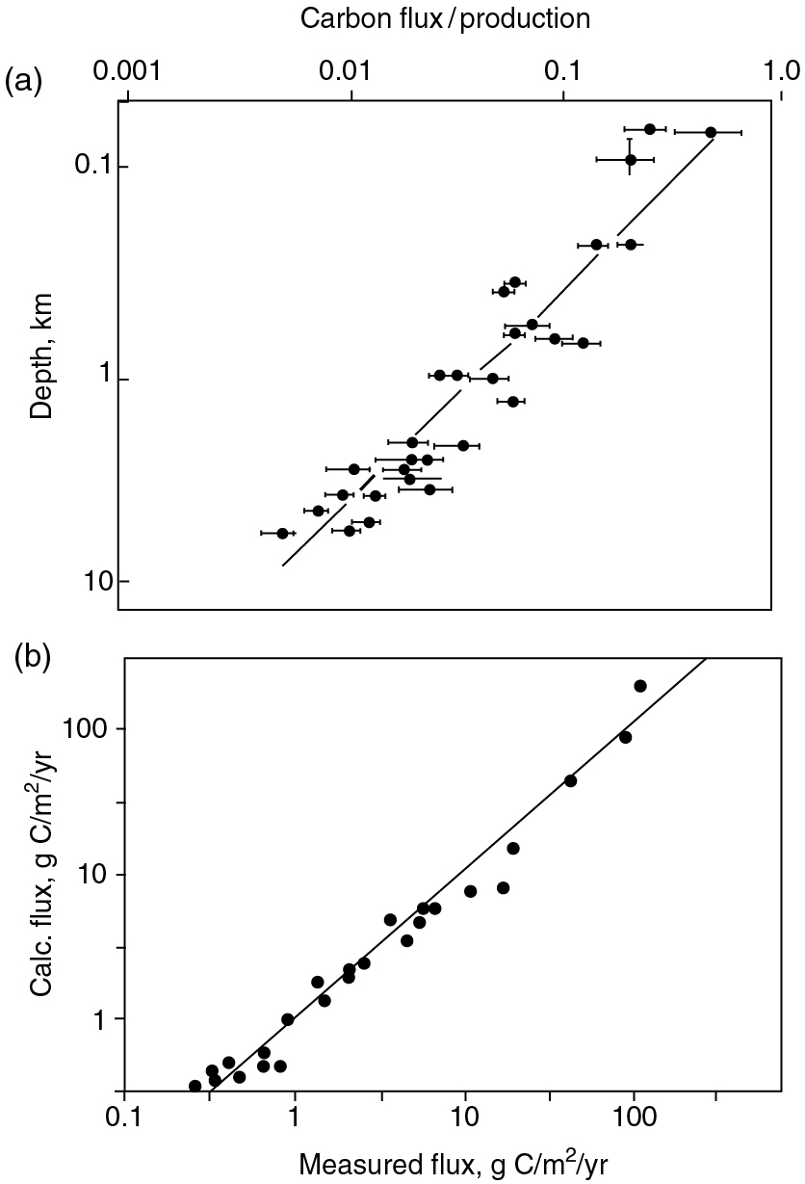
PILSON_Fig 11_03
© Cambridge University Press 2012

Slide 4
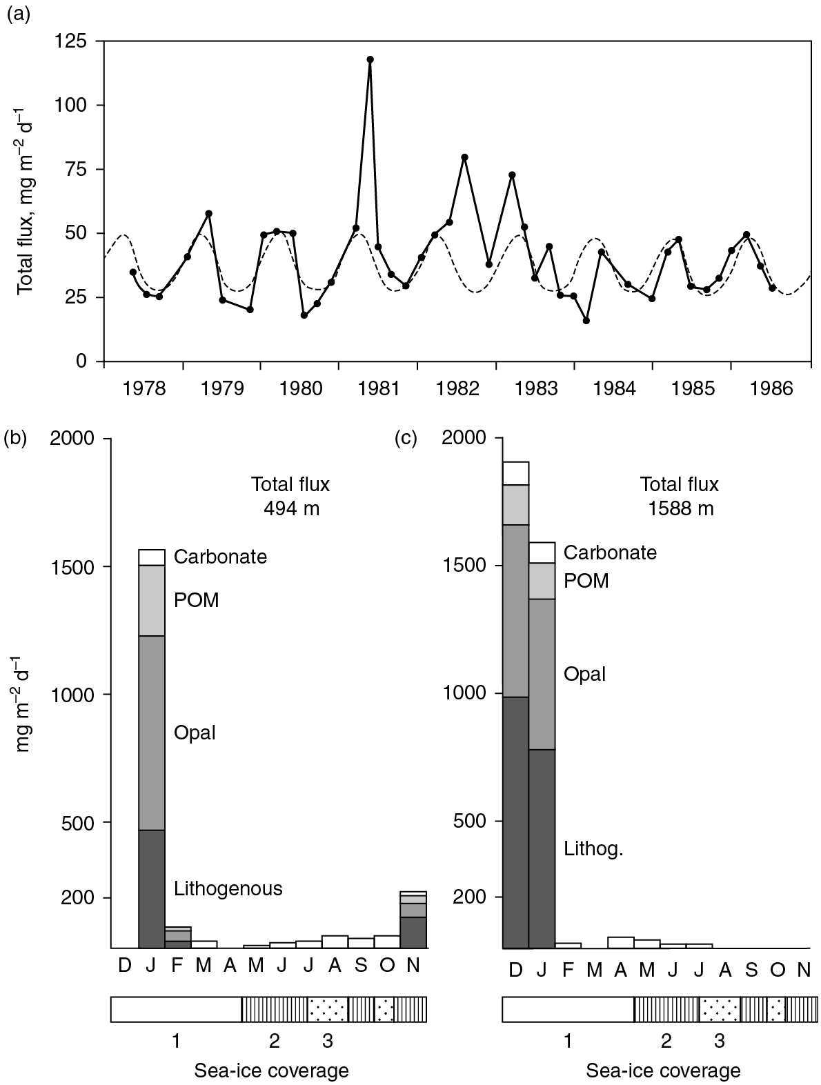
PILSON_Fig 11_04
© Cambridge University Press 2012

Slide 5
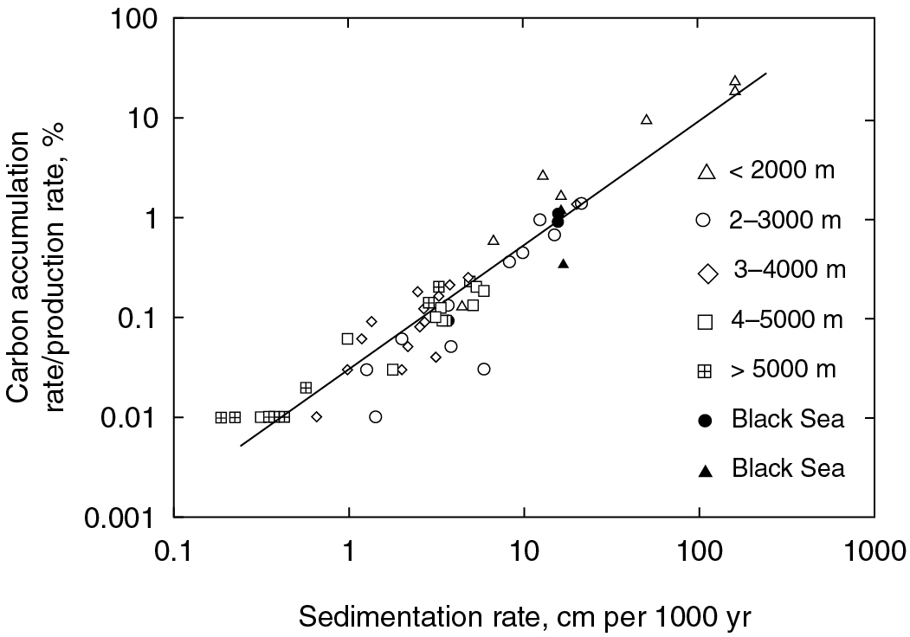
PILSON_Fig 11_05
© Cambridge University Press 2012

Slide 6
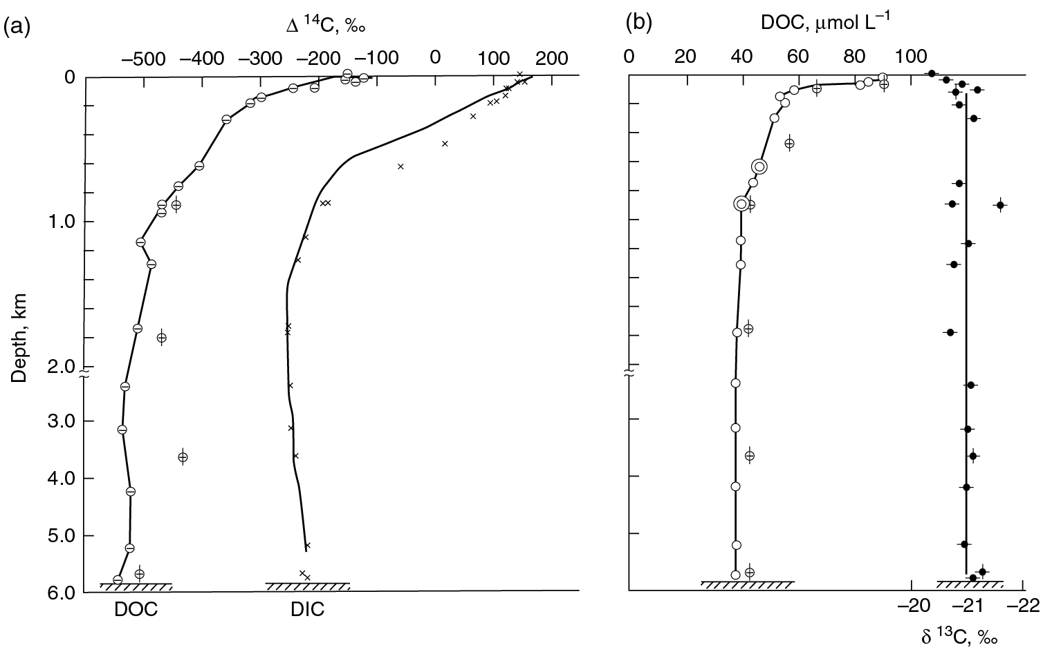
PILSON_Fig 11_06
© Cambridge University Press 2012

Slide 7
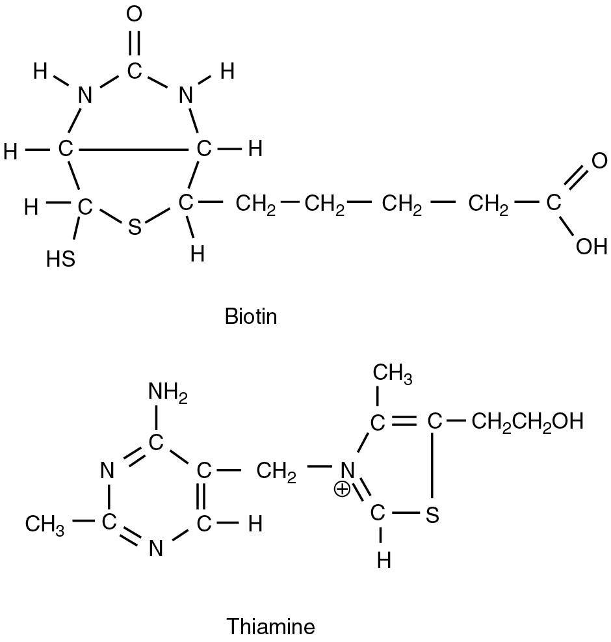
PILSON_Fig 11_07
© Cambridge University Press 2012

Slide 8
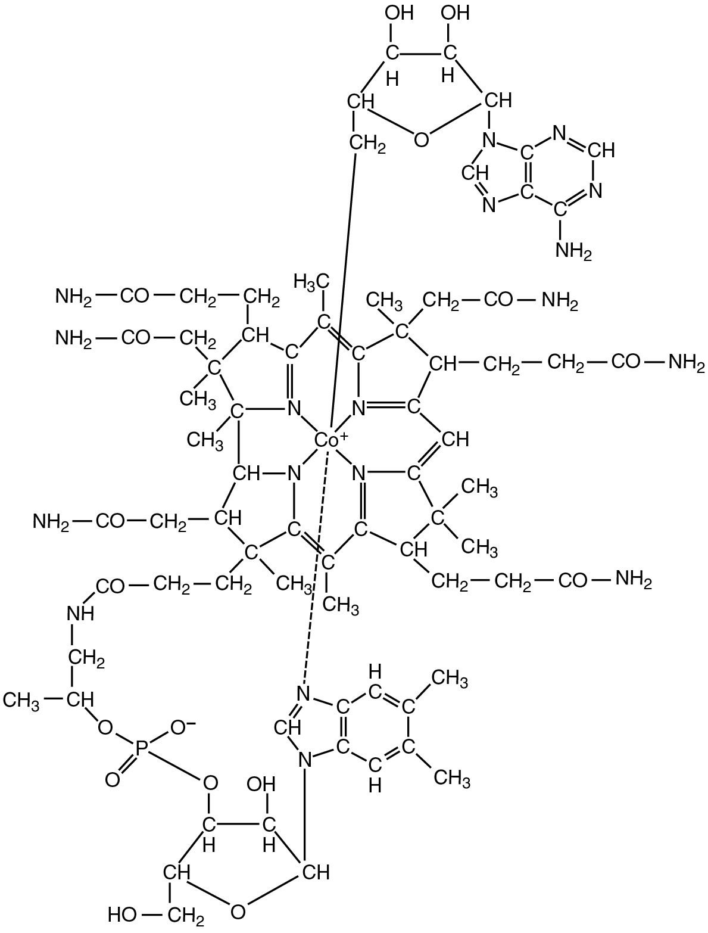
PILSON_Fig 11_08
© Cambridge University Press 2012

Slide 9
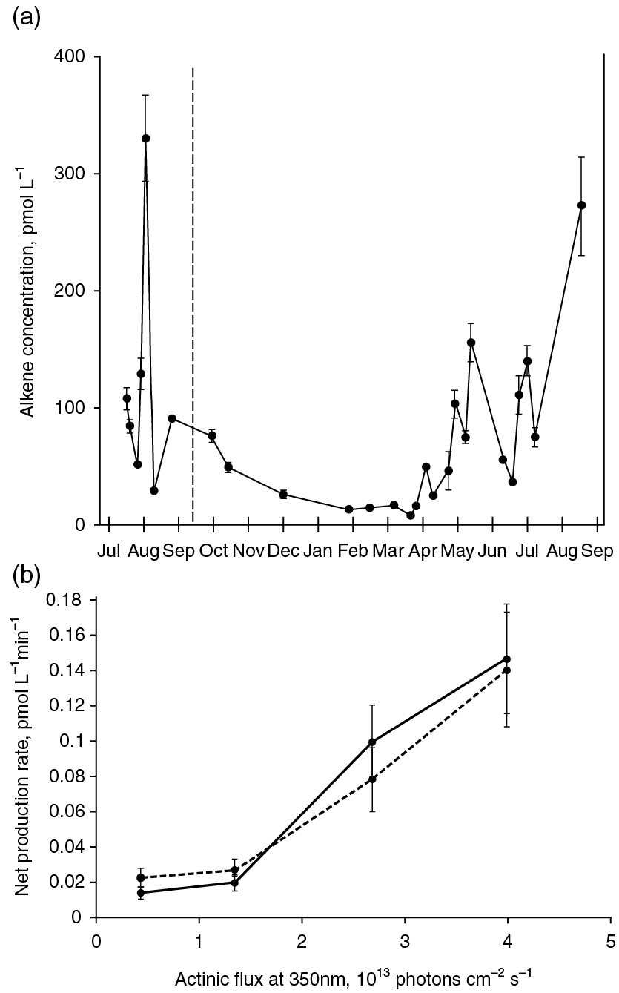
PILSON_Fig 11_09
© Cambridge University Press 2012

Slide 10
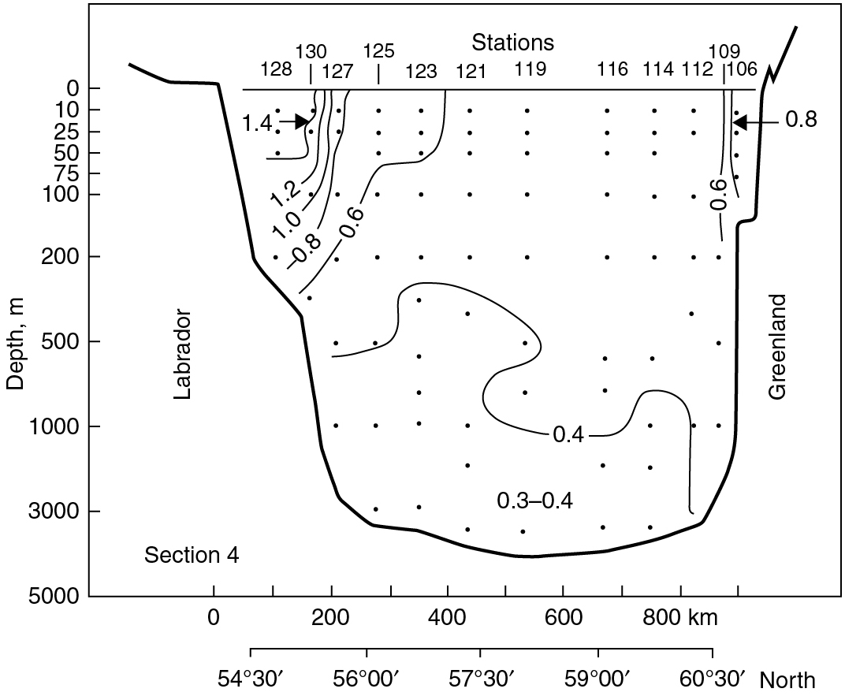
PILSON_Fig 11_10
© Cambridge University Press 2012

Slide 11
PILSON_Fig 11_11
© Cambridge University Press 2012

Slide 12
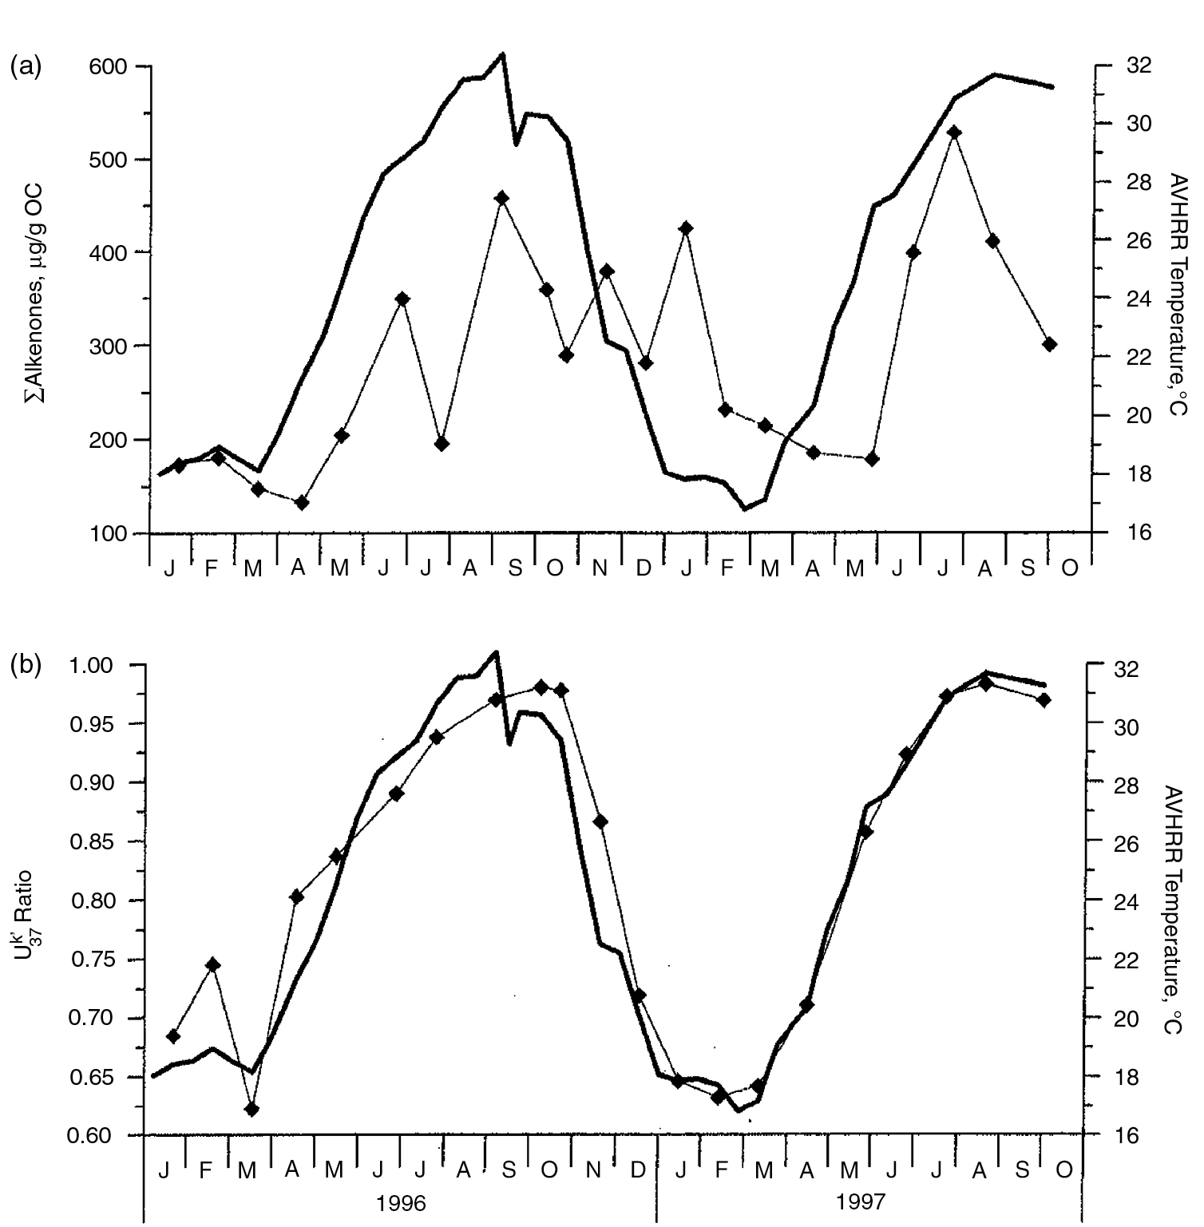
PILSON_Fig 11_12
© Cambridge University Press 2012

Slide 13
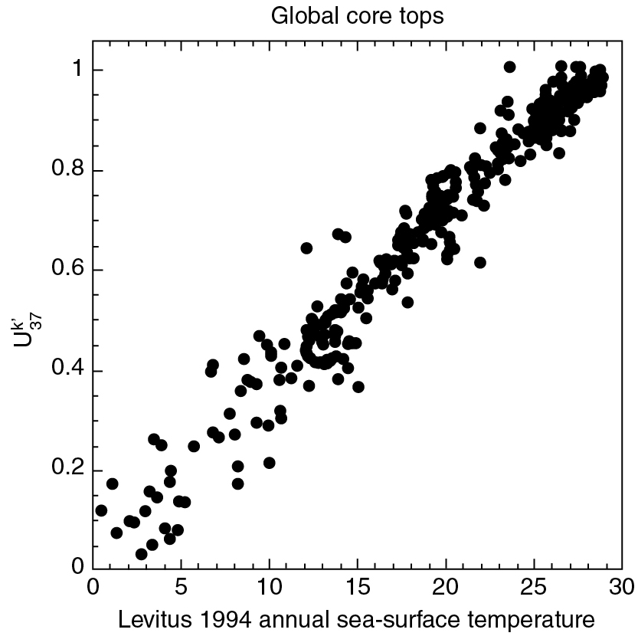
PILSON_Fig 11_13
© Cambridge University Press 2012

Slide 14
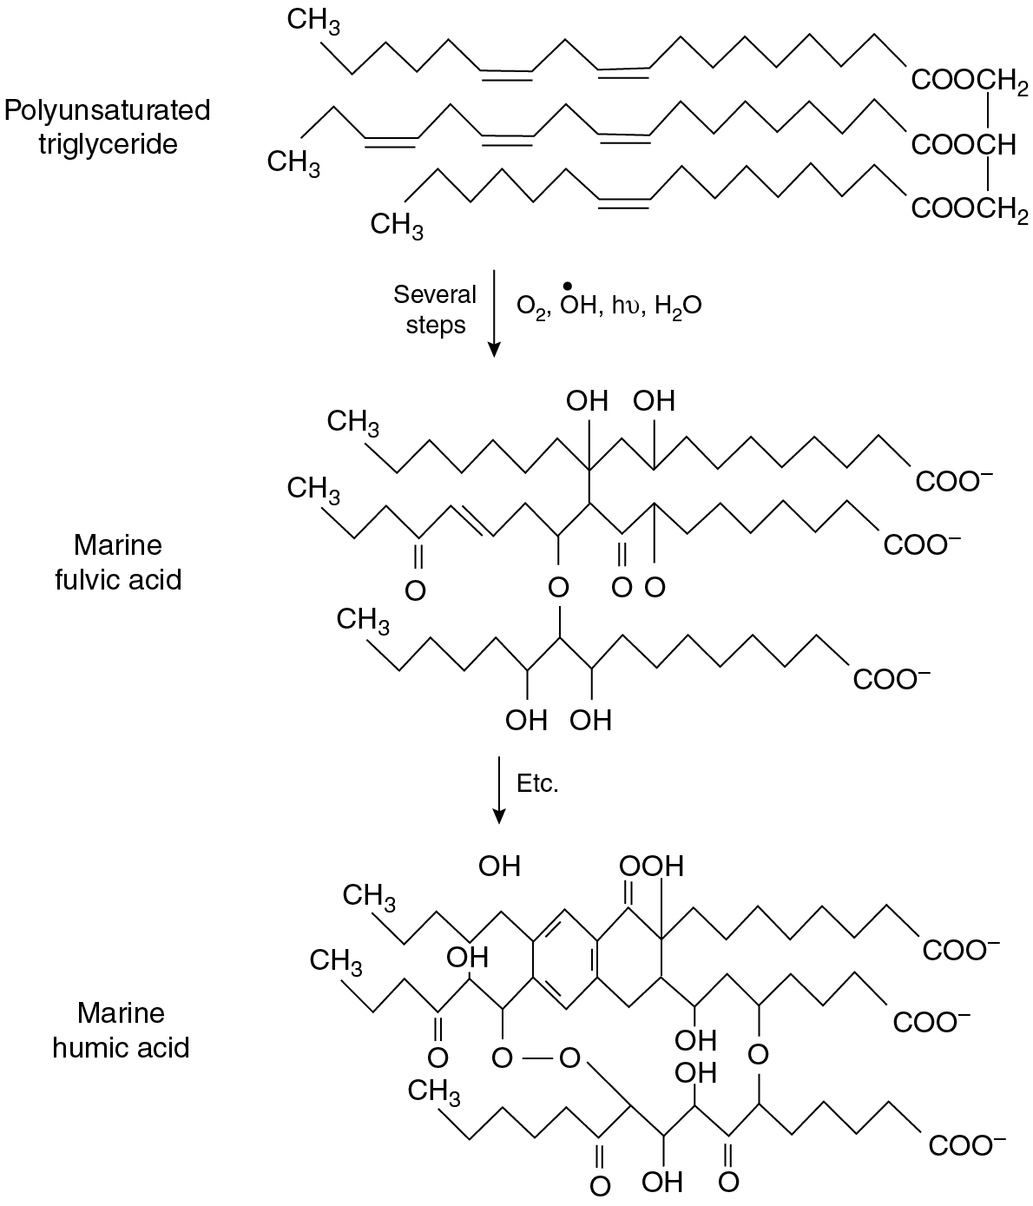
PILSON_Fig 11_14
© Cambridge University Press 2012

Slide 15
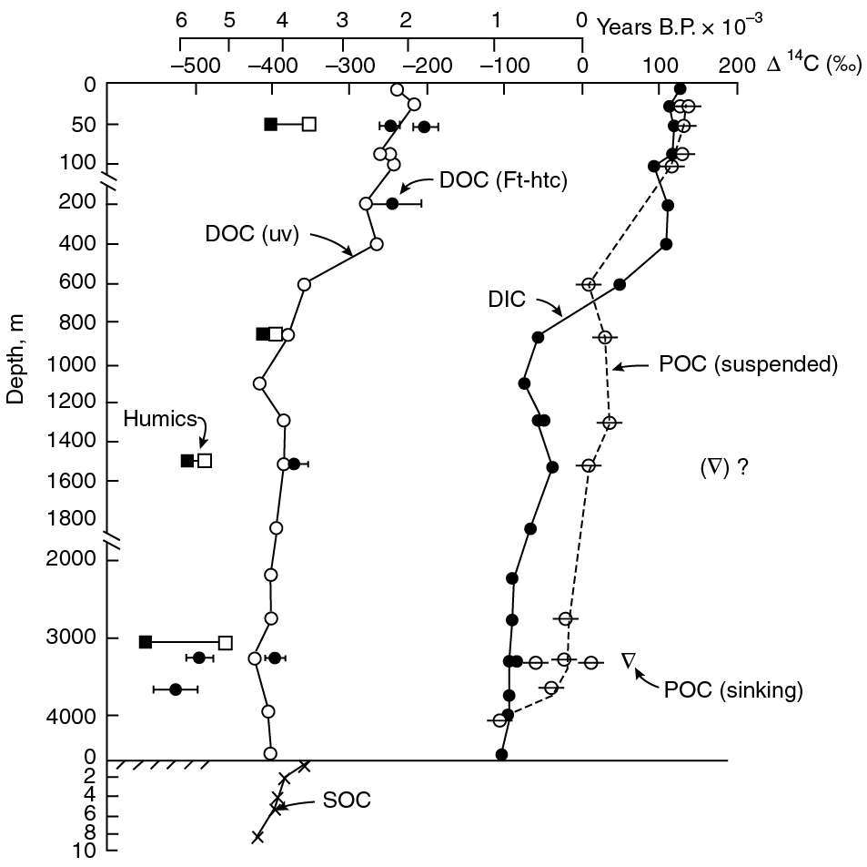
PILSON_Fig 11_15
© Cambridge University Press 2012

