Slide 1
IMPORTANT – PLEASE NOTE:
These resources are provided free of charge by Cambridge University Press with permission of the authors of the corresponding work, but are subject to copyright. You are permitted to view, print and download these resources for your own personal use or for educational purposes, provided any copyright lines on the resources are not removed or altered in any way. Any other use, including but not limited to distribution of the resources in modified form, or via electronic or other media, is strictly prohibited unless you have prior permission from the authors of the corresponding work and the owners of the images displayed herein, and provided you give appropriate acknowledgement of the source.

Slide 2
NOTE TO USERS:
The simplified information included in this presentation is intended to compliment the accompanying CUP book on Glaciovolcanism by Smellie & Edwards. Please refer to the book for further details and information on references cited, etc

Slide 3
Volcano-ice interactions – basic principles
Tolbachik, Russia
Image: Ben Edwards

Slide 4
TALK OUTLINE -
What is glaciovolcanism?
Terminology
Important properties of ice
Hydraulics – the most important property
Heat transfer & emplacement of magma
Historical eruptions – observations & problems

Slide 5
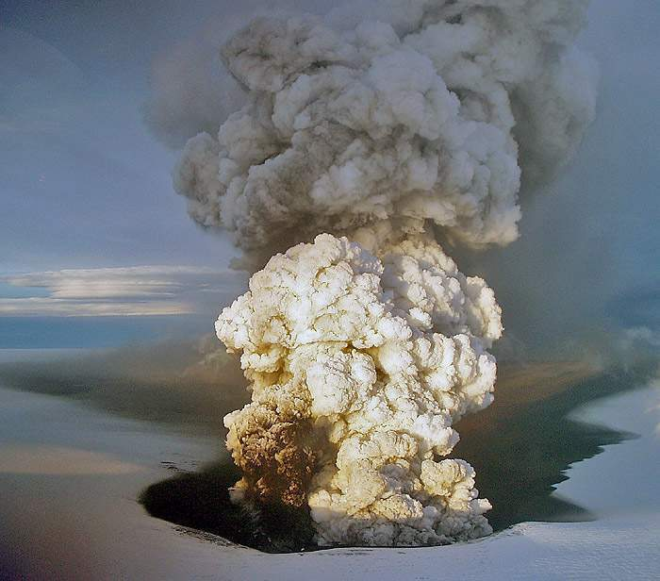
Glaciovolcanism: “The interactions between magma and ice
in all its forms, including snow & any meltwater”
Smellie, 2006, E-Sci Revs
a research area
a boundary condition for ice sheets
a geological hazard
an environmental tool or proxy
Image: Freysteinn Sigmundsson
Grimsvotn 2004

Slide 6
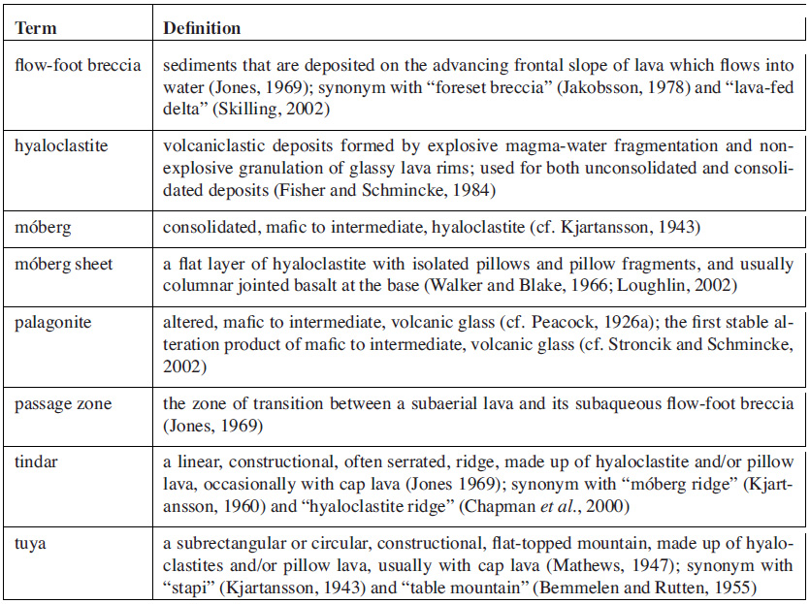
The language of glaciovolcanism – distinctly odd terminology
non-expl.
mechanical
Source: Jakobsson and Gudmundsson (2008; modified); see also Glossary in Smellie & Edwards (2016; CUP book on Glaciovolcanism)

Slide 7
PROPERTIES OF TERRESTRIAL GLACIERS(1):
THERMAL REGIME
Three glacier types -
Warm (‘temperate’) glaciers:
1. At pressure-melting point throughout.
2. Wet-based.
Cold (‘polar’) glaciers:
1. Well below freezing throughout the year.
2. Frozen to their bed.
3. Require more energy to melt.
Polythermal glaciers: two types -
1. Below freezing throughout except in
a thin basal layer.
2. Formed of patches of wet-based and frozen-
based ice.
Warm & polythermal glaciers are collectively called ‘wet-based’
Smellie, 2007, 2009, 2013

Slide 8
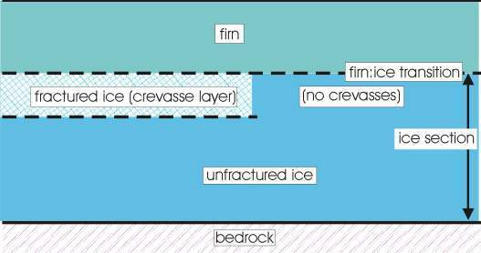
PROPERTIES OF TERRESTRIAL GLACIERS(2):
STRUCTURE
Snow transforms to ice by densification.
Firn is an intermediate stage.
Depth to firn:ice transition may exceed 125 m (thicker in cold glaciers).
Glaciers in tension may have an upper fractured brittle layer that dominates meltwater flow.
Fractures (crevasses) normally pinch out at < 30 m but may exceed 60 m.
snow
Smellie, 2001

Slide 9
PROPERTIES OF TERRESTRIAL GLACIERS(3):
RHEOLOGY
Colder ice is stronger
Dirty ice is stronger
Smellie, 2007, 2009, 2013

Slide 10
PROPERTIES OF TERRESTRIAL GLACIERS(4):
HYDRAULICS
Complicated and relatively poorly understood.
In wet-based ice, water escapes basally, in thin sheet and tunnels.
Unfractured ice is effectively an aquiclude (aquitard).
Snow/firn/fractured ice are aquifers.
Firn permeability is very low, but varies with density.
Fractures readily transmit meltwater.
Gravity flow probably dominant. BUT basal flow determined by surface slope.
BUT: Firn not a classical porous medium.
- hydraulic properties alter because heat transfer between liquid and
solid causes phase changes, probably enhanced by volcanically
heated meltwater.
RESULT: firn hydraulics very hard to assess/model.
Smellie, 2006

Slide 11
GLACIOVOLCANIC ERUPTIONS:
SUMMARY OF IMPORTANT ICE PROPERTIES
1. ICE THERMAL REGIME:
Energy is required to melt ice.
Significantly more energy is needed for cold (‘polar’) ice.
Less space is melted.
2. ICE RHEOLOGY:
Colder ice is stronger.
Dirty ice is stronger.
3. ICE HYDRAULICS:
Wet-based ice transmits water basally.
Cold ice lacks free water & is frozen to its base.
Meltwater cannot escape subglacially below cold ice.
- THE MOST IMPORTANT FOR LITHOFACIES TYPES
& ARCHITECTURE
Smellie, 2001, 2009

Slide 12
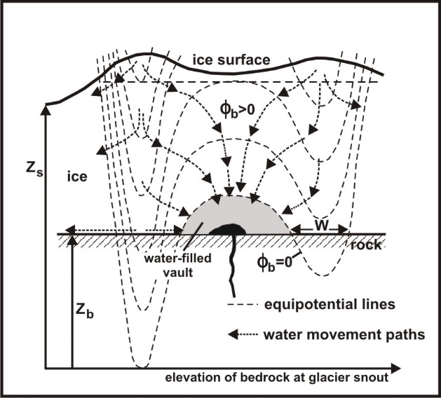
GLACIOVOLCANIC ERUPTIONS:
GLACIER HYDRAULICS –
hydraulic potentials & meltwater flow directions
Meltwater flows into vault
BUT model neglects influence of
pre-existing basal drainage and
resulting vault leakage
Smellie & Edwards, 2016
(modified after Bjornson, 1988)

Slide 13
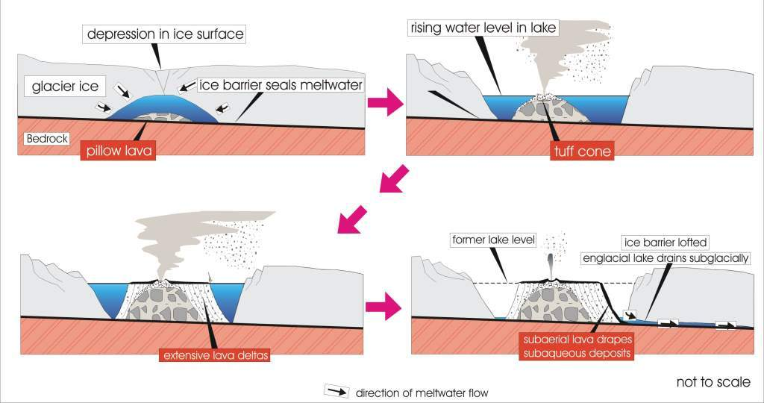
PROPERTIES OF TERRESTRIAL GLACIERS(4):
HYDRAULICS
The orthodox model – a sealed system
Image: John Smellie
(after Bjornsson, 1988)

Slide 14
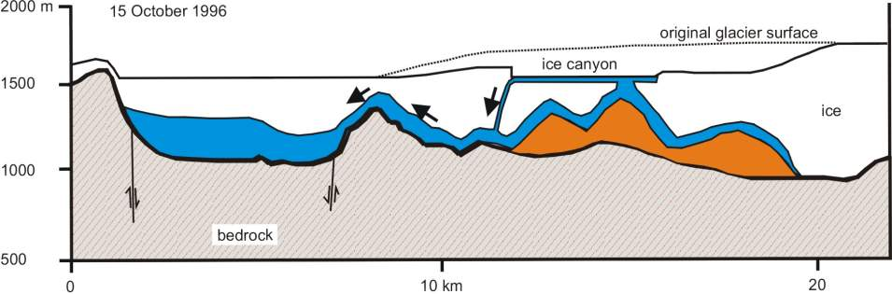
PROPERTIES OF TERRESTRIAL GLACIERS(4):
HYDRAULICS
The reality – a leaky system
1. supraglacial meltwater escape
Gjalp, 1996
[Gudmundsson et al. 1997]

Slide 15
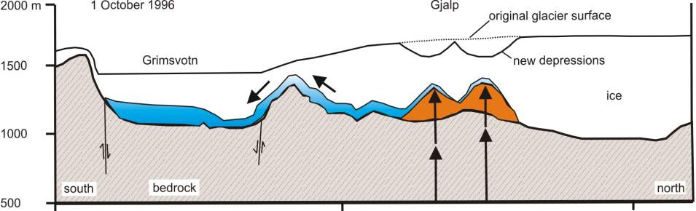
PROPERTIES OF TERRESTRIAL GLACIERS(4):
HYDRAULICS
The reality – a leaky system
2. subglacial meltwater escape
Gjalp 1996
Gudmundsson et al. 1997

Slide 16
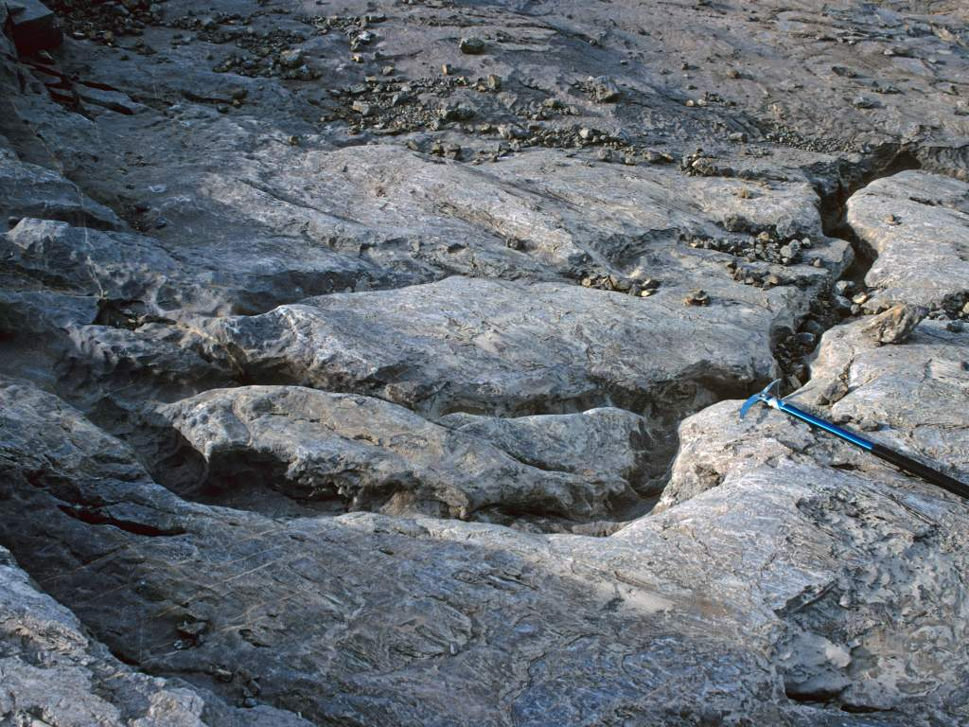
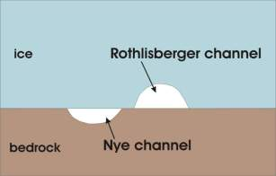
PROPERTIES OF TERRESTRIAL GLACIERS(4):
HYDRAULICS
Images: John Smellie
Leaky systems

Slide 17
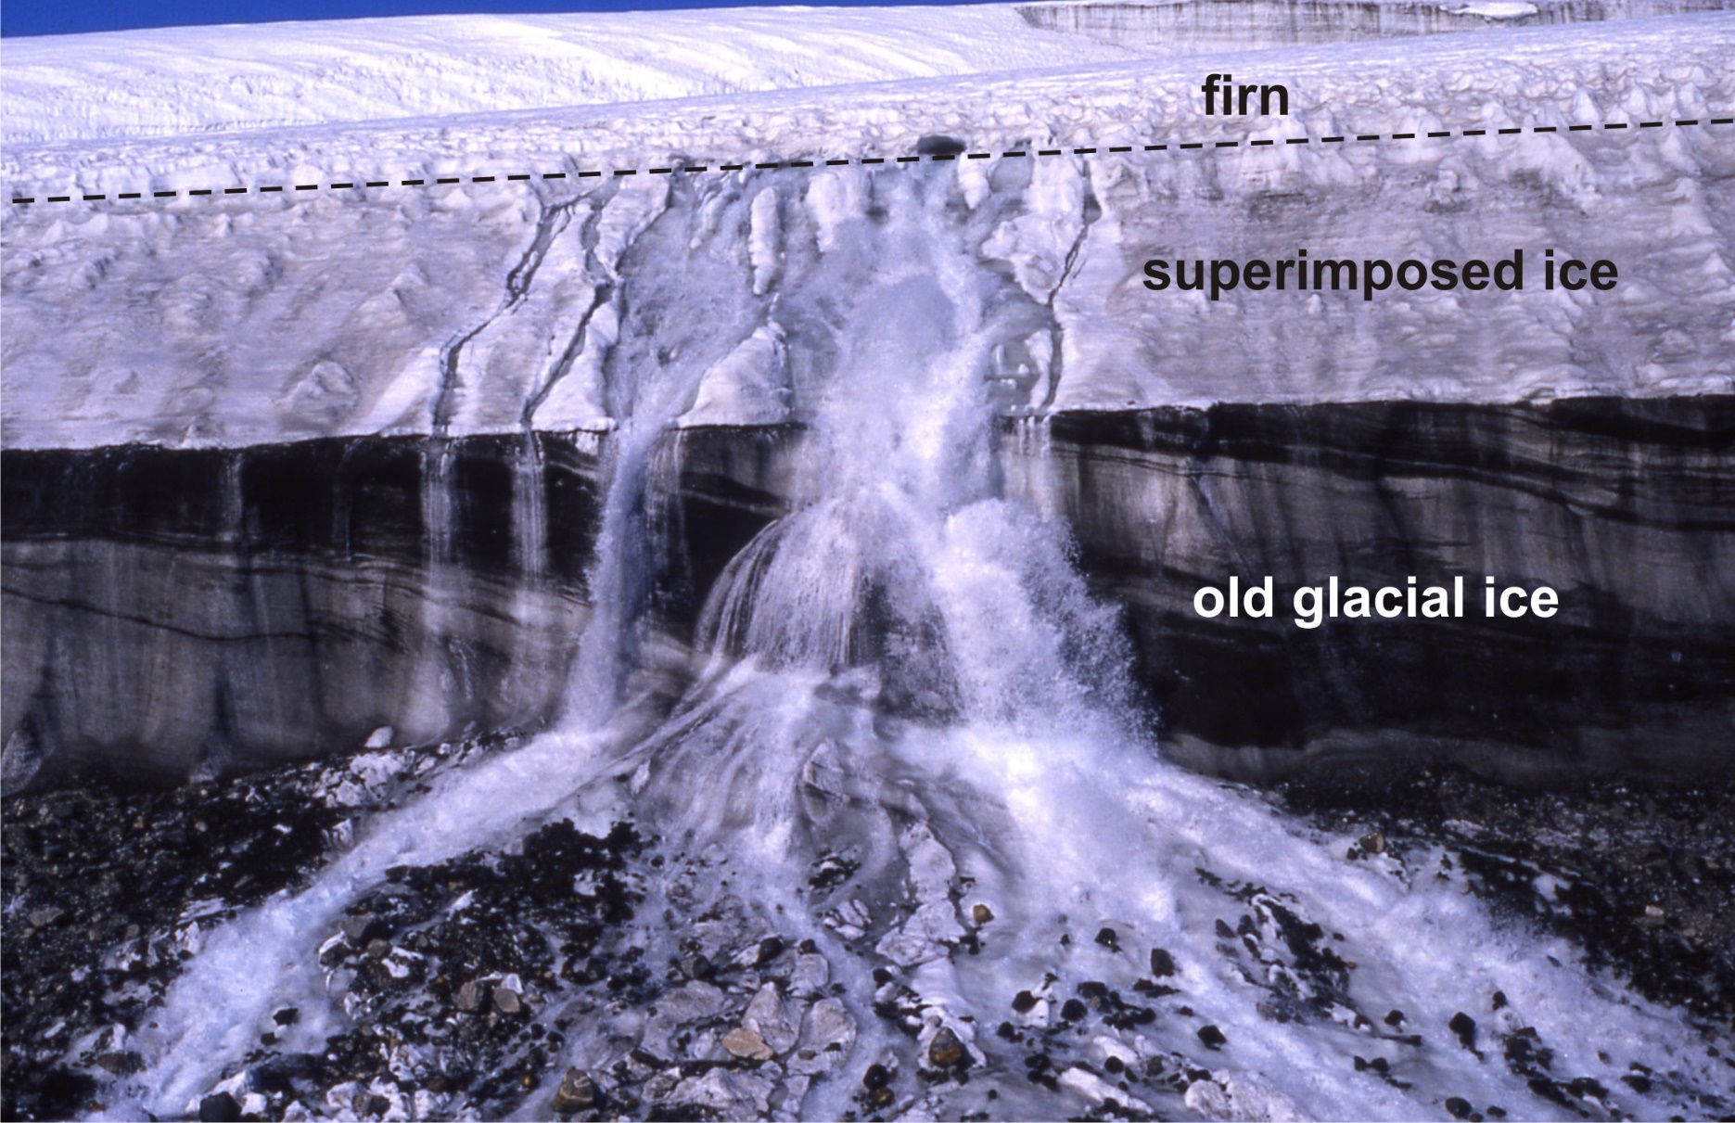
PROPERTIES OF TERRESTRIAL GLACIERS(4):
HYDRAULICS
Image: Damian Gore
Supraglacial meltwater escaping along firn:ice transition

Slide 18
PROPERTIES OF TERRESTRIAL GLACIERS(4):
HYDRAULICS
Evidence for supraglacial and
subglacial meltwater escape during
glaciovolcanic eruptions - 1
Katla, 1918
Tomasson, 1996

Slide 19
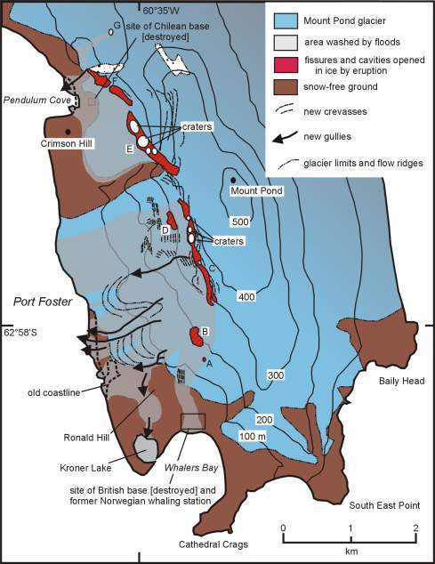
PROPERTIES OF TERRESTRIAL GLACIERS(4):
HYDRAULICS
Smellie, 2002
Evidence for supraglacial and
subglacial meltwater escape during
glaciovolcanic eruptions - 2
Deception Island, 1969

Slide 20
MATHEMATICAL MODELLING & EXPERIMENTATION (1):
HEAT TRANSFER AND MELTING PROCESSES
Coupled conductive cooling of pillows and convectively heated meltwater; radiant heat in
ice-impounded lavas.
Ample thermal energy in magmas, when cooled to ambient temperatures.
Basalt magmas: heat transfer efficiency theoretically exceeds 80%; with negative englacial vault
pressures, meltwater accumulates.
Observed efficiencies much lower (40%); consequences?
Evolved magmas: less efficient heat transfer efficiency, positive vault pressures, meltwater drains
continuously.
High heat flux can be maintained beyond the glass transition during conductive cooling of rhyolite
glass, to similar rates as basalts.
Allen 1980; Hoskuldsson & Sparks 1997; Wilson & Head 2002,2007; Kelman et al. 2002; Wilding et al. 2004; Tuffen, 2007

Slide 21
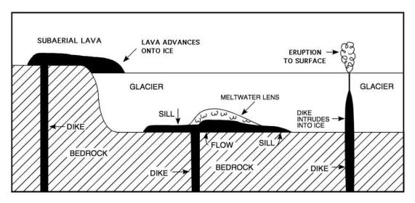
MATHEMATICAL MODELLING & EXPERIMENTATION (2):
EMPLACEMENT PROCESSES
Magma will either spread sideways as sills at the rock:ice interface, or may penetrate as dykes in
the overlying ice.
The sill will inflate and freeze; the dyke will soon collapse into rubble.
During injection, the stress distribution for a sill prevents it thickening into a series of flow fingers
or pillows.
For ice < 100m thick, spontaneous magma disruption will occur.
For magmas with high water contents, disruption may occur under significantly greater ice
thicknesses (500 m for rhyolites?).
Wilson & Head 2002, 2007; Wilson et al., 2013

Slide 22
HISTORICAL SUBGLACIAL ERUPTIONS (1):
OBSERVATIONS
OBSERVATIONS:
Crevassed supraglacial cauldrons form within a few hours of an eruption starting.
Vertical-walled ice chimneys form above vents.
Enormous thicknesses of ice are melted through far more rapidly than current thermohydraulic
models can explain.
Meltwater accumulates rapidly in an englacial vault. [basalts]
Meltwater may overflow, either within narrow supraglacial channels or as unconfined sheets.
Meltwater escapes subglacially from the earliest stages and throughout eruption (‘leaky vaults’; warm
ice), hence overflowing may require unusual/specific circumstances.
Jonsson 1982; Gudmundsson et al. 1997, 2002, 2003a,b; Smellie 2000, 2002

Slide 23
HISTORICAL SUBGLACIAL ERUPTIONS (1):
INTERPRETATIONS
INTERPRETATIONS:
Crevasses & ice chimneys consistent with low vault pressures (collapse of ice ‘piston’).
Pillow lava conduction/water convection too thermally inefficient to be important? Should lead
to positive eruption pressures.
Water pressures in the vault may be significantly lower than envisaged and explosive eruptions may
commonly occur even under ice thicknesses exceeding 750 m.
Heat flux is increased significantly if explosive magma fragmentation occurs. Is this the dominant
subglacial eruptive style in some eruptions?
Even with intensive fragmentation, thermal efficiency is still too low.
Is there an important augmenting role for magmatic gases or superheated steam in melting ice?
Jonsson 1982; Gudmundsson et al. 1997, 2002, 2003a,b; Smellie 2000, 2002

Slide 24
HISTORICAL SUBGLACIAL ERUPTIONS (2): PROBLEMS/CONSEQUENCES
Calculated rates of heat transfer do not match the very fast rates of ice melting that occur
in eruptions.
If explosive fragmentation is characteristic for ice thicknesses <750 m, why do so many
subglacial basalt edifices have pillow lava cores?
If vault pressures are always positive, meltwater should drain away continuously. Yet
pillow lava is characteristic of most subglacial basalt centres.
If subglacial drainage is dominant, vault water levels (and passage zones) are no accurate guide
to coeval ice sheet thicknesses.

Slide 25
SUMMARY
1. The dominant environmental influences on subglacial eruptions are
(a) Ice thermal regime; (b) rheology; and (c ) hydraulics.
2. Meltwater escapes both basally and by overflowing, and both
modes may be unstable.
Heat transfer processes still poorly understood. How do eruptions
melt through ice so rapidly?
4. What are the consequences for interpreting past ice masses?

