Slide 1
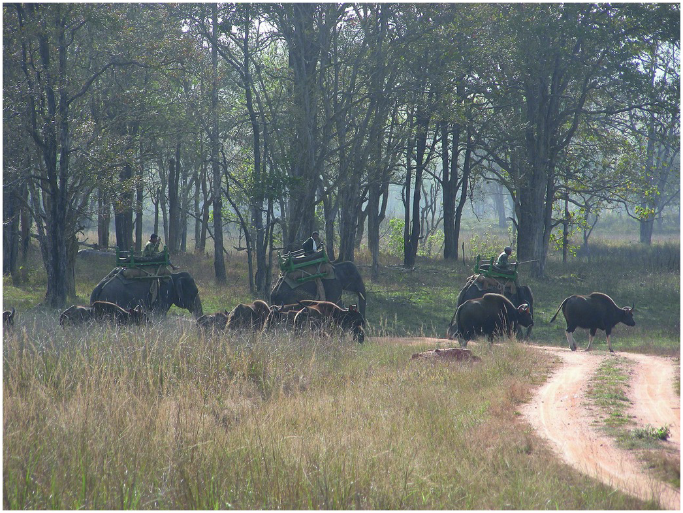
Figure 23.1
Gaur herd being moved into open areas employing captive elephants.
(Photo by Ujjwal Kumar Sinha, WII)

Slide 2
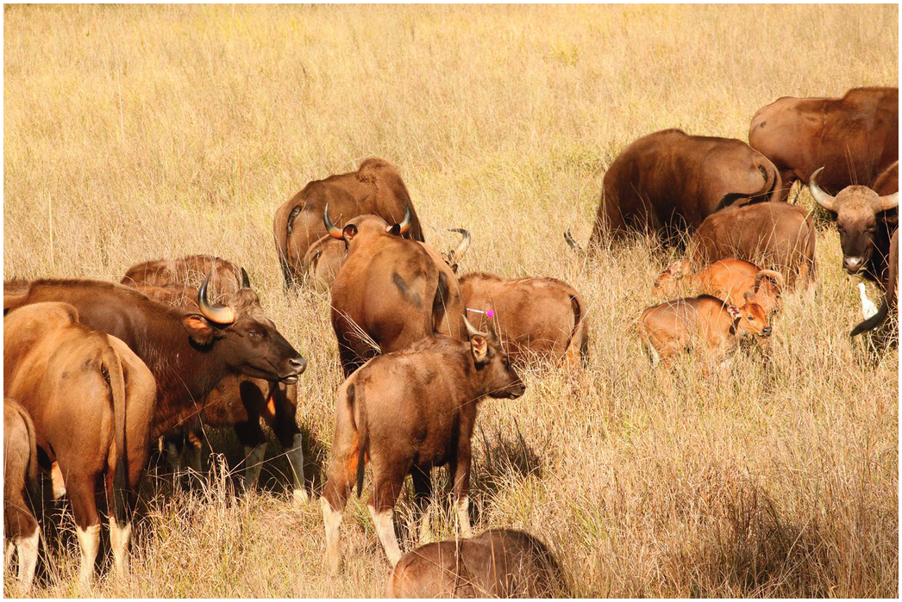
Figure 23.2
Identified Gaur darted within the herd.
(Photo by Ujjwal Kumar Sinha, WII)

Slide 3
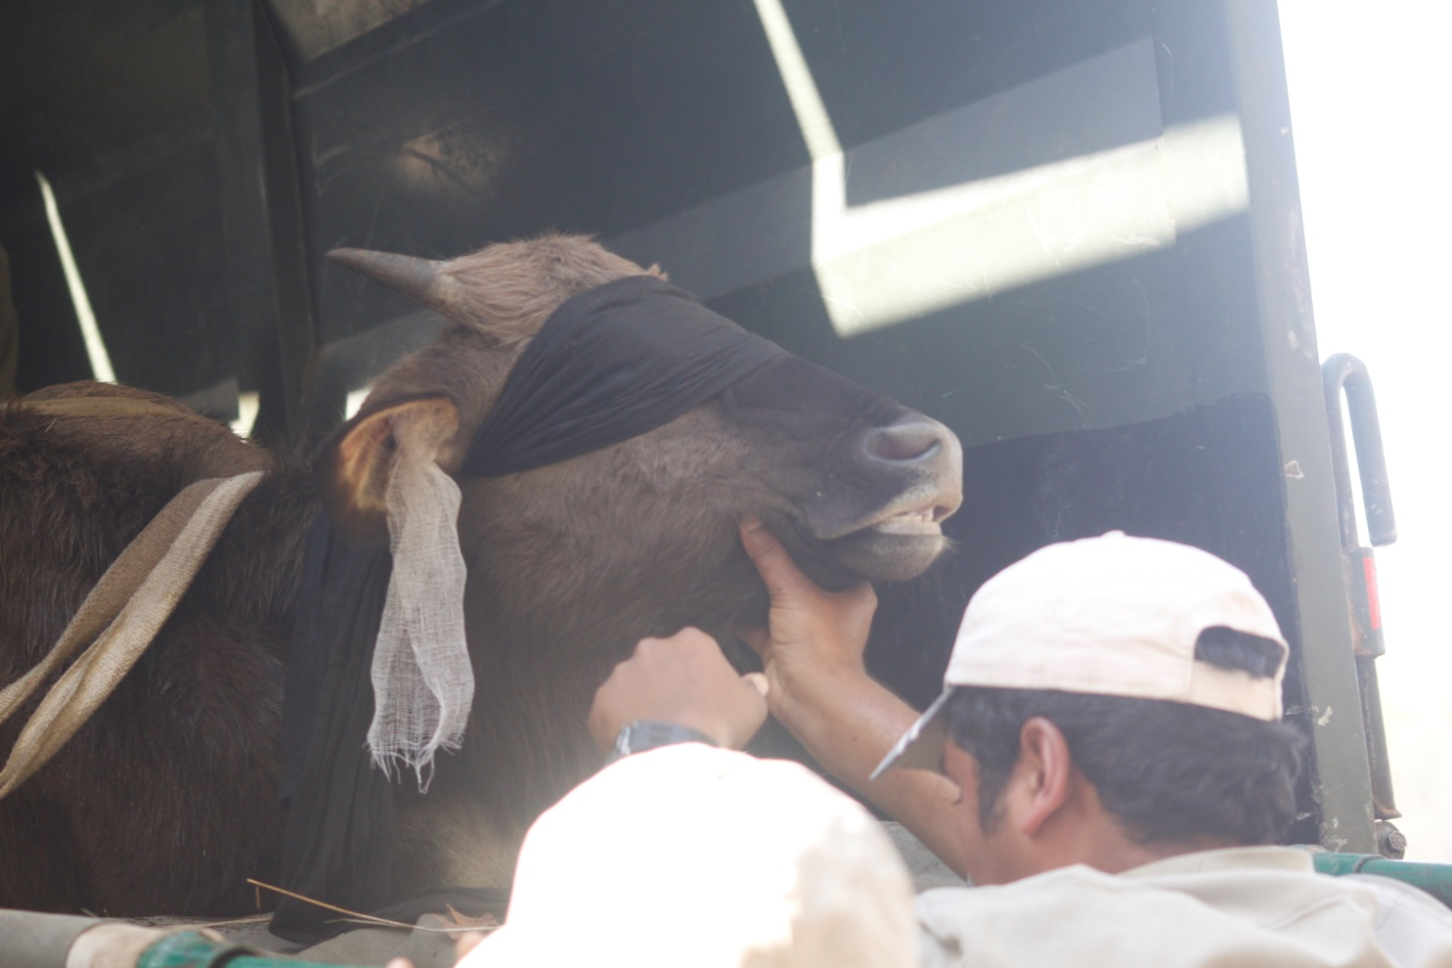
Figure 23.3
Plugging of ears and blind folding of immobilized animal to avoid visual and auditory stimulation. (Photo by Aniruddha Majumder, WII)

Slide 4
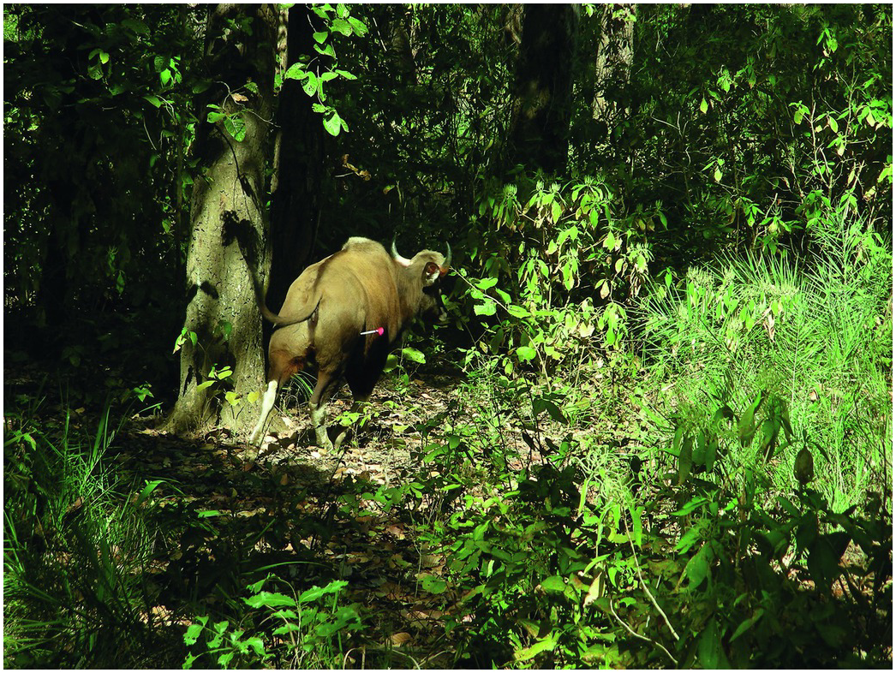
Figure 23.4
Excitement and in-coordination during drug induction.
(Photo by Parag Nigam, WII)

Slide 5
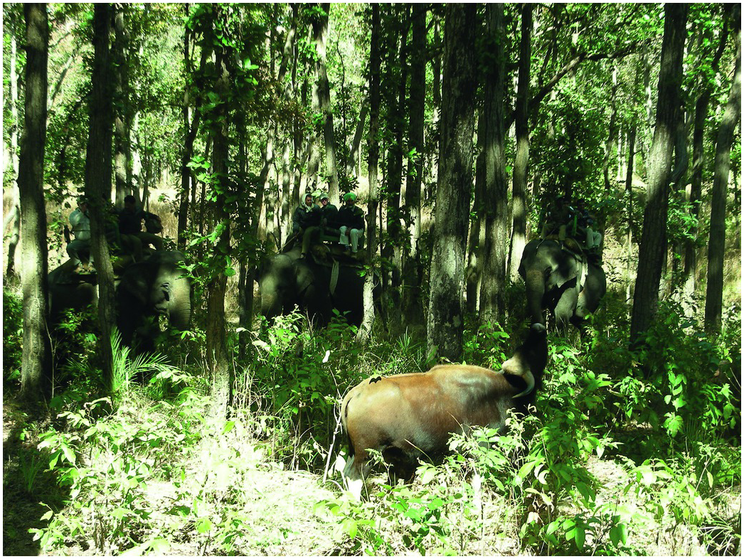
Figure 23.5
Extension of head during drug induction.
(Photo by Parag Nigam, WII)

Slide 6
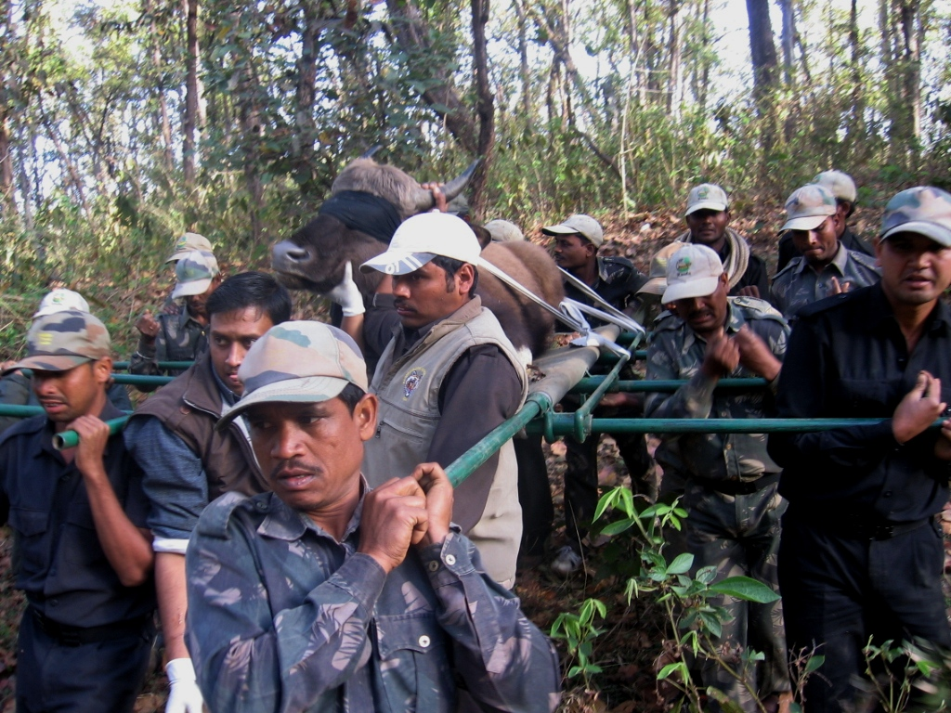
Figure 23.6
Animal loaded on the stretcher being taken to the loading truck
(Photo by Aniruddha Majumder, WII)

Slide 7
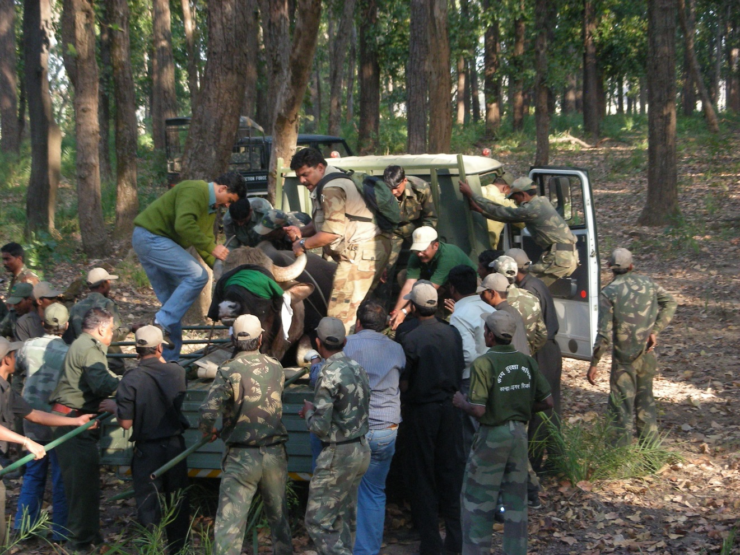
Figure 23.7
Animal loaded on to truck for transport to boma
(Photo by B. Navaneethan, WII)

Slide 8
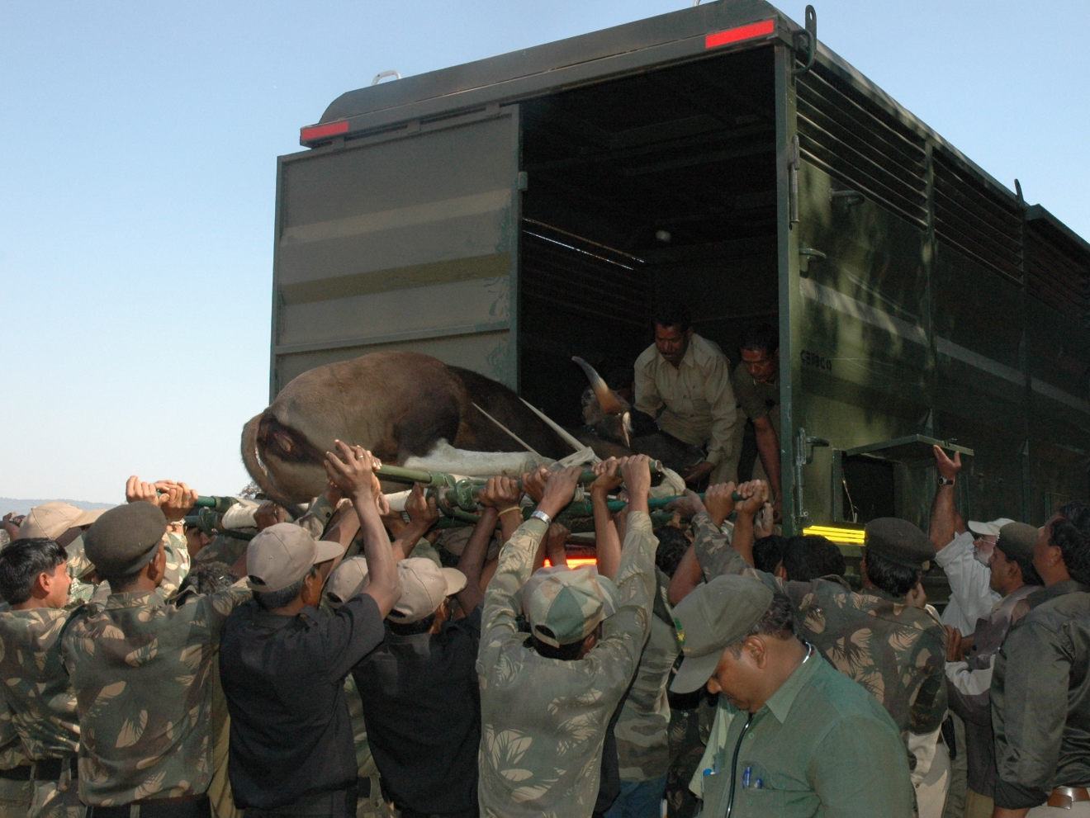
Figure 23.8
Loading of immobilized gaur directly into the transport container.
(Photo by B. Navaneethan, WII)

Slide 9
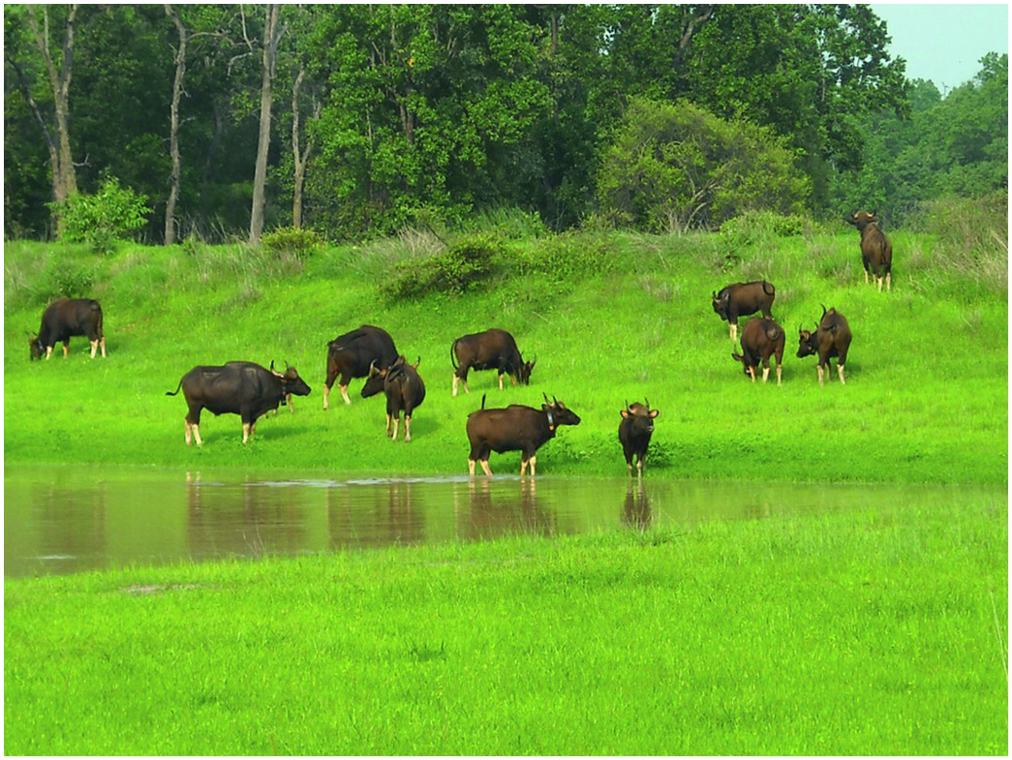
Figure 23.9
Gaur herd at Bandhavgarh Tiger Reserve after the release in wild.
(Photo by B. Navaneethan, WII)

