Slide 1
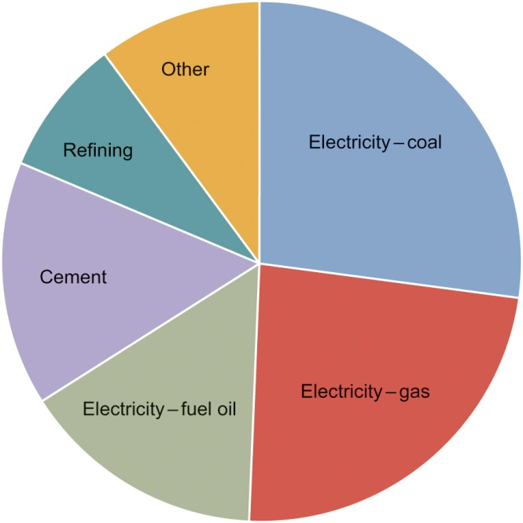
Fig08_01

Slide 2
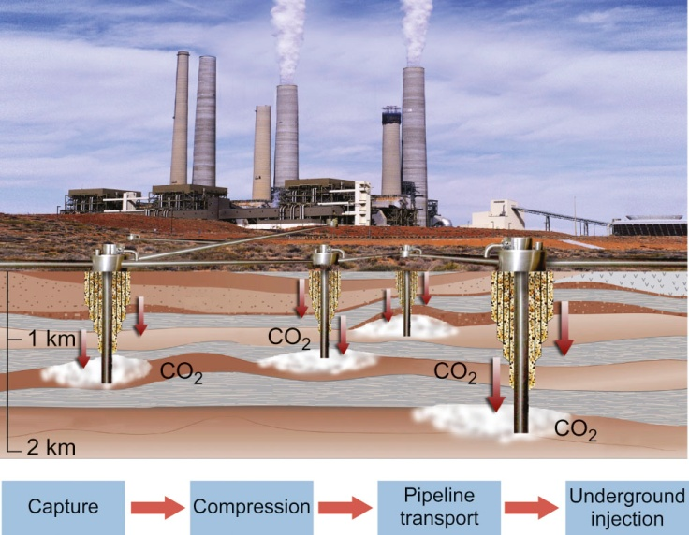
Fig08_02

Slide 3
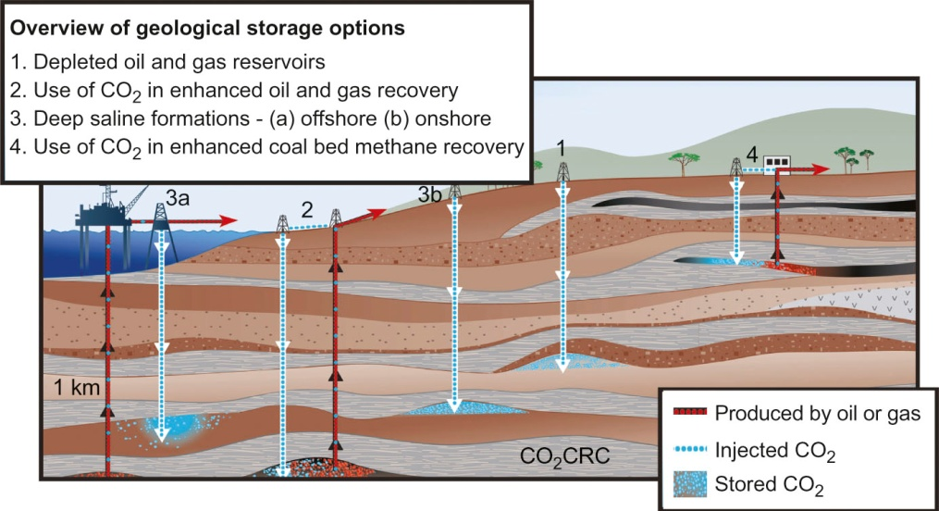
Fig08_03

Slide 4
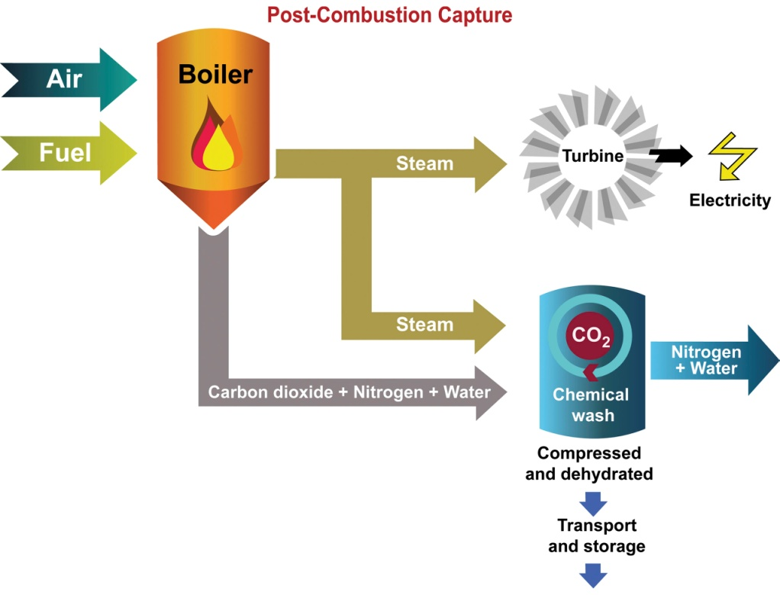
Fig08_04

Slide 5
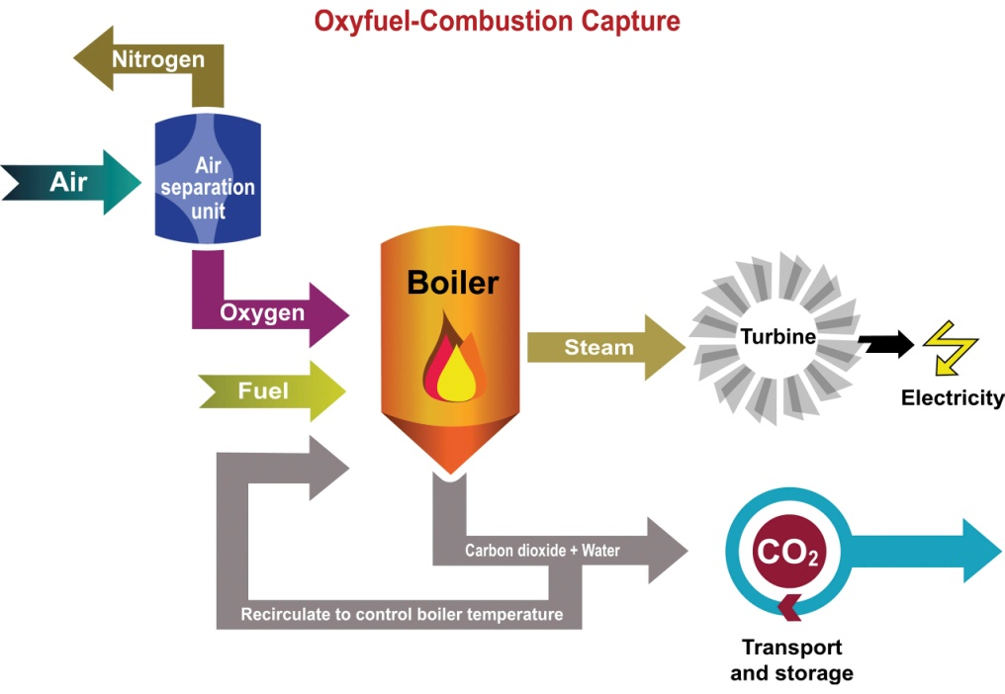
Fig08_05
Courtesy of ZEP

Slide 6
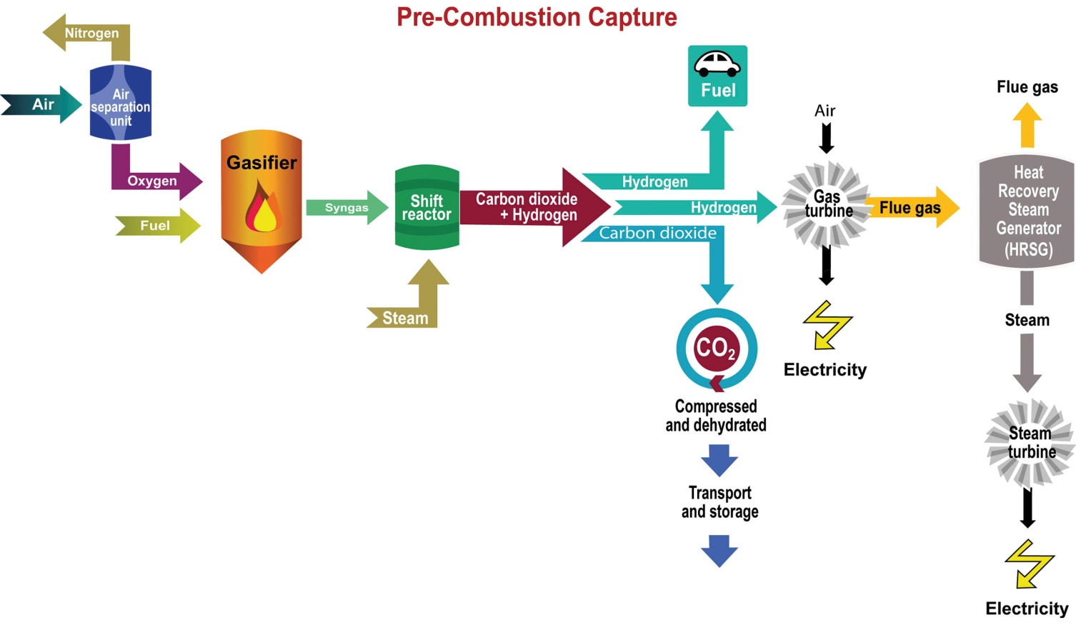
Fig08_06
Courtesy of ZEP

Slide 7
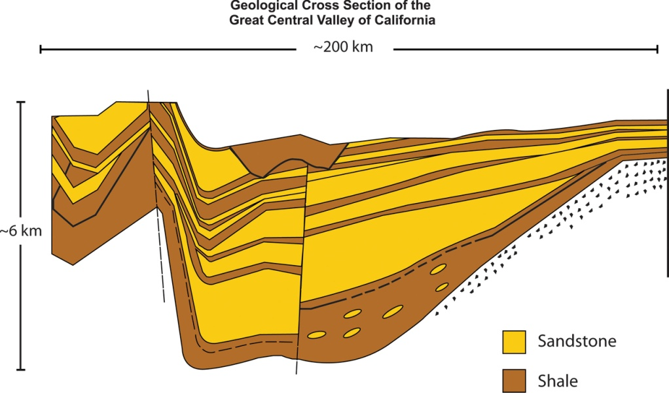
Fig08_07

Slide 8
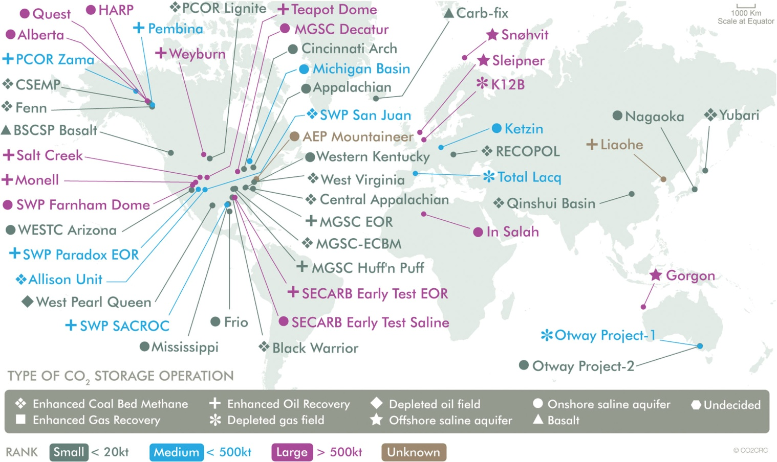
Fig08_08

