Slide 1
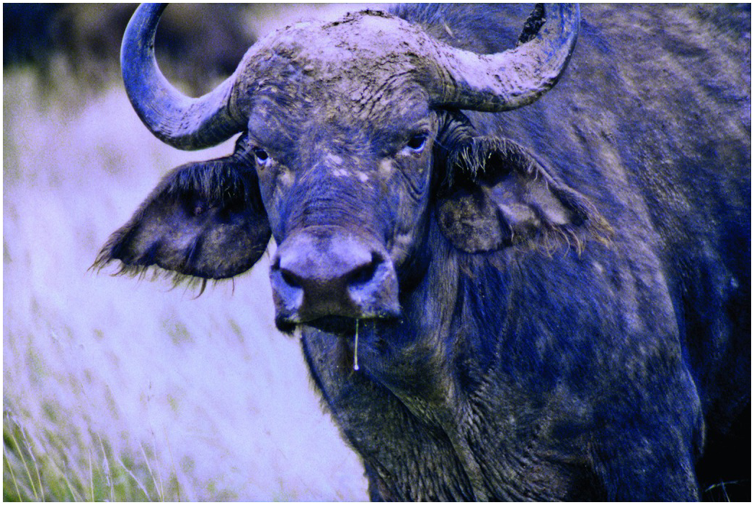
Figure 26.1
African Buffalo adult female infected with rinderpest virus in Nairobi National Park 1996, nasal discharge, diarrhoea, dehydrated and showing poor coat condition, 25% of the herd died (Photo by R. Kock).

