Slide 1
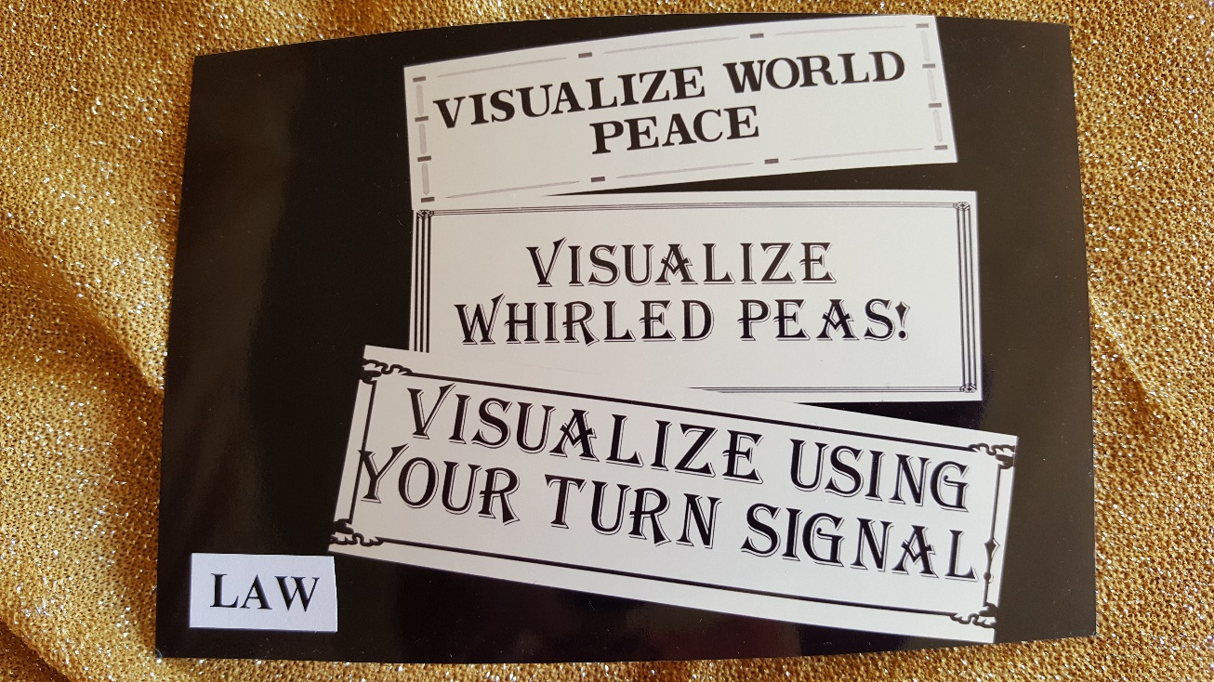
Chapter 12: Humor and Law
by Don and Alleen Nilsen

Slide 2
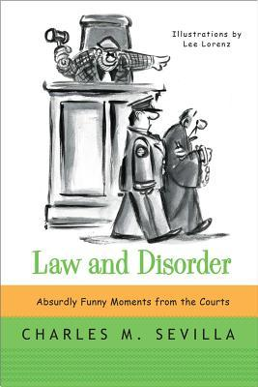
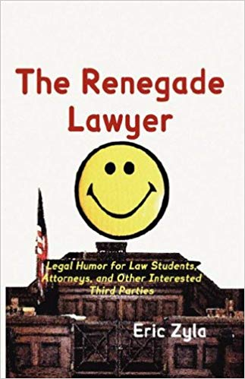

Slide 4
Legal Humour Blog
Legal Humour Blog:
https://www.legalhumour.com/index.cfm?id=28605

Slide 5
ASU’s Law School on the Tempe Campus
This is the Armstrong Building on the ASU Campus, which used to house ASU’s Law School.
It is now the home of ASU’s English Department.

Slide 6
ASU’s New Law School in Downtown Phoenix
This is the new home of the ASU Law School:
The Phoenix Downtown Campus.

Slide 7
The Indian Civil Rights Act of 1968
The US Supreme Court had earlier made clear that tribal internal affairs were not covered by the Fifth Amendment of the US Constitution.
However, during the 1960s, many corrupt, incompetent, or tyrannical tribal officials were found to have abused tribal members.
As a result, the Indian Civil Rights Act of 1968 was endorsed by President Lyndon Johnson and it became law on April 11, 1968 .
It makes many, but not all, of the guarantees of the Bill of Rights applicable within the Indian tribes.

Slide 8
Comparing Bureaucratic Statements:
Pythagorean Theorem:…………………………………….……………24 words
Lord’s Prayer:……………………………………………………….......66 words
Archimedes’ Principle:…………………………………………..……...67 words
Ten Commandments:……………………………………………..……..179 words
Gettysburg Address:………………………………………….………..286 words
Declaration of Independence………………………….……..……...1,300 words
US Constitution with all 27 Amendments:………………..…..……7,818 words
US Government Regulation on the Sale of Cabbage:……….…....26,911 words

Slide 9
Abraham Lincoln

Slide 10
LANHAM (Trademark) ACT Enacted July 5, 1946: Prohibits trademarks that could “disparage…or bring…into contempt or disrepute persons, living or dead.”
In a 2017 Supreme court case, an attorney for “The Slants” (an Asian singing group) successfully argued that “The Slants” had the right to use the expression The Slants as their name, because in their mind the term was “something powerful, something that was considered beautiful or a point of pride.”
Their hope is to make the rest of the world think about it in the same way.

Slide 11
FUNNY CONVERSATIONS FOUND IN COURT RECORDINGS
Q: Doctor, before you performed the autopsy, did you check for a pulse?
A: No.
Q. Did you check for blood pressure?
A: No.
Q: Did you check for breathing?
A: No.
Q: So, then it is possible that the patient was alive when you began the autopsy.
A: No.
Q: How can you be so sure, Doctor?
A: Because his brain was sitting on my desk in a jar.

Slide 12
Jokes about Lawyers Why do they exist, and why are they funny?
Q: What do you have when you’ve got a lawyer buried up to his neck in sand?
A: Not enough sand.
Q: Why don’t sharks attack lawyers?
A: Professional courtesy.
Q: What’s the problem with lawyer jokes?
A: Lawyers don’t think they’re funny, and no one else thinks they’re jokes.

Slide 13
Silly Court Reporter Rants
Silly Court Reporter Rants:
https://www.youtube.com/watch?v=LxUJyS58Q4U

Slide 14
Hustler Magazine v. Jerry Falwell
One of the most famous tests of the legal protection of satire and parody was Hustler Magazine v. Jerry Falwell (485 US 46, 1988). It was a fake ad for Campari Liquor with the caption, “CAMPARI: You’ll never forget your first time.”
It was an imaginary interview with Jerry Falwell, and the joke was that it was
written as if it were about Falwell’s first sexual experience. Falwell says, “My
first time was in an outhouse outside Lynchburg, Virginia.”
A disclaimer (in small print) at the bottom of the page read, “Ad parody---
not to be taken seriously,” but what saved Hustler was that the ad “could not
reasonably be taken as true.”

Slide 17
The Supreme Court held that “parodies of public figures which could not reasonably taken as true are protected against civil liability by the first Amendment, even if intended to cause emotional distress.”
The Supreme Court said that Hustler had to pay Reverend Fallwell 150 thousand dollars (one source said $200,000) for emotional distress, but their conclusion was that “no reasonable reader could understand the publication as an assertion of fact,” and therefore, “it is incapable of harming reputation.”
Later, however, Nathan Poe famously explained that “Without a winking, smiley or other blatant display of humor, it is utterly impossible to parody a Creationist in such a way that someone won’t mistake it for the genuine article.”

Slide 18
Protection of Satire
The Media Law Journal (April 24, 2013) stated, “it’s not that the law clearly protects humorous speech and satire. The question is a bit vexed.”
“With cases involving outrageous parody and satire, the path of least resistance has been to find the ‘speech’ non-defamatory as a matter of law.”
Satire is “the use of humor, irony, exaggeration, or ridicule to expose and criticize people’s stupidity or vices, particularly in the context of contemporary politics and other topical issues.”

Slide 19
Legal Protections for Satire and Parody
The Reporters Committee for Freedom of the Press states that “Satire and Parody are important forms of political commentary that rely on blurring the line between truth and outrageousness to attack, scorn and ridicule public figures.”
“Although they may be offensive and intentionally injurious, these statements contain constitutionally protected ideas and opinions provided a reasonable reader would not mistake the statements as describing actual facts.”

Slide 20
Can Jokes be Copyrighted?
Comedians and writers can make a living from writing original jokes, but not all jokes can be copyrighted.
A joke must be original, and fixed in some tangible form to be eligible for copyright protection, so jokes that are only uttered verbally are ineligible.
Videos, books, and recordings of jokes may be eligible for copyright protection because they are recorded in tangible form.

Slide 21
Jokes must also be original.
Minor variations of other people’s jokes are not eligible for copyright protection; also generalized humorous observations might not be eligible.
The “Fair-Use” exception to copyright laws allows short excerpts of copyrighted material to be used for educational use, for parody, for scholarly review and similar purposes.
Normally only longer jokes, humorous essays, or collections of jokes are copyrighted because other performers could work your jokes into their routines, and claim that they were parodying your jokes.

Slide 22
Ironies and Paradoxes in the Law
VOLTAIRE SAID: “It is forbidden to kill; therefore, all murderers are punished unless they kill in large numbers and to the sound of trumpets.”
HONORÉ DE BALZAC SAID: “Laws are spider webs through which the big flies pass and the little ones get caught.
JIMMY CARTER SAID: “Penalties against possession of a drug should not be more damaging to an individual than the use of the drug itself.”

Slide 23
America’s Favorite Judge Judy

Slide 24
In Washington, there is a “Bigfoot Sanctuary” of roughly one million acres of land, in which it is illegal to poach a Sasquatch.
The reasoning is that if Bigfoot exists, he would have to be considered on the endangered-species list, and therefore in need of protection.
This felony went onto the Washington books in 1969, and is punishable by a $1,000 fine.

Slide 25
“Charlie Chaplin Beats the Israeli Lottery”
This NYT headline (February 18, 2000) was about the Israeli Lottery launching an advertising campaign featuring The Little Tramp selling tickets.
The Chaplin family, which had carefully protected the image, petitioned the Lottery to quit using the images, but the Lottery refused.
In finding for the Chaplin family, the Israeli Supreme Court said that the Lottery must pay $25,000 in court costs. A $1 million suit is still pending.
Adi Levit, the Lottery attorney, said, “It’s time to think about a settlement.
I no longer feel like the young man I was when I first took this case.”

Slide 26
DIFFERENT KINDS OF LOGIC
There is logic and then there is “local logic.”
Explain the “local logic” of each of the following laws:

Slide 27
Alabama
Many years ago, bear wrestling was a popular form of entertainment in Alabama.
However it is now judged to be “cruelty to animals’ based on the way it subjugated the bears to years of abuse due to the harsh conditions of where they had to live, plus it also risked their lives.

Slide 28
Alaska
Flamingo owners in Juno, Alaska can not bring their pets into the barbershops.

Slide 29
Hong Kong
A law in Hong Kong says that women who have cheating husbands can kill them, but only with their bare hands.

Slide 30
Iowa
In Iowa, if a piano player has only one arm,
he or she must perform for free.

Slide 31
North Carolina
In North Carolina, it’s against the law to sing off-key.

Slide 32
Ohio
In Ohio, policemen are allowed to bite a dog,
but only if they think it will calm the dog down.

Slide 33
Tennessee
In Tennessee, it’s illegal to purchase or consume Jack Daniel’s Whiskey in the very town in which it is produced.
We decided that this law is probably designed to keep the employees from drinking on the job.

Slide 34
Sample Laws of Life
Law of Probability—The probability of being watched is directly proportional to the stupidity of your act.
Law of the Result—When you try to prove to someone that a machine won’t work, it will.
Murphy’s Law of Lockers—If there are only two people in a locker room, they will
have adjacent lockers.
Variation Law—If you change grocery store lines (or traffic lanes), the one you were in
before will always move faster than the one you are now in.

Slide 35
Nilsen, Alleen and Don. The Language of Humor: An Introduction. Cambridge, England: Cambridge University Press, 2019.

