Slide 1
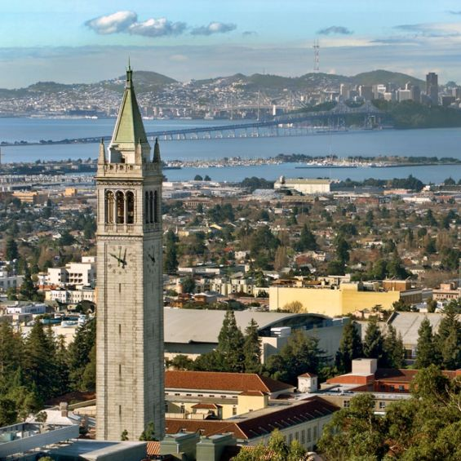
University of California, Berkeley
X-rays and Extreme Ultraviolet Radiation
AST210/EECS213
Fall 2019

Slide 2
Synchrotron Radiation
David Attwood
University of California, Berkeley

Slide 3
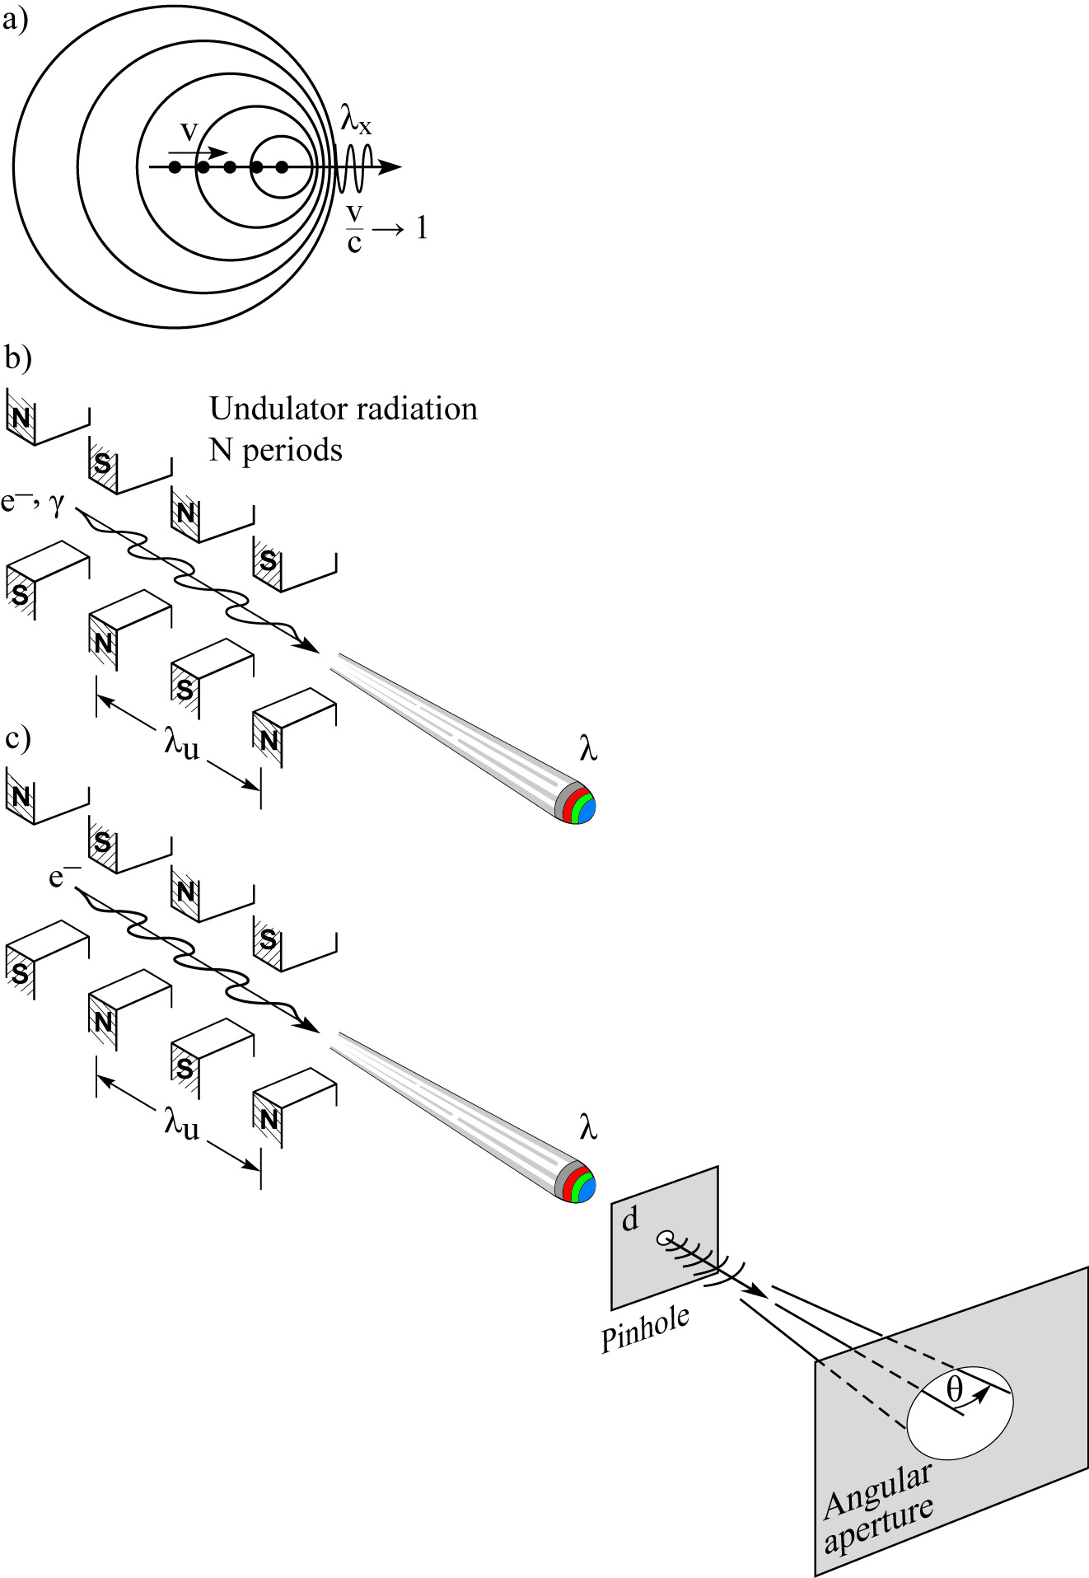
Synchrotron radiation
Bending Magnet:
Wiggler:
(5.96)
Undulator:
Spatial filtering:
(5.76)
(5.41)
(5.82)

Slide 4
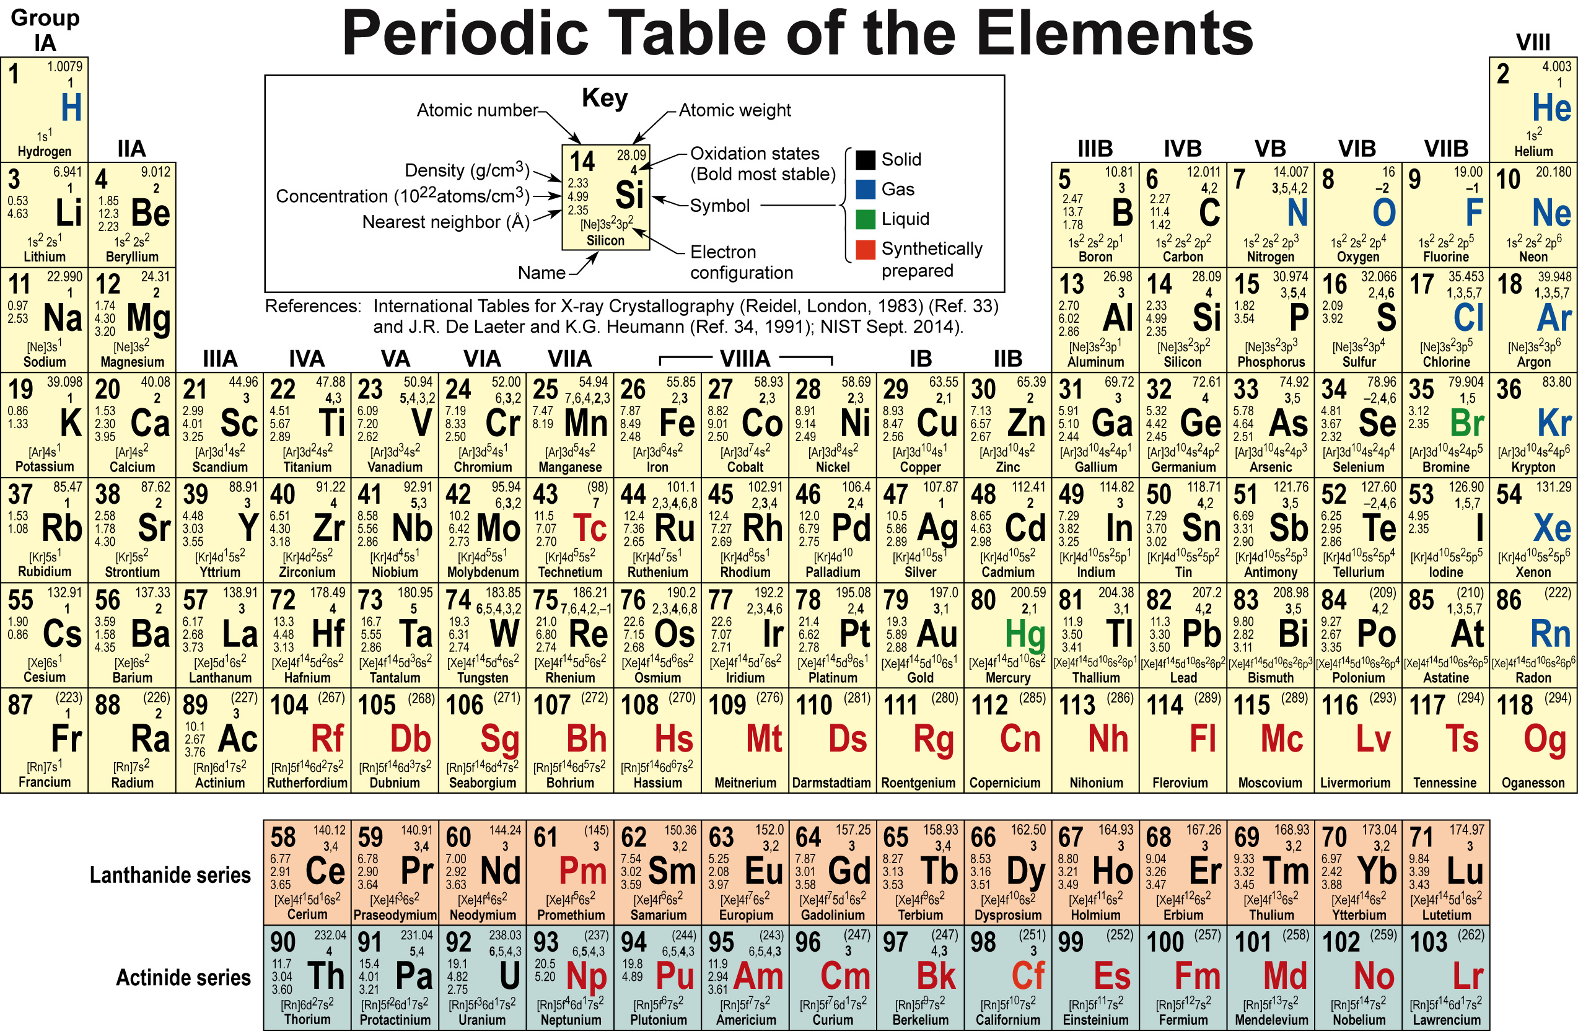
With synchrotron radiation all elements can be probed

Slide 5
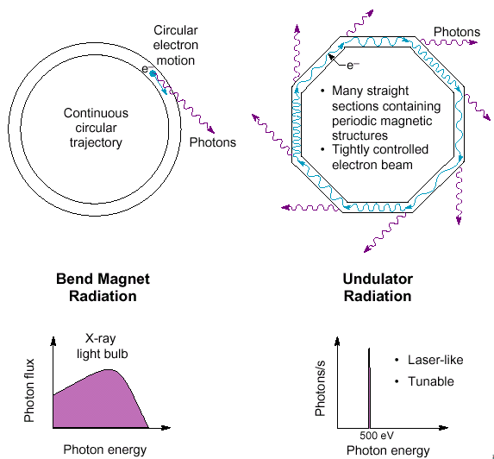
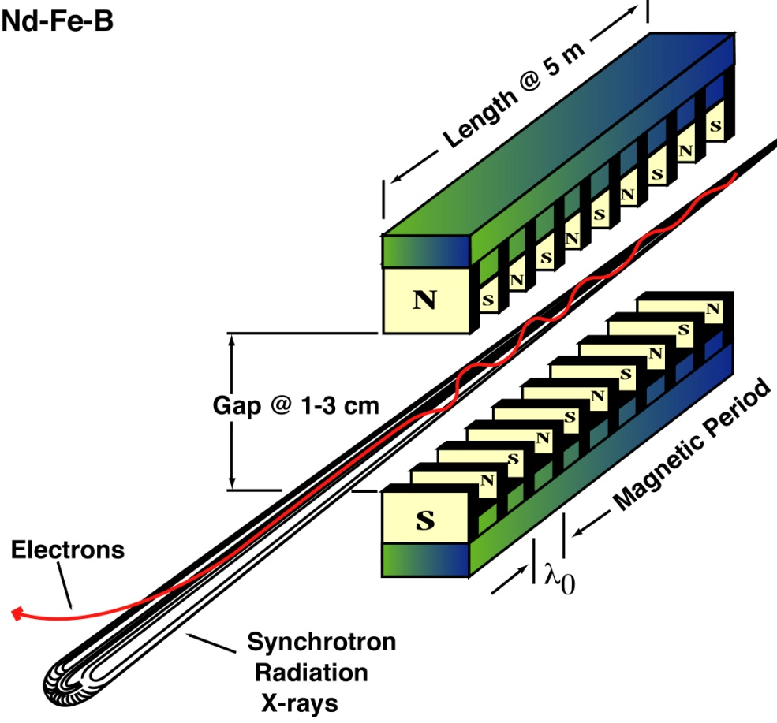
Third Generation Sources: Undulator Insertion Devices
1st, 2nd Generation
3rd Generation: Insertion Devices
u
Courtesy of Richard Garrett, ANSTO
Notes:
Now we will move on to consider the three major kinds of source, and what makes the 3rd generation facilities special. The 3rd generation rings are specifically designed to optimise the radiation from undulator sources. Introduce ID – periodic array of magnets causing the electron beam to wiggle/undulate as it travels down the straight section.

Slide 6
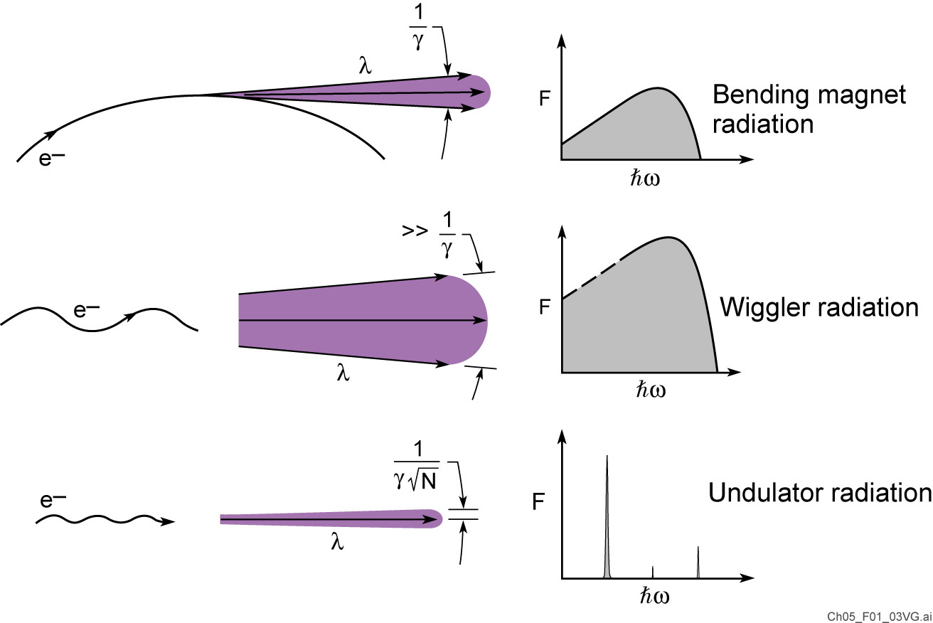
Three forms of synchrotron radiation

Slide 7
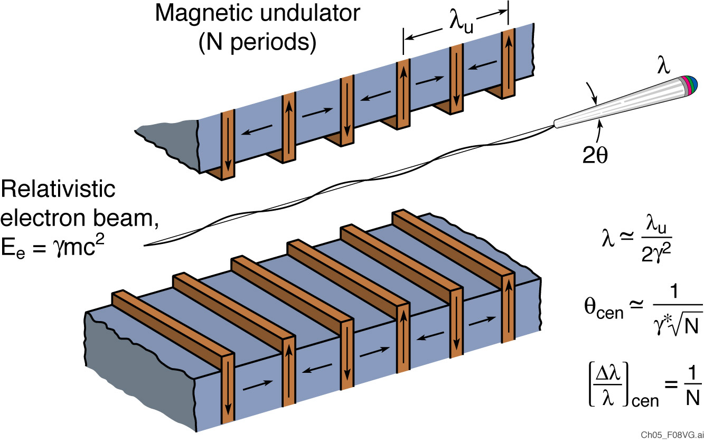
Narrow cone undulator radiation, generated by relativistic electrons traversing a periodic magnet structure

Slide 8
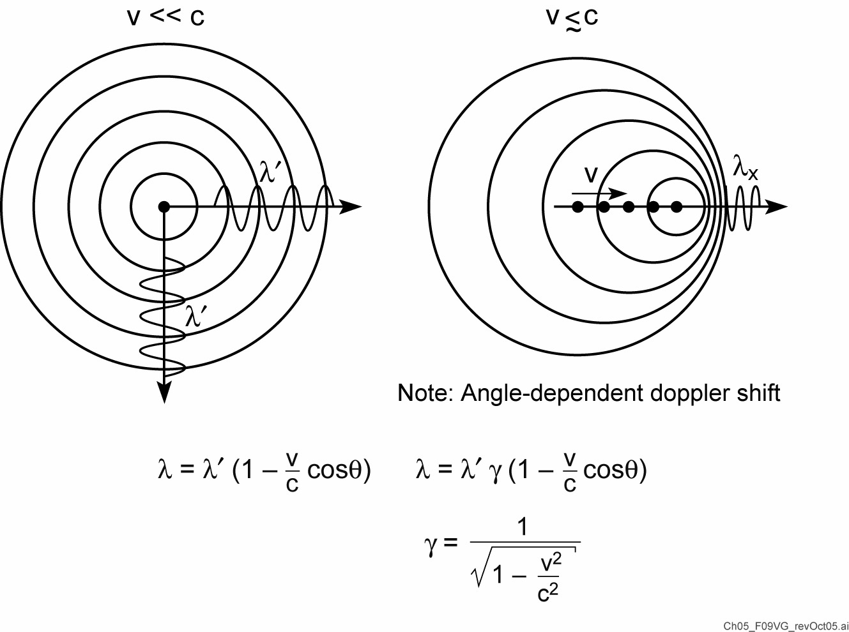
Synchrotron radiation from relativistic electrons
Following J. Madey

Slide 9
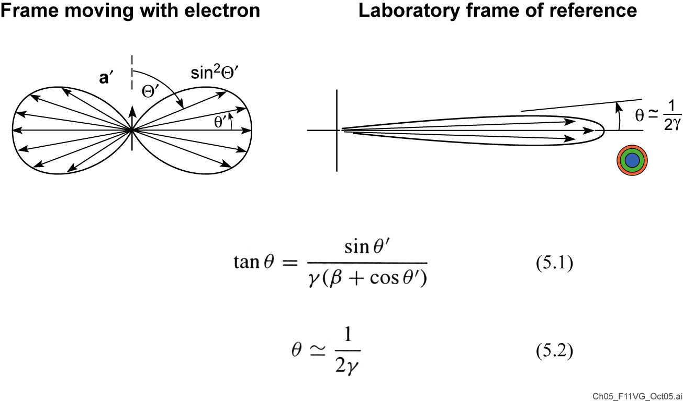
Synchrotron radiation in a narrow forward cone

Slide 10
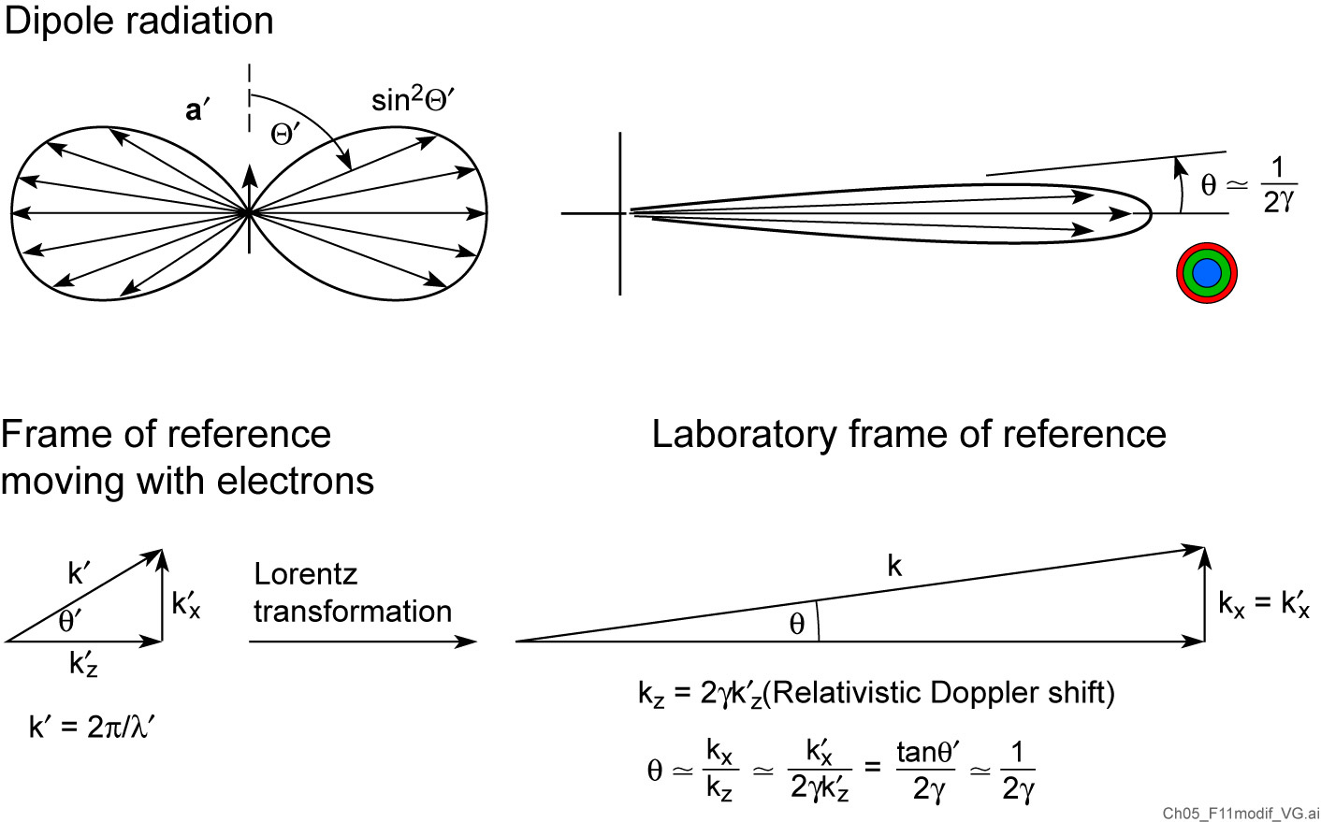
Relativistic electrons radiate in a narrow forward cone

Slide 11

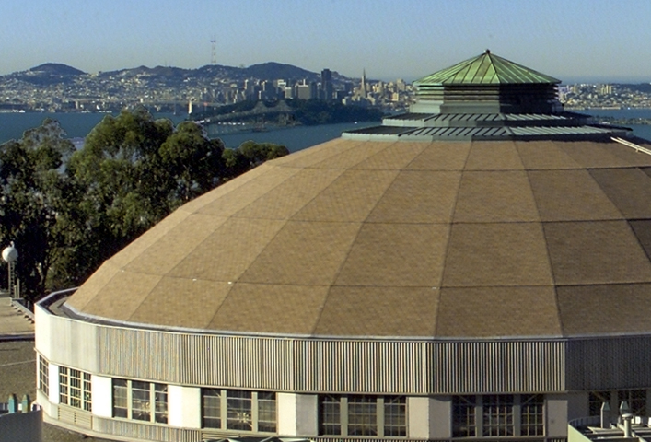
The ALS with San Francisco in the background
1.9 GeV, γ = 3720, 197m circumference

Slide 12
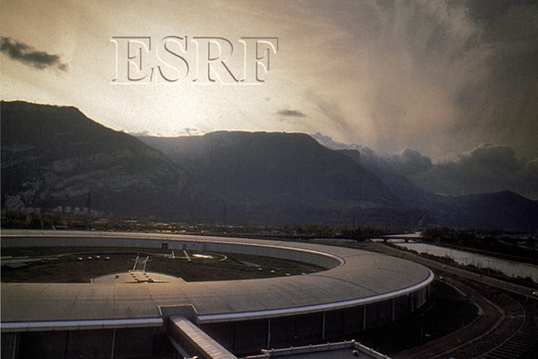
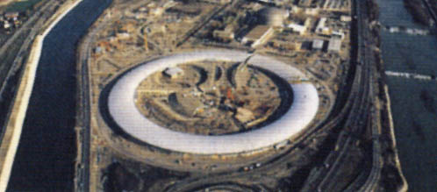
Europe’s ESRF is well situated in Grenoble, France
6 GeV; γ = 11,800; 884 m circumference
At the confluence of two rivers

Slide 13
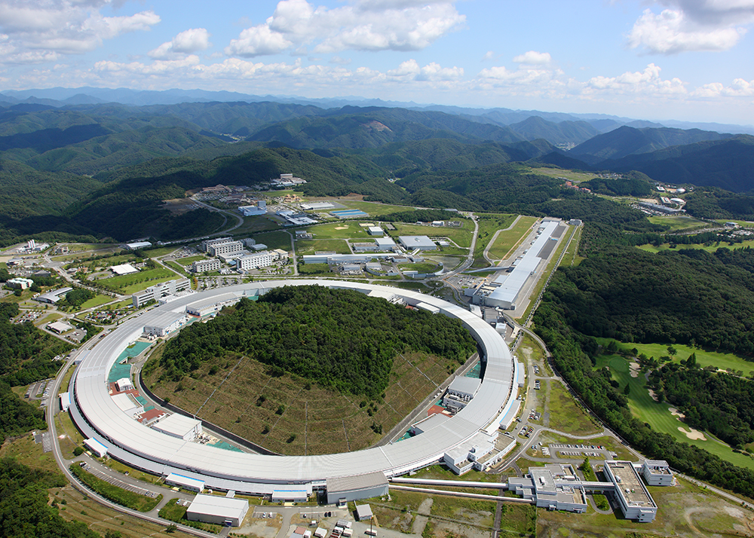
SPring-8 in Hyogo Prefecture, Japan
8 GeV; γ = 15,700; 1.44 km circumference

Slide 14
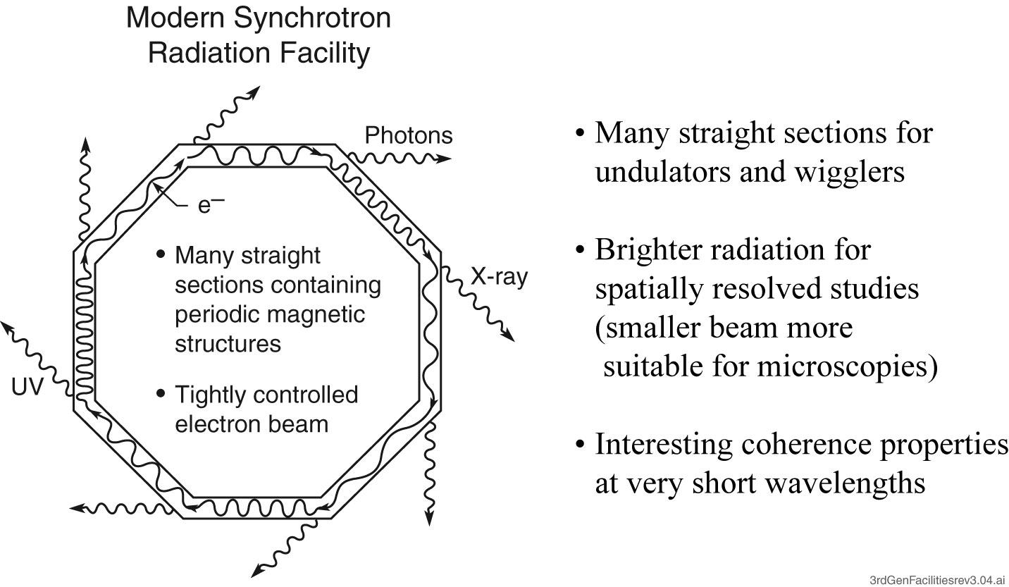
3rd Generation facilities have many straight sections and a small electron beam
Fourth generation light sources
(“DLSRs”) will have smaller
electron beam cross-sections and
thus higher spatial coherence

Slide 15
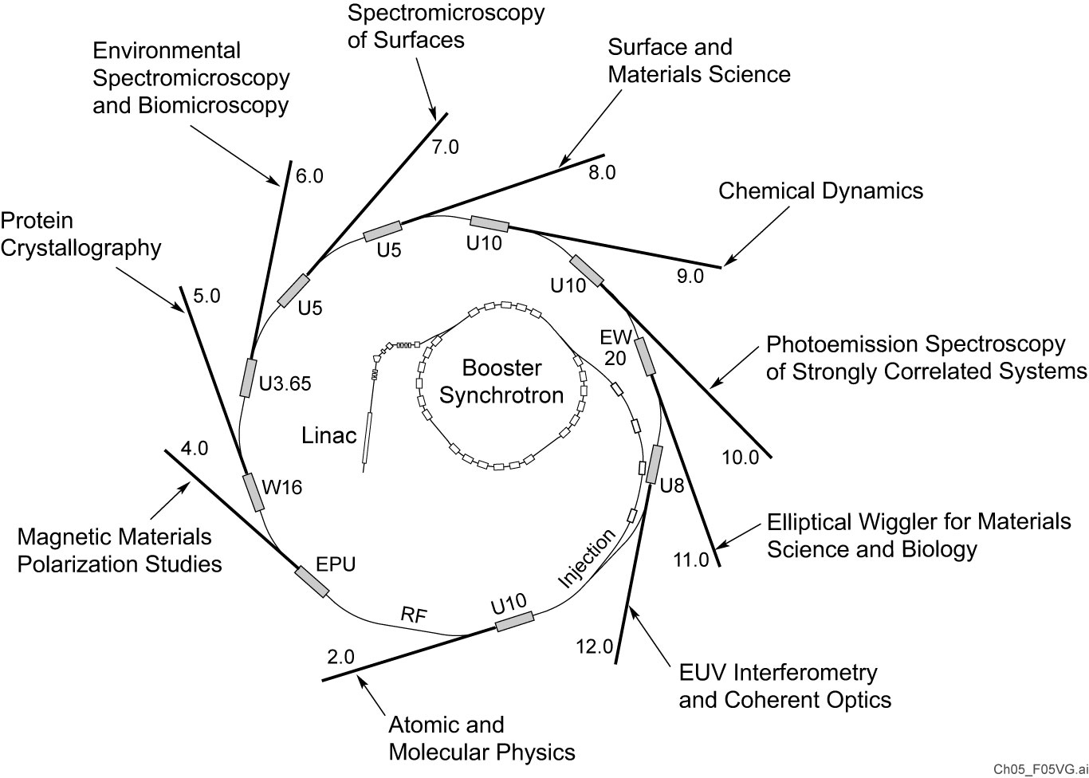
A single storage ring serves many scientific user groups

Slide 16
Typical applications of synchrotron radiation
Surface science
Magnetic materials
Materials chemistry
Environmental sciences
Protein crystallogrphy
Biomicroscopy
Chemical dynamics

Slide 17
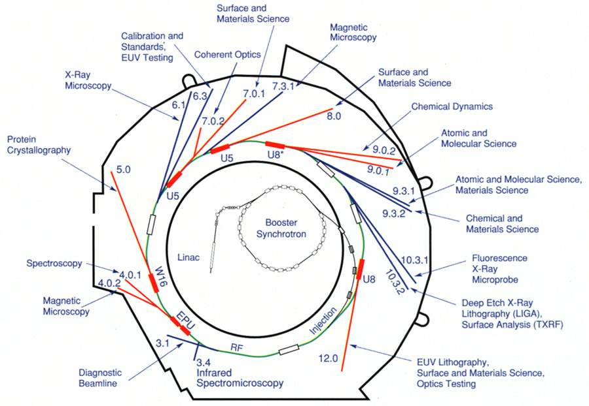
A single storage ring serves many scientific user groups

Slide 18
Undulator Radiation

Slide 19
Synchrotron radiation from relativistic electrons
Following J. Madey

Slide 20
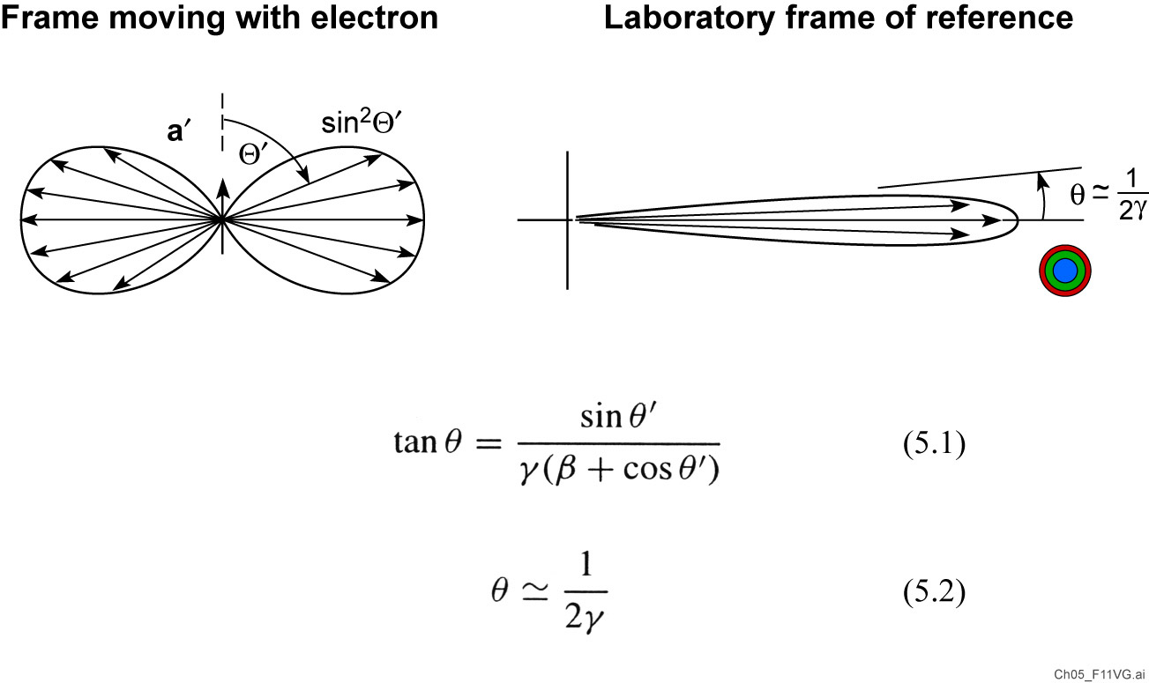
Synchrotron radiation in a narrow forward cone

Slide 21
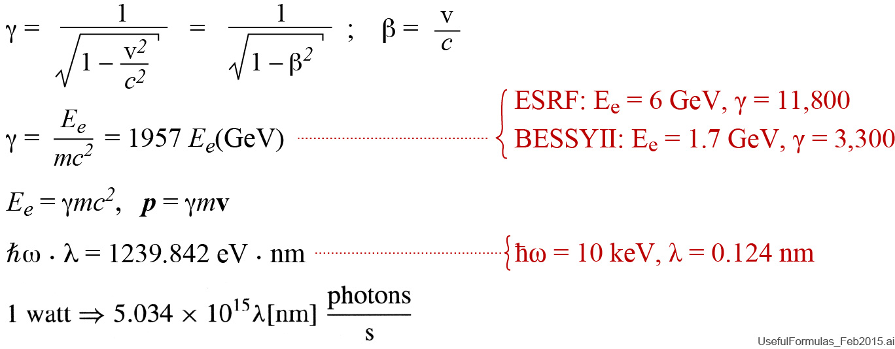
Some useful formulas for synchrotron radiation

Slide 22
Narrow cone undulator radiation, generated by relativistic electrons traversing a periodic magnet structure

Slide 23
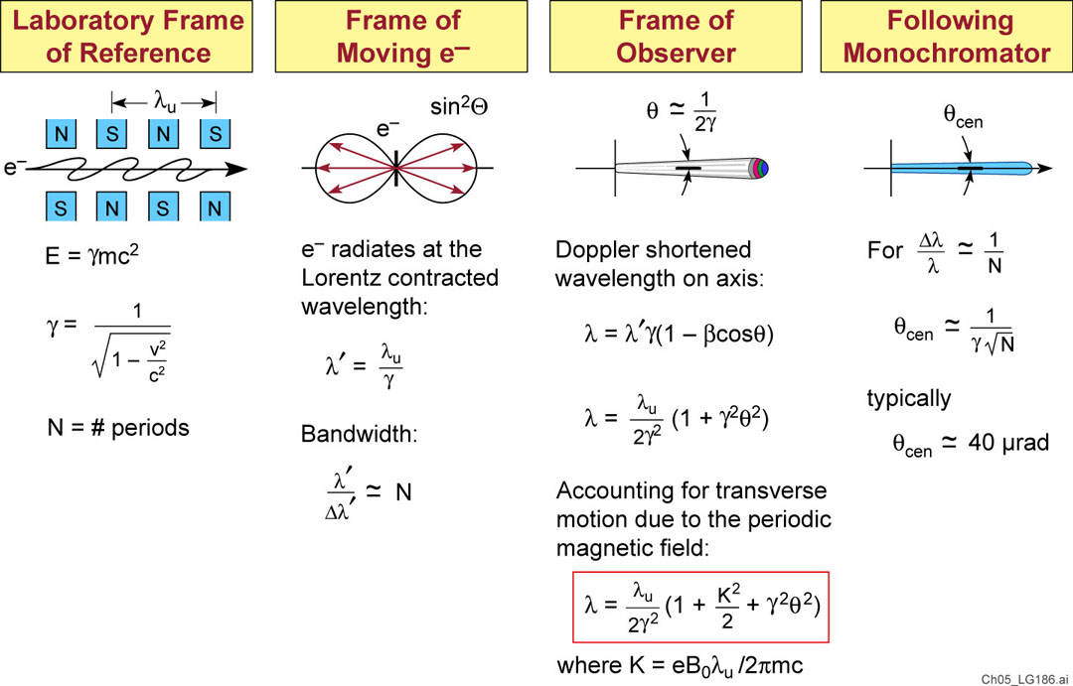
Undulator radiation
Following A. Hoffmann (SLAC)

Slide 24
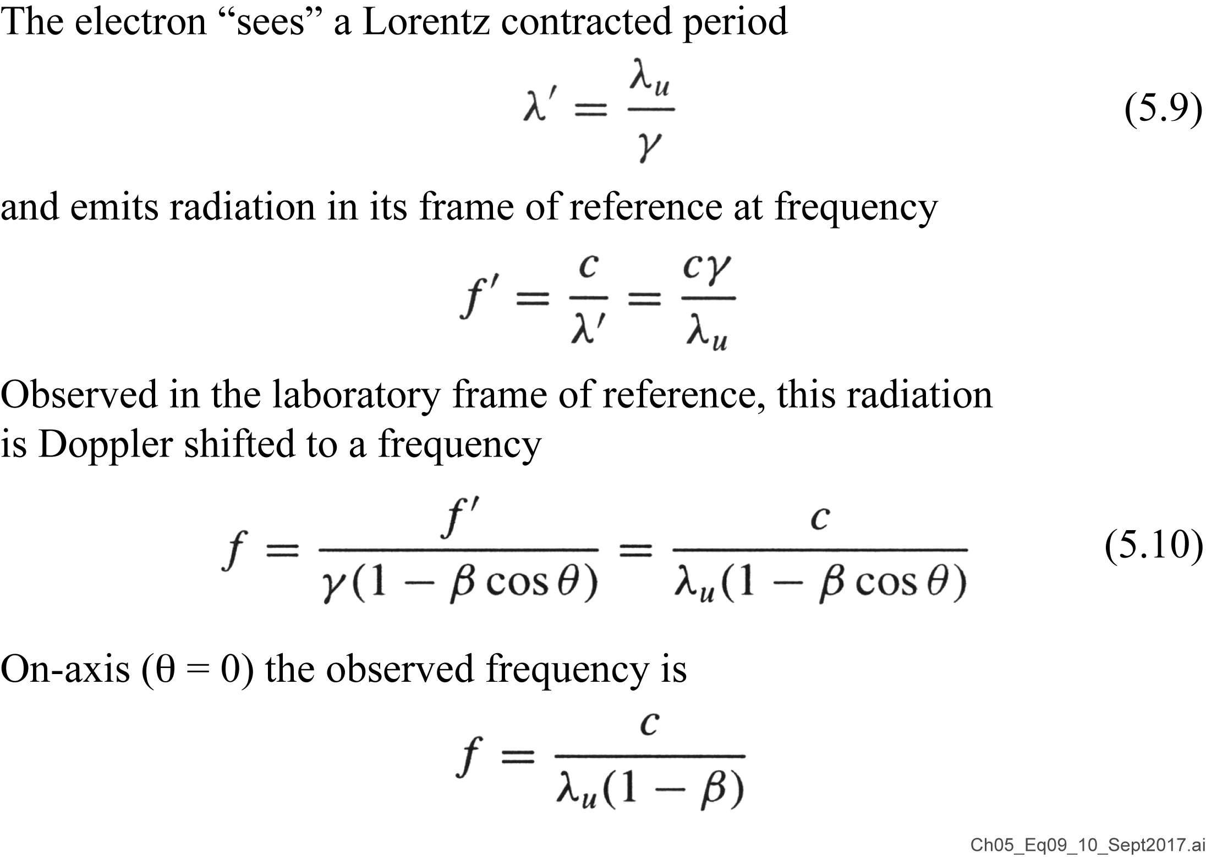
Physically, where does the λ = λ_{u}/2γ² come from?

Slide 25
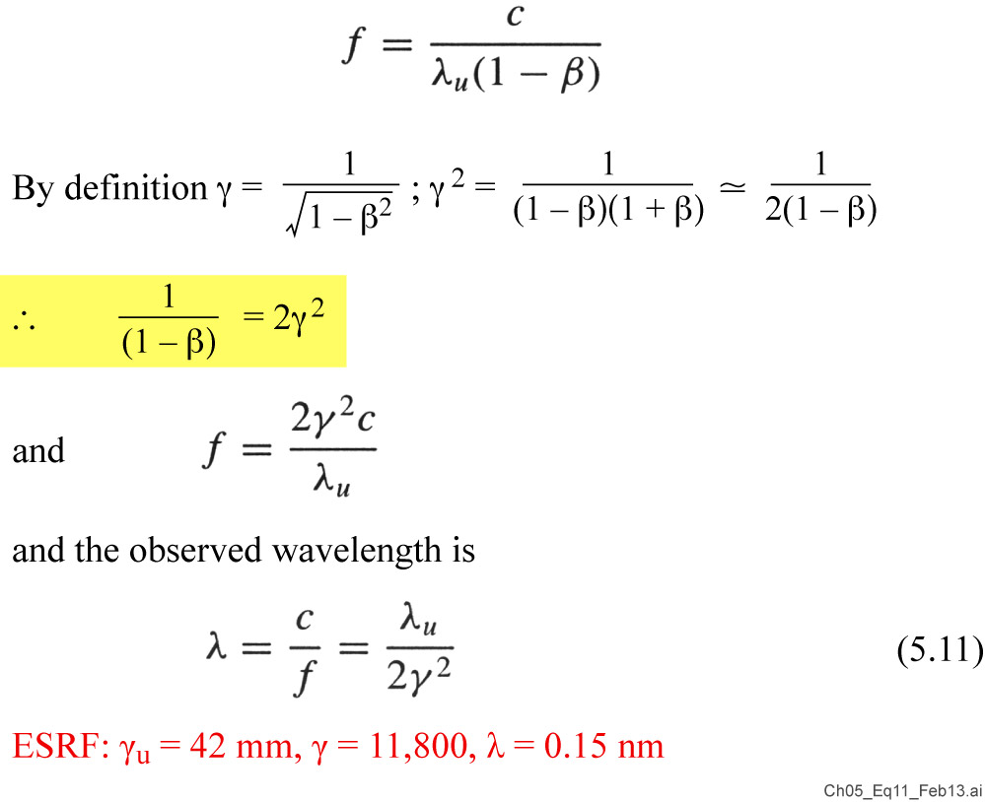
Physically, where does the λ = λ_{u}/2γ² come from?

Slide 26
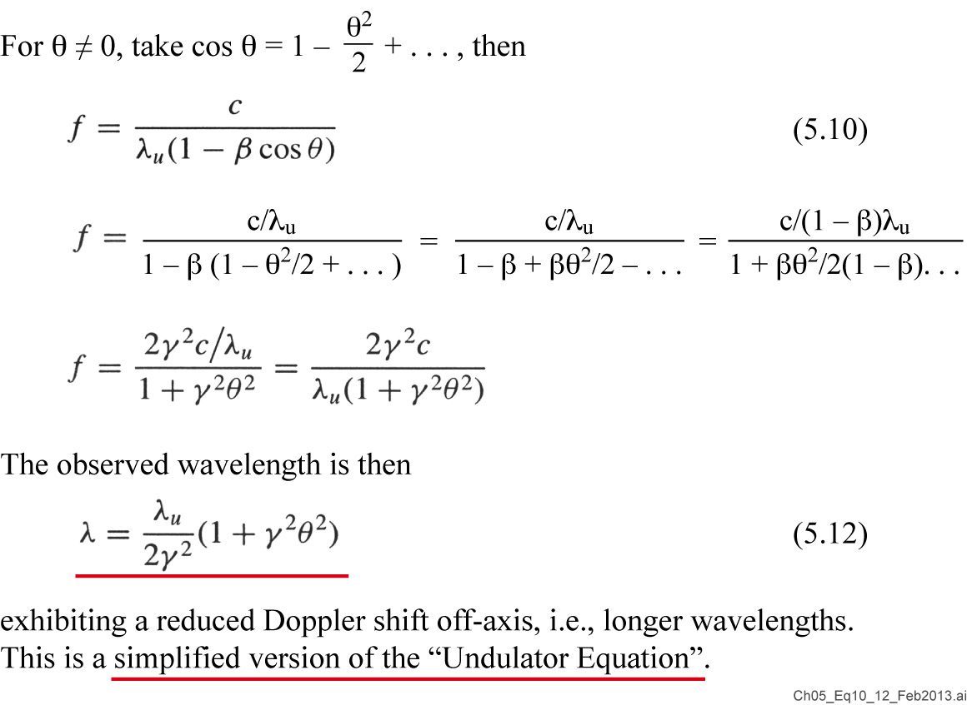
What about the off-axis doppler effect at θ ≠ 0?

Slide 27
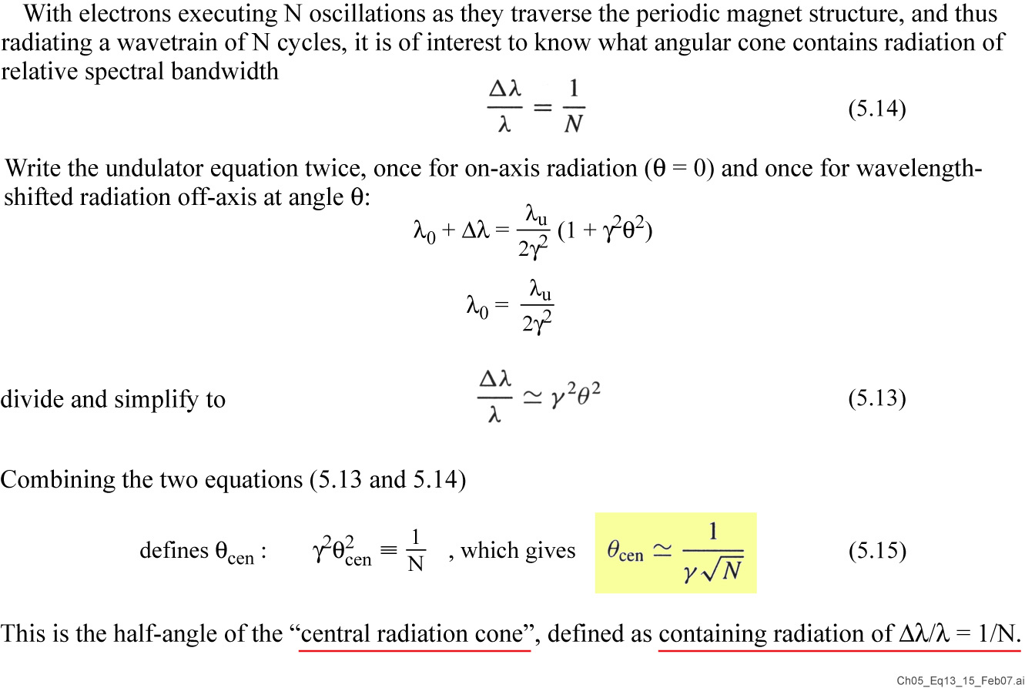
The undulator’s “central radiation cone”

Slide 28
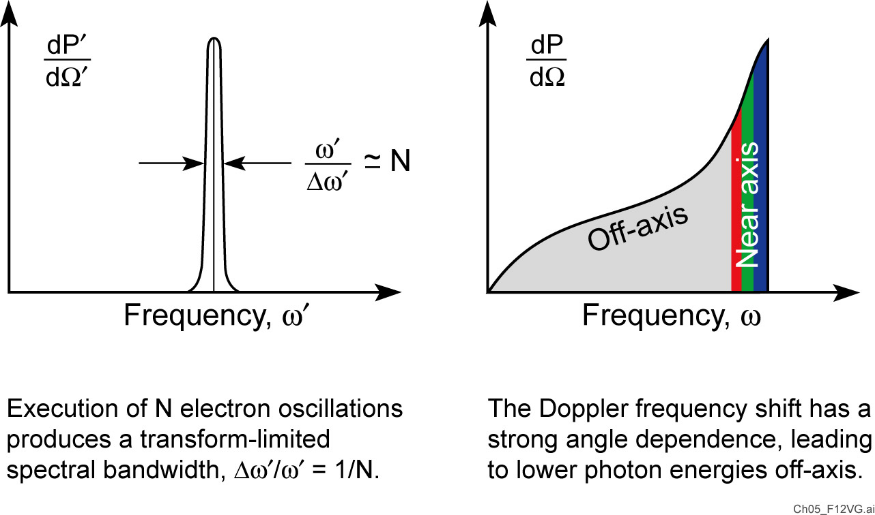
The undulator radiation spectrum in two frames of reference

Slide 29
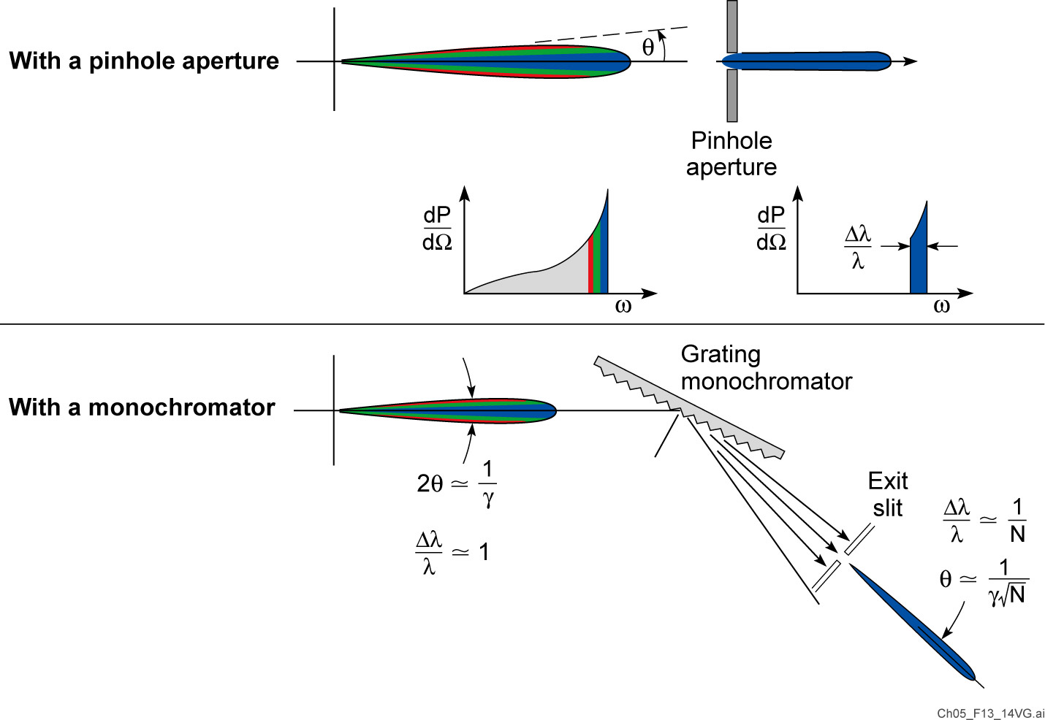
The narrow (1/N) spectral bandwidth of undulator radiation can be recovered in two ways

Slide 30
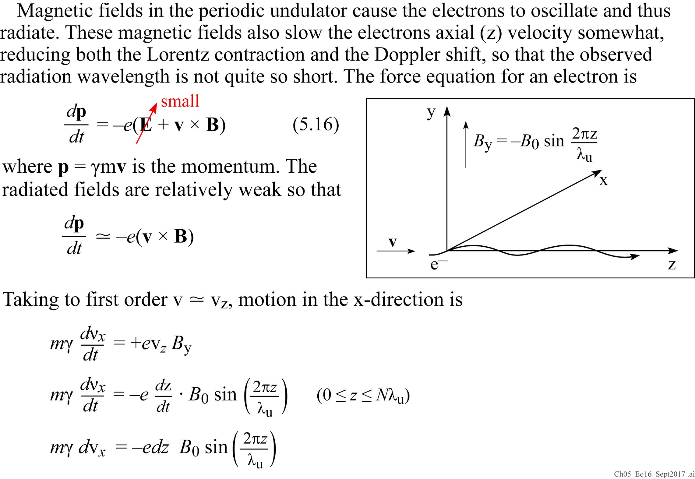
What about magnetic (K) undulator tuning?
Let’s use the equation of motion in an undulator.

Slide 31
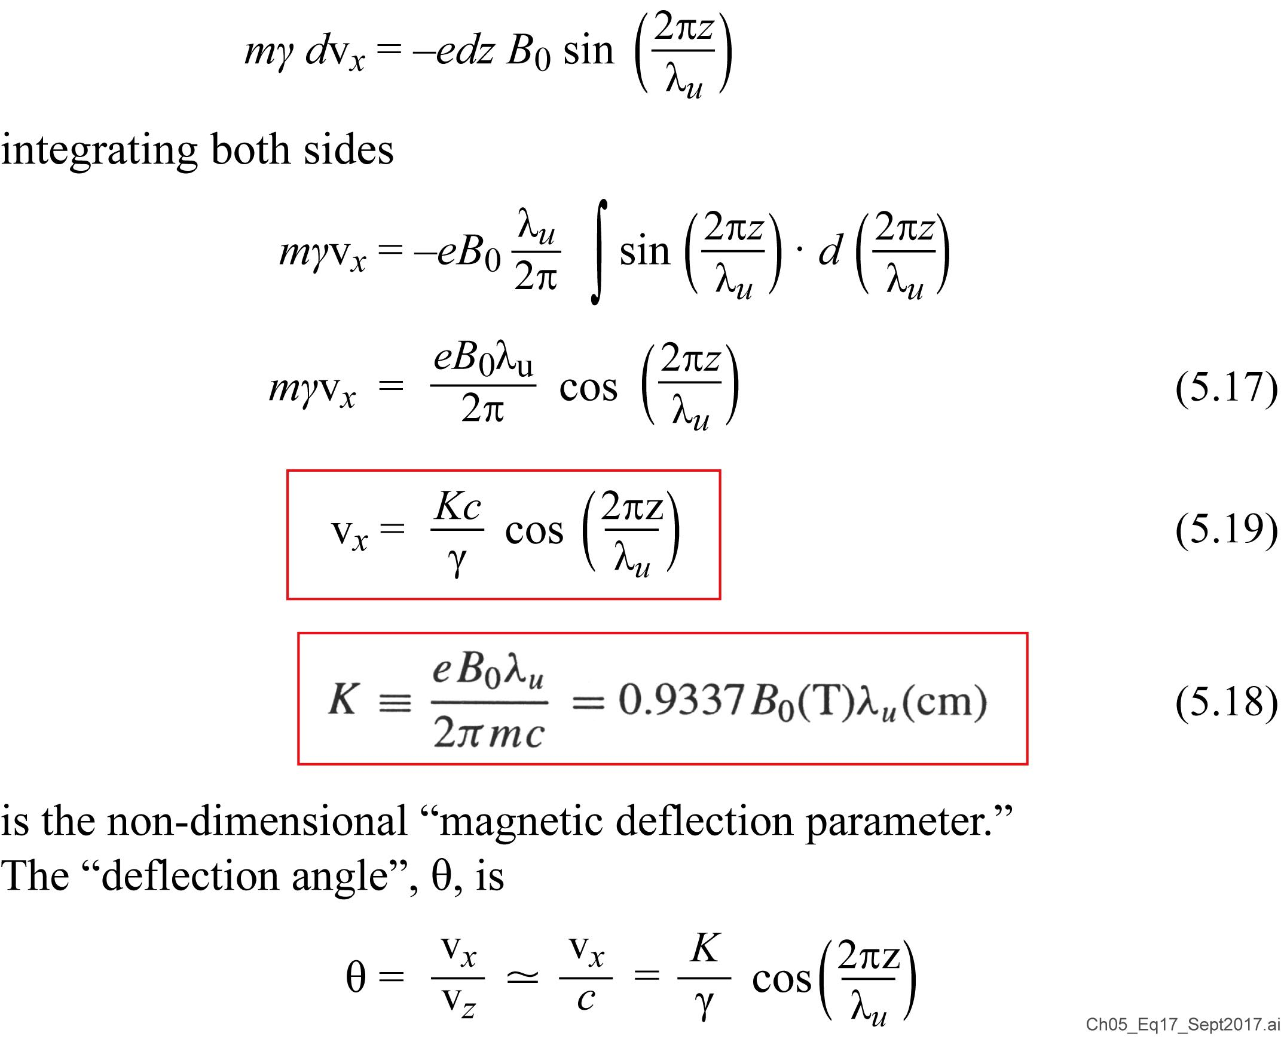
The equation of motion in an undulator (continued)

Slide 32
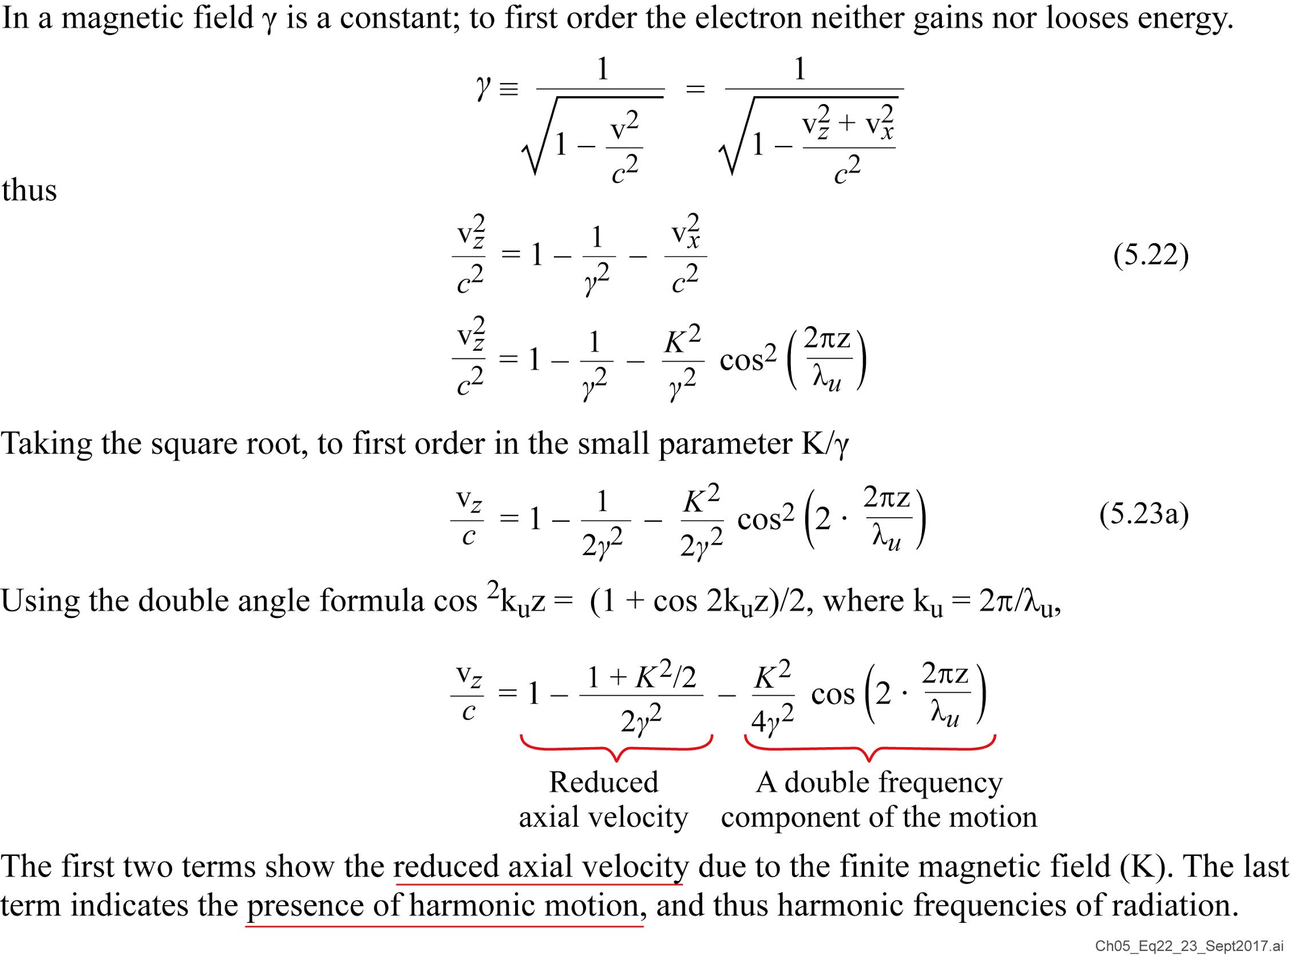
The axial velocity depends on K

Slide 33
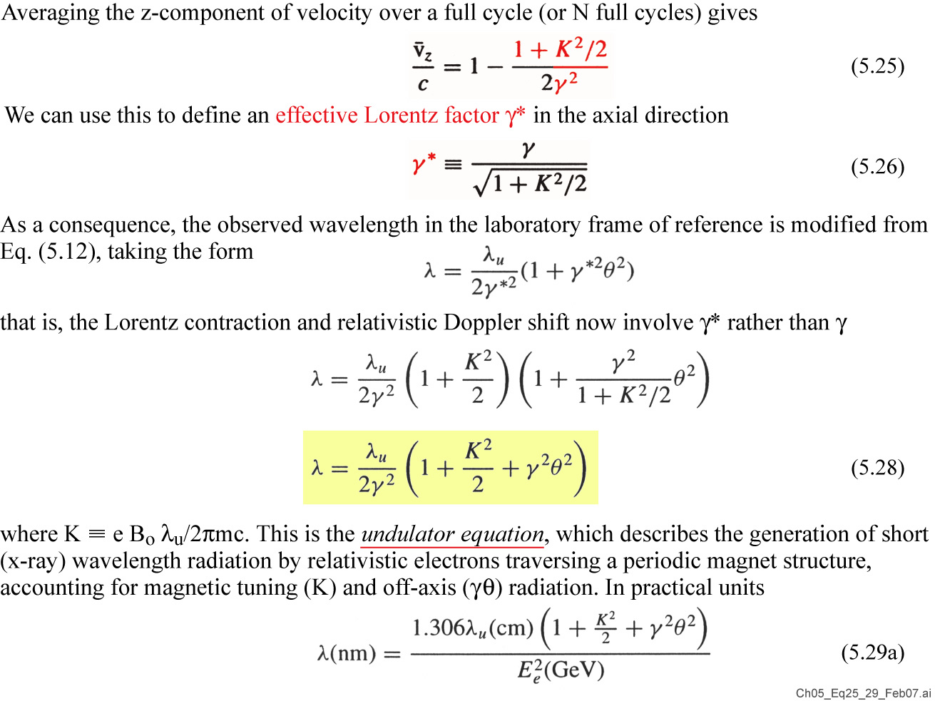
K-dependent axial velocity affects the undulator equation

Slide 34
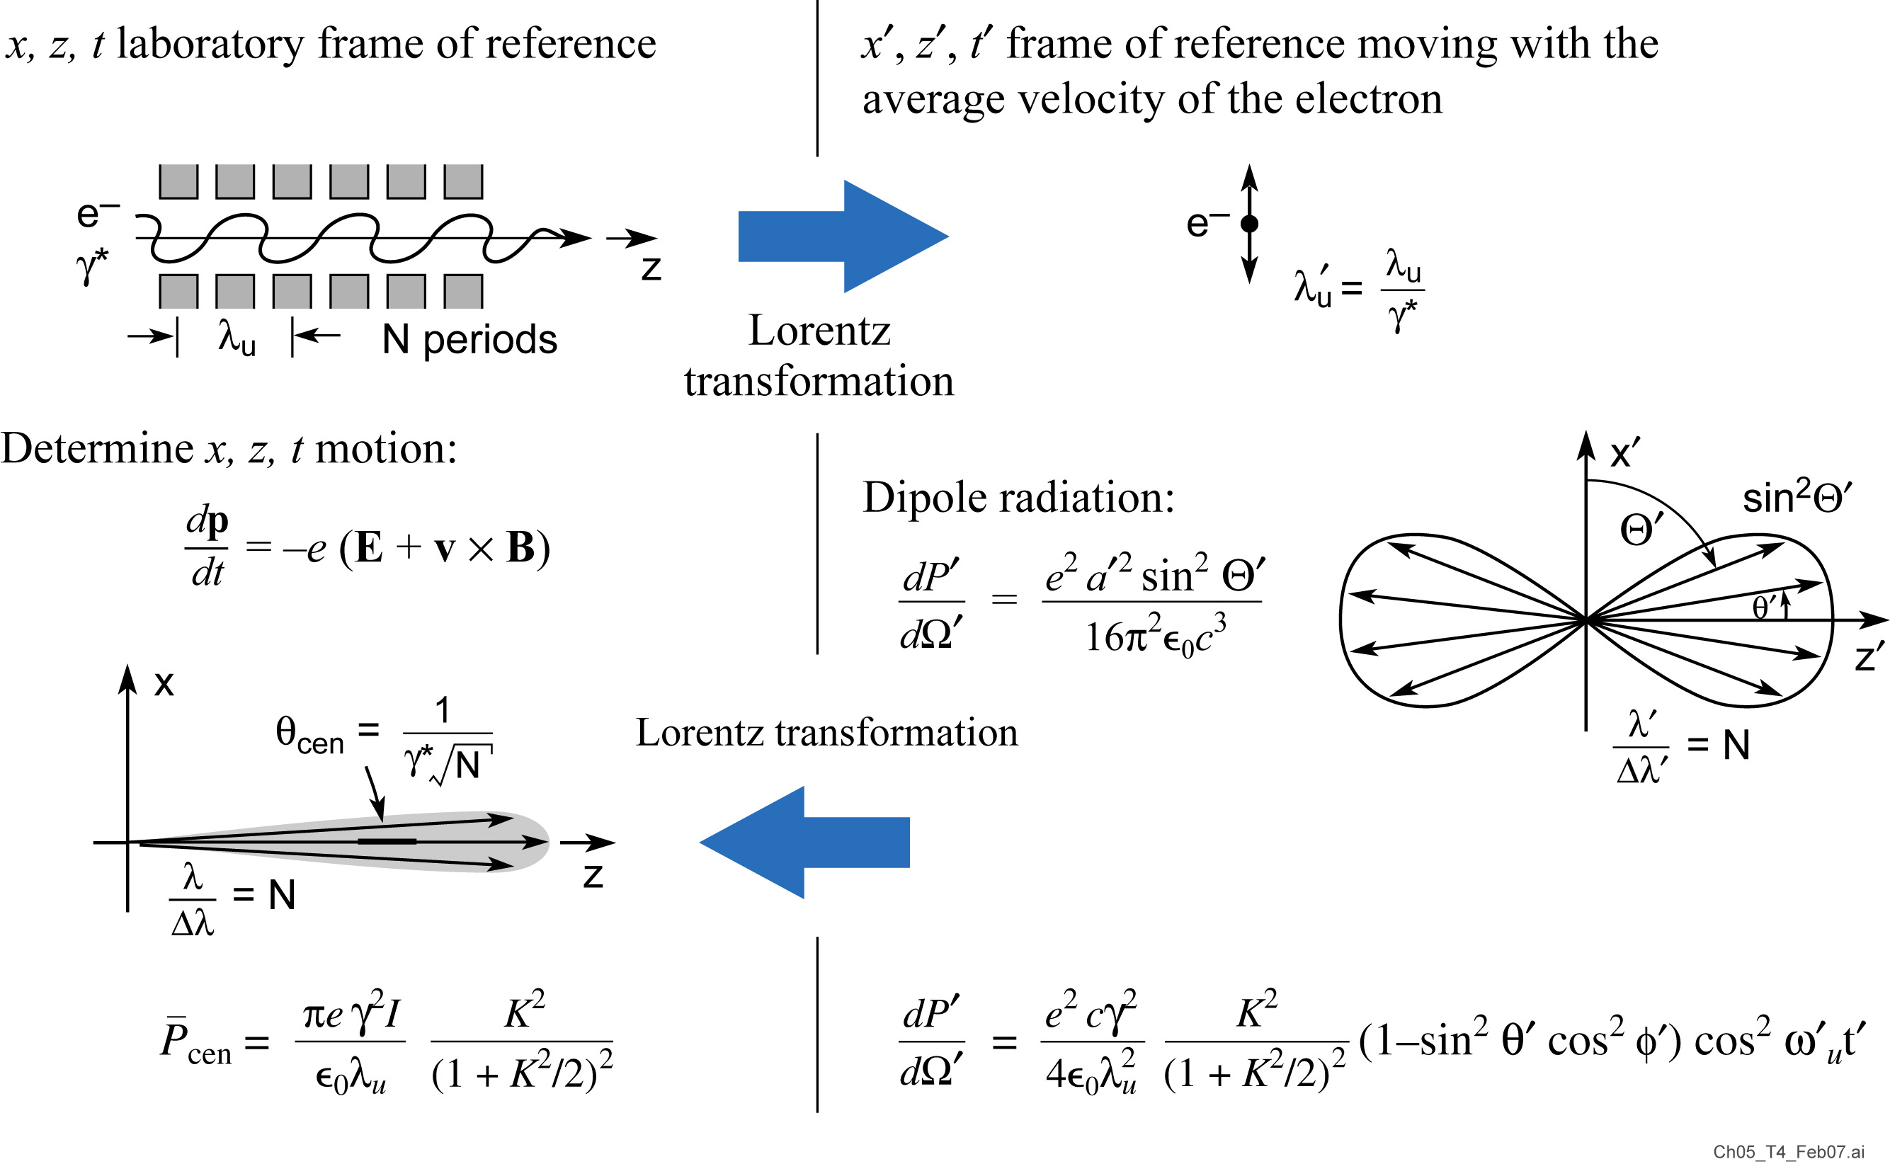
Calculating Power in the Central Radiation Cone: Using the well known “dipole radiation” formula by transforming to the frame of reference moving with the electrons
(see Table 5.4, p.175 for details)

Slide 35
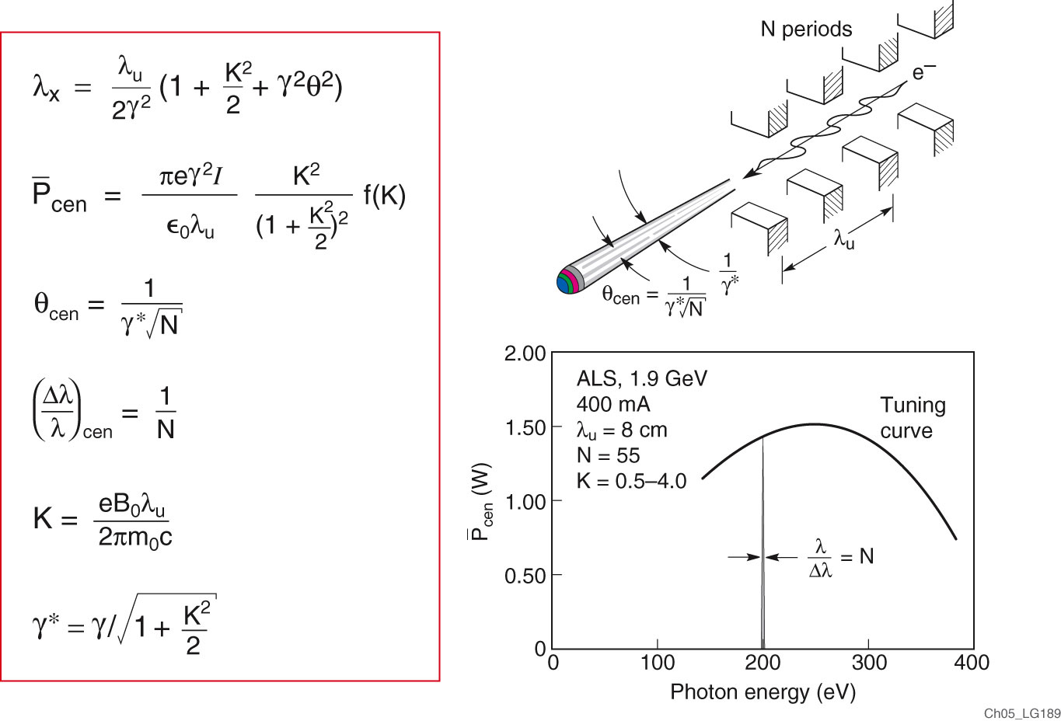
Power in the central cone
[JJ]²

Slide 36

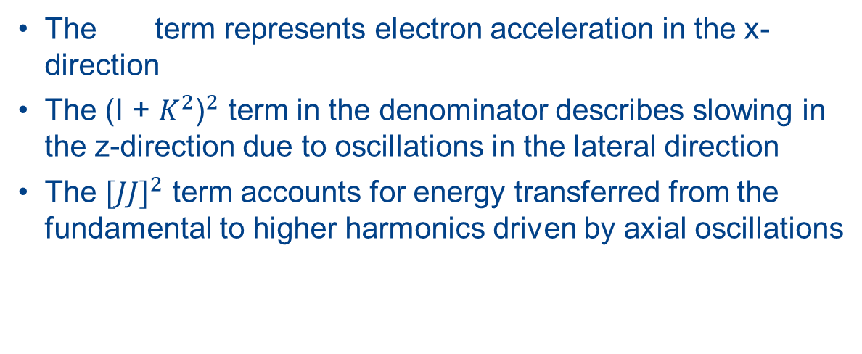
Various K factors in radiated power
The term represents electron acceleration in the x-direction
The ${\text{(}\text{I}\text{ + }K^{2}\text{)}}^{2}$ term in the denominator describes slowing in the z-direction due to oscillations in the lateral direction
The ${[JJ]}^{2}$ term accounts for energy transferred from the fundamental to higher harmonics driven by axial oscillations
$$K^{2}$$

Slide 37
Continue thursday

Slide 38
Synchrotron radiation from relativistic electrons
Following J. Madey

Slide 39
Undulator radiation
Following A. Hoffmann (SLAC)

Slide 40
Calculating Power in the Central Radiation Cone: Using the well known “dipole radiation” formula by transforming to the frame of reference moving with the electrons
(see Table 5.4, p.175 for details)

Slide 41
Power in the central cone
[JJ]²

Slide 42
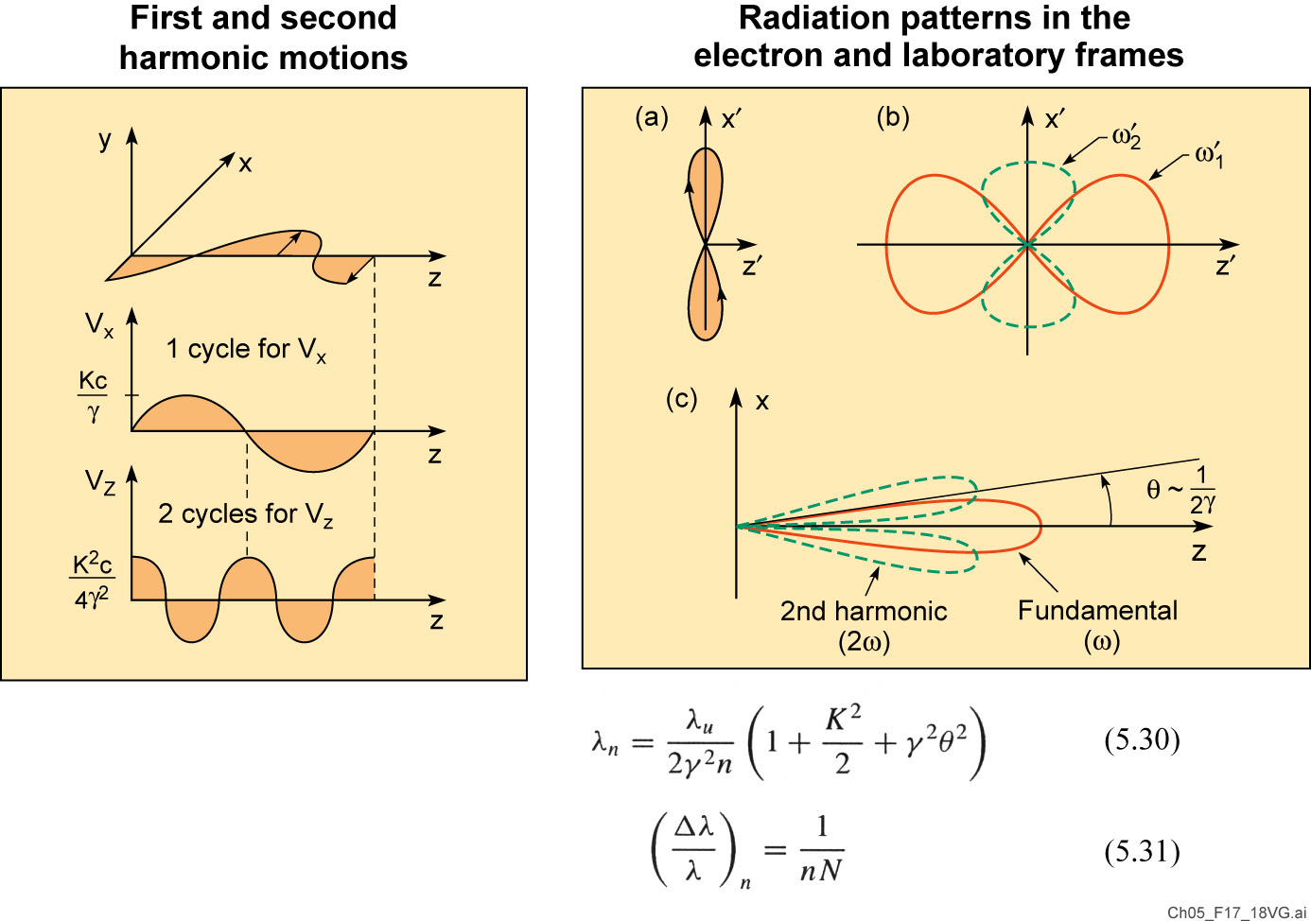
Comments on undulator harmonics

Slide 43
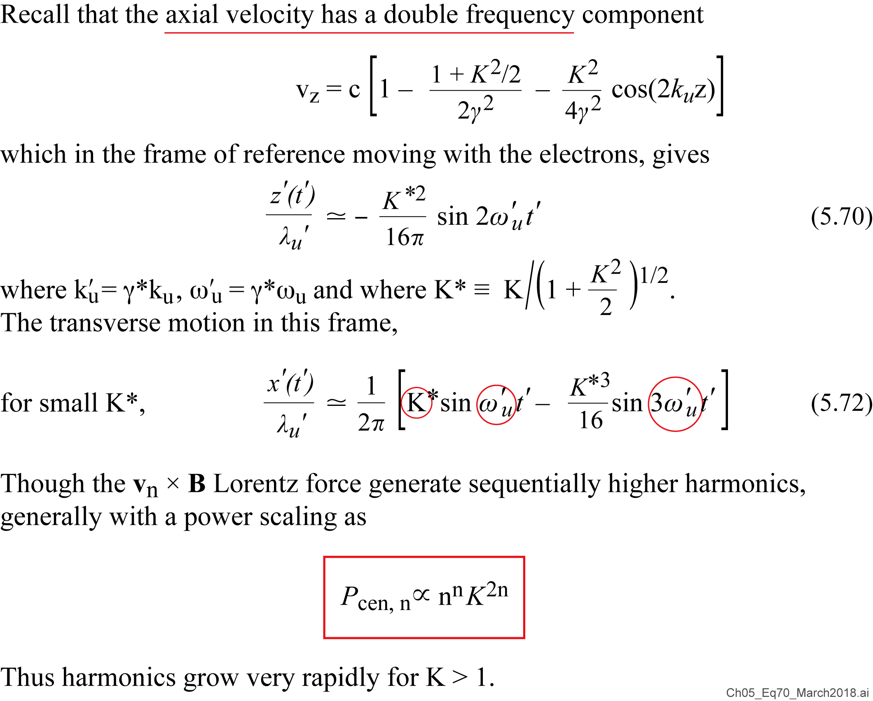



Undulator harmonic power scaling
$${\overline{P}}_{cen,n}∝n^{3}K^{2n}$$
$${\overline{P}}_{cen,n}∝n^{3}K^{2n}$$
$${\overline{P}}_{cen,n}∝n^{3}K^{2n}$$

Slide 44
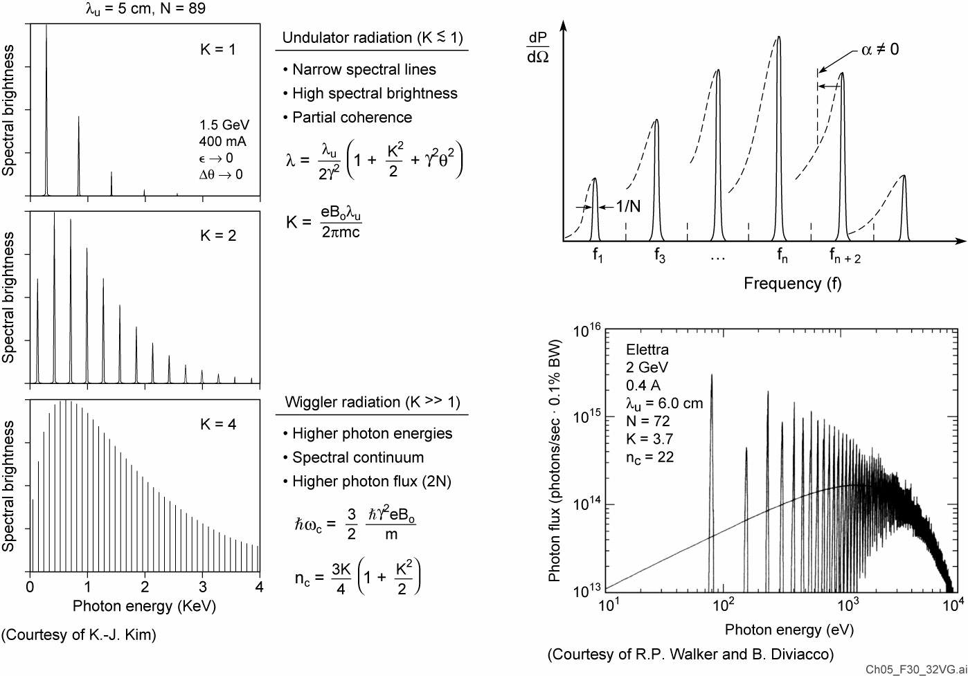
The appearance of harmonics for K > 1

Slide 45
Power in the central cone
[JJ]²

Slide 46

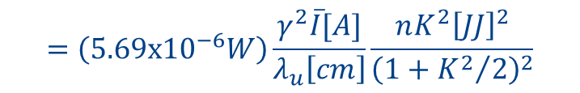

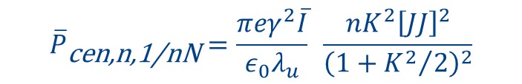
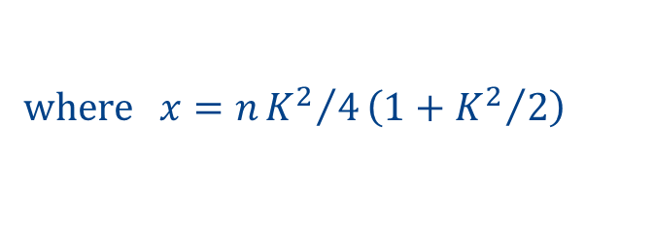
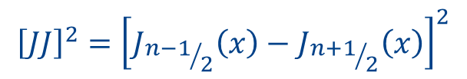

Calculating undulator harmonic power
Undulator harmonics provide a naturally occurring path to higher photon energies, as discussed in Sections 5.42 and 5.5. Extending Eqs.(5.41a,c) for power in the central radiation cone to cover harmonics n, one has
where the factor n combines a factor n² due to harmonic acceleration squared and a factor 1/n due to the reduced harmonic solid angle. For harmonic n,
For a change to photon flux, , 1 W corresponds to 5.034 x 10¹⁵ λ[nm] ph/sec [Eq.(1.2b)], and replacing a relative spectral bandwidth of 1/nN with the synchrotron standard 0.1% by multiplying by nN/1000, one has
An additional multiplicative factor, η, which accounts for beamline efficiency can be introduced to account for finite mirror reflectivities, filter transmissions, and monochromator efficiency (reflection grating or crystals).
$${\overline{P}}_{\text{cen}\text{,}\text{n}\text{,1/}\text{nN}}=\frac{πeγ^{2}\overline{I}}{ε_{0}λ_{u}} \frac{nK^{2}{\left[JJ\right]}^{2}}{{\left(1+{K^{2}}/2\right)}^{2}}$$
$$=\left(5.69x{10}^{−6}W\right)\frac{γ^{2}\overline{I}[A]}{λ_{u}\left[cm\right]}\frac{nK^{2}{\left[JJ\right]}^{2}}{{\left(1+{K^{2}}/2\right)}^{2}}$$
$${\left[JJ\right]}^{2}={\left[J_{{n−1}/2}\left(x\right)−J_{{n+1}/2}\left(x\right)\right]}^{2}$$
$$where x=n{K^{2}}/4\left(1+{K^{2}}/2\right)$$
$$\overline{𝔽}$$
$$\overline{F}=(1.43\text{x}{10}^{14})\frac{\overline{I}[A]NnK^{2}{\left[JJ\right]}^{2}}{\left(1+{K^{2}}/2\right)}\frac{ph/sec}{0.1\%BW}$$
$${\overline{𝔽}}_{n,0.1\%}=$$

Slide 47
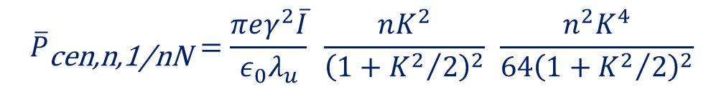
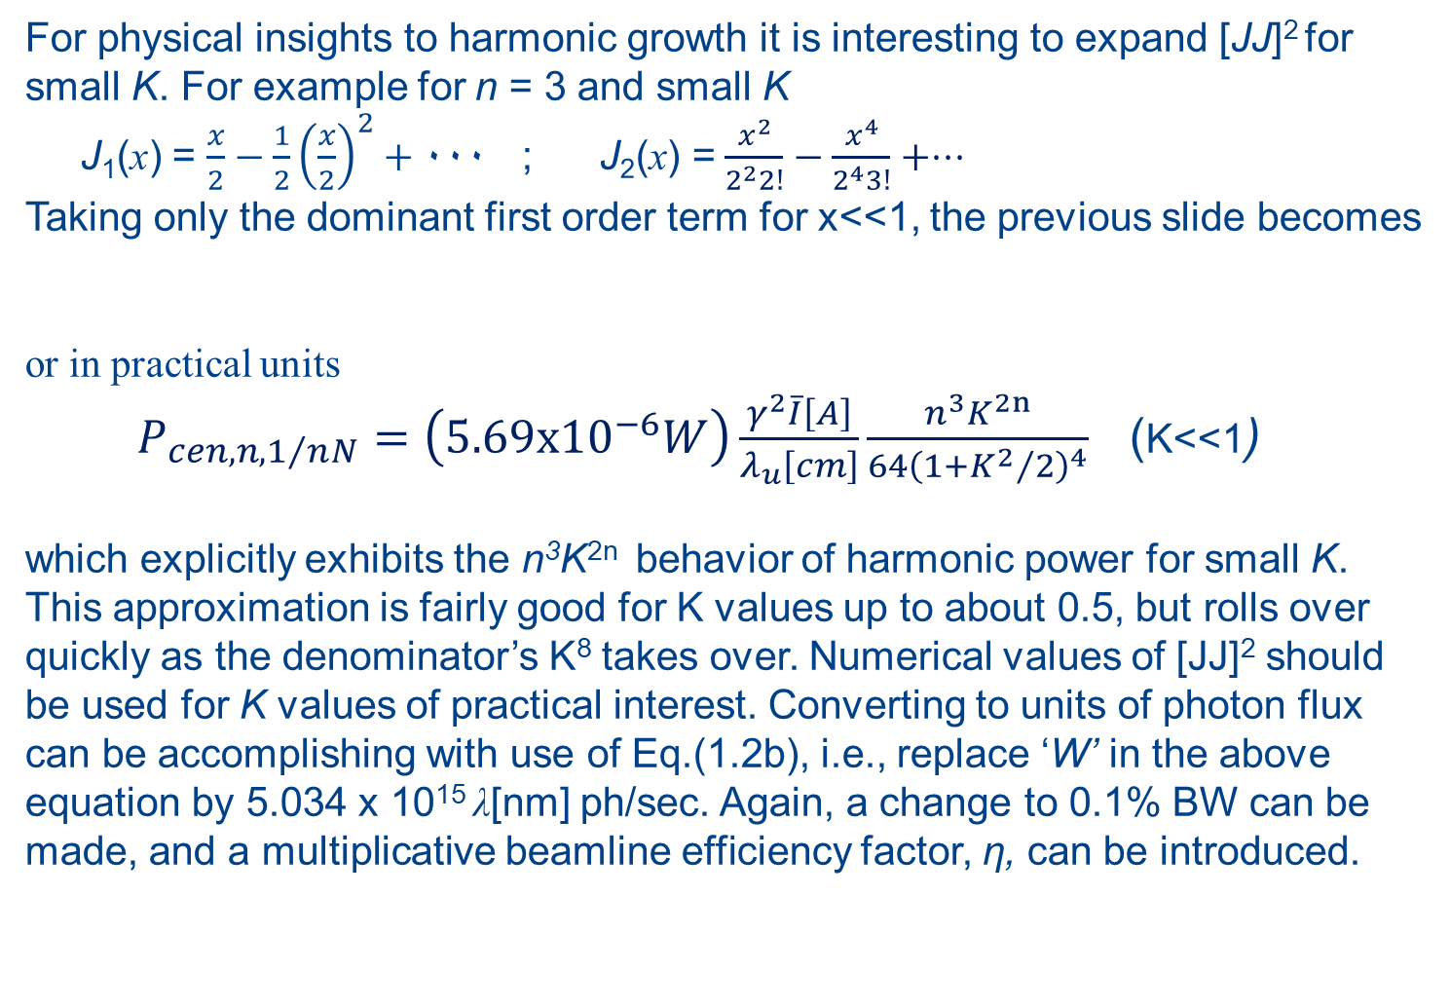
Analytic form of harmonic power for small K
For physical insights to harmonic growth it is interesting to expand [JJ]² for small K. For example for n = 3 and small K
J₁(x) = $\frac{x}{2}−\frac{1}{2}{\left(\frac{x}{2}\right)}^{2}+۰۰۰$ ; $\text{J}\text{2}\text{(}\text{x}\text{) =}$ $\frac{x^{2}}{2^{2}2!}−\frac{x^{4}}{2^{4}3!}+⋅⋅⋅$
Taking only the dominant first order term for x<<1, the previous slide becomes
or in practical units
$P_{cen,n,1/nN}=\left(5.69x{10}^{−6}W\right)\frac{γ^{2}\overline{I}\left[A\right]}{λ_{u}\left[cm\right]}\frac{n^{3}K^{2n}}{64{\left(1+{K^{2}}/2\right)}^{4}}$ (K<<1)
which explicitly exhibits the n³K^{2n} behavior of harmonic power for small K. This approximation is fairly good for K values up to about 0.5, but rolls over quickly as the denominator’s K⁸ takes over. Numerical values of [JJ]² should be used for K values of practical interest. Converting to units of photon flux can be accomplishing with use of Eq.(1.2b), i.e., replace ‘W’ in the above equation by 5.034 x 10¹⁵ λ[nm] ph/sec. Again, a change to 0.1% BW can be made, and a multiplicative beamline efficiency factor, η, can be introduced.
$${\overline{P}}_{\text{c}\text{en}\text{,}\text{n}\text{,}\text{1}\text{/}\text{nN}}=\frac{πeγ^{2}\overline{I}}{ε_{0}λ_{u}} \frac{nK^{2}}{{\left(1+{K^{2}}/2\right)}^{2}} \frac{n^{2}K^{4}}{64{\left(1+{K^{2}}/2\right)}^{2}}$$

Slide 48
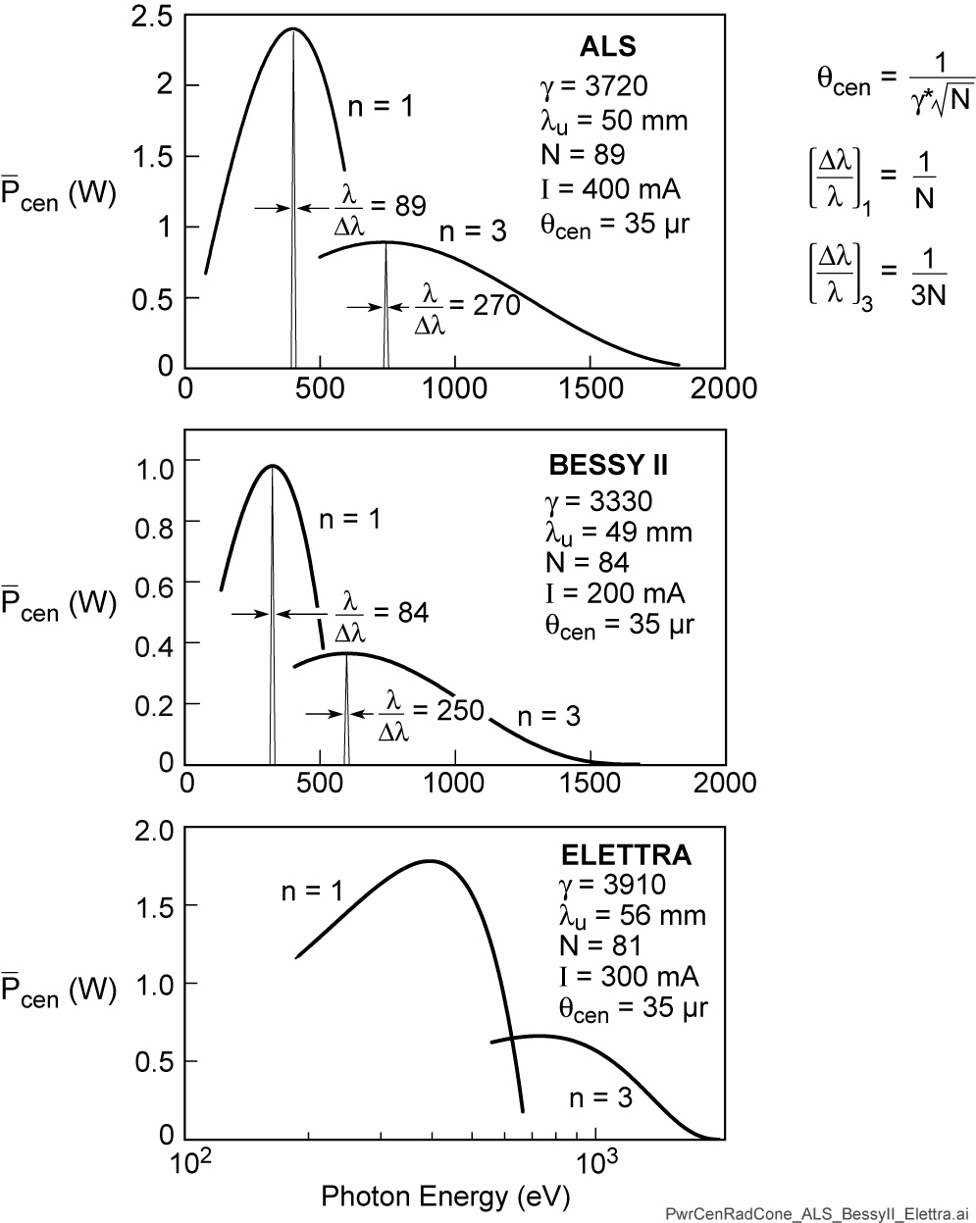
Power in the central radiation cone for soft x-ray undulators at three present facilities*
=42μr
* All have presently embarked on, or are considering upgrades.

Slide 49
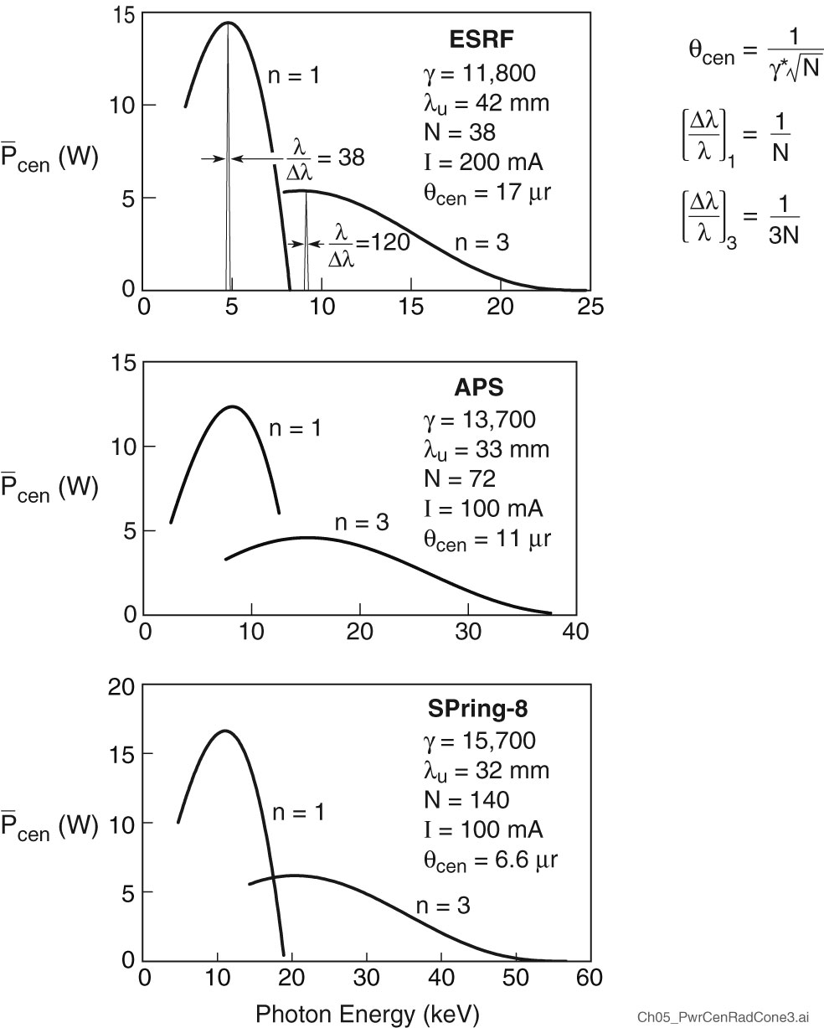
Power in the central radiation cone for hard x-ray undulators at three present facilities*
* All have embarked on
DLSR lattice upgrades.

Slide 50
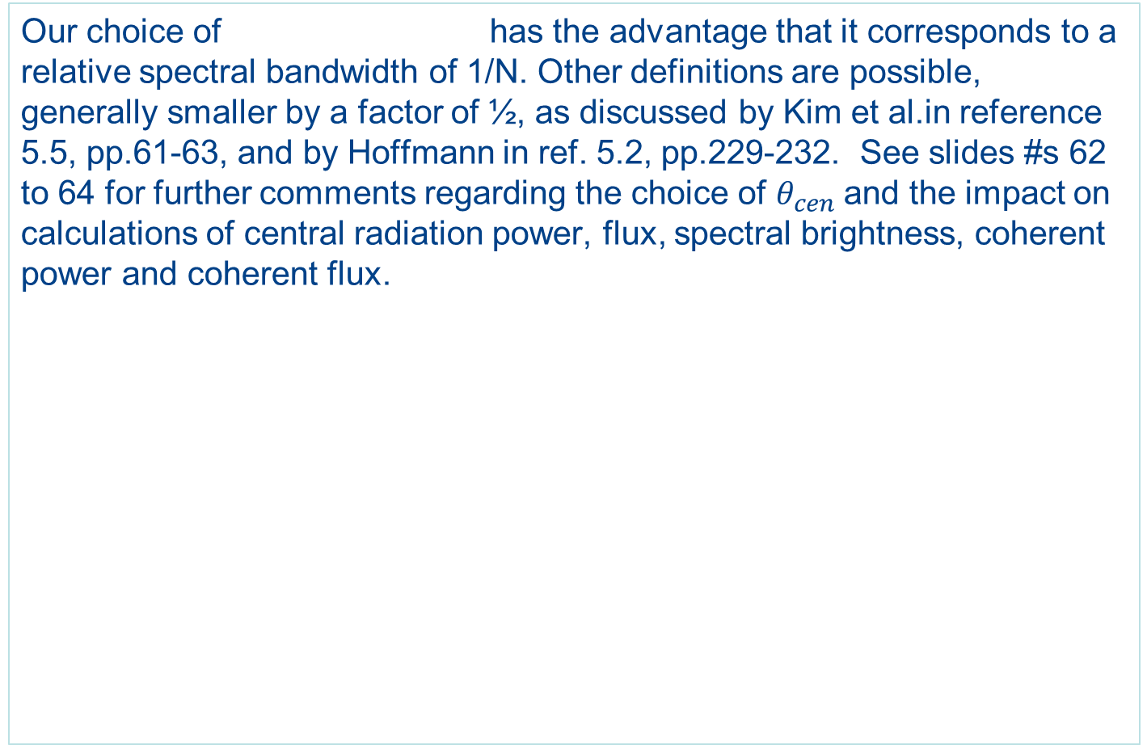
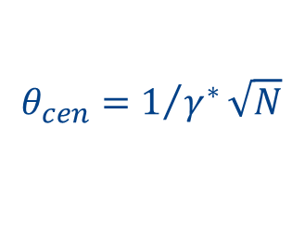
Comments on the definition of θ_{cen}
$$θ_{cen}=1/{γ^{∗}}\sqrt{N}$$
Our choice of has the advantage that it corresponds to a relative spectral bandwidth of 1/N. Other definitions are possible, generally smaller by a factor of ½, as discussed by Kim et al.in reference 5.5, pp.61-63, and by Hoffmann in ref. 5.2, pp.229-232. See slides #s 62 to 64 for further comments regarding the choice of $θ_{cen}$and the impact on calculations of central radiation power, flux, spectral brightness, coherent power and coherent flux.

Slide 51
Beam Parameters and Spectral Brightness

Slide 52
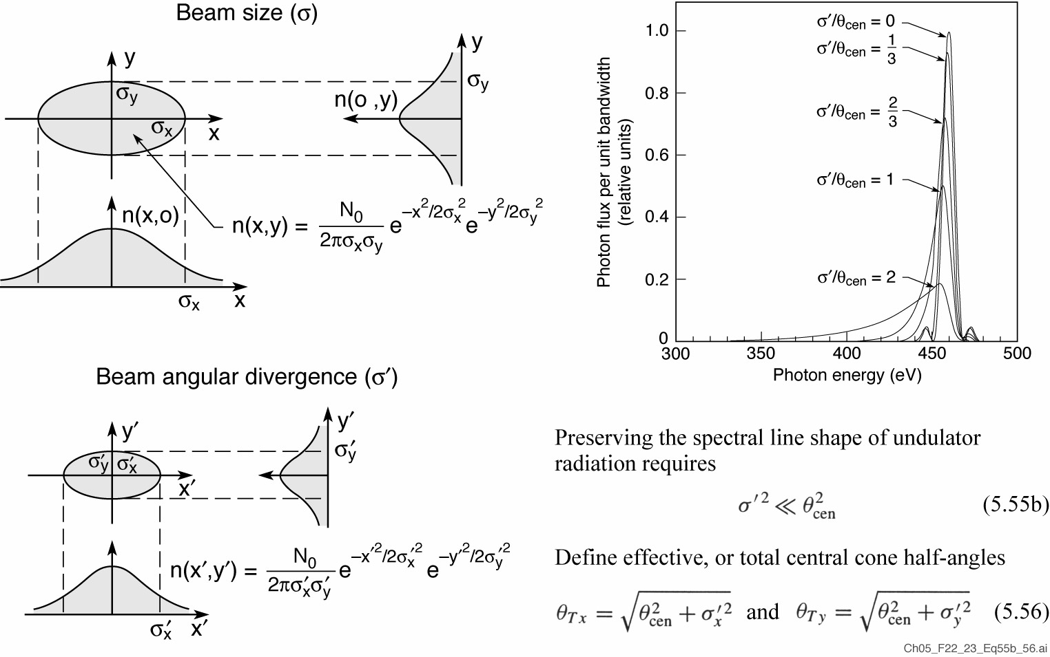
Finite electron beam size and divergence affect undulator radiation

Slide 53
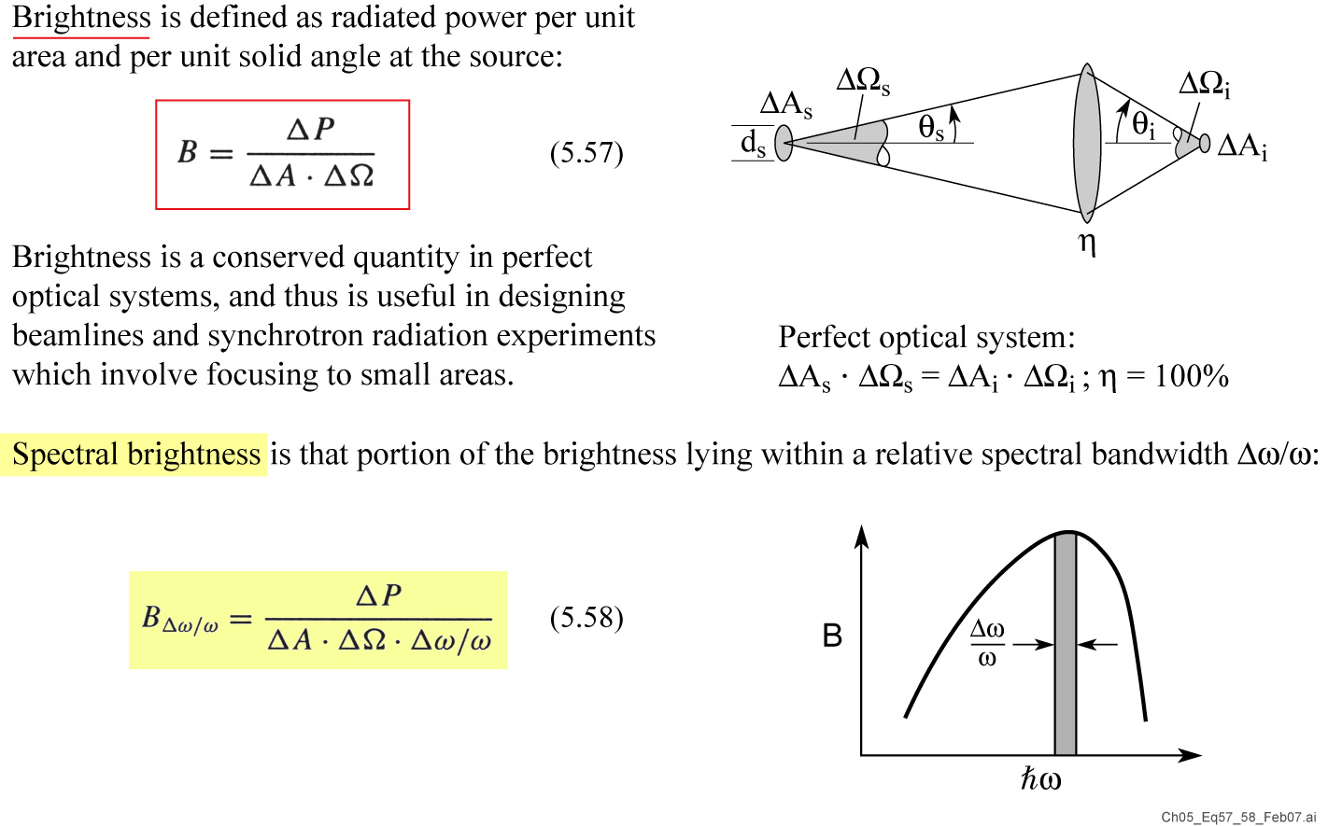
Brightness and spectral brightness

Slide 54
Spectral brightness of undulator radiation

Slide 55
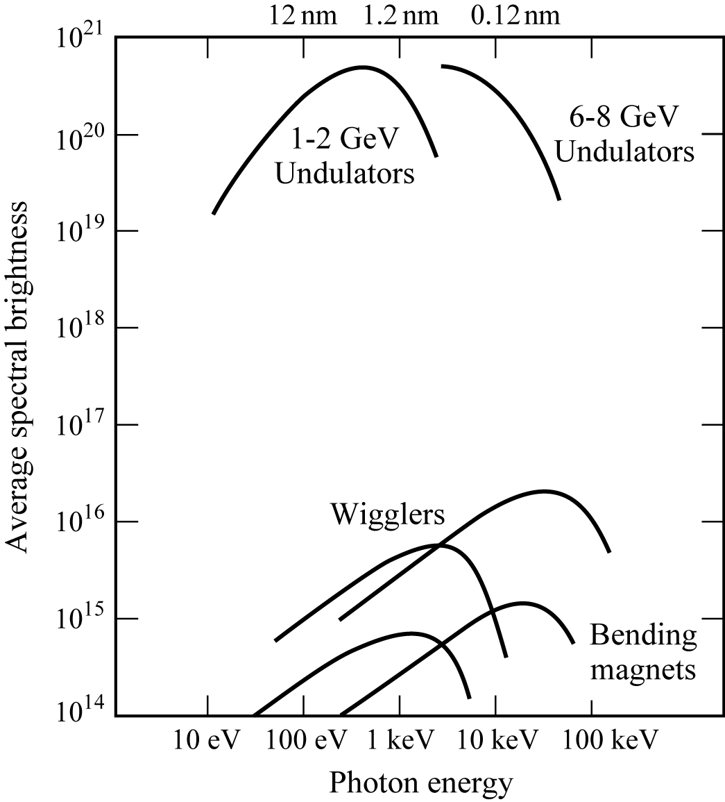
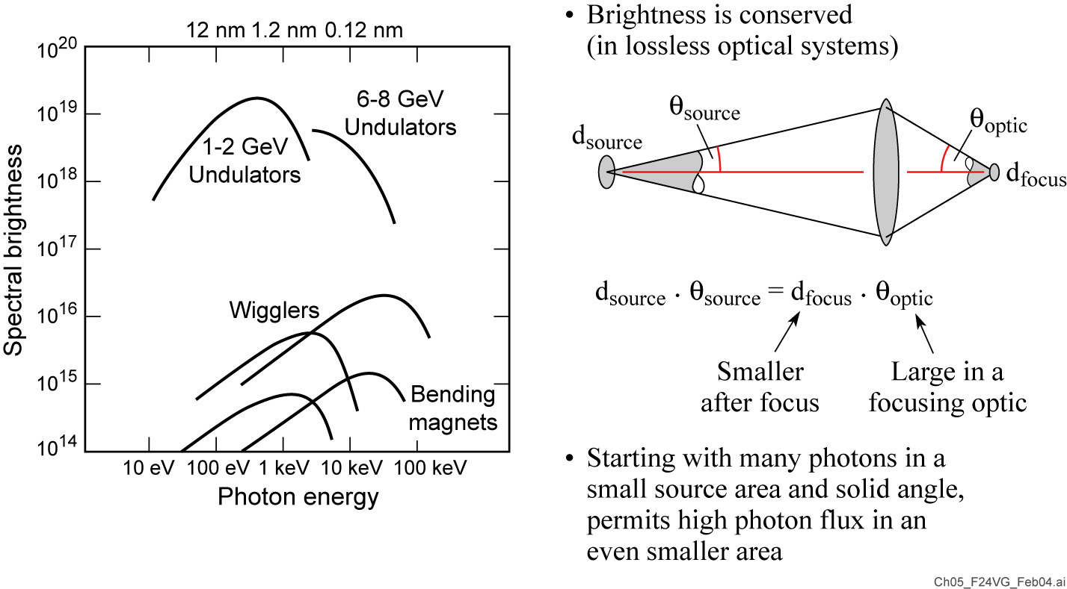
Spectral brightness is useful for experiments that involve spatially resolved studies
Note that spectral brightness values will increase by a factor of order 100 with DLSRs

Slide 56

Diffraction Limited Storage Rings, DLSRs
Upgrades from highly elliptical to near circular electron beams will greatly increase spectral brightness, reduce exposure times for imaging and tomography, and will significantly increase spatially coherent power. The horizontal emittance scales roughly as γ²/N³_{bend} , where $γ$ is the Lorentz factor and N_{b} is the number of bends. This has been demonstrated at MAX IV in Lund, Sweden (N_{b} = 7) and is in various stages of planning or implementation at facilities worldwide. Increases of several hundred in spectral brightness and spatially coherent power are expected, perhaps more with other improvements. These will lead to commensurate reductions in exposure time for all x-ray imaging experiments and all coherence experiments.
Figure courtesy of
C. Steier, ALS
For articles on DLSRs see M. Eriksson et al., J. Synchr. Rad. 21, 837 (2014); R. Hettel, p. 843; J. Susini et al., p. 986; M. Borland et al., p. 912; and other articles in that issue. Upgrade beam parameters are available at each facility web site.

Slide 57

The King and the PM meet the Lord of the Rings
Swedish Prime Minister Stefan Löfven and H.M. King Carl XVI Gustav being briefed by Mikael Eriksson about the very special diffraction limited storage ring MAX IV.
Synchrotron Radiation News 29,16 (Nov/Dec 2016;Taylor & Francis).

Slide 58
Diffraction Limited Storage Rings, DLSRs
Upgrades from elliptical to circular electron beams will greatly increase spectral brightness, reduce exposure times for imaging and tomography, and will significantly increase spatially coherent power. This has been demonstrated at MAX IV in Lund, Sweden, and is in various stages of planning at facilities worldwide. Increases of several hundred in spectral brightness and coherent power are expected, perhaps more with other improvements. These will lead to commensurate reductions in exposure time for all x-ray imaging experiments and all x-ray coherence experiments.
For articles on DLSRs see M. Eriksson et al.,J. Synchr. Rad. 21, 837 (2014) and other articles in that issue.

Slide 59

How to Design a Brighter Ring
The horizontal emittance is a characteristic equilibrium quantity
for each storage ring, where E² is the electron beam energy and
θ is the angle per bending magnet. is a lattice dependent factor.
Emission of SR also reduces emittance – “natural emittance” of a
storage ring is equilibrium between SR and energy spread.
Reduce energy (not too much or no X-rays)
Reduce angle of bending magnets
More synchrotron radiation
Courtesy of Richard Garrett, ANSTO, Australia

Slide 60

(Horizontal emittance normalized to square of energy)
Planned Upgrades to Diffraction Limited Storage Rings
3rd Generation
Courtesy of Richard Garrett, ANSTO, Australia

Slide 61
What’s in a name?
Diffraction Limited Storage Ring (DLSR)
or
4th Generation Storage Ring Light Source (4GLS)?
What’s the issue* ?
*Suggested by Robert Hettel, APS Upgrade Project Director, ANL, at
Coherence in Particle and Photon Beams: Past, Present and Future
March 15, 2019

Slide 62
Spatially Coherent
Undulator Radiation

Slide 63

Spatial and spectral filtering of partially coherent radiation
Ordinary thermal light source, atoms radiate independently.
A pinhole can be used to obtain spatially coherent light, but at a great loss of power.
A color filter (or monochromator) can be used to obtain temporally coherent light, also at a great loss of power.
Pinhole and spectral filtering can be used to obtain light which is both spatially and temporally coherent but the power will be very small (tiny).
With cavity optics all of a laser’s light is both spatially and temporally coherent*.
Arthur Schawlow, “Laser Light”, Sci. Amer. 219, 120 (Sept. 1968)

Slide 64

Spatially filtered undulator radiation

Slide 65

Spatially filtered undulator radiation

Slide 66

Spatially coherent power from a soft x-ray undulator
K.M. Rosfjord, Y.W. Liu and D.T. Attwood, “Tunable Coherent Soft X-rays”, IEEE JSTQE 10 (6) (Nov/Dec 2004)
Airy pattern courtesy of K. Rosfjord, EECS,
and Y.W. Liu, AS&T, both UC Berkeley

Slide 67

Coherent Hard X-rays at the Advanced Photon Source
APS beamline 34-ID-C, Courtesy of R. Harder
G. Ju et al., “Characterization of the x-ray coherence properties of an undulator beamline
at the Advanced Photon Source”, J. Synchr. Rad. 25 (4),1036 (July 2018)

Slide 68







Spatially coherent harmonic power and photon flux
With spatial filtering, as described in Sections 4.2 and 5.6, it is possible to generate substantial levels of spatially coherent undulator power at shorter harmonic wavelengths. The extension of Eqs.(5.76),(5.56a,b) and (5.32) for harmonic n, and for spectral bandwidth bw (1/N or 0.1%) gives
where
; ;
Equivalently in terms of the wavelengths for which the radiation is of full spatial coherence,
where
In the axisymmetric case,
and
$${\overline{P}}_{coh,n,bw}=\frac{λ/2π}{d_{Tx}θ_{Tx}}\frac{λ/2π}{d_{Ty}θ_{Ty}}{\overline{P}}_{cen,n,bw}$$
$$d_{Tx,y}=2\sqrt{σ_{x,y}^{2}+{\left(λ/4πθ_{cen,n}\right)}^{2}}$$
$$θ_{Tx,y,n}=\sqrt{θ_{cen,n }^{2}+σ_{x,y}^{,2}}$$
$$θ_{cen,n}=1/{γ^{∗}}\sqrt{nN}$$
$${\overline{P}}_{coh,n,bw}=\left(\frac{λ}{λ_{coh,n,x}}\right)\left(\frac{λ}{λ_{coh,n,y}}\right){\overline{P}}_{cen,n,bw}$$
$$λ_{coh,n,x,y}=2πd_{Tx,y}θ_{Tx,y,n}$$
$${\overline{P}}_{coh,n,bw}={\left(\frac{λ}{λ_{coh,n}}\right)}^{2}{\overline{P}}_{cen,n,bw}$$

Slide 69





Spatially coherent harmonics (continued)
From a previous slide, #46,
The coherent power, for simplicity here in the axisymmetric case, and now within a 0.1% relative spectral bandwidth (multiply by nN/1000), is
where
$${\overline{P}}_{\text{cen}\text{,}\text{n}\text{,1/}\text{nN}}=\frac{πeγ^{2}\overline{I}}{ε_{0}λ_{u}} \frac{nK^{2}{\left[JJ\right]}^{2}}{{\left(1+{K^{2}}/2\right)}^{2}}$$
$$=\left(5.69x{10}^{−6}W\right)\frac{γ^{2}\overline{I}}{λ_{u}\left[cm\right]}\frac{nK^{2}{\left[JJ\right]}^{2}}{{\left(1+{K^{2}}/2\right)}^{2}}$$
$${\overline{P}}_{coh,n,0.1\%}=(5.69x{10}^{−9}W)\frac{\left.Nγ^{2}\overline{I}[A\right]}{\left.λ_{u}[cm\right]}\frac{n^{2}K^{2}{\left[JJ\right]}^{2}}{{\left(1+{K^{2}}/2\right)}^{2}}\frac{{\left(λ/4π\right)}^{2}}{\left[σ^{2}+{\left(4πθ_{cen,n}\right)}^{2}]({σ^{′}}^{2}+θ_{cen,n}^{2}\right)}$$
$$θ_{cen,n}=1/{γ^{∗}}\sqrt{nN}={\sqrt{1+{K^{2}}/2}}/γ\sqrt{nN.}$$
Converting to photon flux by replacing 1 W by 5.034 x 10¹⁵ ph/sec λ[nm]
${\overline{𝔽}}_{coh,n,0.1\%}=(1.43\text{x}{10}^{14}ph/sec)\frac{NI[A]nK^{2}{\left[JJ\right]}^{2}}{\left(1+{K^{2}}/2\right)}\frac{λ^{2}}{\left.{\left(4π\right)}^{2}[σ^{2}+{\left(λ/4πθ_{cen,n}\right)}^{2}][σ′^{2}+θ_{cen,n}^{2}\right]}$
To estimate coherent power and flux, for 0.1% bandwidth at the sample, one should include a multiplicative beamline efficiency factor, η, which accounts for mirror reflectivities, filter transmissions, and monochromator efficiency.

Slide 70



Coherent power proportional to (nN)²
In the special, but common, case where
and
where one observes the (nN)² dependence expected for spatially coherent radiation. The difference between σ and σ_{T} is generally not significant.
$$σ^{2}≫{\left(λ/4πθ_{cen,n}\right)}^{2}$$
$${σ^{′}}^{2}≪θ_{cen,n}^{2}$$
$${\overline{P}}_{coh,n,0.1\%}=(5.69x{10}^{−9}W)\frac{\left.\left(nN\right)2γ^{4}\overline{I}[A\right]}{\left.λ_{u}[cm\right]}\frac{nK^{2}{\left[JJ\right]}^{2}}{{\left(1+{K^{2}}/2\right)}^{3}}\frac{{\left(λ/4π\right)}^{2}}{σ2}$$

Slide 71

Enhanced spatially coherent power with DLSRs
Following the demonstration of a significantly reduced horizontal emittance at MAX IV in Lund, facilities around the world are upgrading to new “diffraction limited storage rings” (DLSRs), or making plans to do so. The goal of these upgrades is to reduce the high eccentricity of present elliptically shaped electron beam cross-sections to something approaching circular. This will result in substantially reduced exposure times, or data taking times, for all x-ray imaging experiments, both coherent and incoherent, and all spatial coherence related experiments. See slide #48 and references to DLSRs in the text, in the caption to Fig.5.24, p.196.
The ALS in Berkeley is in the design stage (ALS-U) for a potential 9-bend multi-bend achromat (MBA) lattice with the goal of achieving an electron beam of circular cross-section with σ_{x} = σ_{y} = 10μm and beam divergence σ’ = 5 μrad, at a beam energy of 2 Gev (γ = 3914) and an average current of 500 mA. A candidate undulator would have a period of 2.67 cm, 150 periods (N), and a tuning range set by 0.4 $≤$ K$≤$2.98. For these parameters the predicted coherent power is (see next slide)

Slide 72




Example of spatially coherent power (ALS-U #s)
With ALS-U parameters γ = 3914, I = 0.5 A, and a candidate undulator
with λ_{u} = 2.67 nm, and N = 150
$${\overline{P}}_{coh,n,0.1\%}=\left(2.45 \text{W}\right)\frac{n{2K}^{2}{\left[JJ\right]}^{2}}{{\left(1+{K^{2}}/2\right)}^{2}}\frac{λ^{2}}{\left.{\left(4π\right)}^{2}{[σ}_{}^{2}+{\left(λ/4πθ_{cen,n}\right)}^{2}](σ′^{2}+θ_{cen,n}^{2}\right)}$$
or a coherent flux
$${\overline{𝔽}}_{coh,n,0.1\%}$$
$$=(1.07\text{x}{10}^{16}ph/sec)\frac{nK^{2}{\left[JJ\right]}^{2}}{\left(1+{K^{2}}/2\right)}$$
$$\frac{λ^{2}}{\left.{\left(4π\right)}^{2}[σ^{2}+{\left(λ/4πθ_{cen,n}\right)}^{2}][σ′^{2}+θ_{cen,n}^{2}\right]}$$

Slide 73

Example of spatially coherent power (continued)
For the proposed ALS upgrade, radiation in the fundamental, n = 1, with K = $\sqrt{2}$(where central cone power is maximum), λ = 1.743 nm (711.3 eV), θ_{cen} = 29.50 μand θ_{T} = 29.92 μrad, λ_{coh} = 4.144 nm (298.4 eV), x = 0.2500 and [JJ]² = 0.740, the equations predict,${\overline{ P}}_{cen,1/N}$= 6.04W and ${\overline{P}}_{coh,1/N}$= 0.904 W, corresponding to a spatially coherent fraction ${\left(λ/λcoh\right)}^{2} of$ 17.7%. For a 0.1% relative spectral bandwidth ${\overline{P}}_{coh,1,0.1\%}$= 0.160 W, corresponding to a spatially coherent flux of 1.40 x 10¹⁵ ph/sec in a 0.1% bandwidth. For n = 1, K = 2.98, λ = 4.741 nm (261.5 eV), λ_{coh} = 7.778 nm (159.4 eV), x = 0.4081, [JJ]² = 0.5758, predicting a spatially coherent power of 157 mW, a spatially coherent flux of 3.75 x 10¹⁵ ph/sec, and a coherent fraction of 37.2%, all within a 0.1% bandwidth. For a higher harmonic, such as n = 3 with K = $\sqrt{2}$, x =0.7500, [JJ]² = 0.07933, the upgraded lattice would generate ${\overline{P}}_{coh,3,0.1\%}$ = 55.2 mW of spatially coherent power at λ = 0.5810 nm (2.134 keV), corresponding to a coherent flux of 1.61 x 10¹⁴ photons/sec, also in a 0.1% relative spectral bandwidth. The spatial coherence factor in this case is 6.32 %. These numbers indicate an increase in coherent flux of order hundred compared to values with the present lattice, undulator and operating conditions (γ, I, λ_{u} , N).

Slide 74

Comments on the definition of θ_{cen} and its effect on calculated coherent power and flux
We have used the definition $θ_{cen,n}=1/{γ^{∗}}\sqrt{nN}$. An alternate is the use of $θ_{cen,n}=1/{{2γ}^{∗}}\sqrt{nN}.$ Each has its advantages, as discussed by Kim et al. (ref. 5, pp.51 & 61) and by Hofmann (ref. 2, pp.231,232). The first is convenient in that it provides a clear identification with the 1/nN spectrum set by the off-axis Doppler effect and the collection angle, broadened to a relative width 1/nN by the finite undulator length (Eqs. 5.28 & 5.31). This is most useful when σ' is much less than θ_{cen} ,as is the case for soft x-ray facilities where θ_{cen} is relatively large. The alternate definition, smaller by 1/2, is chosen to match the associated depth of radiation to the undulator length. It is most appropriate at hard x-ray facilities where σ' $≤$ θ_{cen} . In this case the spectrum approaches a Gaussian distribution. Although calculated power and photon flux in the central radiation cone are less for the smaller defined angle, this does not affect calculations of spectral brightness as the reductions in photon flux and reduced solid angle cancel. It also does not affect calculations of coherent power, or coherent flux, as the reduction is compensated by an increased coherence fraction within the reduced angles, a factor of two in each direction. Small variations in calculated brightness and coherent power, or flux, occur due to approximations implicit in the definitions of d_{T} and θ_{T}.

Slide 75

Further comments on the definition of θ_{cen} and its effect on calculated coherent power and flux
The factor of two larger solid angle assumed for the Gaussian model is due to the spectral broadening caused by off-axis electron trajectories (σ'), pushing in-band radiation outside the assumed central angle. While this is correct for the Gaussian model, it leads to an apparent factor of two difference in photon flux values. These differences relate to whether use is made of a monochromator or an angle defining aperture, or both, as the σ' broadened spectrum extends beyond the defined central radiation cone. To some degree these differences are due to the appropriateness of assuming a Gaussian photon beam. Recent publications discussing these issues, and appropriate measures of spatial coherence, include the following:
K.-J. Kim, Z. Huang and R. Lindberg, Synchrotron Radiation and Free Electron Lasers: Principles of Coherent X-Ray Generation (Cambridge University Press, 2017), pp. 51 and 61;
A. Hofmann, The Physics of Synchrotron Radiation (Cambridge Univ. Press, 2004), pp. 231-232.
R. Lindberg, How many $π$ 's do you divide from λ to get the undulator radiation emittance? (In preparation).
R. Walker, Undulator brightness and coherence near the diffraction limit (submitted).
T. Tanaka and H. Kitamura, “SPECTRA: a synchrotron radiation calculation code”, J. Synchr. Rad. 8, 1221 (2001); Latest version of SPECTRA 10 is online at http://cheiron2014.spring8.or.jp/SPECTRA/SPECTRA%20Home.htm

Slide 76

The effect of electron energy distribution on spectral bandwidth and spectral brightness
The spectral width of undulator radiation is given as Δλ/λ_{FWHM} = 0.8895/nN (Fig. 5.21, but written for wavelength) where N is the number of magnet periods and n is the harmonic number. This, however, neglects the effect of electron beam energy spread 2.35σ_{γ} = 2.35(Δγ/γ)_{rms} , which increases spectral width. Typically σ_{γ} $≅$ 10⁻³, which seems relatively small, but photon energy depends on γ² (see Eq. 5.52) so that the effect on spectra is proportional to 2σ_{γ}. The contribution of electron energy spread to FWHM spectral bandwidth is thus proportional to 2.35 (2 σ_{γ})$≅$ 4.7 x 10⁻³ = 1/210. Comparing the two contributions, Δλ/λ_{FWHM} = 0.8895/nN and 2.35 (2 σ_{γ})$≅$ 4.7 x 10⁻³ = 1/210, one sees that for the fundamental, n = 1, and N = 150, the finite oscillation term (nN) is 1/168 while the electron energy spread term is 1/210, so that the two are quite similar. For n = 3 and N = 150, the nN linewidth term decreases to 1/510, so that the electron spread term of 1/210 begins to dominate. For higher harmonics, n = 5, …, the spectral width increases significantly beyond 0.8895/nN and spectral brightness is decreased proportionately. The two effects must be combined via a convolution of the Gaussian electron energy distribution and the sinc² finite nN function. For convenience this is sometimes approximated by a sq. root of sums of squares of rms equivalents. While odd, this provides a convenient measure of the resultant spectral width. For better accuracy, numerical simulations, such as the Tanaka and Kitamura SPECTRA code are useful (see previous slide for the citation).
A recent paper treating the effect of electron energy spread in a more general manner is:
G. Geloni et al., “Effects of energy spread on brightness and coherence of undulator sources”, J. Synchr. Rad. 25,1335 (2018).

Slide 77

Coherent power with the present ALS lattice

Slide 78

Coherent power with an EPU at ALS
with the present ALS lattice

Slide 79

Coherent power SPring-8 (present lattice)

Slide 80

Young’s double slit experiment: spatial coherence and the persistence of fringes

Slide 81

Undulator beamline for high spatial coherence measurements

Slide 82


Spatial coherence measurements of undulator radiation using Young’s 2-pinhole technique
Courtesy of Chang Chang, UC Berkeley and LBNL.
λ = 13.4 nm, 450 nm diameter pinholes, 1024 x 1024 EUV/CCD at 26 cm ALS, 1.9 GeV, λ_{u} = 8 cm, N = 55

Slide 83


Spatial coherence measurements of undulator radiation using Young’s 2-pinhole technique
Courtesy of Chang Chang, UC Berkeley and LBNL.
λ = 13.4 nm, 450 nm diameter pinholes, 1024 x 1024 EUV/CCD at 26 cm ALS, 1.9 GeV, λ_{u} = 8 cm, N = 55

Slide 84
Some experiments that require spatial coherence
X-ray standing wave for depth profiled probing of materials properties
Scanning transmission x-ray microscope (STXM) for nanoscale spectromicroscopy
Coherent diffractive Imaging (CDI)
Ptychographic nanoscale imaging
X-ray holography for nanoscale imaging

Slide 85

X-ray standing waves at a surface
Requires spatial and temporal coherence
Courtesy of M.J. Bedzyk, Cornell University, now at Northwestern University

Slide 86

The scanning transmission x-ray microscope (STXM)
Requires spatially coherent illumination to achieve the smallest spot size and thus highest spatial resolution. Roughly the zone plate outer zone width, Δr.

Slide 87

Coherent Diffractive Imaging (CDI)

Slide 88
Ptychography using a defocused STXM
Pinhole spatial filter
Zone plate is defocused to a larger size at the sample, no longer sets resolution.
Scanned 2D diffraction data is obtained in many overlapping areas.
Numerical techniques used to reconstruct image. Tomography possible, but with long data collection time. DLSRs will help.
Original figure S. Vogt(ANL), modified by J.Deng et al.,Sci.Rep. 7,445 (2017) .

Slide 89


X-ray holography with spatially filtered undulator radiation
Imaging magnetic nanostructures (Stanford & BESSY II)
S. Eisebitt, J. Lüning, W.F. Schlotter, M. Lörgren, O. Hellwig,
W. Eberhardt and J. Stöhr, Nature 432, 885 16December 2004)

Slide 90


Slide 91
Bending magnet radiation, wigglers, elliptically polarizing undulators (EPUs), time structure and beamlines

Slide 92

Bending magnet radius

Slide 93

Bending magnet radiation

Slide 94

Bending magnet radiation (continued)

Slide 95

Bending magnet photon flux at the ALS

Slide 96
The transition from undulator radiation (K ≤ 1) to wiggler radiation (K >> 1)

Slide 97

For very large K >> 1, a continuum emerges

Slide 98

Wiggler radiation

Slide 99

Variable polarization undulator radiation

Slide 100

APPLE II undulator for variably polarized radiation
Courtesy of S. Sasaki, text reference 5.25.

Slide 101




Crossed Undulator and APPLE II Undulator
Crossed undulator
Onuki-Undulator (tilted by 45°)
Phase shifter
APPLE I 1993
APPLE II 1994
Onuki undulator
APPLE undulator
APPLE II: workhorse
at most 3rd generation SR
Courtesy of Johannes Bahrdt, HZB
Notes:
APPLE Undulator: high degree of polarization, high fields, but still low switching frequency

Slide 102

Third generation synchrotron facilities

Slide 103

Typical parameters for synchrotron radiation

Slide 104

Typical parameters for synchrotron radiation

Slide 105

Typical parameters for synchrotron radiation

Slide 106

Diffraction Limited Storage Rings, DLSRs
Upgrades from highly elliptical to near circular electron beams will greatly increase spectral brightness, reduce exposure times for imaging and tomography, and will significantly increase spatially coherent power. The horizontal emittance scales roughly as , where γ is the Lorentz factor and N_{b} is the number of bends. This has been demonstrated at MAX IV in Lund, Sweden (N_{b} = 7) and is in various stages of planning or implementation at facilities worldwide. Increases of several hundred in spectral brightness and spatially coherent power are expected, perhaps more with other improvements. These will lead to commensurate reductions in exposure time for all x-ray imaging experiments and all coherence experiments.
Figure courtesy of
C. Steier, ALS
For articles on DLSRs see M. Eriksson et al., J. Synchr. Rad. 21, 837 (2014), R. Hettel, p. 843, and other articles in that issue.
$${γ^{3}}/{N_{b}^{3}}$$

Slide 107
(Horizontal emittance normalized to square of energy)
Planned Upgrades to Diffraction Limited Storage Rings
3rd Generation
Courtesy of Richard Garrett, ANSTO, Australia

Slide 108

Beamlines are used to transport photons to the sample, and take a specified spectral slice

Slide 109

A typical beamline: monochromator plus focusing optics deliver radiation to the sample

Slide 110

High spectral resolution beamline

Slide 111

Beamline 7.0 at Berkeley’s
Advanced Light Source
Courtesy of Richard Garrett, ANSTO, Australia

Slide 112

Time structure of synchrotron radiation

Slide 113

What are the relative merits?

Slide 114

References: Synchrotron Radiation and Beamlines
7)
K.-J. Kim, “Characteristics of Synchrotron Radiation,” pp. 565–632 in Physics of Particle Accelerators, AIP Conference Proccedings 184 (Amer. Inst. of Physics, New York, 1989), M. Month and M. Dienes, Editors.

Slide 115
Synchrotron, FEL and Beamline References
D. Attwood and A. Sakdinwat, X-rays and Extreme Ultraviolet Radiation (Cambridge, UK 2017).
J. Als-Nielsen and D. McMorrow, Elements of Modern X-ray Physics (Wiley, New York, 2009), Second edition.
K.-J. Kim, Z. Huang and R. Lindberg, Synchrotron Radiation and Free Electron Lasers: Principles of Coherent X-ray Generation (Cambridge, UK, 2017).
A. Hoffmann, Synchrotron Radiation (Cambridge, UK, 2004).
P. Schmüser, M. Dohlus, J. Rossbach and C. Behrens, Free-Electron Lasers in the Ultraviolet and X-ray Regime (Springer, Heidelberg, 2014).
C. MacDonald, Introduction to X-ray Physics, Optics and Applications (Princeton University Press, 2017).
P. Willmott, An Introduction to Synchrotron Radiation: Techniques and Applications (Wiley, Chichester, UK, 2011).
P. Duke, Synchrotron Radiation (Oxford, UK, 2000).
J. Samson and D. Ederer, Vacuum Ultraviolet Spectroscopy I and II (Academic Press, San Diego, 1998). Paperback available.
A. Chao, K. Mess, M. Tigner and F. Zimmermann, Handbook of Accelerator Physics and Engineering (World Scientific, Singapore, 2013), Second edition.

