Slide 1
X-Ray Interaction with Matter: Radiated Power and Scattering
David Attwood University of California, Berkeley

Slide 2
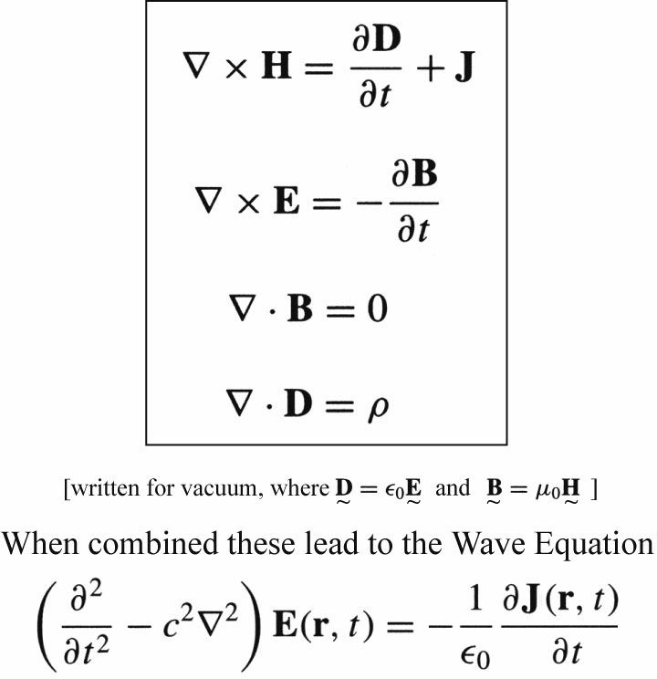
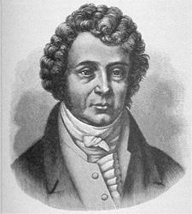
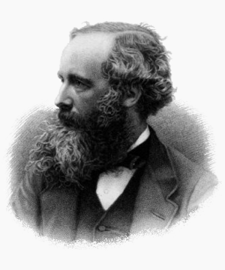
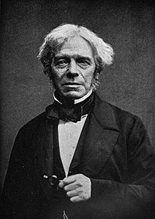
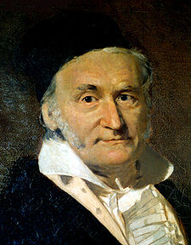
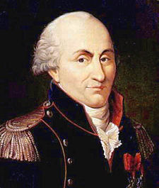
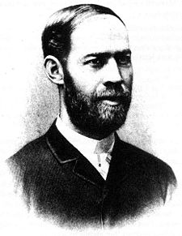
The Equations of Light
André-Marie Ampère
Maxwell’s Equations
Michael Faraday
James Clerk Maxwell
Carl Friedrich Gauss
Charles-Augustin de Coulomb
Heinrich Hertz
Courtesy of Andrew Aquila (AS&T, UC Berkeley; now SLAC, LCLS)

Slide 3
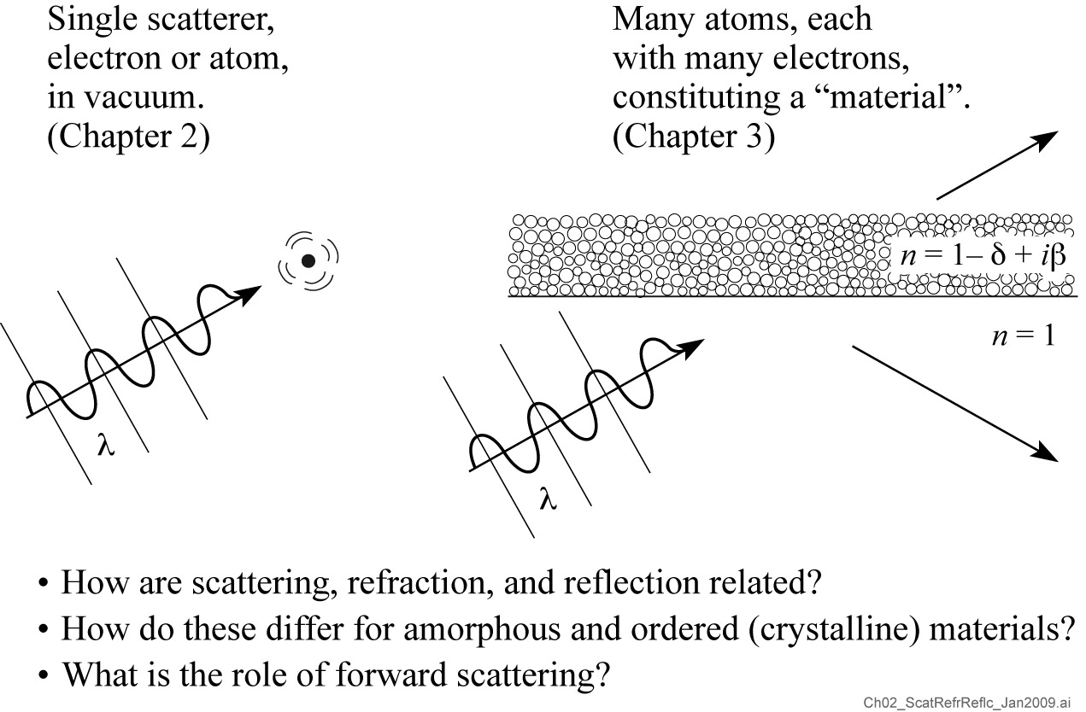
Scattering, Refraction, and Reflection

Slide 4
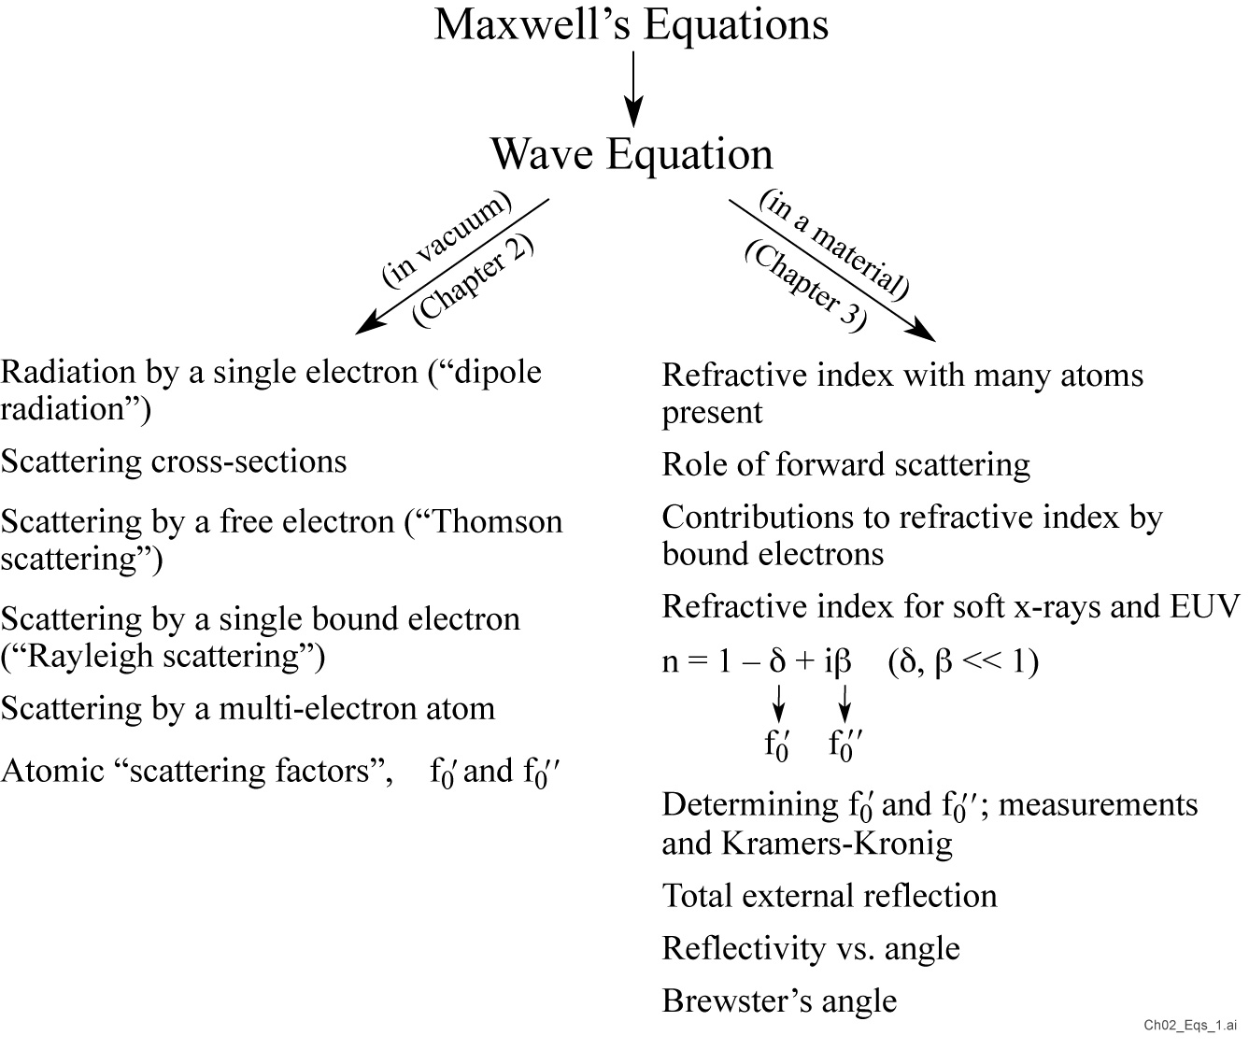

Slide 6
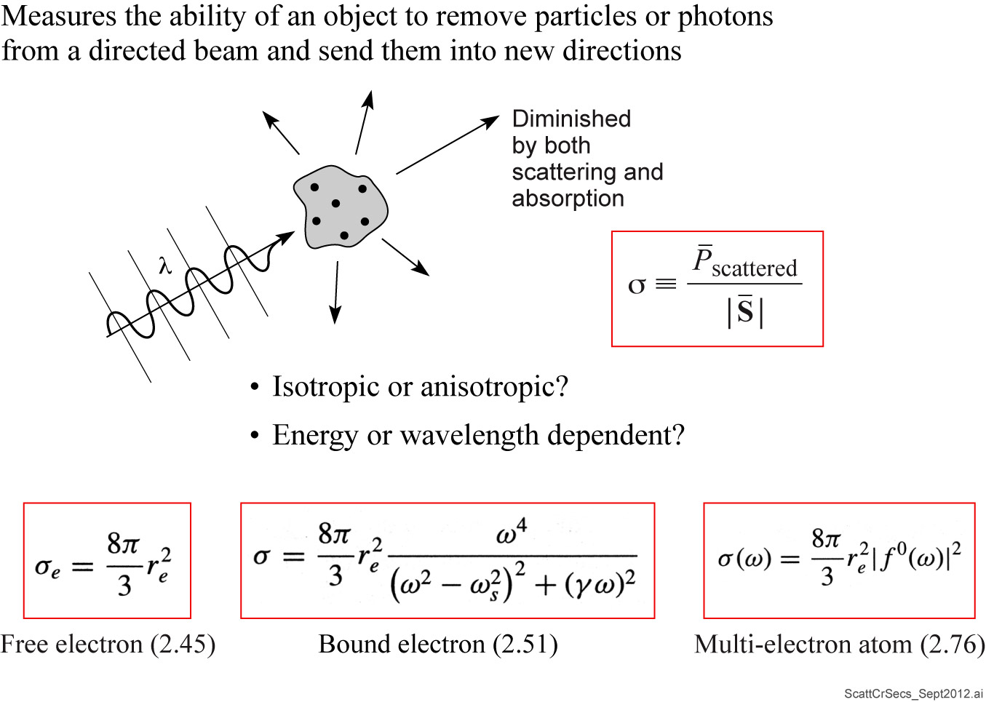
Scattering Cross-Sections

Slide 7
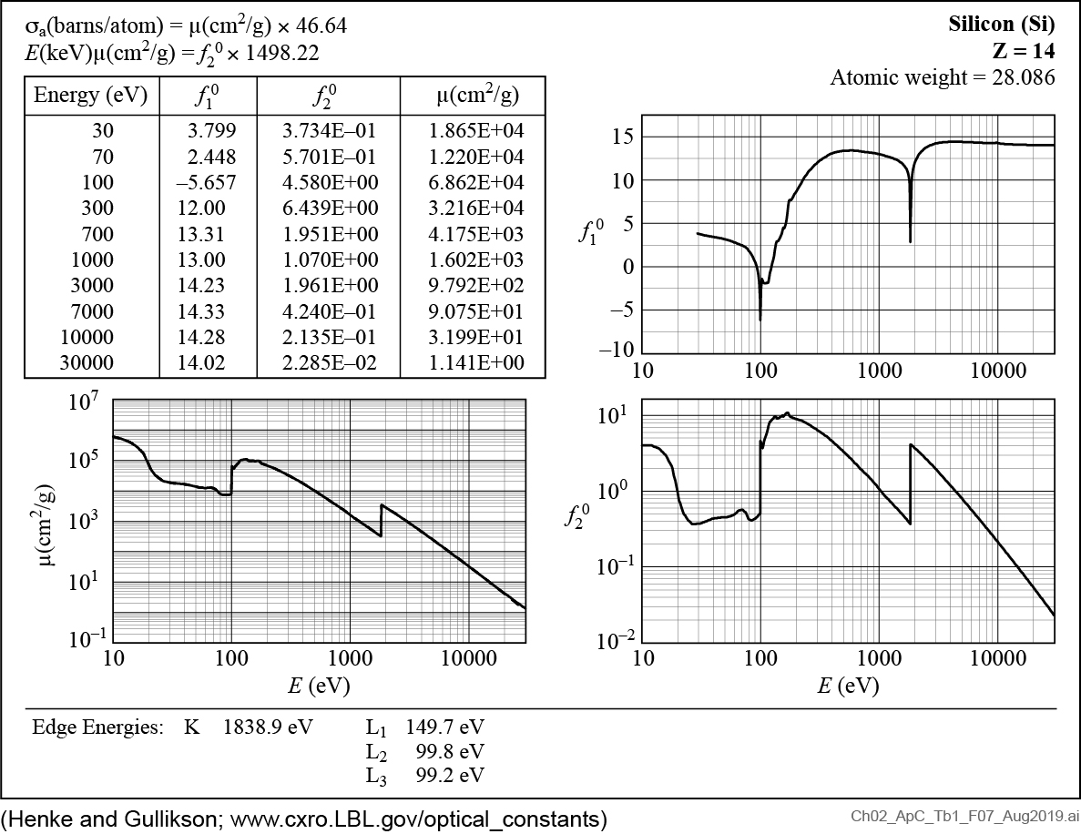
Atomic Scattering Factors for Silicon (Z = 14)

Slide 8
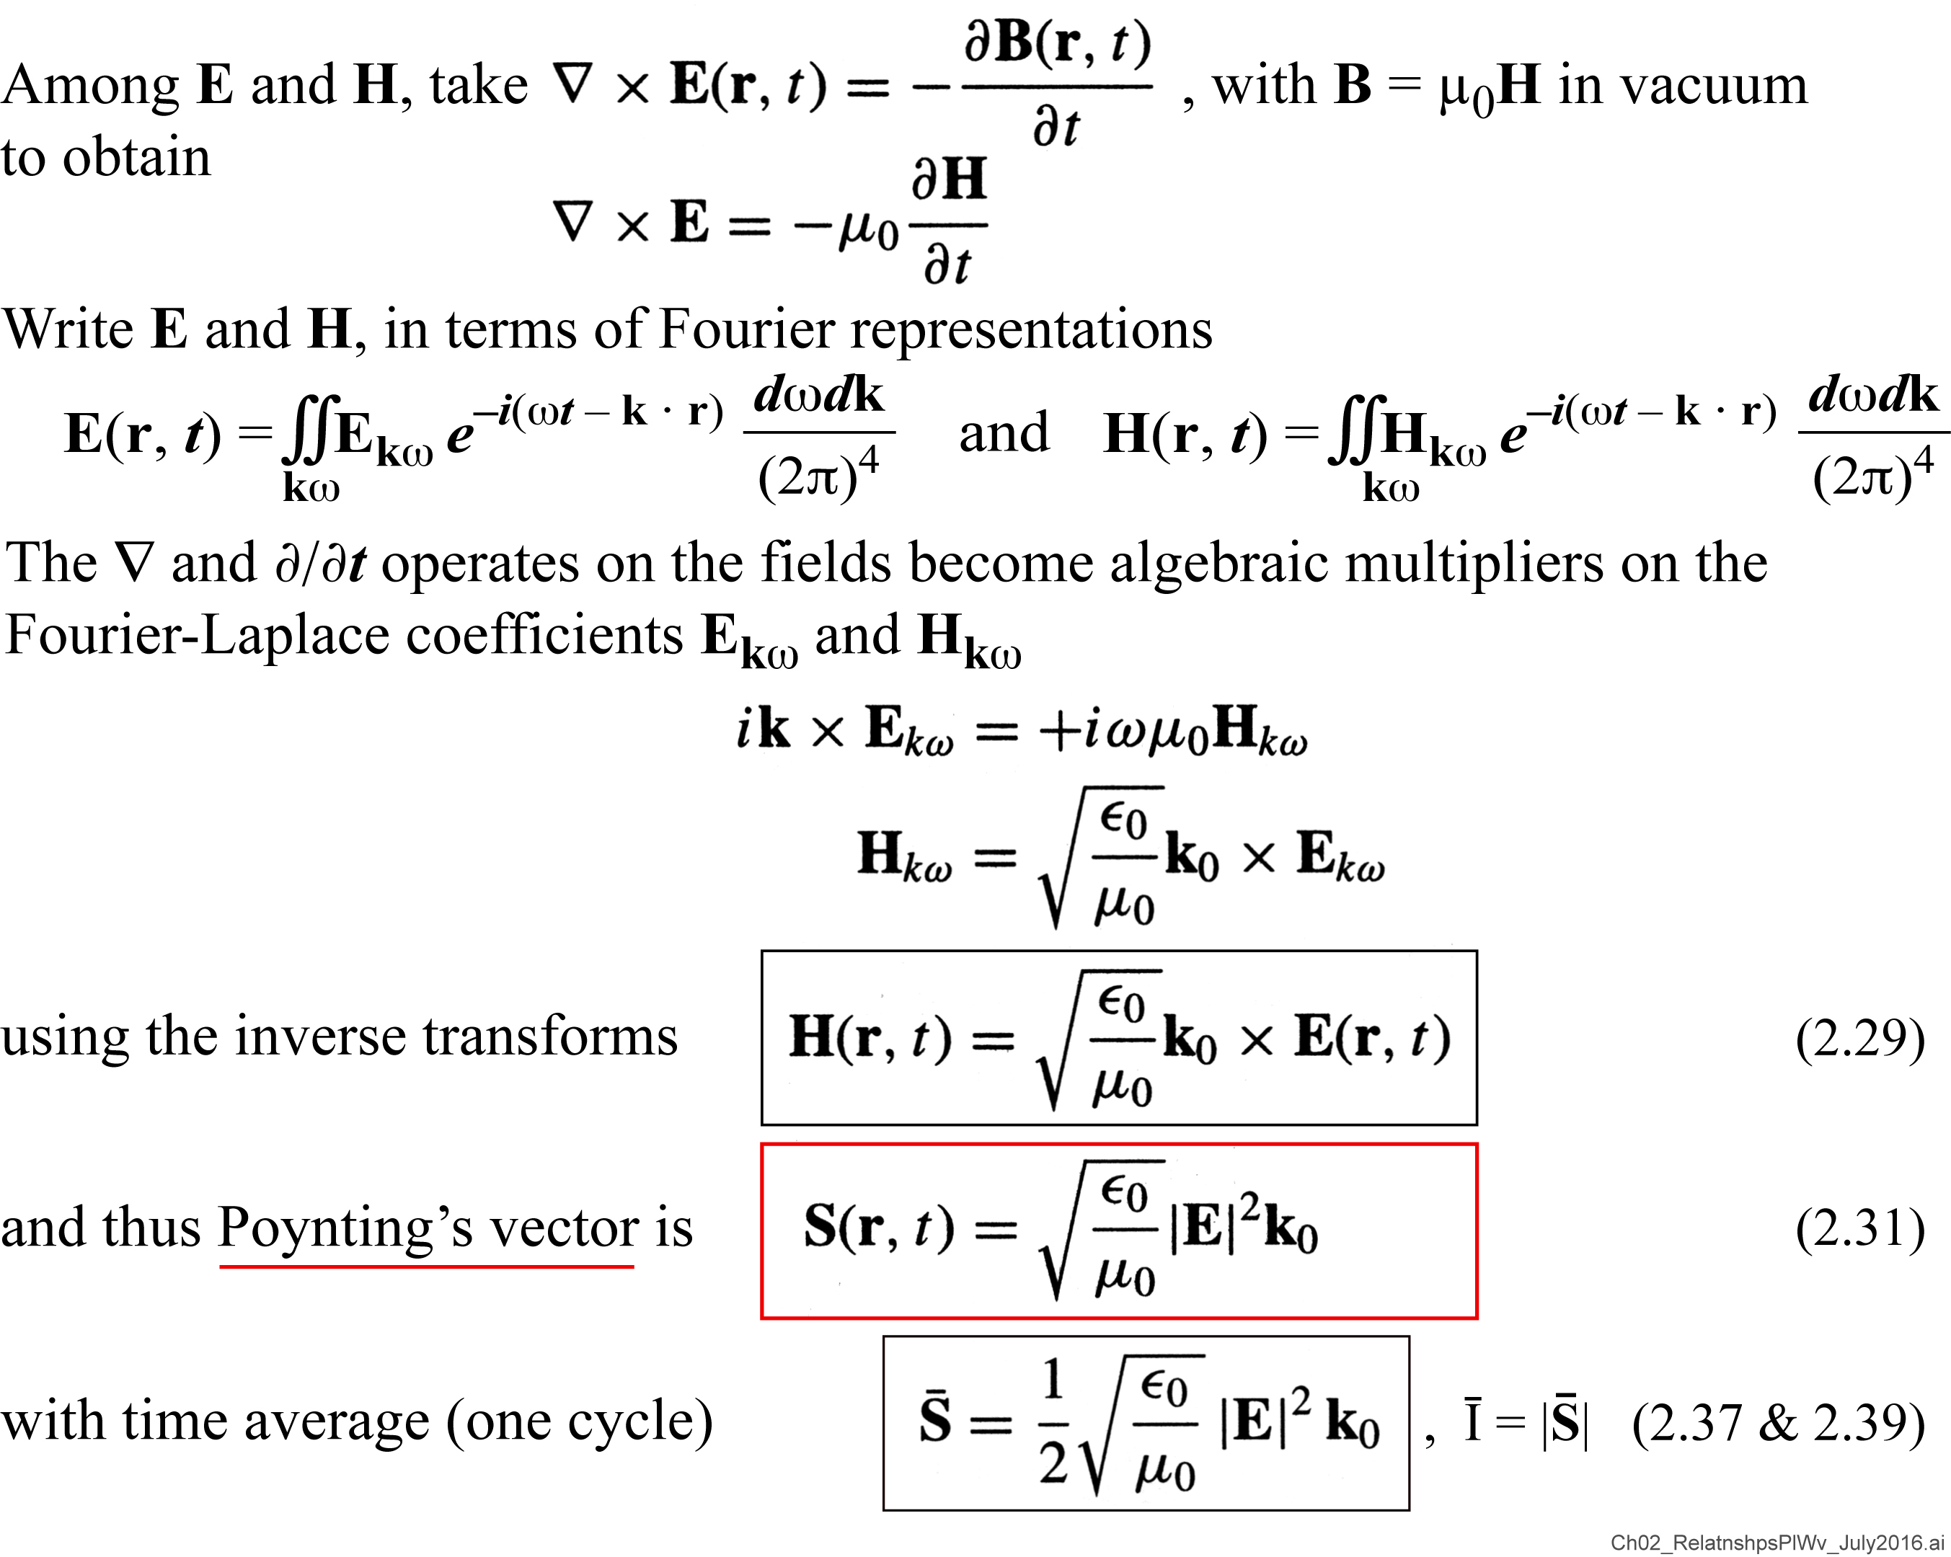
Relationships Among E, H, S and Intensity for a Plane Wave in Vacuum

Slide 9
Relationships among electric field and intensity for a plane wave in vacuum
$$E_{0}=2.745x{10}^{−7}\sqrt{\overline{I}\left[W/cm^{2}\right]}V/Å$$

Slide 10
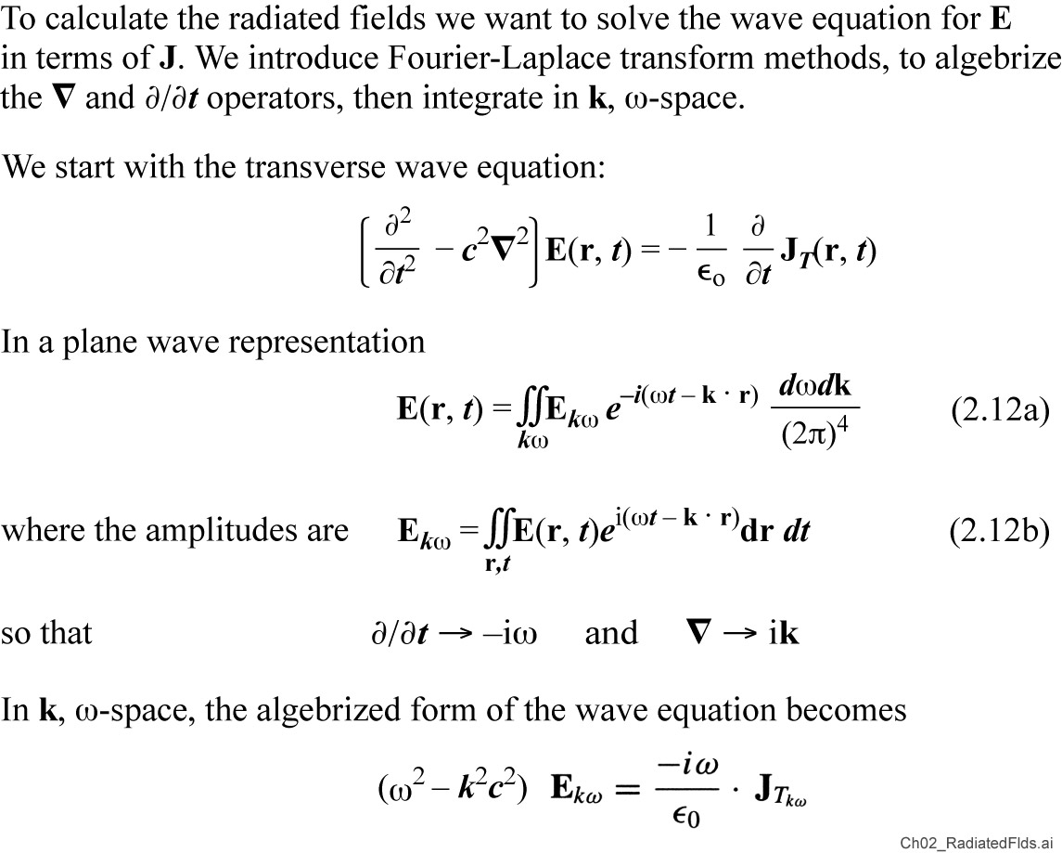
Radiated Fields Due to a Current J

Slide 11
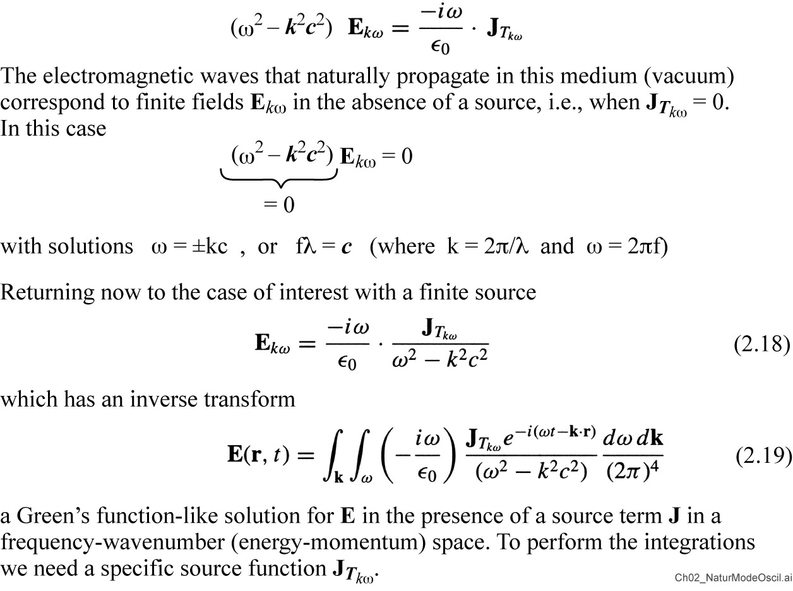
Radiated Fields Due to a Current J (continued)

Slide 12
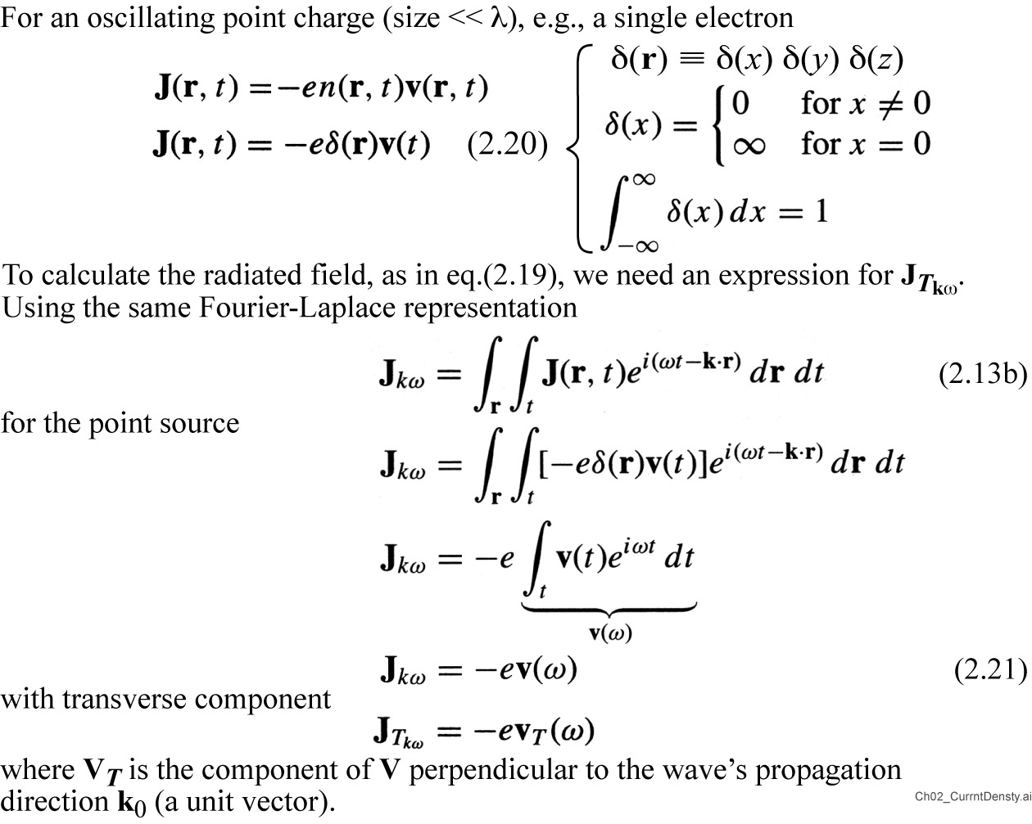
Current Density J Associated with an Accelerated Electron

Slide 13
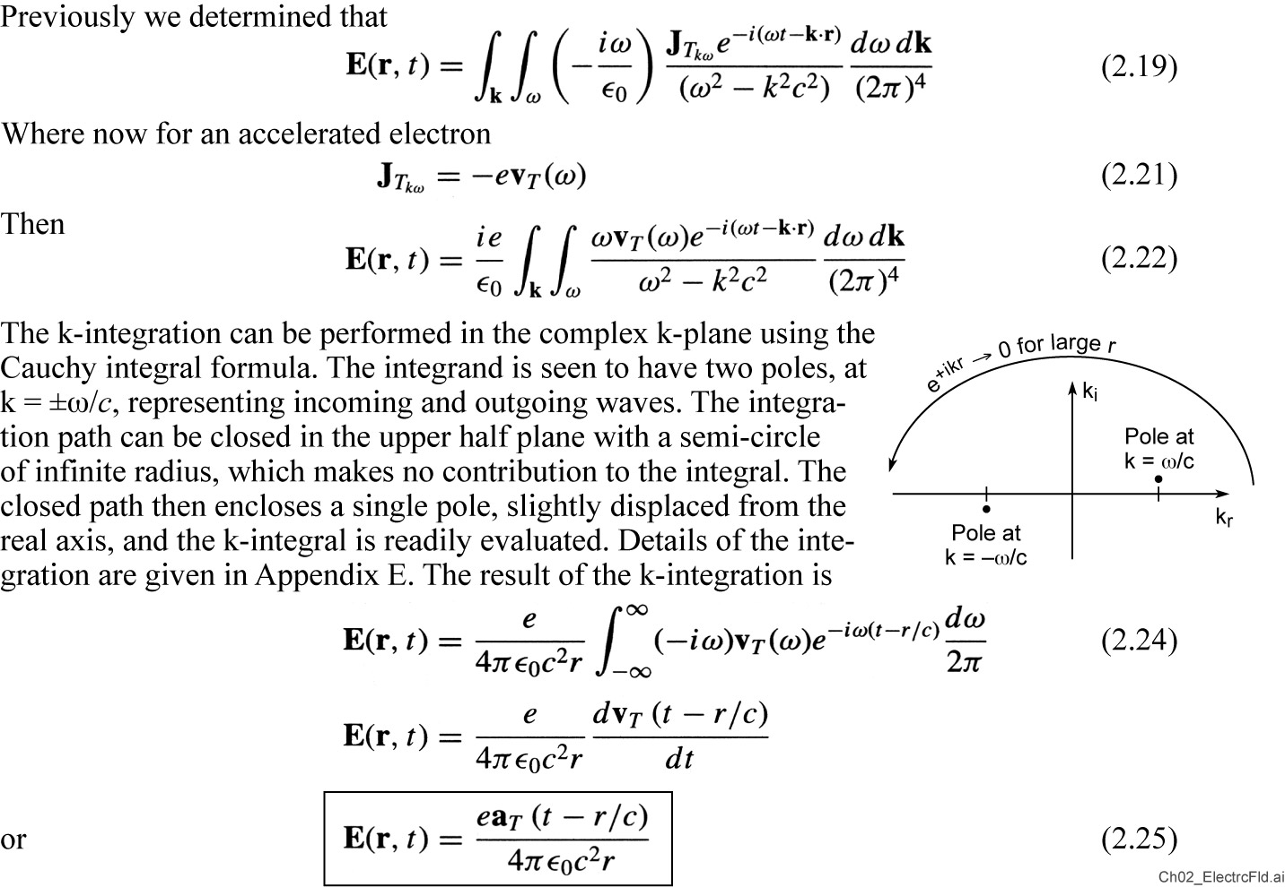
Electric Field Radiated by an Accelerated Charge

Slide 14
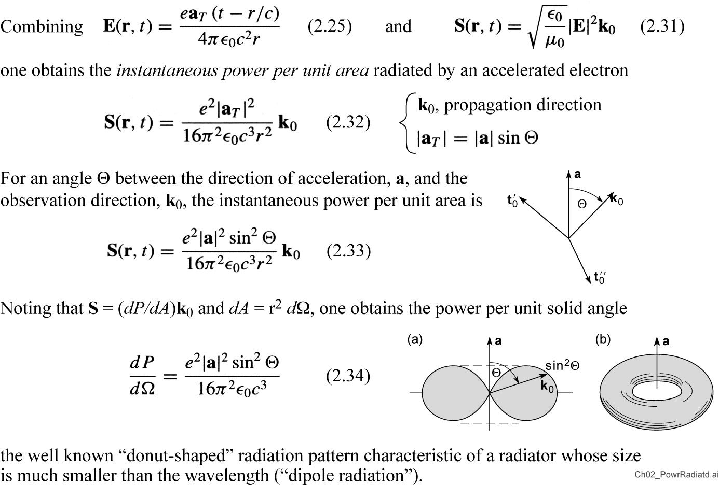
Dipole radiation by an Accelerated Point Charge

Slide 15
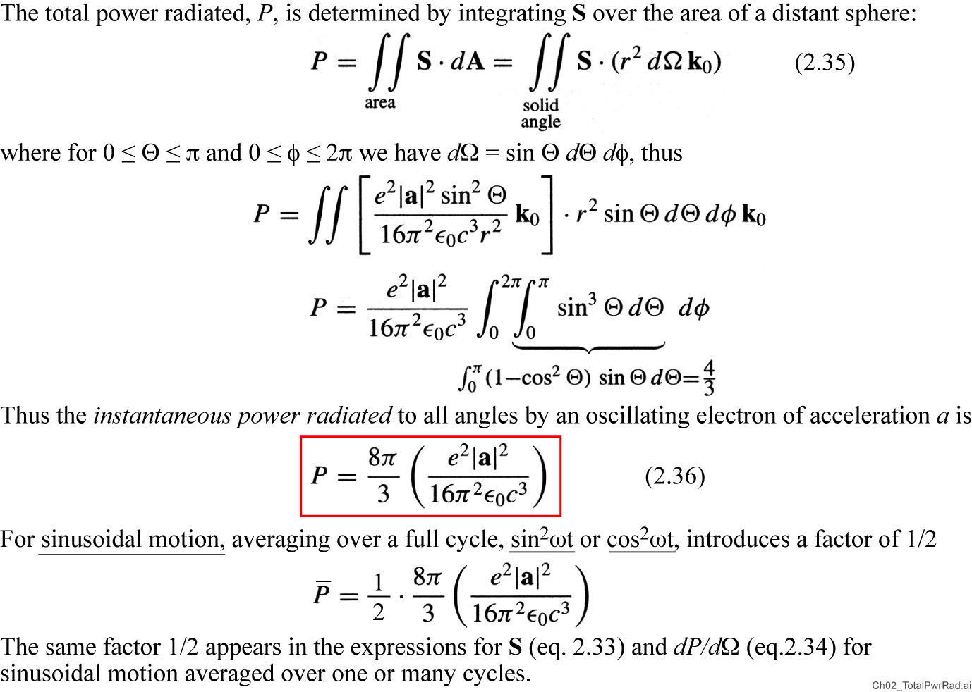
Total Power Radiated by an Oscillating Point Charge

Slide 16
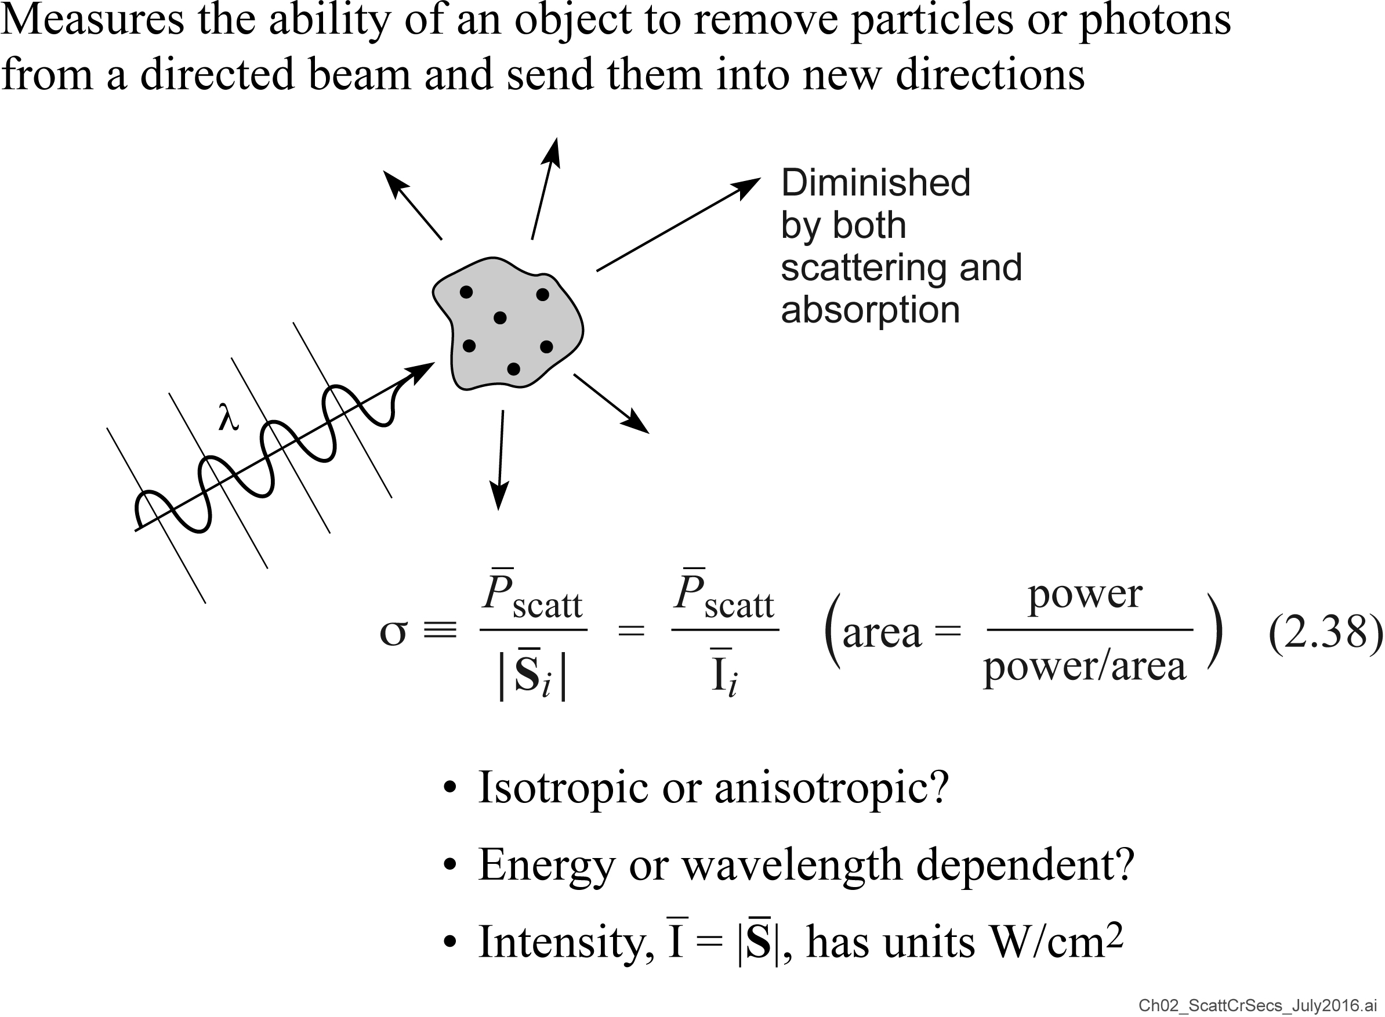
Scattering Cross-Section

Slide 17
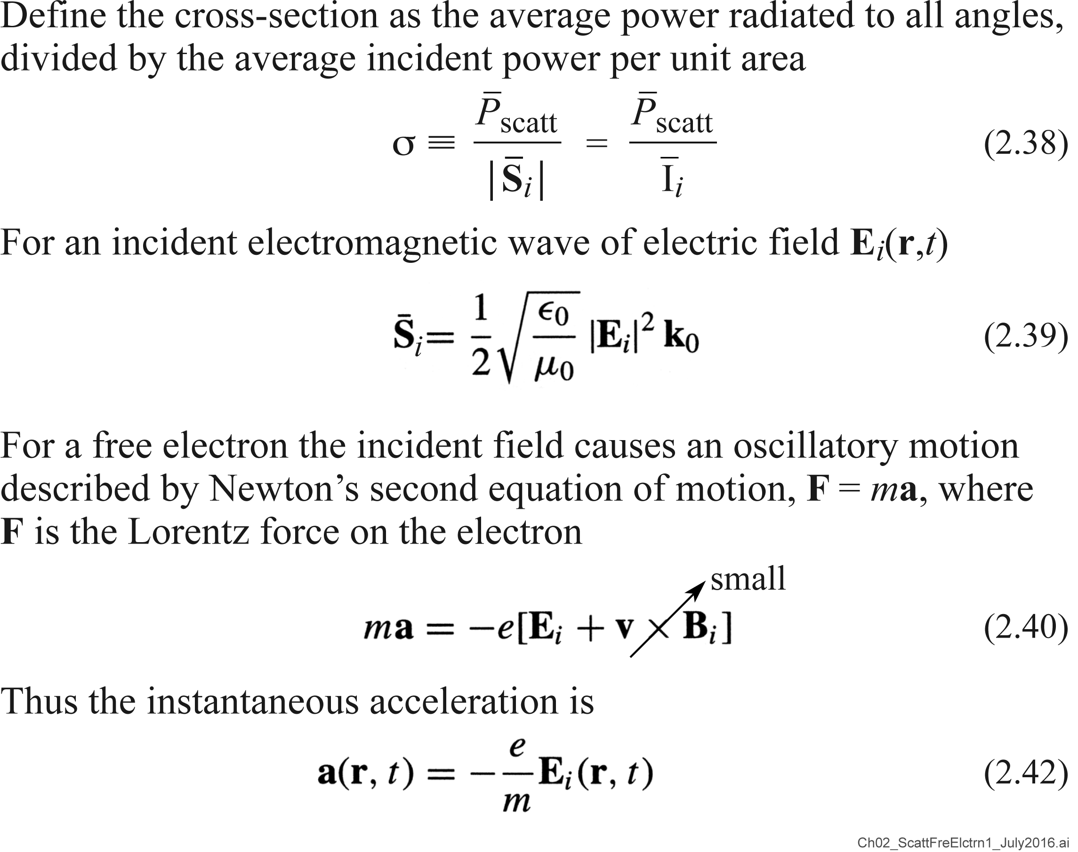
Scattering by a Free Electron

Slide 18
Scattering by a Free Electron (continued)

Slide 19
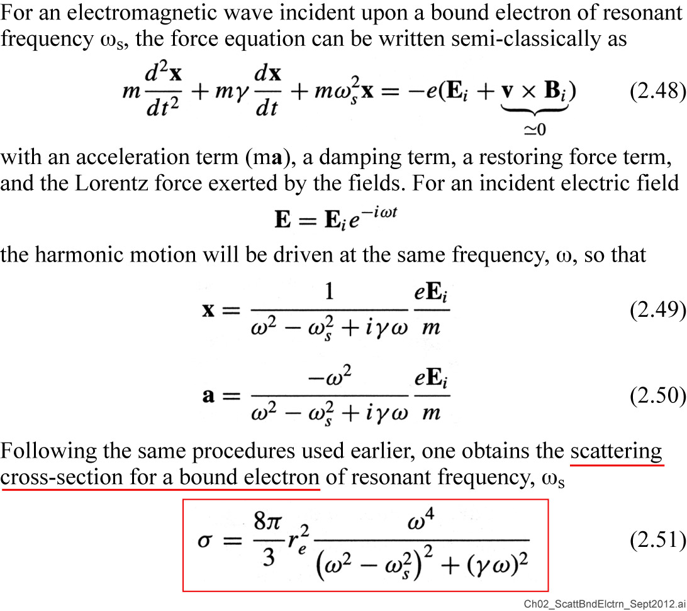
Scattering by a Bound Electron

Slide 20
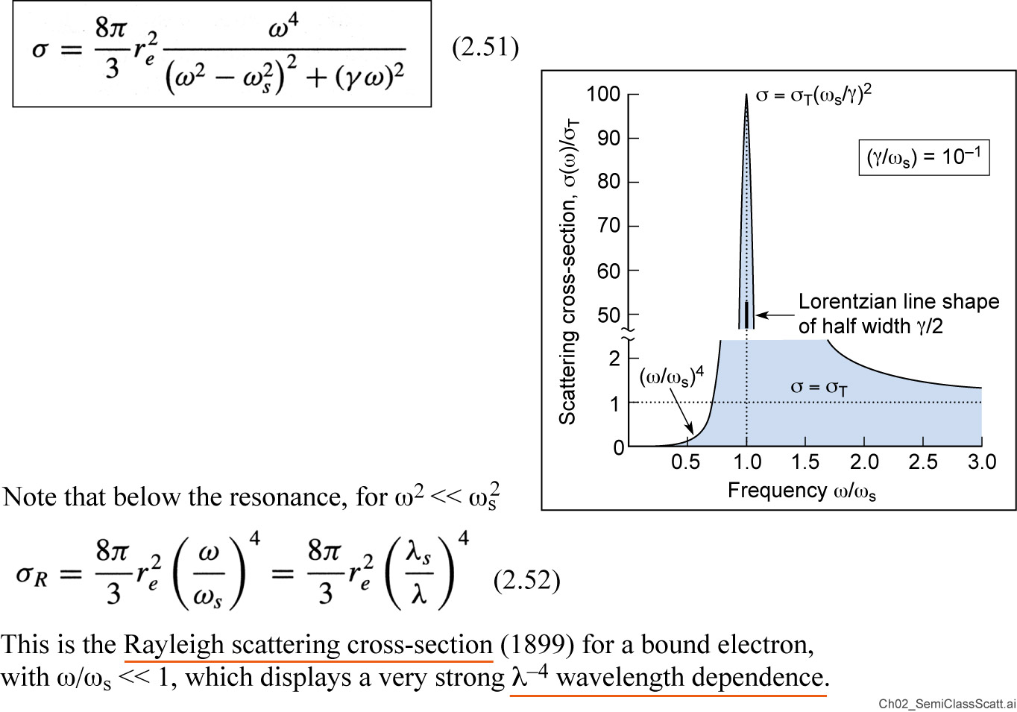
Semi-Classical Scattering Cross-Section for a Bound Electron

Slide 21
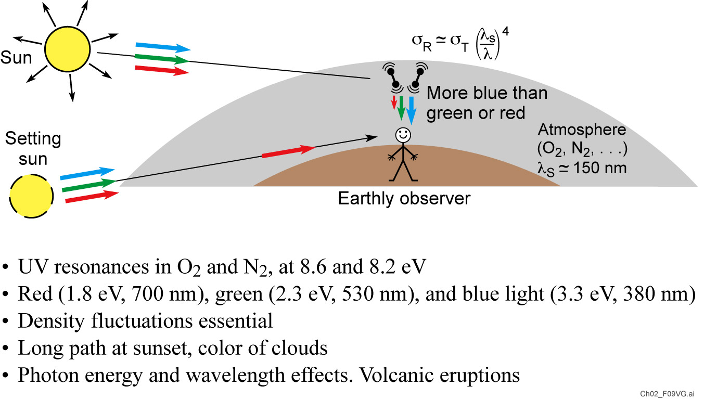
The Sky Appears Blue Because of the Strong Wave Length Dependence of Scattering by Bound Electrons

Slide 22
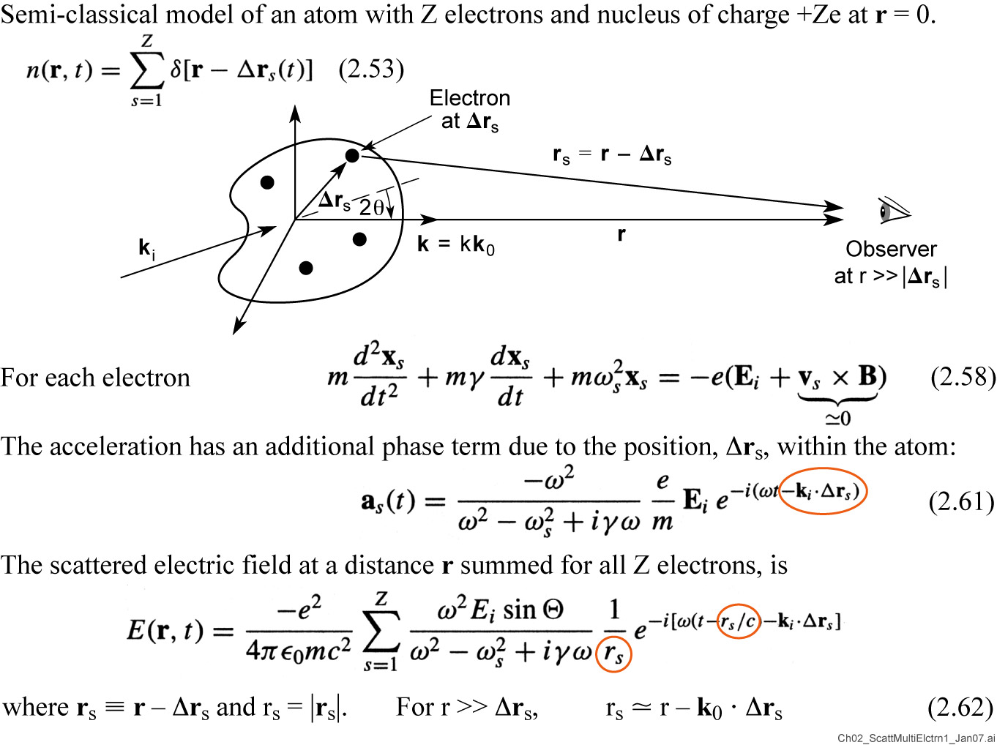
Scattering by a Multi-Electron Atom

Slide 23
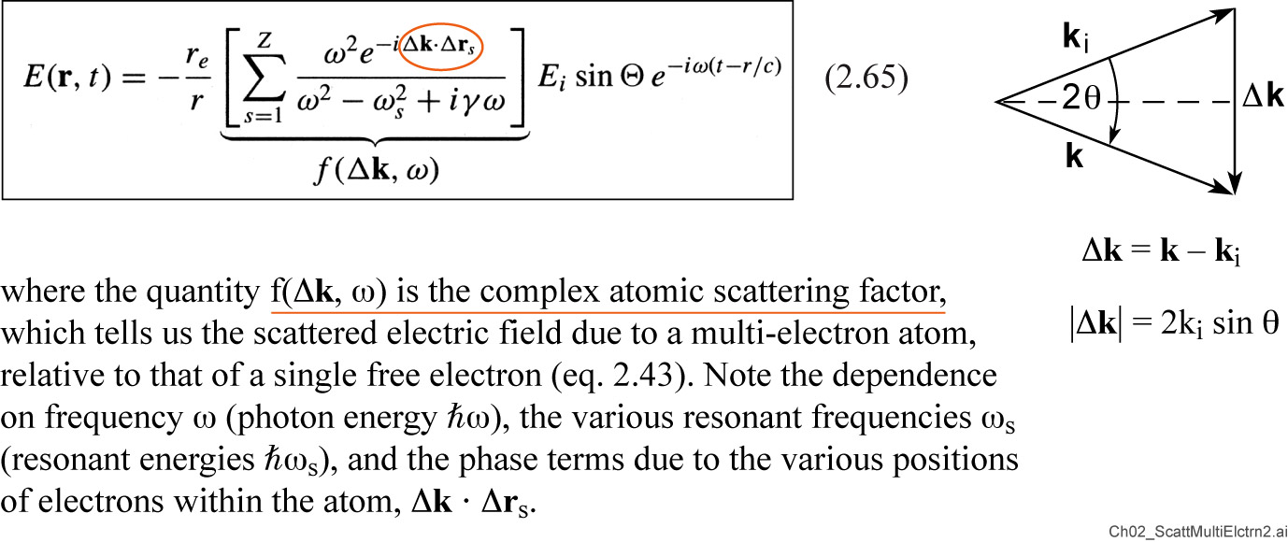
Scattering by a Multi-Electron Atom (continued)

Slide 24
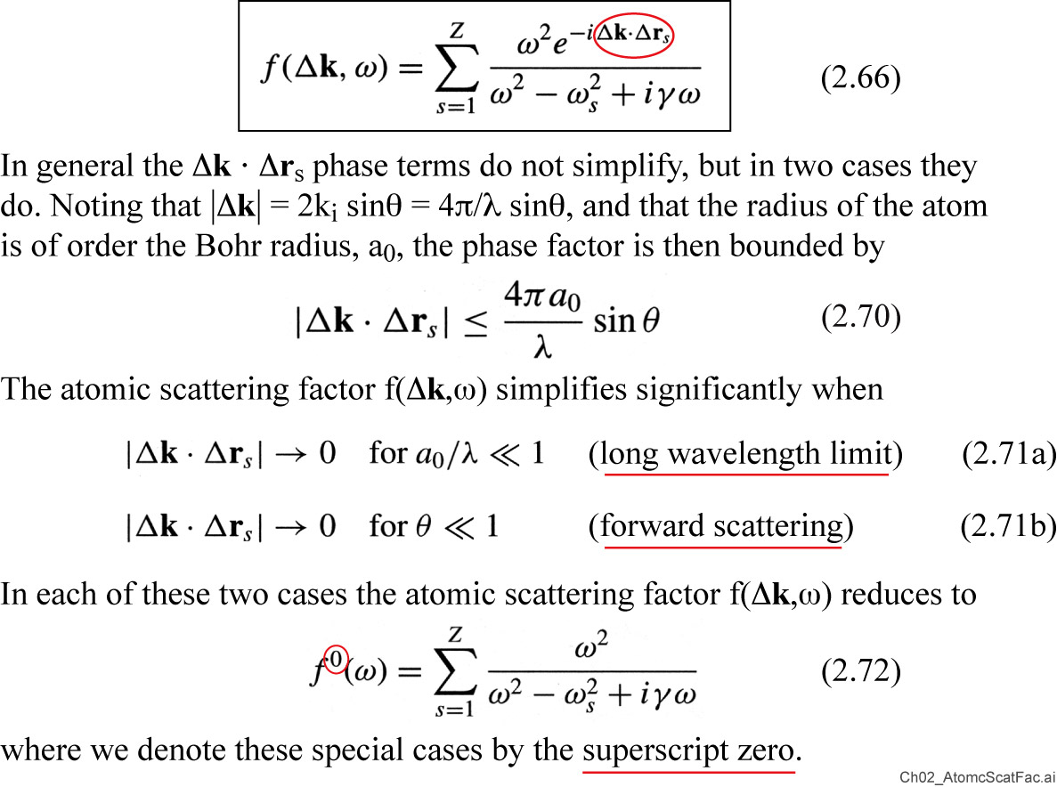
The Atomic Scattering Factor

Slide 25
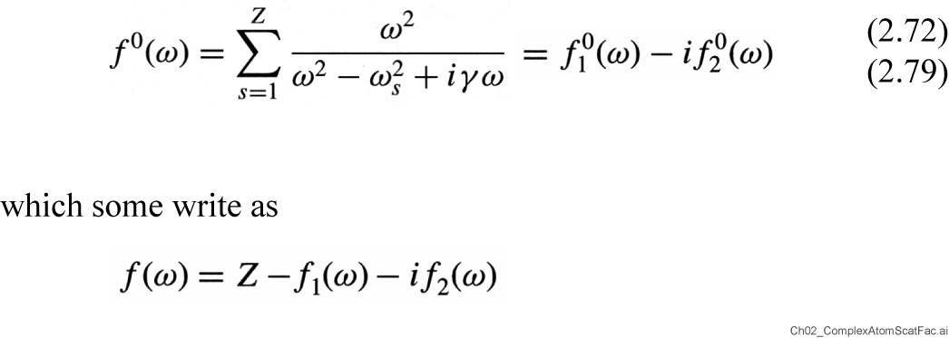
Complex Atomic Scattering Factor

Slide 26
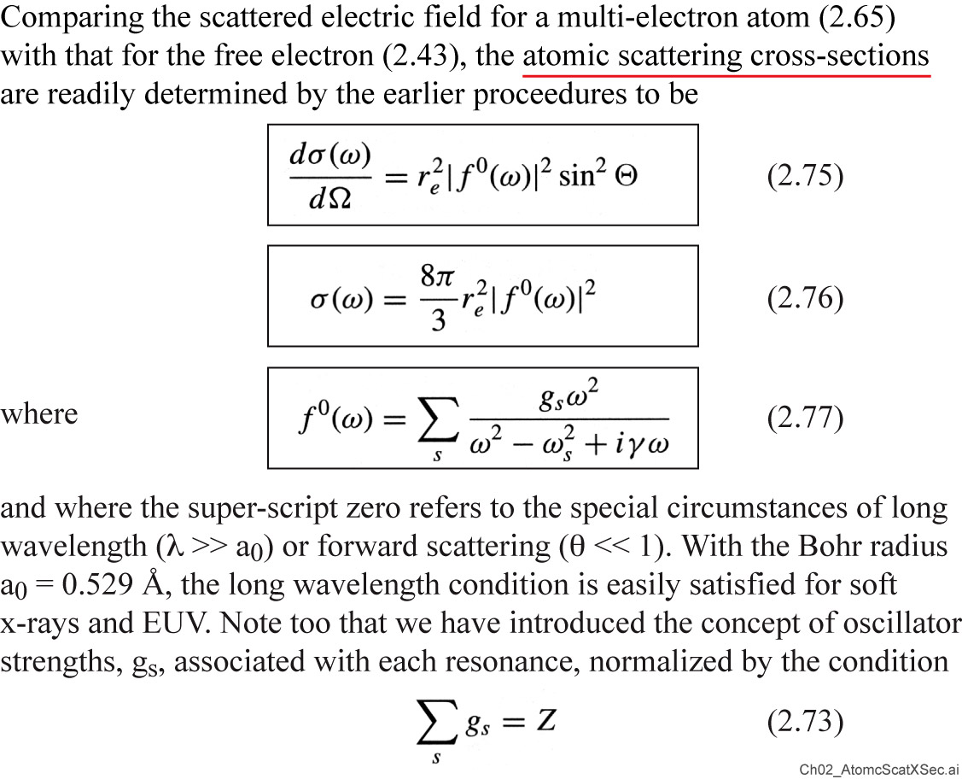
Atomic Scattering Cross-Sections

Slide 27
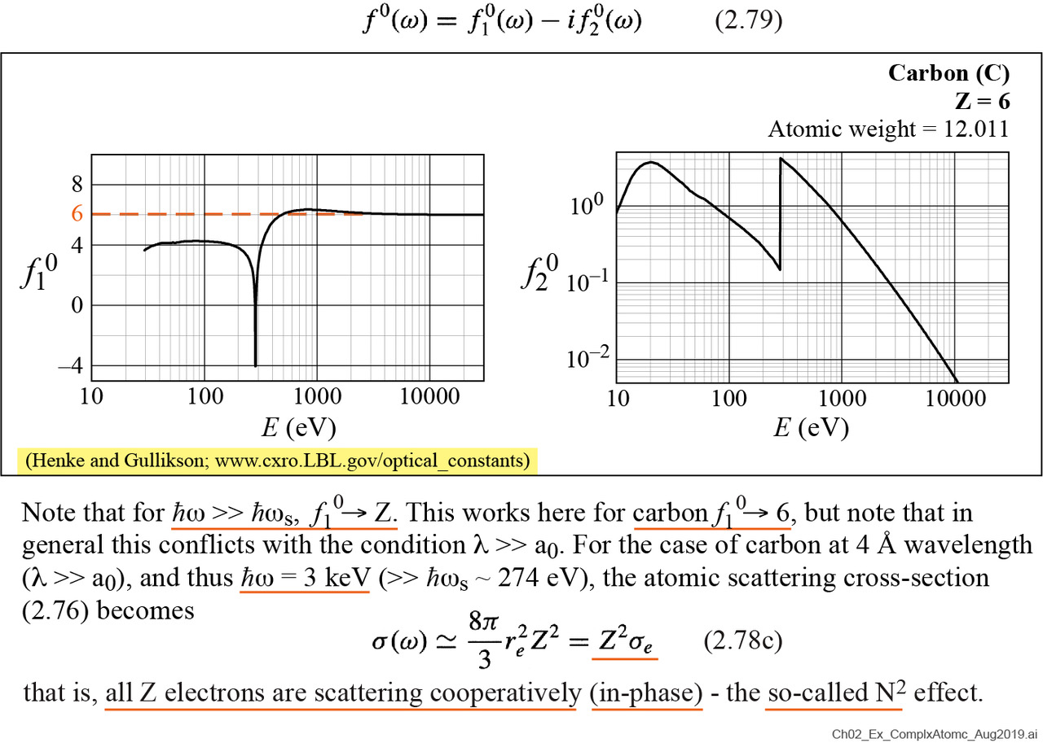
Example: Complex Atomic Scattering Factor for Carbon

Slide 28
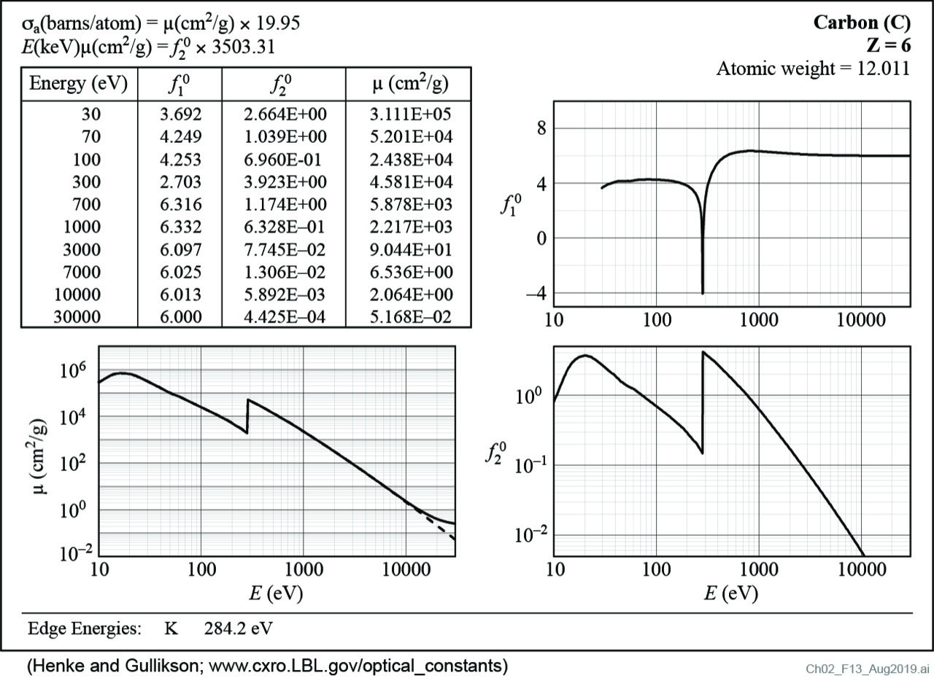
Atomic Scattering Factors for Carbon (Z = 6)

Slide 29
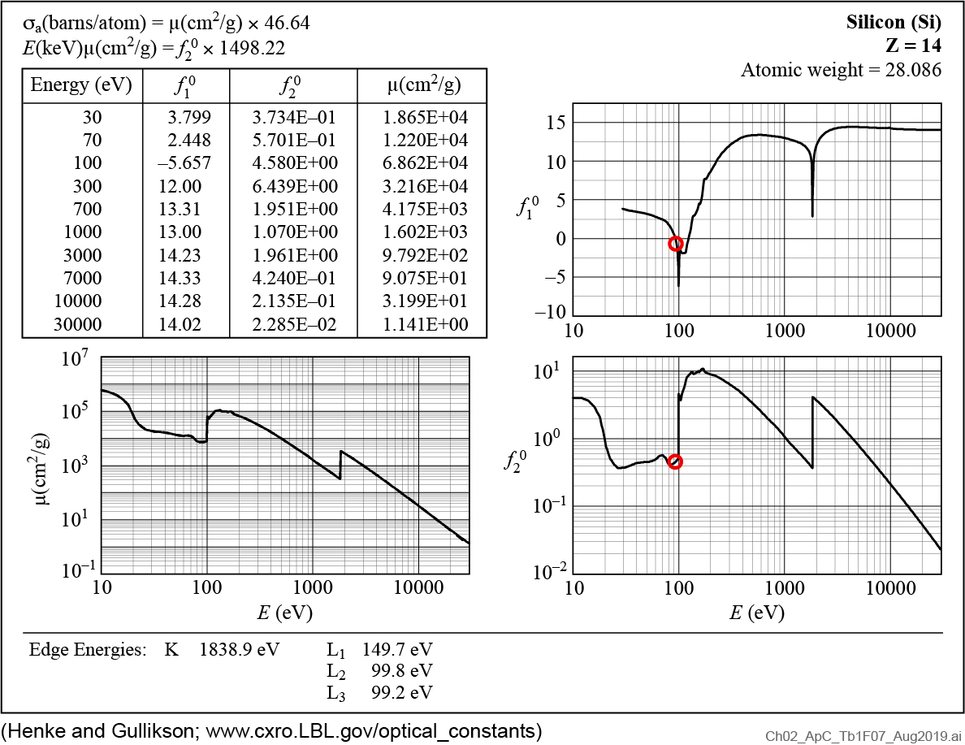
Atomic Scattering Factors for Silicon (Z = 14)

Slide 30
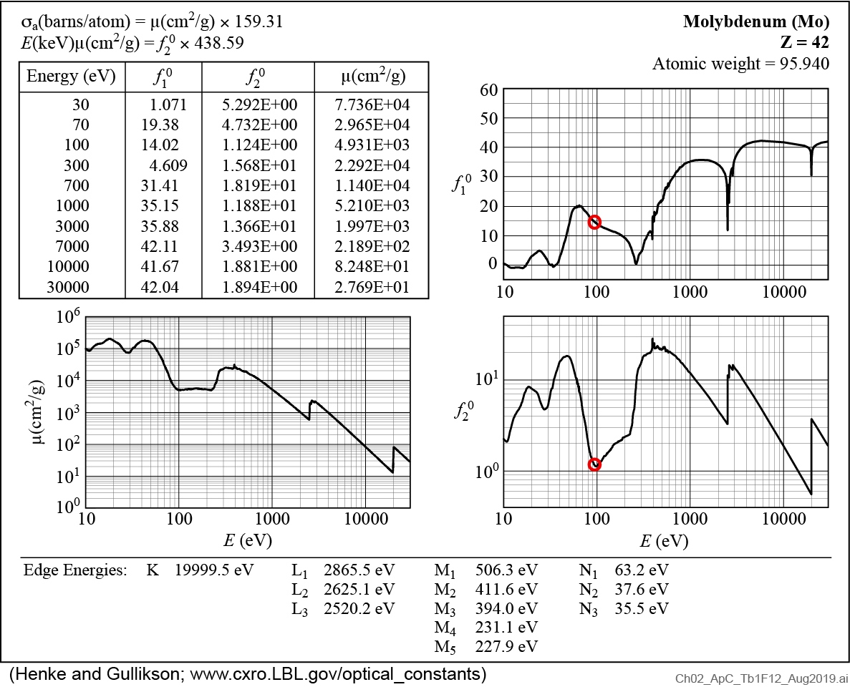
Atomic Scattering Factors for Molybdenum (Z = 42)

Slide 31
Multilayer coatings provide a modest band pass, and have achieved 70% normal incidence EUV reflectivity .
mλ = 2d sinθ
Courtesy of S. Bajt (Lawrence Livermore National Laboratory; presently DESY Laboratory, Hamburg)

Slide 32
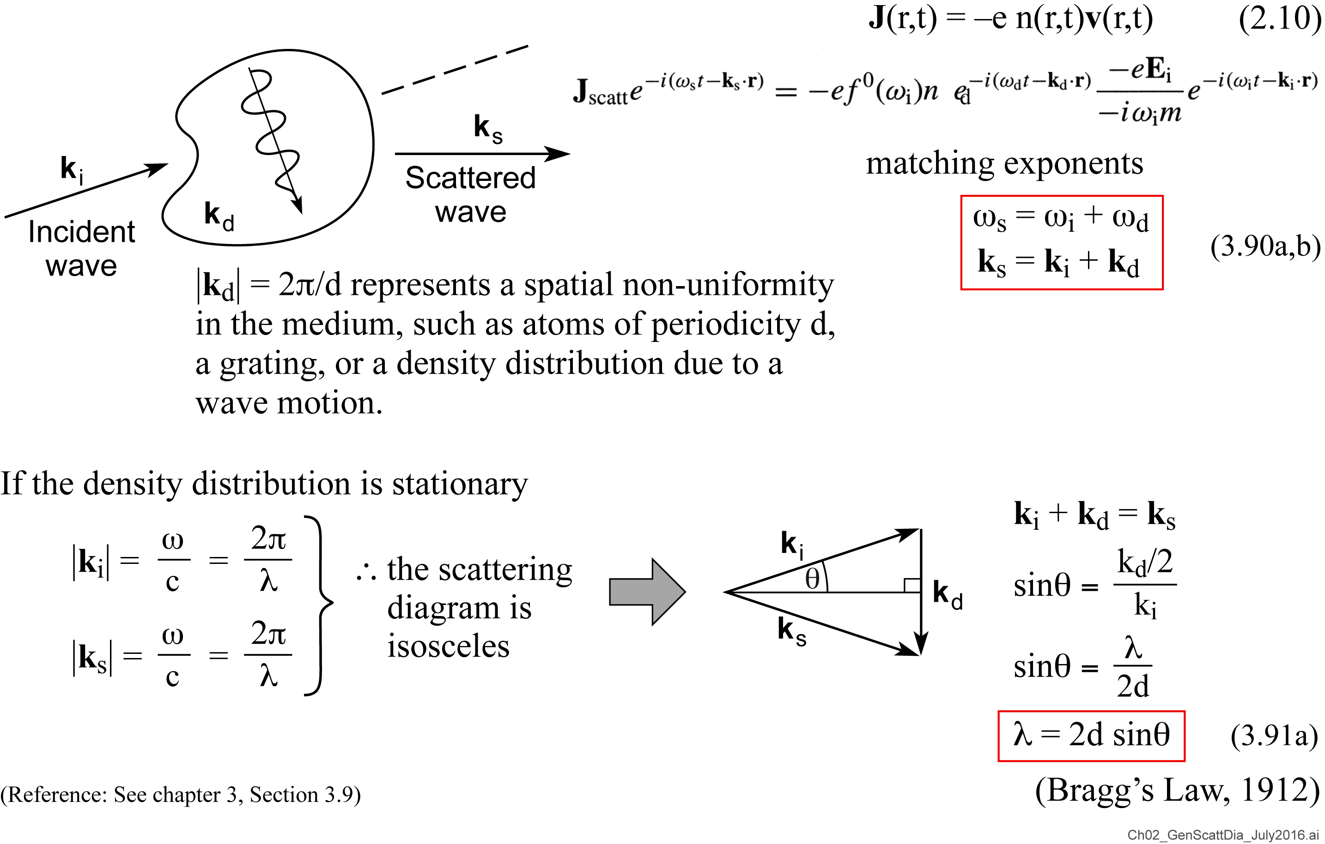
A General Scattering Diagram

