Slide 1
Fibre Amplifiers and Lasers for Near-IR Spectroscopy
Fundamental Principles

Slide 2
Rare Earth Elements for Near-IR Fibre Amplifiers and Lasers
Rare earth ion | Pump wavelengths (nm) | Emission bands (nm)
Ytterbium, Yb³⁺ | 915-976 | 1010–1150
Neodymium, Nd³⁺ | 810, 880 | 860–940, 1040–1080, 1280–1420
Erbium, Er³⁺ | 980, 1480 | 1500–1620
Thulium, Tm³⁺ | 790, 1660 | 1700–2100
Holmium, Ho³⁺ | 1100 | 2000–2200

Slide 3
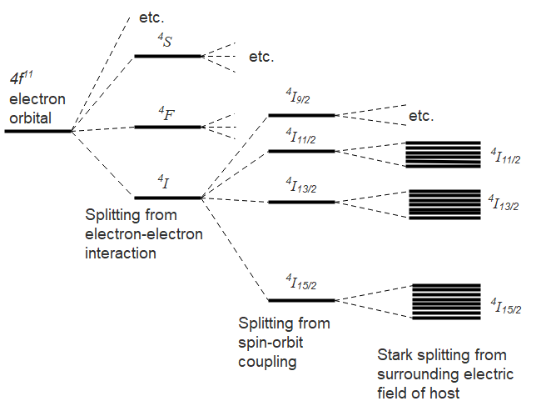
Splitting of The Energy Levels of The 4f¹¹ Electrons of Erbium Ions in Glass

Slide 4
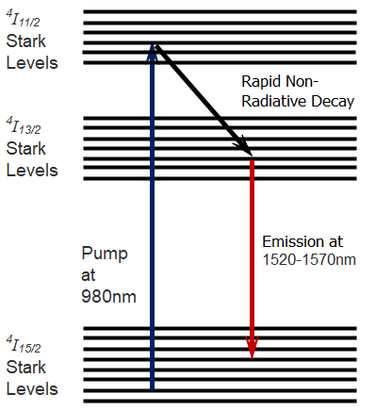
The Most Important Energy Levels for Near-IR Erbium-Doped Fibre Amplifiers and Lasers

Slide 5
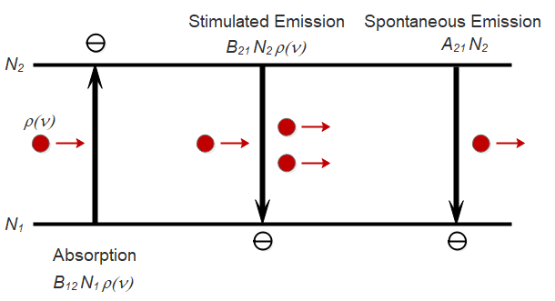
The Einstein Relations for Absorption & Emission Coefficients
where g_{a}(ν) and g_{e}(ν) are the absorption and emission line shape functions

Slide 6
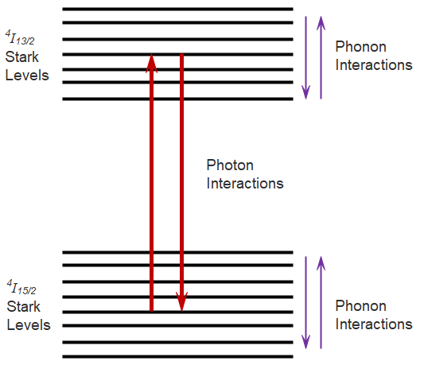
Photon and Phonon Interactions with the Energy Levels

Slide 7
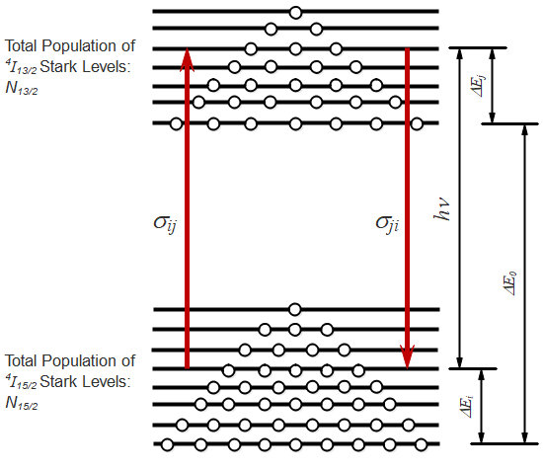
Thermalisation of the Population of the Stark Levels through Phonon Interactions
Thermal population distribution from phonon interactions within Stark levels
Photons interact between individual Stark levels, i and j of each manifold, with absorption and emission cross-sections of σ_{ij} and σ_{ji}
Thermal population distribution from phonon interactions within Stark levels

Slide 8
McCumber Relationship
The rapid thermalisation of the Stark energy levels within each manifold through phonon interactions occurs on a timescale much faster than the optical processes. This results in the ‘McCumber relationship’:
where σ_{e}(ν) is the effective emission cross-section, σ_{a}(ν) is the effective absorption cross-section and ε is the mean energy difference between the ⁴I_{13/2} and the ⁴I_{15/2} manifolds

Slide 9
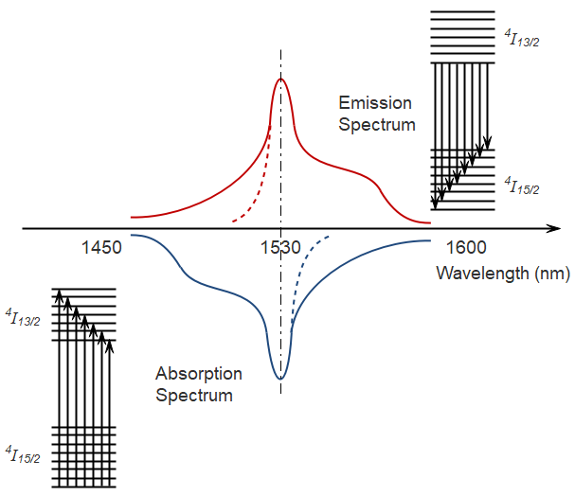
Absorption and Emission Spectrum of Erbium-Doped Fibre
Low Temperature Downward Transitions
Room Temperature
Low T
Low T
Room Temperature
Low Temperature Upward Transitions

Slide 10
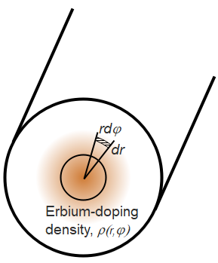
Parameters Describing Erbium-Doped Fibre
Erbium doping density distribution:
Effective area of the doped region:
Absorption and emission coefficients:
Γ is the normalised overlap factor between the erbium density distribution and the optical intensity distribution

Slide 11
Erbium-Doped Fibre Amplifier
Atomic rate equation (power expressed in photons/s):
Length averaged fractional inversion level:
Length averaged gain:
τ₂₁ is the upper state lifetime
Pump absorption coefficient:

Slide 12
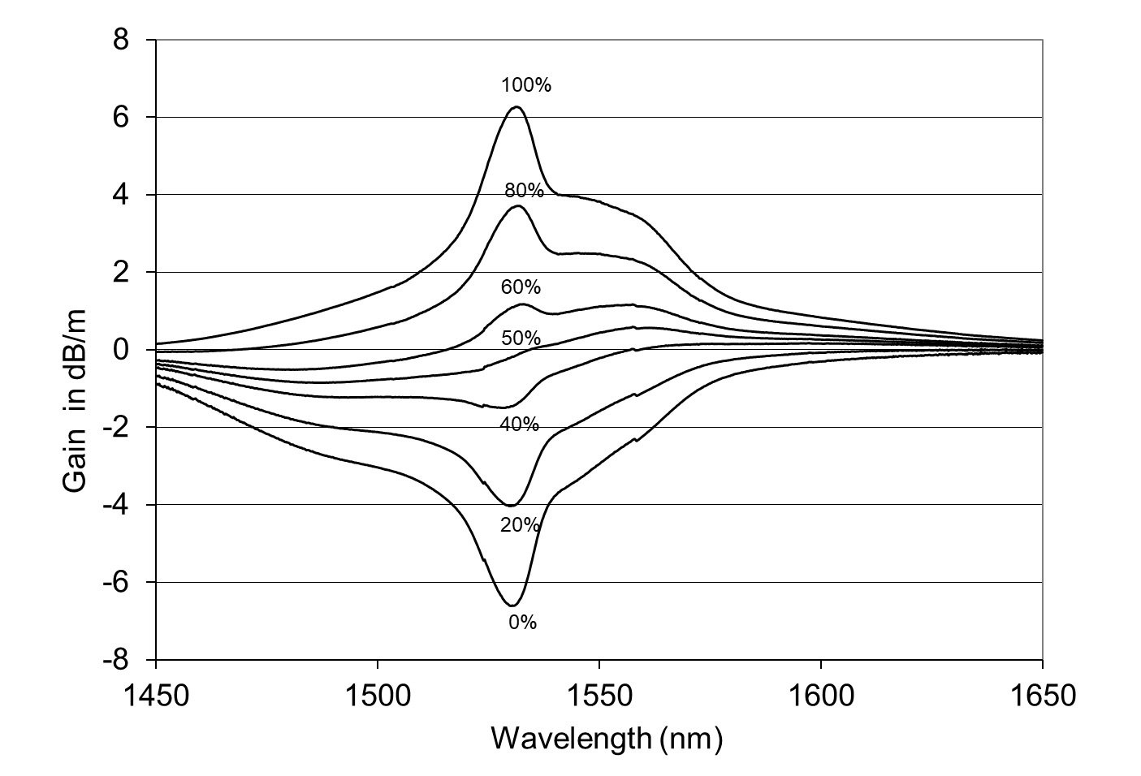
Typical Gain/Loss Curves for Erbium-Doped Fibre Amplifier for 0-100% Inversion
Gain in dB/m =
Fractional Inversion Level,

Slide 13
Atomic & Cavity Rate Equations for Fibre Lasers
Atomic rate equation:
Cavity rate equation:
τ is the round trip time of the cavity, dq is the number of modes involved, A_{SE} is the amplification factor for the spontaneous emission and R_{ASE} is the rate of amplified spontaneous emission.

Slide 14
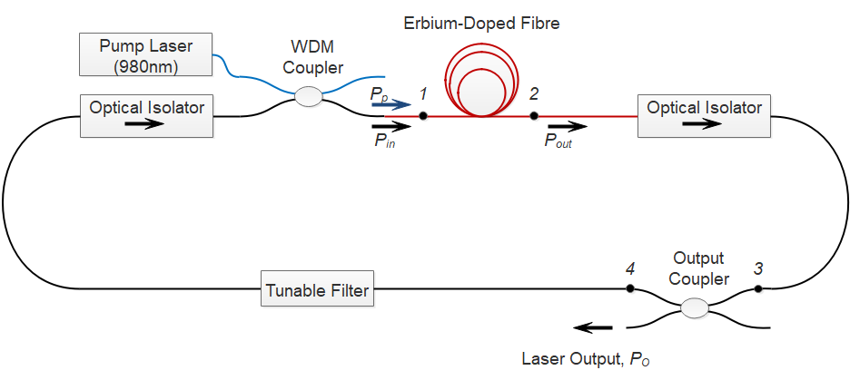
Typical Construction of a Ring Cavity Fibre laser

Slide 15
Typical Parameters for an Erbium Fibre Ring Laser at 1560nm
Lasing wavelength | 1560nm
Absorption coefficient, α_{a} | 1.85dB/m
Emission coefficient, γ_{e} | 3.23dB/m
Pump wavelength | 980nm
Pump absorption coefficient, α_{p} | 4.5dB/m
Upper state lifetime, τ₂₁ | 10ms
Erbium fibre length, l | 10m
Erbium ion density, ρ_{e} | 5x10²⁴ ions.m⁻³
Effective area of erbium doping, S_{e} | 10⁻¹¹ m²
Total length of fibre ring cavity, L_{c} | 20m
Longitudinal mode spacing, Δν_{m} | 10MHz
Round-trip time of cavity, τ | 100ns
Values for cavity loss, α_{c} | 6, 8 or 13dB
Out-coupled ratio of coupler, R | 10%
Erbium fibre output-to-coupler loss, α₂₃ | 3dB

Slide 16
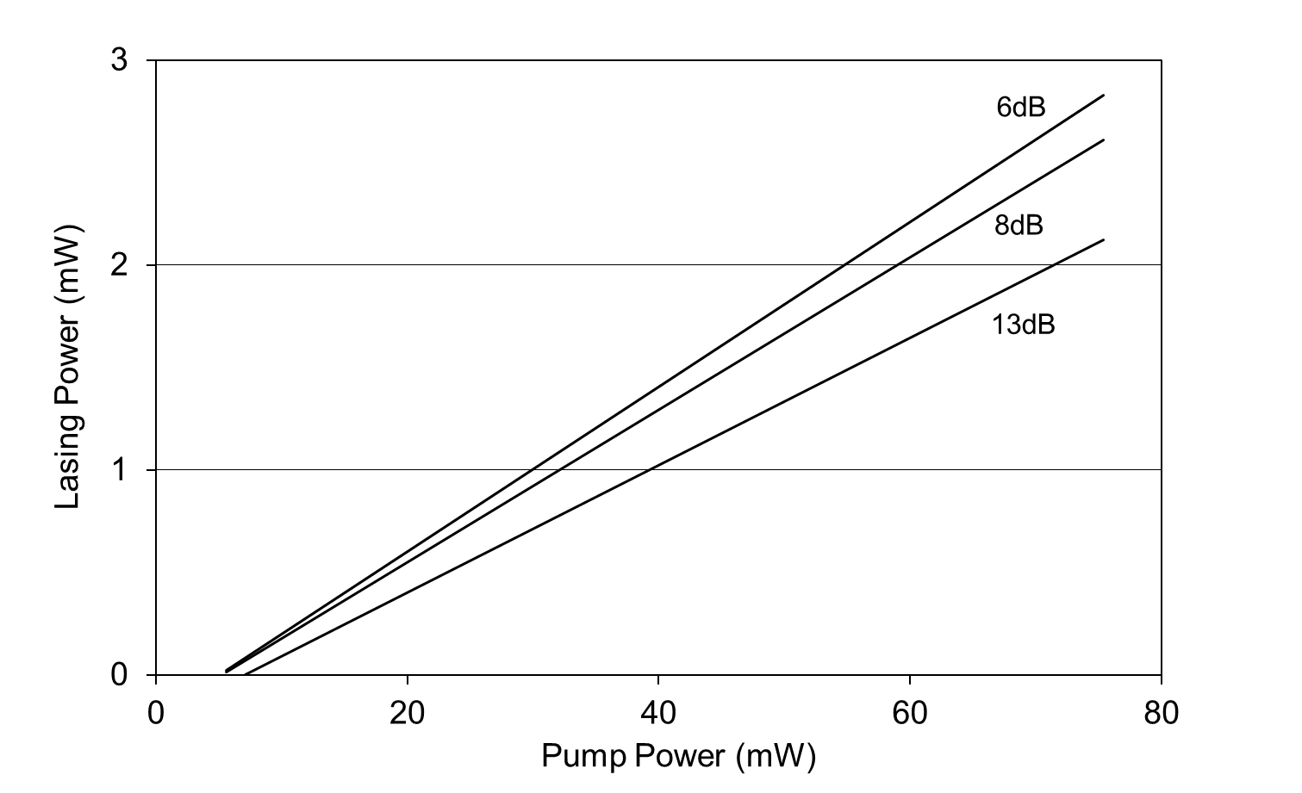
Typical Output Power Characteristics of Erbium Fibre Ring Laser
Cavity Loss
η is the “slope efficiency”

Slide 17
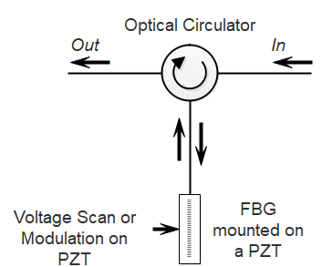
Wavelength Tuning, Modulation or Scanning with a FBG and a PZT

Slide 18
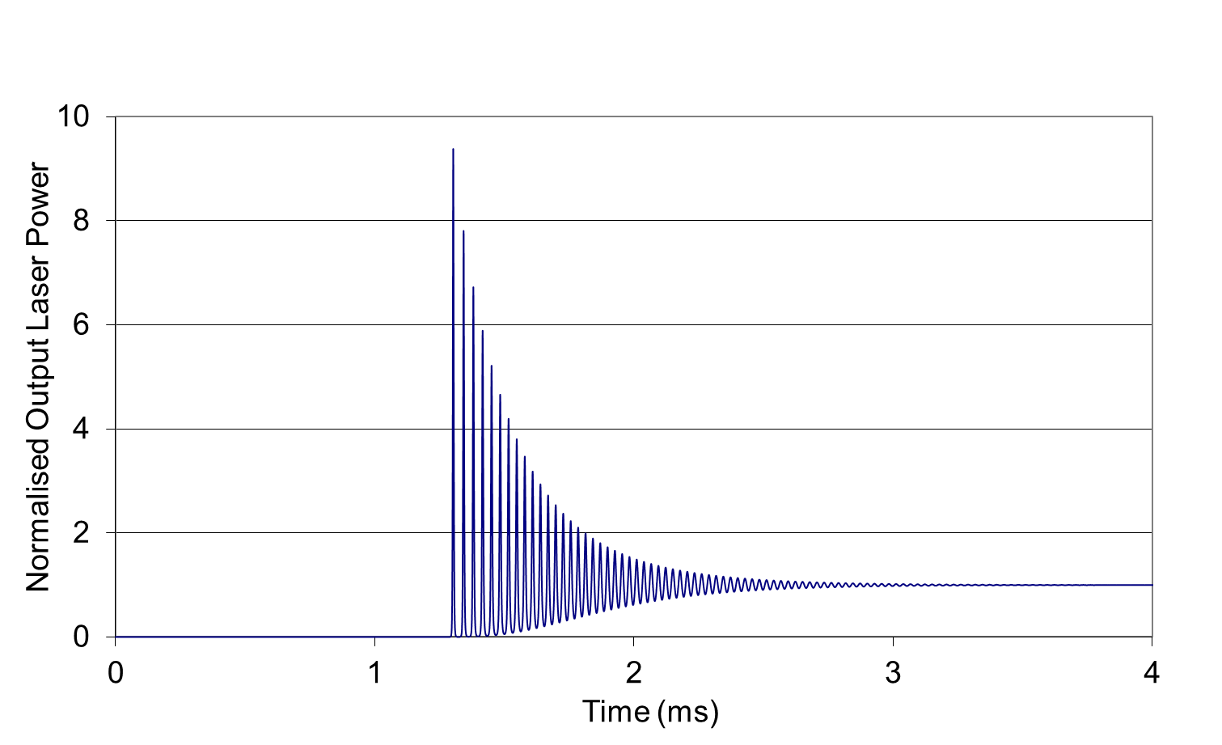
Transient Laser Response after Application of a Step Input to the Pump Power (13dB cavity loss with ξ = 8)
Relaxation oscillations
frequency
decay constant
Delay time
cavity lifetime
Delay time to threshold

Slide 19
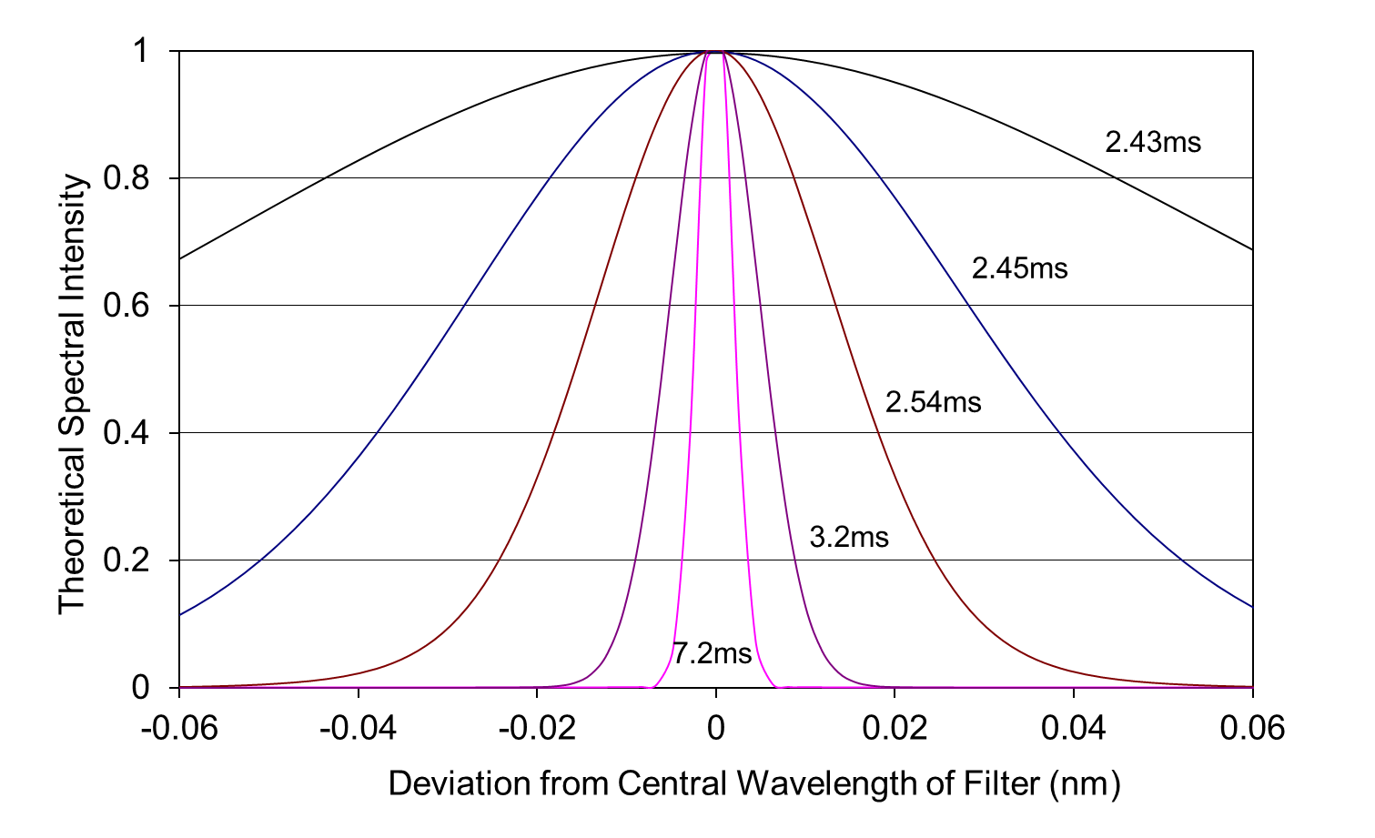
Example of The Spectral Narrowing Occurring During the Transient Period (1nm Filter Bandwidth)

Slide 20
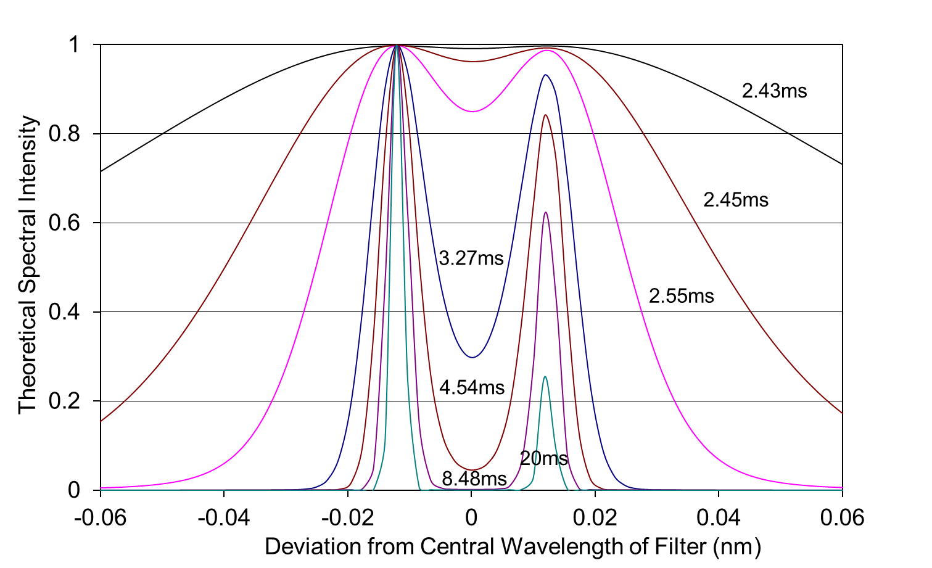
The Effect of an Absorption Line of 5GHz Linewidth on The Spectral Narrowing

Slide 21
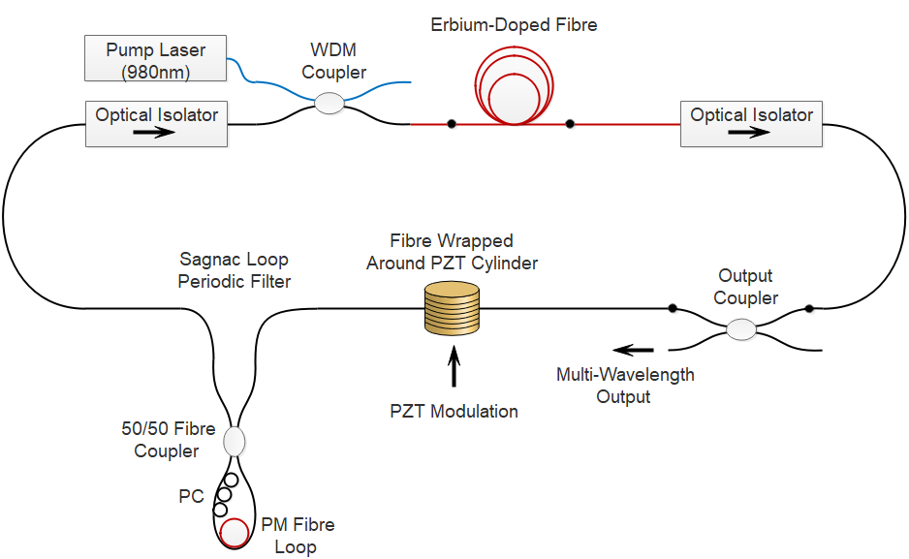
Multi-Wavelength Operation of a Fibre Ring Laser
Multi-wavelength outputs generated at the peaks of the Sagnac loop filter through the cavity length modulation induced by the PZT

Slide 22
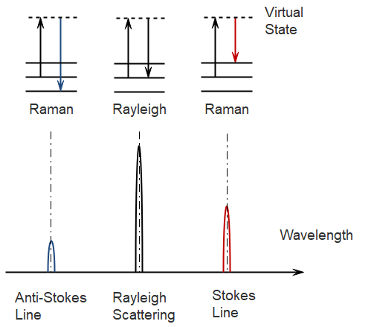
Raman Fibre Amplifiers & Lasers
Rayleigh and Raman Scattering

Slide 23
Raman Fibre Amplifiers & Lasers
Stimulated Raman Scattering (SRS) may be employed to extend the operation wavelength range of fibre lasers and amplifiers.
Raman scattering in optical fibres occurs over a broad frequency band with a broad peak in the Raman gain at a wavelength shift of ~100nm and width of ~5THz.
The Raman gain is given by:
I_{p} is the pump intensity in W/m² and l is the interaction length.
g_{R} is the Raman gain coefficient with a peak value of ~6x10⁻¹⁴ m/W at a pump wavelength of ~1550nm
Although the Raman gain coefficient is very small, long interaction lengths of several kilometres are possible with optical fibres and high pump intensities can be achieved in the fibre core.

Slide 24
Summary & Conclusions
The special properties of the 4f electron shell in rare earth elements give rise to the unique characteristics of fibre amplifiers and lasers.
Phonon interactions give rapid thermalisation of the population of the Stark energy levels in rare earth doped fibre, leading to the McCumber relationship between the absorption and emission cross-sections.
The absorption and emission spectra of rare earth doped fibres are broad and predominantly homogeneously-broadened.
Cavity and atomic rate equations provide the basic tools to model the behaviour of fibre lasers under various operating conditions, including steady-state, multi-wavelength, transient and mode-locked regimes.
Stimulated Raman scattering may be employed to extend the operation range of fibre amplifiers and lasers.

