Slide 1
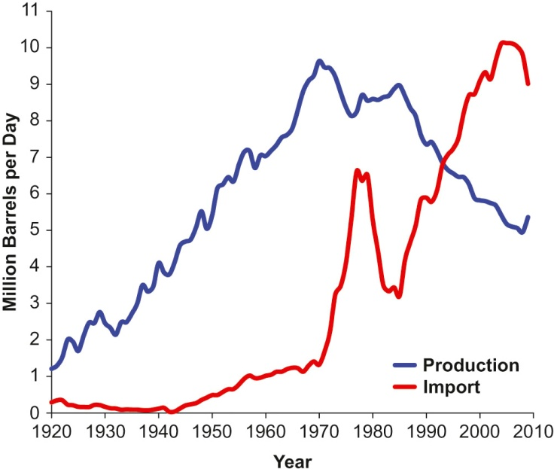
Fig26_01

Slide 2
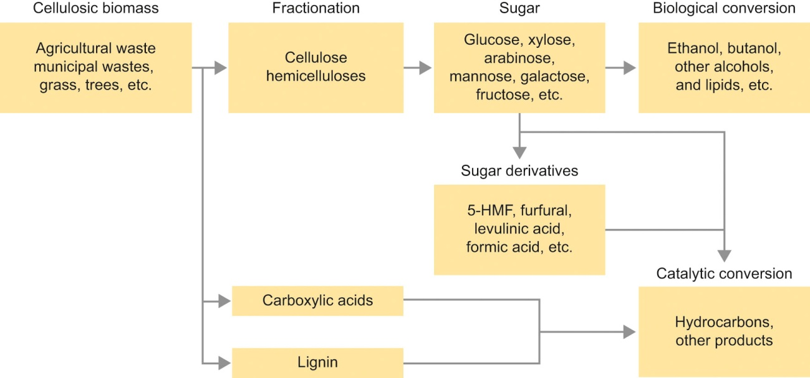
Fig26_02

Slide 3
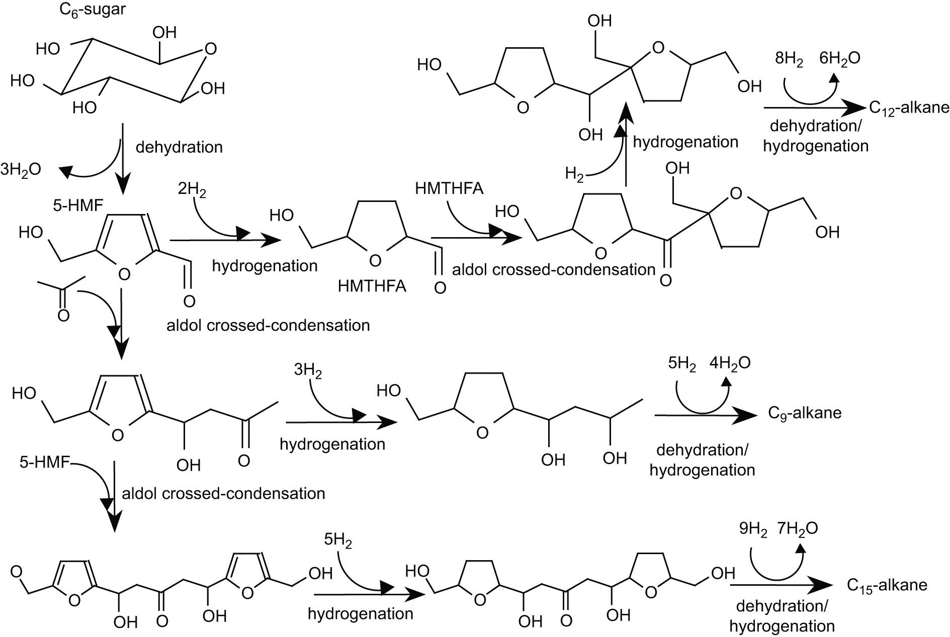
Fig26_03

Slide 4
Fig26_04

Slide 5
Fig26_05

Slide 6
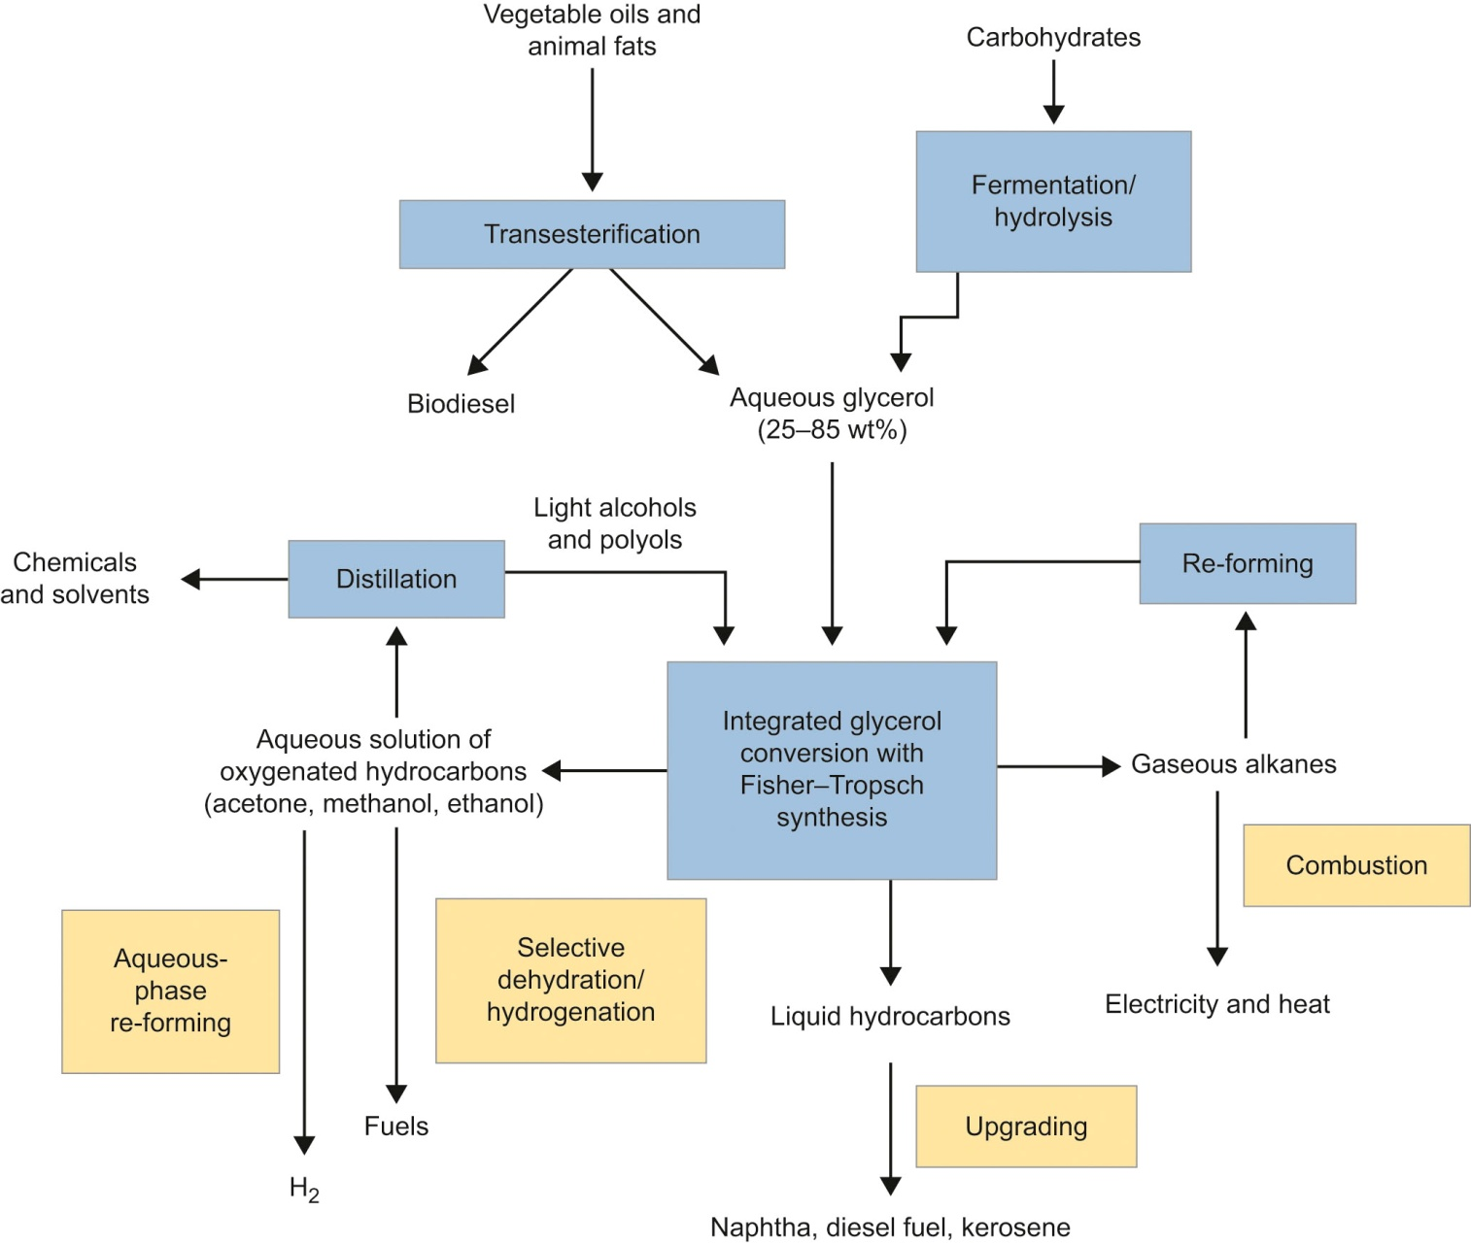
Fig26_06

