Slide 1
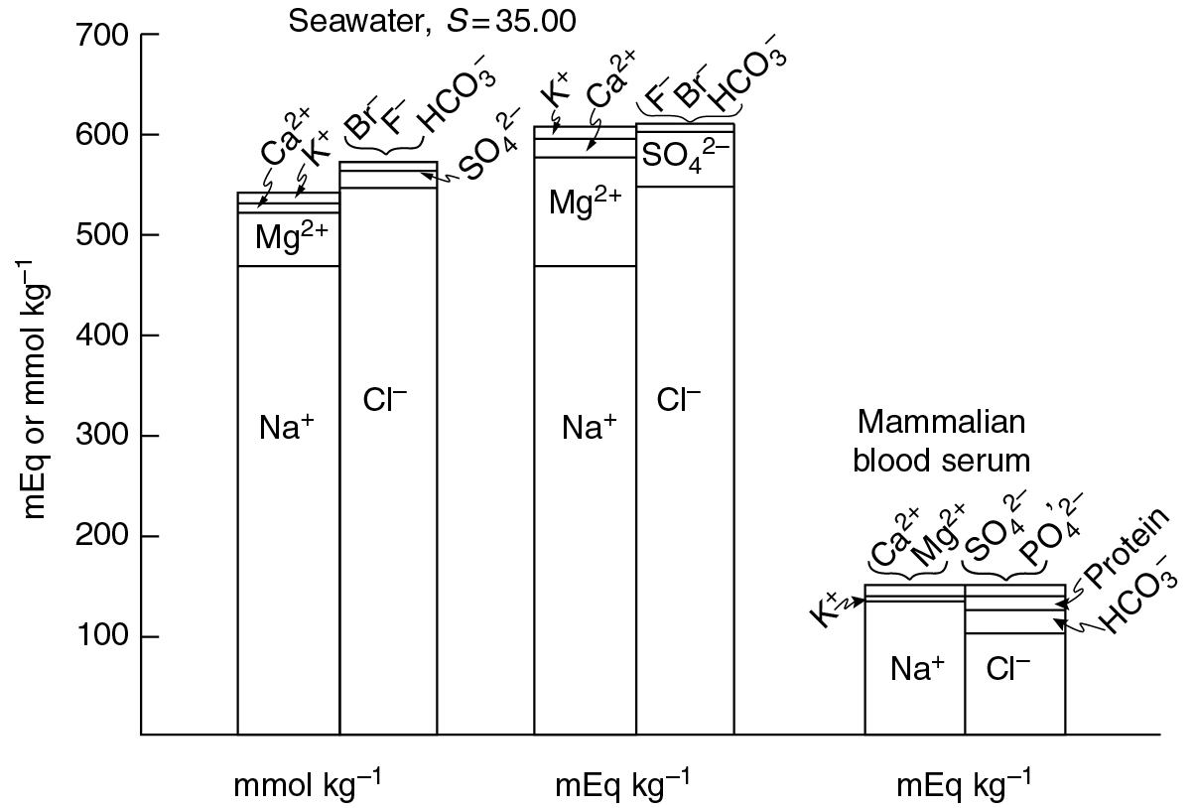
PILSON_Fig 04_01
© Cambridge University Press 2012

Slide 2
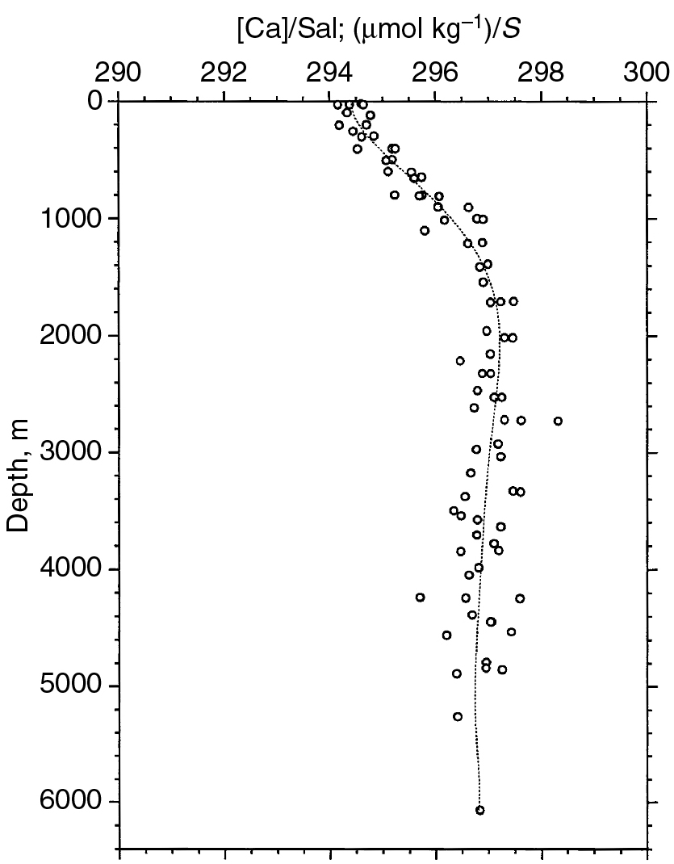
PILSON_Fig 04_02
© Cambridge University Press 2012

