Slide 1
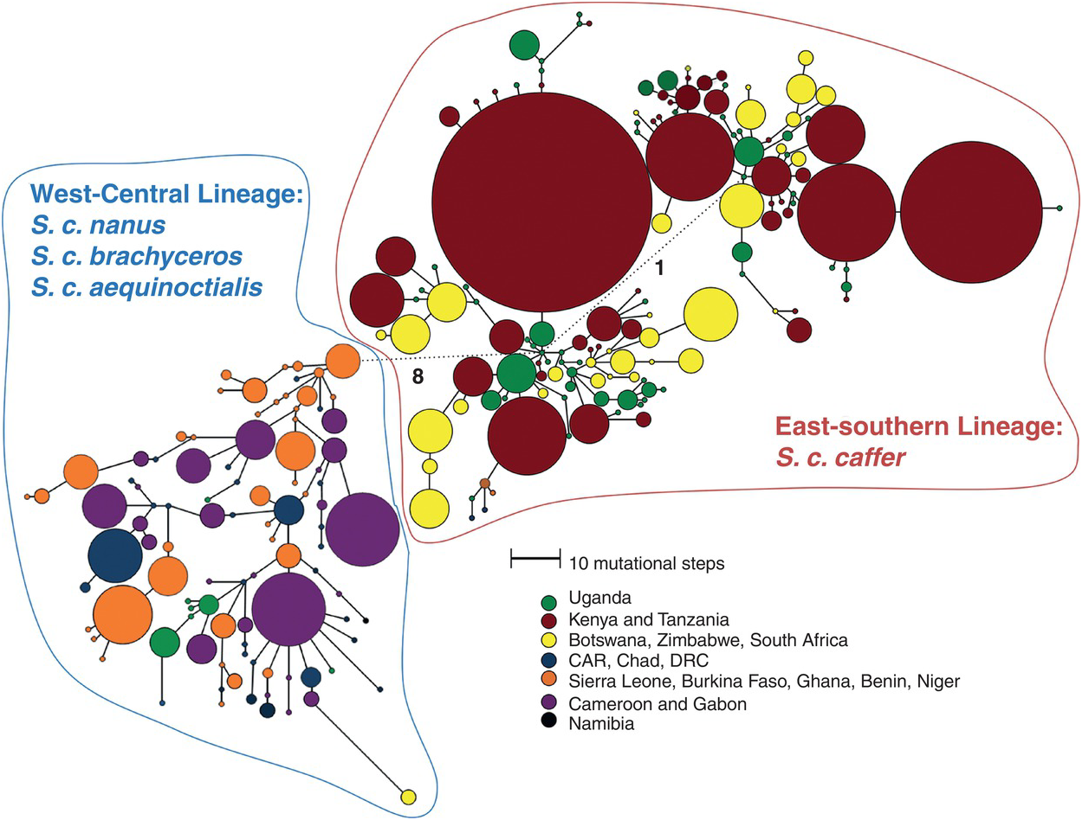
Figure 25.2
Figure extracted from Smitz et al. 2013, based on 787 samples (D-Loop), representing an unrooted minimum spanning tree of Syncerus sp. haplotypes. The circle sizes are proportional to the haplotype frequency and the length of lines is proportional to the number of nucleotide substitutions separating the haplotypes, except for the dotted lines, where the numbers of mutational steps joining the circles are indicated above the connecting branches. CAR: Central African Republic; DRC: Democratic Republic of the Congo.

Slide 2
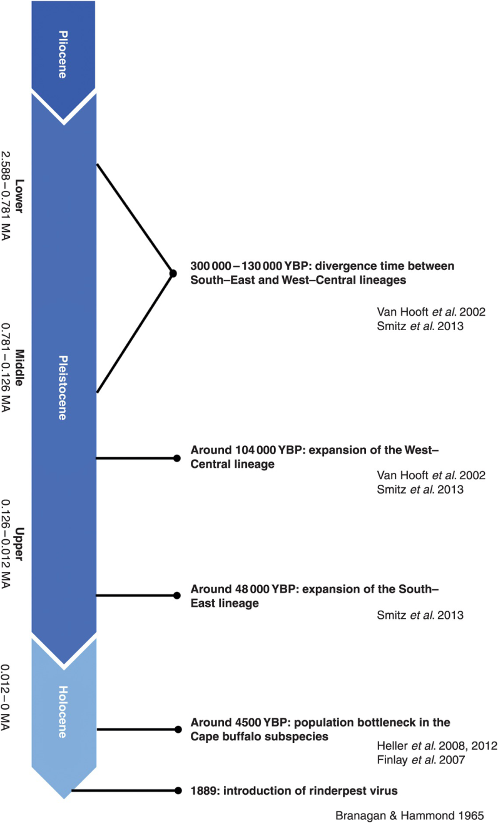
Figure 25.3
Time scale representing all major evolutionary events in the history of the African buffalo.

Slide 3
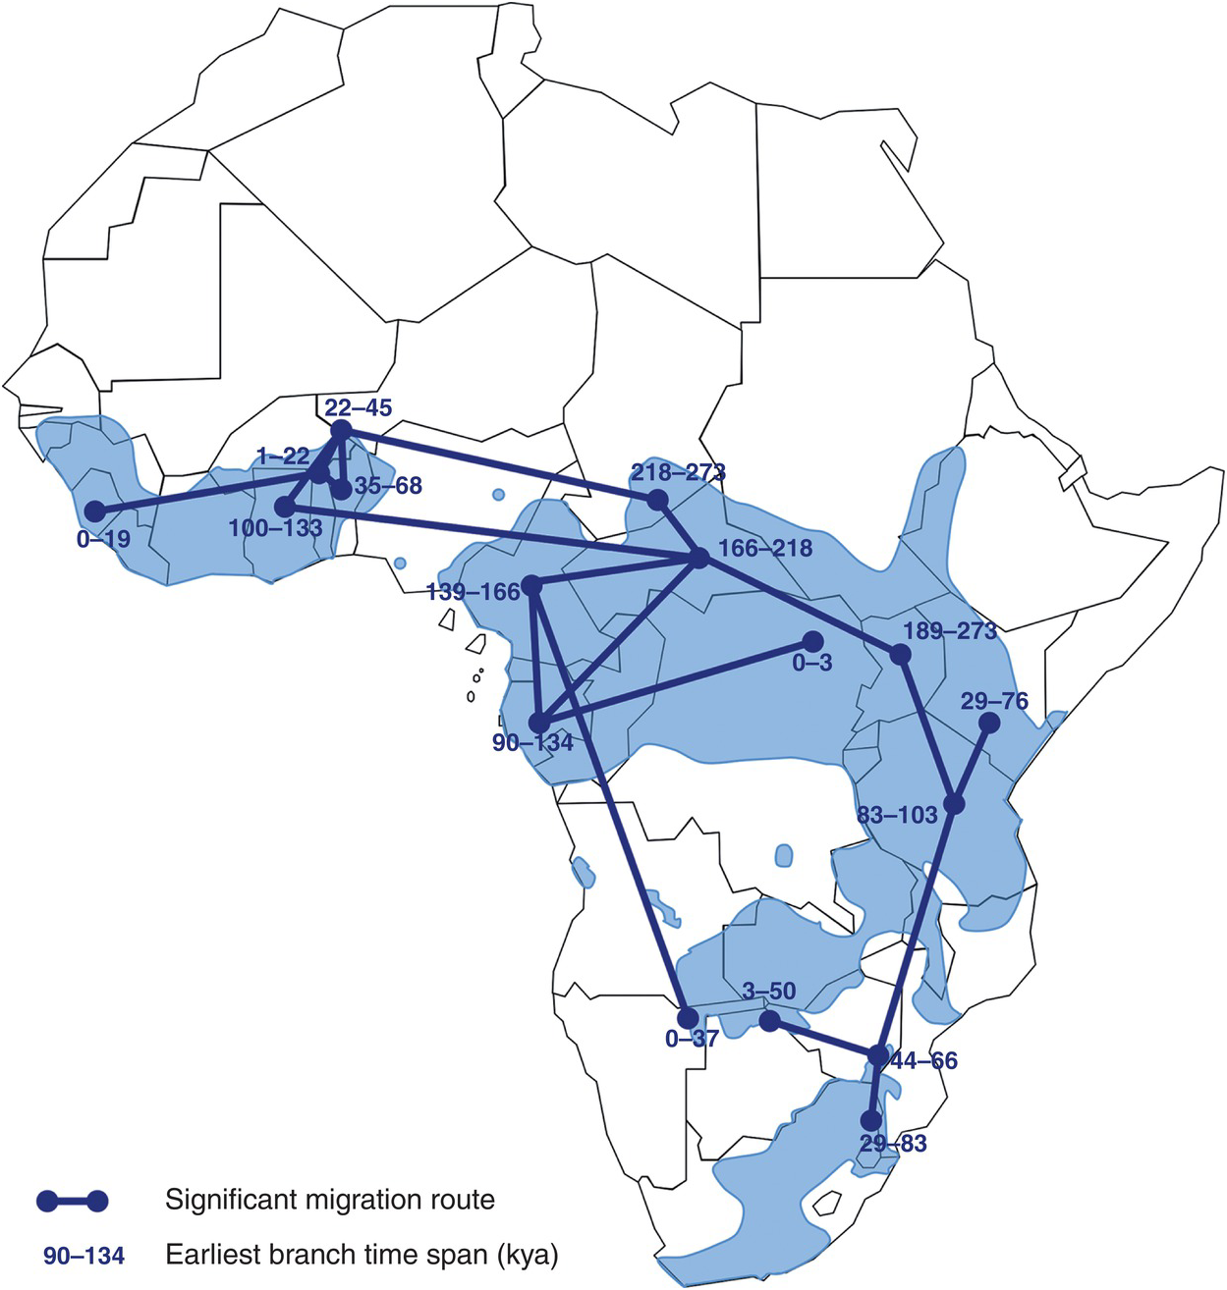
Figure 25.4
Figure extracted from Smitz et al. 2013, based on 787 samples (D-Loop), representing a map of the African continent showing the 17 historical migration rates between sampled localities supported by a Bayes factor > 3. Grey shapes on the map represent the actual distribution of the African buffalo according to the IUCN Antelope Specialist Group, 2008. Numbers on the map indicate the median time endpoints over all BEAST trees of the earliest branch with a given locality state. Hence, it provides an estimate of the earliest migration into each locality.

