Slide 1
Extreme Ultraviolet and
Soft X-ray Atomic Lasers
David Attwood
University of California, Berkeley

Slide 2
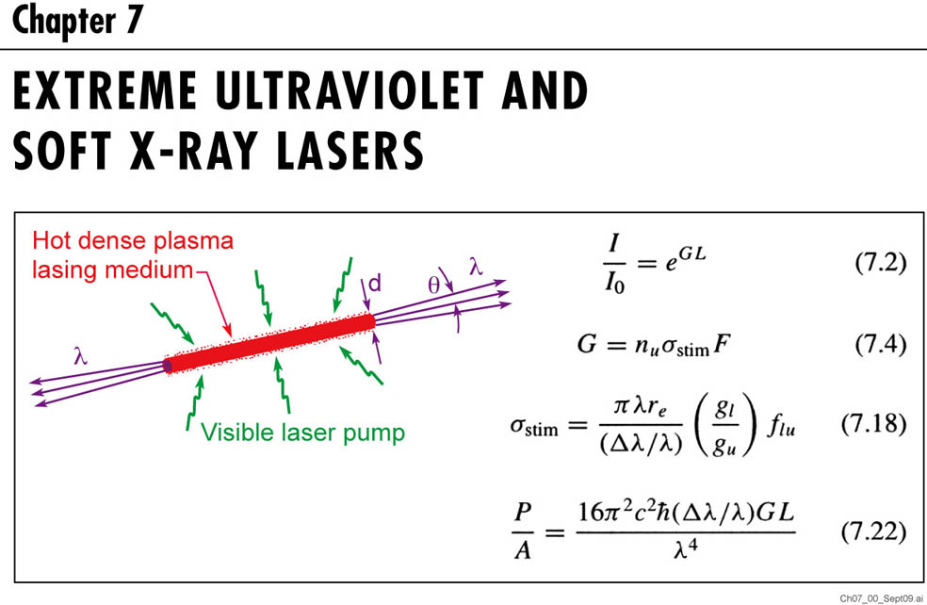
9
(9.2)
(9.4)
(9.18)
(9.22)

Slide 3
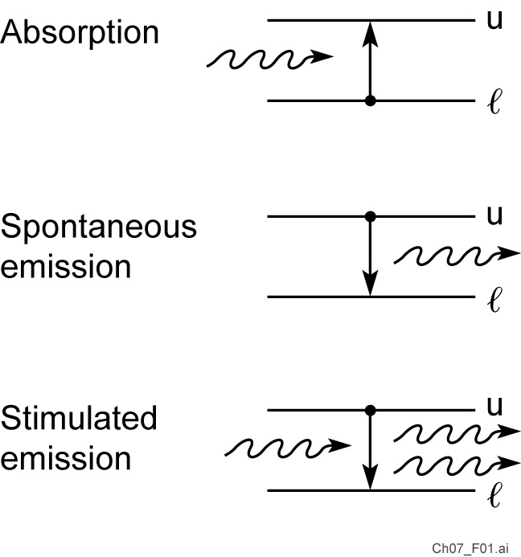
The processes of absorption, spontaneous emission, and stimulated emission

Slide 4
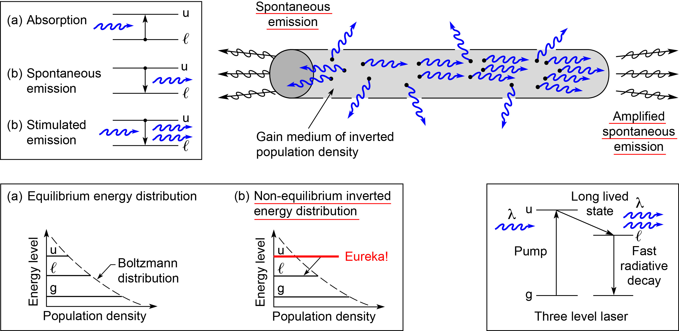
The lasing process begins with amplified spontaneous emission (ASE)

Slide 5
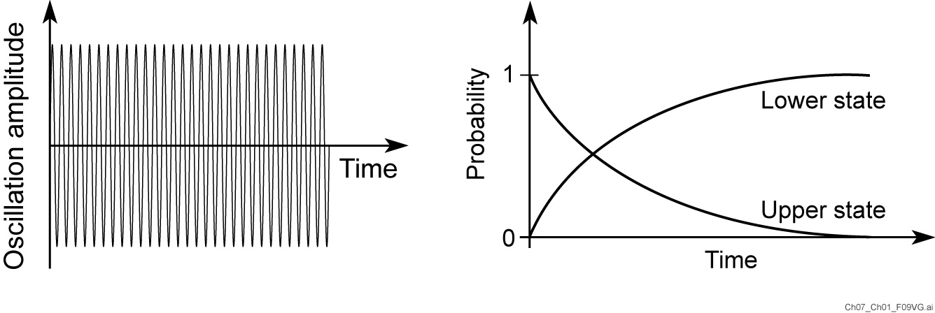
Radiative decay involves an atom oscillating between two stationary states at the frequency ω_{if} = (E_{i} – E_{f})/ħ

Slide 6
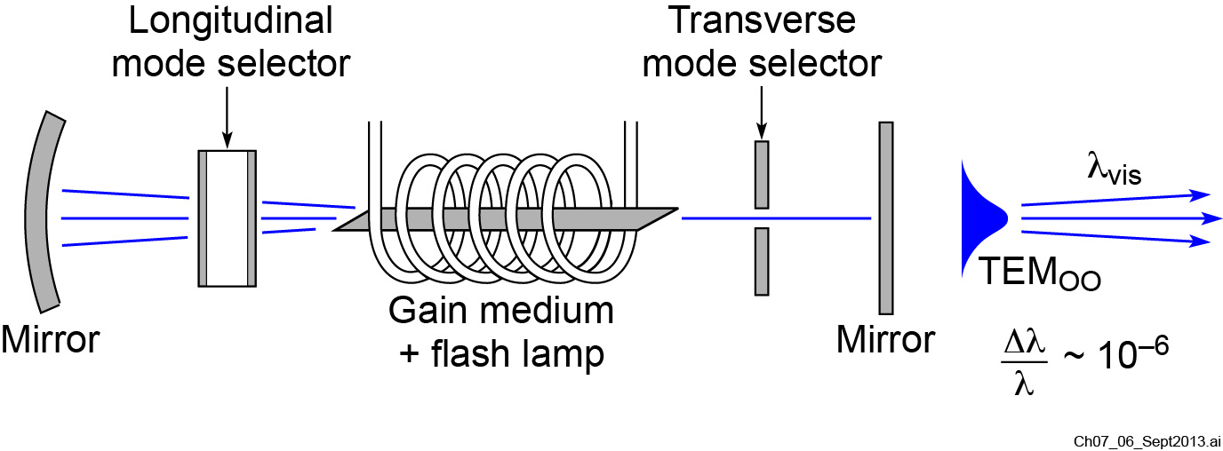
A visible light laser cavity

Slide 7
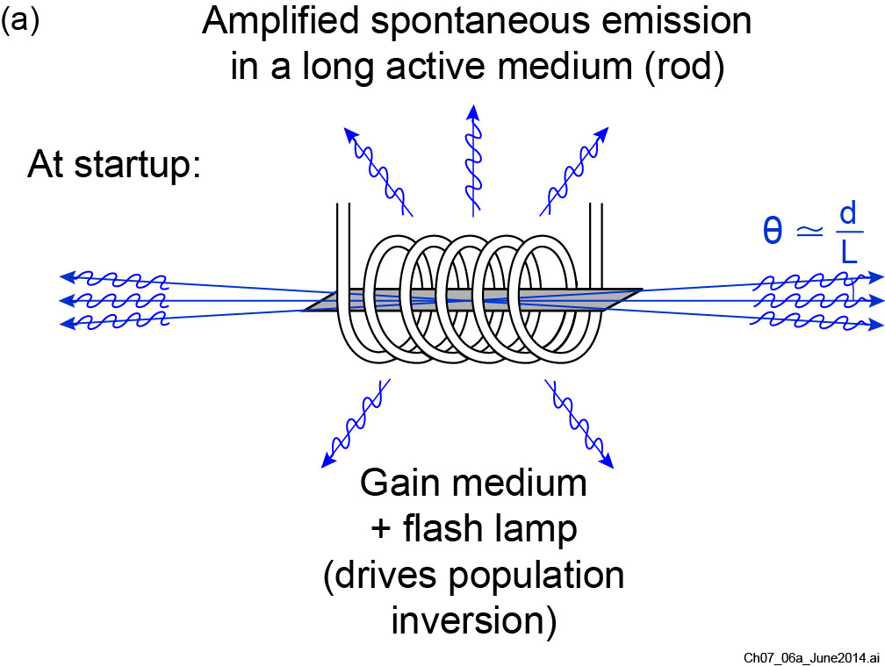
Building a laser cavity

Slide 8
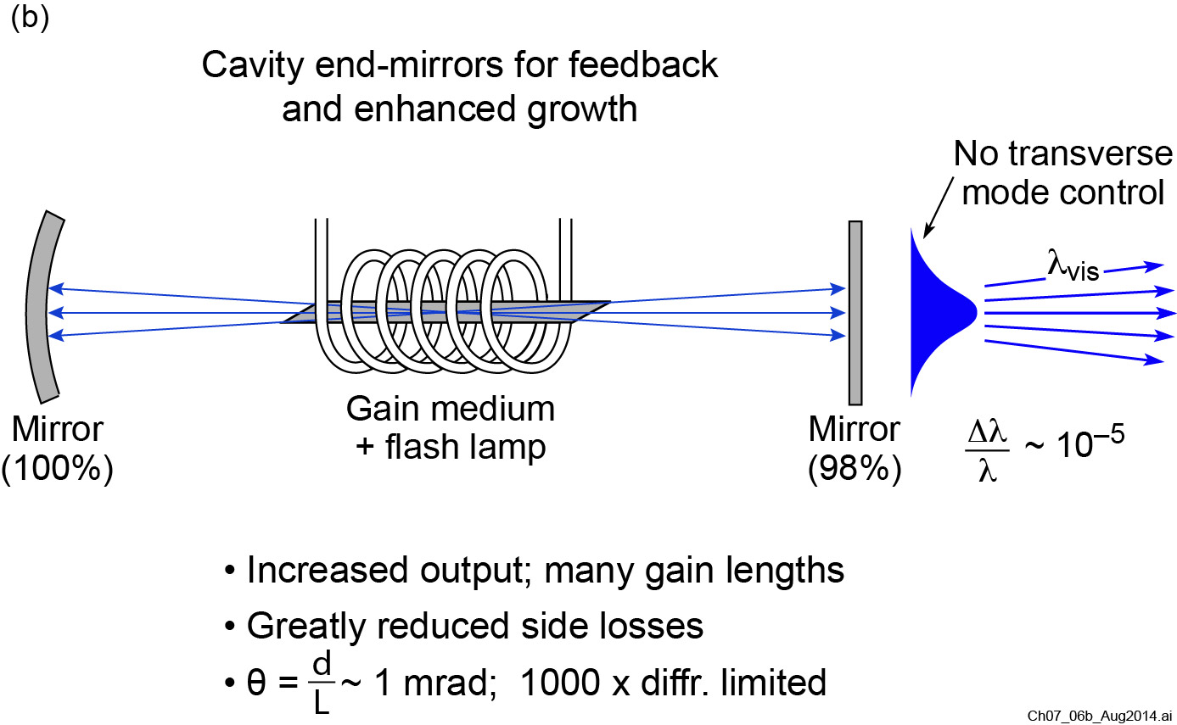
Building a laser cavity
Set by transition
linewidth

Slide 9
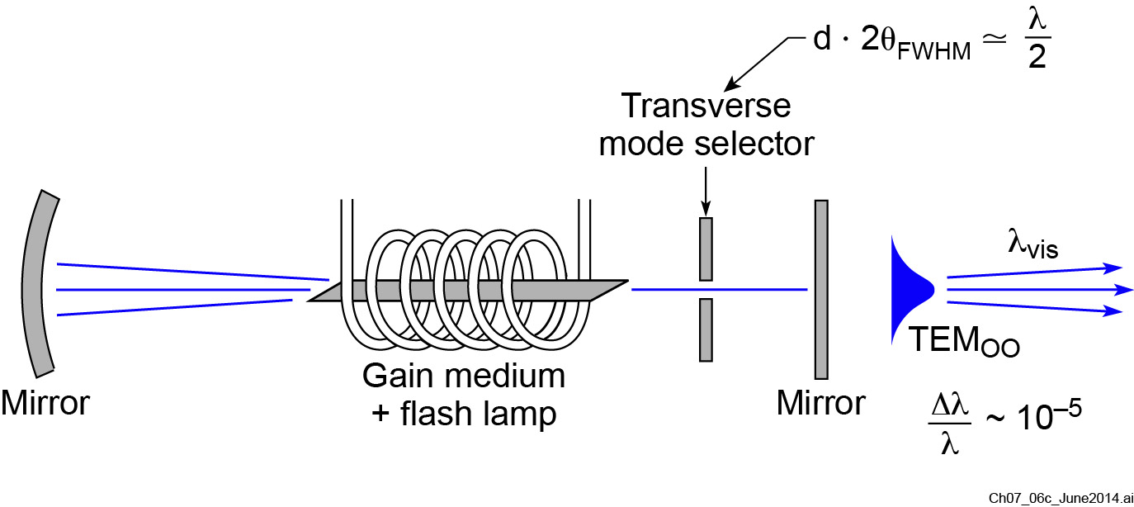
Improving spatial coherence
(c)

Slide 10
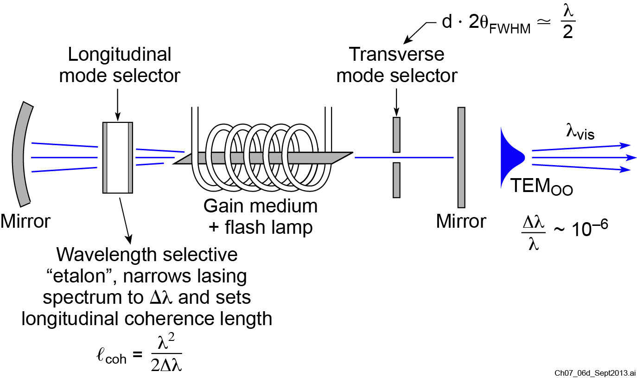
Building a laser cavity for full spatial and temporal coherence
(d)
Set by etalon

Slide 11
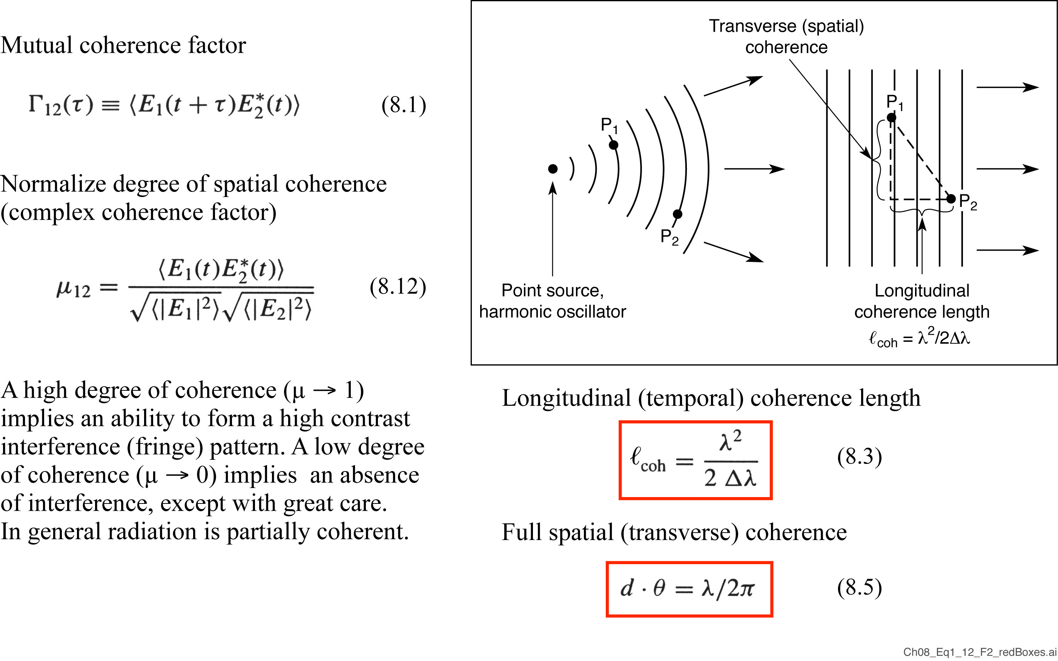
Spatial and temporal coherence

Slide 12
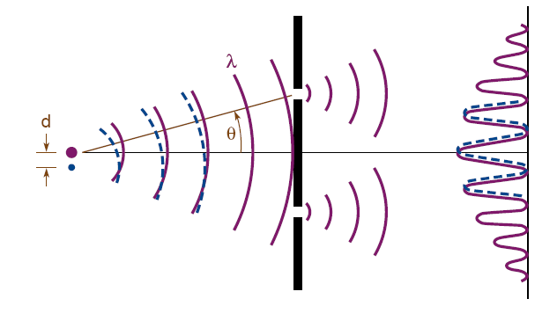
Spatial and temporal coherence
Temporal Coherence
Ability of a light beam to form fringes with a delayed version of itself
Spatial Coherence
Ability of spatially separated points in a wavefront to form fringes.

Slide 13
Further discussion of coherence
Spatial and temporal coherence can be imposed to some degree by a filtering process
But the degree of coherence may not be completely as desired
For example, spherical wavefronts can be achieved, but at great cost in intensity and with jumbled phase in the propagation direction

Slide 14
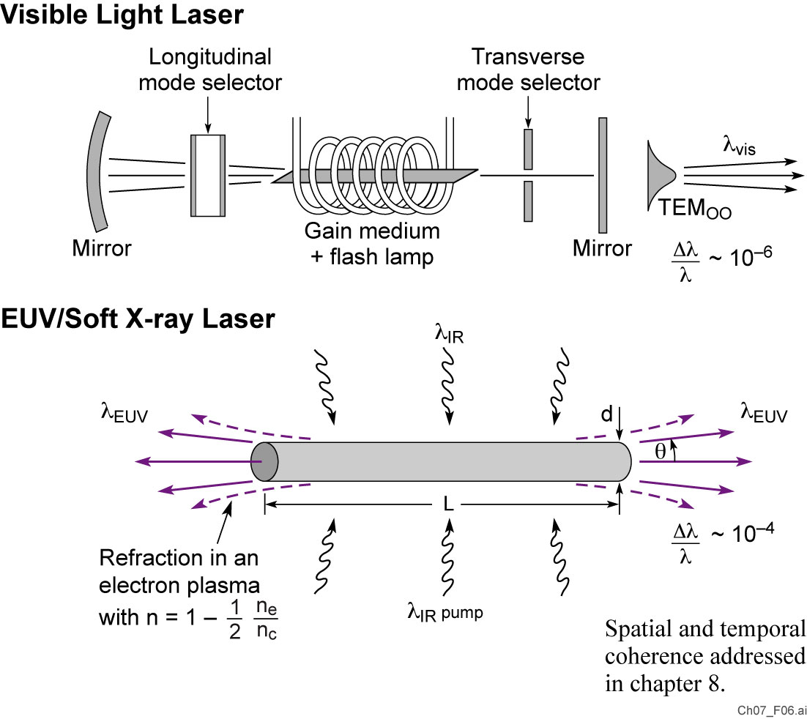
EUV/SXR lasers are high gain with minimal cavity optics
Set by etalon
4

Slide 15
Early successes with lasing in the 4-46 nm wavelength region
Recombination lasing in rapidly cooled H-like carbon (Princeton)
Collisionaly pumped lasing in Ne-like Se (LLNL)
Extension to shorter wavelengths with collisionally pumped Ni-like Ta, W, . . . (LLNL)
Saturation of Ni-like Ag, In, Sn, Sm, . . . With refraction compensated plasmas (Rutherford-Appleton)
Table-top lasing at 46.9 nm with high spatial coherence and mW average power (Colorado State)
Saturation with table-top lasers to wavelengths as short as 13.9 nm (Colorado State)
Compact EUV lasing with seeded fsec transient gain techniques (Colorado State)

Slide 16
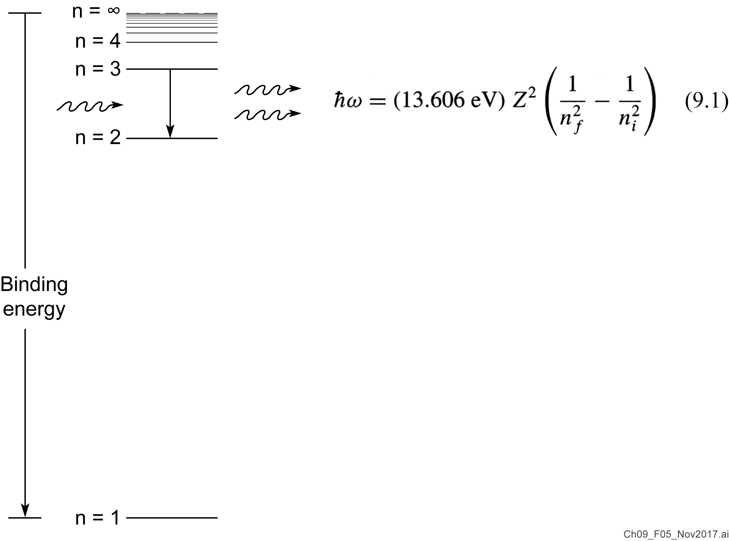
Stimulated n = 3 to n = 2 emission for a hydrogen-like ion

Slide 17
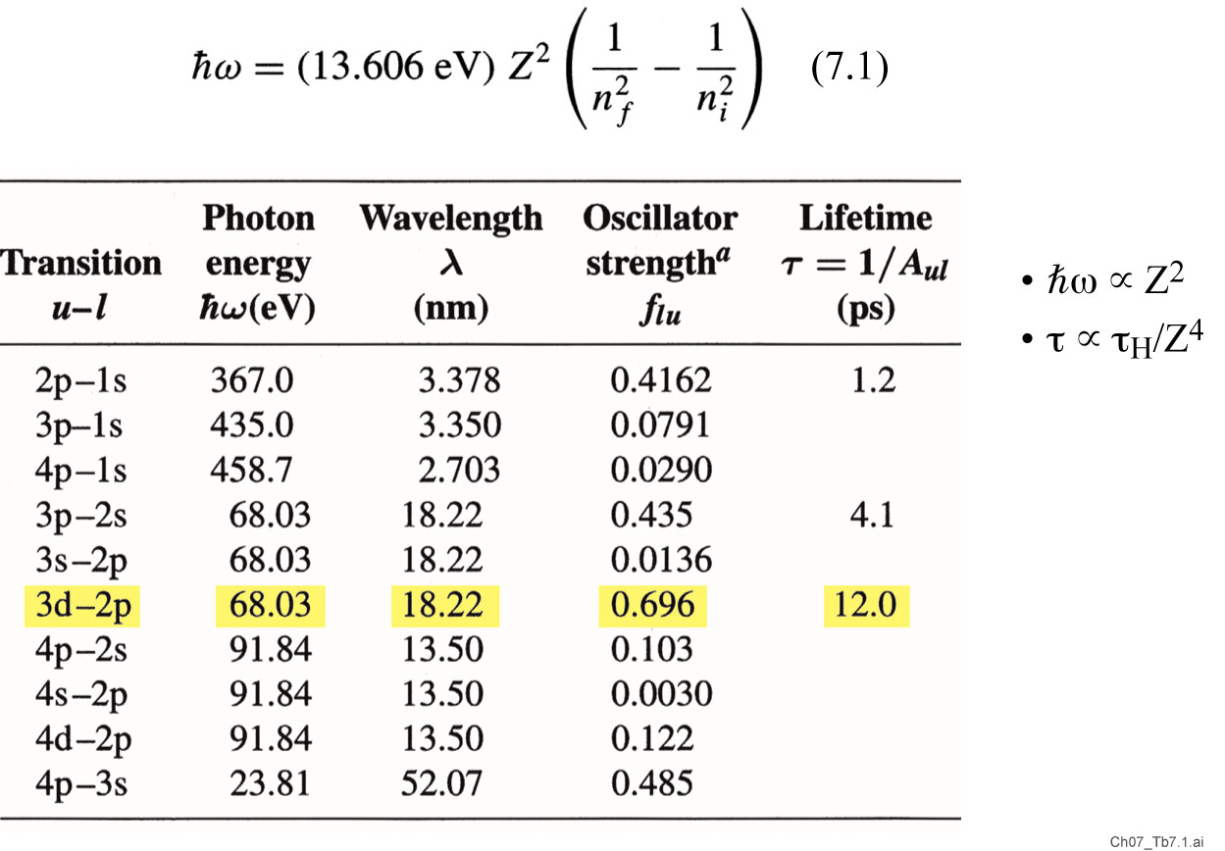
Transitions in single electron, hydrogen-like carbon ions (Z = 6)
(9.1)

Slide 18

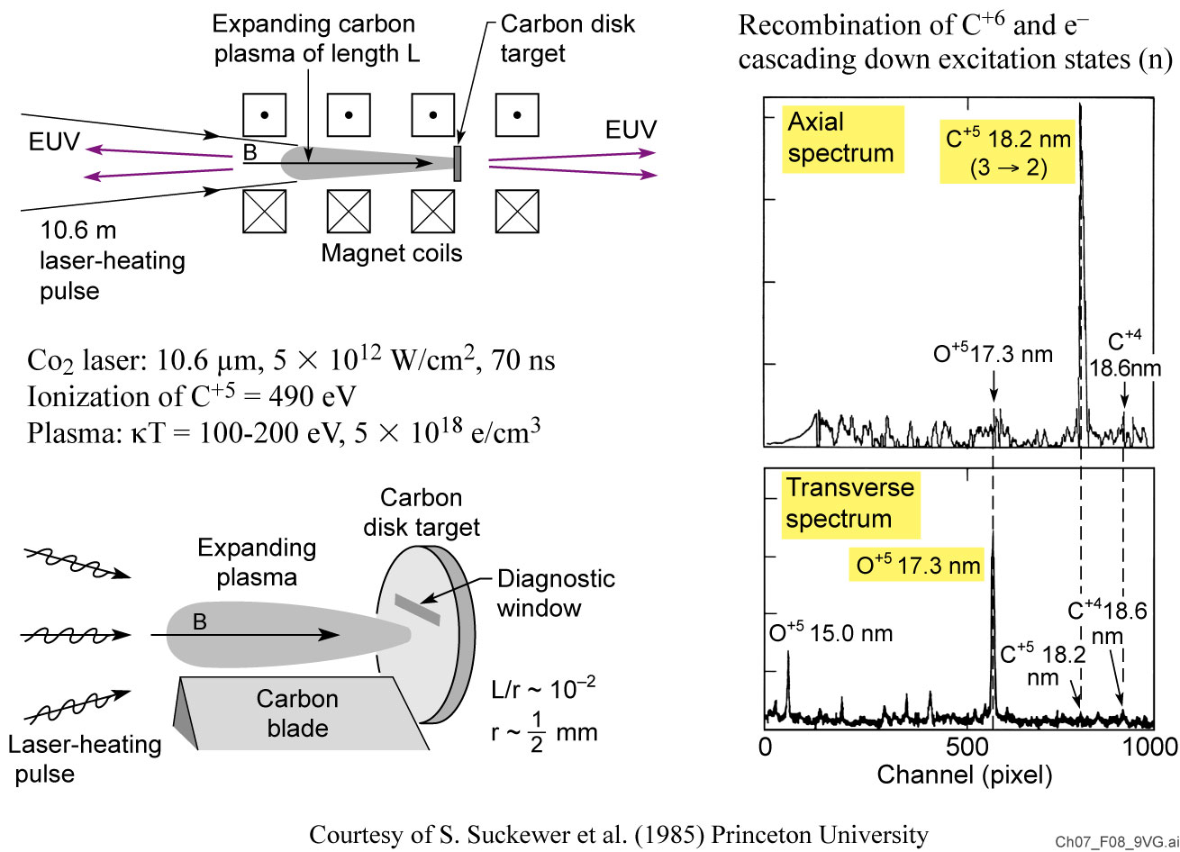
Recombination lasing with H-like carbon ions

Slide 19

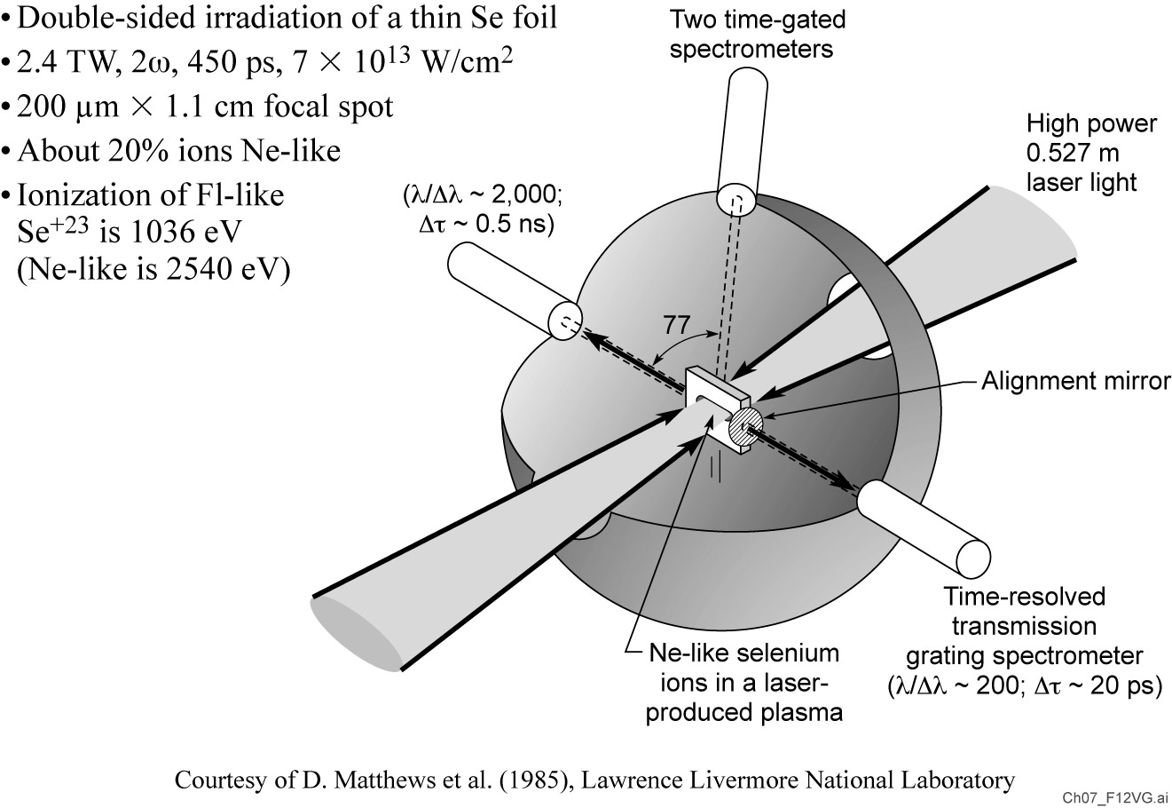
Laser produced plasma for Ne-like lasing in selenium (Z = 34)

Slide 20
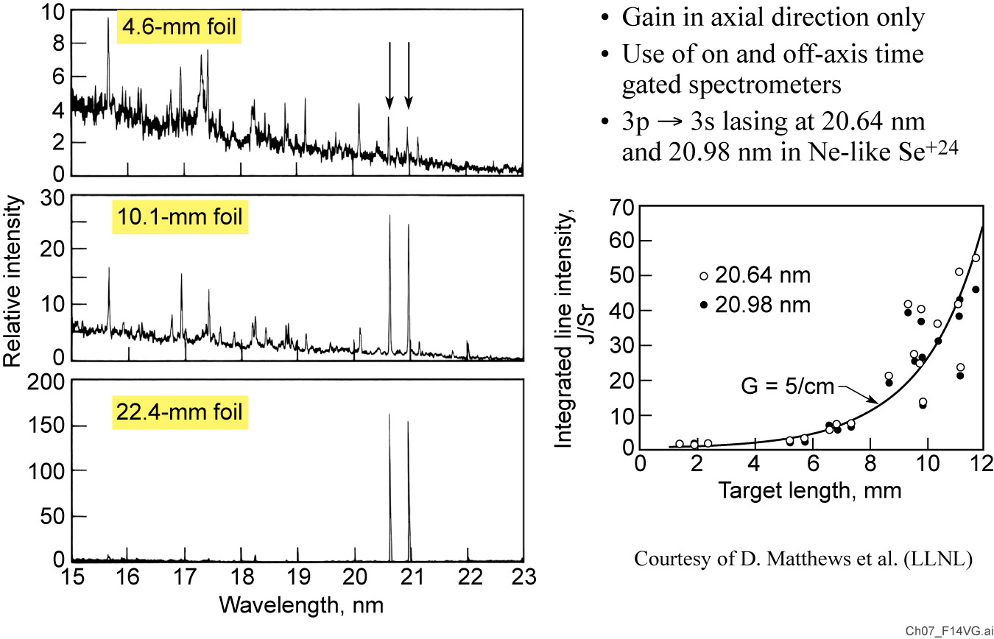
Exponential gain observed in neon-like selenium with increasing plasma length

Slide 21
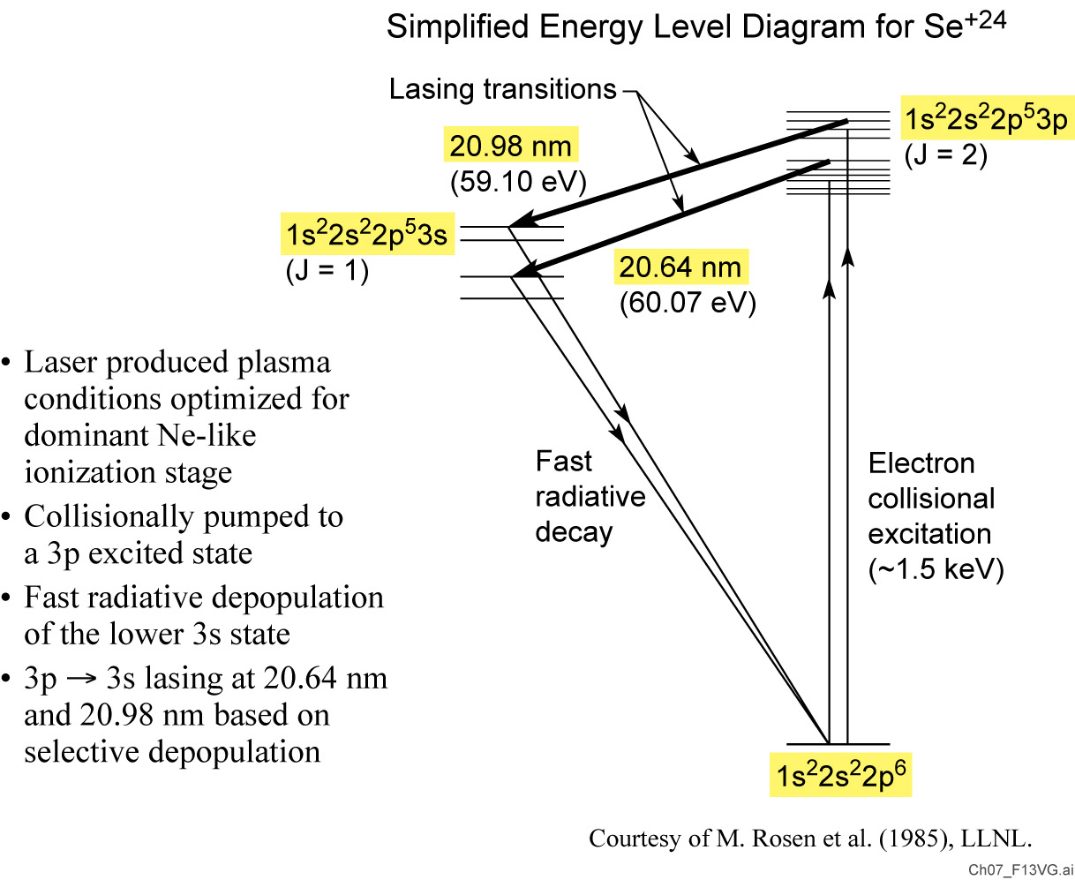
Population inversion in neon-like selenium

Slide 22
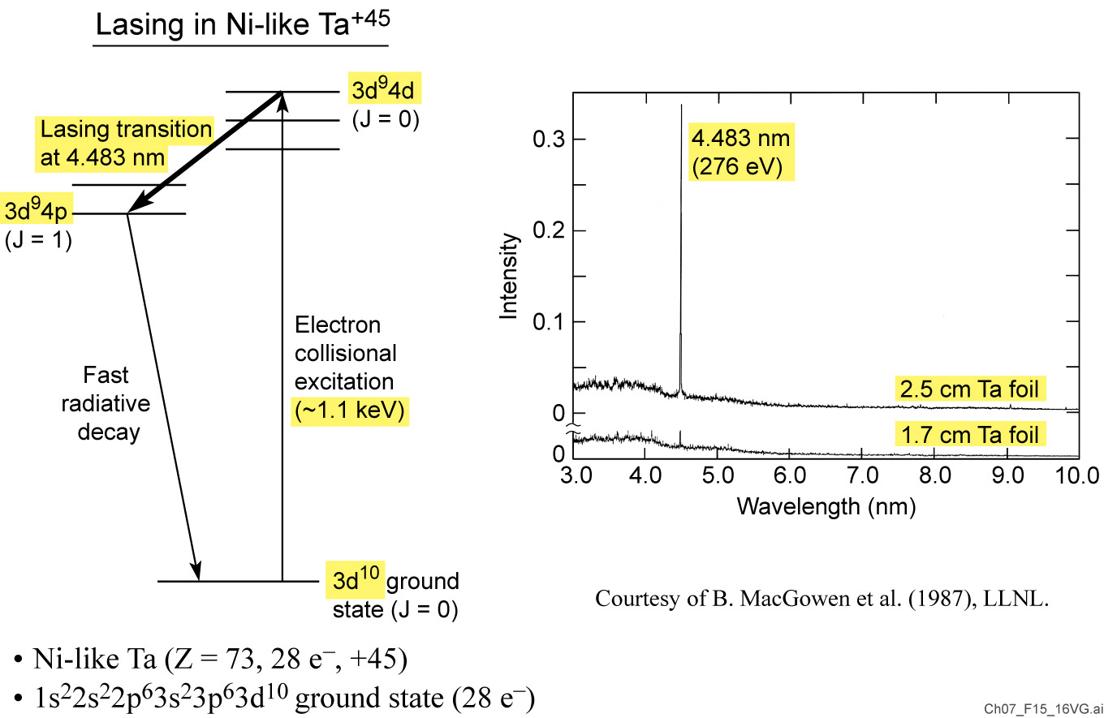
Extension to nickel-like ions: Permits lasing at shorter wavelengths without the need for higher electron temperature

Slide 23
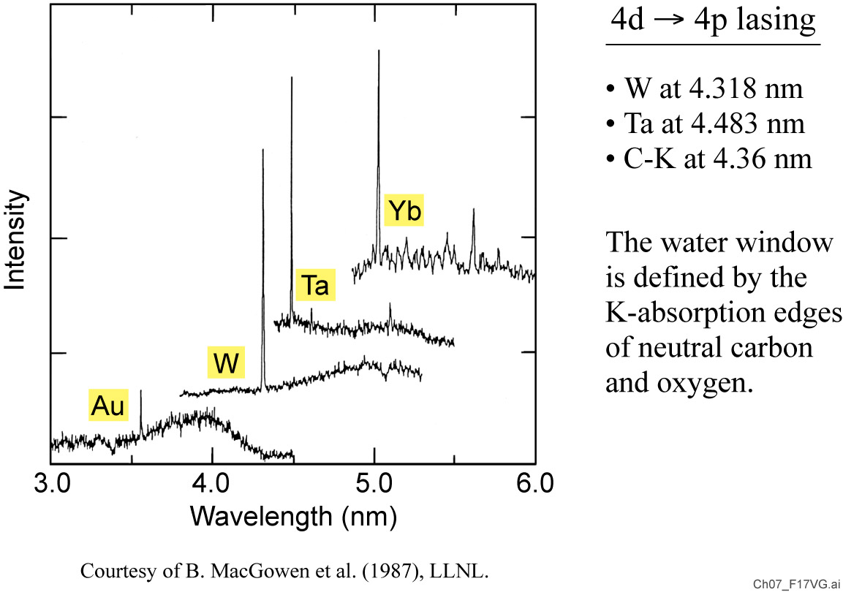
Nickel-like lasing across the K-edge of neutral carbon

Slide 24
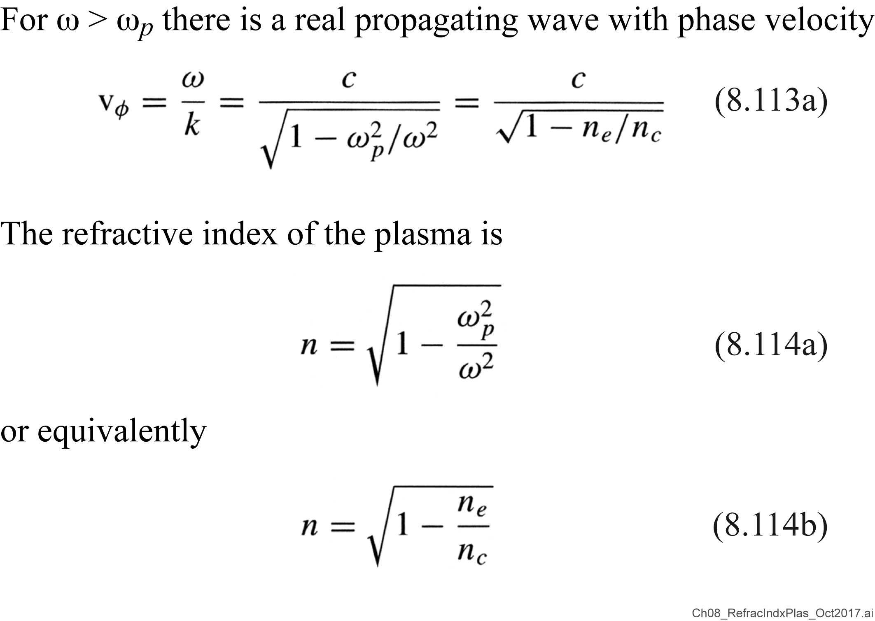
Refractive index of a plasma: Faster wave at higher n_{e}

Slide 25
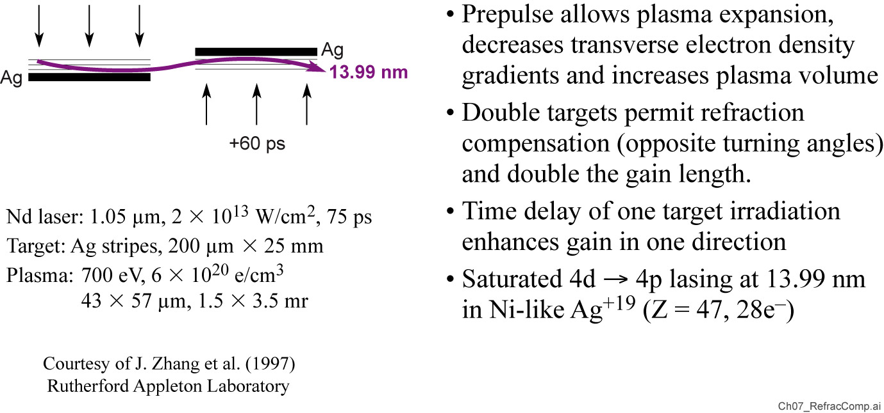
Refraction compensating double-targets used to achieve ‘saturation’ of lasing at 13.99 nm in Ni-like Ag

Slide 26
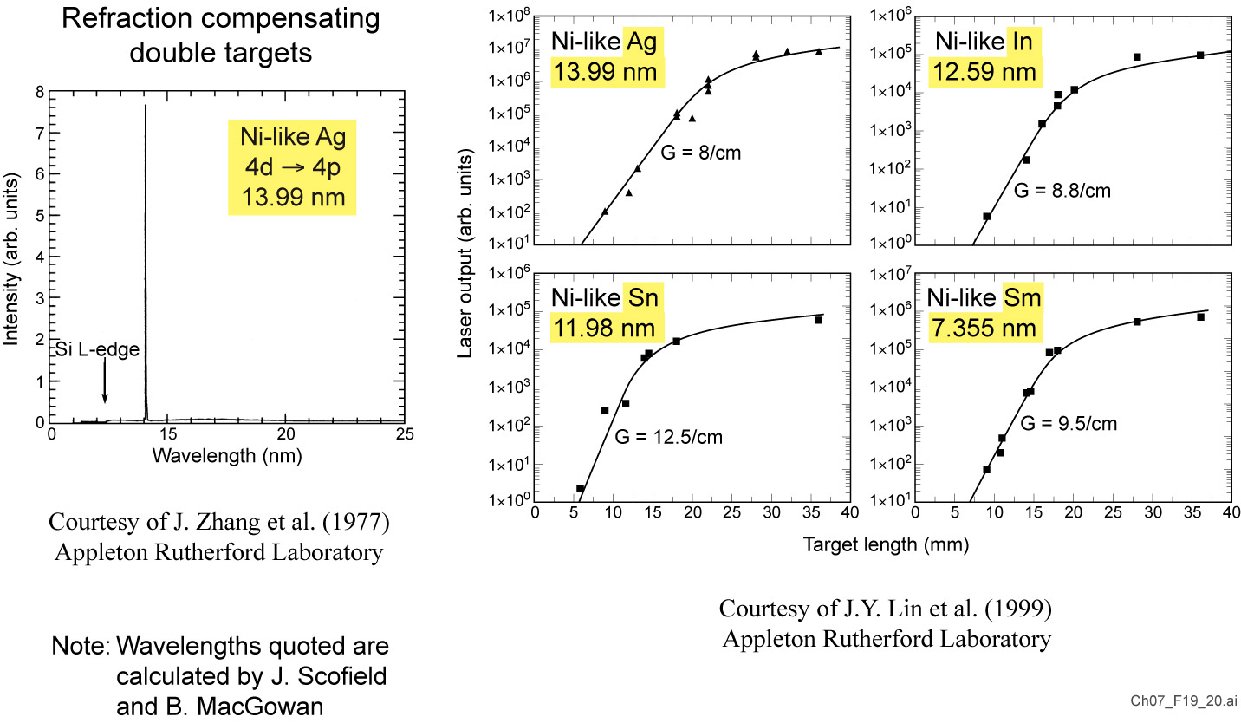
Saturation* of nickel-like lasing in Ag, In, Sn, and Sm
*Saturation in the context of an EUV/SXR plasma
driven atomic laser refers to the transition from exponential gain vs. distance to a linear gain vs. distance

Slide 27
‘Table-top’ plasma driven EUV atomic lasers

Slide 28

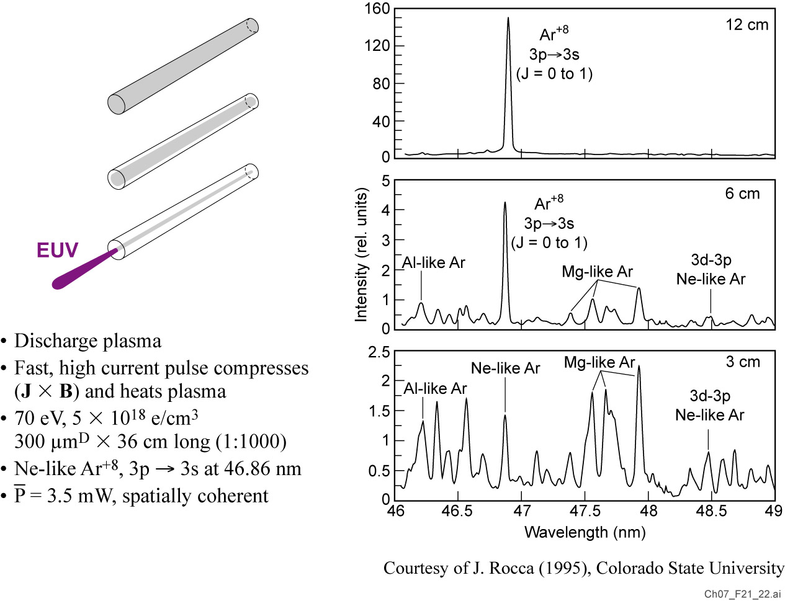
Table-top lasers: High average power, high spatial coherence at 46.86 nm in neon-like Ar
46.86 nm
26.46 eV
, 7 Hz

Slide 29
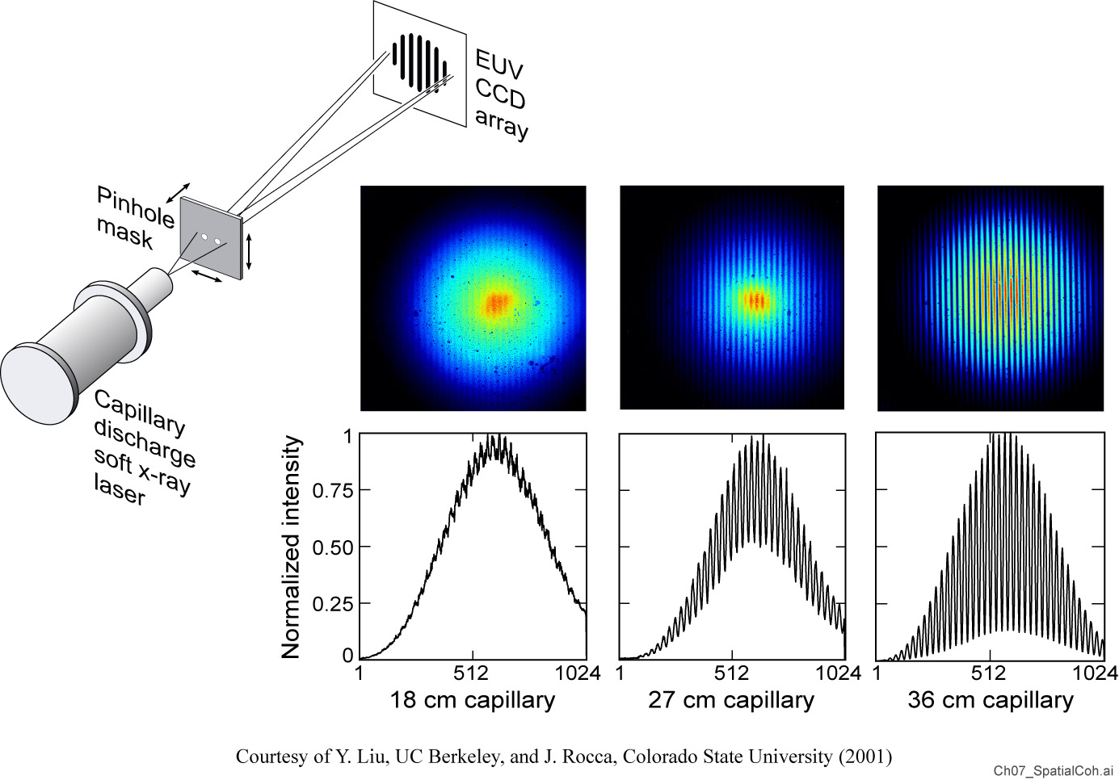
Spatial coherence of 46.86 nm laser
First spatially coherent EUV/SXR laser

Slide 30
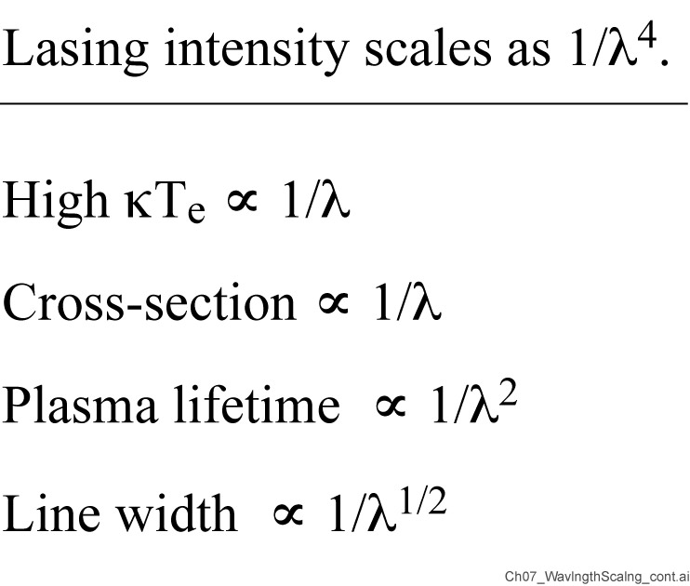
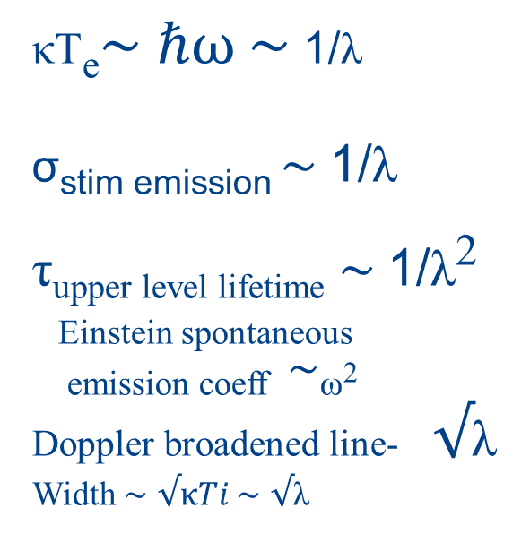
Wavelength scaling of EUV and soft x-ray lasers
κT_{e}$\sim ℏω \sim$ 1/λ
σ_{stim emission} $\sim$1/λ
τ_{upper level lifetime} $\sim$1/λ²
_{Einstein spontaneous}
_{emission coeff} $\sim$_{ω}2
Doppler broadened line- $√$λ
Width $\sim$ $√κTi$ $\sim$ $√$λ
P/A = I ; intensity required to maintain lasing conditions in a plasma scales as 1/λ^{4.5}

Slide 31
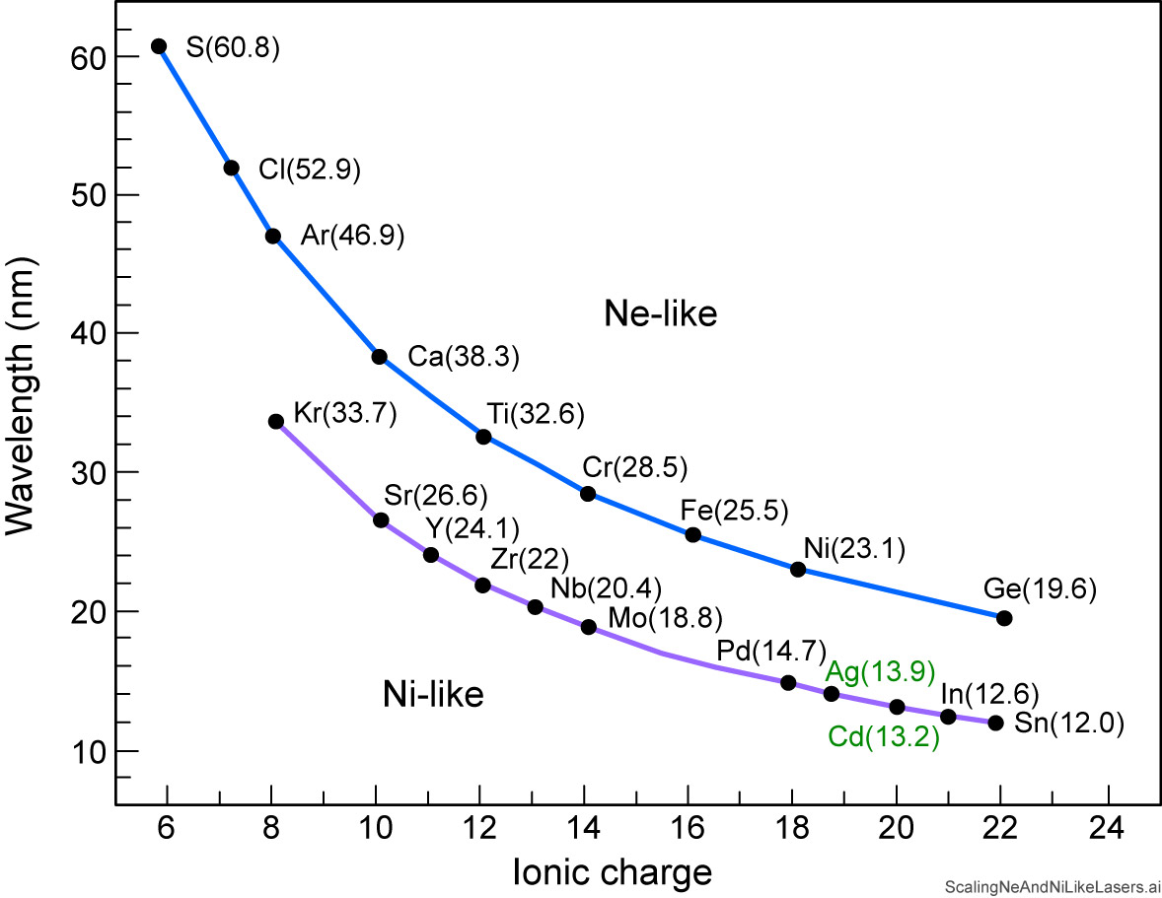
Scaling to EUVL relevant 13 nm requires excitation of Ni-like Cd ions (Cd ⁺ ²⁰)
Ar(46.9)
Courtesy of J. Rocca
Colo. State Univ.

Slide 32
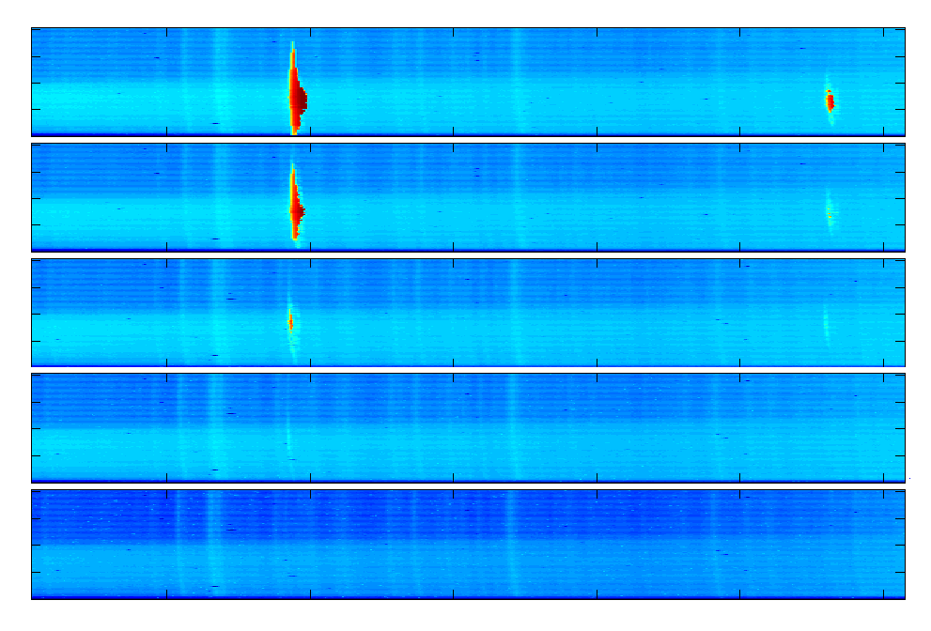
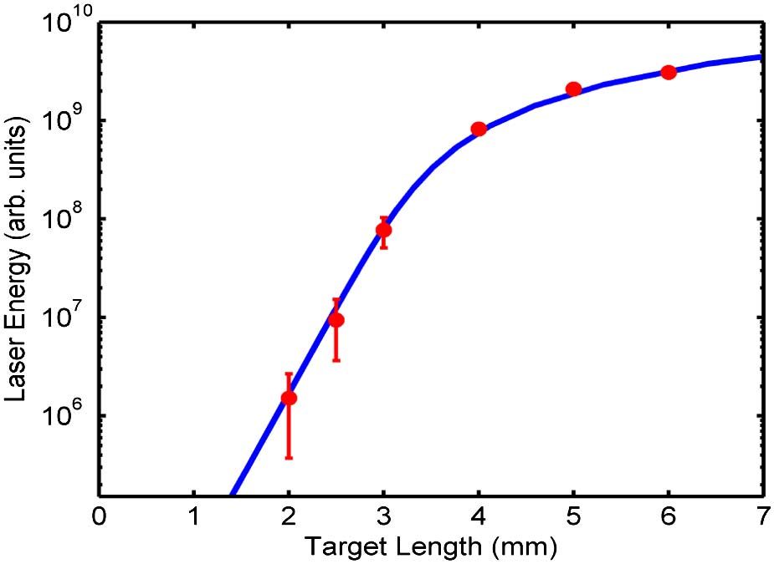
Saturated* 18.9 nm Ni-like Molybdenum Laser
4 mm
3 mm
18.9 nm, Ni-like Mo, 1.5 μJ, 5 psec, 100 Hz, 43/cm, gL = 17
2.5 mm
2 mm
Courtesy of J. Rocca
Colorado State University
1.5 mm
*Saturation in the context of an EUV/SXR plasma driven atomic laser refers to the transition from exponential gain vs. distance to a linear gain vs. distance
18
19
20
21
22
23
wavelength (nm)

Slide 33
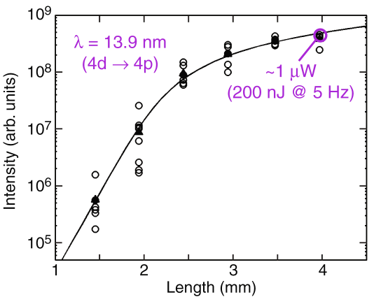
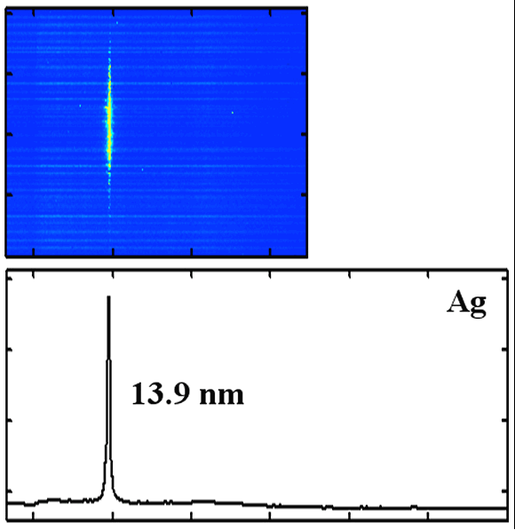
Saturated laser operation at 13.9 nm
in Nickel-like Ag
1 J short (8 ps) pulse excitation;
g₀=67 cm⁻¹ ; gL= 16.8
850 nJ/shot
Courtesy of J. Rocca
Colorado State University

Slide 34
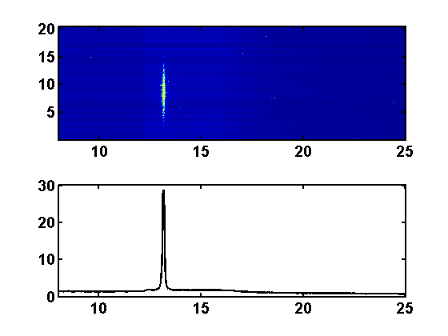
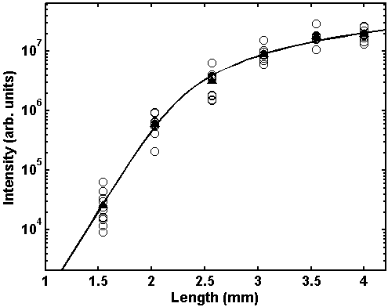
Gain-saturated Ni-like 13.2 nm Ni-like Cd laser
1 J short pulse ; 23 degrees grazing incidence angle
CCD channel (x10⁻²)
Intensity (arb. Units)
Intensity (a. u.)
g₀=69 cm⁻¹
g×L=17.6
wavelength (nm)
Length (mm)
Courtesy of J. Rocca
Colorado State Univiversity
Notes:
On the shorter wavelength side of 13.5 nm is nickel like cadmium. Again we show saturation of the output for this laser. In this case the optimum delay between pump pulses is 100ps and the grazing incidence angle is 23 degrees.

Slide 35
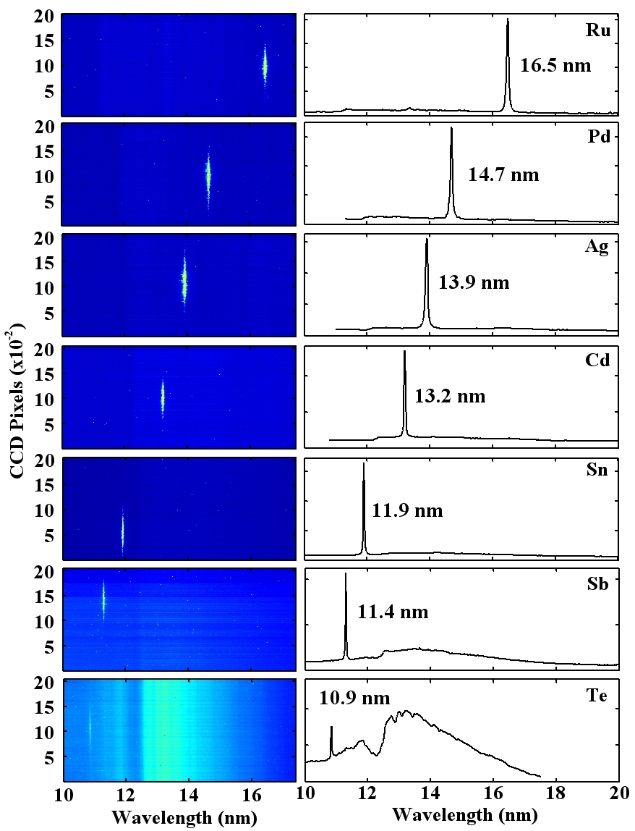
Lasing observed at wavelengths
as short as 10.9 nm
Gain saturated operation demonstrated
Courtesy of J. Rocca
Colo. State Univ.

Slide 36
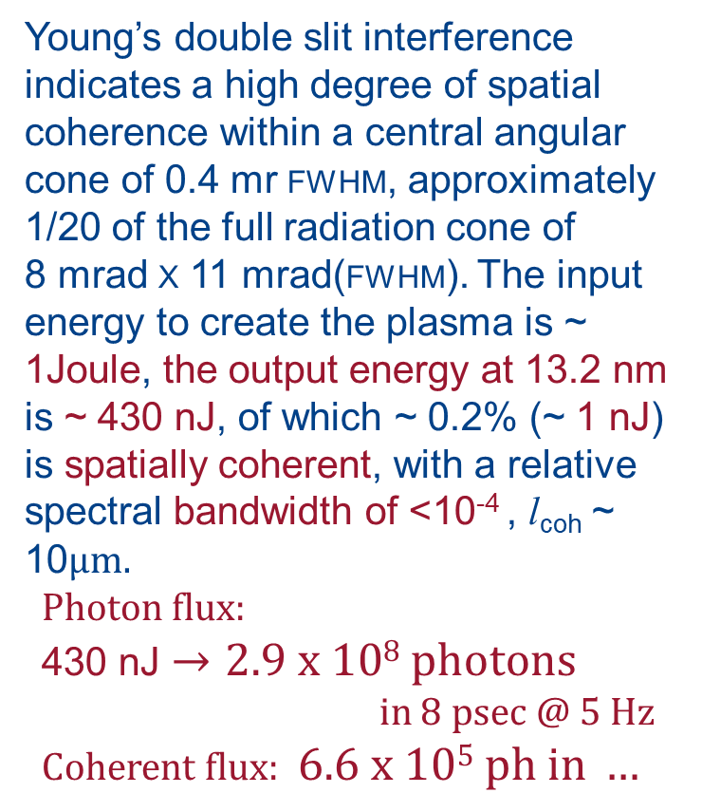
Spatial coherence of an EUV laser at 13.2 nm
Young’s double slit interference indicates a high degree of spatial coherence within a central angular cone of 0.4 mr FWHM, approximately 1/20 of the full radiation cone of
8 mrad X 11 mrad(FWHM). The input energy to create the plasma is ~ 1Joule, the output energy at 13.2 nm
is ~ 430 nJ, of which ~ 0.2% (~ 1 nJ)
is spatially coherent, with a relative spectral bandwidth of <10⁻⁴ , l_{coh} ~ 10μm.
Photon flux:
430 nJ $→2.9 x 108 photons$
in 8 psec @ 5 Hz
Coherent flux: $6.6 x 105 ph in …$
Courtesy of Y. Liu (UC Berkeley, now SLAC) and J. Rocca (CSU)
Optics Express 14, 12872 (25 December 2006)

Slide 37
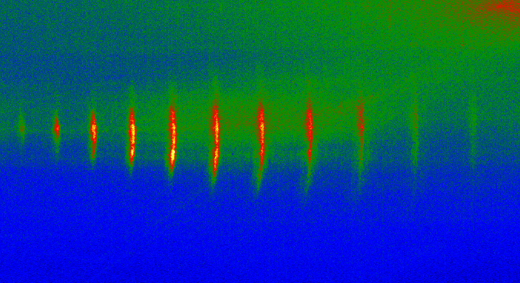
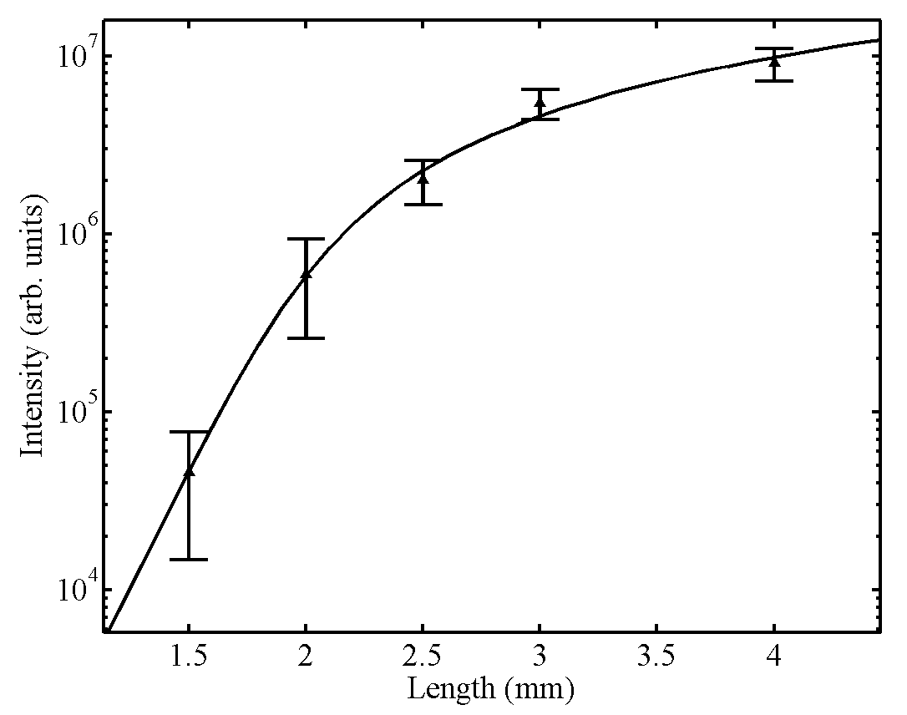
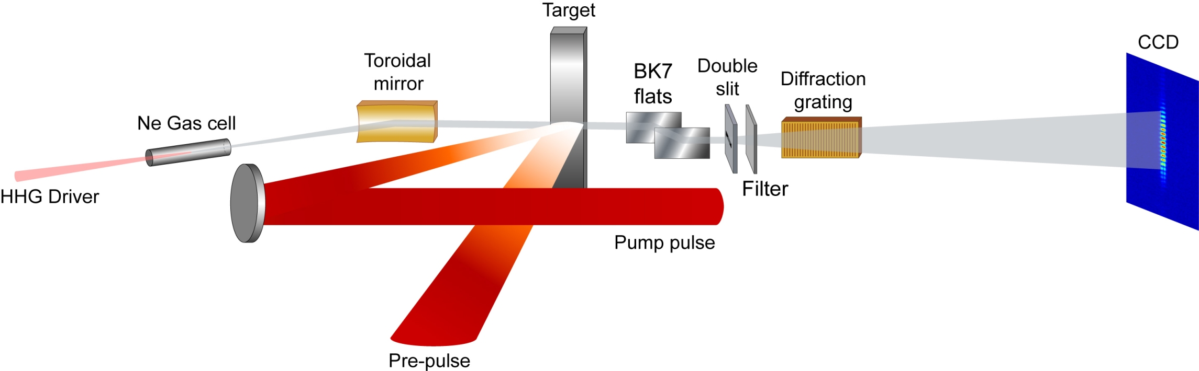
Injection-seeded λ = 10-20 nm lasers
Ni-like Mo, 18.9 nm
4 mm
3 mm
go = 65 cm-1
gL=15.3
57th
2.5 mm
65th
63rd
61st
59th
55th
53rd
51st
49th
2 mm
1.5 mm
18
19
20
21
22
23
wavelength (nm)
20 Torr
Y. Wang et al., “Phase Coherent, Injection Seeded,
Table-top Soft X-ray Lasers at 18.9 nm and 13.9 nm”,
Nature Photonics 2, 94 (2008).

Slide 38
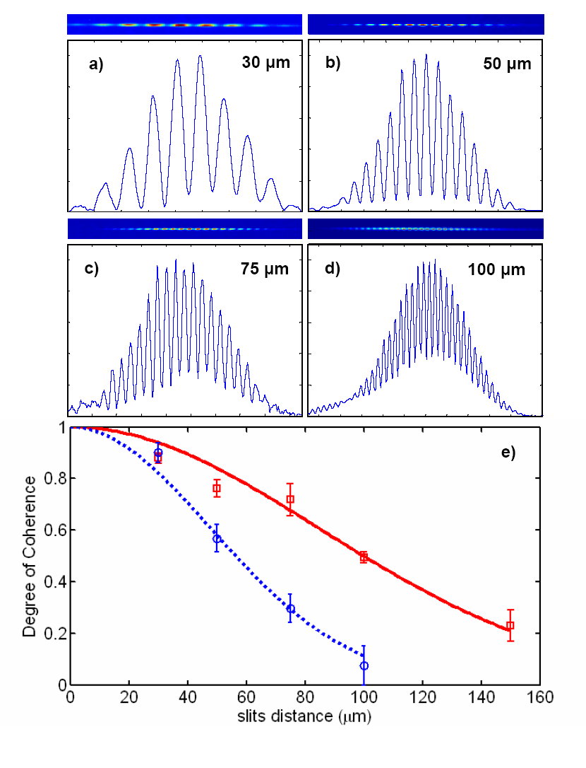
Full spatial coherence:
HHG seeded Ni-like Mo at 18.9 nm
Seeded beam diam. 80-90 µm
Beam size
seeded
Unseeded beam diam.~ 1mm
unseeded
Courtesy of Jorge Rocca, Colorado State University

Slide 39
Details of EUV/soft x-ray laser wavelength scaling

Slide 40
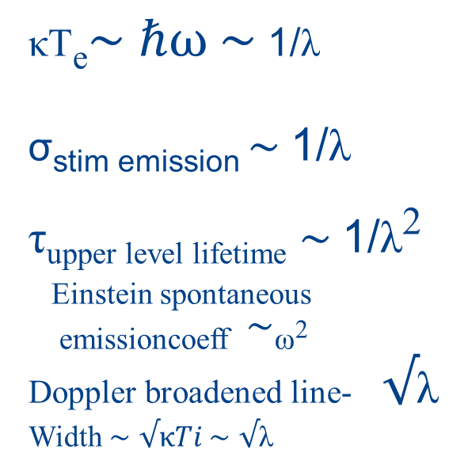
Wavelength scaling of EUV and soft x-ray lasers
κT_{e}$\sim ℏω \sim$ 1/λ
σ_{stim emission} $\sim$1/λ
τ_{upper level lifetime} $\sim$1/λ²
_{Einstein spontaneous}
_{emissioncoeff} $\sim$_{ω}2
Doppler broadened line- $√$λ
Width $\sim$ $√κTi$ $\sim$ $√$λ
P/A = I ; intensity required to maintain lasing conditions in a plasma scales as 1/λ^{4.5}

Slide 41
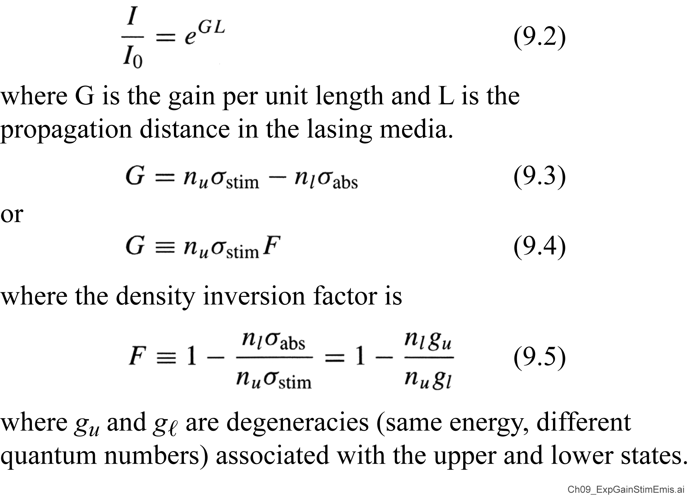
Exponential gain from stimulated emission

Slide 42
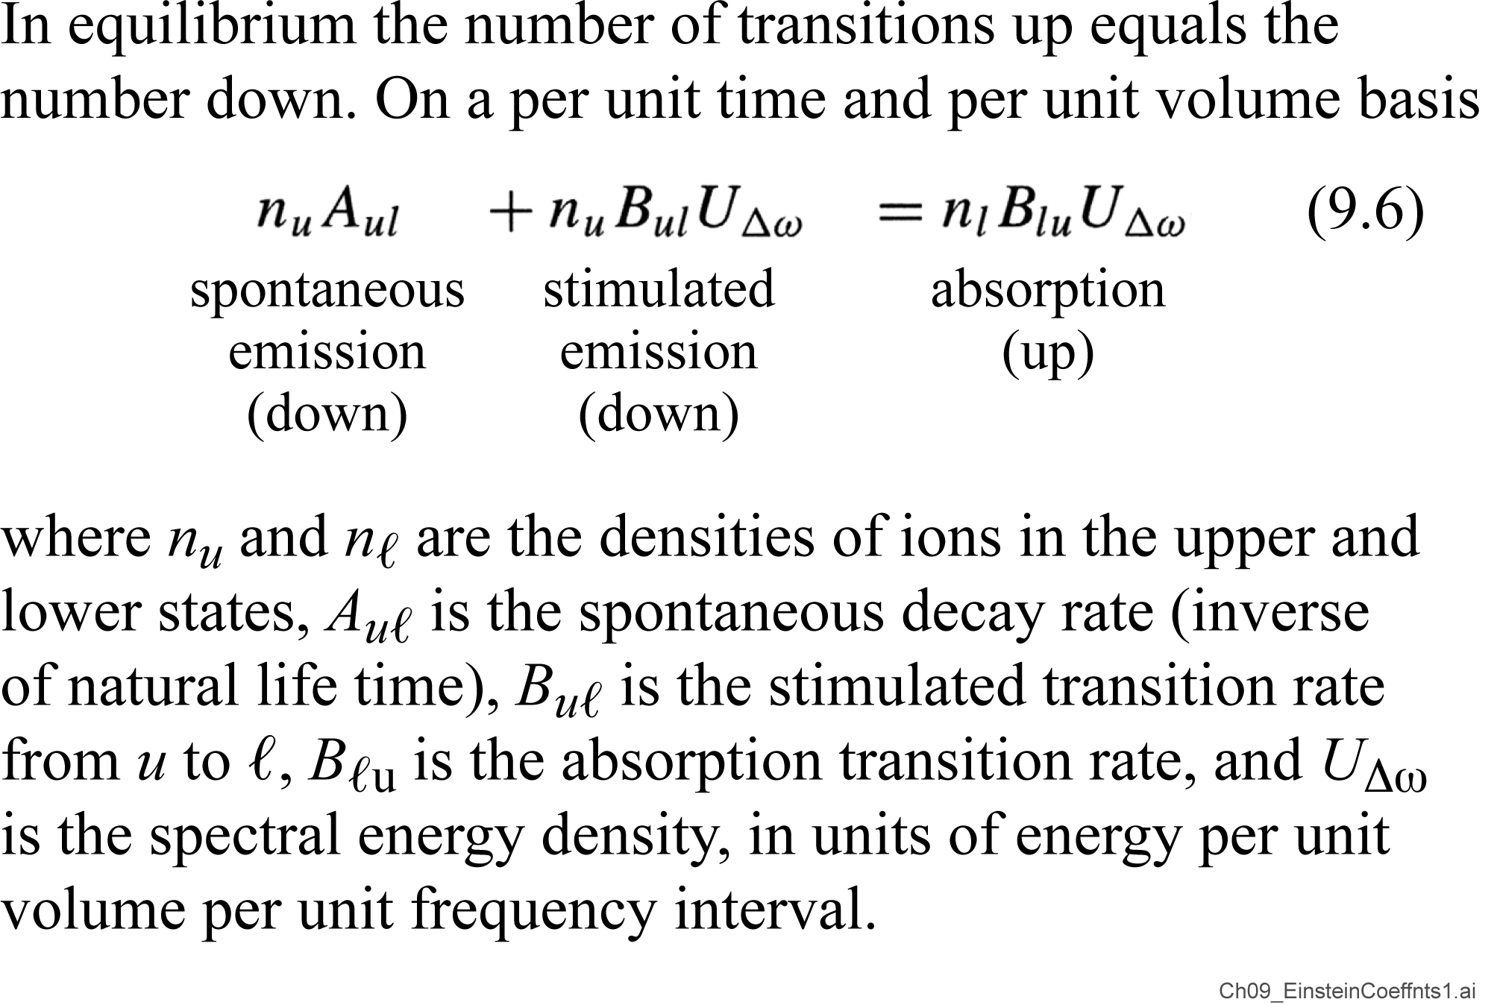
Transition rates: Einstein A and B coefficients

Slide 43
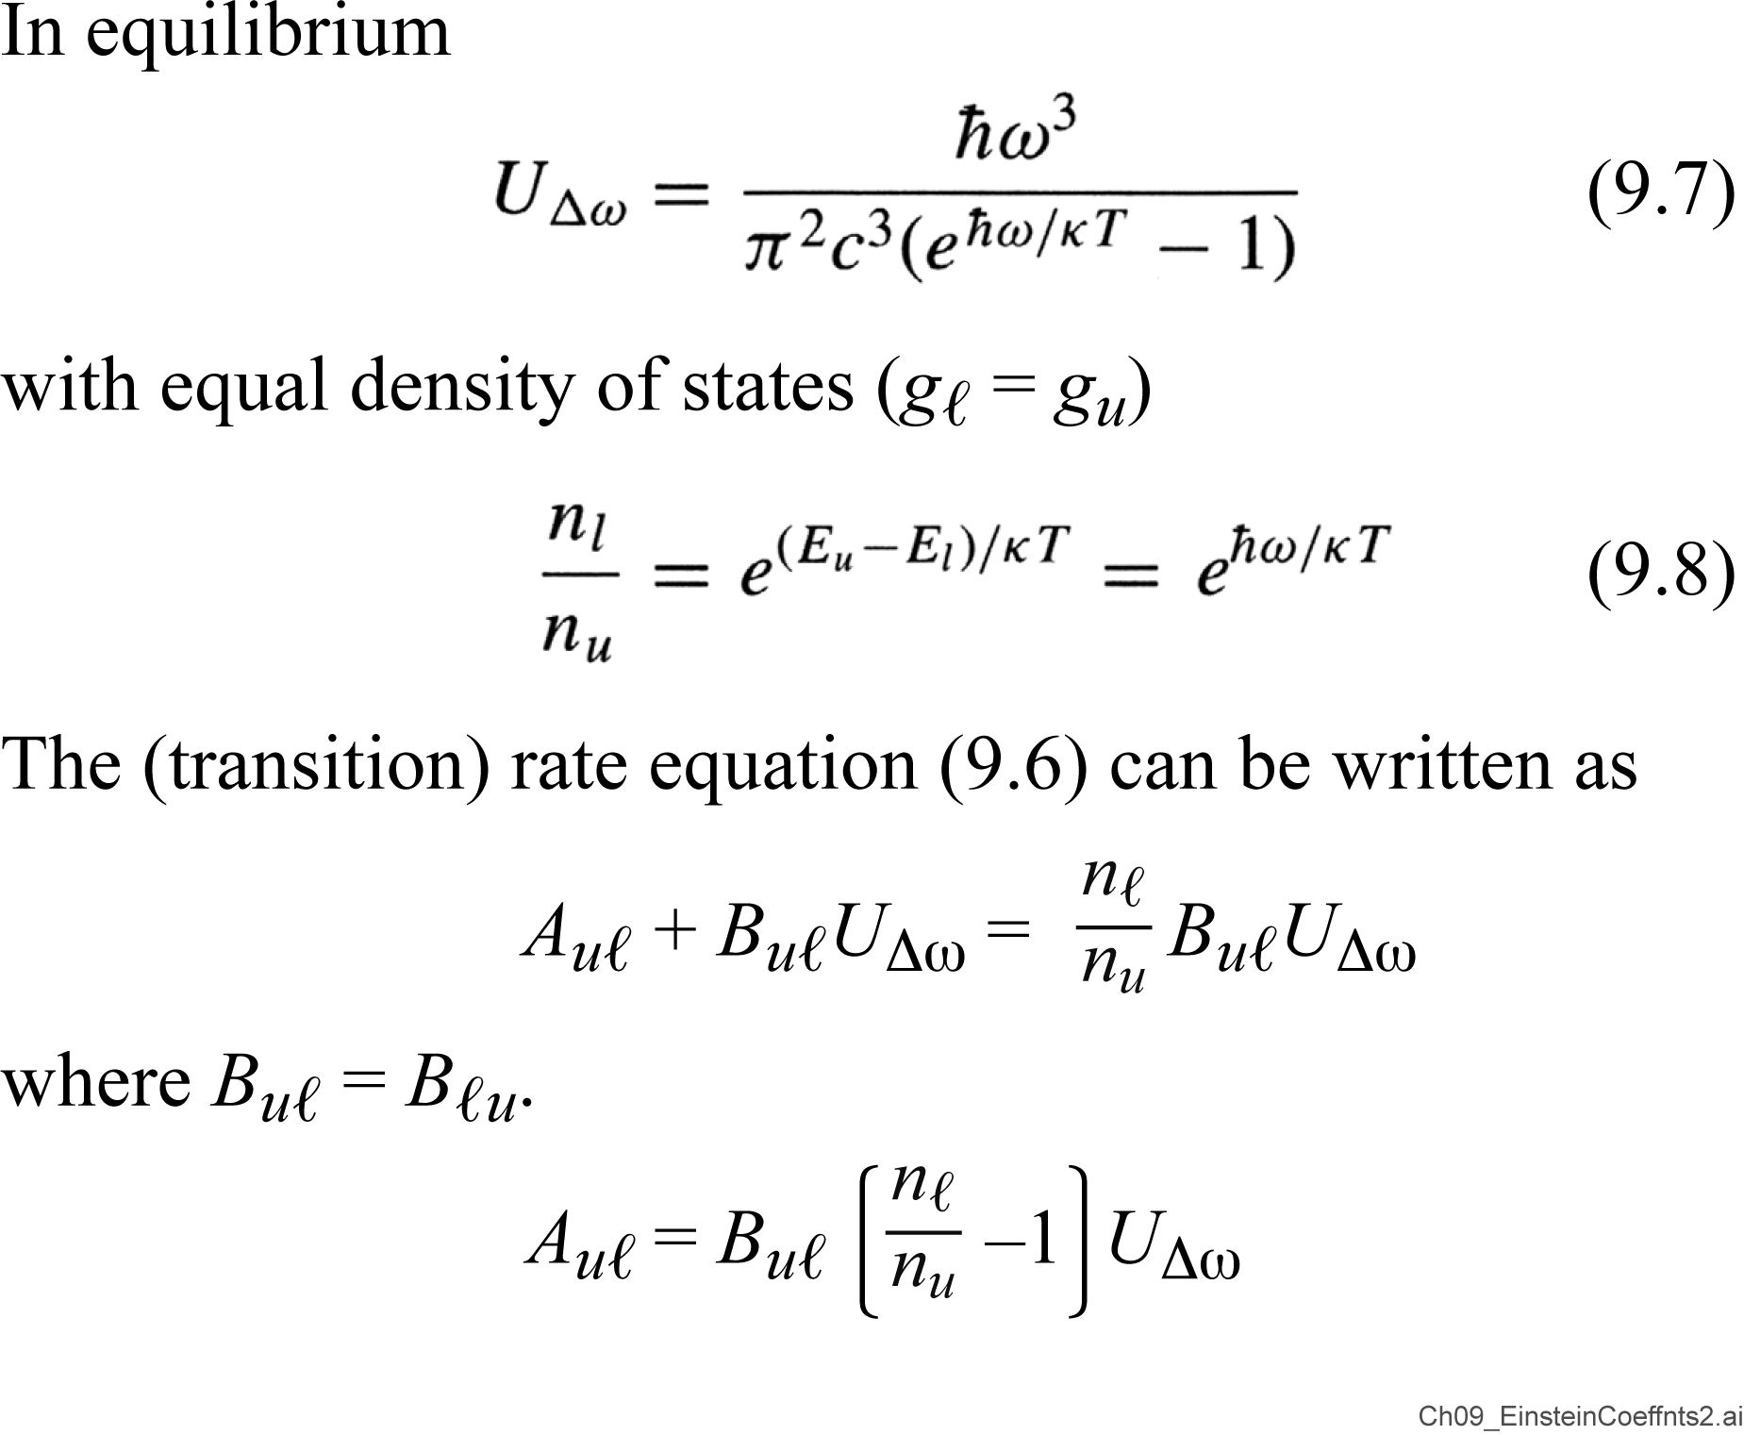
Transition rates: Einstein A and B coefficients (continued)

Slide 44
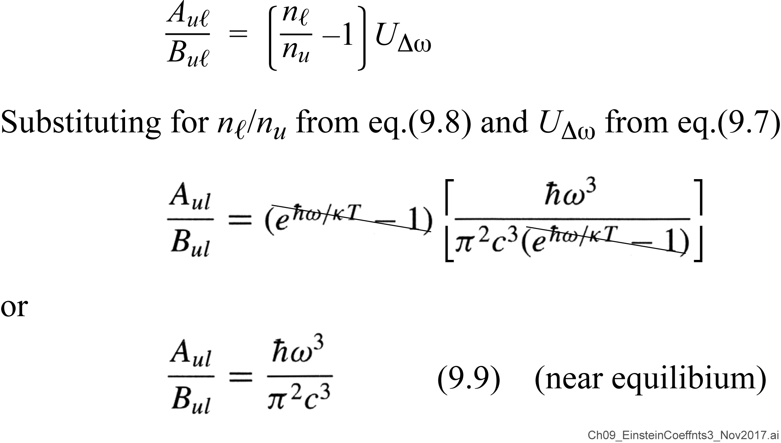
Transition rates: Einstein A and B coefficients (continued further)

Slide 45
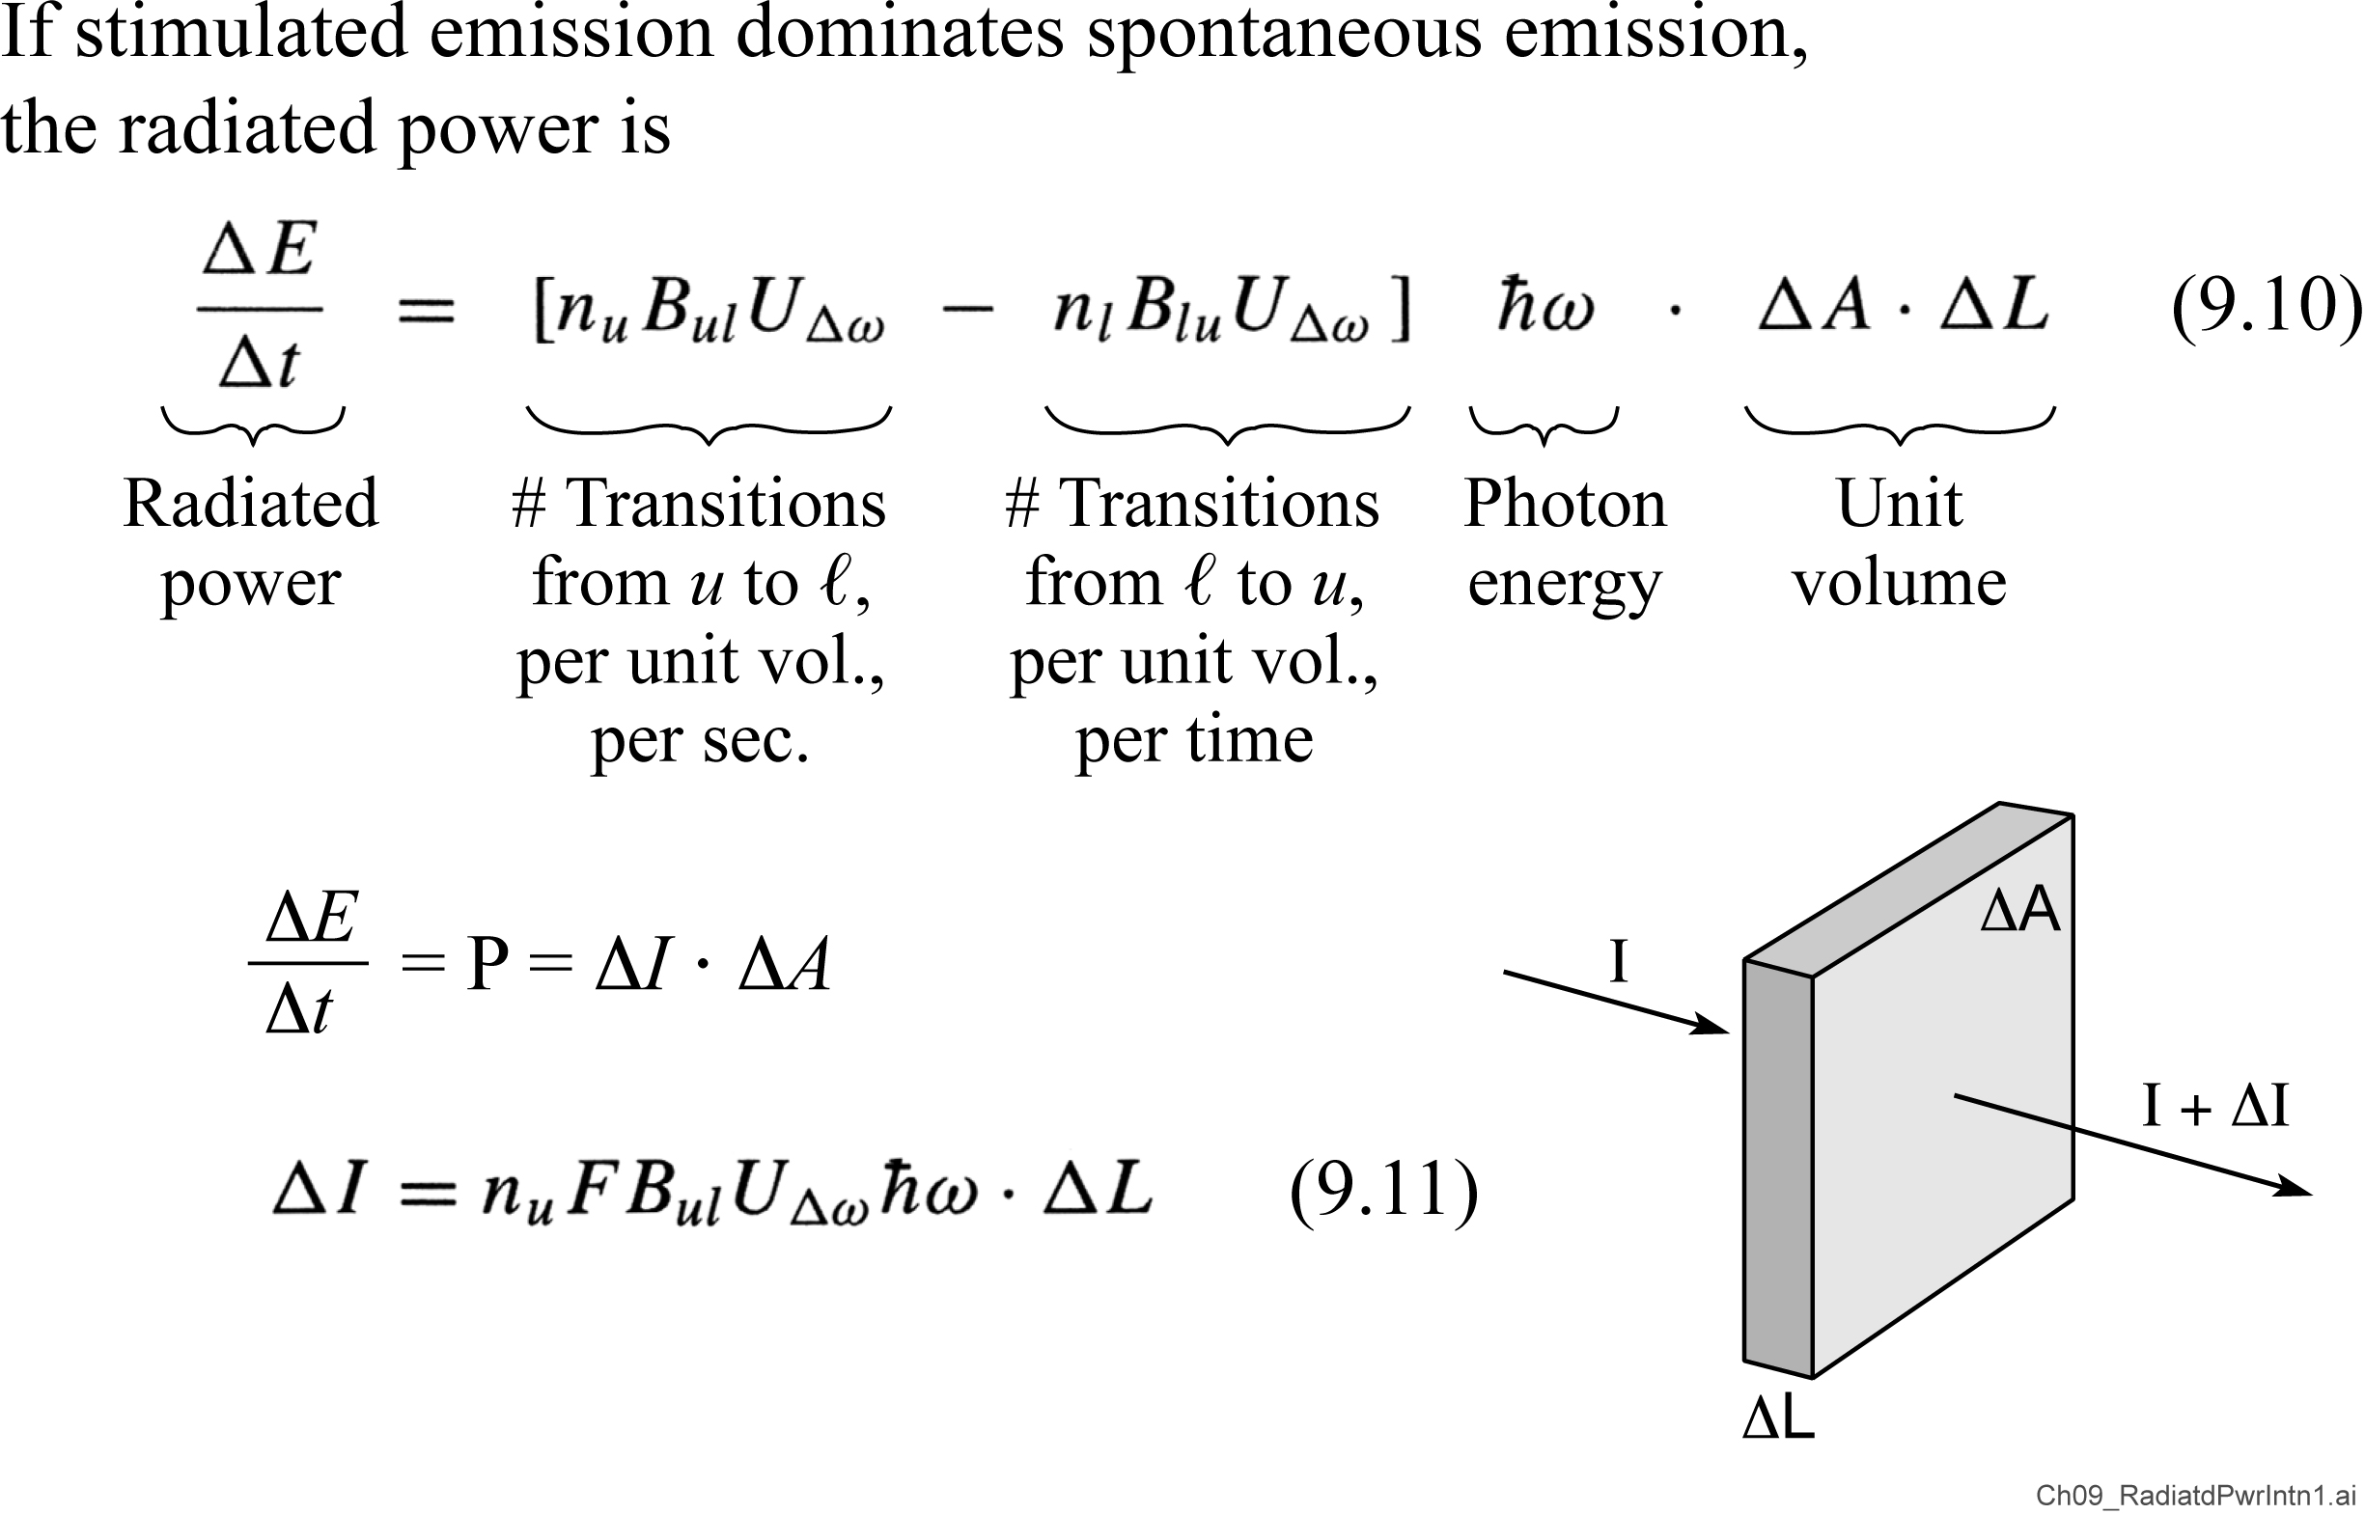
Radiated power and intensity

Slide 46
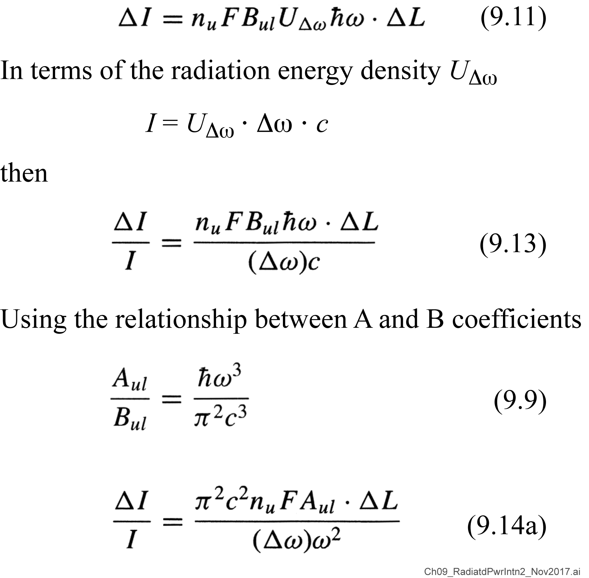
Radiated power and intensity (continued)

Slide 47
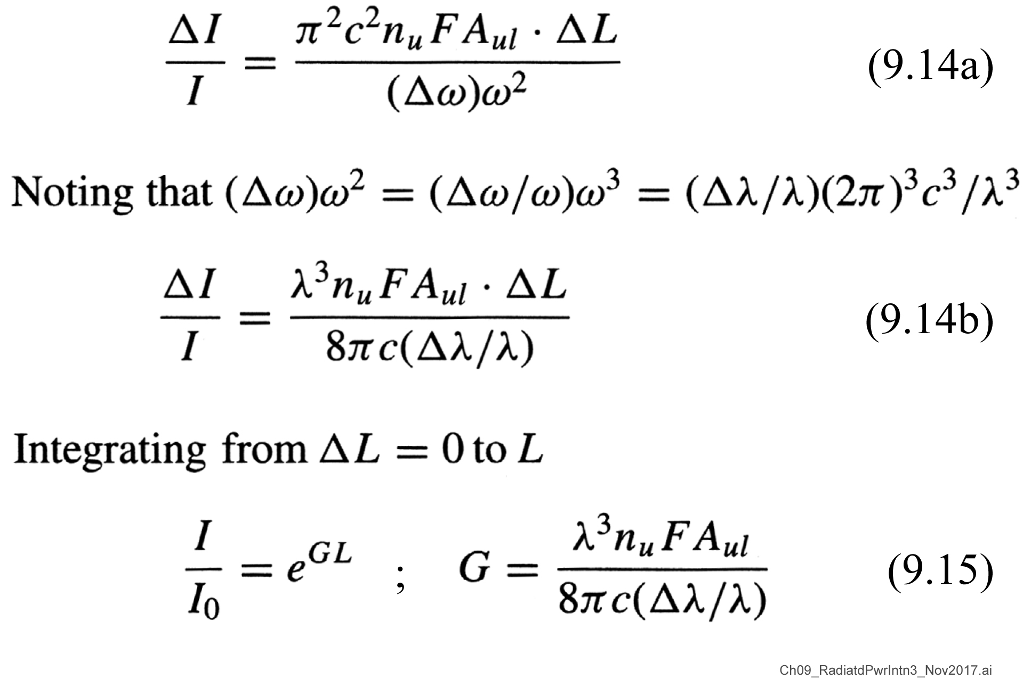
Radiated power and intensity (continued further)

Slide 48
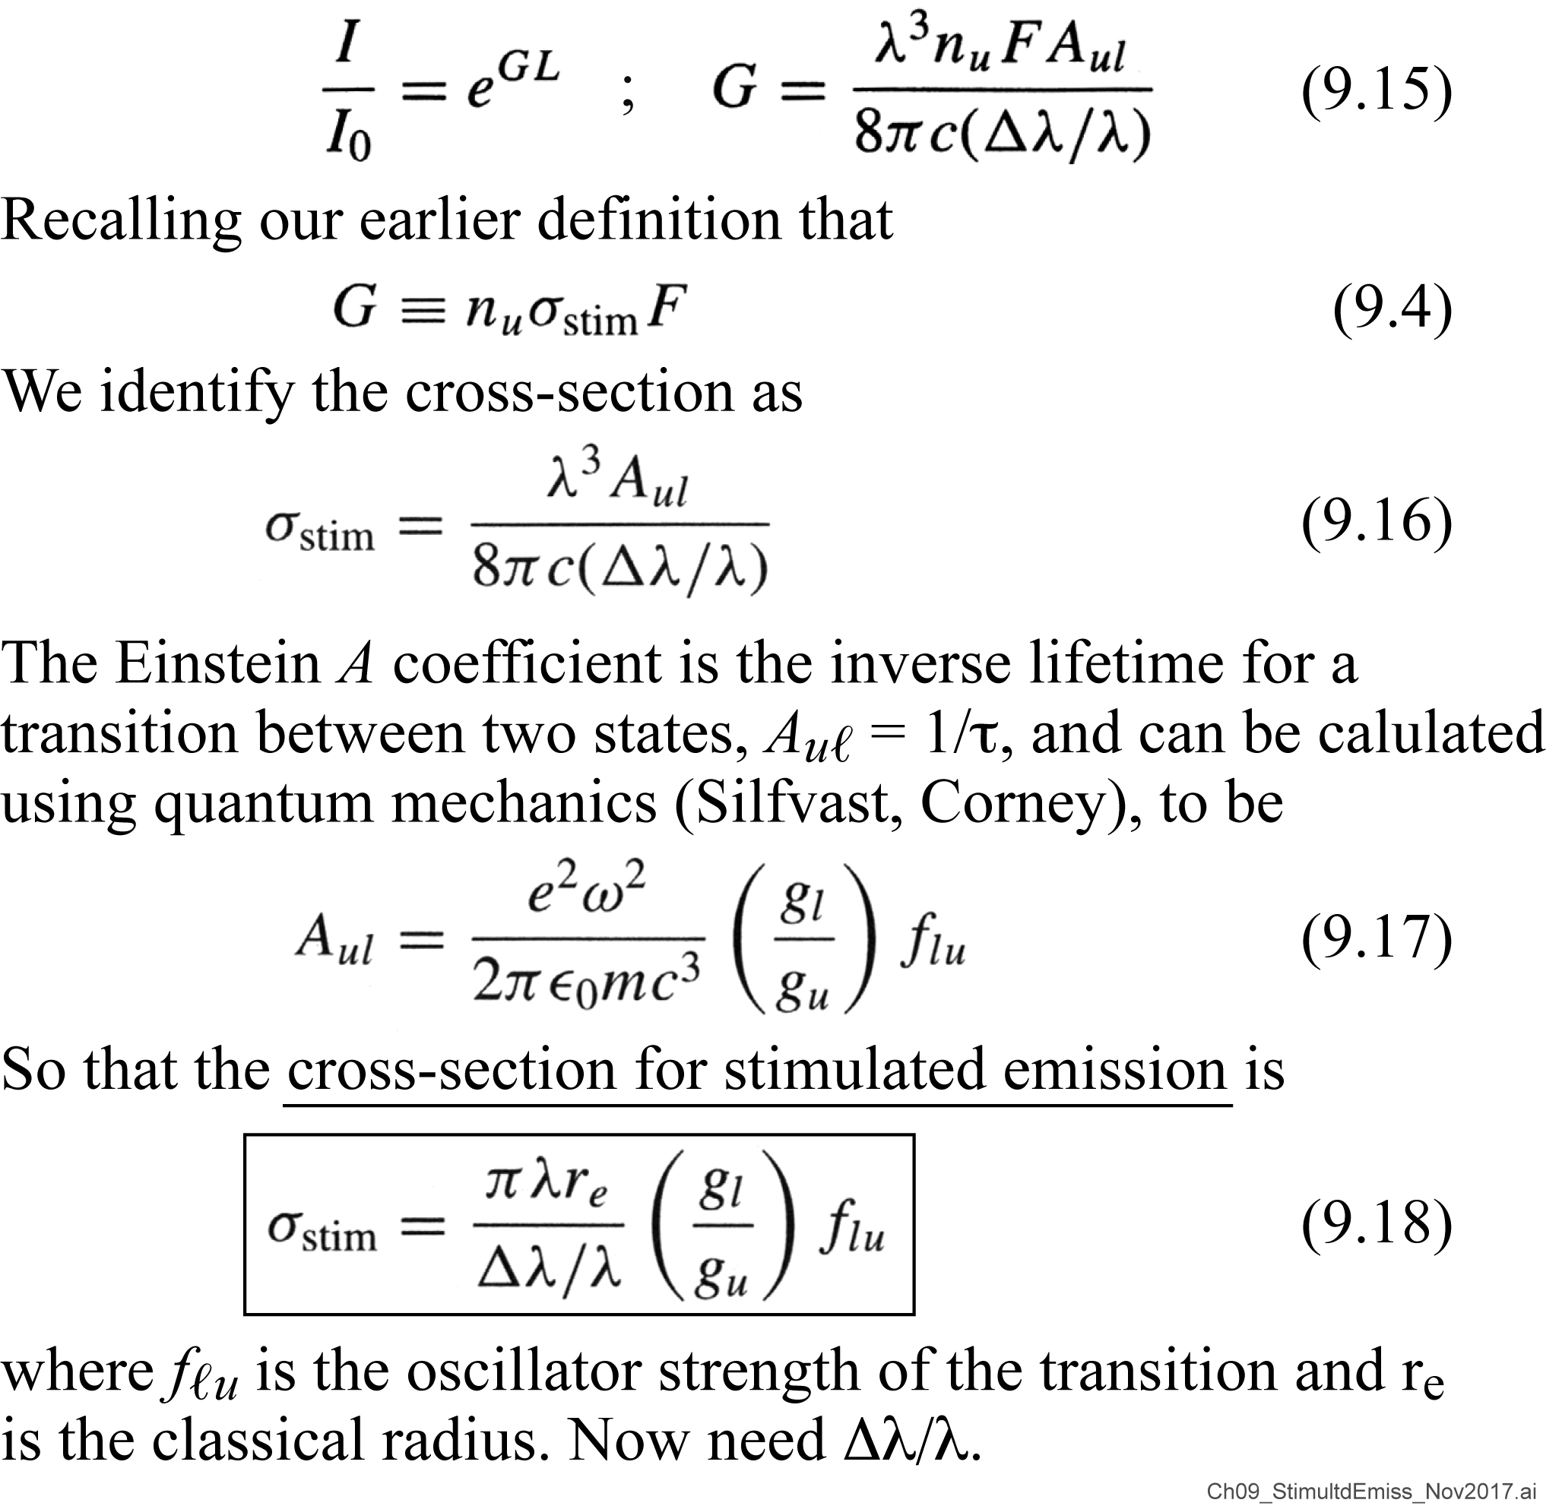
Stimulated emission cross-section

Slide 49
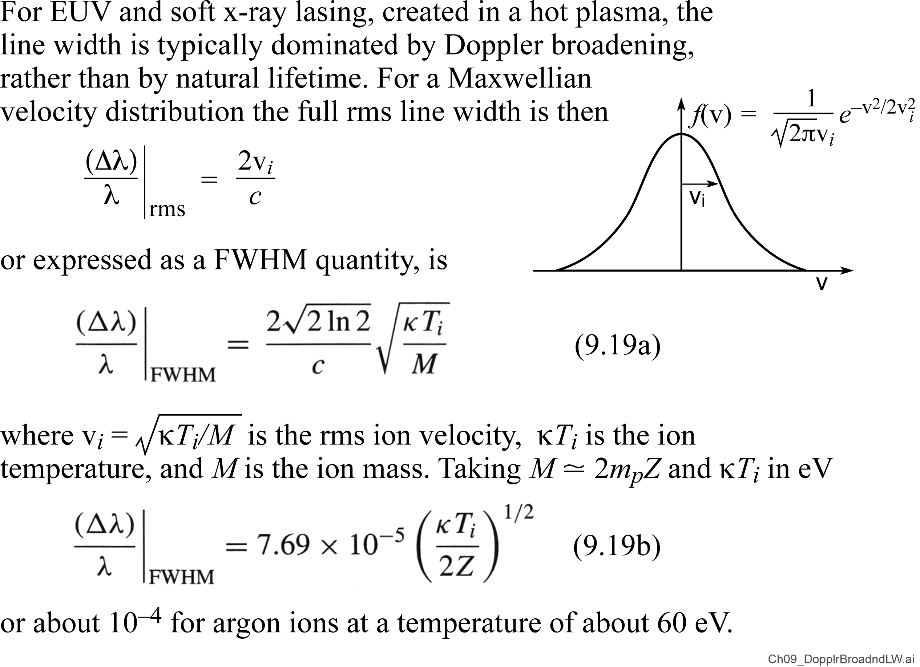
Doppler broadened line width

Slide 50

Wavelength scaling of EUV and soft x-ray lasers

Slide 51
Slides discussed in an earlier class

Slide 52



The Nobel Prize in Physics 1964
Charles Hard Townes
Nicolay Gennadiyevich Basov
Aleksandr Mikhailovich Prokhorov
“For fundamental work in the field of quantum electronics,
which has led to the construction of oscillators and amplifiers
based on the maser-laser principle”

Slide 53

The Nobel Prize in Physics 1981
“For contributions to the development of laser spectroscopy”
Arthur Leonard Schawlow
A.L. Schawlow and C.H. Townes, Infrared and Optical Masers, Phys. Rev. 112, 1940 (1958)

Slide 54


The first visible light laser: A ruby laser at 694.3 nm
First laser demonstrated at
Hughes Research Laboratories
May 16, 1960
Theodore Maiman
Ruby laser: Synthetic sapphire (Al₂O₃₎ doped with chromium, Al₂O₃:Cr³⁺ . Cr has a long-lived, narrow
(0.53 nm) resonant line at 694.3 nm and a broad absorption band at 400-550nm. The flat, parallel rod ends were coated with Al. Pumping was with a Xe filled quartz flashlamp.
B.S. Engineering Physics,
U. Colorado, Boulder
Ph.D. Physics, Stanford,1955
T. Maiman, Stimulated Optical Radiation in Ruby, Nature 187, 493 (1960).

Slide 55

The Nobel Prize in Physics 2018
Mourou and Strickland developed chirped pulse amplification (CPA), a method of generating high-intensity, ultra-short pulses, when they were both at the University of Rochester. The scheme allows creation of powerful laser pulses that would otherwise damage the optical materials in the amplifiers. CPA is now a universally used laser technology and has paved the way for higher-intensity, ultra-sharp laser beams now used in many applications, including asec pulses and corrective eye surgeries.
Bell Laboratories,
“for optical tweezers
and applications
to biological systems”
École Polytechnique,
Palaiseau, France
University of Michigan,Ann Arbor
University of Waterloo, Canada
“for their method of generating
high intensity, ultrashort optical
Pulses”

Slide 56

Short pulses have a broad bandwidth
Δτ∙Δℏω ≥ ℏ/2
Short pulses have a broad spectral bandwidth
Time duration of pulse
Fourier transform,
spectral bandwidth

Slide 57

Chirped Pulse Amplification

Slide 58

Chirped Pulse Amplification (CPA)
Z. Néda et al.
Gérard Mourou and Donna Strickland developed chirped pulse amplification (CPA), a method of generating high-intensity, ultra-short pulses, when they were both at the University of Rochester. Donna was a graduate student.

Slide 59

Grad student in the laser lab, University of Rochester
Gérard Mourou
Donna Strickland
D. Strickland and G. Mourou, “Compression of Amplified Chirped Optical pulses”, Optics Communications 56, 219 (1 December 1985)

Slide 60
Nobel Prize for Physics 2018
Nobel Prize Ceremony
10 December 2018
Gerard Mourou at the Nobel Prize Award Ceremony.
Donna Strickland receives her medal and diploma from the King of Sweden.

Slide 61



Donna Strickland escorted to dinner by the king
Nobel Laureate
Donna Strickland
King Carl XVI Gustaf
Of Sweden

Slide 62

Nobel prize-winning scientist Donna Strickland made full professor at the University of Waterloo
Nobel laureate Donna Strickland is now a full professor at the University of Waterloo. Strickland had been an associate professor of physics and astronomy.
2 Oct2018 to 26 Oct2018

Slide 63
Book by UC Berkeley’s Charles Townes

Slide 64
“Lasers” by Tony Siegman

Slide 65
“Laser Fundamentals” by William Silfvast

