Slide 1
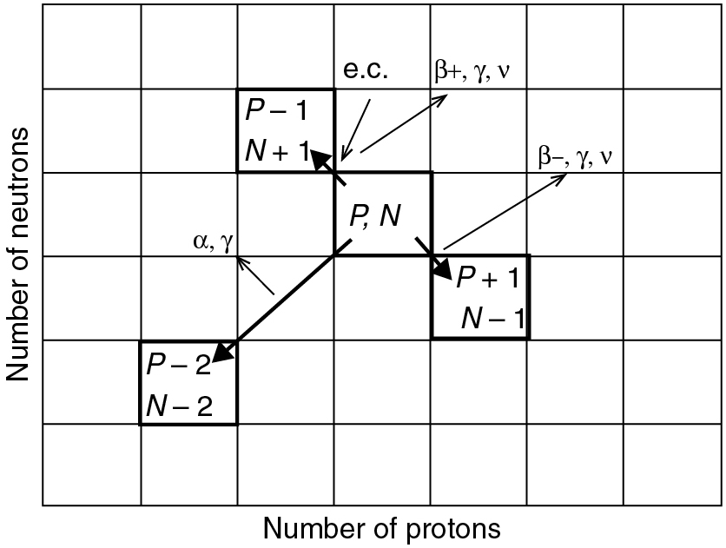
PILSON_Fig 10_01
© Cambridge University Press 2012

Slide 2
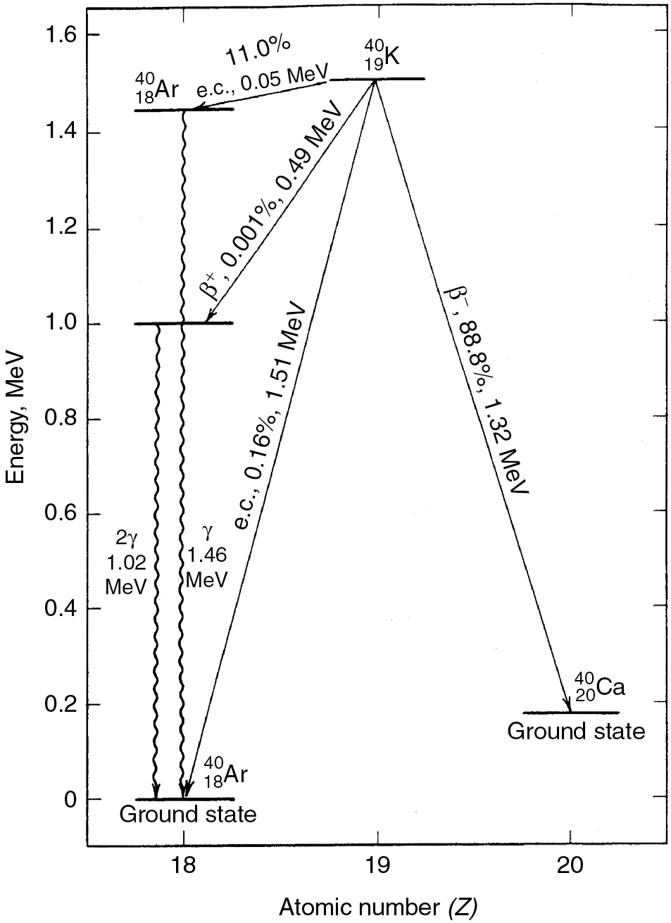
PILSON_Fig 10_02
© Cambridge University Press 2012

Slide 3
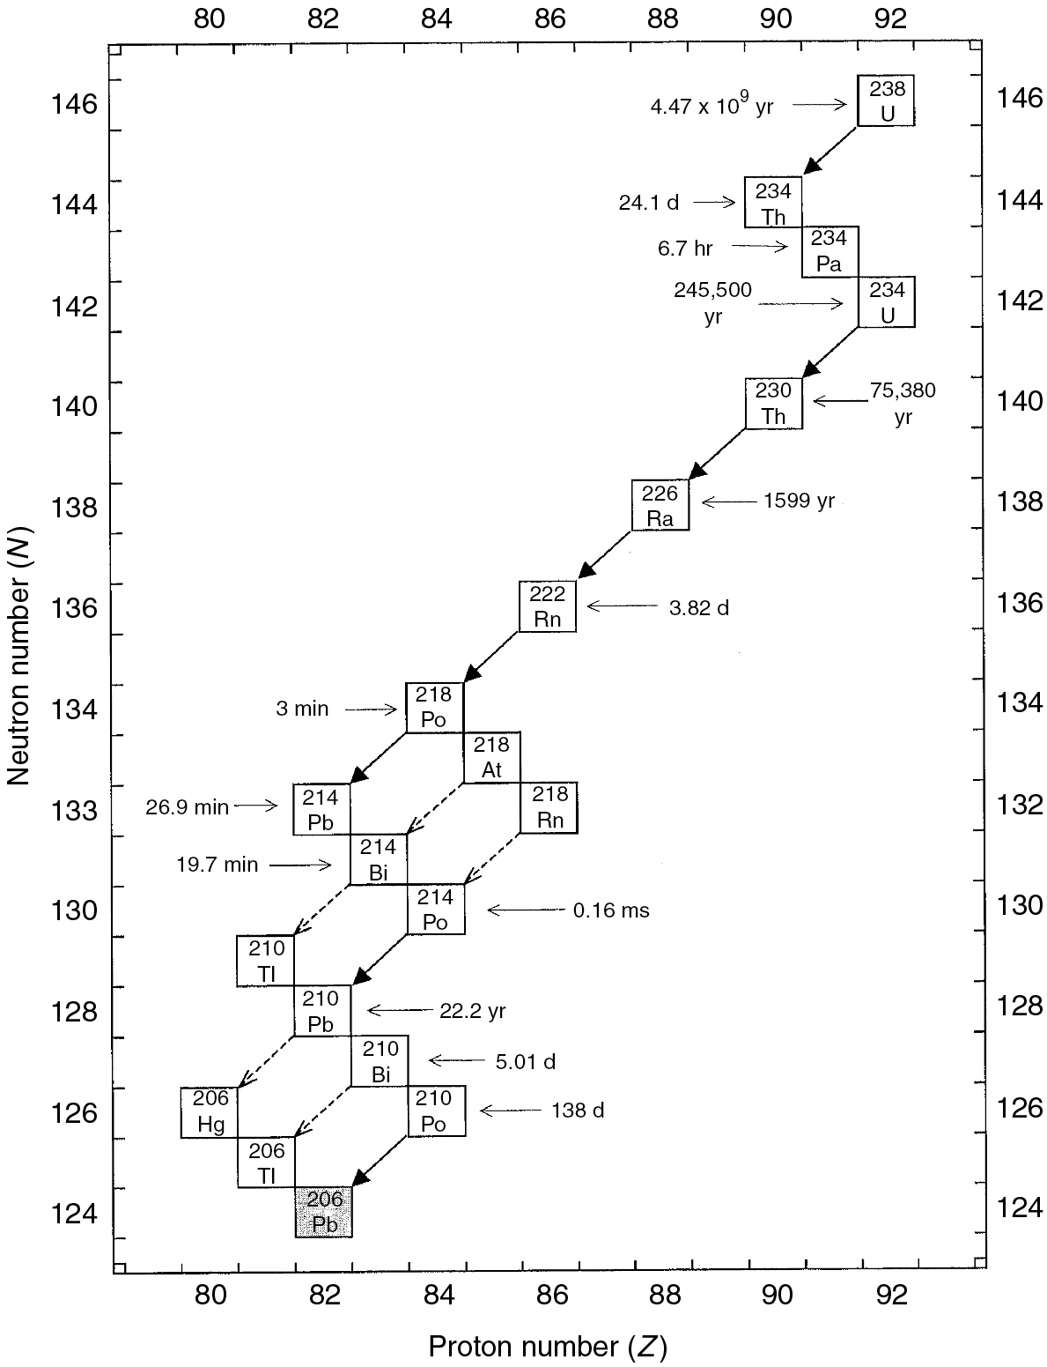
PILSON_Fig 10_03
© Cambridge University Press 2012

Slide 4
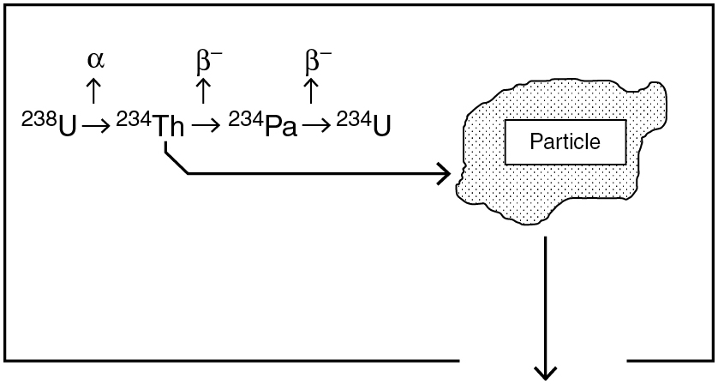
PILSON_Fig 10_04
© Cambridge University Press 2012

Slide 5
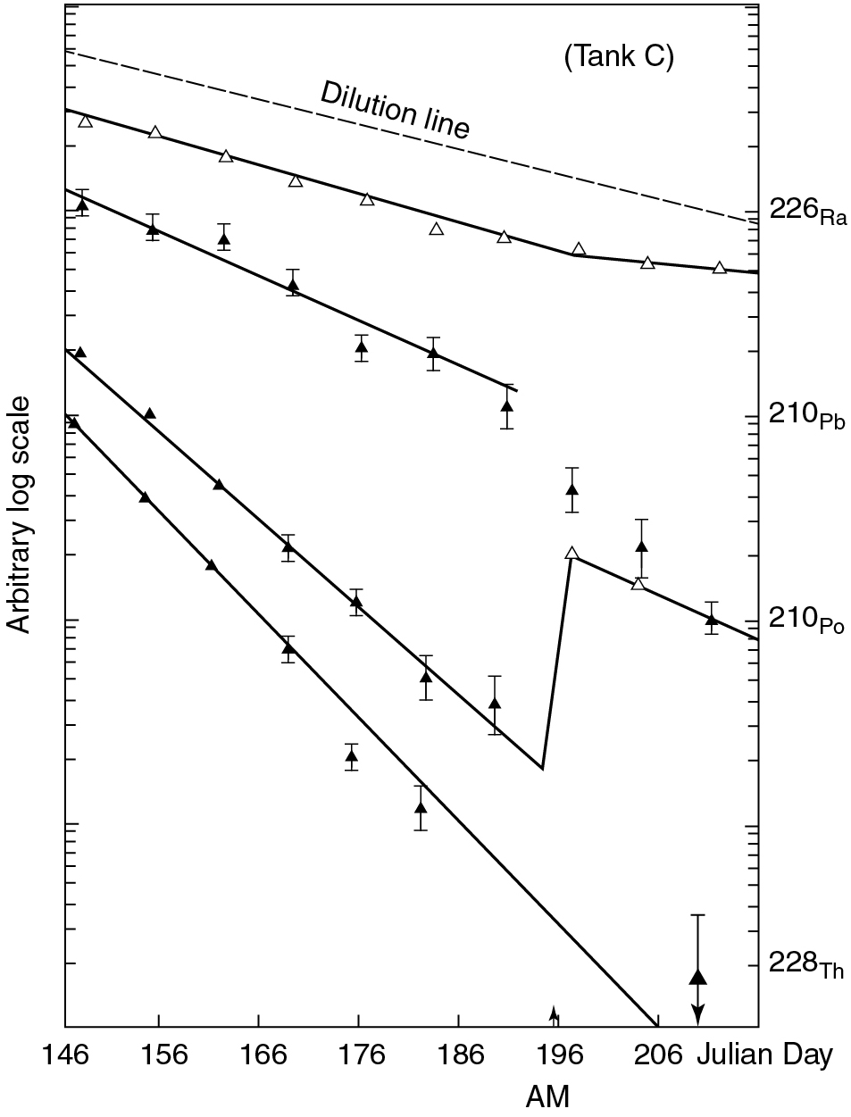
PILSON_Fig 10_05
© Cambridge University Press 2012

Slide 6
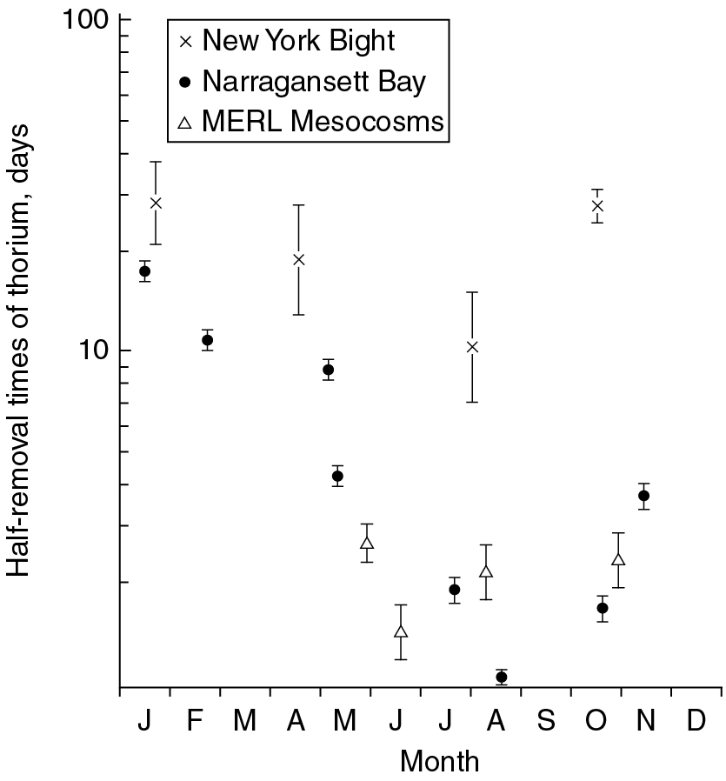
PILSON_Fig 10_06
© Cambridge University Press 2012

Slide 7
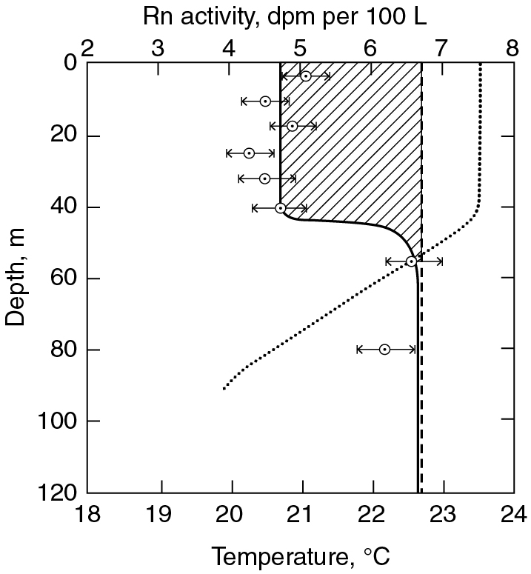
PILSON_Fig 10_07
© Cambridge University Press 2012

Slide 8
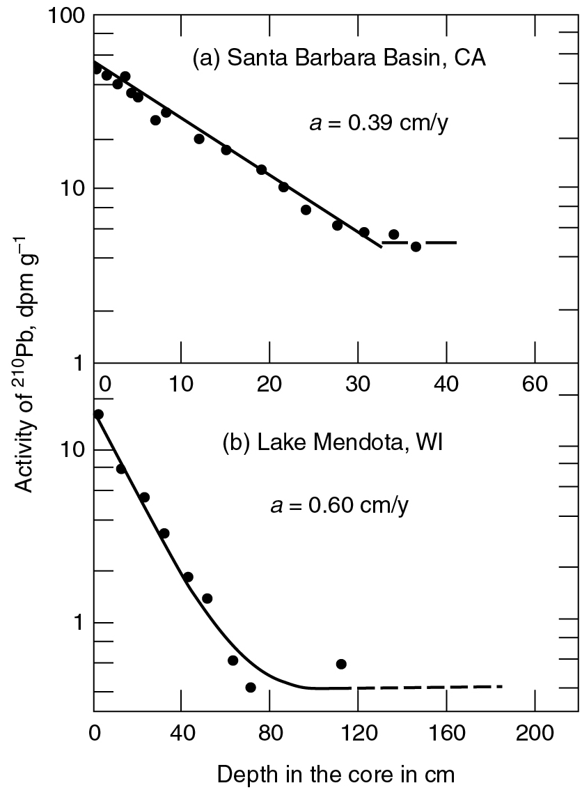
PILSON_Fig 10_08
© Cambridge University Press 2012

Slide 9
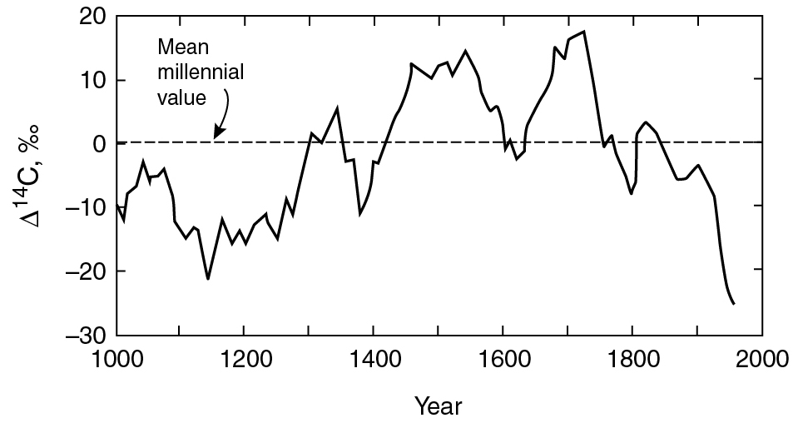
PILSON_Fig 10_09
© Cambridge University Press 2012

Slide 10
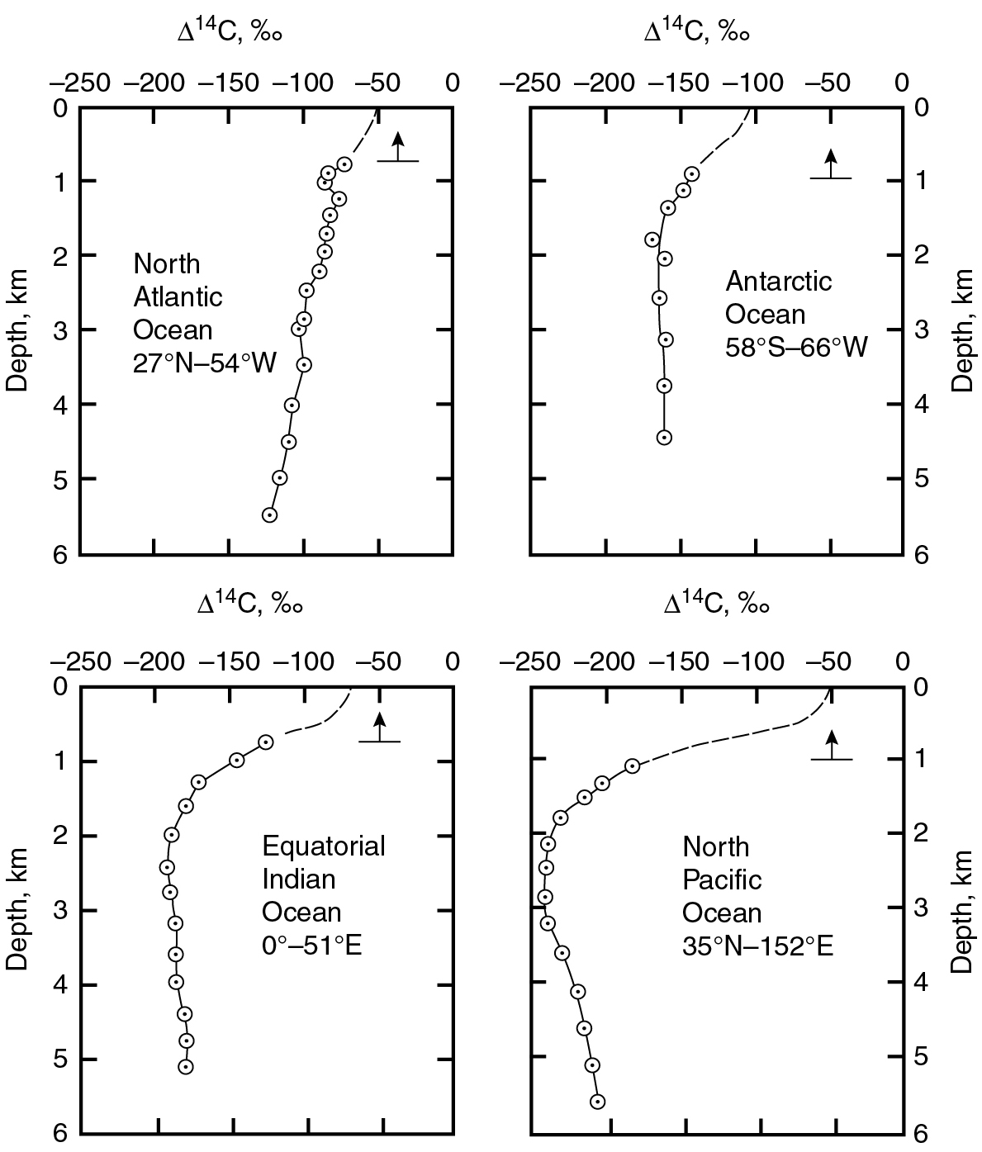
PILSON_Fig 10_10
© Cambridge University Press 2012

Slide 11
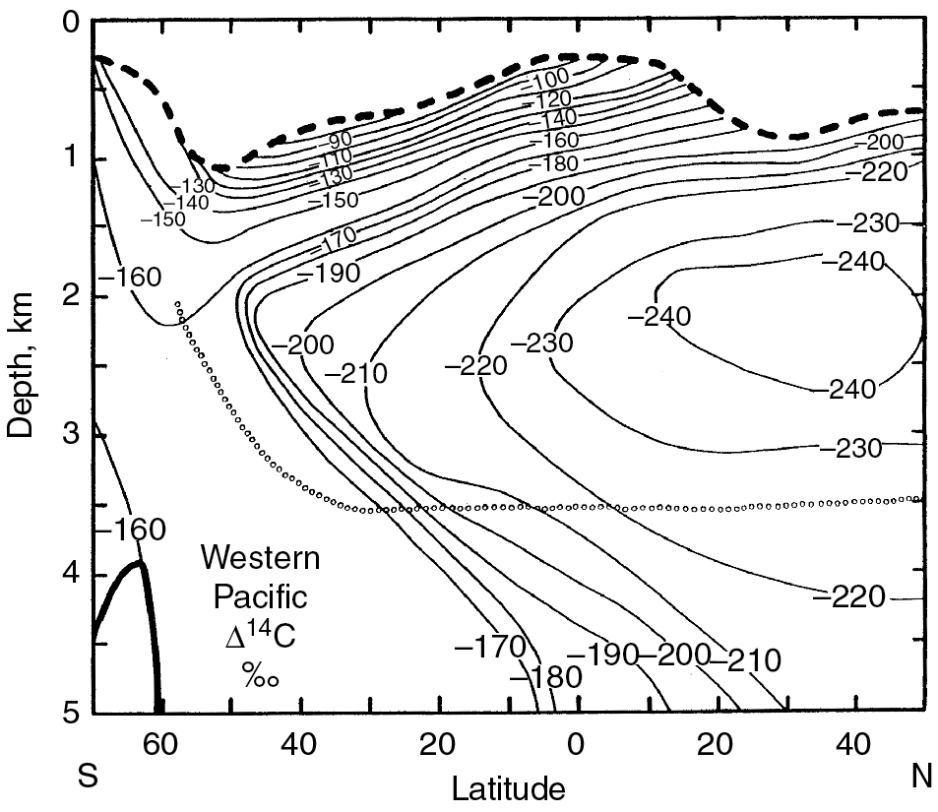
PILSON_Fig 10_11
© Cambridge University Press 2012

Slide 12
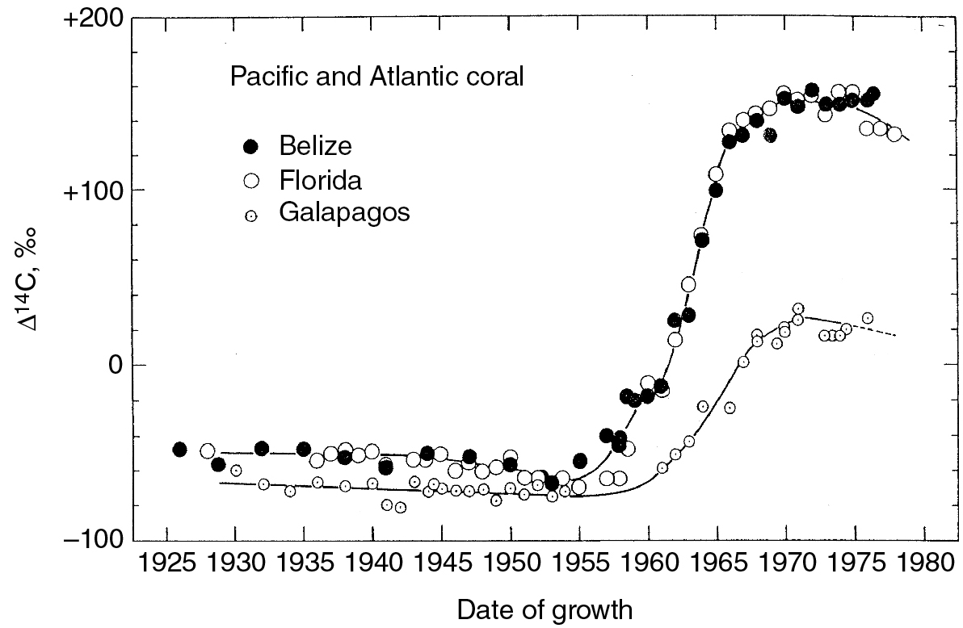
PILSON_Fig 10_12
© Cambridge University Press 2012

