Slide 1
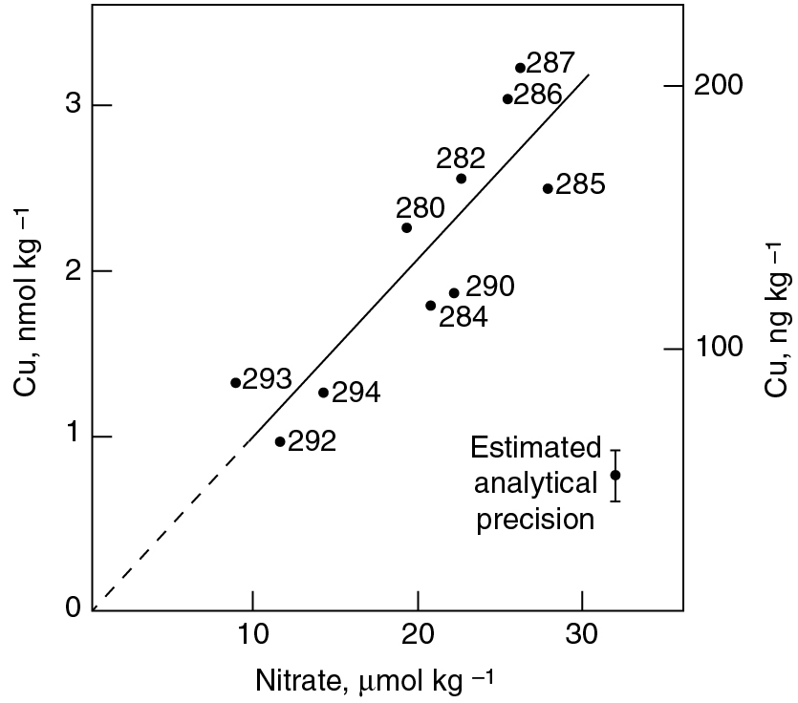
PILSON_Fig 09_01
© Cambridge University Press 2012

Slide 2
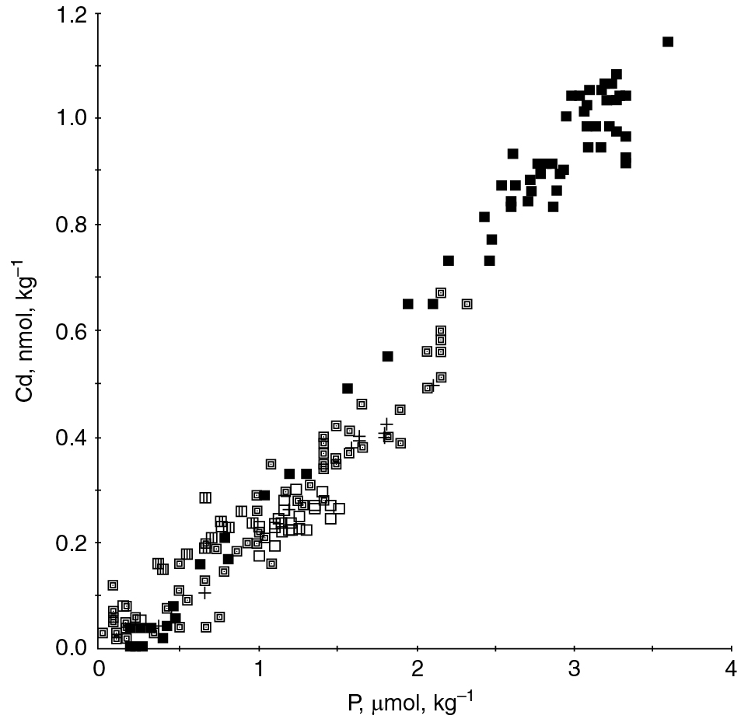
PILSON_Fig 09_02
© Cambridge University Press 2012

Slide 3
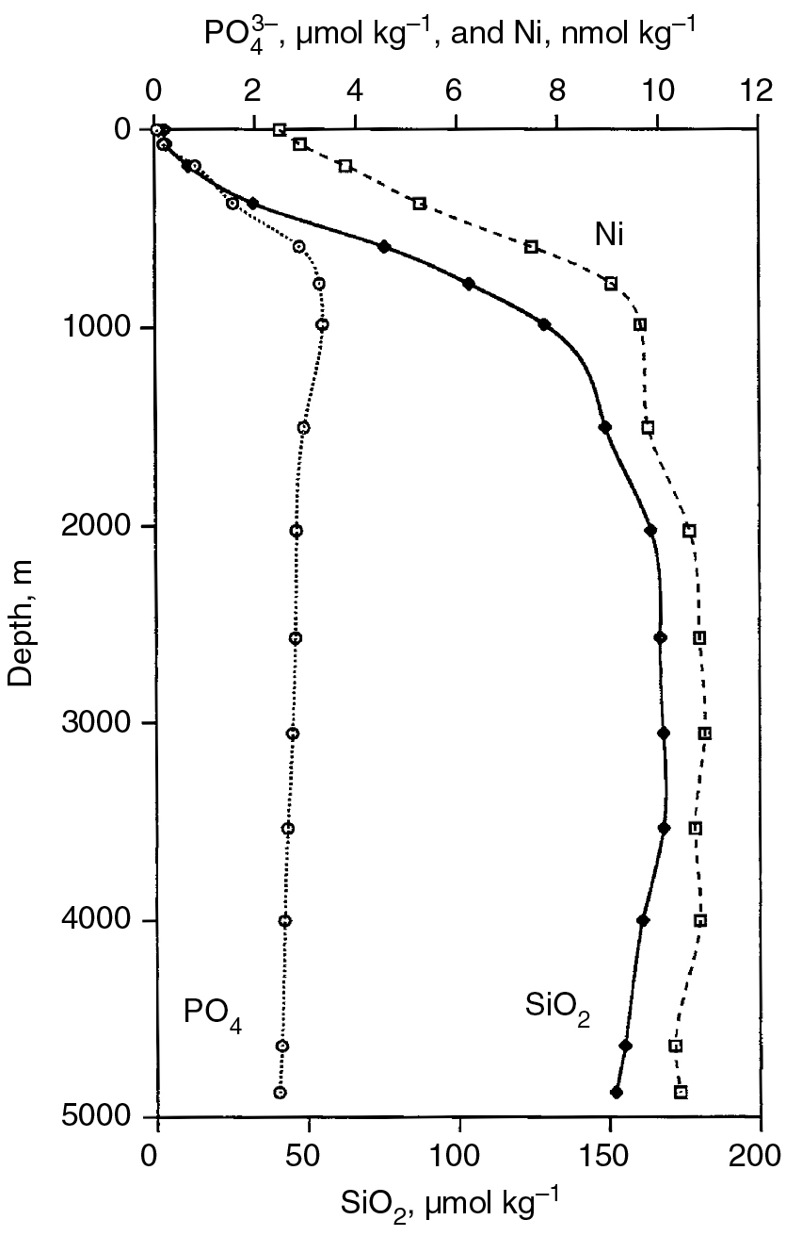
PILSON_Fig 09_03
© Cambridge University Press 2012

Slide 4
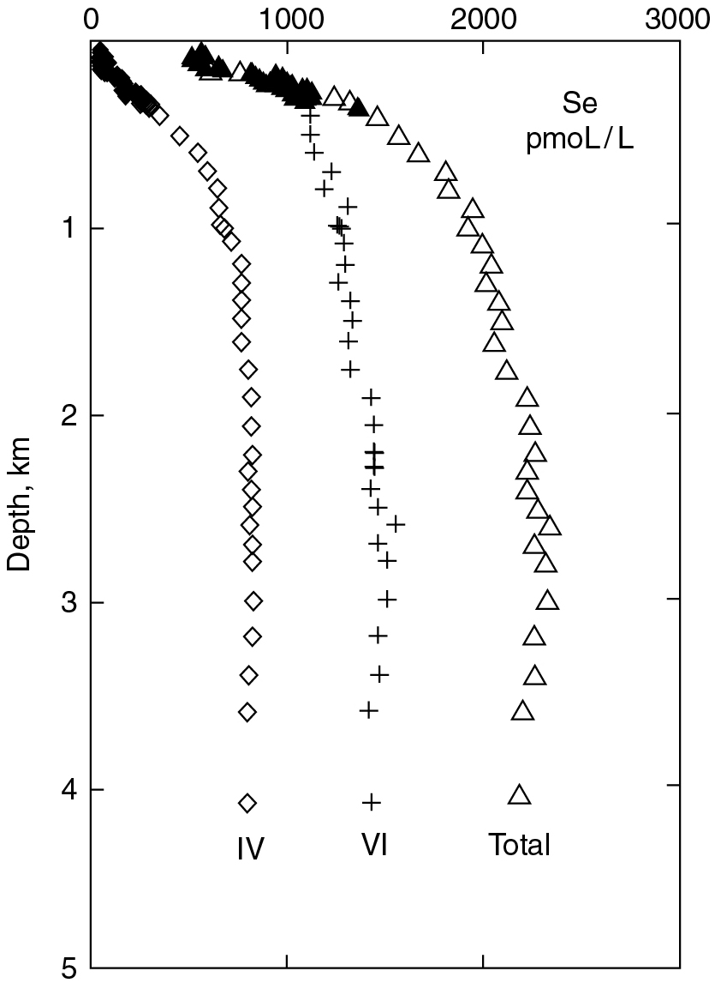
PILSON_Fig 09_04
© Cambridge University Press 2012

Slide 5
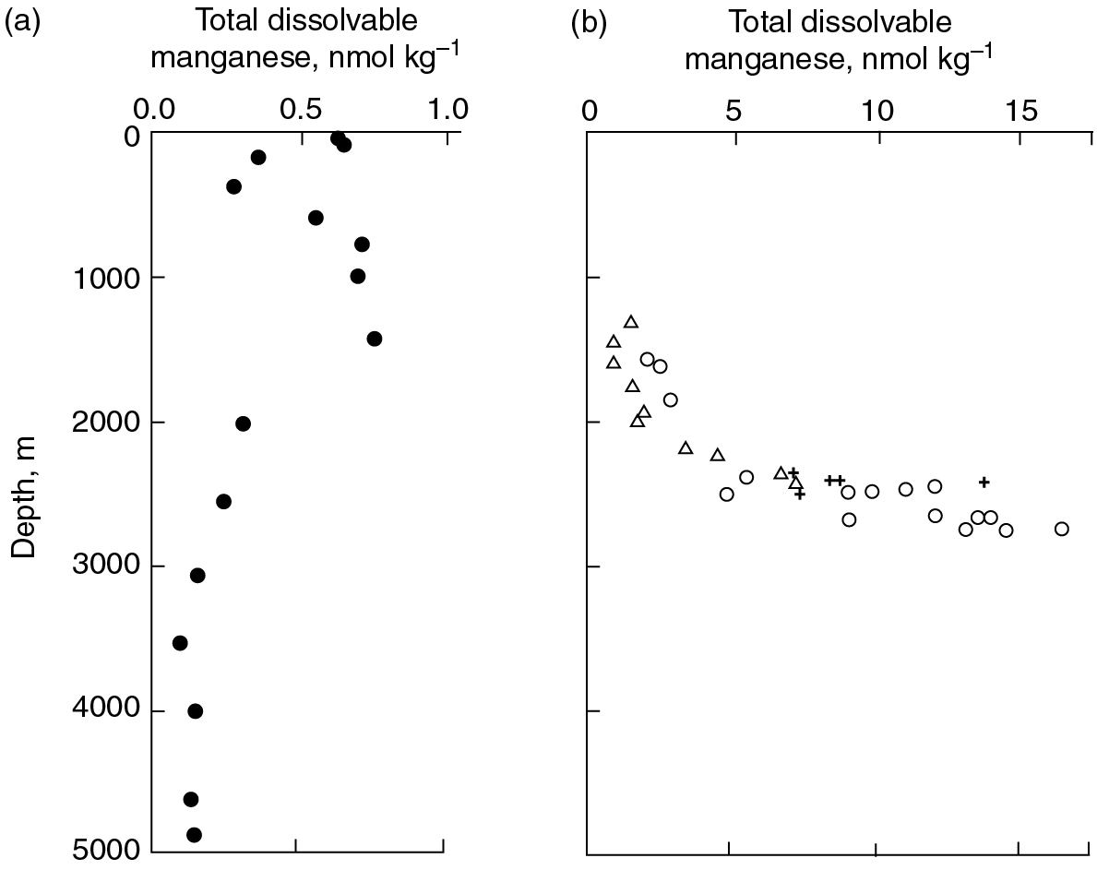
PILSON_Fig 09_05
© Cambridge University Press 2012

Slide 6
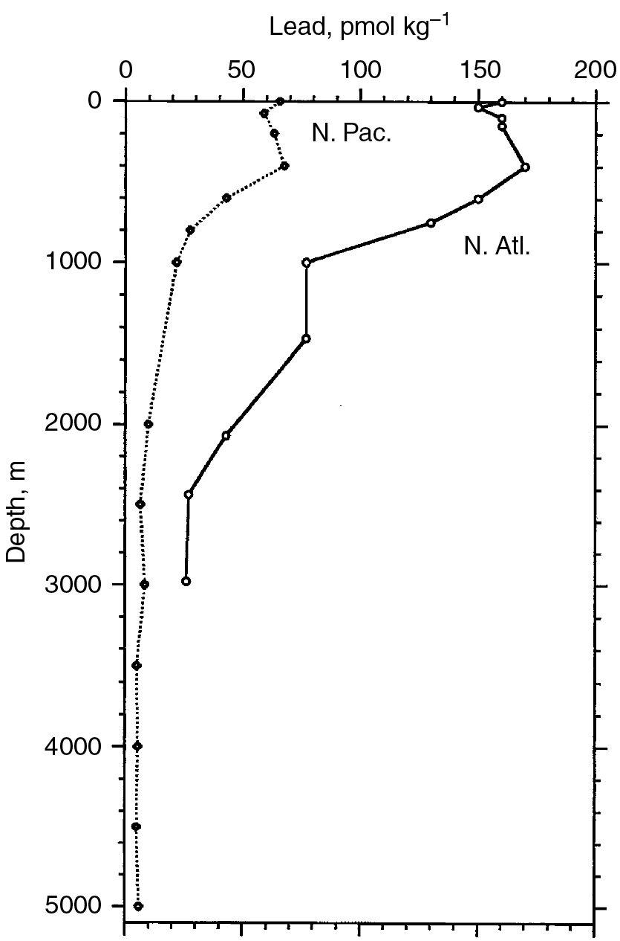
PILSON_Fig 09_06
© Cambridge University Press 2012

Slide 7
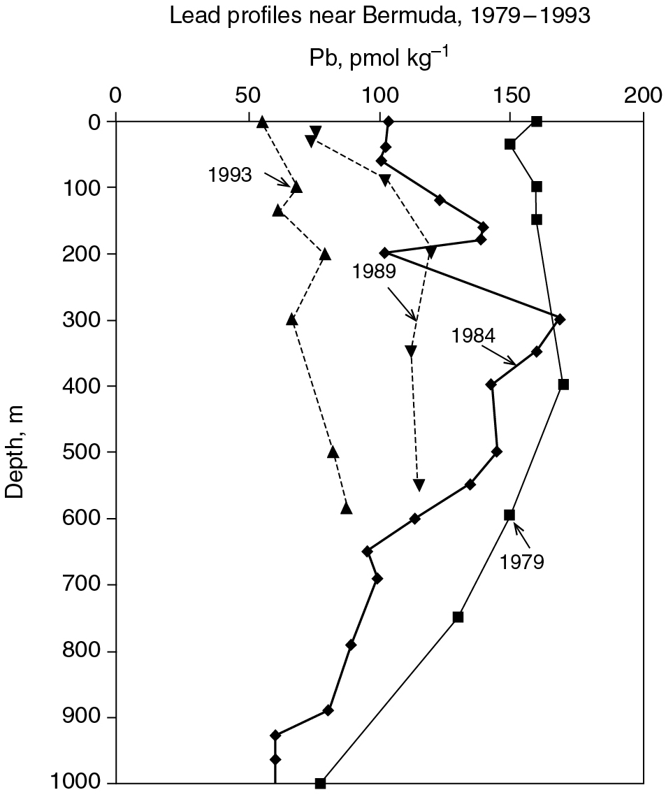
PILSON_Fig 09_07
© Cambridge University Press 2012

Slide 8
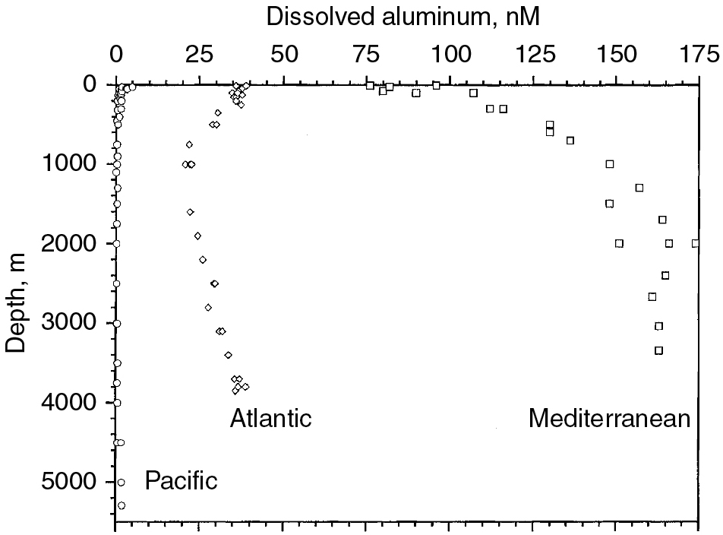
PILSON_Fig 09_08
© Cambridge University Press 2012

Slide 9
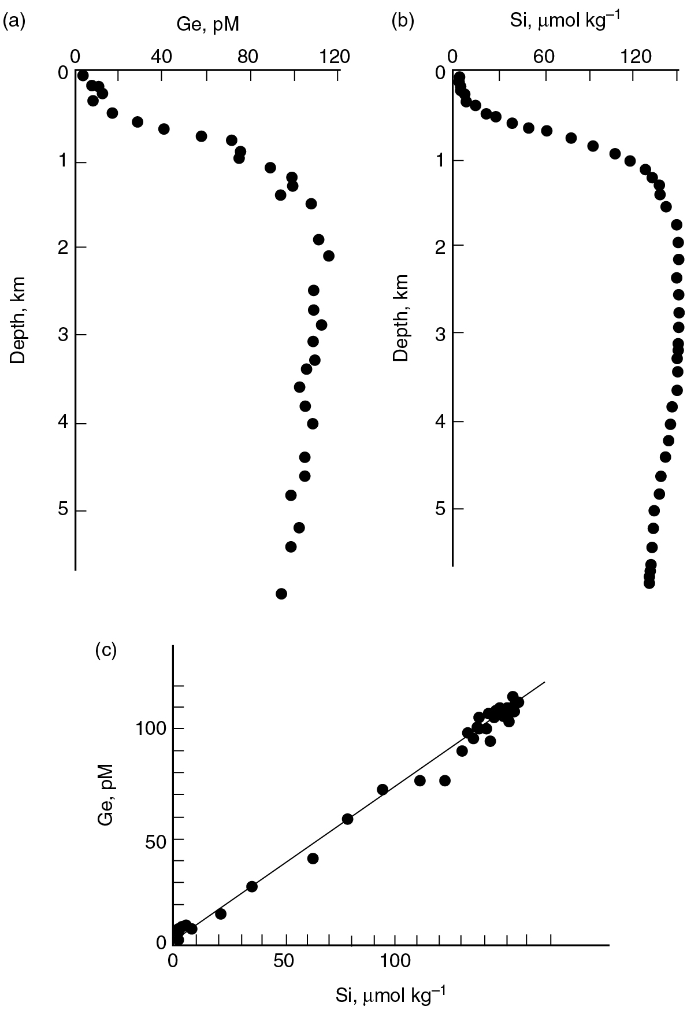
PILSON_Fig 09_09
© Cambridge University Press 2012

Slide 10
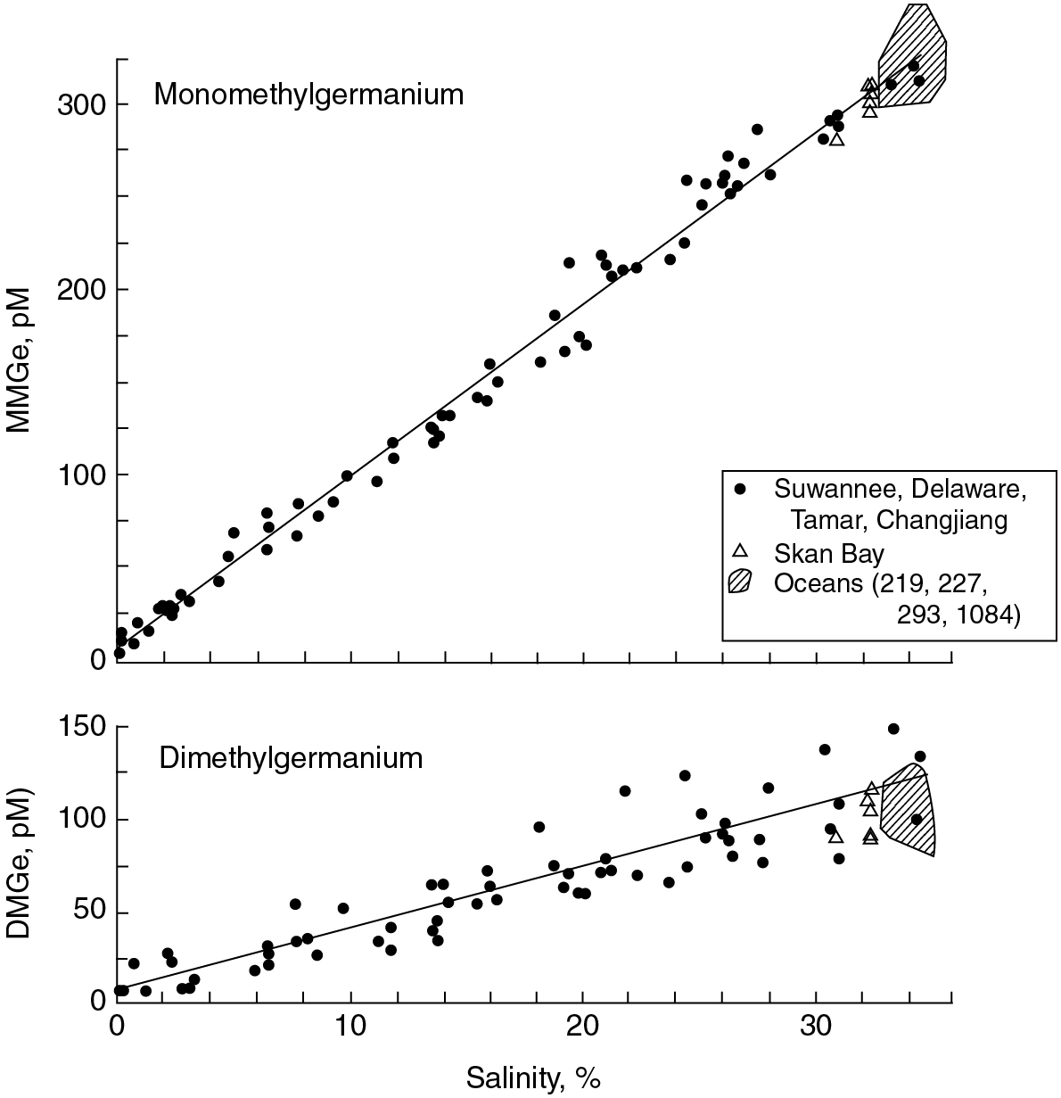
PILSON_Fig 09_10
© Cambridge University Press 2012

Slide 11
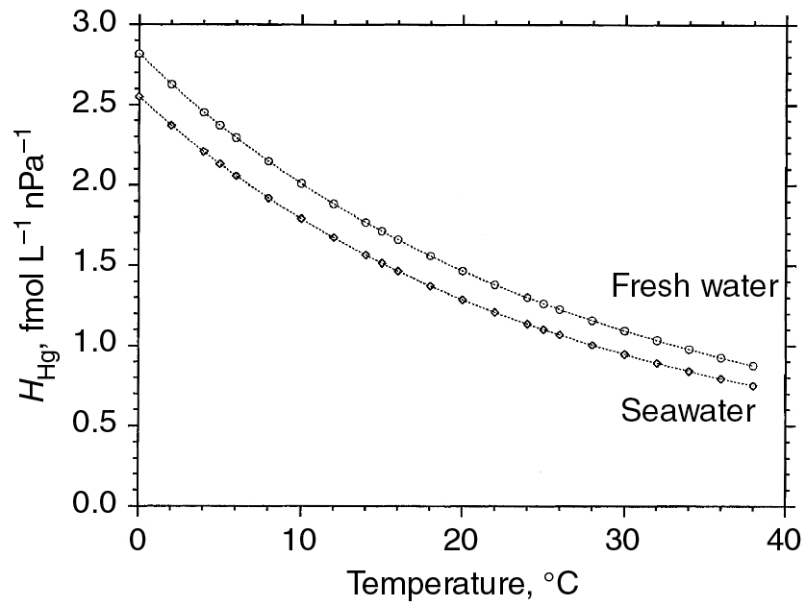
PILSON_Fig 09_11
© Cambridge University Press 2012

Slide 12
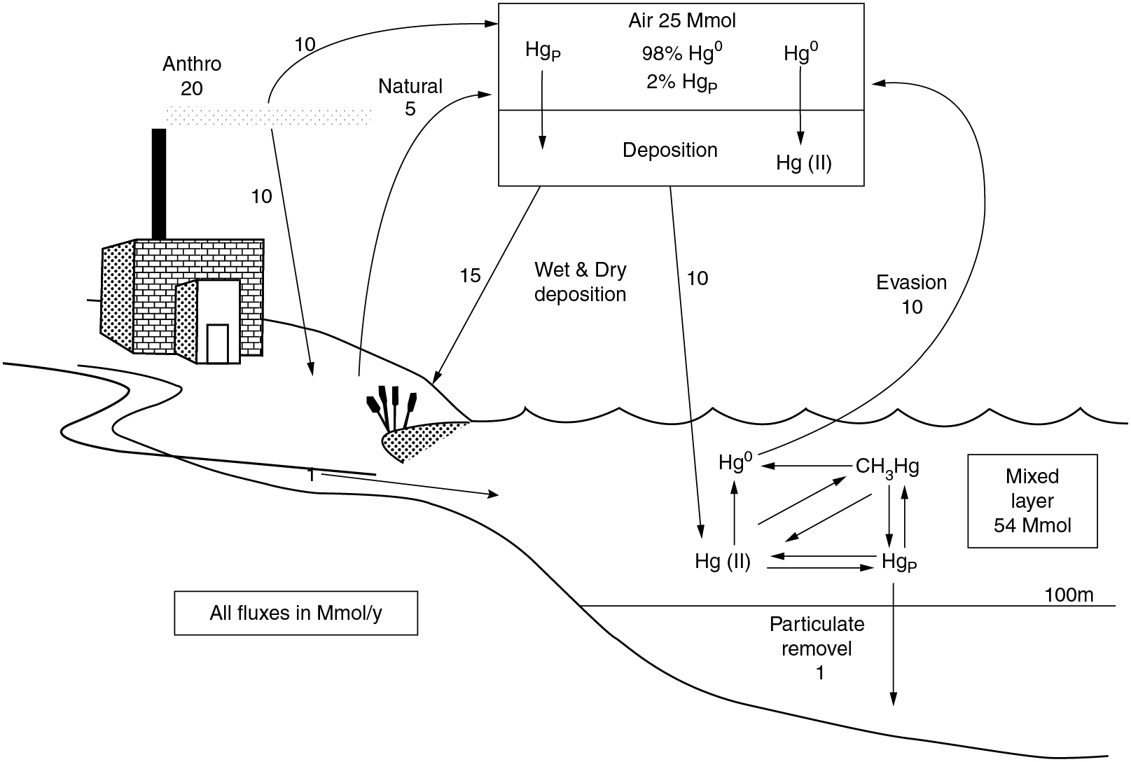
PILSON_Fig 09_12
© Cambridge University Press 2012

Slide 13
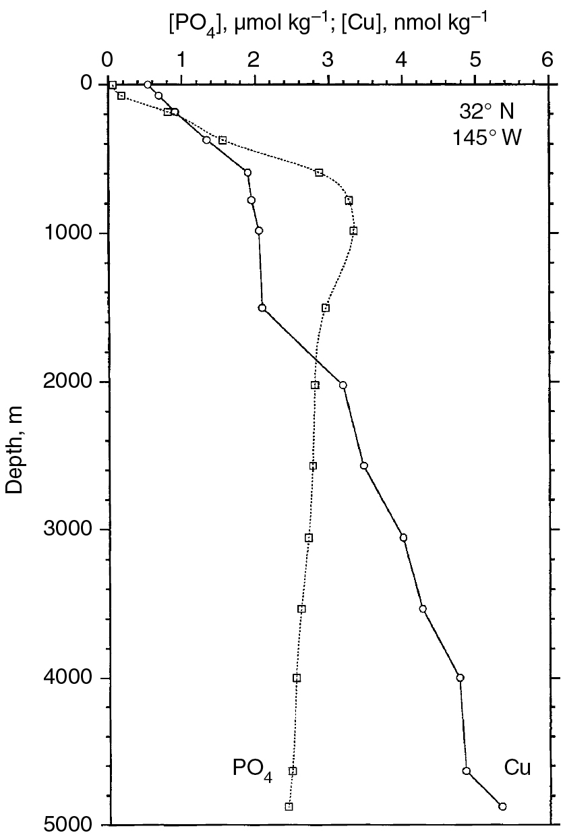
PILSON_Fig 09_13
© Cambridge University Press 2012

Slide 14
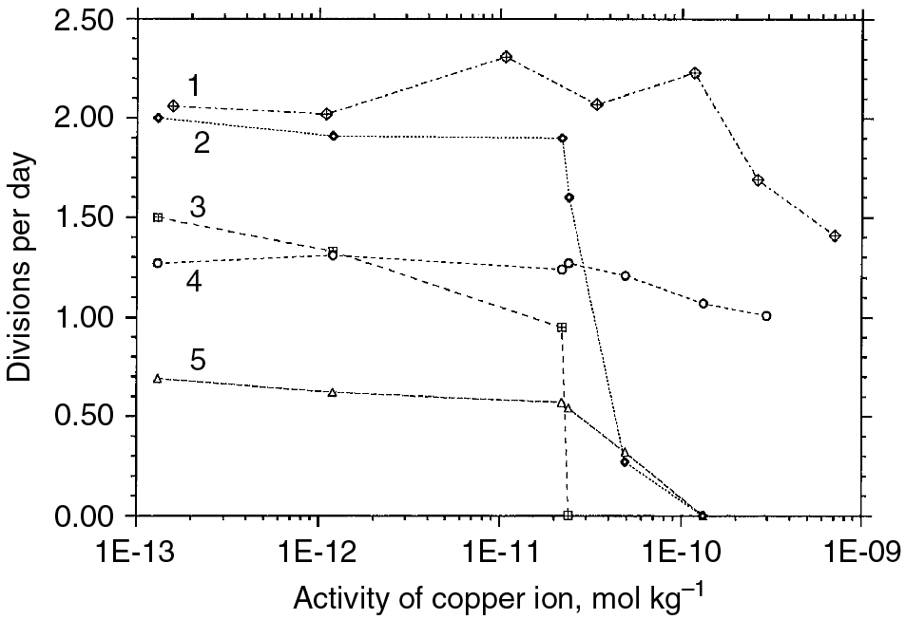
PILSON_Fig 09_14
© Cambridge University Press 2012

Slide 15
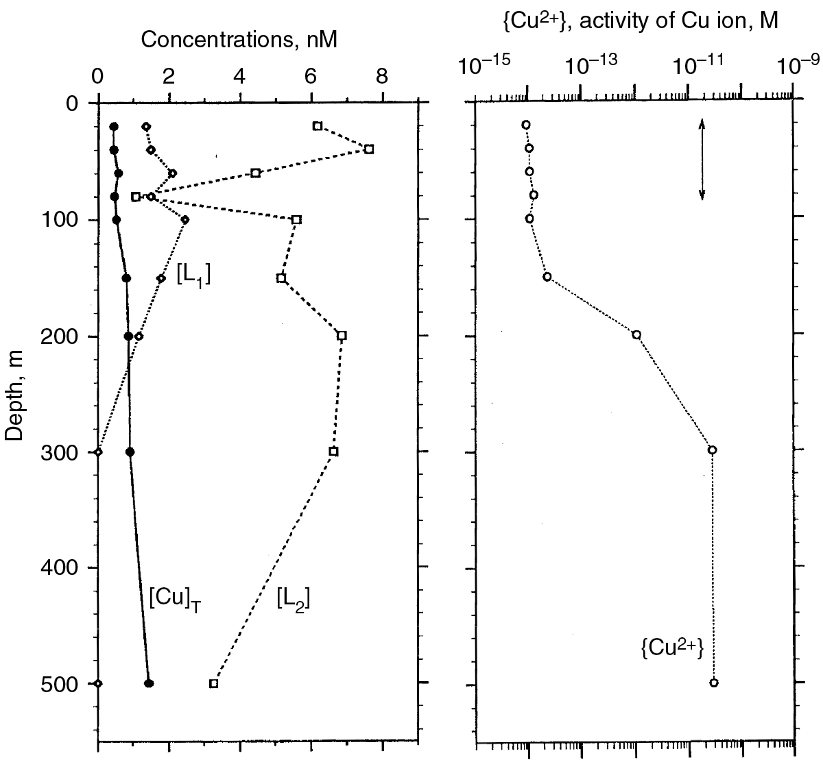
PILSON_Fig 09_15
© Cambridge University Press 2012

Slide 16
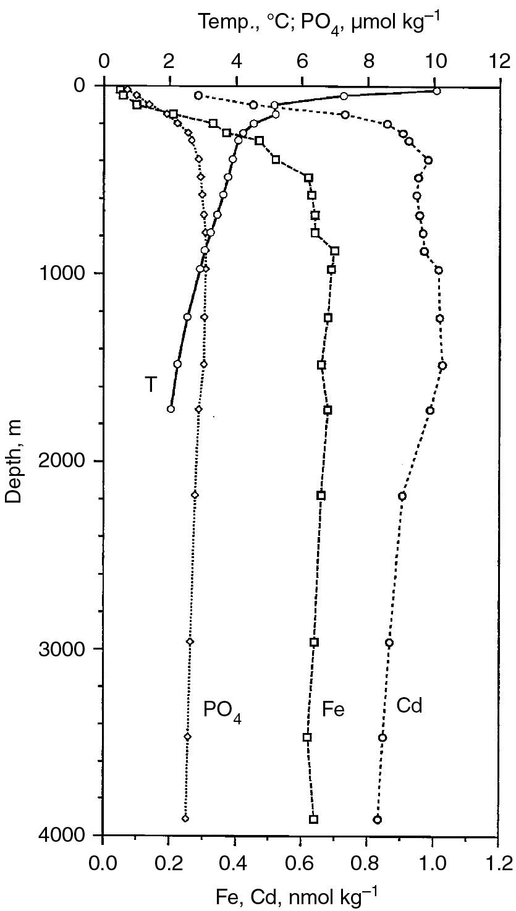
PILSON_Fig 09_16
© Cambridge University Press 2012

Slide 17
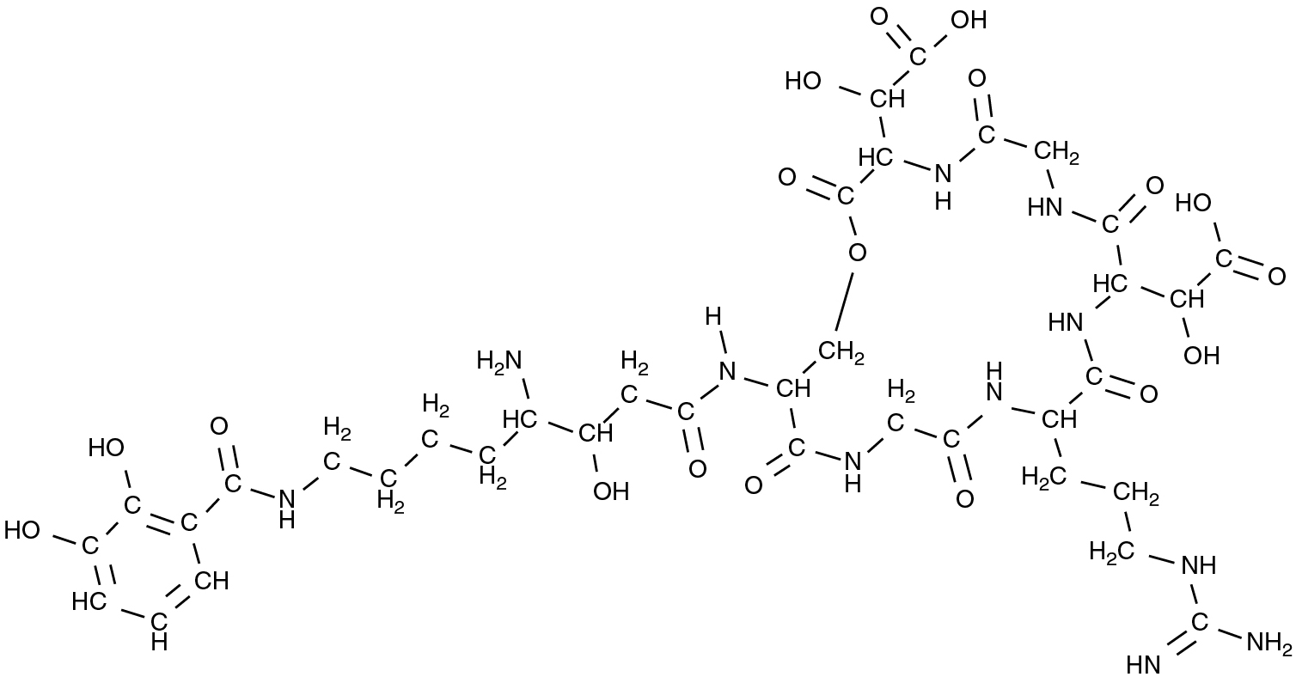
PILSON_Fig 09_17
© Cambridge University Press 2012

