Slide 1
Chapter 12
Asymptotic Capacity Analysis

Slide 2
Outline
Review of asymptotic analysis
Capacity scaling laws of wireless ad hoc networks
  Case 1: Protocol model
    An upper bound
    A lower bound
  Case 2: Physical model
    An upper bound
    A lower bound
  Case 3: Generalized physical model
    A lower bound

Slide 3
Review of asymptotic analysis
Asymptotic analysis
  To find how much information that the source nodes can send to their destination nodes as
    The node density goes to infinity, or
    The network area goes to infinity (with the same node density)
Notation
  f(n) = Ω(g(n)) if f(n) ≥Cg(n) for all n>n₀
  f(n) = O(g(n)) if f(n) ≤Cg(n) for all n>n₀
  f(n) = Θ(g(n)) if C₁g(n) ≤ f(n) ≤ C₂ g(n) for all n>n₀
    where C, C₁, C₂, n₀ are positive constraints
3

Slide 4
Interference models
Case 1: Protocol model
  A transmission is successful if
    The receiver is within a transmission range of the transmitter
    The receiver is outside an interference range of other transmitters
  The achievable rate of a successful transmission is a constant B
Case 2: Physical model
  A transmission is successful if the SINR at receiver is over certain threshold
  The available rate of a successful transmission is assumed to be a constant B
Case 3: Generalized physical model
  The achievable rate B of a transmission is determined by the Shannon capacity formula, i.e., B = Wlog₂(1+SINR)
4

Slide 5
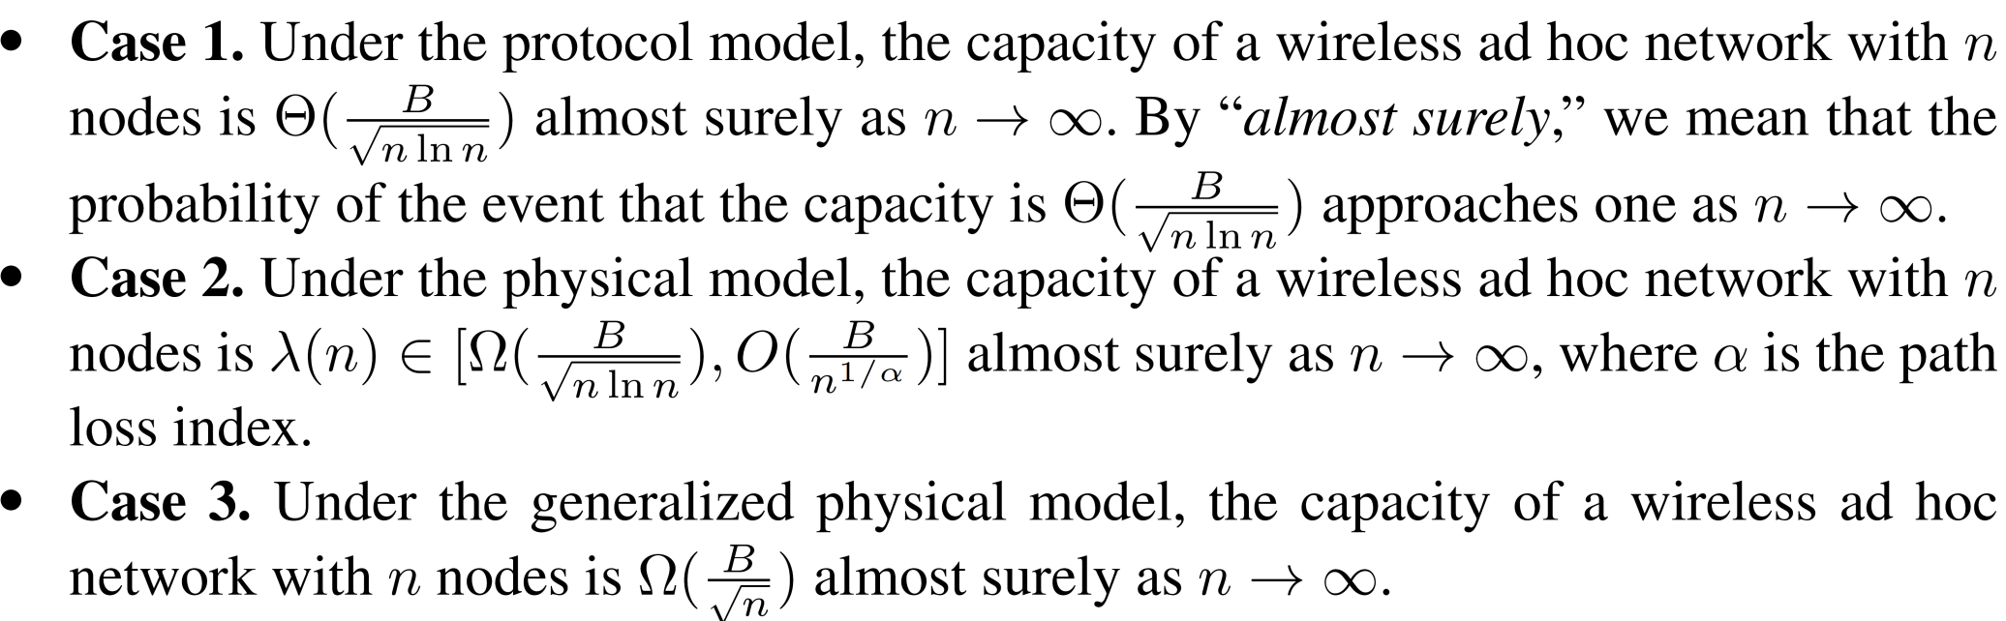
Main results
where n is the number of nodes in the network

Slide 6
Outline
Review of asymptotic analysis
Capacity scaling laws of wireless ad hoc networks
  Case 1: Protocol model
    An upper bound
    A lower bound
  Case 2: Physical model
    An upper bound
    A lower bound
  Case 3: Generalized physical model
    A lower bound

Slide 7
Case 1: Asymptotic capacity under the protocol model
Problem statement
  Setting
    An ad hoc network with large number of nodes
    Nodes are randomly distributed
    Each node has a randomly selected destination
    All nodes in the network have the same transmission range and interference range
  Goal:
    Find the maximum λ(n) that can be transported from each node to its destination
Approach
  Develop a capacity upper bound
  Develop a constructive lower bound
7

Slide 8
Outline
Review of asymptotic analysis
Capacity scaling laws of wireless ad hoc networks
  Case 1: Protocol model
    An upper bound
    A lower bound
  Case 2: Physical model
    An upper bound
    A lower bound
  Case 3: Generalized physical model
    A lower bound

Slide 9
Case 1: A capacity upper bound (1)
An upper bound on the asymptotic capacity under the protocol model
A sketch of a proof
  Let D be the mean distance between a source to its destination
  Then the mean number of hops for each S-D pair is at least D/r(n)
  Thus, the aggregate rate (AR) of the network is lower bounded by nDλ(n)/r(n)
9
Notes:
9

Slide 10
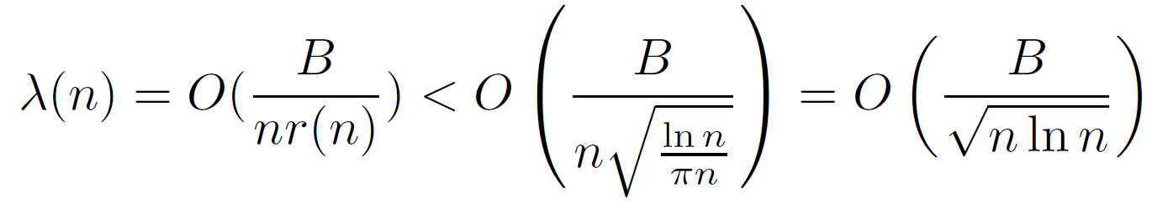
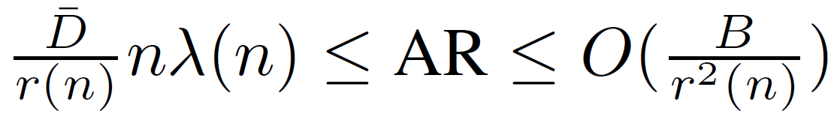
Case 1: A capacity upper bound (2)
  If we draw a disk of radius ∆r(n)/2 at each of the transmitting nodes, then these disk must be disjoint
  The number of disks is bounded by O(r⁻²(n)), indicating that the network can support O(r⁻²(n)) transmissions at any time
  Since the rate of each transmission is B, the AR is upper bounded by O(B/r²(n))
  Combining these two results, we have
10
Notes:
10

Slide 11
Outline
Review of asymptotic analysis
Capacity scaling laws of wireless ad hoc networks
  Case 1: Protocol model
    An upper bound
    A lower bound
  Case 2: Physical model
    An upper bound
    A lower bound
  Case 3: Generalized physical model
    A lower bound

Slide 12
Case 1: A capacity lower bound (1)
An lower bound on the asymptotic capacity under protocol model
This lower bound is obtained by constructing a feasible solution, which contains
    A routing scheme
      Divide the unit square area into small cells
      Use cell-based routing to avoid interference
    A scheduling scheme
      Identify the required number of time slots for scheduling
12
Notes:
12

Slide 13
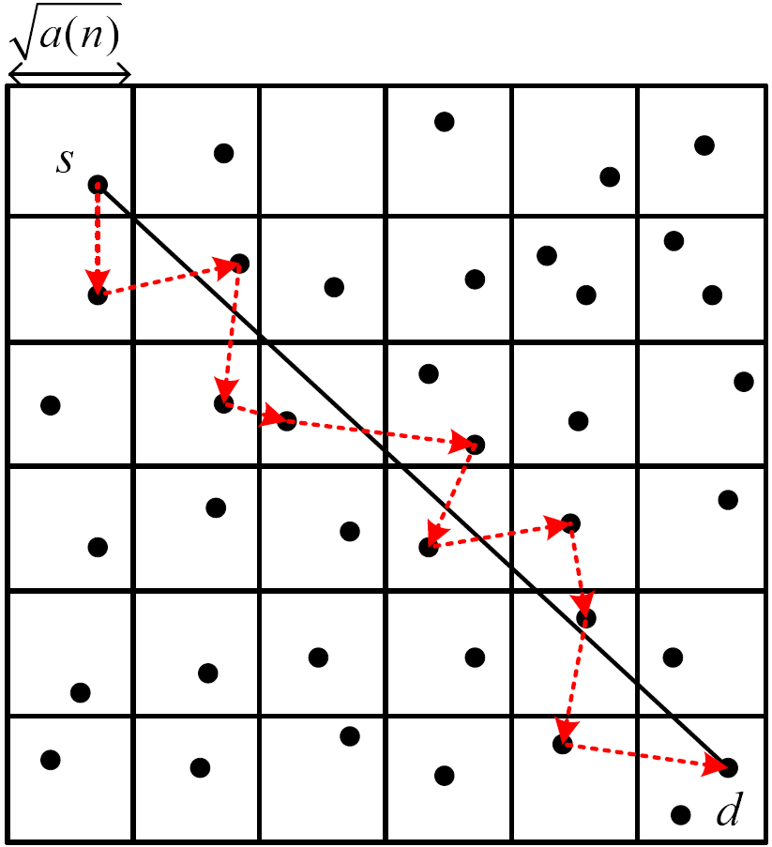
Case 1: A capacity lower bound (2)
—— Routing scheme
Divide the unit square into small squares with width √ln(n)/n, then the cell area is a(n) = ln(n)/n
Set transmission range of each node to r(n) = √5a(n)
  A node in a cell can transmit to a node in any of its neighboring cells
Draw a line to connect an S-D pair
13
Notes:
13

Slide 14
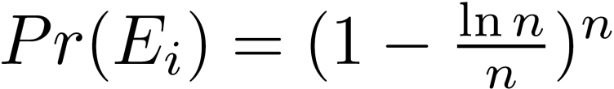


Case 1: A capacity lower bound (3)
—— Routing scheme
A sketch of a proof
  Each node can be in any cell with an equal probability of ln(n)/n. Let E_{i} be the event that this cell is an empty cell. Then,
  and
  We have when n→∞
14
Notes:
14

Slide 15
Case 1: A capacity lower bound (4)
—— Routing scheme
Define p_{ij} as the probability that the S-D line L_{i} passes through cell Q_{i}. Then we have
A sketch of a proof
  Denote X_{i} and Y_{i} as the source and destination of the S-D pair i
  X_{i} can fall either inside or outside the disk
15
Notes:
15

Slide 16
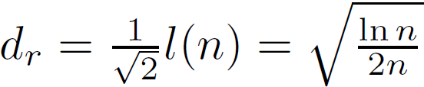
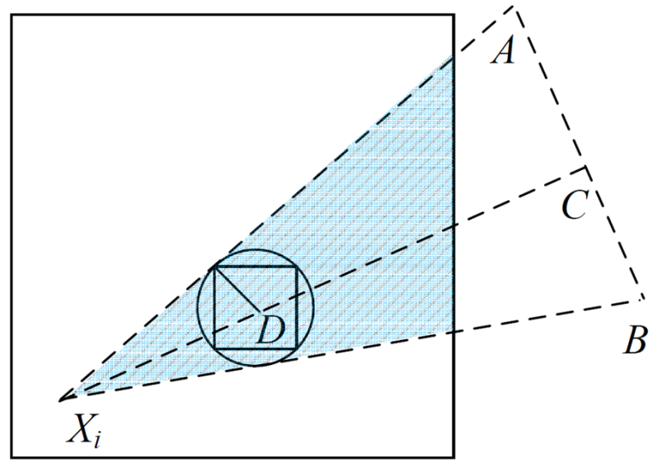
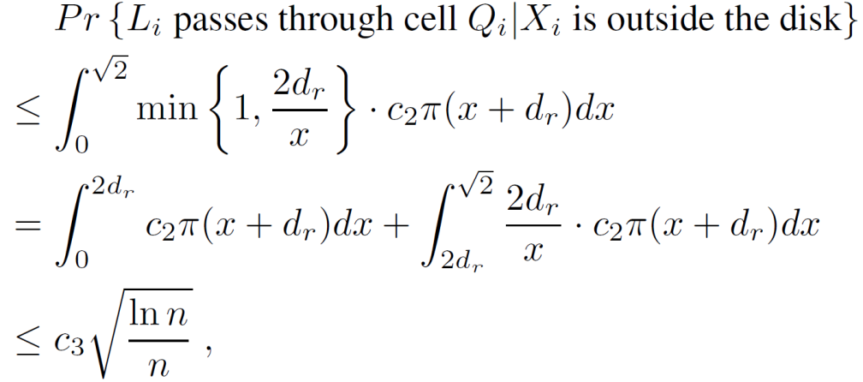
Case 1: A capacity lower bound (5)
—— Routing scheme
  Cell Q_{j} is contained in a disk of radius that is centered at Q_{j}’s center D
  Scenario 1: X_{i} falls outside the disk
        Let |X_{i}A| = |X_{i}B| and C is the midpoint of AB
        L_{i} passes through Q_{j} only if Y_{i} is in the shadowed area
        Since X_{i} is uniformly distributed, the probability density that it is at a distance x away from the disk is upper bounded by c₂∏(x+d_{r}) for some c₂. Thus,
16
Notes:
16

Slide 17
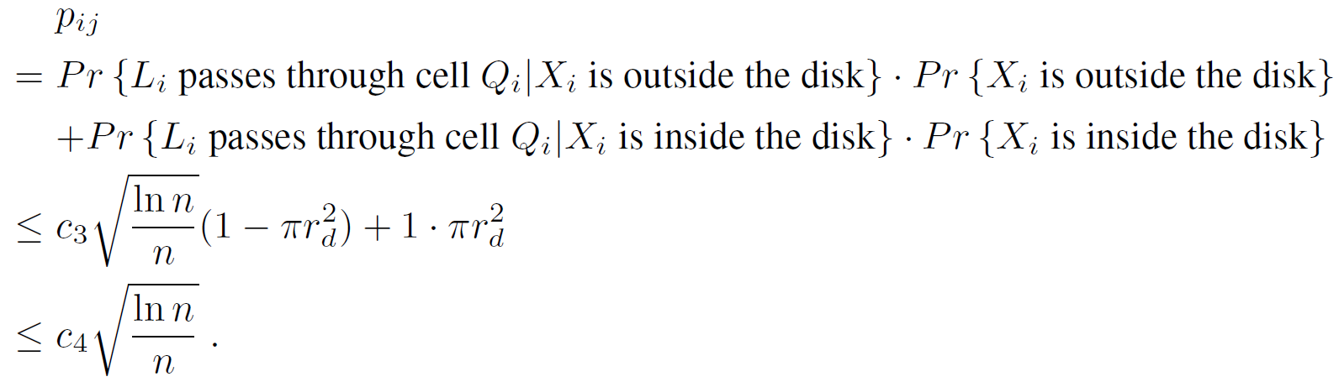
Case 1: A capacity lower bound (6)
—— Routing scheme
      Scenario 2: X_{i} falls inside the disk, we have
      Then, we have
17
Notes:
17

Slide 18
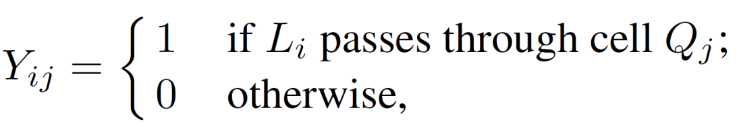
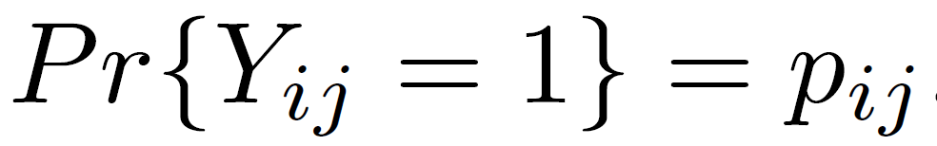
Case 1: A capacity lower bound (7)
—— Routing scheme
A sketch of a proof
  For 1≤ i ≤n and 1 ≤ j ≤ m, denote
  Then, we have
18
Notes:
18

Slide 19
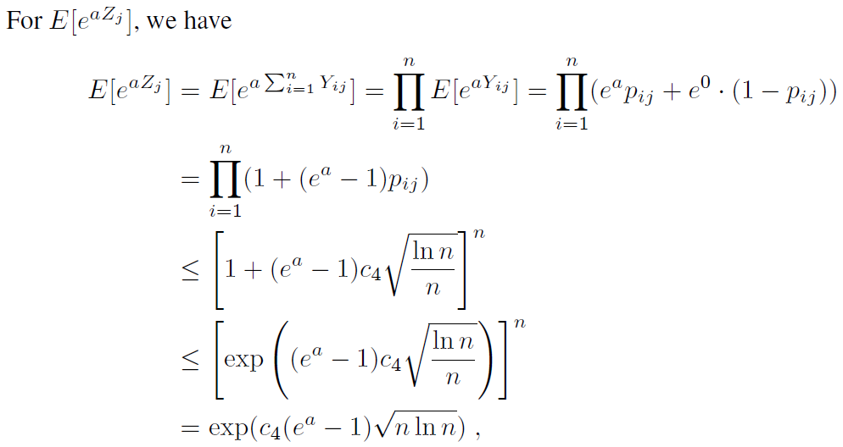
Case 1: A capacity lower bound (8)
—— Routing scheme
19
Notes:
19

Slide 20
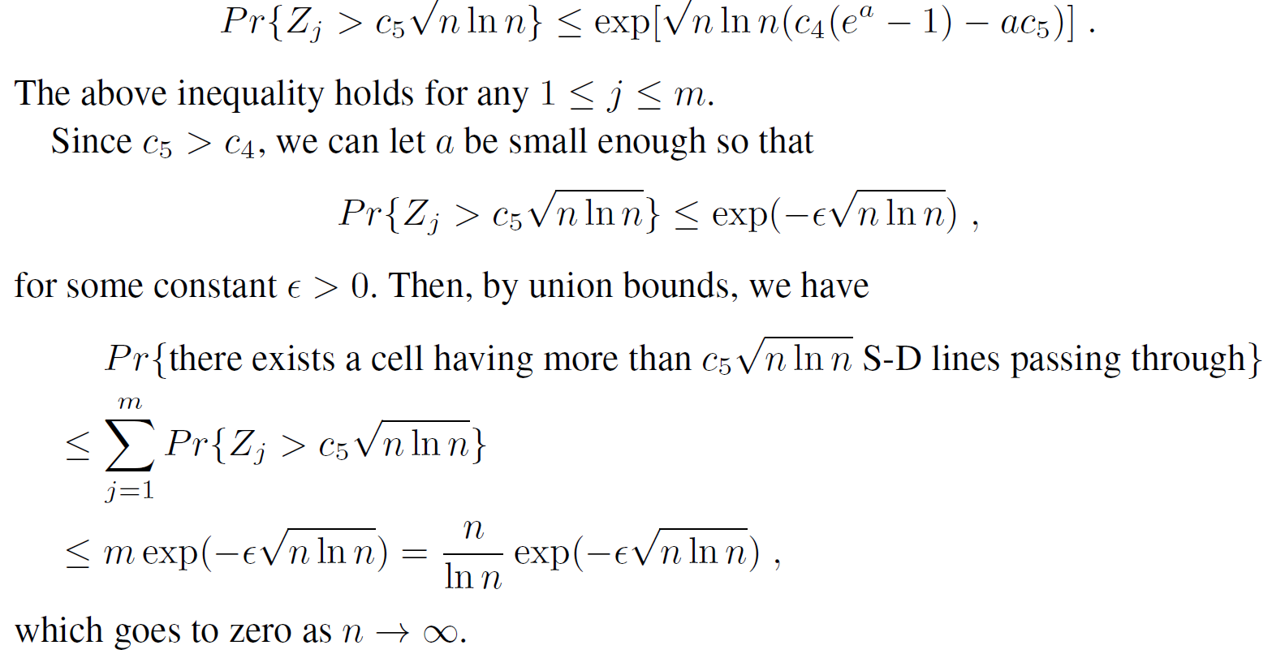
Case 1: A capacity lower bound (9)
—— Routing scheme
  Letting s = c₅sqrt(n ln(n)), we have
20
Notes:
20

Slide 21
Case 1: A capacity lower bound (10)
—— Scheduling scheme
Consider time slot based scheduling for cells
The number of time slots required for scheduling is determined by the number of conflicting links in the network
  First analyze the number of interfering cells
  Then analyze the number of conflicting links in an interfering cell
21
Notes:
21

Slide 22
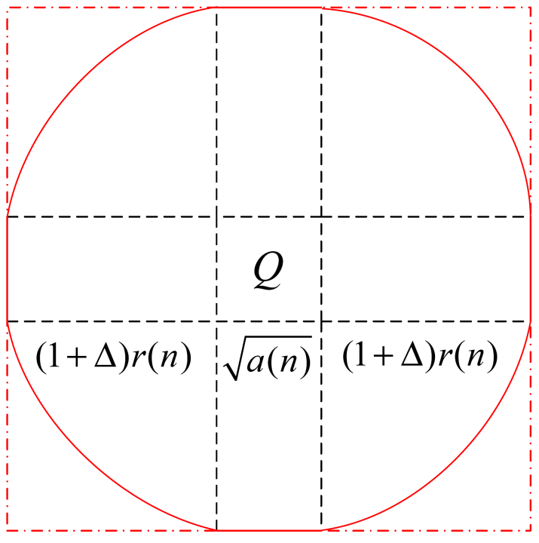
Case 1: A capacity lower bound (11)
—— Scheduling scheme
A sketch of proof
  We show that the number of interfering cells w.r.t cell Q is a constant
  For a receiving node j in cell Q, the transmitting nodes of the links that interfere with j must be within the area inside the solid line
22
Notes:
22

Slide 23
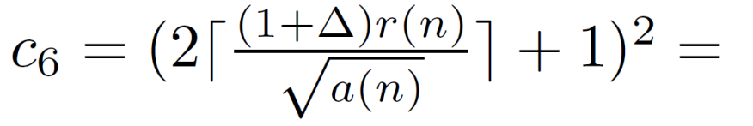
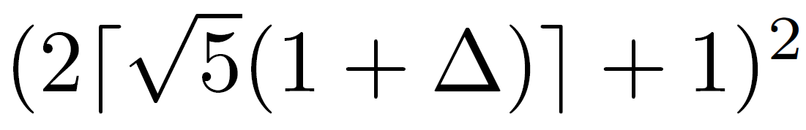
Case 1: A capacity lower bound (12)
—— Scheduling scheme
  To obtain an upper bound, we define the outermost square area as the interfering area that shall not have any transmitting node in it
  Hence, the number of interfering cells is no more than
23
Notes:
c₆ is a constant
23

Slide 24

Case 1: A capacity lower bound (13)
—— Scheduling scheme
  We analyze the number of links that interfere with link (i, j) in each interfering cell
  Based on Lemma 12.2 and the adopted routing scheme, the number of transmissions in a cell is equal to the number of S-D lines intersecting this cell, which is
  Following a similar analysis, we can obtain the same result on the number of conflicting links that are interfered by link (i, j).
  Then the number of all conflicting links for a link (i, j) is upper bounded by
24
Notes:
24

Slide 25
Case 1: A capacity lower bound (14)
A proof of the lower bound given by Theorem 12.2
  We show that the number of interfering cells w.r.t cell Q is a constant
  For a receiving node j in cell Q, the transmitting nodes of the links that interfere with j must be within the area inside the solid line
  We define the outermost square area as the interfering area that shall not have any transmitting node in it
  Hence, the number of interfering cells is no more than
25
Notes:
25

Slide 26

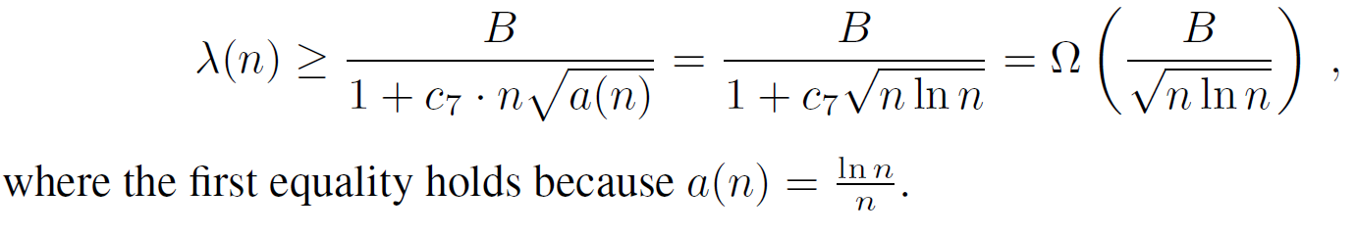
Case 1: A capacity lower bound (15)
  Divide one time frame into at most
  equal length time slots for scheduling
  Therefore, the achievable throughput λ(n) is given by
26
Notes:
26

Slide 27
Outline
Review of asymptotic analysis
Capacity scaling laws of wireless ad hoc networks
  Case 1: Protocol model
    An upper bound
    A lower bound
  Case 2: Physical model
    An upper bound
    A lower bound
  Case 3: Generalized physical model
    A lower bound

Slide 28
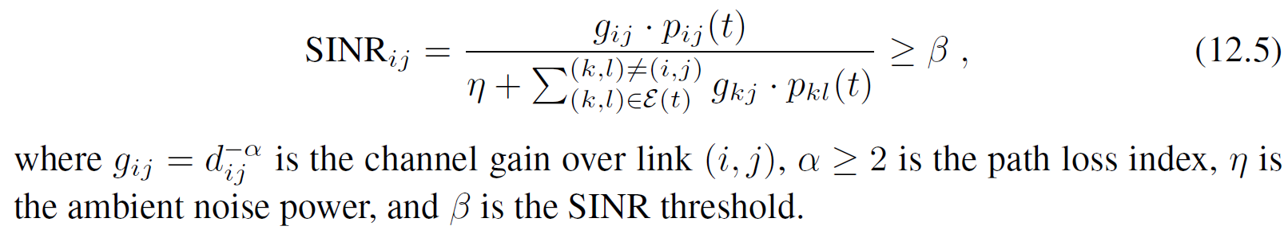
Case 2: Asymptotic capacity under the physical model
We analyze the capacity scaling law under the physical model
Each node is allowed to perform power control
A transmission with rate B is successful if and only if the SINR satisfies
Main result is summarized as follows
28
Notes:
Denote p_{ij}(t) as the power used by node i to transmit to node j.
28

Slide 29
Case 2: An upper bound (1)
Analyze the aggregate capacity-distance over T, denoted as ACD_{T}
By exploring the relationship between ACD_{T} and λ(n) as well as an upper bound for ACD_{T,} we have the following result
29
Notes:
29

Slide 30
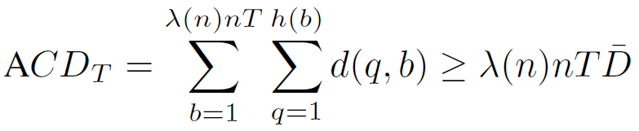

Case 2: An upper bound (2)
The relationship between ACD_{T} and λ(n)
  During T, the network can transport λ(n)nT units of data
  For a particular unit of data b, denote h(b) as the number of hops on its routing path and d(q, b) as the length of the q-th hop.
  We have , where is
  the average distance between source and destination
30
Notes:
30

Slide 31
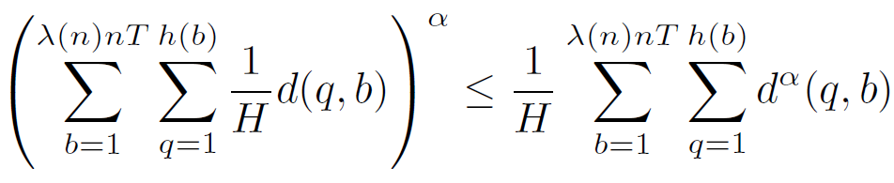

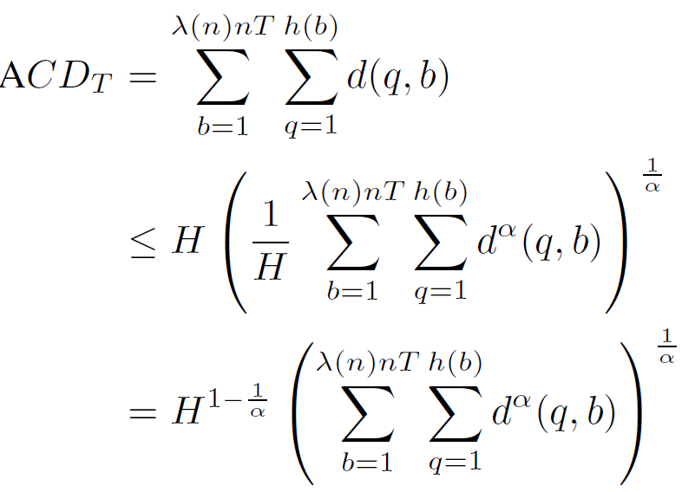
Case 2: An upper bound (3)
An upper bound for ACD_{T}
  Due to convex function f(x)=x^{α}, we have
  ,
  where
  We have
31
Notes:
31

Slide 32

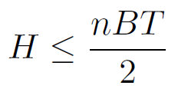
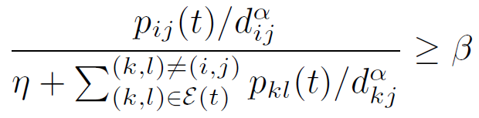
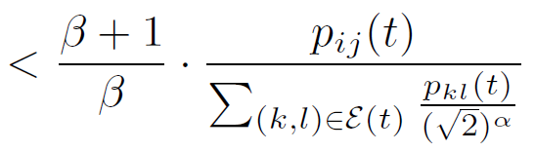

Case 2: An upper bound (4)
An upper bound for ACD_{T} (cont’d)
  We need to analyze H and
  An upper bound for H
    Due to half-duplex, at most n/2 nodes are transmitting at any time.
    A link’s capacity is B.
    Thus,
  An upper bound for
    For a transmission from node i to j, we have
    Then we have
32
Notes:
32

Slide 33
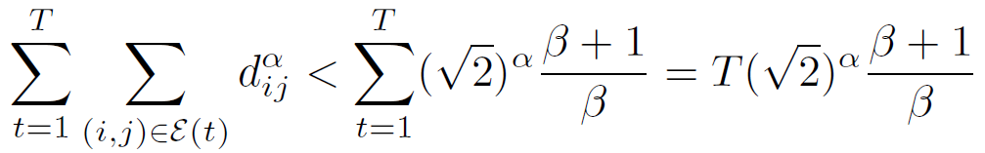
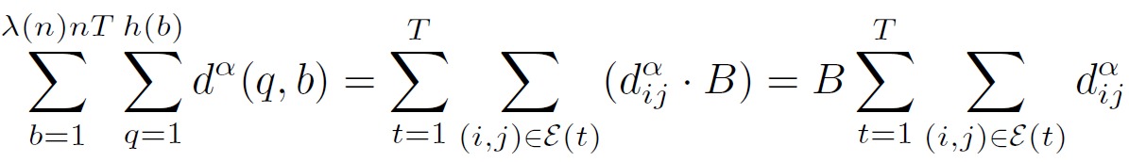
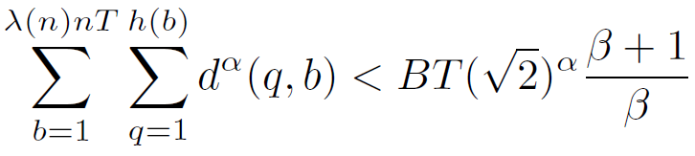
Case 2: An upper bound (5)
An upper bound for ACD_{T} (cont’d)
  An upper bound for (cont’d)
    Summing over all transmission over a time duration T, we have
    We also have
    ,
    where the first equality holds due to link capacity B.
    The above two results give us
33
Notes:
33

Slide 34
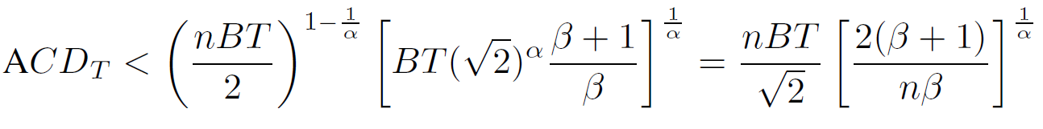
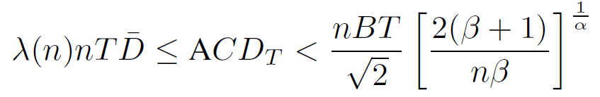
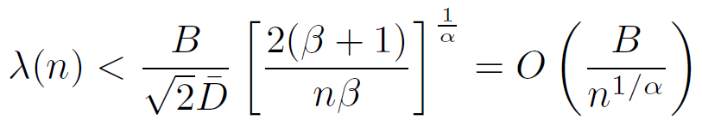
Case 2: An upper bound (6)
An upper bound for ACD_{T} (cont’d)
  With upper bounds for H and , we have
Then we have
and
34
Notes:
34

Slide 35
Outline
Review of asymptotic analysis
Capacity scaling laws of wireless ad hoc networks
  Case 1: Protocol model
    An upper bound
    A lower bound
  Case 2: Physical model
    An upper bound
    A lower bound
  Case 3: Generalized physical model
    A lower bound

Slide 36
Case 2: A lower bound (1)
A feasible solution can be used as a lower bound
The feasible solution developed for the protocol model can be applied to the physical protocol if ∆ is set to be large enough
The following theorem gives a lower bound
36
Notes:
36

Slide 37
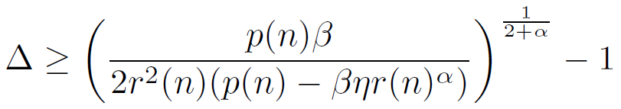

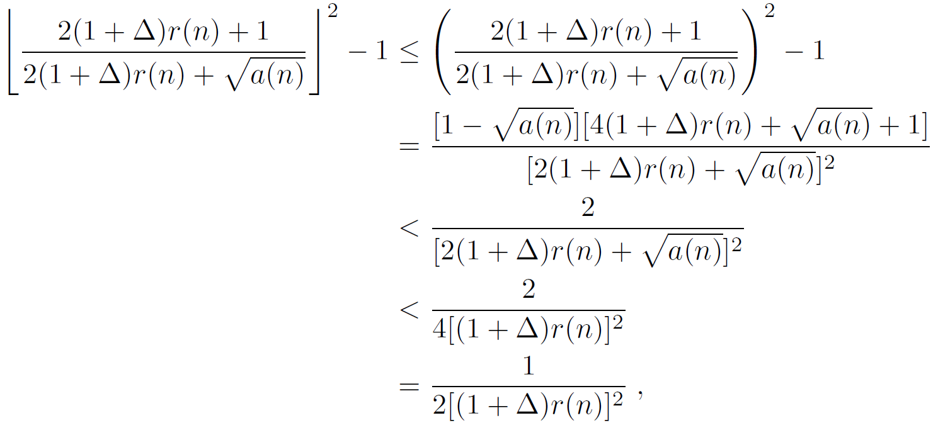
Case 2: A lower bound (2)
We set
Once a link (i, j) is active, nodes within a square with side length 2(1+∆)r(n)+ cannot transmit
The number of links that interfere with link (i, j) is at most
37
Notes:
37

Slide 38

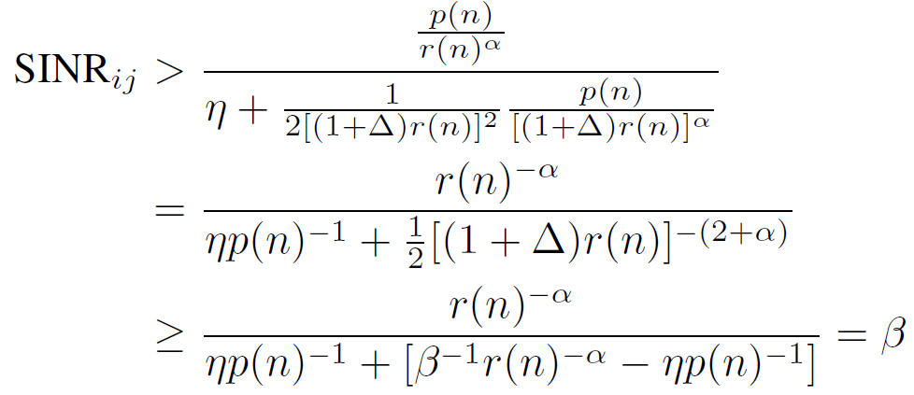

Case 2: A lower bound (3)
The interference from each of these links is at most
We have
Thus, the constructed solution is feasible.
We have the same lower bound
38
Notes:
38

Slide 39
Outline
Review of asymptotic analysis
Capacity scaling laws of wireless ad hoc networks
  Case 1: Protocol model
    An upper bound
    A lower bound
  Case 2: Physical model
    An upper bound
    A lower bound
  Case 3: Generalized physical model
    A lower bound

Slide 40
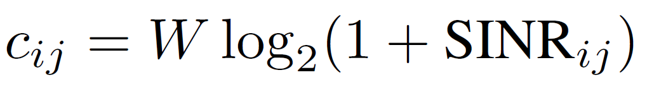
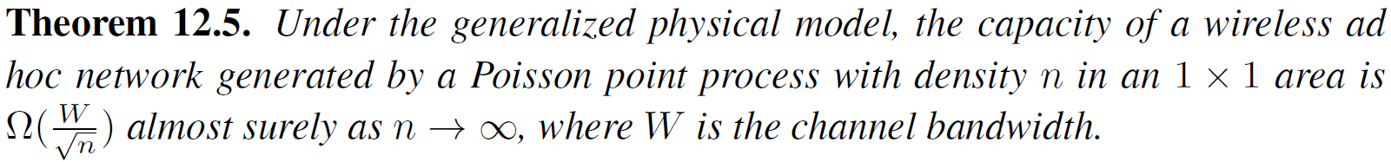
Case 3: Asymptotic capacity under the generalized physical model
The achievable rate from node i to node j is
This model is the most challenging one among the three models
  The asymptotic upper bound for this model remains open
  A lower bound by applying the Percolation theory is developed
40
Notes:
40

Slide 41
Case 3: A lower bound (1)
Consider a random network generated by a Poisson point process with density n in an 1x1 area
Each node is the destination of exactly one source
All nodes use the same transmitting power
Main idea
  Divide the entire network area into small cells
  A solution on multi-hop routing is based on a highway system in the network
  A single node in each cell that is crossed by a highway path is selected to transmit data along this highway
41
Notes:
41

Slide 42
Case 3: A lower bound (2)
A feasible solution can be used as a lower bound
Two steps to establish a lower bound
  Construction of the highway
  Deriving a feasible solution based on the highway
    Routing scheme
    Scheduling scheme
42
Notes:
42

Slide 43
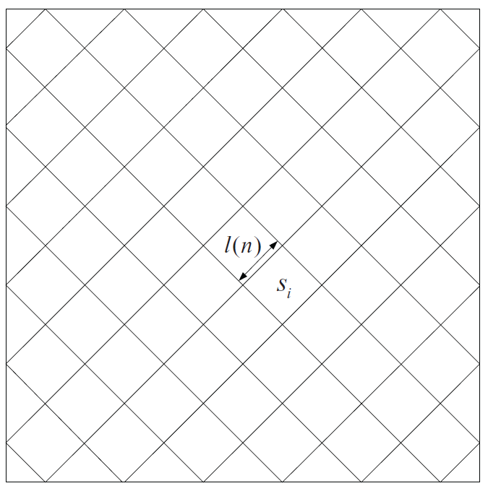


Case 3: A lower bound (3)
Construction of the highway
  Let and
  Partition the area into cells
  A cell is empty if there is no nodes in this cell
43
Notes:
43

Slide 44
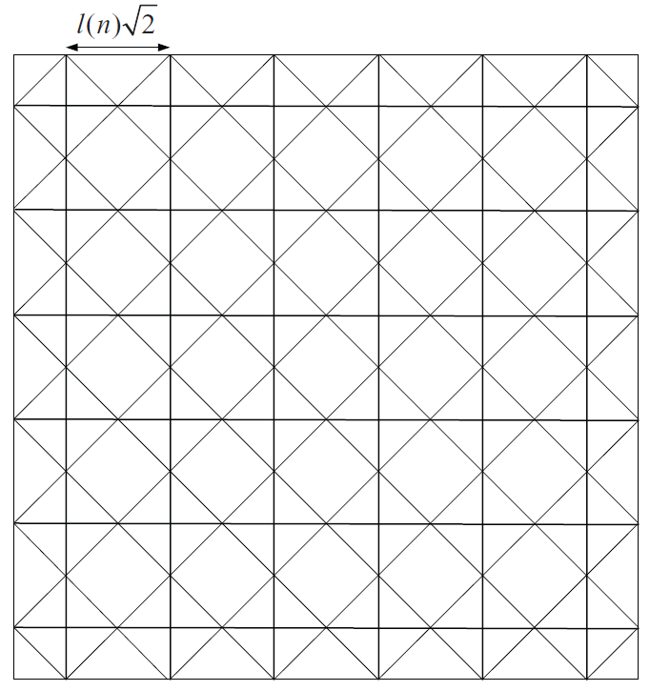

Case 3: A lower bound (4)
Construction of the highway
(cont’d)
  Draw m(n) horizontal lines and m(n)
  vertical lines across half of the cells
  A path include some segments from
  these lines
  A path is open if it does not cross
  any empty cell
  We call these paths as the highway system
There are at least open paths crossing the network area between left and right sides and paths between left and right sides.
44
Notes:
44

Slide 45
  Case 3: A lower bound (5)
An end-to-end transmission has four phases
  Phase i: Nodes send their data to a node in the highway via one-hop transmissions
  Phase ii: Data is carried by a horizontal highway path
  Phase iii: Data is carried by a vertical highway path
  Phase iv: Data is delivered from a node in the highway to the destination nodes via one-hop transmission
Routing scheme
  For Phases (ii) and (iii), a highway system for data transmission has been built in previous part
  For Phases (i) and (iv), we now design a routing scheme and show that the hop length is at most
45
Notes:
Kappa is a constant.
45

Slide 46


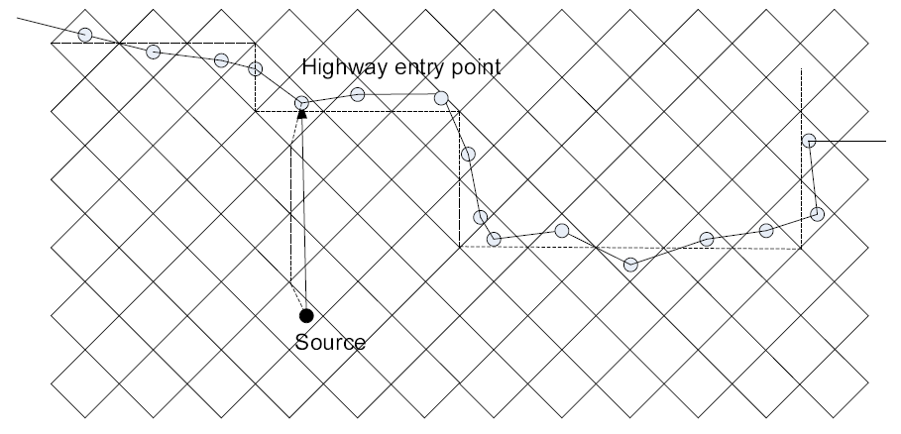
  Case 3: A lower bound (6)
Routing scheme for Phase (i)
  Slice network area into horizontal strips of height
    One strip corresponds to one cross path
  Identify an entry point for each source in a strip
    The source and entry point is within diagonal cells
Routing scheme for Phase (iv) is similar
46
Notes:
46

Slide 47
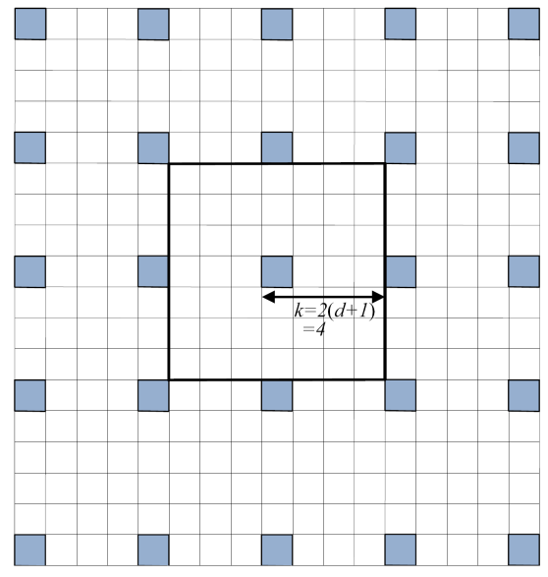
  Case 3: A lower bound (7)
Scheduling scheme
  Design a time slot based scheduling
  Basic idea: when a node transmits, the nodes within its interference range cannot transmit simultaneously, but the nodes outside this distance can transmit
  k² time slots are used for scheduling, where k=2(d+1)
  A set of cells that are allowed
  to transmit in a time slot
47
Notes:
47

Slide 48
  Case 3: A lower bound (8)
Scheduling scheme (cont’d)
48
Notes:
48

Slide 49
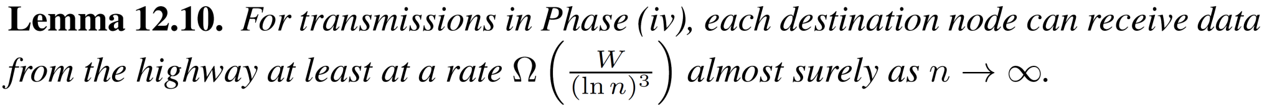
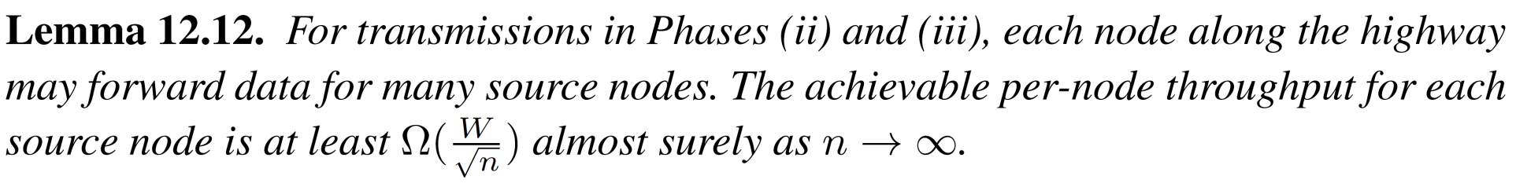
  Case 3: A lower bound (9)
Analyze the achievable per-node throughput in Phases (i)–(iv)
49
Notes:
49

Slide 50

  Case 3: A lower bound (10)
The communication bottleneck resides in the highway Phases (ii) and (iii) with a per-node throughput of
The analyzed lower bound
50
Notes:
50

Slide 51
Summary
Studied the asymptotic capacity of three interference models
  Case 1: Protocol model
  Case 2: Physical model
  Case 3: Generalized physical model
51

