Slide 1
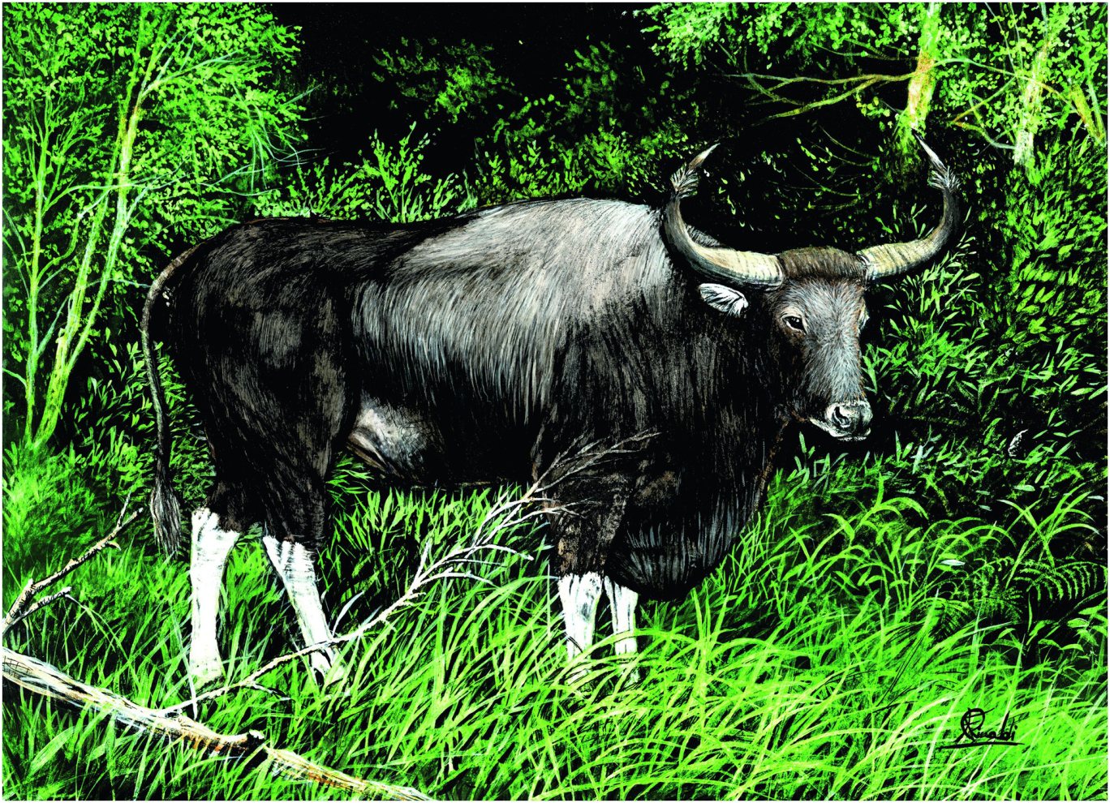
Plate 17
Kouprey (illustration by Francesco Rinaldi)

Slide 2
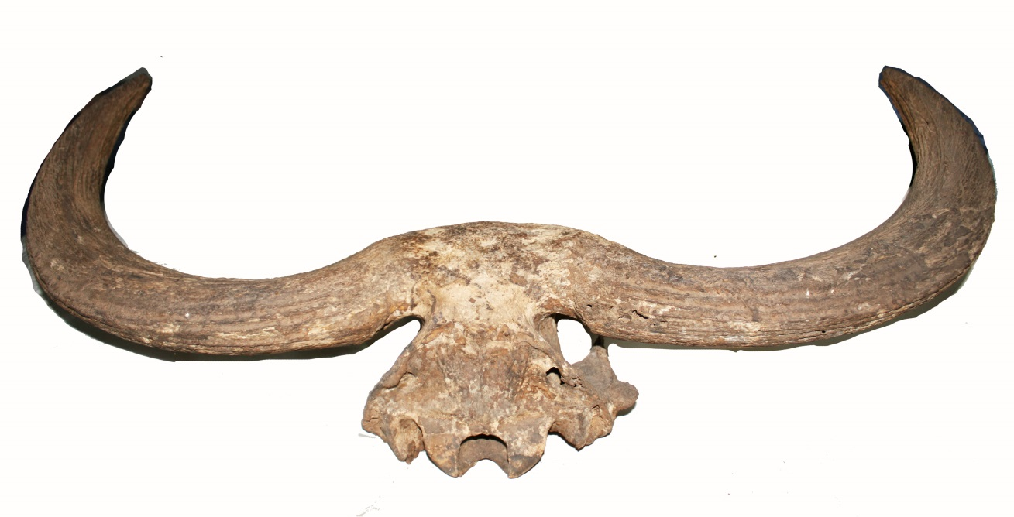
Figure 14.1
Pleistocene horn fossil found in Thailand (Photo by C. Vidthayanon, Collection of Zoology).

Slide 3
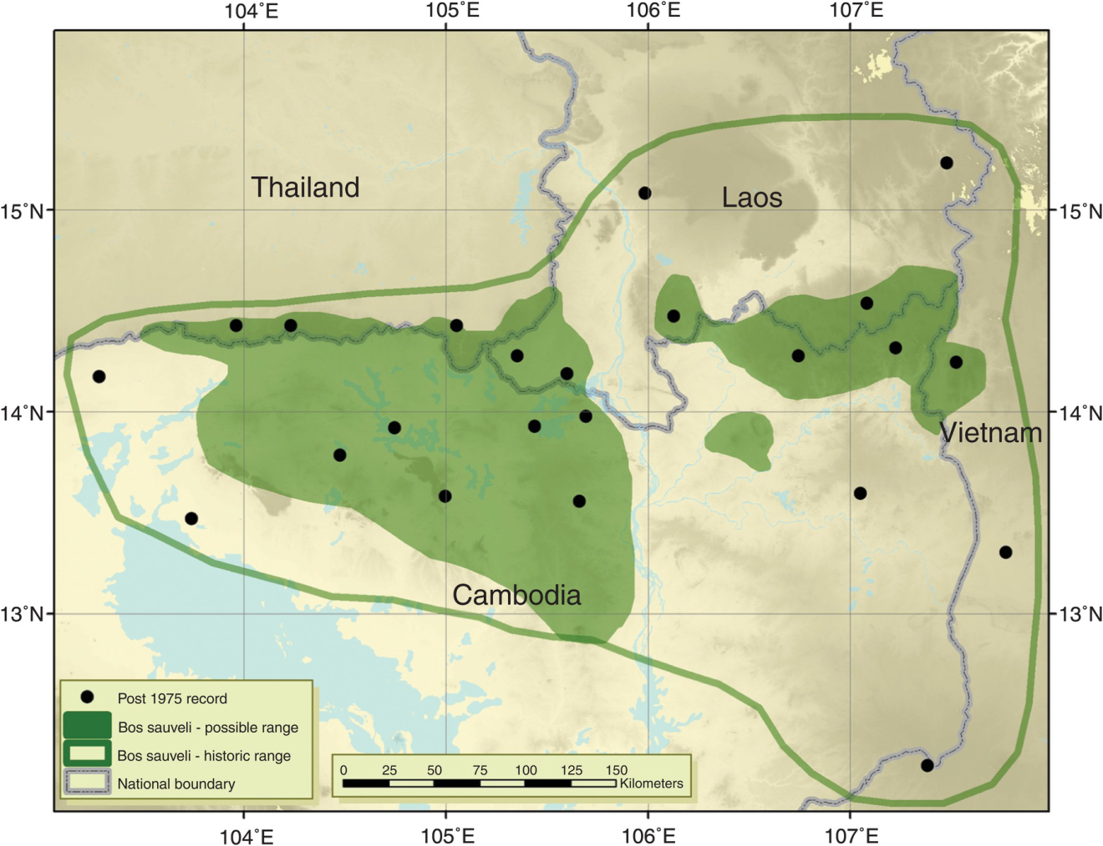
Figure 14.2
A zoomed in map showing the possible range of Kouprey, along with post-1975 records from villagers and other sources.
Adapted from MacKinnon, J. R. and S. N. Stuart. (1989).

