Slide 1
Fibre Amplifiers and Lasers for Near-IR Spectroscopy
Applications

Slide 2
Typical Application Areas
Fibre amplifiers may be used to boost the power from a DFB laser source in wavelength modulation spectroscopy or photo-acoustic spectroscopy applications.
Fibre lasers have a broad tuning range of ~100nm and may be used as sources for near-IR spectroscopy.
Mode-locked fibre lasers are used for the generation of frequency combs in dual comb spectroscopy.
A fibre laser acts as a high finesse cavity which may be used to enhance the sensitivity with an intra-cavity cell.

Slide 3
Examples of Applications of Fibre Amplifiers in Near-IR Spectroscopy
Boosting the optical power in a large area fibre optic network where the output from a single laser source with WMS is split into a large number of paths for multiple sensing points.
Laser tomographic imaging where ~100 laser beams derived from a single modulated source are used to create 2-d real-time images of exhaust emissions.
Sensitivity improvement in photo-acoustic spectroscopy by generation of a high power output from a modulated DFB source by an erbium or Raman fibre amplifier.

Slide 4
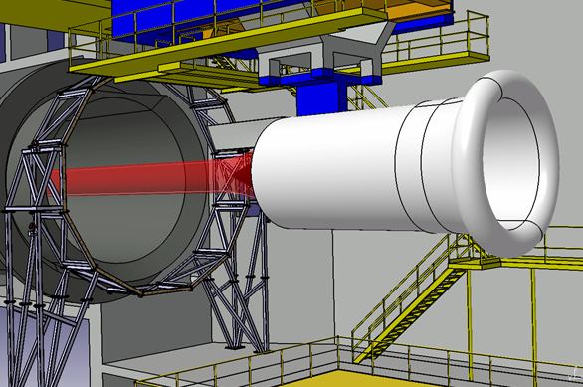
Tomographic Imaging of CO₂ Emissions from Aero-Engines
Multiple laser beams directed through the exhaust plume
Aero-engine in testbed
The modulated output of a single DFB laser is amplified from a few milliwatts to a few watts by a thulium-doped fibre amplifier and is then split and fibre coupled to ~100 different paths through the exhaust plume.

Slide 5
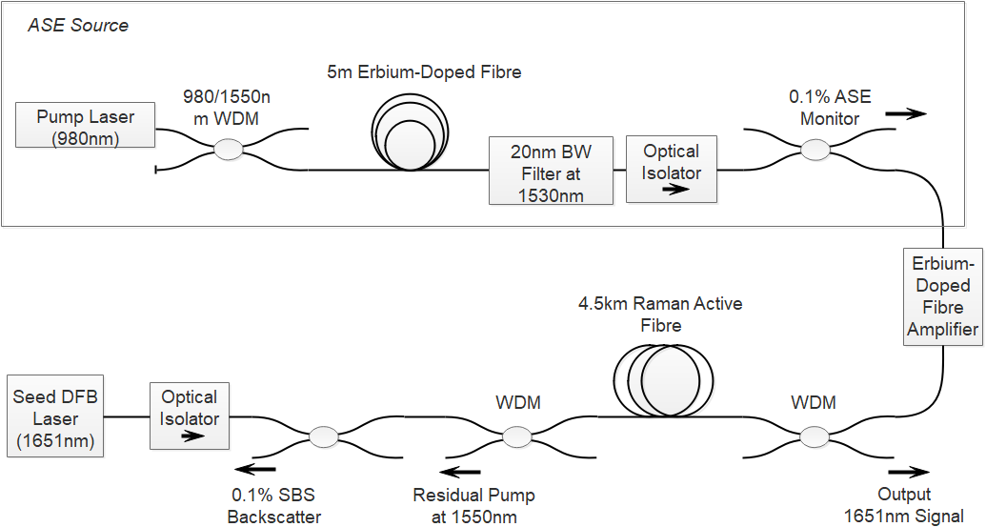
Example of a Raman Fibre Amplifier for Generation of a High Power Output at 1651nm for PAS of CH₄ [Bauer]
Pump for Raman active fibre
Seed laser modulated as in standard PAS but with additional 500kHz FM for SBS suppression

Slide 6
Examples of Fibre Lasers as Sources for Near-IR Spectroscopy
Erbium fibre lasers have a broad tuning range of ~100nm and may be used for near-IR spectroscopy of several gases, with WMS performed through a PZT and fibre Bragg gratings.
Selection of individual gas cells in a multipoint fibre network may be performed by choice of the mode-lock frequency in a mode-locked fibre laser system.
Thulium fibre lasers give an output up to 2100nm and may be used for the spectroscopy of gases such as CO₂.

Slide 7
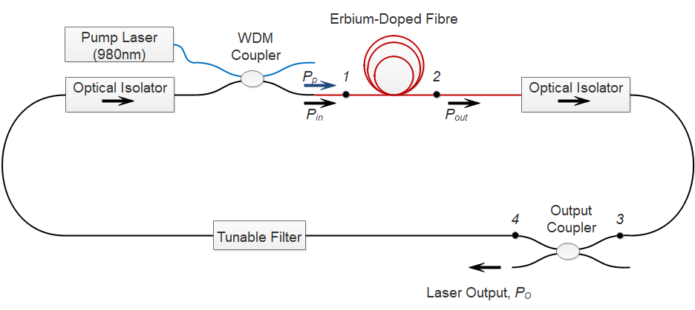
Basic Ring Cavity Erbium Fibre Laser Source for Spectroscopy Applications

Slide 8
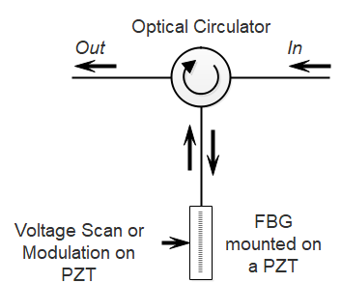
FBG and a PZT for Tuning, Modulation and Scanning of Fibre Laser Wavelength in WMS Applications

Slide 9
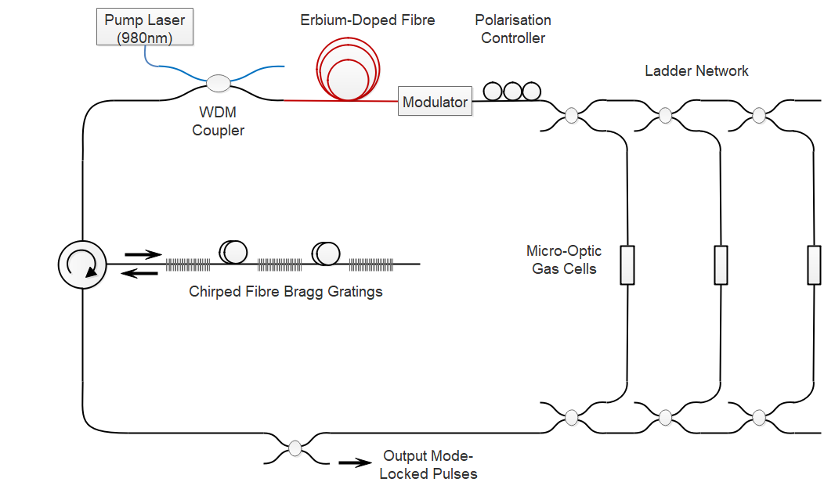
Mode-Locking of a Fibre Laser for Addressing Multiple Gas Cells
Cells addressed by matching the mode-lock frequency to the round-trip time for each cell.
Mode-lock frequency may also be used to select a particular FBG and hence operation wavelength by using delay lines

Slide 10
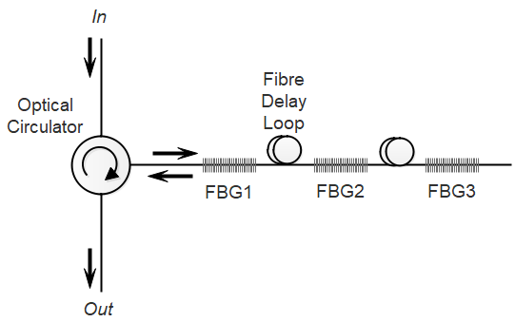
Wavelength Selection and Tuning by Adjustment of the Mode-Lock Frequency
Wavelength tuning may be performed by a chirped FBG with dispersion, D. For a cavity round-trip time of τ, the wavelength tuning is related to a fractional shift in the mode-lock frequency by:

Slide 11
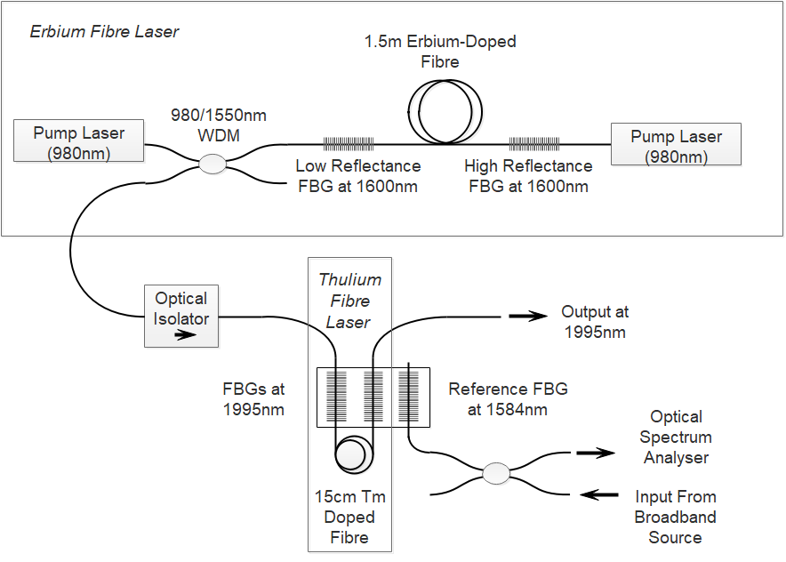
Example of a Thulium Fibre Laser for CO₂ Detection at ~2μm Wavelength [Bremer]
Pump source for thulium fibre laser (1600nm erbium fibre laser)
1600nm pump for thulium fibre

Slide 12
Frequency Comb Spectroscopy with Fibre Lasers
The comb output of a mode-locked fibre laser effectively acts as a parallel set of thousands of narrow-linewidth CW laser sources.
Frequency comb spectroscopy can be used to probe absorption features over a very large bandwidth, typically 10 – 100nm and at a very high resolution of ~200MHz.
Erbium and ytterbium-doped fibre laser combs in the near-IR are widely available commercially.
Near-IR fibre combs can also be used for the generation of mid-IR combs by down-conversion in a non-linear crystal.

Slide 13
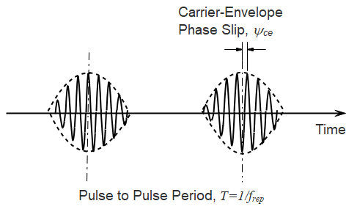
Output of a Mode-Locked Laser in the Time Domain
As a result of the unequal phase and group velocities of the carrier and the pulse envelope, the carrier phase slips with respect to the envelope by an amount of ψ_{ce} on each round trip, corresponding to a carrier-envelope-offset frequency of:

Slide 14
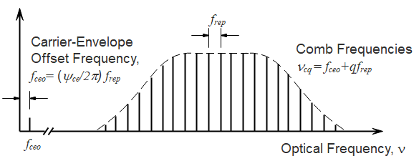
Output of a Mode-Locked Laser in the Frequency Domain
The two frequencies f_{ceo} and f_{rep} are in frequency range of 10⁶ – 10⁹ Hz so a stable comb of well-defined optical frequencies may be realised through control of these two RF frequencies.

Slide 15
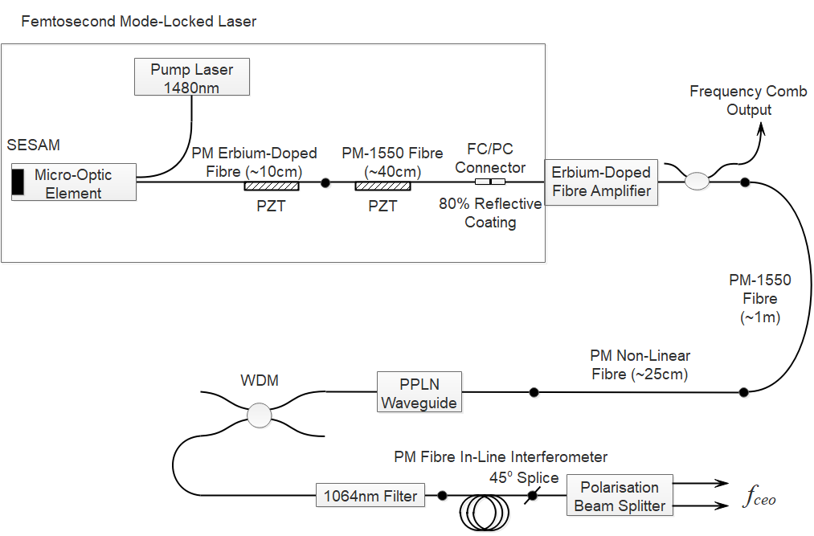
Example of a Field-Deployable Erbium Fibre Laser Comb [Sinclair]
SESAM=SEmiconductor Saturable Absorber Mirror
Extraction of the carrier-envelope offset frequency, f_{ceo}
f_{ceo} locked to a stable RF frequency

Slide 16
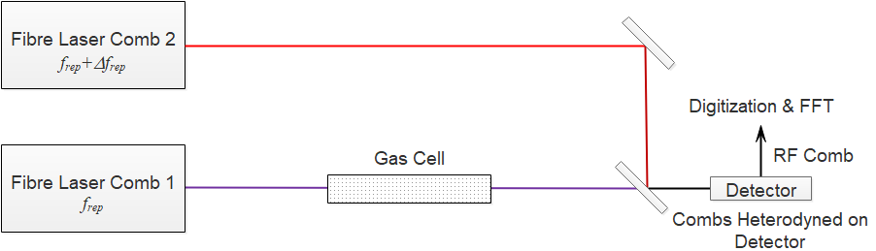
Dual Comb Spectroscopy
In dual-comb spectroscopy, two mode-locked lasers generate frequency combs with a small difference in their repetition rate, typically 100 – 1000Hz, and one (or both) combs are passed through the gas cell.
Interference between the comb lines produces an RF comb on the detector, with the optical absorption features transferred to the RF comb.

Slide 17
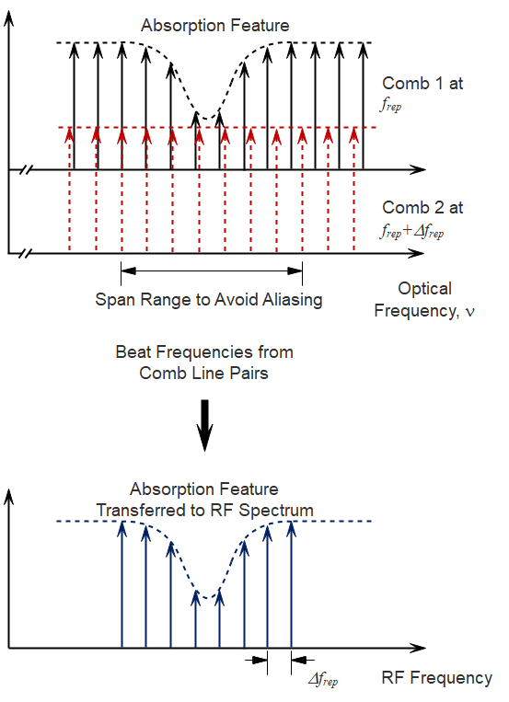
Frequency Domain View of Dual-Comb Output
The limit on the optical spectrum width to avoid aliasing is:
The optical spectrum is compressed to a RF spectrum of width:

Slide 18
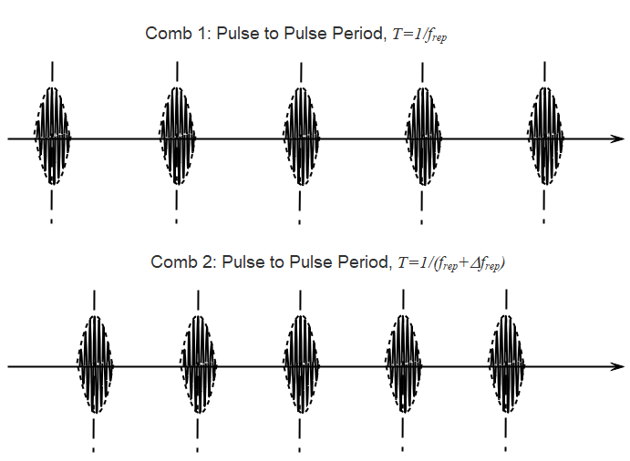
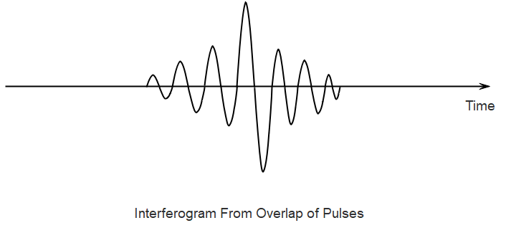
Time Domain View of Dual Comb Output
The pulse train of one comb effectively samples the pulse train of the other comb and the Fourier transform of the resulting interferogram gives the RF spectrum

Slide 19
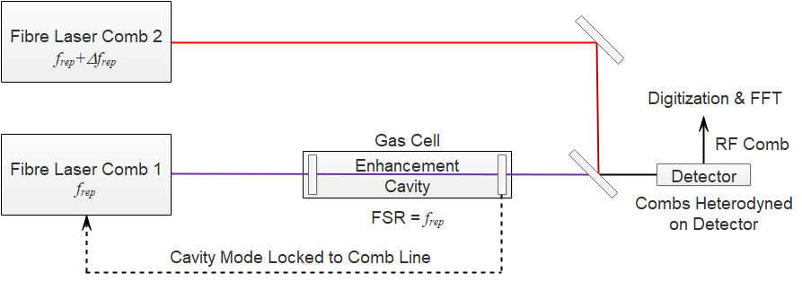
Cavity-Enhanced Dual Comb Spectroscopy
The gas cell is a high finesse optical cavity with its FSR matched to the pulse repetition frequency of comb 1 and with a comb line locked to one of the cavity modes. The cell length enhancement factor is: where F is the finesse and R the reflectivity.

Slide 20
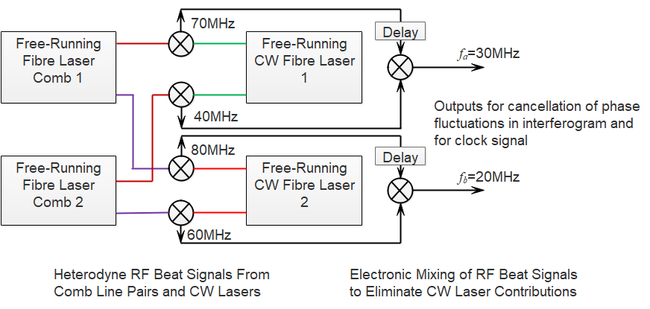
Use of Free-Running Dual Combs with an Adaptive Approach [Ideguchi]
A 50MHz signal, generated electronically as 3f_{a}-2f_{b} is multiplied with the interferogram signal before digitisation to compensate for phase fluctuations of the interferogram signal. A second signal at 100MHz, generated as 10(f_{a}-f_{b} ) provides an adaptive clock signal, triggering the data acquisition of the interferogram and accounting for timing fluctuation of the pulses.

Slide 21
Examples of Applications of Near-IR Fibre Laser Combs in Spectroscopy
Atmospheric trace gas monitoring [Rieker et al.]: measurement of ~700 absorption lines at sub-1kHz accuracy over 1600 – 1670nm with open air path lengths of 2km. CO₂, ¹³CO₂, CH₄, H₂O, HDO concentrations measured, with a precision of <1ppm for CO₂ and <3ppb for CH₄.
Field-deployable systems [Coburn et al.]: continuous detection, location and quantification of methane emissions over areas of several square kilometres with a sensitivity of ~2 ppb·km for CH₄ and the ability to monitor emission rates down to 1.6 g min⁻¹ from a distance of 1 km.
Power plants [Schroeder et al.]: simultaneous measurements of temperature, H₂O and CO₂ concentration in the exhaust of a 16 MW stationary gas turbine .

Slide 22
Sensitivity Enhancement by Multiple Circulations Through a Gas Cell Within a Fibre Laser Cavity
Fibre Loop Cavity for Ring-Down Spectroscopy.
Sensitivity Enhancement Near Threshold in CW Fibre Lasers
ASE Within a Fibre Laser Cavity for Spectroscopy
Intra-Cavity Photo-Acoustic Spectroscopy
Intra-Cavity Laser Absorption Spectroscopy (ICLAS)

Slide 23
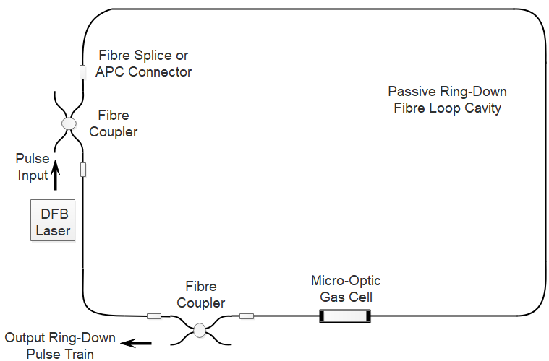
Simple Optical Fibre Loop for Ring-Down Spectroscopy
Γ_{dB} is the round-trip loop loss in units of decibels, τ is the round-trip time and t_{r} is the ringdown time
Number of circulations in loop:
Small number of circulations since Γ_{dB} is ~1dB, hence need to compensate for loss.

Slide 24
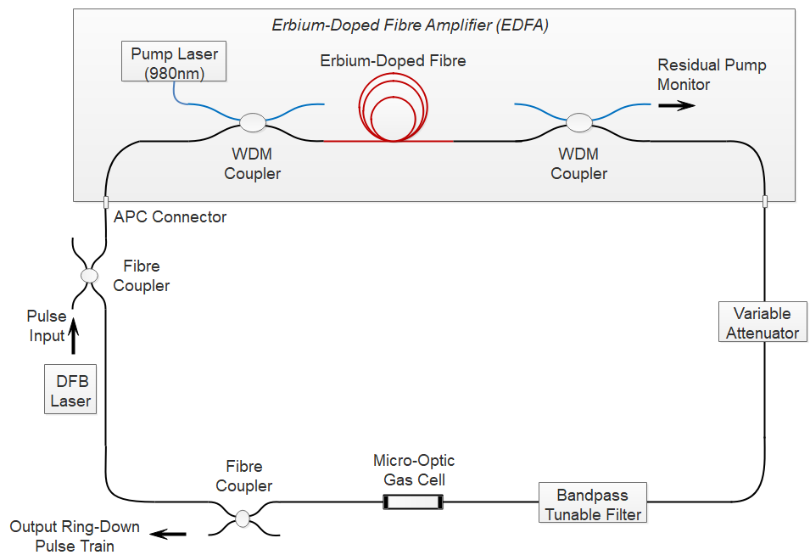
Ring-Down Loop With An EDFA to Compensate for Background Loss

Slide 25
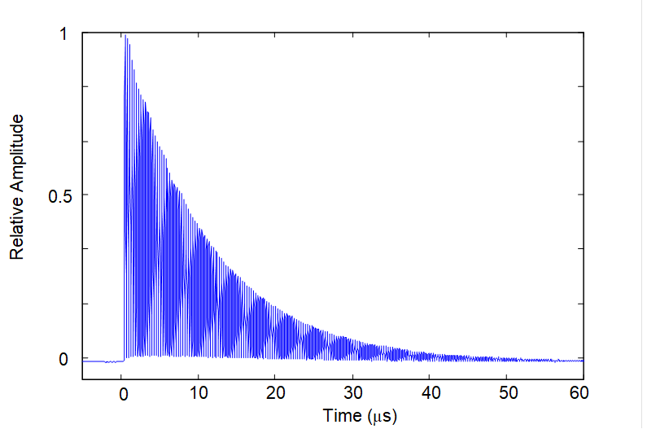
Typical Ring-Down Pulse Train from Fibre Loop (EDFA Gain Just Below Threshold)

Slide 26
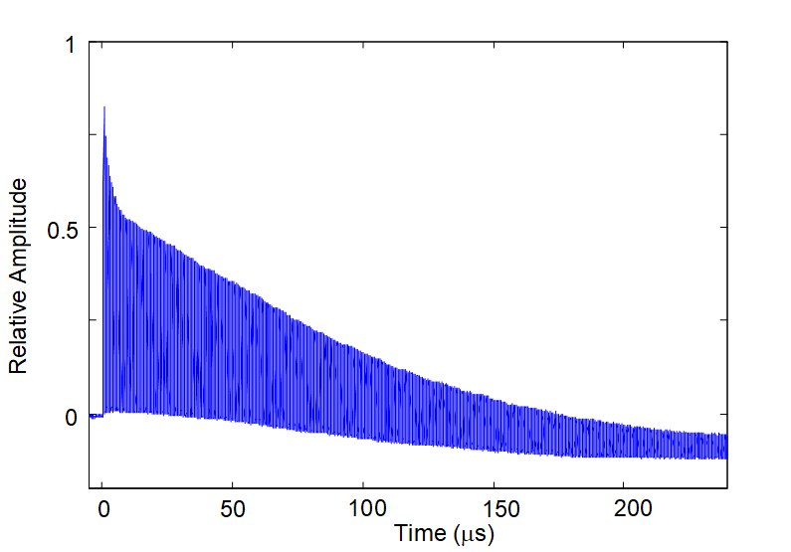
Typical Ring-Down Pulse Train from Fibre Loop (EDFA Gain Above Threshold)

Slide 27
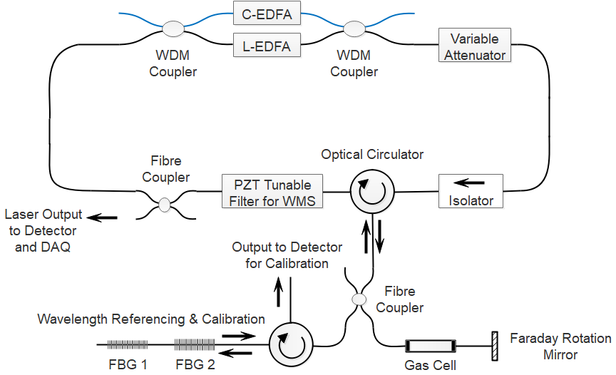
Near-Threshold Operation of a CW Fibre Laser With an Intra-Cavity Gas Cell [Liu et al.]
Sensitivity enhancement just above threshold condition

Slide 28
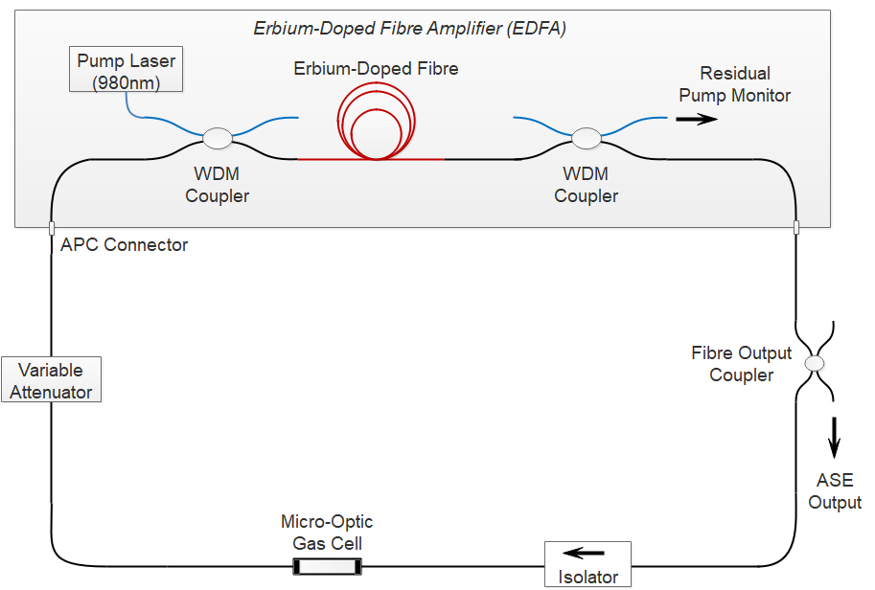
Use of ASE in a Fibre Loop Laser to Observe Absorption Lines
The cell length enhancement is L/δ(ν)
where δ(ν) is the difference between the cavity background loss and the erbium fibre gain at the optical frequency ν.

Slide 29
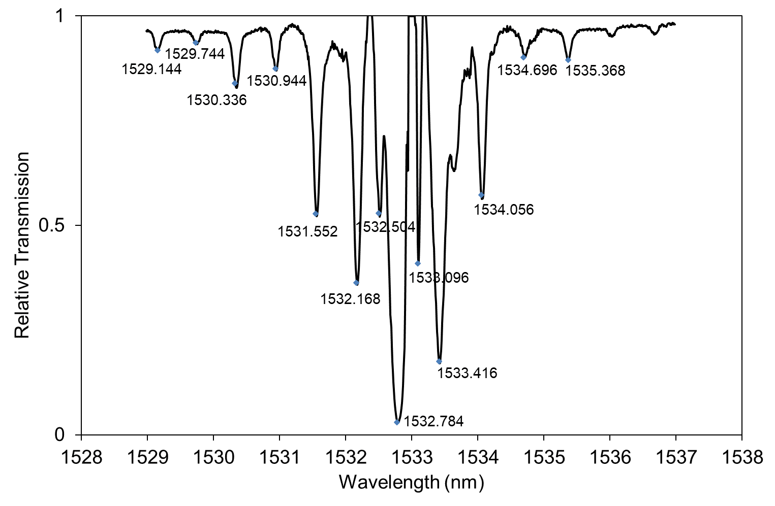
Normalised ASE Output with 1% C₂H₂ (6cm intra-cavity cell)

Slide 30
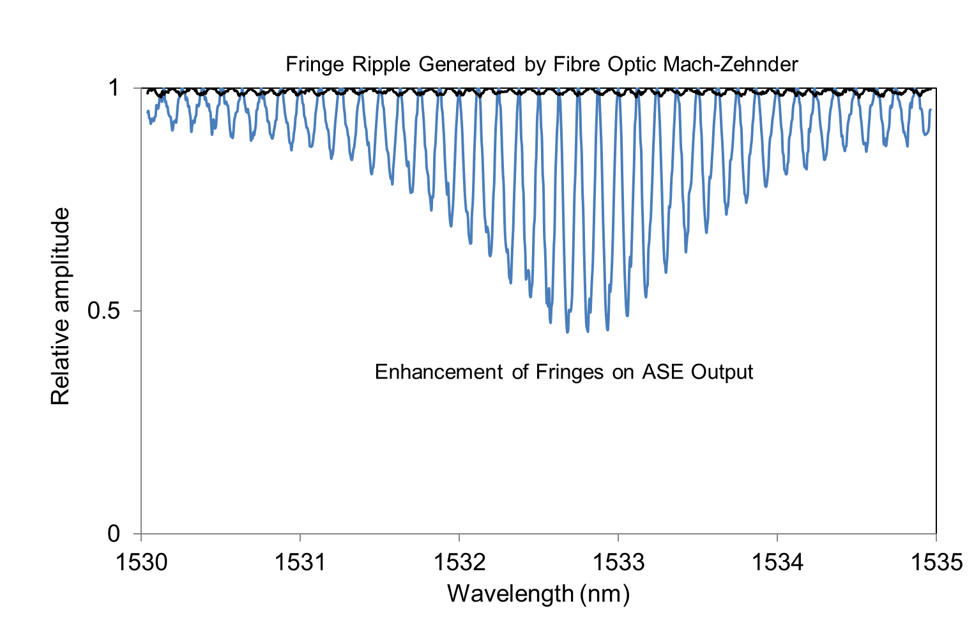
ASE Output Showing Fringe Enhancement With a Fibre Mach-Zehnder Interferometer in Loop

Slide 31
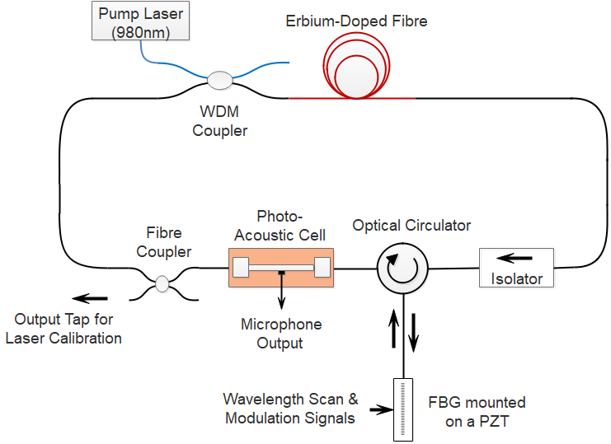
Fibre Laser with an Intra-Cavity Photo-Acoustic Gas Cell [Wang et al.]

Slide 32
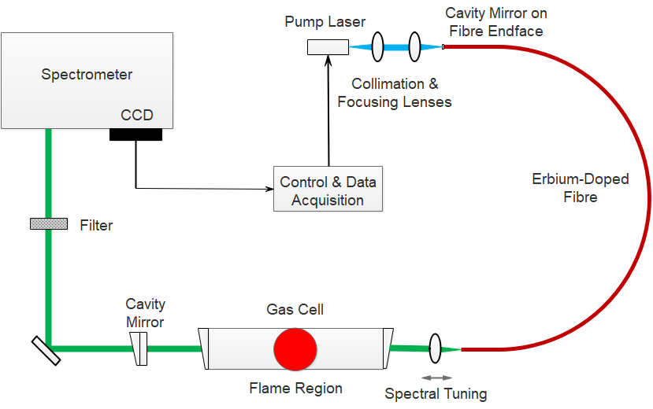
Intra-cavity Laser Spectroscopy System for Flame and Gas Spectra [Löhden et al.]

Slide 33
Summary & Conclusions
Fibre laser sources offer the potential of a wide bandwidth but are more cumbersome for WMS spectroscopy as compared with DFB laser sources.
Dual-comb spectroscopy with fibre lasers offers simultaneous, fast, high-resolution and broad spectral coverage with direct recovery of absorption line profiles without the need for prior knowledge of modulation parameters as in WMS. However it lacks the sensitivity advantages associated with WMS lock-in detection methods.
In principle, enhanced sensitivity may be achieved by using a fibre laser to effectively create a high finesse cavity for ring-down or cavity-enhanced spectroscopy but stability and repeatability are key problems.
Intra-cavity laser absorption spectroscopy with fibre lasers gives a very high sensitivity over a medium spectral range, but to date, the resolution is low and the gas sample must be contained within the fibre laser cavity.
Near-IR fibre laser sources may be used for the generation of coherent mid-IR light and mid-IR frequency combs for dual-comb spectroscopy.

