Slide 1
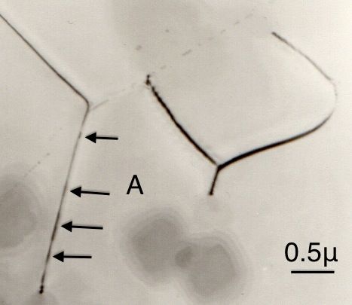
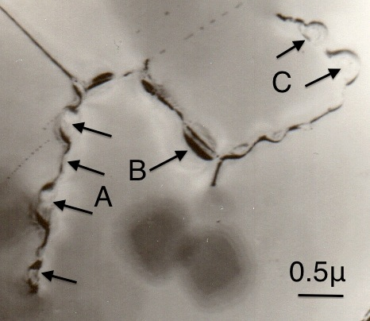
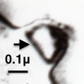
0.1 μm
0.5 μm
0.5 μm

Slide 2
C
B
A
Notes:
1.04” x 3”, tiff.

Slide 3
W, c
0
W
c₀
c
−
0
+
x
Notes:
1.75” x 3”, tiff.

Slide 4
c
0
c₀
c₀
A
c₂
c₁
B
l
x
x
(a)
(b)
Notes:
1.63” x 5”, tiff.

Slide 5
diluted
A
B
enriched
Notes:
4.5” x 3”, tiff.

Slide 6
W
x
(a)
(b)
x
Notes:
1.63” x 5”, tiff.

Slide 7
δy
y
v
x
Notes:
1.39” x 3”, tiff.

Slide 8
y
B'
II
A'
B''
A
III
r₁
I
x
A''
B
A'''
IV
B'''
v
Notes:
3.64” x 3”, tiff.

Slide 9
II: J_{x}
III: J_{y}
r₁
I: J_{y}
D/v
r₁
IV: J_{x}
D/v
Notes:
2.97” x 3”, tiff.

Slide 10
y
c << c₀
x
c >> c₀
Notes:
2.97” x 3”, tiff.

Slide 11
ϕ
r
r₀
Notes:
2.78” x 3”, tiff.

Slide 12
f(z)
8
6
4
2
0
z
0
1
2
3
4
5
6
7
8
9
Notes:
2.71” x 5”, tiff.

Slide 13
c
c
0
x
0
x
(a)
(b)
c
σ
0
x
0
v_{c}
v
(c)
(d)
Notes:
3.27” x 5”, tiff.

Slide 14
F/L
~17 c₀β
Eq. 18.89
πc₀β
v
Eqs. 18.61
& 18.72
v_{c}
Notes:
2.31” x 5”, tiff.

Slide 15
c, W
v
W
c
0
x
Notes:
3.44” x 5”, tiff.

Slide 16
W
Q
R
P
(a)
2πθ
0
θ
P
Q
R
W
Q
R
P
(b)
0
R
P
Q
θ
2π
P
Q
R
Notes:
5.72” x 5”, tiff.

Slide 17
F/L
Eqs. 18.110 &
18.112
A
Eq. 18.108
v_{c}
v
Notes:
1.81” x 4”, tiff.

Slide 18
B
b
b
A
d
Notes:
1.22” x 4”, tiff.

Slide 19
F/L
F/L
v_{D}
v_{S}
v_{c}
v_{D}
v_{S}
v
v
(a)
(b)
Notes:
1.75” x 5”, tiff.

Slide 20
A
A
B
B
Notes:
1.09” x 3”, tiff.

Slide 21
l
a
r
θ
Notes:
2.65” x 3”, tiff.

Slide 22
σ
σ
σ
v_{S}
v_{S}
v_{D}
σ*
breakaway
v_{D}
v_{S}
v_{p}
v
v
v
ρ
ρ
ρ
ε
ε
ε
(a)
(b)
(c)
Notes:
3.14” x 5”, tiff.

Slide 23
(a)
B
(b)
A
C
(c)
Notes:
4.15” x 5”, tiff.

Slide 24
(a)
(b)
(c)
(d)
1 μm
Notes:
7” x 4.4”, tiff.

Slide 25
APB
APB
(a)
(b)
Notes:
1.06” x 4”, tiff.

Slide 26
r_{e}
δr
(a)
δr
(b)
(c)
δr
r > r_{e}
(d)
Notes:
4.14” x 3”, tiff.

