Slide 1
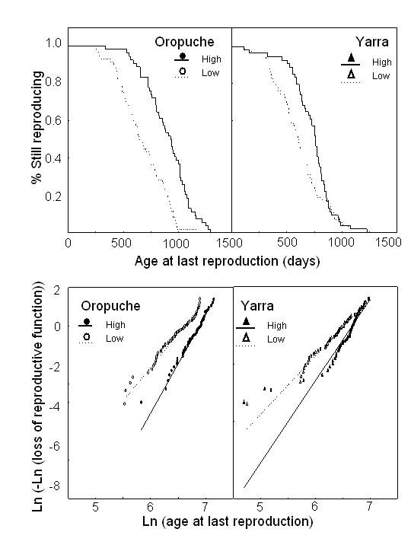
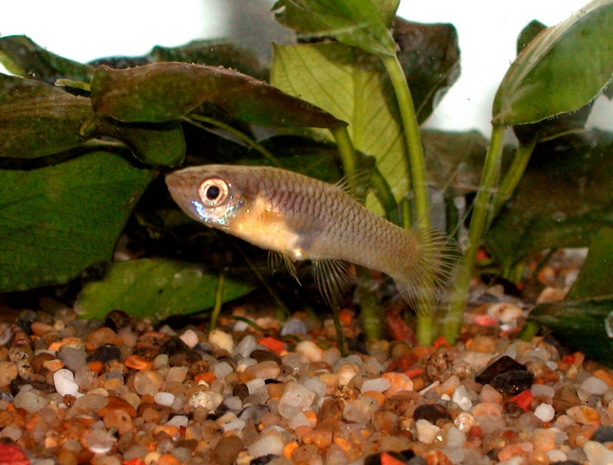
Survivorship (Age
at last reproduction)
The Oldest Fish –
1465 days

