Slide 1
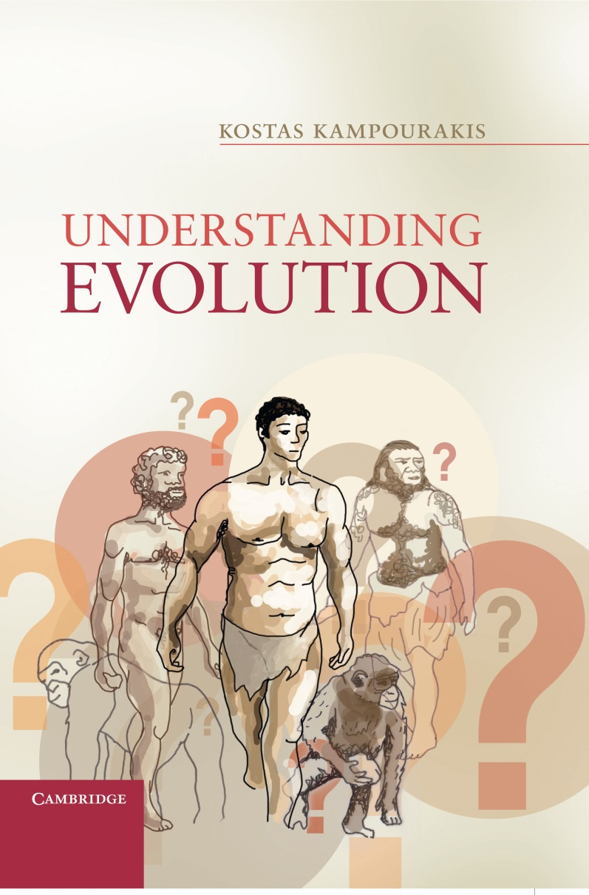
Chapter 4
Charles Darwin and the Origin of Species:
A historical case study
of conceptual change

Slide 2
Figure 4.1
Charles Drawin. Photograph by Maull & Fox, c. 1857. (DAR 225:175). With permission from the Syndics of Cambridge University Library.

Slide 3
Figure 4.2
How varieties gradually diverge and become distinct species.

Slide 4
Figure 4.3
The major phases and shifting points in Darwin’s thinking

Slide 5
Figure 4.4
The conceptual foundations and the arguments in the Origin. Note that Darwin theory was based on particular analogies.

