Slide 1
Mid-IR Systems for Gas Absorption Spectroscopy
The Future of Near-IR & Mid-IR Spectroscopy

Slide 2
Topics Considered
Comparison of near-IR and mid-IR absorption lines
Mid-IR sources: diode lasers, fibre lasers & combs
Spectroscopic techniques for the mid-IR
Mid-IR materials for windows and lenses
Types of fibre for mid-IR transmission
Mid-IR detectors: materials and performance
Relative merits of near-IR and mid-IR gas sensors

Slide 3
The HITRAN Database
Spectral line parameters for both near-IR and mid-IR absorption lines are available on the HITRAN database:
http://www.hitran.org
Absorption spectra may be modelled with various adjustable parameters such as temperature, pressure, line shape (Voigt, Lorentz, or Doppler), path length, wavenumber range, etc. using the HITRAN application sites:
The HITRAN Application Programming Interface (HAPI)
http://www.hitran.org/hapi
HITRAN on the Web
http://hitran.iao.ru/home

Slide 4
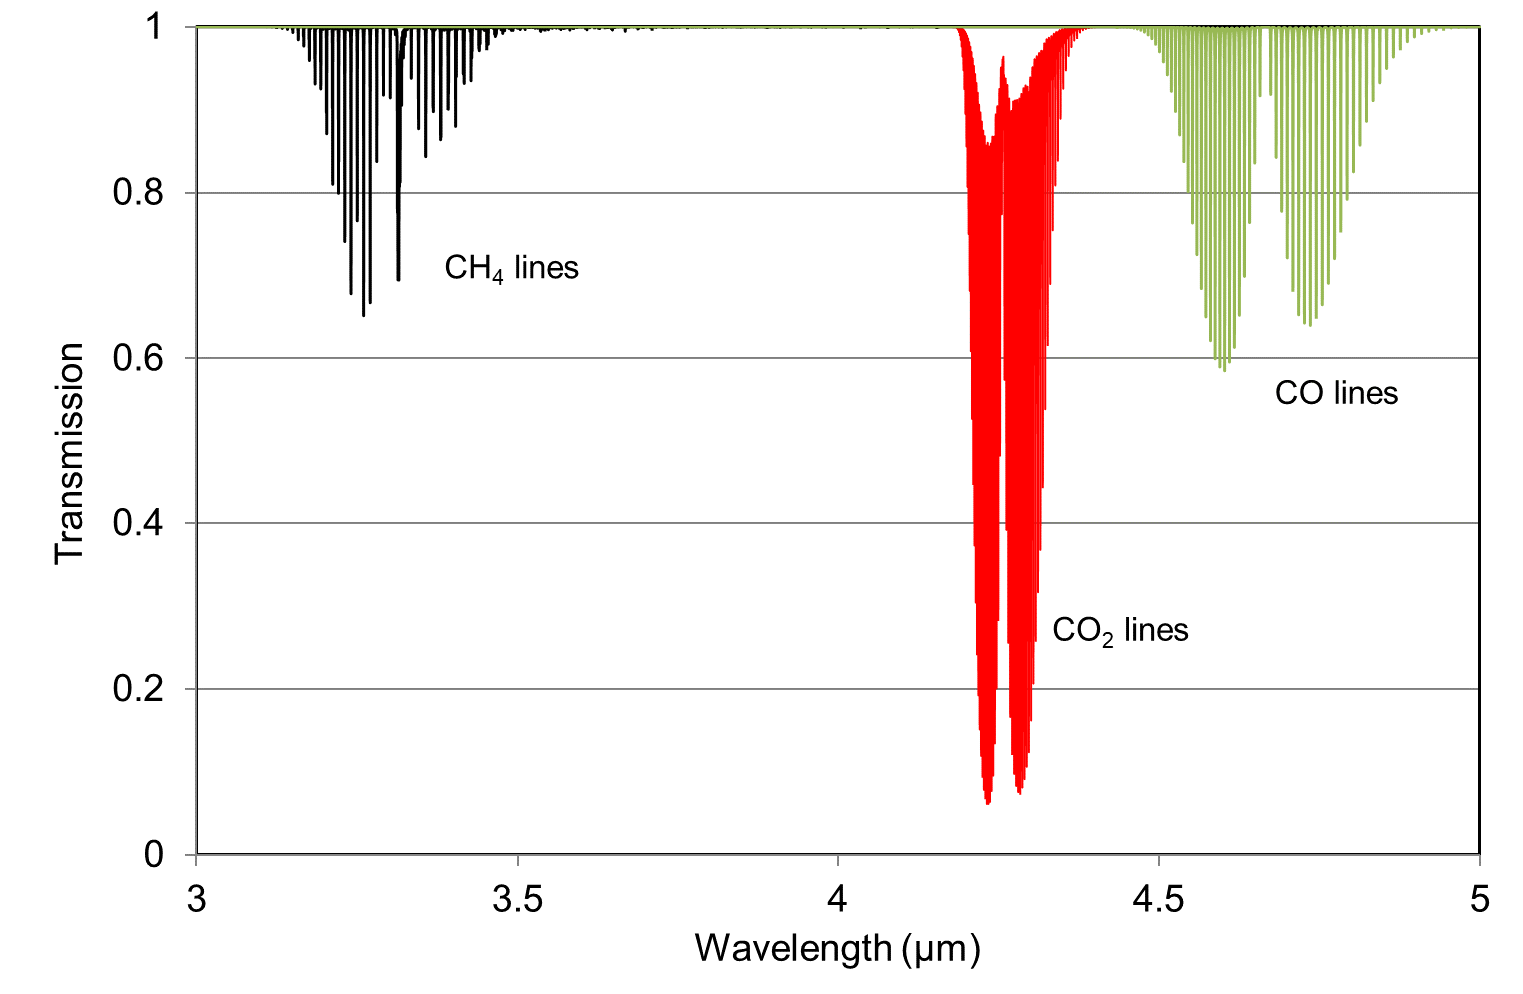
Typical Mid-IR Absorption Lines for Several Gases
Transmission=exp(-αCl) with Cl=0.01cm

Slide 5
Comparison With Near-IR Lines of CH₄
Transmission=exp(-αCl) with Cl=1cm

Slide 6
Comparison with Near-IR Lines of CO₂ in the 2μm region
Transmission=exp(-αCl) with Cl=1cm

Slide 7
Comparison with Near-IR Lines of CO
Transmission=exp(-αCl) with Cl=1cm

Slide 8
Important Mid-IR Sources
Diode laser sources:
quantum well (QW) lasers
interband cascade lasers (ICL’s)
quantum cascade lasers (QCL’s)
Fibre laser sources in the mid-IR region.
Generation of mid-IR by down-conversion of near-IR light by:
Difference Frequency Generation (DFG)
Optical Parametric Oscillation (OPO)
Mid-IR frequency comb sources.

Slide 9
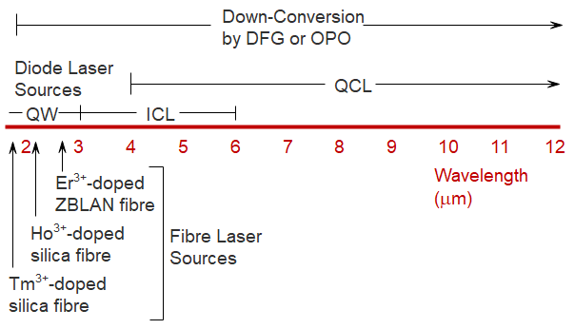
Wavelength Range of Mid-IR Sources

Slide 10
Properties of Mid-IR Diode Lasers
Quantum Well (QW) Diode Lasers: wavelength range ~1.8−3μm. Electron-hole transitions between conduction and valence bands in III-V semiconductor AlGaIn:AsSb with room temperature operation.
Interband Cascade Lasers (ICL): wavelength range ~3−6μm. Electron-hole transitions between conduction and valence bands through a cascade of quantum well structures (as in a QCL) but with lower threshold current and input electrical power than a QCL. Typically, ICL’s based on GaSb operate at room temperature with a threshold current of ~50mA, slope efficiency of ~0.06mW/mA, temperature tuning coefficient of 0.3nm/ºC and current tuning coefficient of 0.2nm/mA.
Quantum Cascade Lasers (QCL): wavelength range ~4μm to the far infrared. Inter-sub-band transitions in a superlattice arrangement of quantum wells, consisting of alternating electron injector and active regions (see next slide). Commercially available with room temperature operation, thermal tuning over a range of 50GHz, high output optical powers of tens or hundreds of milliwatts but with relatively high threshold currents of several hundreds of mA to 1A.

Slide 11
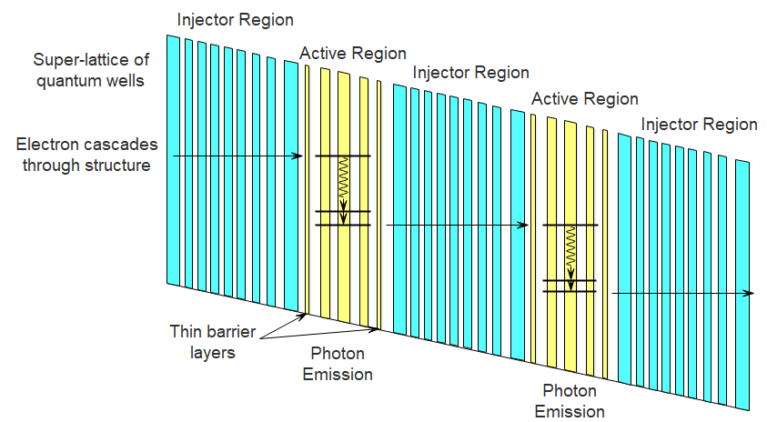
Quantum Cascade Laser
Energy Band Diagram for 2 Stages
The operation wavelength is not dependent on the band-gap but on the chosen thicknesses of the quantum wells in the active regions, so can be engineered for a large range of wavelengths.

Slide 12
Mid-IR Fibre Lasers in ZBLAN Fibre
The fibre lasers listed below are at various stages of development and some, such as erbium at 3.45μm and holmium at 3.95μm, require nitrogen cooling.
Rare Earth Ion | Electronic Transition | Lasing Wavelength (mm)
Er³⁺ | ⁴I_{11/2} – ⁴I_{13/2} | 2.7
Er³⁺ | ⁴F_{9/2} – ⁴I_{9/2} | 3.45
Tm³⁺ | ³H₄ – ³H₅ | 2.31
Ho³⁺/Pr³⁺ | ⁵I₆ – ⁵I₇ | 2.86
Ho³⁺ | ⁵S₂ – ⁵F₅ | 3.22
Ho³⁺ | ⁵I₅ – ⁵I₆ | 3.95
Dy³⁺ | ⁶H_{13/2} – ⁶H_{15/2} | 2.9
One of the most important mid-IR fibre lasers is the erbium-doped fibre laser at ~2.7μm, based on the ⁴I_{11/2} – ⁴I_{13/2} electronic transition (see next slide). High power, diode-pumped, versions are available commercially

Slide 13
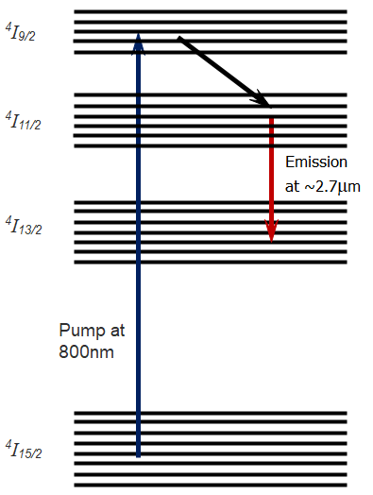
Energy Levels for the 2.7μm Fibre Laser in Erbium-Doped ZBLAN

Slide 14
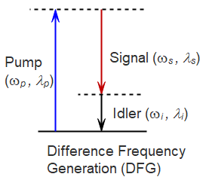
Mid-IR Sources Based on Down-Conversion of Near-IR by Difference Frequency Generation (DFG)
A non-linear crystal generates a difference or idler frequency of:
Erbium fibre laser pump at ~1.5μm
Tunable near-IR signal source, 1.7-2μm
Output mid-IR idler tuneable over 6-13μm
If the pump source is a Nd:YAG laser at 1064nm and the signal source is a near-IR DFB diode laser at 1547nm, the idler is ~3.4μm suitable for methane detection.

Slide 15
Commercial Mid-IR Sources Based on Down-Conversion of Near-IR by Difference Frequency Generation
Genia Photonics Source:
  DFG in the non-linear crystal, orientation-patterned GaAs.
  Pump input from an erbium fibre laser at a wavelength of either 1542nm or 1597nm in a master oscillator power amplifier (MOPA) configuration (see next slide).
  Signal input from a programmable laser based on an actively mode-locked thulium-doped fibre producing ~25ps duration pulses, dispersion-tuned over 1893–2000nm.
  Output powers of ~0.4–1mW tuneable over a wavelength range of 6.7–10.2μm.
Toptica FemtoFiber Dichro MidIR femtosecond laser source:
  DFG process in a non-linear crystal.
  An erbium-doped fibre ring laser, operating at 1.5μm and mode-locked with a saturable absorber mirror (SAM) with 2 EDFA’s provides both pump and signal inputs.
  The 1.5μm pulsed output from one EDFA provides a pump signal.
  The seed signal is produced by passing the pulsed output from the other EDFA over a length of highly nonlinear fibre to generate a supercontinuum over ~1.7–2μm.
  Output power of ~1mW tuneable over a wavelength range of ~5–15μm.

Slide 16
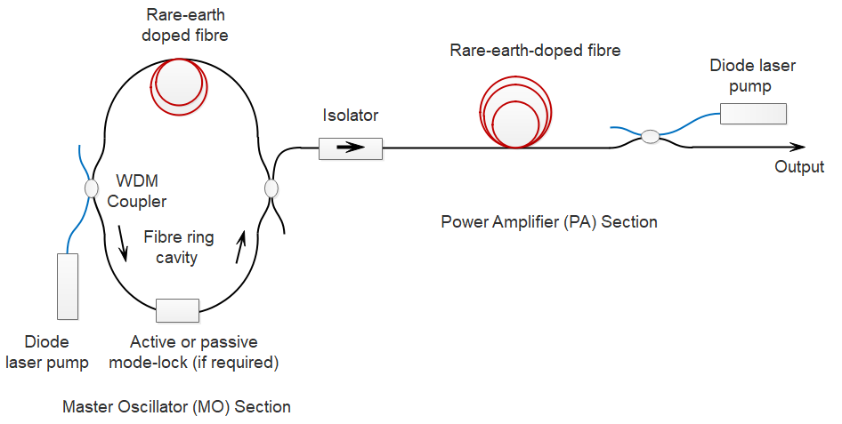
Typical Pump Source for DFG
Master-Oscillator-Power-Amplifier

Slide 17
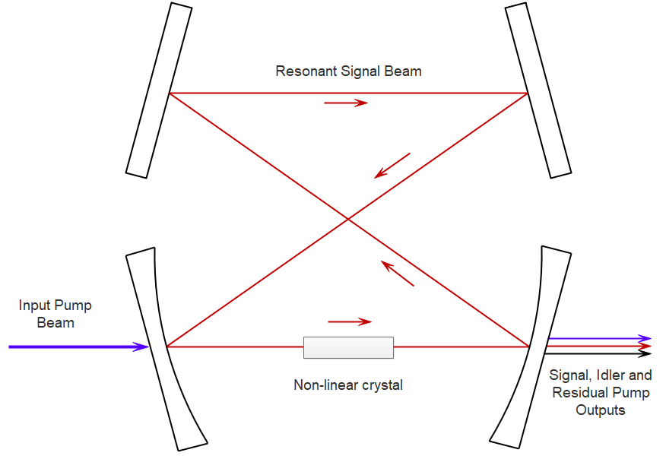
Mid-IR Sources Using An
Optical Parametric Oscillator (OPO)
An OPO can give much higher output powers, of the order of watts, as compared with DFG and the mid-IR wavelength can be tuned over a large range.

Slide 18
Commercial Mid-IR Source Using An
Optical Parametric Oscillator
Toptica: Tuneable Optical Parametric Oscillator (TOPO)
  DFB seed laser and fibre amplifier for the pump source.
  Coherent CW output of 1–2W power with linewidth of ~2MHz
  Tuneable across the broad wavelength range of 1.45–4.0μm
    (1.45–2µm from the signal beam and 2–4.00µm from the idler beam)
  Coarse wavelength tuning achieved through crystal translation and temperature
  Mode-hop-free fine tuning over ~300MHz through pump or PZT tuning.

Slide 19
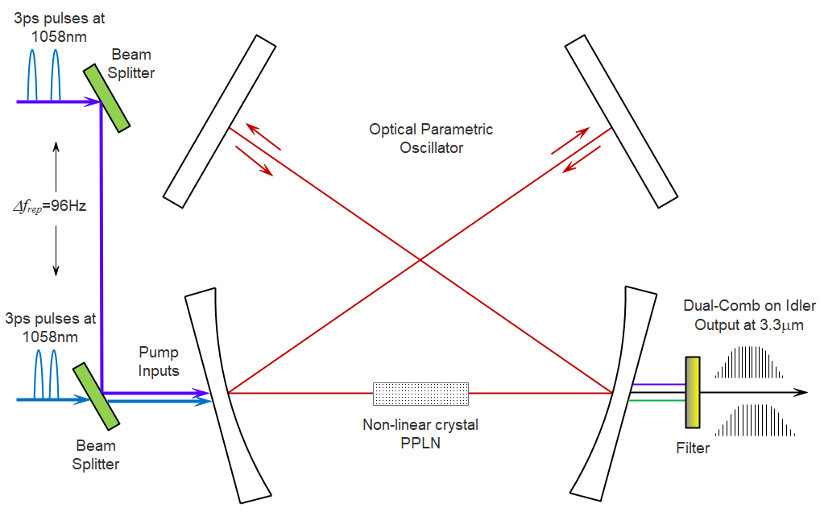
Example of a Mid-IR Dual Comb Generated Using an OPO

Slide 20
Commercial Mid-IR Comb Sources
Menlo Systems: mid-IR comb through DFG
  spectral range of 3.1–3.4µm or 6.5–7.8µm.
  spectral bandwidth of greater than 200 nm.
  comb mode spacing of either 100 or 250MHz.
IRsweep: mid-IR QCL dual comb source
  InGaAs/InAlAs quantum cascade laser with ~6mm long cavity.
  Around 200 comb lines at ~7.5GHz line spacing.
  Centre wavelengths in the range of 5–10μm.
  Spectral coverage of ~60cm⁻¹, spectral sampling interval of less than 0.5 cm⁻¹ and a resolution of 10 MHz.

Slide 21
Silicon Photonics for Combs
Silicon has a number of properties which make it an excellent platform for comb generation and for integration of optical components on a single chip:
Wide-transparency window over 1.2–8μm.
Micro-ring resonators of ~100μm radius using Si₃N₄ deposition, compatible with Complementary-Metal-Oxide-Semiconductor (CMOS) technology, can be fabricated with very high Q-factors of >10⁷ and low threshold pump powers.
High refractive index for tight confinement in ring resonators with high power densities.
Large third-order optical nonlinearity for the generation of comb lines through four-wave mixing.
Near-IR and mid-IR combs have been demonstrated using micro-ring resonators on integrated hybrid silicon chip platforms.

Slide 22
Mid-IR Spectroscopy Techniques
In general, the spectroscopic techniques used in the near-IR region are equally applicable in the mid-IR region, taking into account the longer wavelength of operation and any limitations imposed by the properties of mid-IR sources.
Examples of techniques that may be used in the mid-IR include:
Wavelength modulation spectroscopy.
Cavity-enhanced absorption spectroscopy.
Evanescent wave spectroscopy.
Photo-acoustic spectroscopy.

Slide 23
Materials for Mid-IR Windows or Lenses
Material | Refractive Index | Transmission Range (μm)
Quartz, SiO₂ | 1.45 | 0.2 – 3.5
Sapphire, Al₂O₃ | 1.7 | 0.2 – 5
Silicon, Si | 3.5 | 1 – 10
Germanium, Ge | 4.0 | 2 – 20
ZnS | 2.3 | 0.5 – 10
ZnSe | 2.4 | 0.5 – 15
MgF₂ | 1.35 | 0.2 – 7
CaF₂ | 1.4 | 0.2 – 8
BaF₂ | 1.45 | 0.2 – 12

Slide 24
Mid-IR Fibres
Heavy-metal-fluoride fibres:
  Susceptible to moisture and surface crystallization.
    ZBLAN fibre: 53% ZrF₄, 20% BaF₂, 4% LaF₃, 3%AlF₃, 20% NaF, Transmission window ~0.4–4μm, loss ~50–100dB/km.
    Fluoride fibre based on InF₃ extends the transmission range to ~5μm
Chalcogenide glass fibres:
    As₂S₃, As₂Se₃ and the binary system 70% Ga₂S₃: 30% La₂S₃
Germanate-based fibres:
  Similar to SiO₂ fibres but with the silicon replaced by germanium
  PbO doping to raise core refractive index.
Hollow-core fibres
  Made from silicate glass but light guided in hollow core surrounded by a pattern of air holes forming an anti-resonant structure.

Slide 25
Mid-IR Detectors
Photon energy is inversely proportional to the wavelength, so a mid-IR semiconductor photodiode has a smaller band-gap energy as compared with the near-IR.
Thermal transitions across a smaller band-gap are more probable so noise performance at room temperature is inferior.
Some mid-IR detectors have sufficiently low noise to be operated at room temperature, but others require cooling to improve the detectivity (D* is typically in the range of 10⁹ – 10¹² cmHz^{1/2}W⁻¹ )
The required detector temperature to achieve background-limited performance is:
Peltier thermoelectric cooling is desirable (relatively simple to implement) but cryogenic cooling with liquid-nitrogen may be necessary for long wavelength detectors.

Slide 26
Common Near-IR and Mid-IR Detectors
Detector Type | Spectral Response Range (mm)
Si | 0.2 – 1.1
InGaAs | 0.5 – 2.6
InAs | 1 – 3
InSb | 1 – 6
InAsSb | 5, 8, 11
HgCdTe (MCT) | 2 – 16
HgCdTe (MCT) | 2 – 16
PbS | 1 – 2.9
PbSe | 1.5 – 4.8

Slide 27
Summary & Conclusions
Much higher sensitivities are possible with the fundamental gas absorption lines, making mid-IR spectroscopy very attractive for gas sensing applications.
Major advances in recent years in the performance of mid-IR components:
  Quantum well, inter-band cascade and quantum cascade lasers.
  Mid-IR frequency comb sources by down-conversion from femtosecond near-IR fibre lasers or with quantum cascade laser sources.
  Mid-IR detectors can perform as well as their near-IR counterparts with cooling when required.
  On-going research on mid-IR fibres to improve durability and reduce losses.
Silicon has many attractive features as a platform for the development of compact, integrated silicon-chip devices for both near-IR and mid-IR gas spectroscopy.
Near-IR gas sensing will still have an important role to play where sensitivity is not the primary issue since it has the advantages of lower component costs, greater flexibility by use of standard fibre optics and a high level of maturity.

