Slide 1
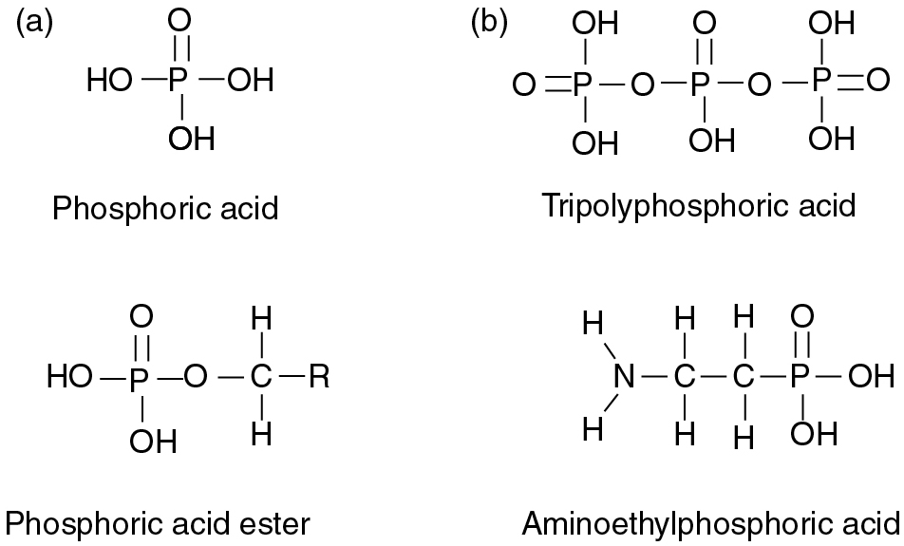
PILSON_Fig 08_01
© Cambridge University Press 2012

Slide 2
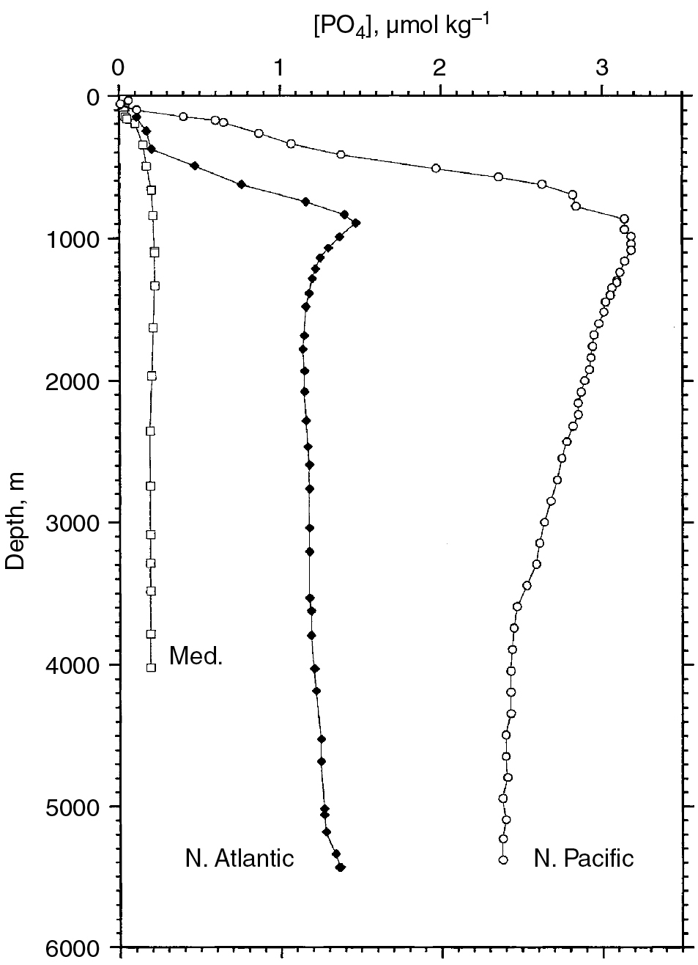
PILSON_Fig 08_02
© Cambridge University Press 2012

Slide 3
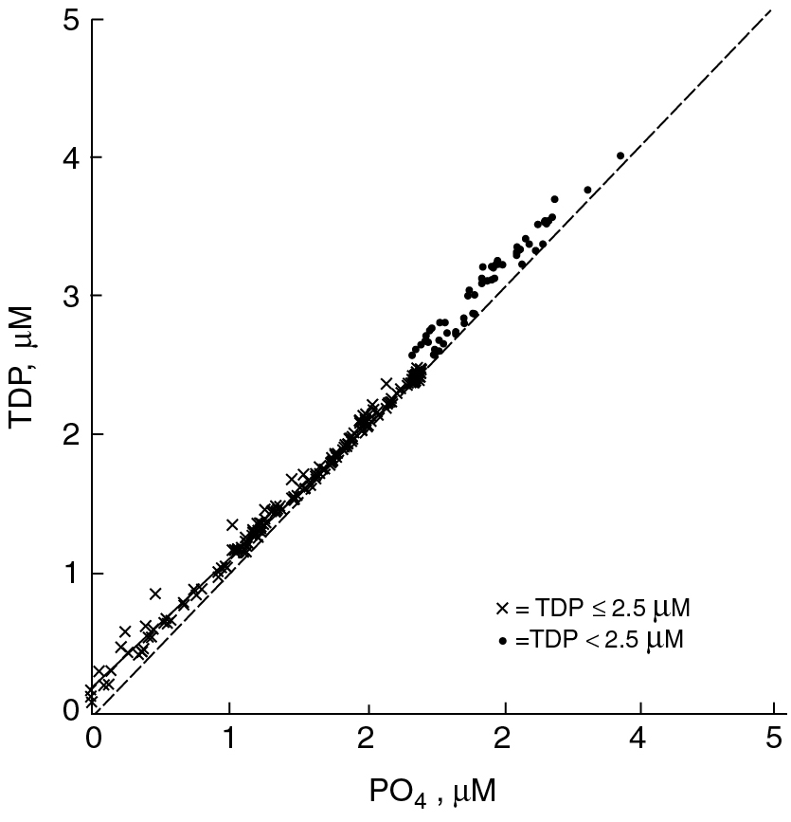
PILSON_Fig 08_03
© Cambridge University Press 2012

Slide 4
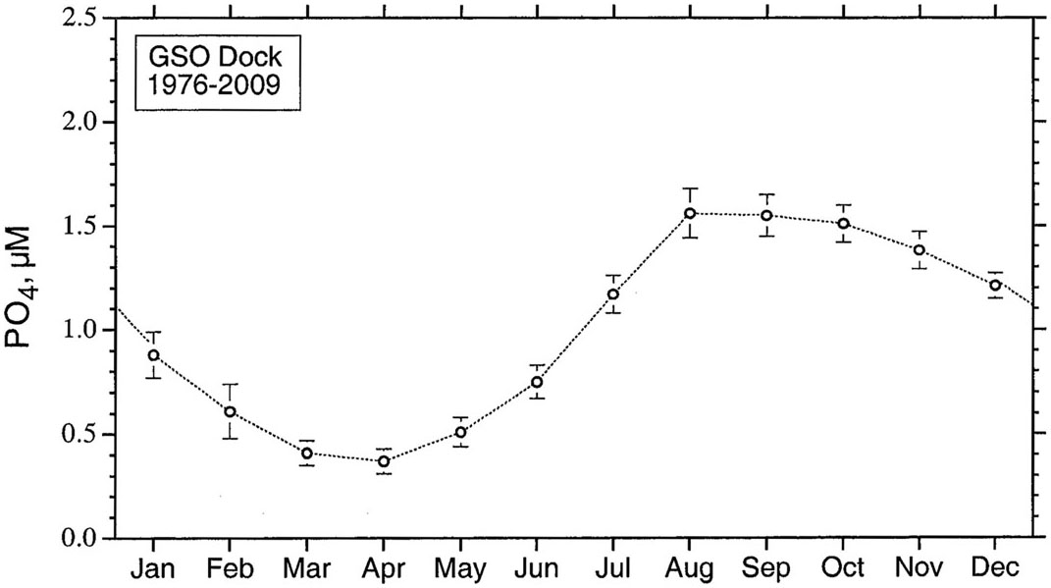
PILSON_Fig 08_04
© Cambridge University Press 2012

Slide 5
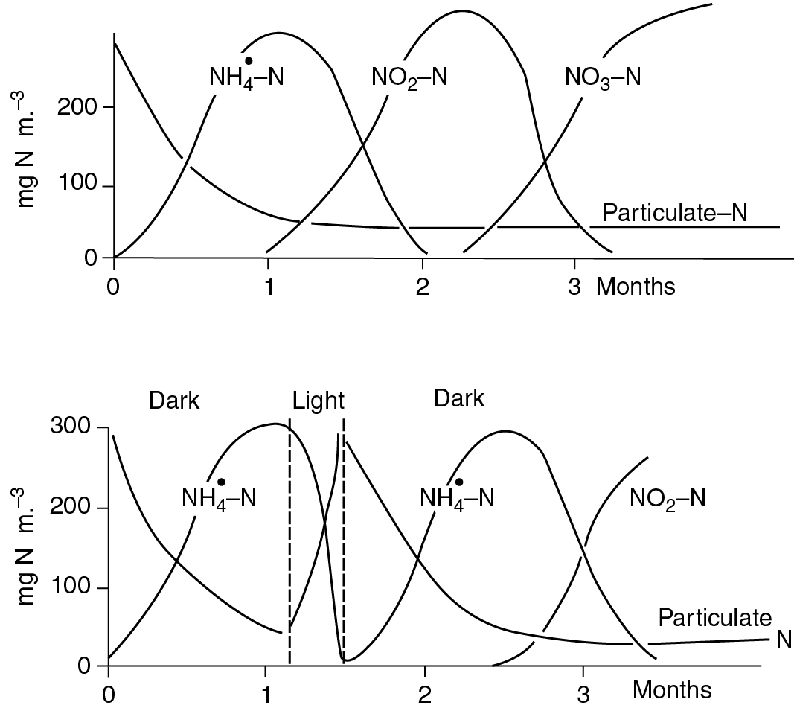
PILSON_Fig 08_05
© Cambridge University Press 2012

Slide 6
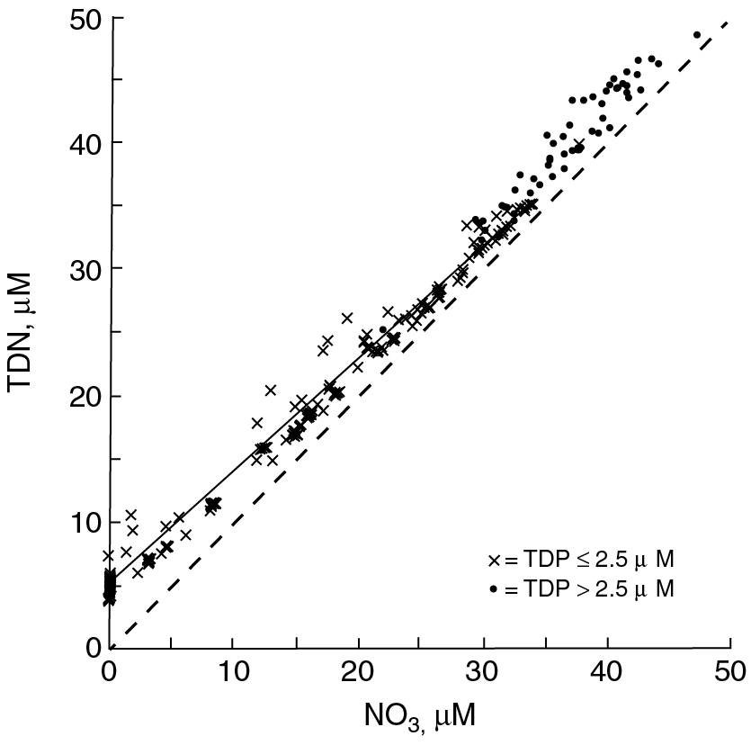
PILSON_Fig 08_06
© Cambridge University Press 2012

Slide 7
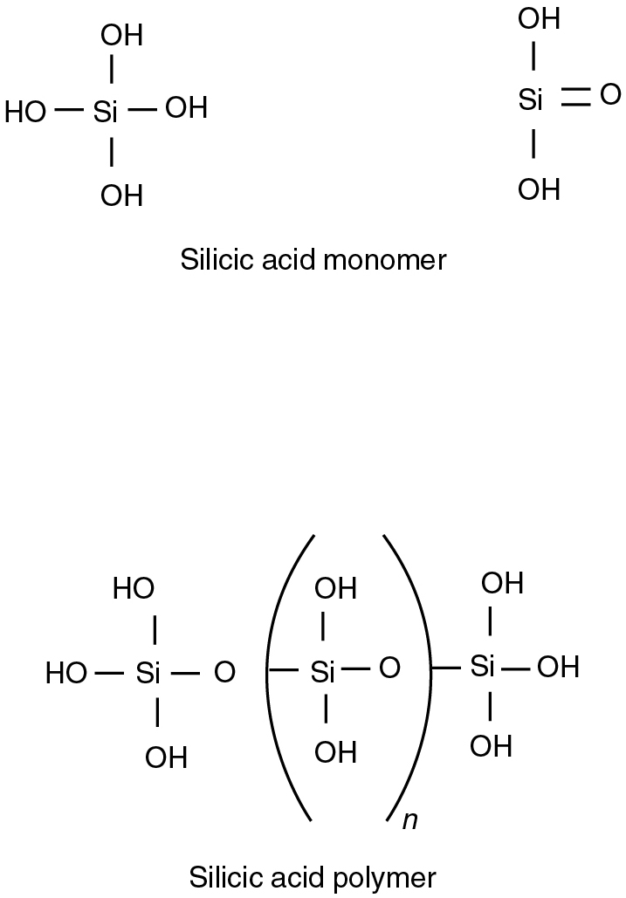
PILSON_Fig 08_07
© Cambridge University Press 2012

Slide 8
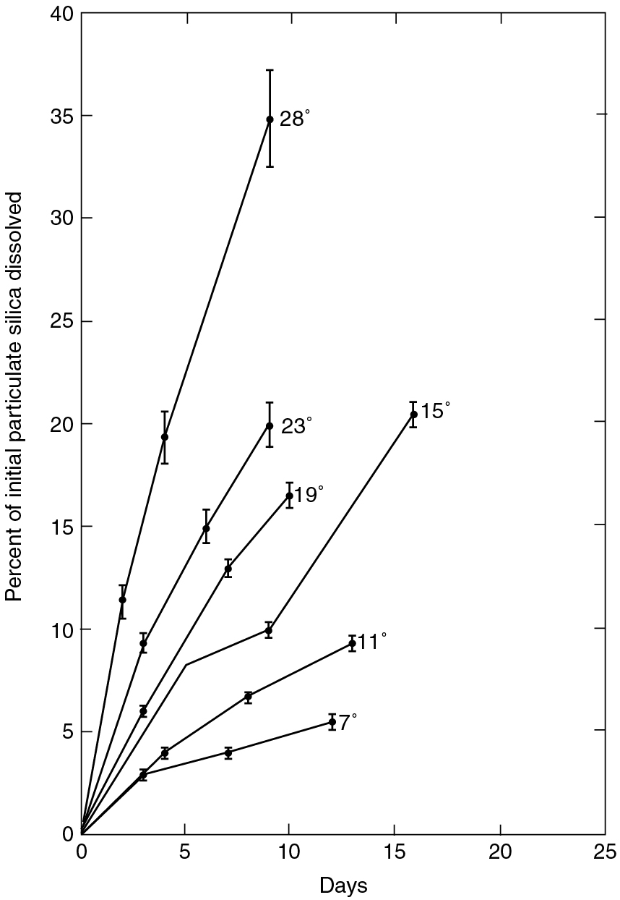
PILSON_Fig 08_08
© Cambridge University Press 2012

Slide 9
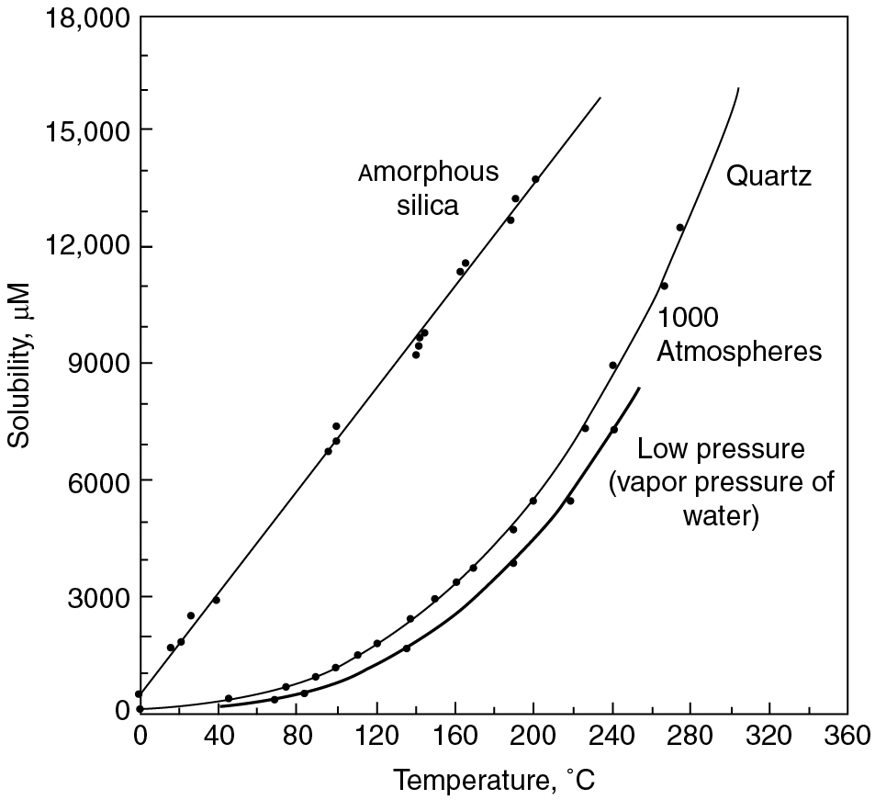
PILSON_Fig 08_09
© Cambridge University Press 2012

Slide 10
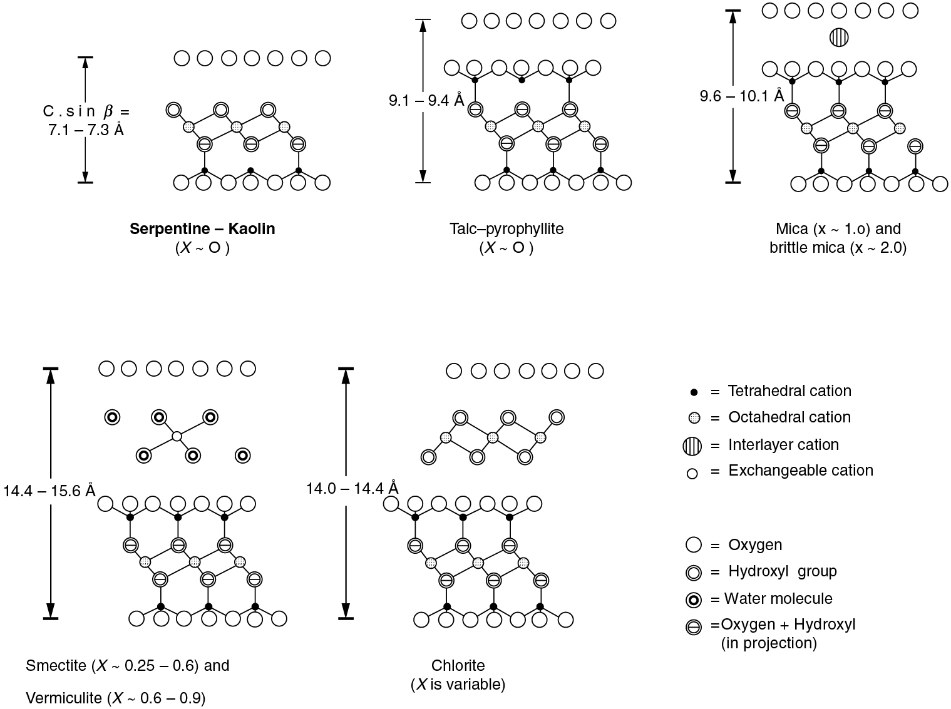
PILSON_Fig 08_10
© Cambridge University Press 2012

Slide 11
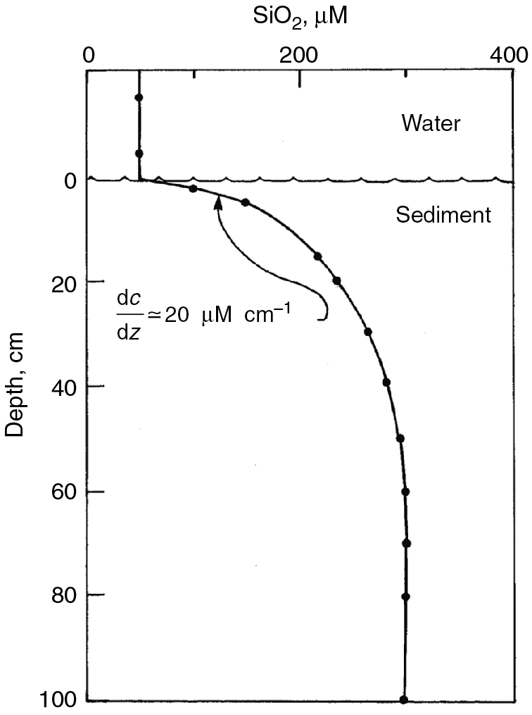
PILSON_Fig 08_11
© Cambridge University Press 2012

Slide 12
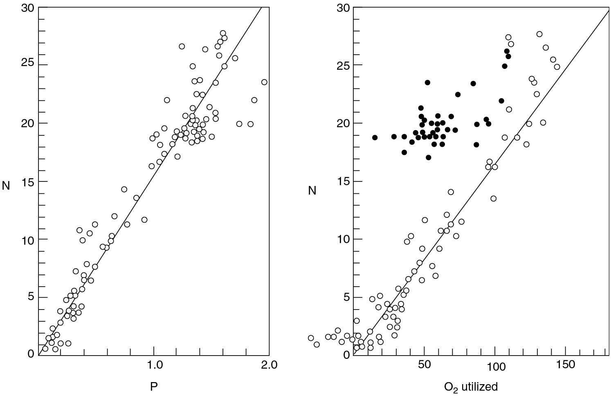
PILSON_Fig 08_12
© Cambridge University Press 2012

Slide 13
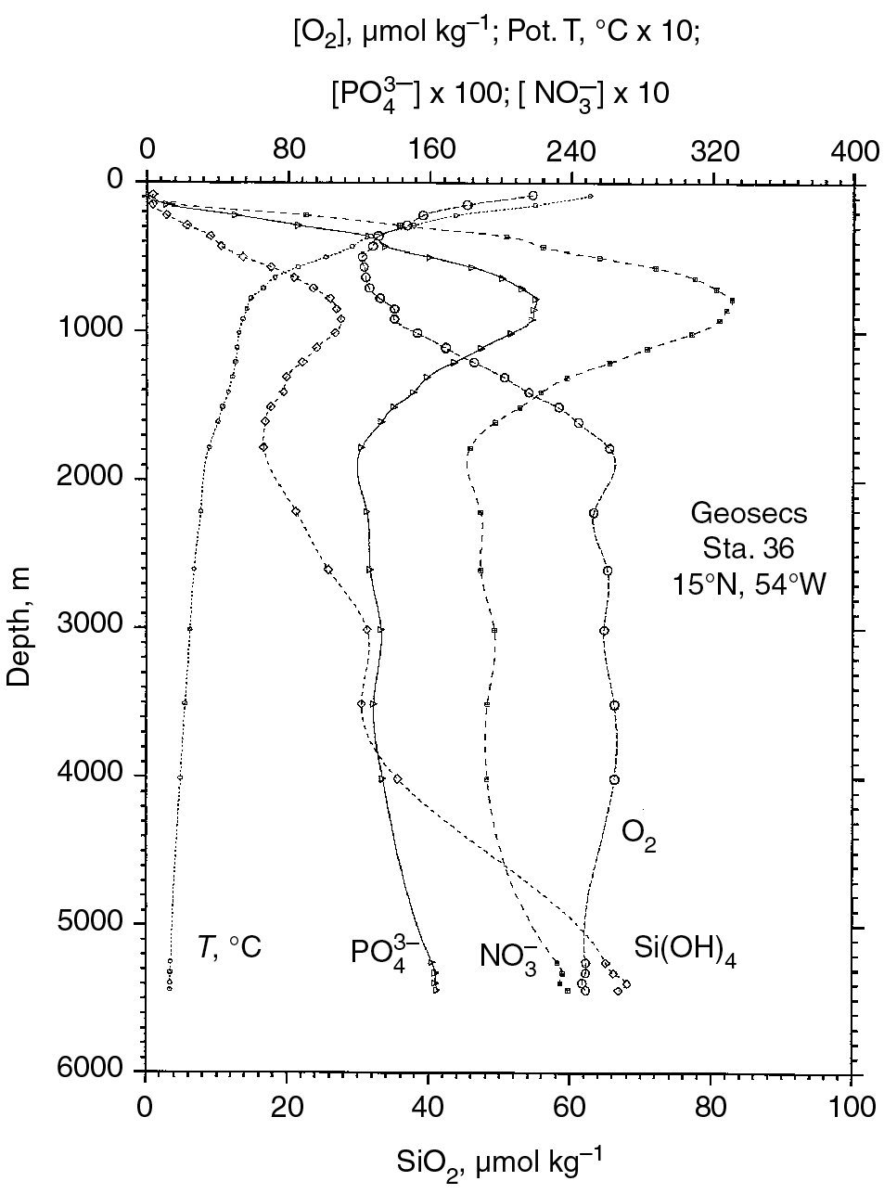
PILSON_Fig 08_13
© Cambridge University Press 2012

Slide 14
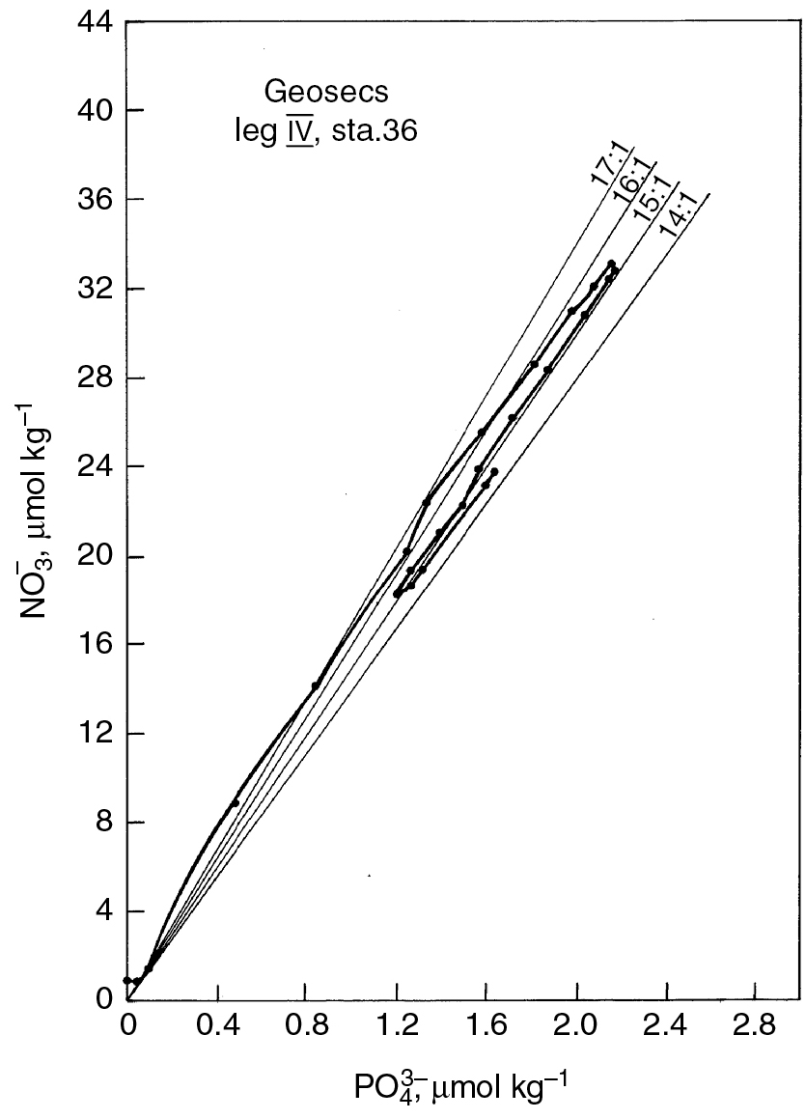
PILSON_Fig 08_14
© Cambridge University Press 2012

Slide 15
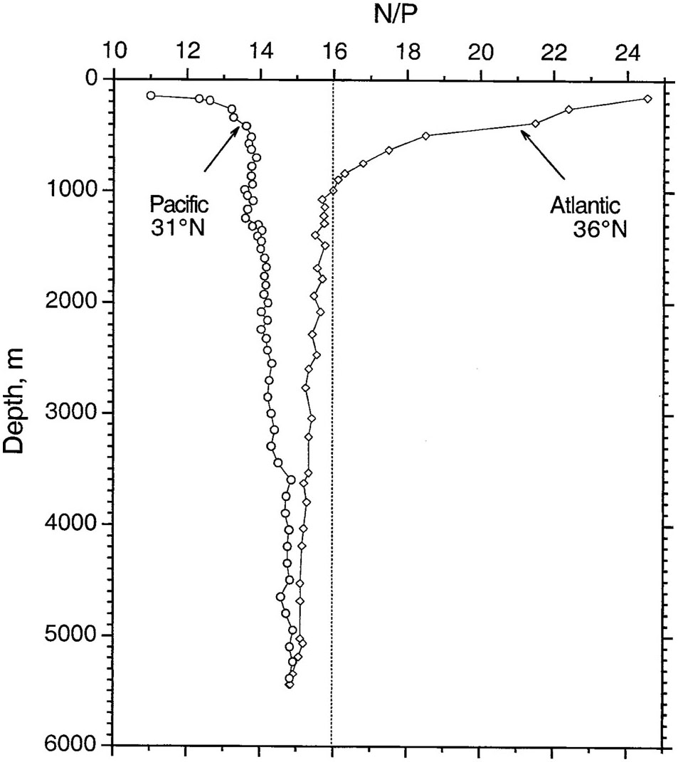
PILSON_Fig 08_15
© Cambridge University Press 2012

Slide 16
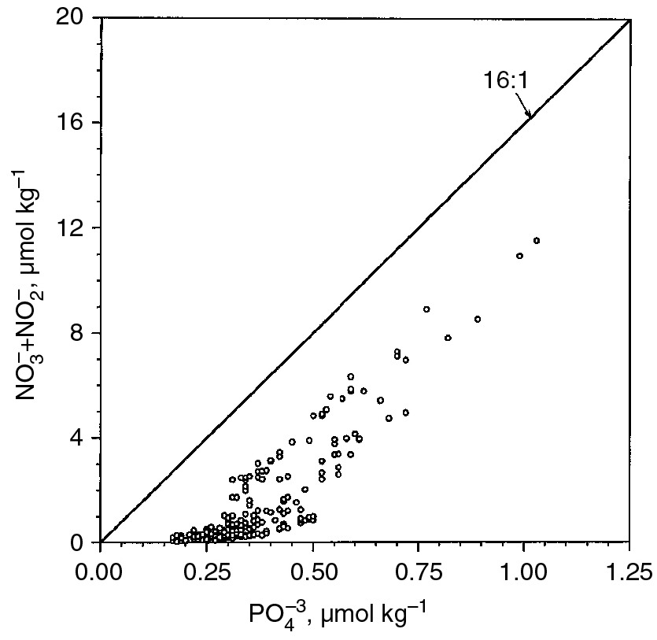
PILSON_Fig 08_16
© Cambridge University Press 2012

Slide 17
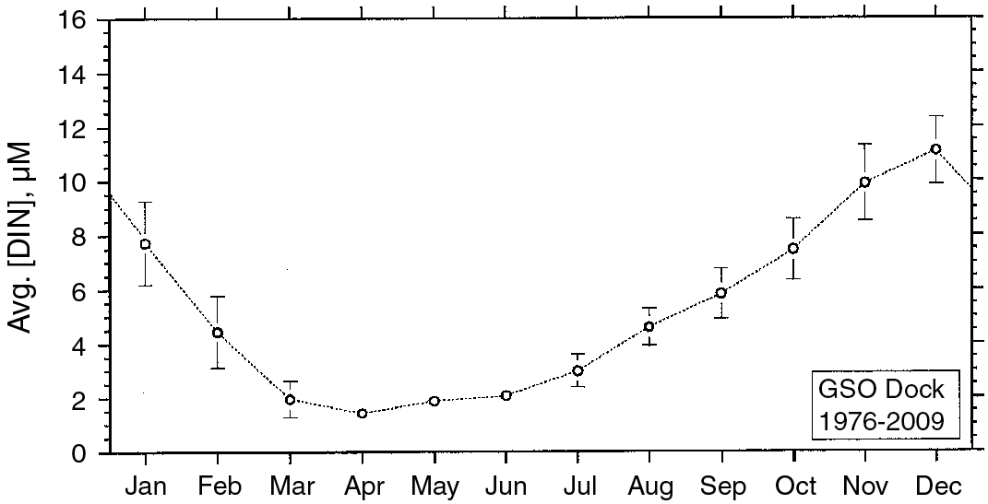
PILSON_Fig 08_17
© Cambridge University Press 2012

Slide 18
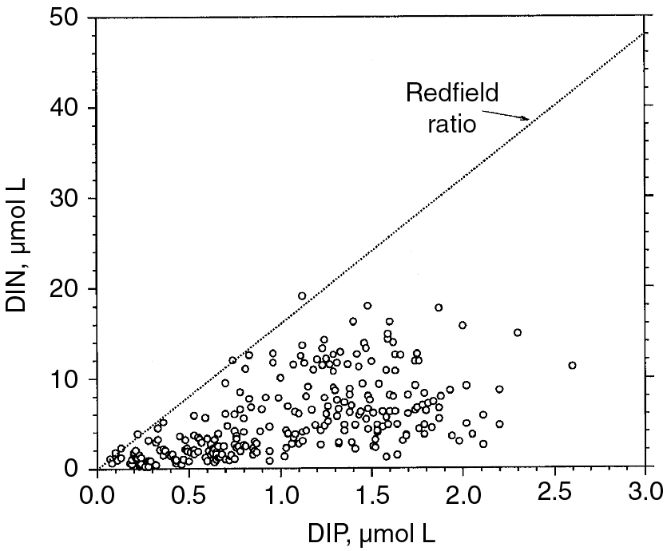
PILSON_Fig 08_18
© Cambridge University Press 2012

Slide 19
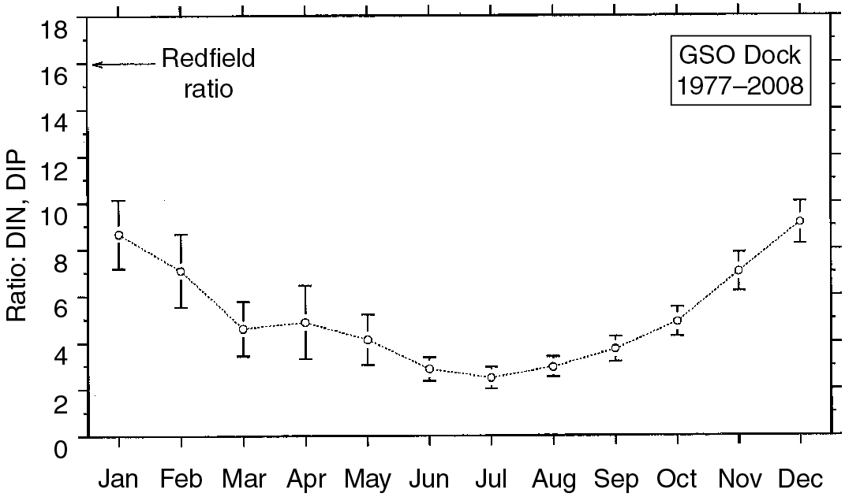
PILSON_Fig 08_19
© Cambridge University Press 2012

Slide 20
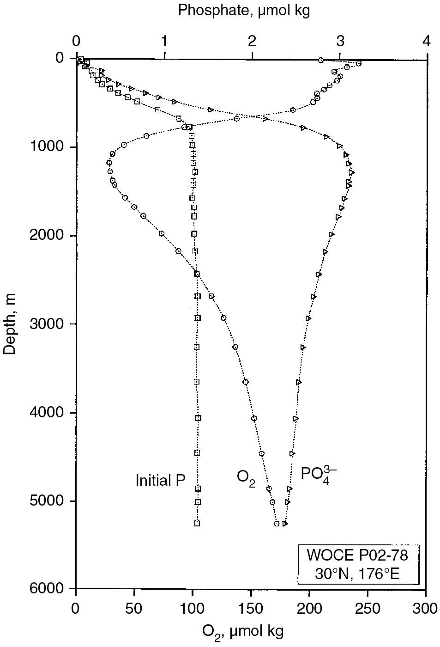
PILSON_Fig 08_20
© Cambridge University Press 2012

Slide 21
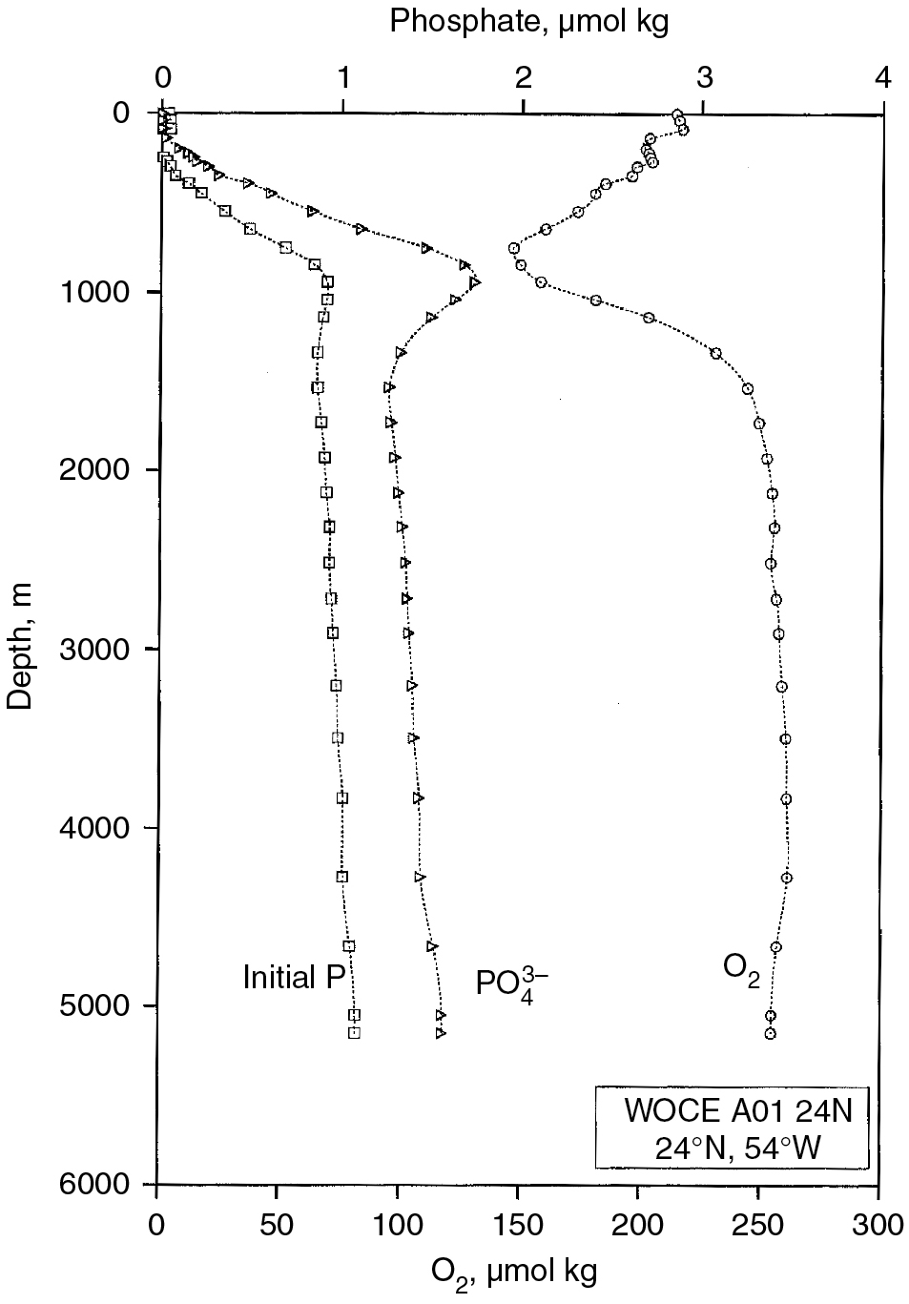
PILSON_Fig 08_21
© Cambridge University Press 2012

