Slide 1
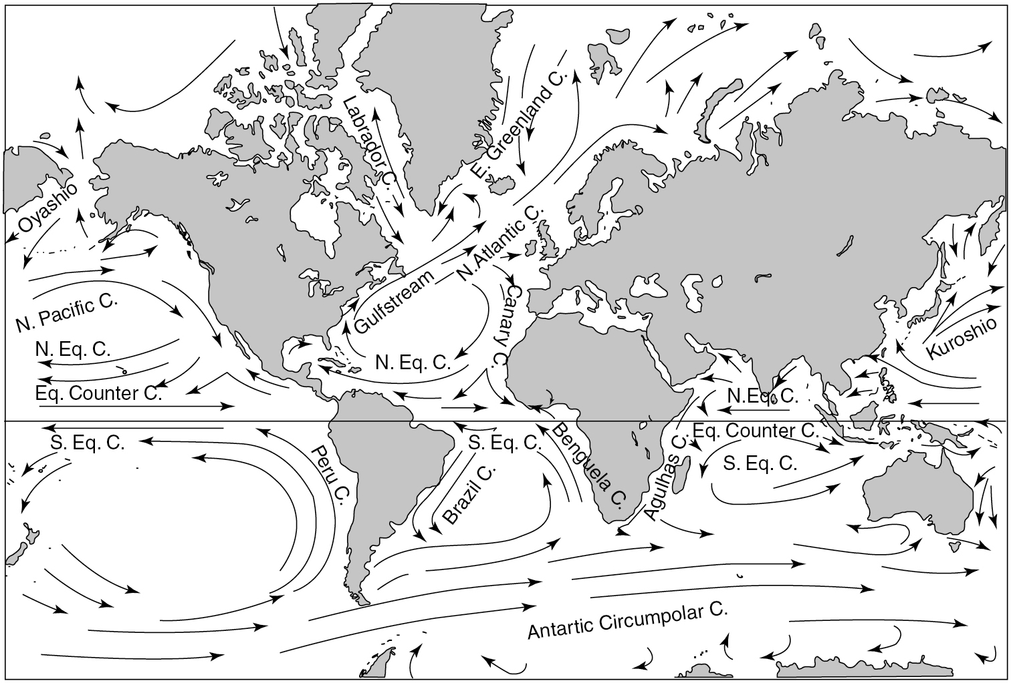
PILSON_Fig 01_01
© Cambridge University Press 2012

Slide 2
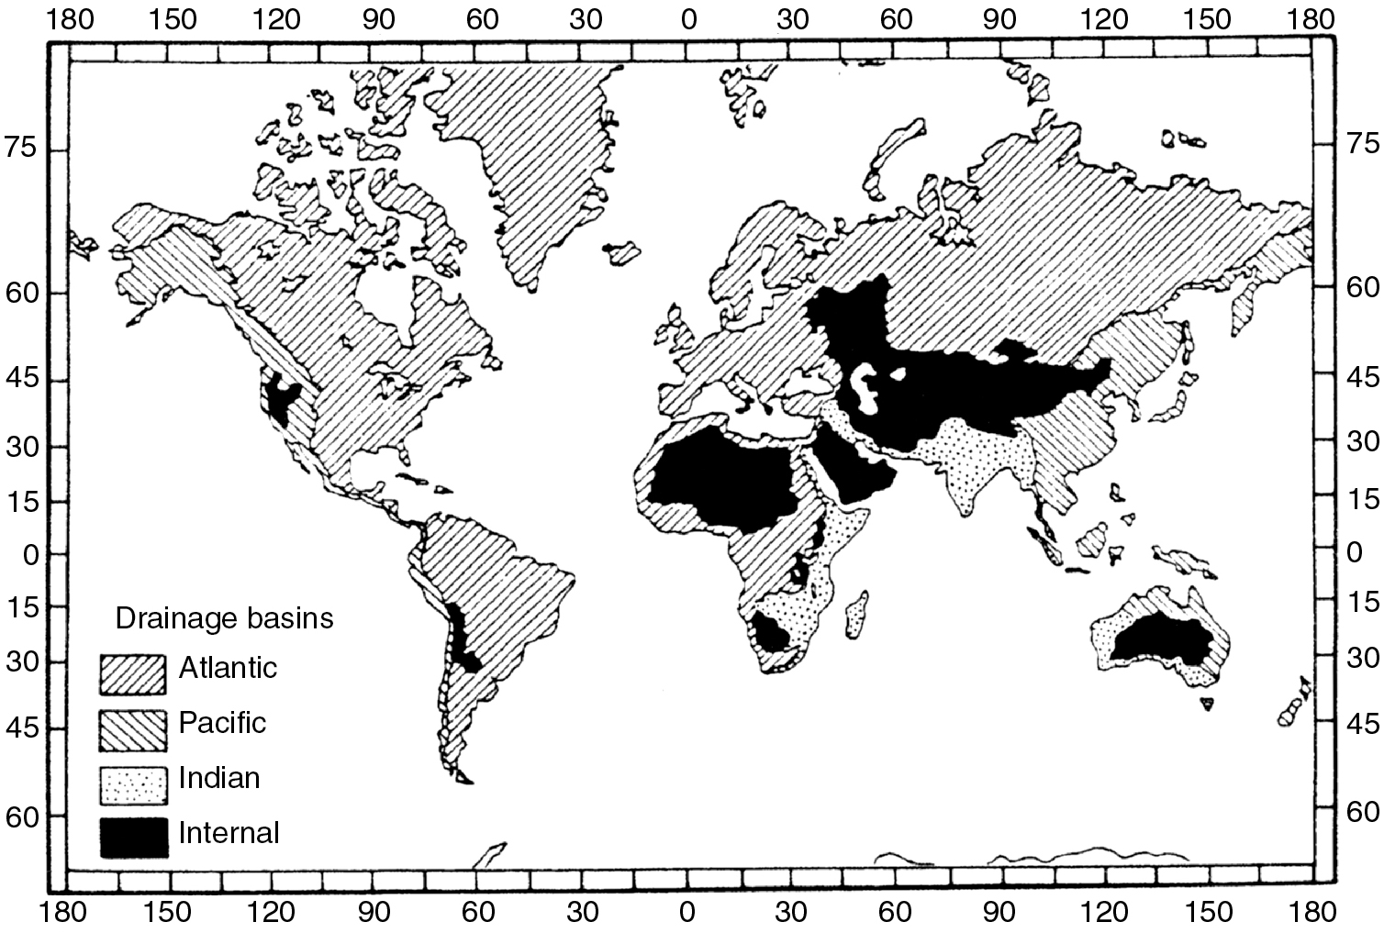
PILSON_Fig 01_02
© Cambridge University Press 2012

Slide 3
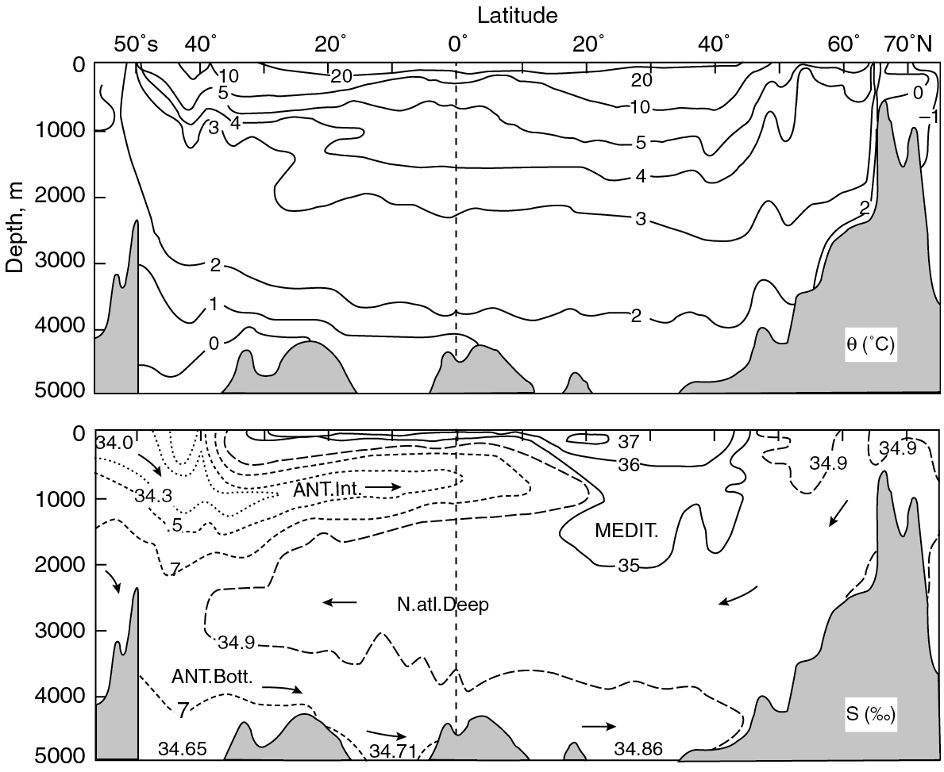
PILSON_Fig 01_03
© Cambridge University Press 2012

Slide 4
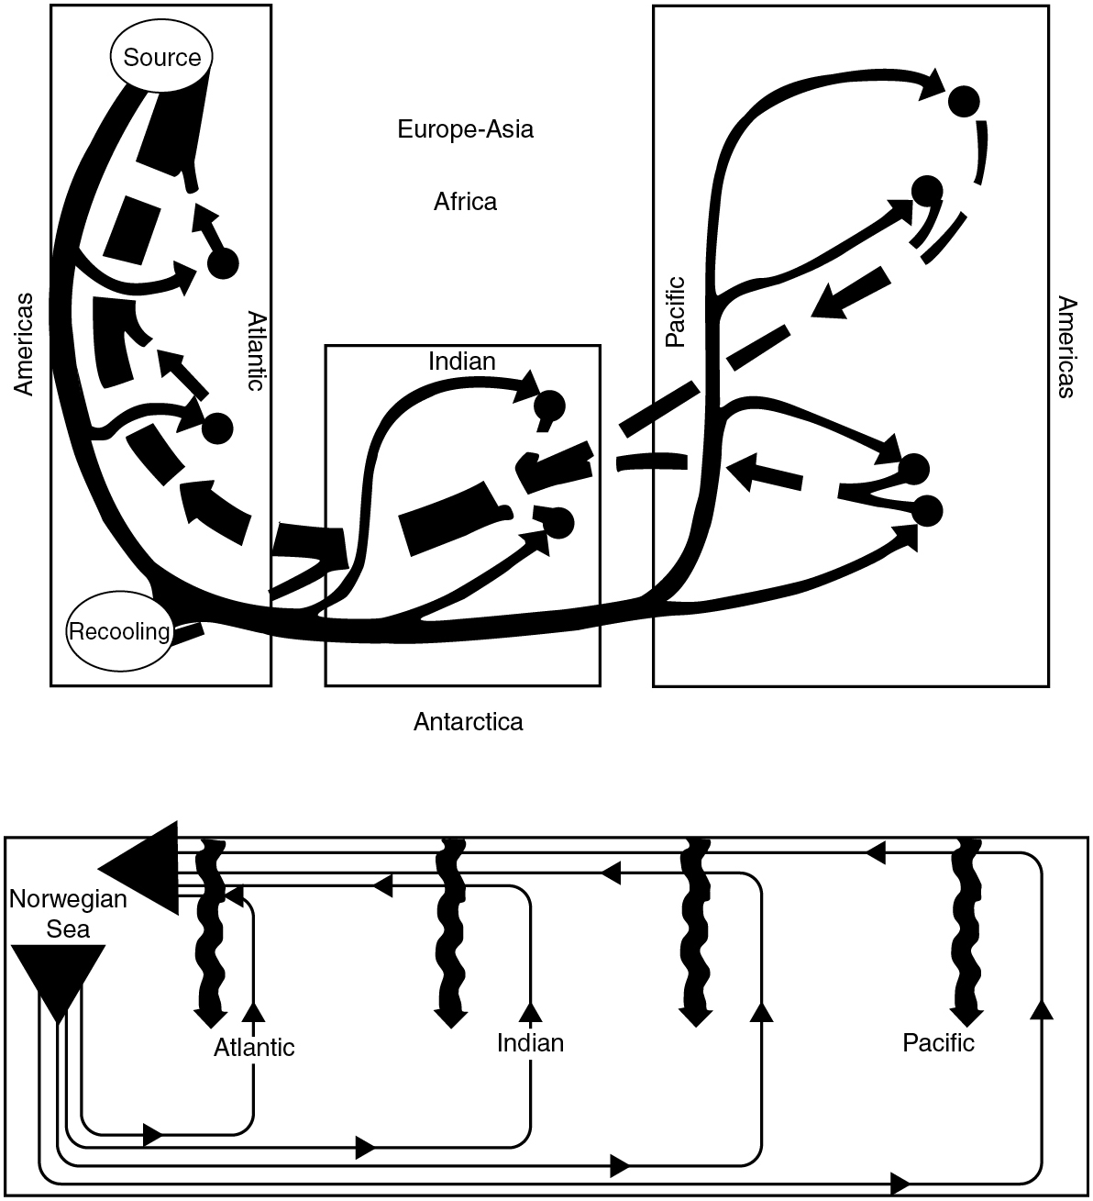
PILSON_Fig 01_04
© Cambridge University Press 2012

