Slide 1
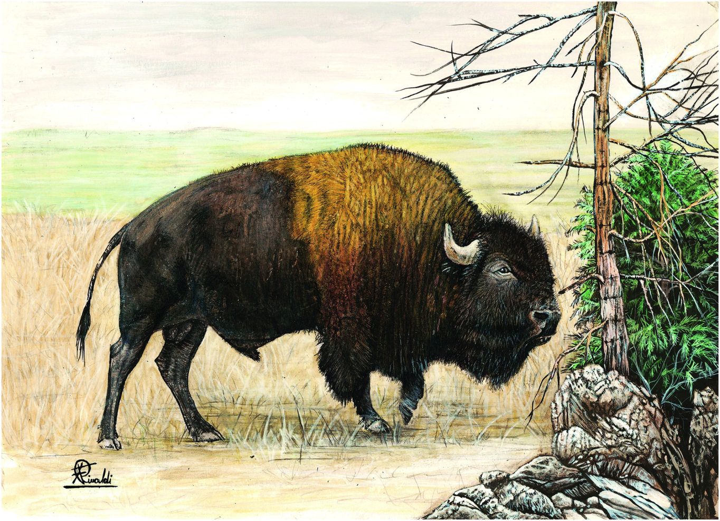
Plate 12
American Bison (illustration by Francesco Rinaldi)

Slide 2
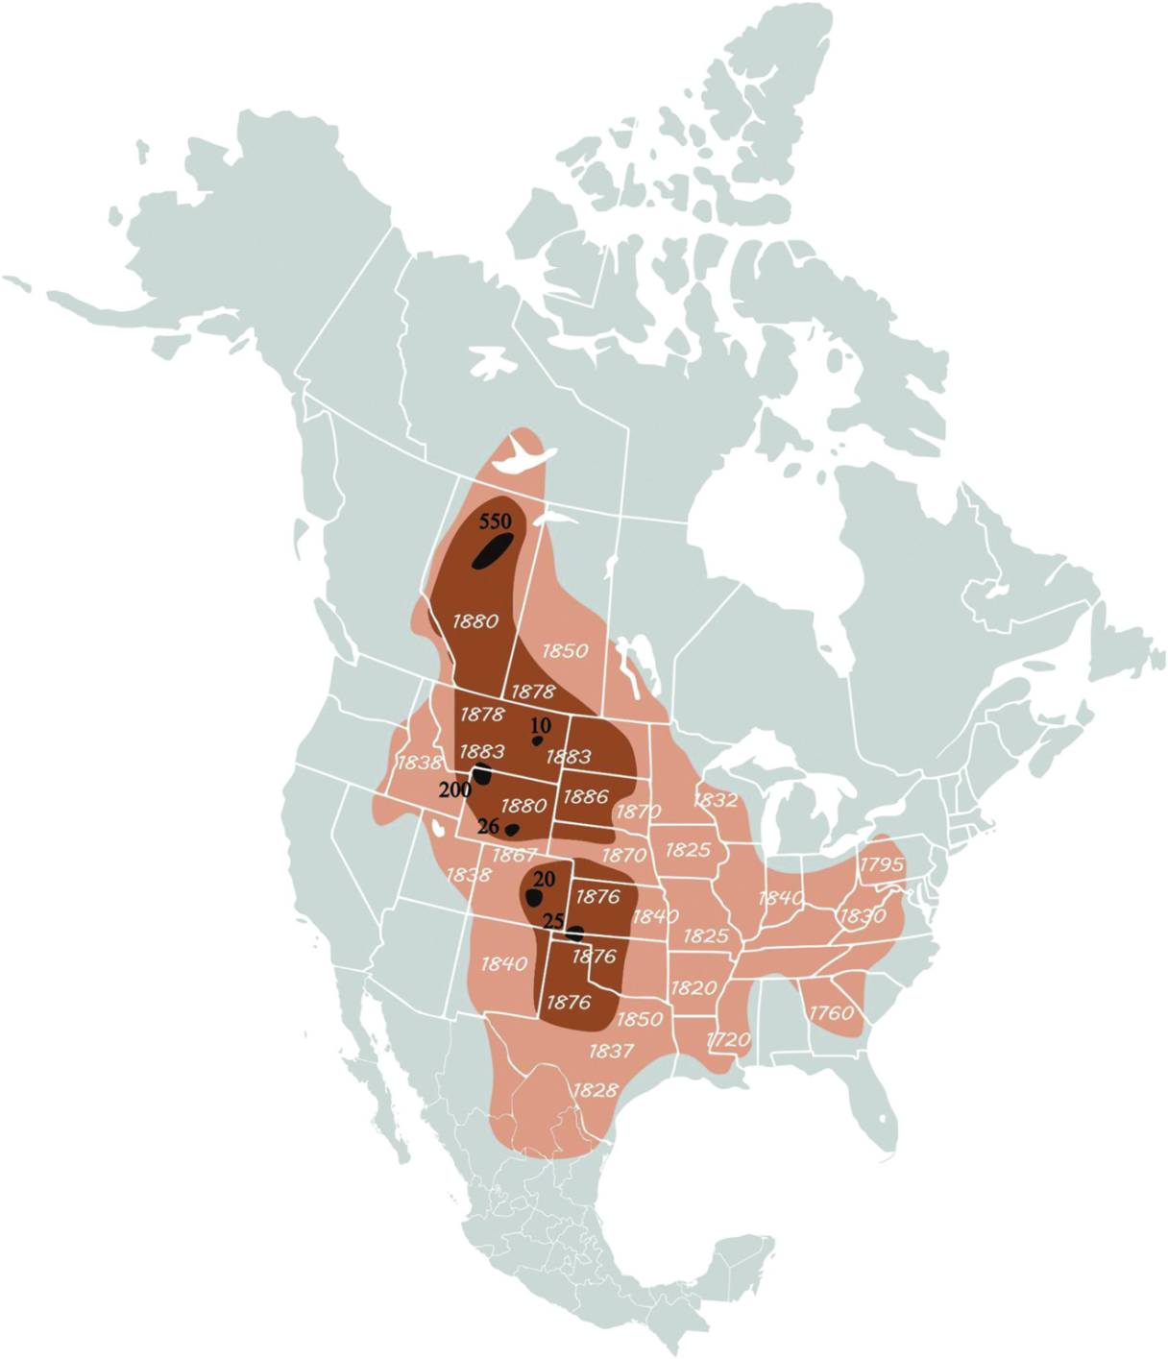
Figure 9.1
Original home range and dates of estimated local exterminations of plains bison and wood bison. Dark number indicate number of bison as January 1st 1889. Light numbers give the date of local extermination. Light brown , range as of 1870; dark brown , range as of 1889, with modern state and province borders. Recreated from Hornaday (1889). Courtesy of Wildlife Conservation Society.

Slide 3
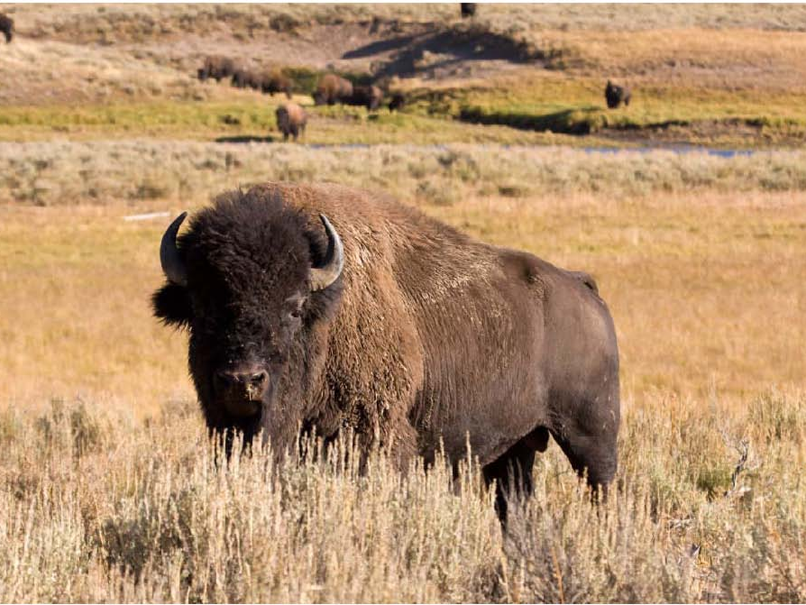
Figure 9.4
Plains bison bull at Yellowstone National Park. Courtesy of Wildlife Conservation Society

Slide 4
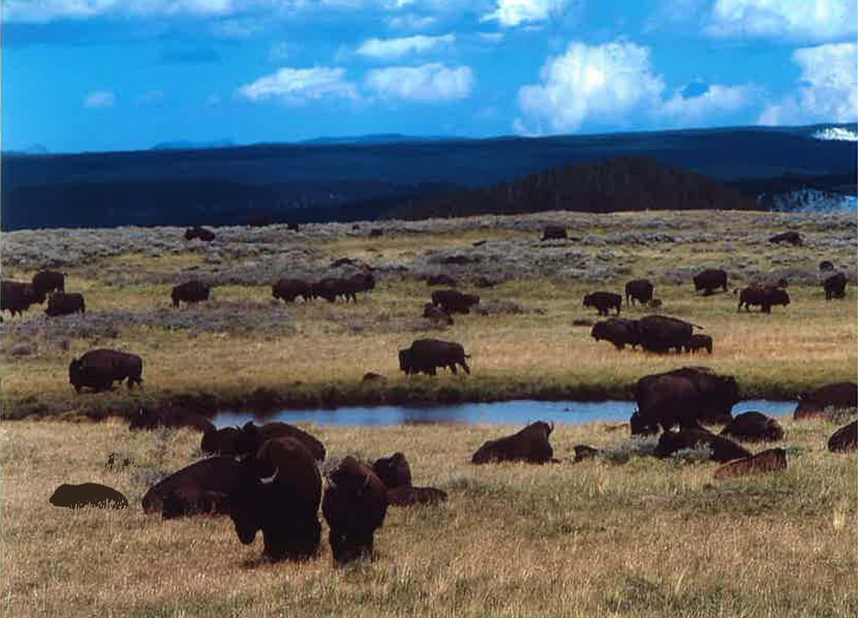
Figure 9.5
A herd of plains bison in mixed grassland forest habitat at ~2,400m elevation at Yellowstone National Park. Courtesy of the United States National Park Service.

Slide 5
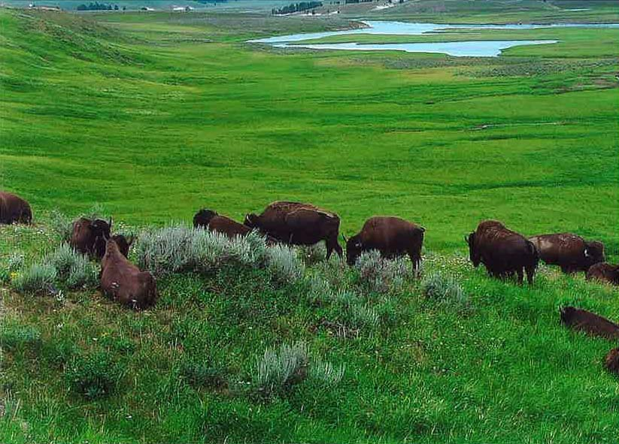
Figure 9.6
Bison group size declines amidst peak summer green biomass at Yellowstone National Park. Courtesy of the United States National Park Service.

Slide 6
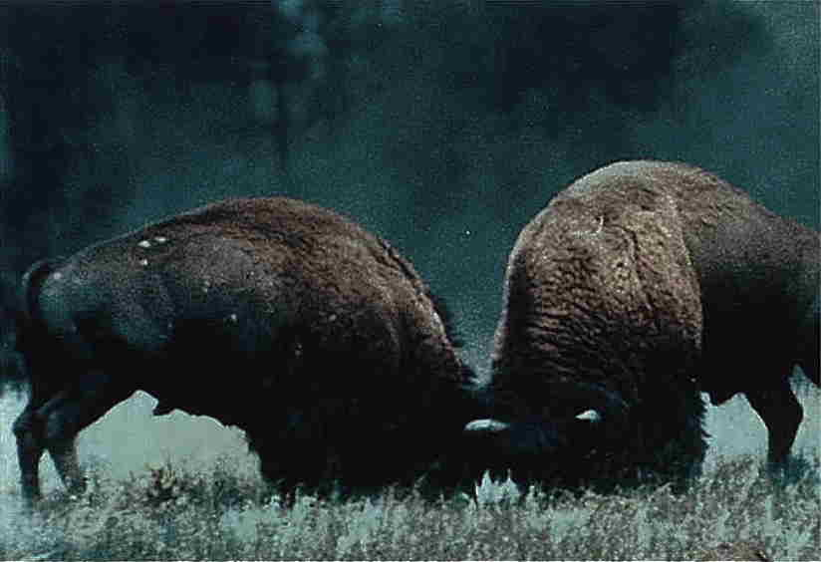
Figure 9.7
Aggression between adult male plains bison peaks during the summer rut at Yellowstone National Park. Although uncommon, serious injury would subsequently predispose that animal to selective wolf or bear predation. Courtesy of United States National Park Service.

Slide 7
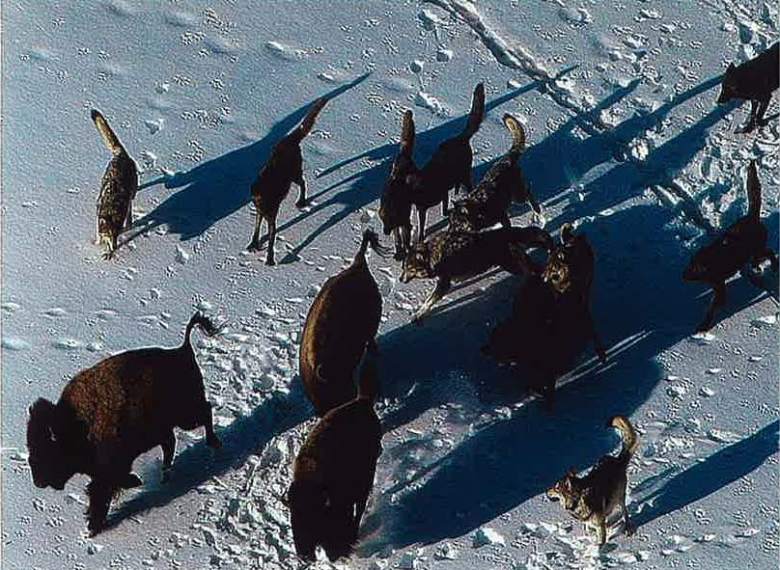
Figure 9.8
Despite defensive group behavior by plains and wood bison, wolf predation of bison can occur, especially when local terrain conditions favour wolf aggression. In this example from Yellowstone National Park, wolves were unable to gain sufficient advantage, resulting only in harassment of these bison for a short period of time. Courtesy of the United States National Park Service.

Slide 8
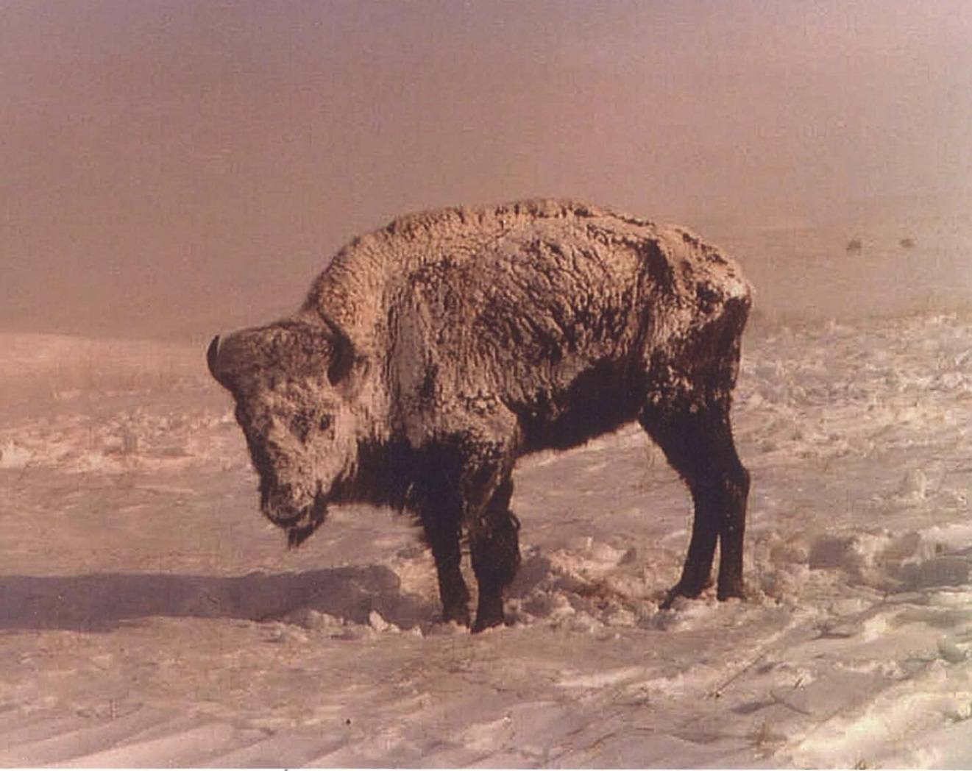
Figure 9.9
In the face of extreme weather, plains bison will often reduce movement and thus energy expenditure. In this case, this female waited out a 3 day winter snow blizzard on a nature preserve in South Dakota, USA. Courtesy of Glenn Plumb.

