Slide 1
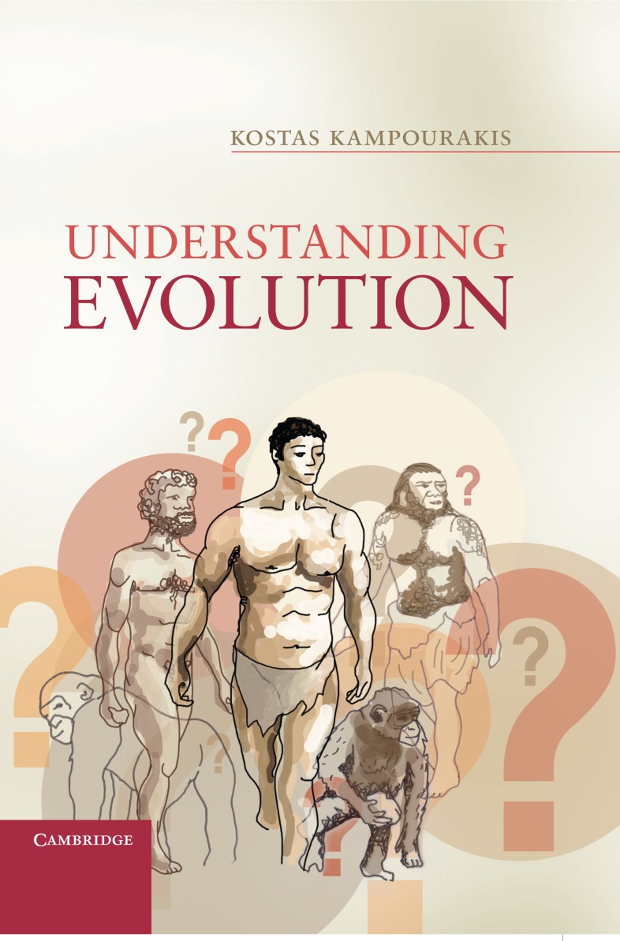
Chapter 5
Common ancestry

Slide 2
Figure 5.1
Two families of a) African and b) European origin. Children usually resemble their parents in several characters such as hair type or skin color as it is the case here. Image © Alashi.

Slide 3
Figure 5.2
Two depictions of family trees. Figure b) is probably more accurate than a) because in the latter case all family members in each of the families have the same skin color. Image adapted from Figure 5.1, © Alashi.

Slide 4
Figure 5.3
All members of these families are related to each other and to any other human and as a consequence they all share some common “humane” characters. Scientists estimate that modern humans (Homo sapiens) emerged about 200,000 years ago. However, they still lack several details of human evolution (see Figure 1.4). Image adapted from Figure 5.1, © Alashi.

Slide 5
Figure 5.4
Analogy between family trees and evolutionary trees. A family tree (a) is gradually (b) transformed to an evolutionary tree (c) in order to show the similarity in the process of reconstructing human and species ancestry (under some abstract assumptions of course – see text for details). Family trees and evolutionary trees are not equivalent but they are both constructed to represent genealogies. Image adapted from Figure 5.1, © Alashi.

Slide 6
Figure 5.5
a) The tree of life with 6 kingdoms: 1 including prokaryotes and 5 including eukaryotes. b) The evolutionary network of life with the 3 domains. The gray shading indicates our uncertainty for what happened during the early stages of evolution and the exact relation between the 3 domains. Only vertical descent is depicted in the evolutionary trees. Instances of horizontal gene transfer both within and between domains are not depicted (adapted from Koonin 2010a).

Slide 7
Figure 5.6
Evolutionary trees of vertebrates based on a single character (existence/absence of limbs). Reptiles are classified differently depending on whether one thinks of reptiles as not having (e.g. snakes in a) or having (e.g. crocodiles in b) limbs (CAVL: common ancestor of vertebrates with limbs; CAVnL: common ancestor of vertebrates without limbs). Such depictions are clearly inadequate, and more accurate criteria are required for constructing evolutionary trees. Image adapted from “300 vector silhouettes of animals (mammals, birds, fish, insects)” © Shutterstock.com/ntnt; “Big collection of vector” © Shutterstock.com/Pavel K; “66 pieces of detailed vectoral (fish silhouette) © Shutterstock.com/pinare; “vector animals silhouettes” © Shutterstock.com/lilac.

Slide 8
Figure 5.7
Skeletons of the seven major vertebrate groups (not in scale). Image © Simon Tegg.

Slide 9
Figure 5.8
The skeleton of a modern human compared to the skeleton of the imaginary Gogonasus man, which consists of the bones present in both humans and Devonian advanced lobe-finned fish, drawn to the same scale as humans (reproduced from Long (2012) with permission from Cambridge University Press.

Slide 10
Figure 5.9
Symplesiomorphies and synapomorphies, or how the study of form of extant taxa as well that of extinct taxa in dated fossils can help clarify evolutionary relatedness. Note: Tiktaalik and Archaeopteryx are NOT the common ancestors; however, the common ancestor in each case could be similar to Tiktaalik or Archaeopteryx and so these are included in the evolutionary tree. Not possessing limbs is the plesiomoprhic character and a symplesiomorphy for lampreys (jawless fish), sharks (cartilaginous fish) and trouts (bone-fish); possessing limbs is the apomorphic character and a synapomorphy for frogs (amphibians) and birds; wings are a synapomorphy for eagles and hens. Image adapted from “300 vector silhouettes of animals (mammals, birds, fish, insects)” © Shutterstock.com/ntnt; “Big collection of vector” © Shutterstock.com/Pavel K; “66 pieces of detailed vectoral (fish silhouette) © Shutterstock.com/pinare; “vector animals silhouettes” © Shutterstock.com/lilac.

Slide 11
Figure 5.10
A thought experiment of how to infer history from contemporary data. Balls A-D roll over the black and gray planes and colored, numbered papers stick on the balls as they roll over them. At the end, depending on which papers are found on each ball one can infer the actual route of each of the balls. Image © Simon Tegg.

Slide 12
Figure 5.11
An evolutionary tree of vertebrates based on apomorphic characters (CAV: common ancestor of vertebrates). Note that the apparent progression from jawless fish to mammals (from left to right) is an illusion (see next figure). Image adapted from “300 vector silhouettes of animals (mammals, birds, fish, insects)” © Shutterstock.com/ntnt; “Big collection of vector” © Shutterstock.com/Pavel K; “66 pieces of detailed vectoral (fish silhouette) © Shutterstock.com/pinare; “vector animals silhouettes” © Shutterstock.com/lilac.

Slide 13
Figure 5.12
The phylogenetic relationships of vertebrates of Figure 5.11 can be represented in various ways as shown here. All these evolutionary trees are equivalent and represent the same relationships (the double arrows indicate the nodes in which the taxa belonging in a clade have just changed relative places; CAV: common ancestor of vertebrates). Image adapted from “300 vector silhouettes of animals (mammals, birds, fish, insects)” © Shutterstock.com/ntnt; “Big collection of vector” © Shutterstock.com/Pavel K; “66 pieces of detailed vectoral (fish silhouette) © Shutterstock.com/pinare; “vector animals silhouettes” © Shutterstock.com/lilac.

Slide 14
Figure 5.13
The “evolution” of “Nathan”. Contemporary “Nathan” character can be homologies if they have evolved from a common ancestor (either “Nathanael” or “Jonathan”), or homoplasies if they have evolved independently from different ancestors (“Nathanael” and “Jonathan”). “Nathan” and “Jon” are synapomorphies, i.e. derived characters from an ancestral one (“Nathanael”), whereas contemporary “Nathanael” are symplesiomorphies.

Slide 15
Figure 5.14
Bird and bat wings are homologies as vertebrate forelimbs but they are homoplasies as vertebrate wings. Whereas their structure is due to the common ancestor of vertebrates, their functionality as wings evolved independently. Image adapted from “300 vector silhouettes of animals (mammals, birds, fish, insects)” © Shutterstock.com/ntnt; “Big collection of vector” © Shutterstock.com/Pavel K; “66 pieces of detailed vectoral (fish silhouette) © Shutterstock.com/pinare; “vector animals silhouettes” © Shutterstock.com/lilac.

Slide 16
Figure 5.15
Eagle and hen wings are homologies as they are derived from a common ancestor; both of them and bat wings are homoplasies. Image adapted from “300 vector silhouettes of animals (mammals, birds, fish, insects)” © Shutterstock.com/ntnt; “Big collection of vector” © Shutterstock.com/Pavel K; “66 pieces of detailed vectoral (fish silhouette) © Shutterstock.com/pinare; “vector animals silhouettes” © Shutterstock.com/lilac.

Slide 17
Figure 5.16
Bat (a) and bird (b) skeletons. Image © Simon Tegg.

Slide 18
Figure 5.17
Transitional forms in the evolution of modern whales (Balaena) from tetrapod ancestors (adapted from Coyne 2009, p.54). Image © Simon Tegg.

Slide 19
Figure 5.18
Wings of bats and birds and hydrodynamic shapes of fish and sea mammals as homoplasies and homologies. Image adapted from “300 vector silhouettes of animals (mammals, birds, fish, insects)” © Shutterstock.com/ntnt; “Big collection of vector” © Shutterstock.com/Pavel K; “66 pieces of detailed vectoral (fish silhouette) © Shutterstock.com/pinare; “vector animals silhouettes” © Shutterstock.com/lilac.

Slide 20
Figure 5.19
The evolutionary trees show all possible topologies for each set of taxa (humans /chimpanzees/ gorillas, 5–8 million years ago; chordates / arthropods / nematodes, >550 million years ago). Below each topology, the percentage and number (in parentheses) of DNA coding sequences (DCSs), and rare genomic changes (RGCs) supporting that topology are shown (based on maximum likelihood analyses). A number of DNA coding sequences in each case are uninformative: a) 6 of 98 DCSs; and b) 179 of 507 DCSs (adapted from Rokas and Carroll, 2006). What the resulting trees indicate is that we cannot be 100% certain about which topology is the accurate one. However, RGCs increase the level of certainty compared to DCSs.

Slide 21
Figure 5.20
The possible independent evolution of multicellularity (adapted from Arthur 2011, p.12). The important conclusion here is that not all multicellular organisms are derived from a single, first multicellular common ancestor.

Slide 22
Figure 5.21
Three perspectives of evolution: a) changes in individuals, which is wrong; b) changes in the genetic structure of populations, which is inadequate, and c) changes in the developmental trajectories of individuals which is the evo-devo perspective.

Slide 23
Figure 5.22
Cases of developmental reprogramming: a) Part of the development of an embryo, divided in time frames (DT: developmental time), is shown. At DT 3 a DNA sequence is expressed in the mid-anterior part and a protein is synthesised (grey region) which guides the development of limbs until DT 6. b) Heterochrony: the DNA sequence starts being expressed at a later time (DT 5) and stops being expressed at DT 6. As a result the protein was produced for a shorter time and the limbs are shorter. c) Heterotopy: At DT 3 a DNA sequence is expressed, but in the mid-posterior part, and a protein is synthesised (grey region) which guides the development of limbs until DT 6, but at another place of the embryo than before. d) Heterometry: At DT 3 a DNA sequence is expressed in the mid-anterior part and a protein is synthesised, but in a greater amount (dark grey region), which guides the development of longer limbs until DT 6. e) Heterotypy: At DT 3 a DNA sequence is expressed in the mid-anterior part and a protein is synthesised (grey region) which guides the development of limbs until DT 6, but this time limbs grow to a different direction than before. It is important to note that in all cases the DNA sequence that produces the protein is the same and changes have only taken place in the regulatory sequences that control its expression.

Slide 24
Figure 5.23
Evolutionary relationships among animals. Notice the “inversion” of systems between protostomes and deuterostomes. Protostomes have the central nervous system ventral to the digestive system whereas deuterostomes have the central nervous system dorsal to the digestive system (dark grey: digestive system; light grey: nervous system; adapted from De Robertis 2008, 2009).

Slide 25
Table 5.1
Comparison of some characters of bacteria, archaea and eukaryotes (refers to the majority of cases; from Cavvichiolli 2011)

Slide 26
Table 5.2
Apparent origins of some key molecular systems of eukaryotes (adapted from Koonin 2010b)

Slide 27
Table 5.3
Some derived characters among vertebrates (not all these groups correspond to classes). Such tables can be constructed by using DNA, RNA or protein sequences and used for inferring evolutionary relationships

