Slide 1
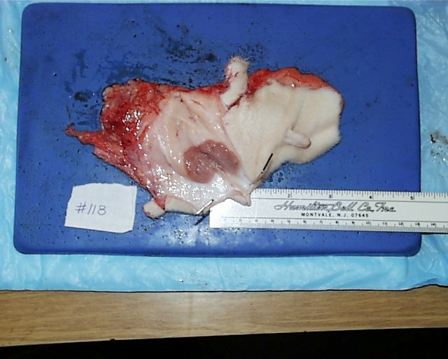
Figure 5.1a
Panel A shows a sagittal section of the mammary gland of a 75-day-old Holstein heifer. Note the very dense, compact mass of mammary parenchymal tissue surrounded by the mammary fat pad.

Slide 2
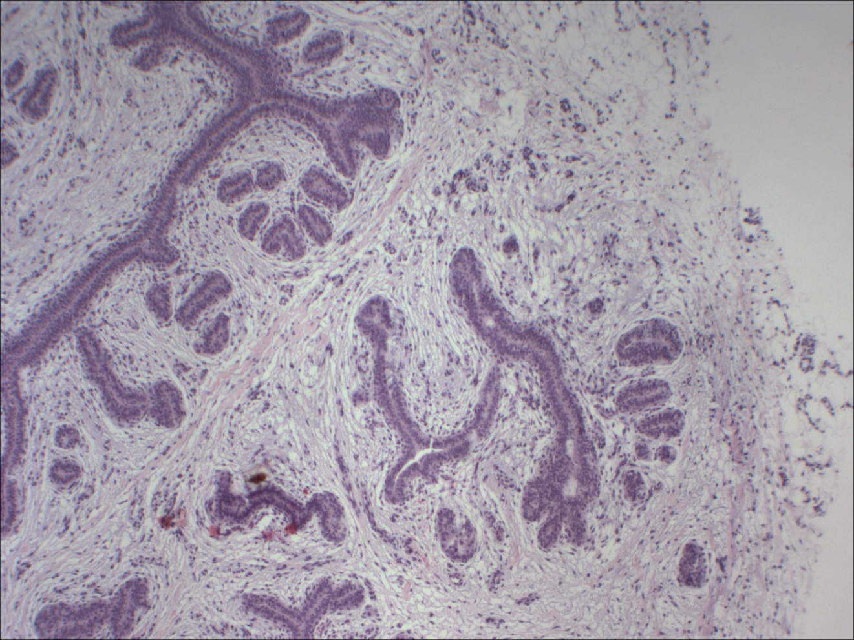
Figure 5.1b
Panel B illustrates developing ducts within the parenchymal of a 4-month-old Holstein heifer. Note profiles of ducts surrounded by stromal cells and extracellular matrix but few apparent adipocytes.

Slide 3
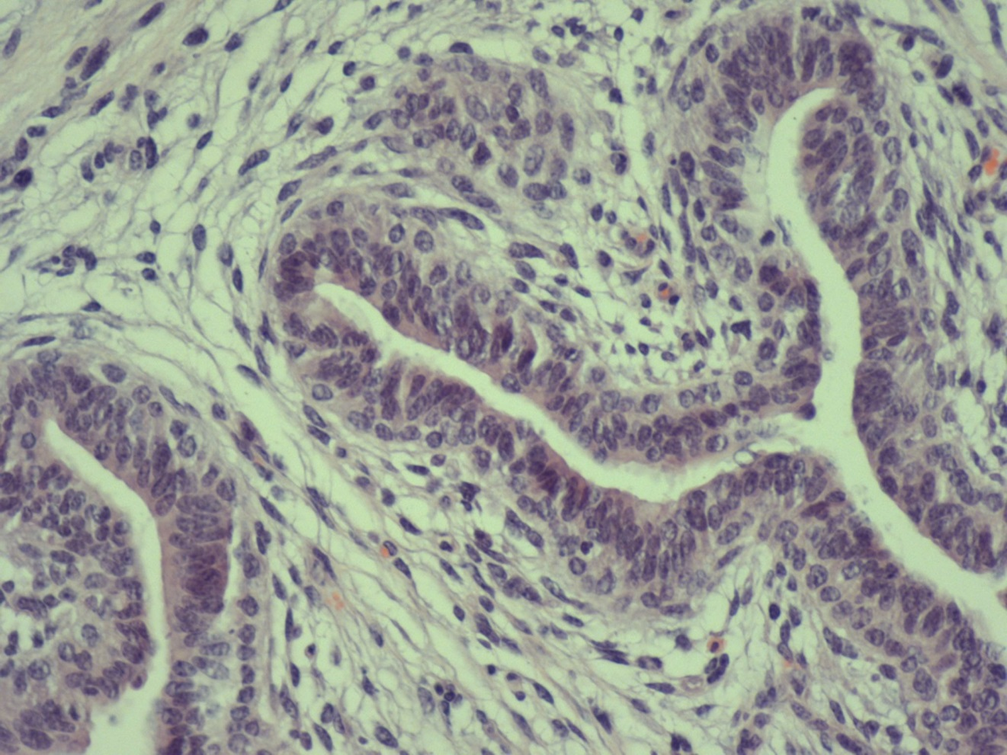
Figure 5.1c
Panel C. shows the multilayered epithelium of mammary ducts from a 4 month old Holstein heifer.

Slide 4
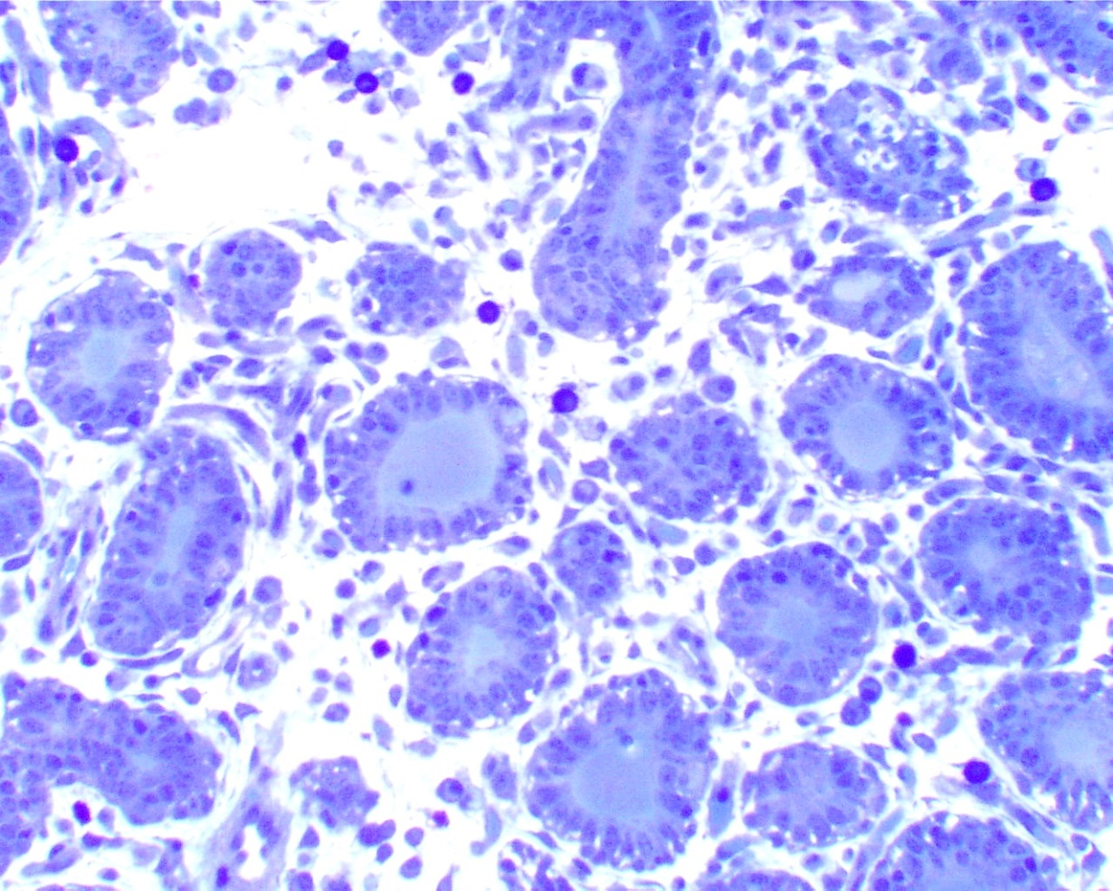
Figure 5.1d
Panel D show the early development of mammary alveoli from a Holstein heifer at 160 days of gestation.

Slide 5
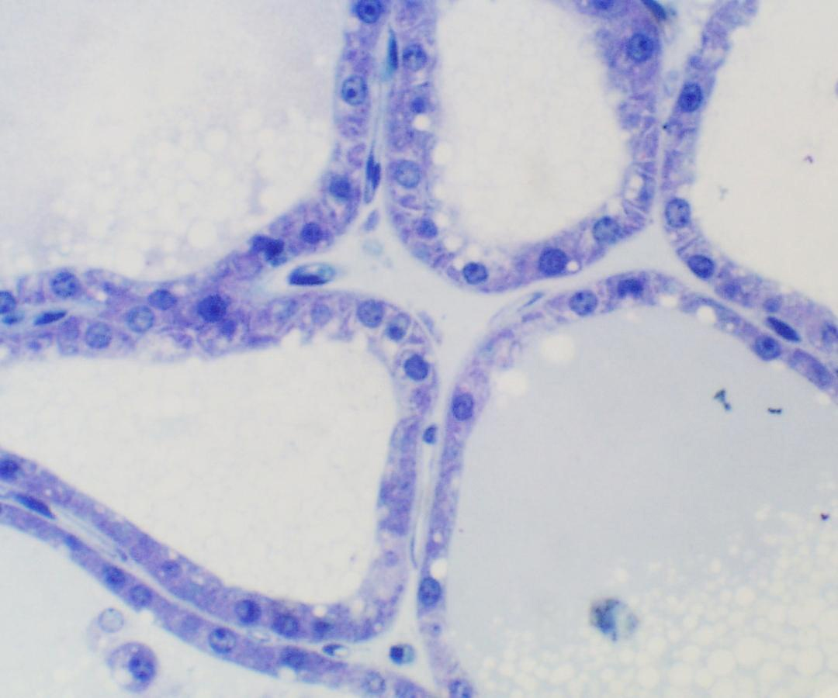
Figure 5.1e
Panel E shows a cross section of the closely aligned mammary alveoli from a lactating Holstein cow.

Slide 6
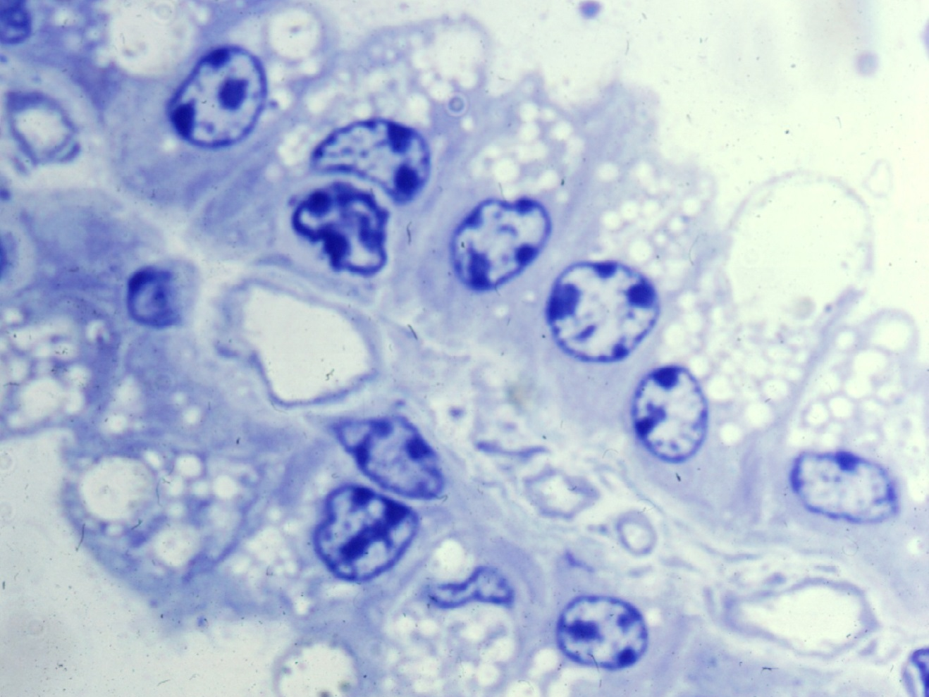
Figure 5.1f
Panel F shows a profile of two adjacent alveoli and the marked cytological differentiation of the alveolar epithelial cells from a lactating Holstein cow.

Slide 7
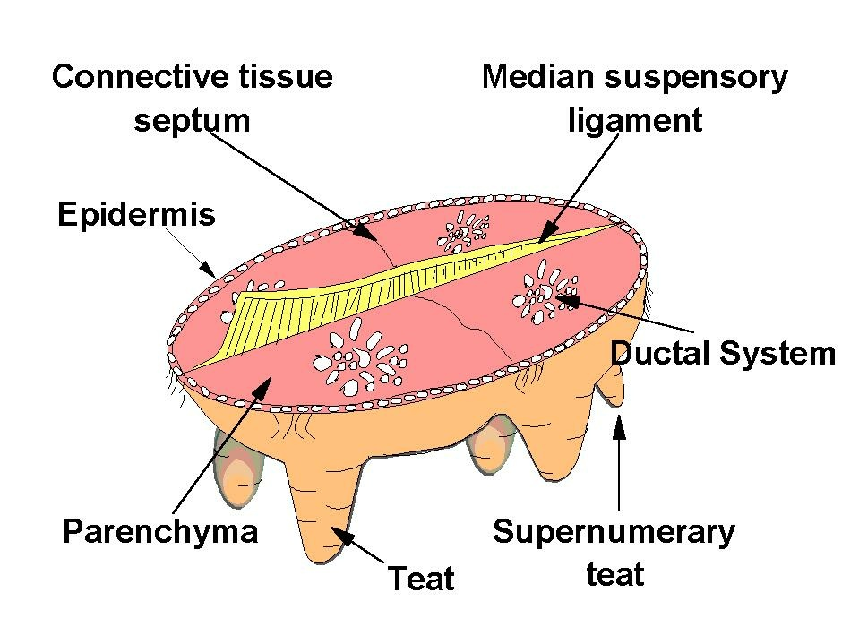
Figure 5.2
The upper panel illustrates the gross anatomy of the mature mammary gland of a lactating Holstein dairy cow.

Slide 8
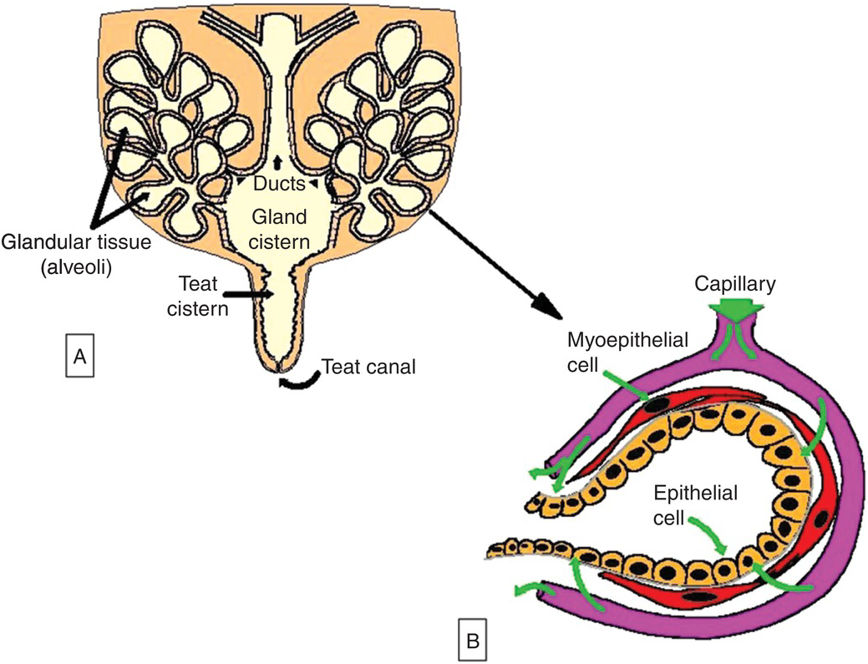
Figure 5.3 a&b
The middle panel (a and b) provides a stylized view of the arrangement of lobules of alveoli with major mammary ducts, the gland and teat cistern as well as the arrangement cells within an alveolus and blood supply (with permission from Nickerson and Akers, 2011).

