Slide 1
Absorption Spectroscopy of Gases
Fundamentals

Slide 2
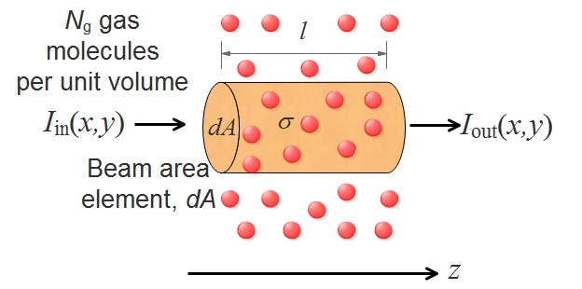
The Beer-Lambert Law
where σ is the cross-section and α is the absorption coefficient

Slide 3
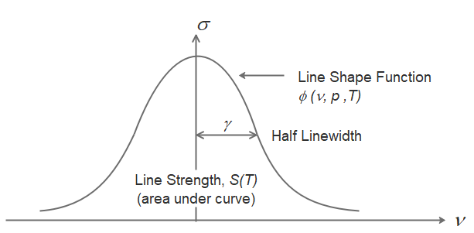
Parameters of Absorption Lines

Slide 4
Line Shape Functions
Doppler Broadened: Gaussian
Collisional Broadened: Lorentzian
Voigt Line Shape: Convolution of Gaussian and Lorentzian Profiles

Slide 5
Gas Parameters and Line Shape
Measurement of the half-width, γ, and line centre depth, d_{c}, of an absorption line yields information on the gas concentration, pressure or temperature.
For example for a Lorentzian line we have the relationships:
Temperature may be obtained through measurements on two absorption lines of the same gas:

Slide 6
Molecular Vibrations
Molecular vibration modes may be viewed on the web site:
https://www.chemtube3d.com/category/structure-and-bonding/molecular-vibrations-ir/

Slide 7
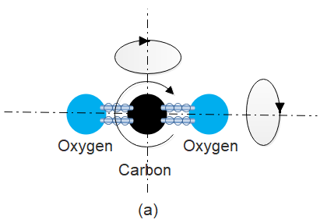
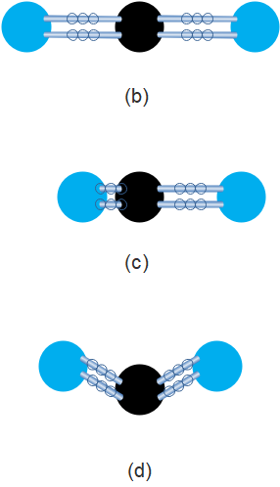
Rotation & Vibration of CO₂ Molecule
Rotations of CO₂ Molecule
Vibrations of CO₂ Molecule
The three axes of rotation
(b) Symmetric stretch (c) Anti-symmetric stretch (d) Bending mode

Slide 8
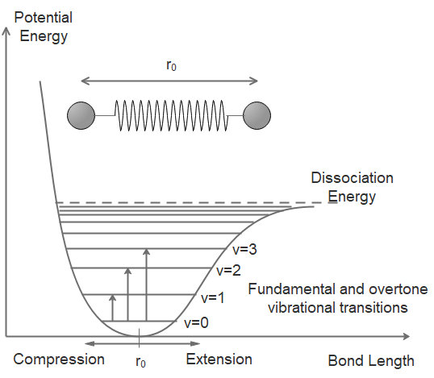
Energy Levels of Anharmonic Oscillator

Slide 9
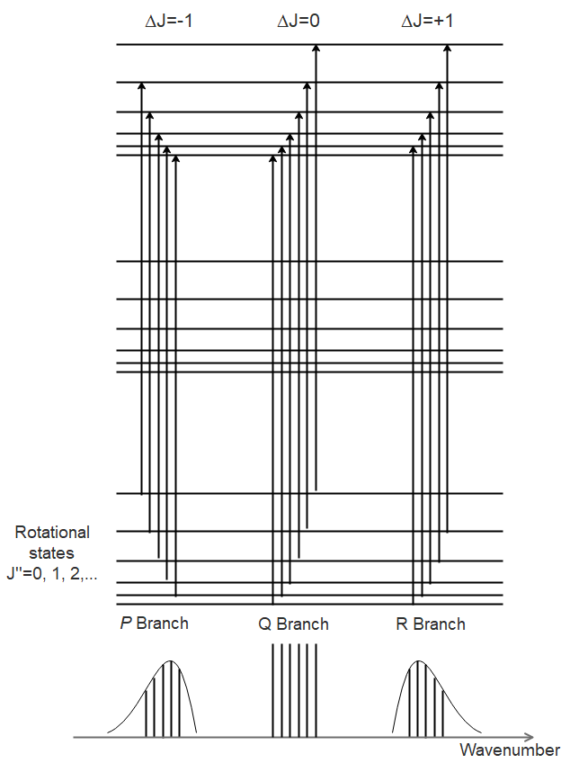
Near-IR Rovibrational Absorption Lines

Slide 10
The HITRAN Database
An extremely useful source of information on spectral line parameters is the HITRAN database:
http://www.hitran.org
Absorption spectra may be modelled with various adjustable parameters such as temperature, pressure, line shape (Voigt, Lorentz, or Doppler), path length, wavenumber range, etc. using the HITRAN application sites:
The HITRAN Application Programming Interface (HAPI)
http://www.hitran.org/hapi
HITRAN on the Web
http://hitran.iao.ru/home

Slide 11
Near-IR Lines of CO
Transmission=exp(-αCl) with Cl=1cm

Slide 12
Near-IR Lines of CO₂ (1.6μm region)
Transmission=exp(-αCl) with Cl=1cm

Slide 13
Near-IR Lines of CO₂ (2μm region)
Transmission=exp(-αCl) with Cl=1cm

Slide 14
Near-IR Lines of C₂H₂
Transmission=exp(-αCl) with Cl=1cm

Slide 15
Near-IR Lines of CH₄
Transmission=exp(-αCl) with Cl=1cm

Slide 16
Near-IR Lines of H₂O (1.4μm region)
Transmission=exp(-αCl) with Cl=1cm

Slide 17
Near-IR Lines of NH₃
Transmission=exp(-αCl) with Cl=1cm

Slide 18
Near-IR Lines of H₂S (1.6μm region)
Transmission=exp(-αCl) with Cl=1cm

Slide 19
Near-IR Lines of H₂S (1.9μm region)
Transmission=exp(-αCl) with Cl=1cm

Slide 20
Line Centre Attenuation for Pure Gas
Gas Molecule | Absorption Line Wavelength (µm) | α₀ (cm⁻¹) | Attenuation at line centre (dB/cm)
Carbon Monoxide (CO) | 1.5680 | 0.0025 | 0.011
Carbon Dioxide (CO₂) | 1.5723 2.0035 | 0.0014 0.1 | 0.006 0.434
Acetylene (C₂H₂) | 1.5201 | 0.69 | 2.99
Methane (CH₄) | 1.6510 | 0.36 | 1.56
Water Vapour (H₂O) | 1.3827 | 0.36 | 1.56
Ammonia (NH₃) | 1.5139 | 0.27 | 1.19
Hydrogen Sulphide (H₂S) | 1.5781 1.9250 | 0.019 0.05 | 0.08 0.22

Slide 21
Summary & Conclusions
The basic principles and parameters of gas absorption spectroscopy have been reviewed.
Line-shape measurements may be used to determine concentration, pressure or temperature in a variety of situations.
Optical sensors based on near-IR lines can be highly flexible and relatively inexpensive.
However for high sensitivity use of mid-IR lines is essential.

