Slide 1
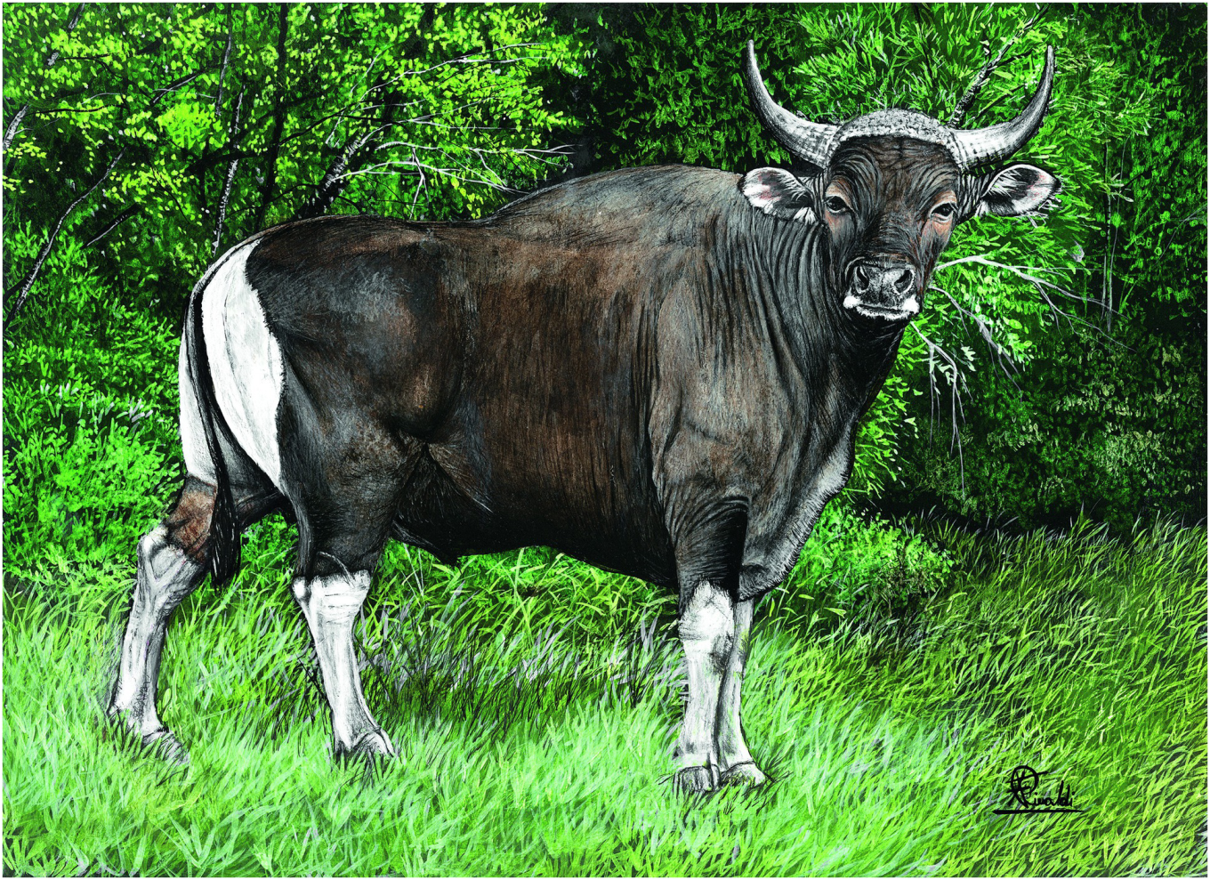
Plate 16
Banteng (illustration by Francesco Rinaldi)

Slide 2
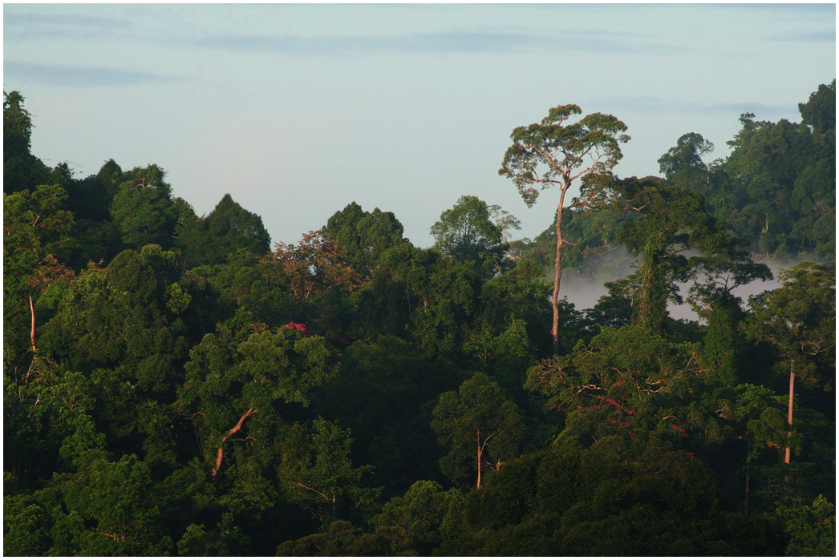
Figure 13.5
Tropical lowland dipterocarp forest is the principle habitat type of banteng in Sabah, Borneo (Photo by Penny C. Gardner)

Slide 3
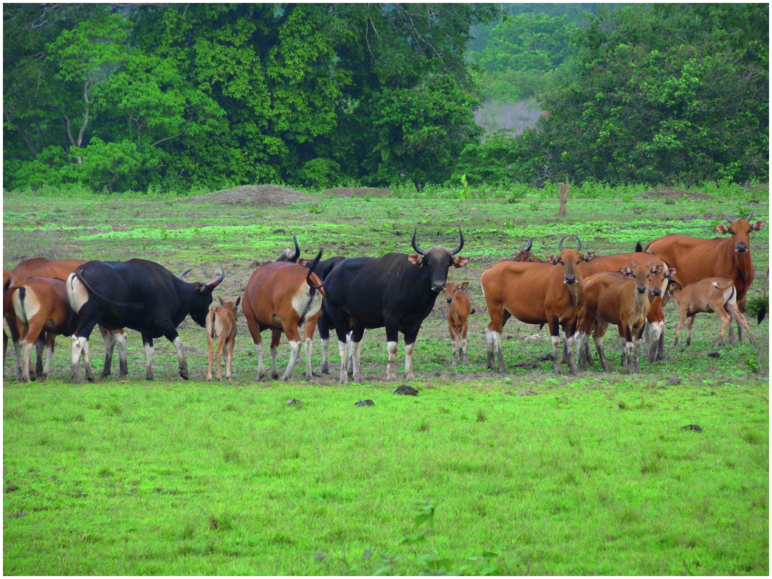
Figure 13.2
A mixed herd of banteng in Alas Purwo National Park (Java) consisting of bulls, cows, sub adult and juvenile (Photo by Pudyatmoko).

Slide 4
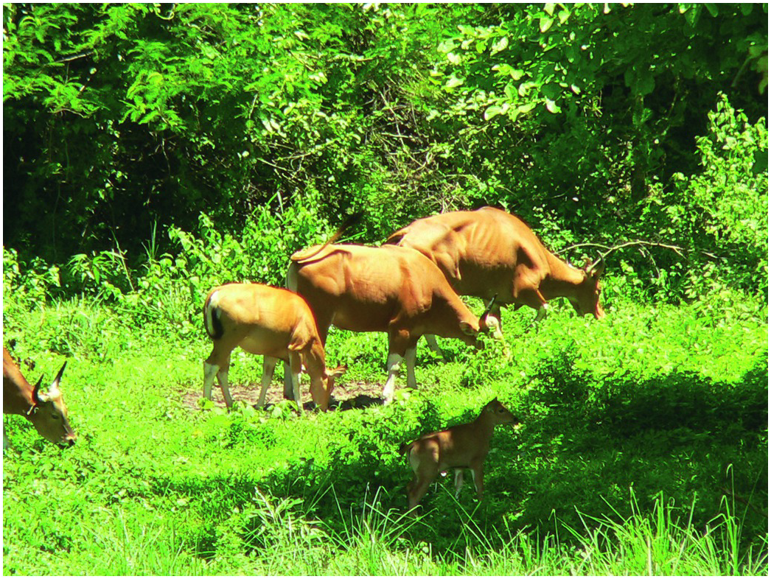
Figure 13.3
The Banteng form herds with several clans (cows with calf and juvenile in Thailand); herds ranging from 2 to 30 individuals. Each herd is usually led by an old cow.

Slide 5
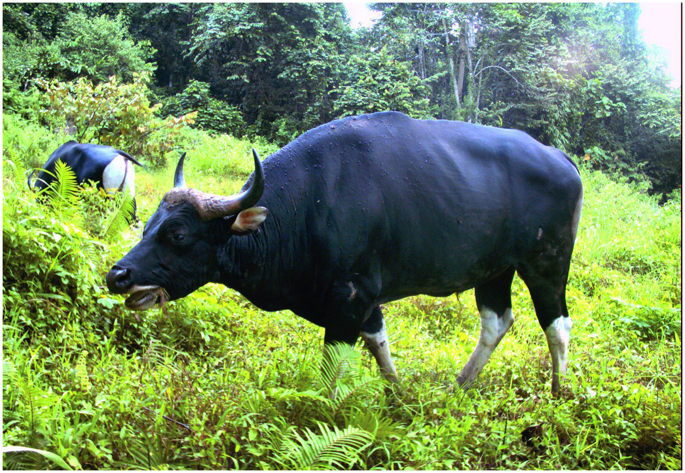
Figure 13.4
Mature dominant bull in Malua Forest Reserve/Malua BioBank (Borneo), captured on camera trap in 2011 (© Danau Girang Field Centre/Sabah Wildlife Department using Reconyx PC800 HyperFire Professional Semi-Covert IR camera trap).

