Slide 1
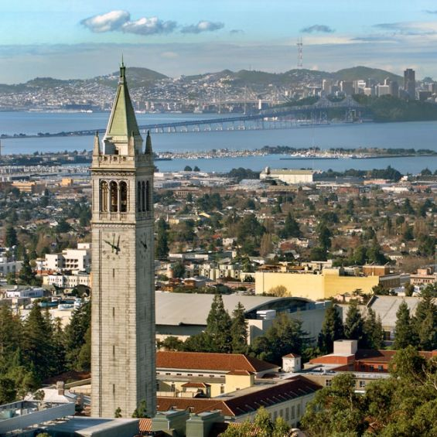
University of California, Berkeley,
X-rays and Extreme Ultraviolet Radiation
AST210/EECS213
Fall 2019

Slide 2
Spatial and Temporal Coherence at very short wavelengths
David Attwood
University of California, Berkeley

Slide 3
Spatial and temporal coherence
Fourier transform pairs: Heisenberg Uncertainty Principle:
Δτ Δω ≥ ½ (4.4a) ΔE_{FWHM} ∙Δτ_{FWHM} ≥ 1.825 eV∙fsec (4.4b) Δx Δk ≥ ½ (4.5a) Δx∙Δp ≥ ħ/2 (4.5b)
or equivalently

Slide 4
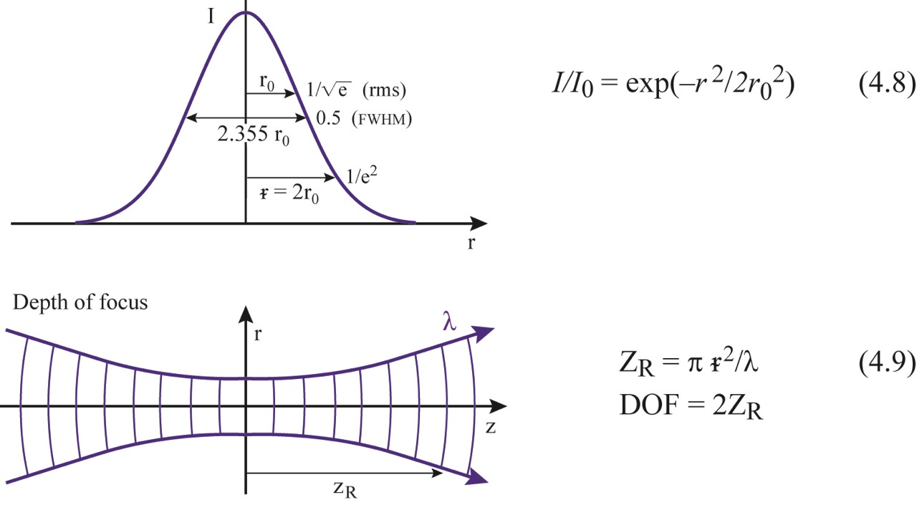
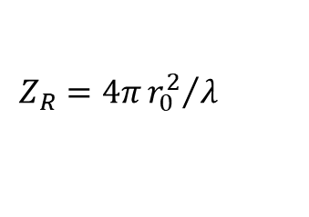
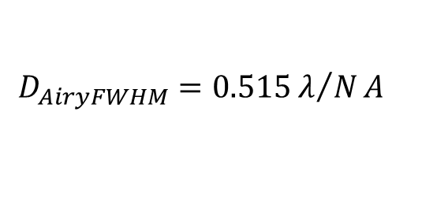
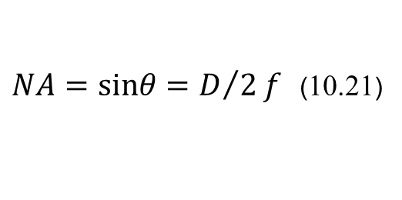

Gaussian and depth of focus definitions
$$Z_{R}=4π{r_{0}^{2}}/λ$$
$DOF=±\frac{1}{2}\frac{λ}{NA^{2}}$ (10.45)
$NA=sinθ=D/2f$ (10.21)
$$D_{AiryFWHM}=0.515λ/NA$$

Slide 5
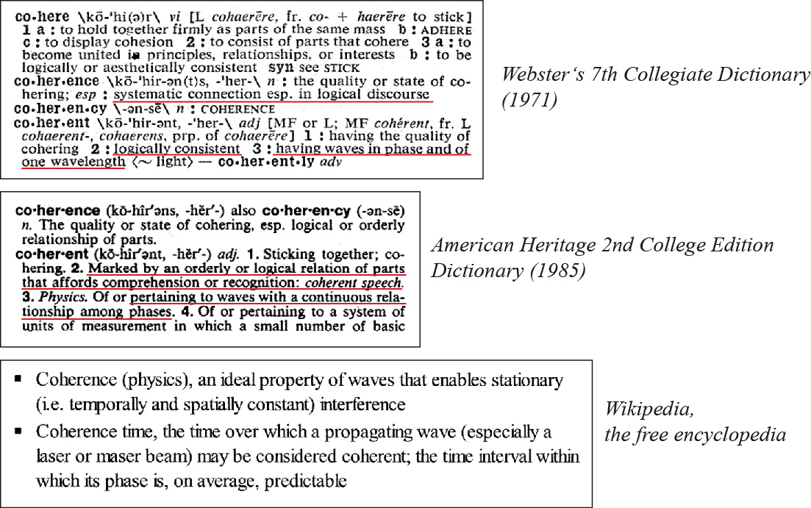
Coherence

Slide 6
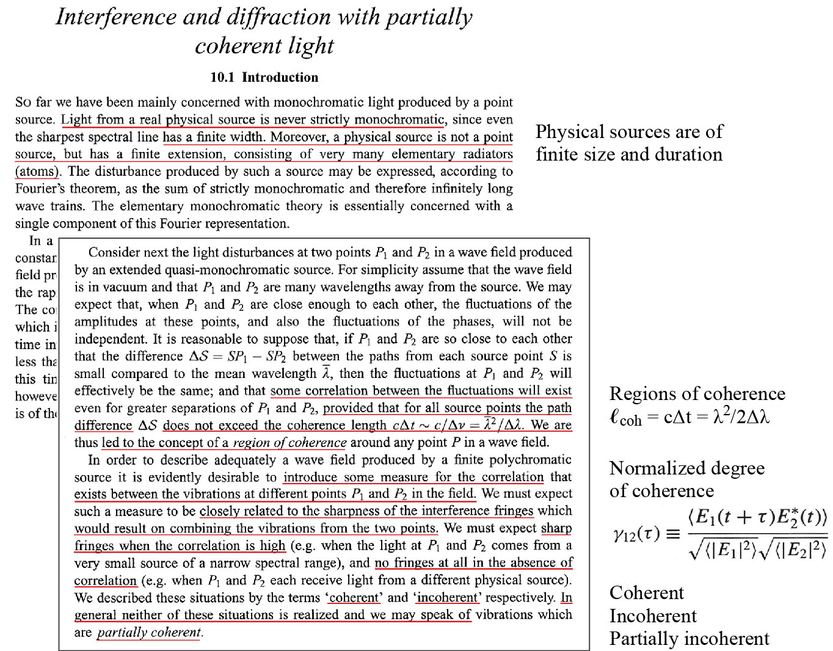
Born and Wolf, Chapter 10

Slide 7
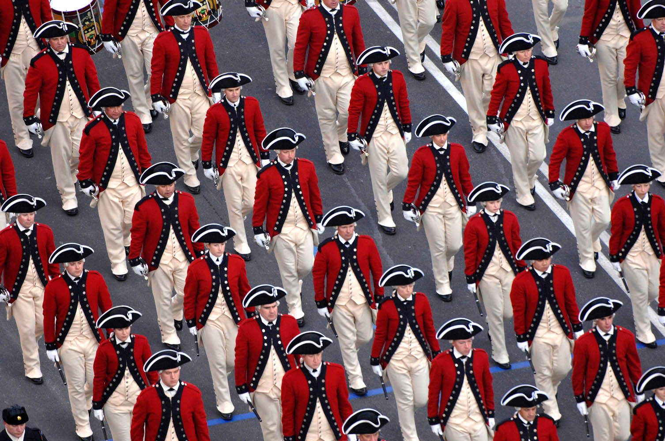
Marching band and coherence lengths
Courtesy of the US Fife and Drum Corps, inaugural parade, Pennsylvania Avenue, Washington DC, 20January 2009

Slide 8
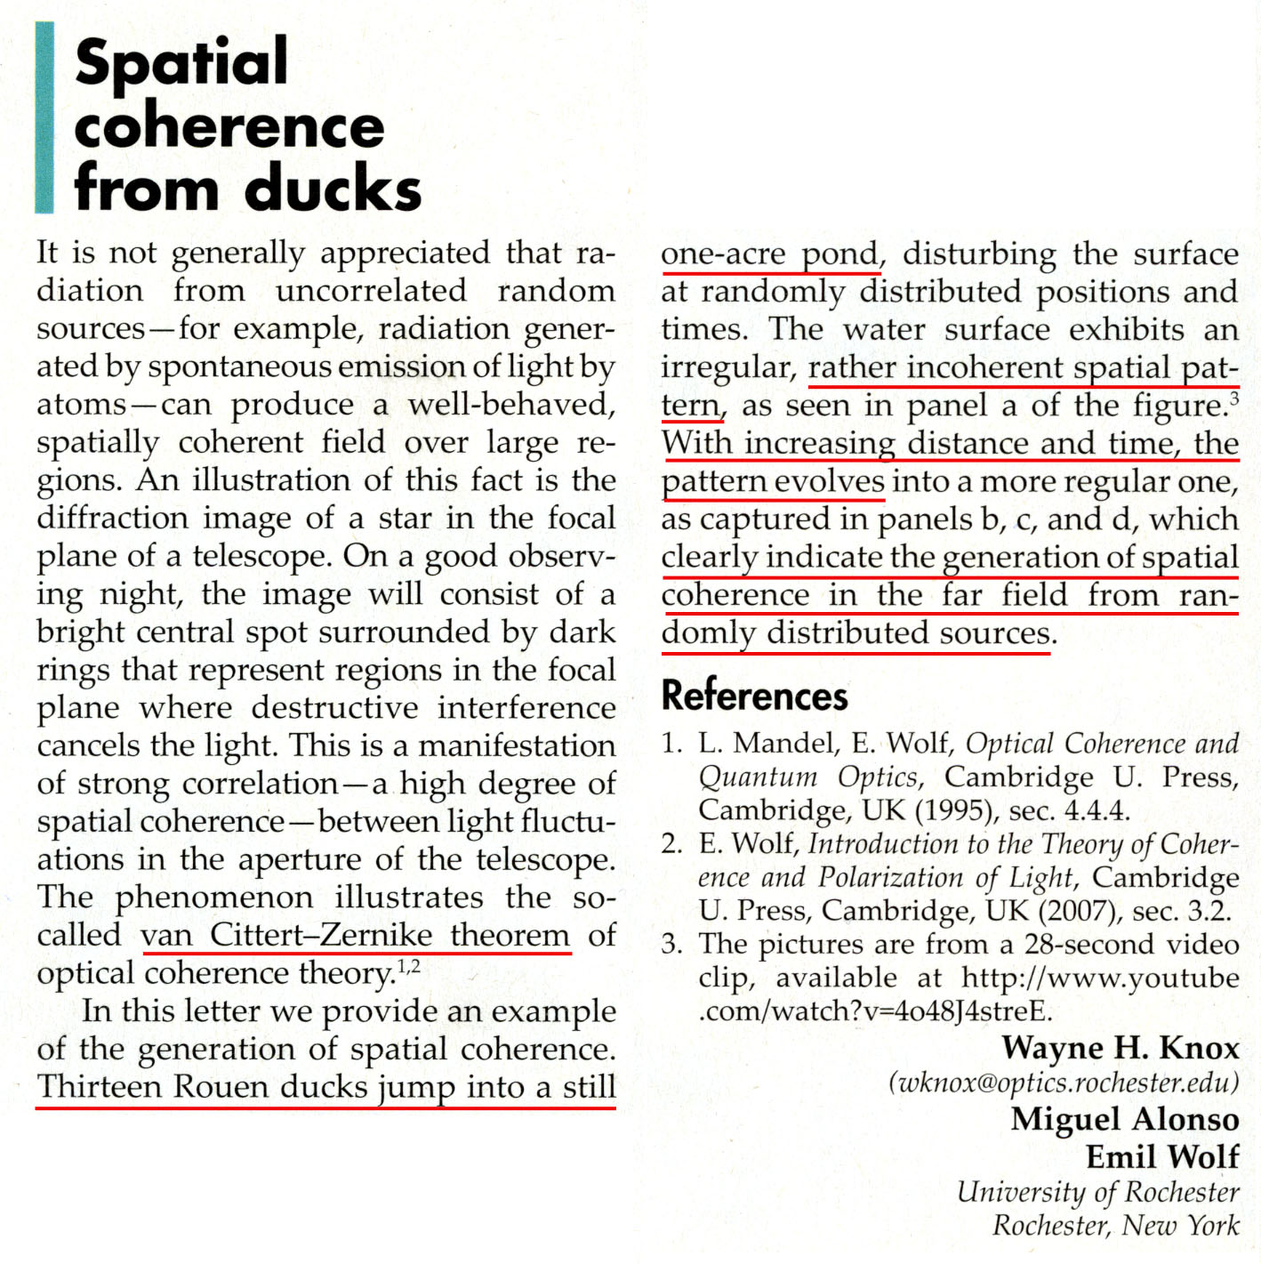
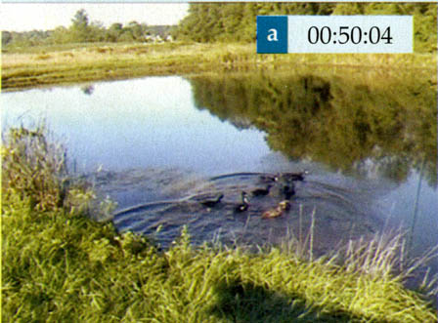
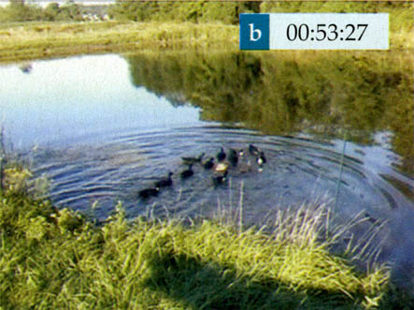
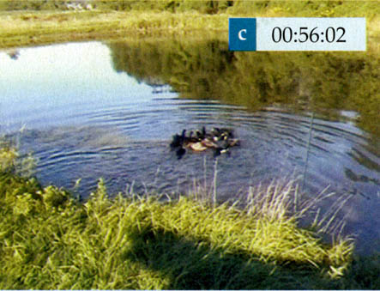
Spatial coherence and ducks
Physics Today (March 2010)

Slide 9
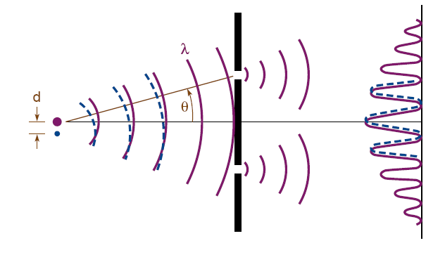
Spatial and temporal coherence
Temporal Coherence
Ability of a light beam to form fringes with a delayed version of itself
Spatial Coherence
Ability of spatially separated points in a wavefront to form fringes.

Slide 10
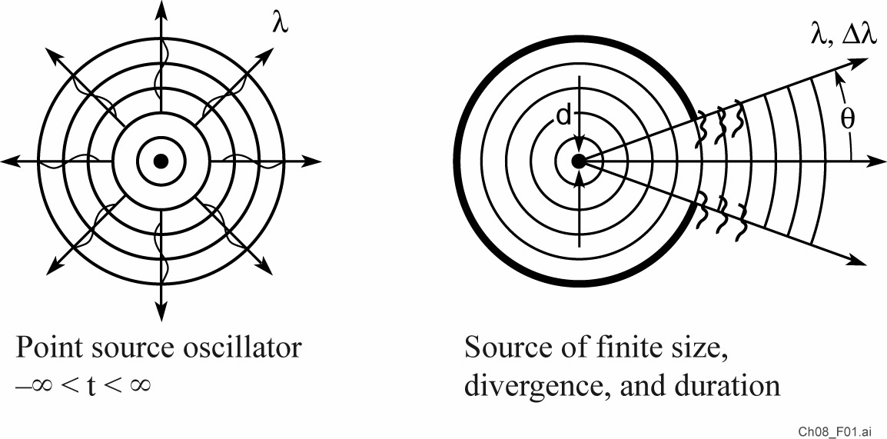
Coherence, partial coherence, and incoherence

Slide 11
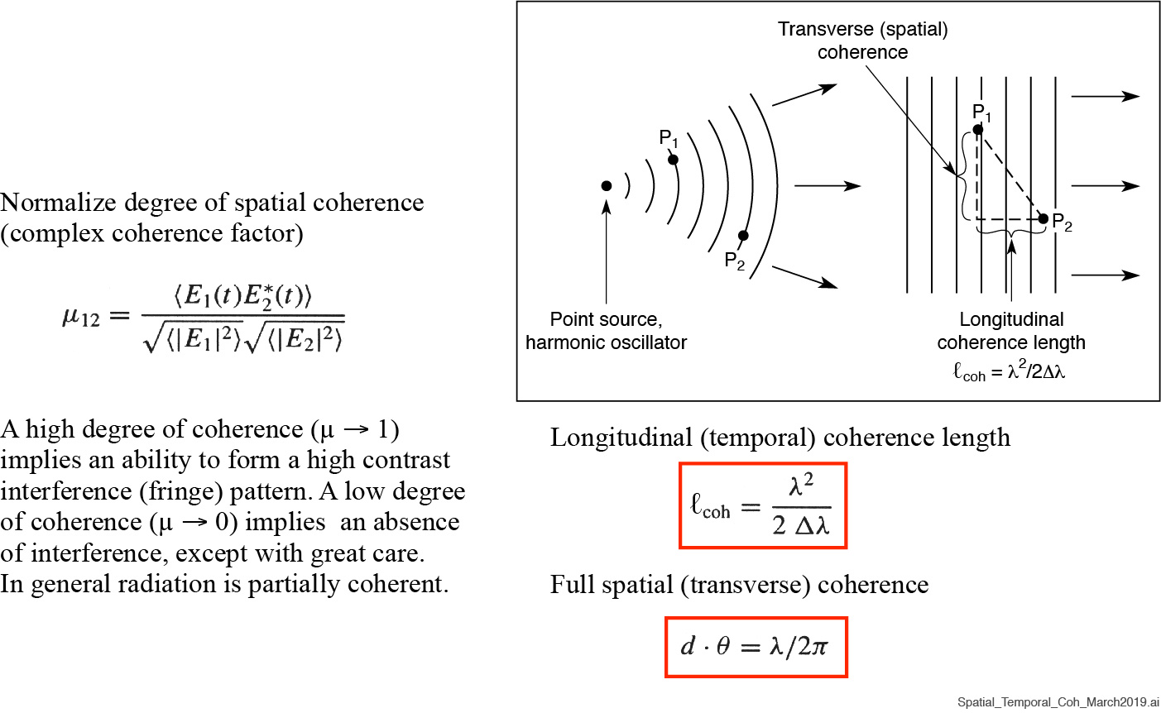
Spatial and temporal coherence

Slide 12
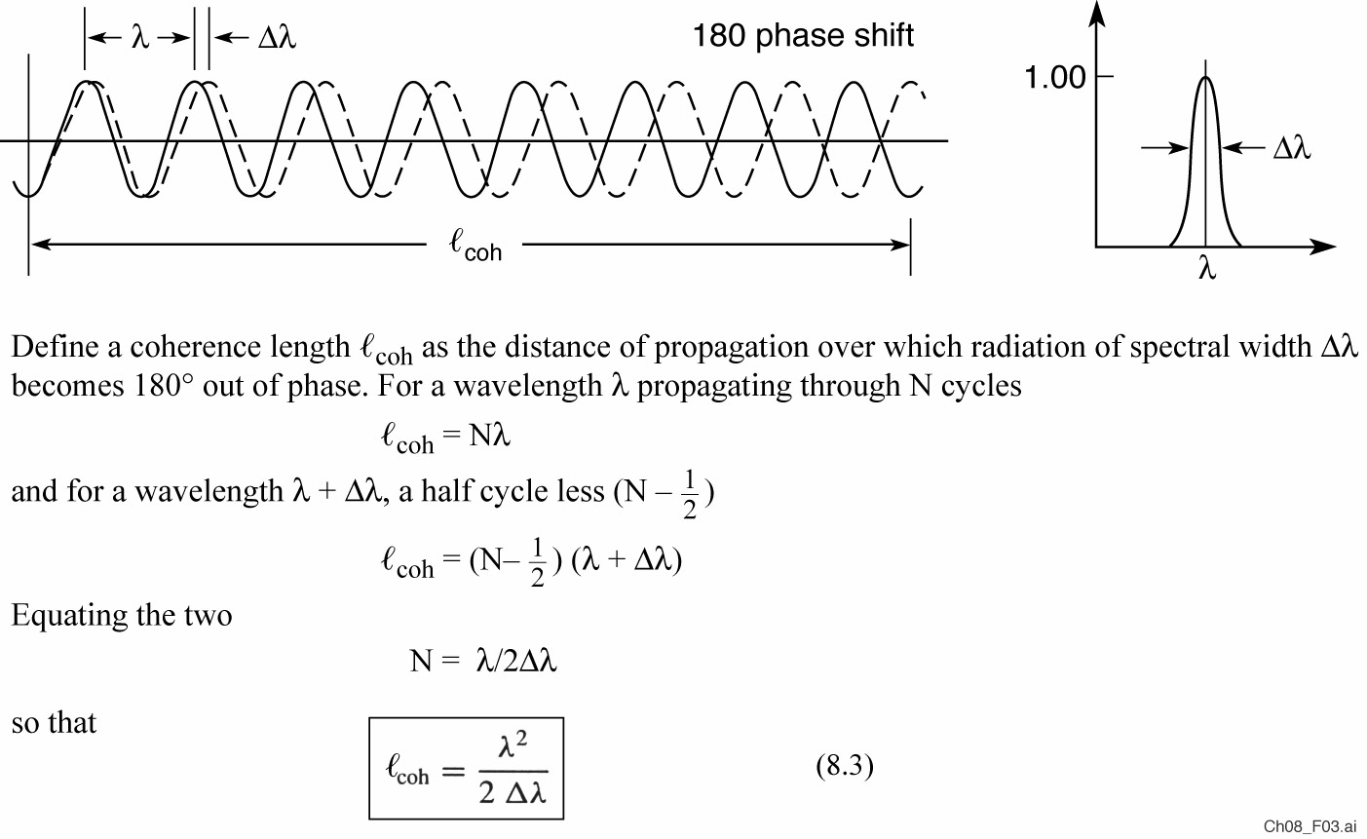
Spectral bandwidth and longitudinal coherence length

Slide 13
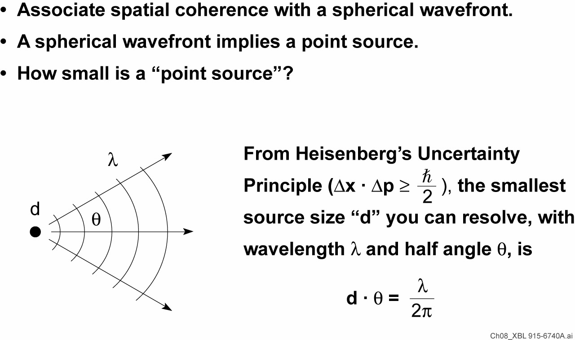
A practical interpretation of spatial coherence

Slide 14
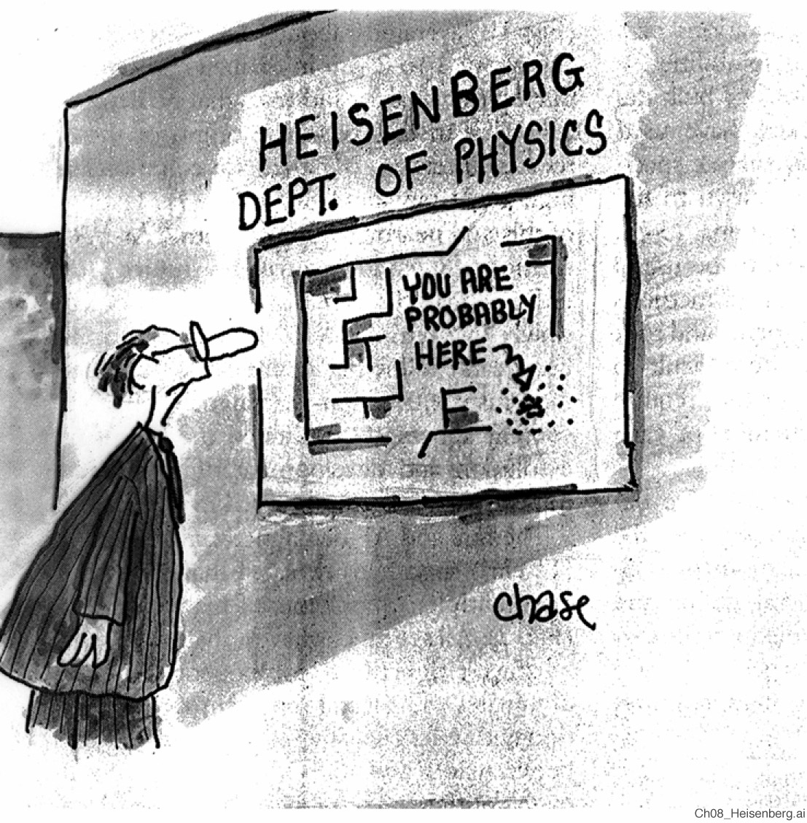
John Chase, Science 242, 1151
(25 November 1988)

Slide 15
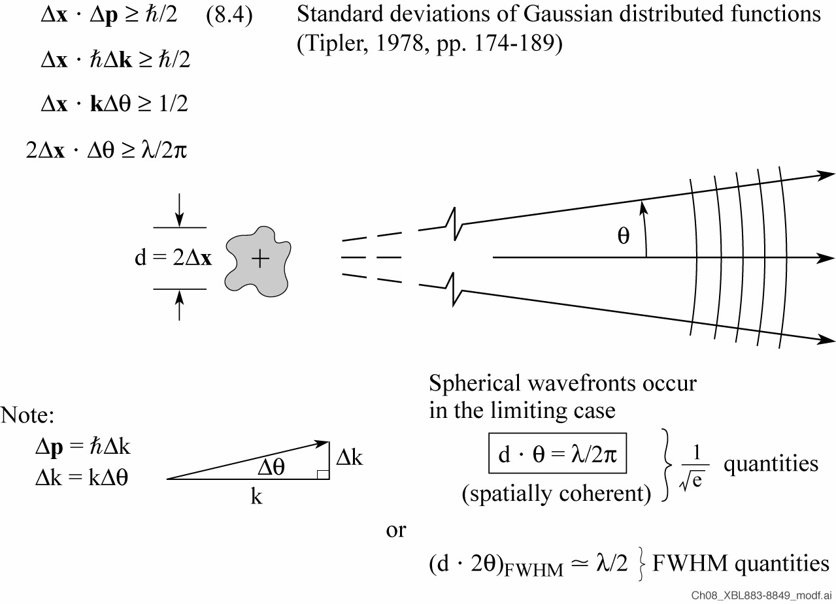
Partially coherent radiation approaches uncertainty principle limits

Slide 16
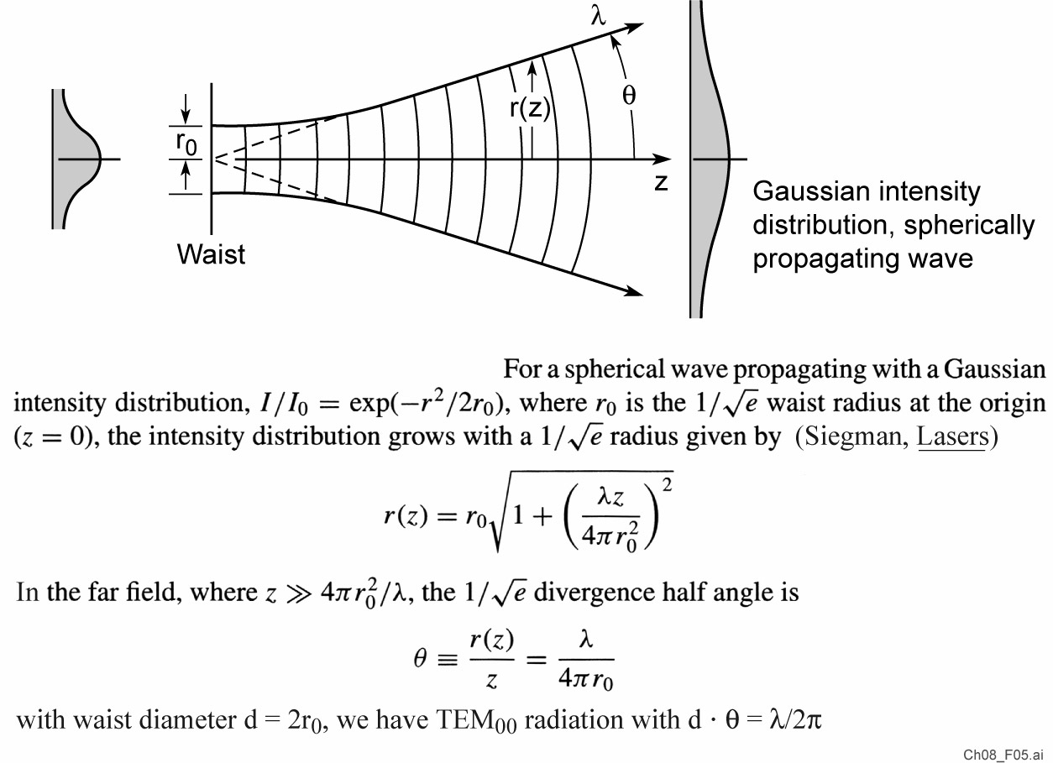
Propagation of a Gaussian beam

Slide 17
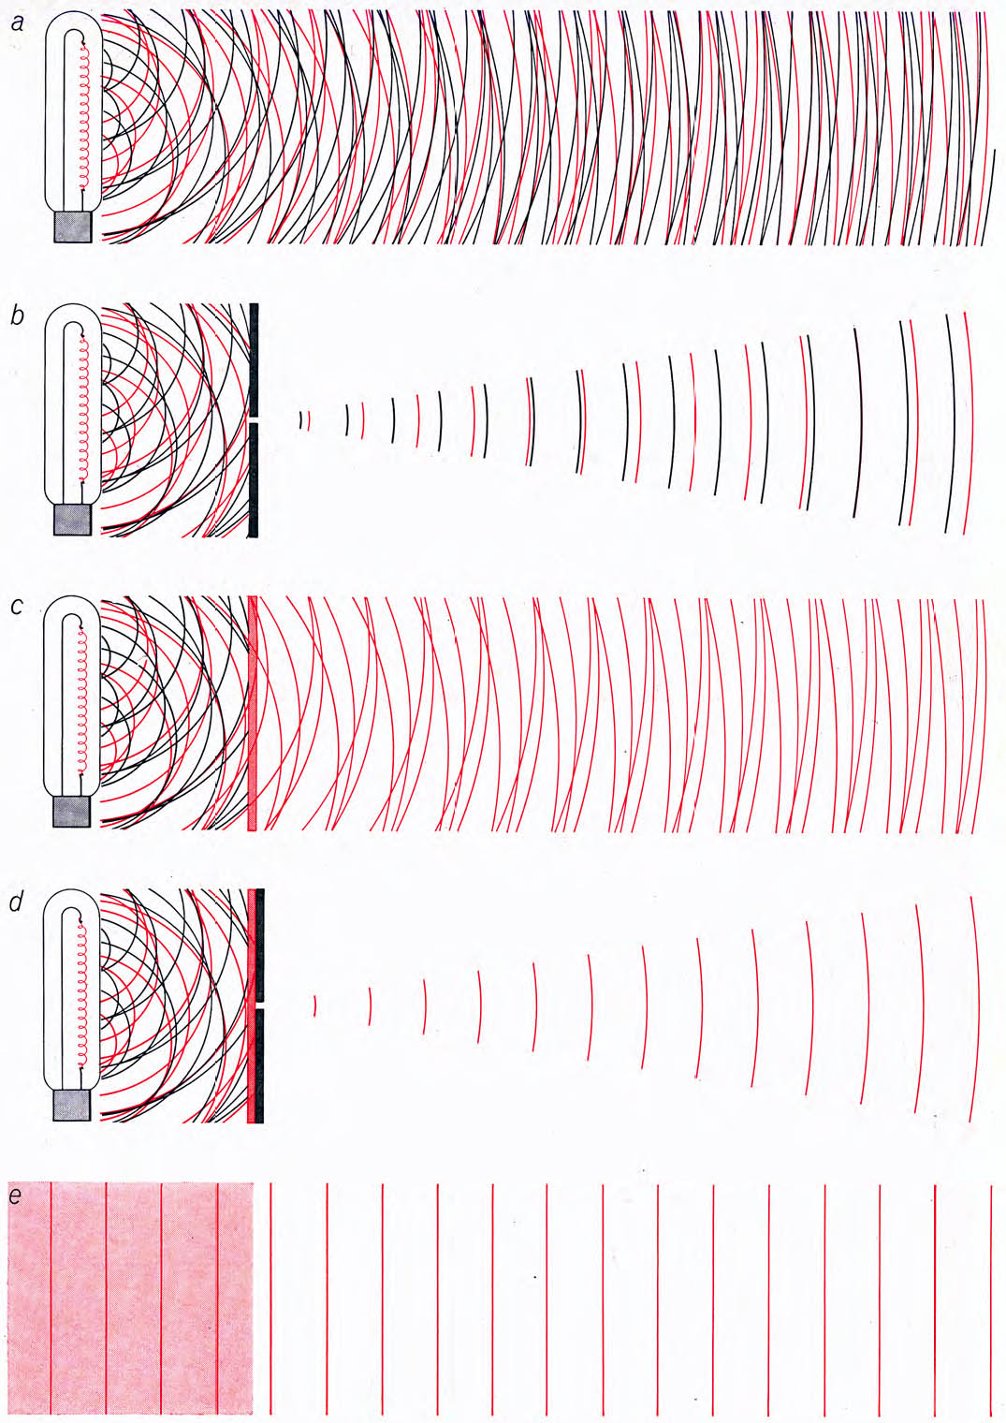
Spatial and spectral filtering can provide spatially and spectrally coherent radiation
Ordinary thermal light source, atoms radiate independently.
A pinhole can be used to obtain spatially coherent light, but at a great loss of power.
A color filter (or monochromator) can be used to obtain temporally coherent light, also at a great loss of power.
Pinhole and spectral filtering can be used to obtain light which is both spatially and temporally coherent but the power will be very small (tiny).
All of the laser light is both spatially and temporally coherent*.
Arthur Schawlow, “Laser Light”, Sci. Amer. 219, 120 (Sept. 1968)

Slide 18
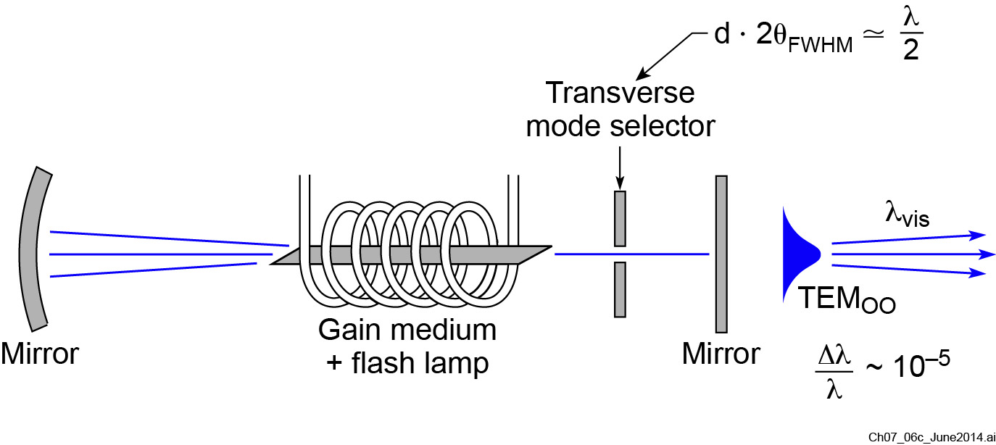
Adding a pinhole inside the cavity provides spatial coherence
(c)

Slide 19

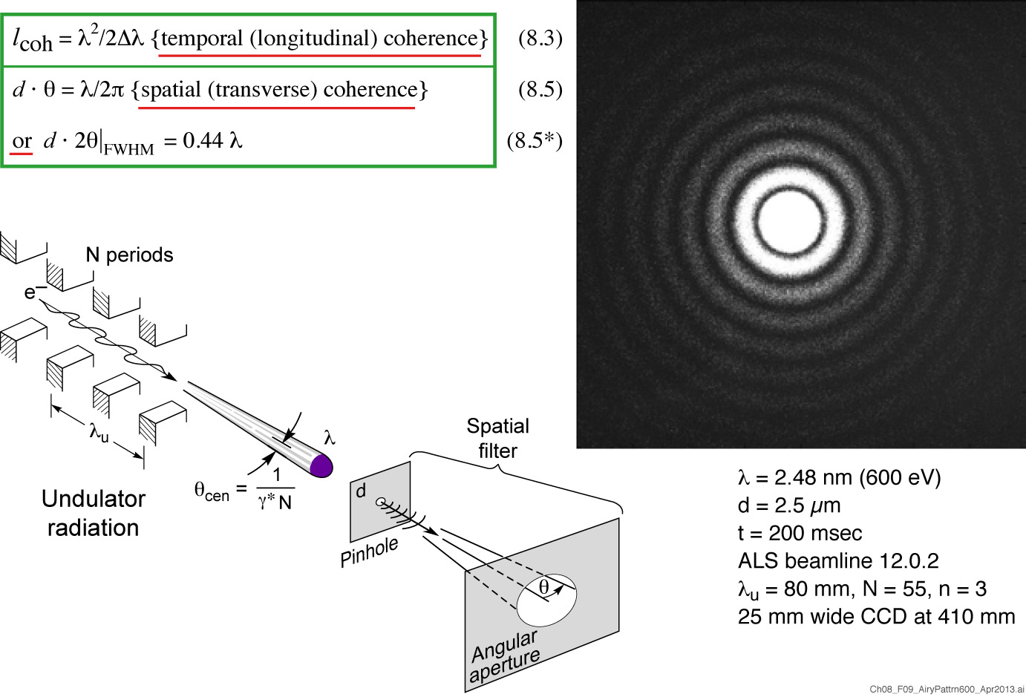
Spatially coherent undulator radiation
Courtesy of Kris Rosfjord, EECS, and Y.W. Liu, AS&T, both UC Berkeley

Slide 20
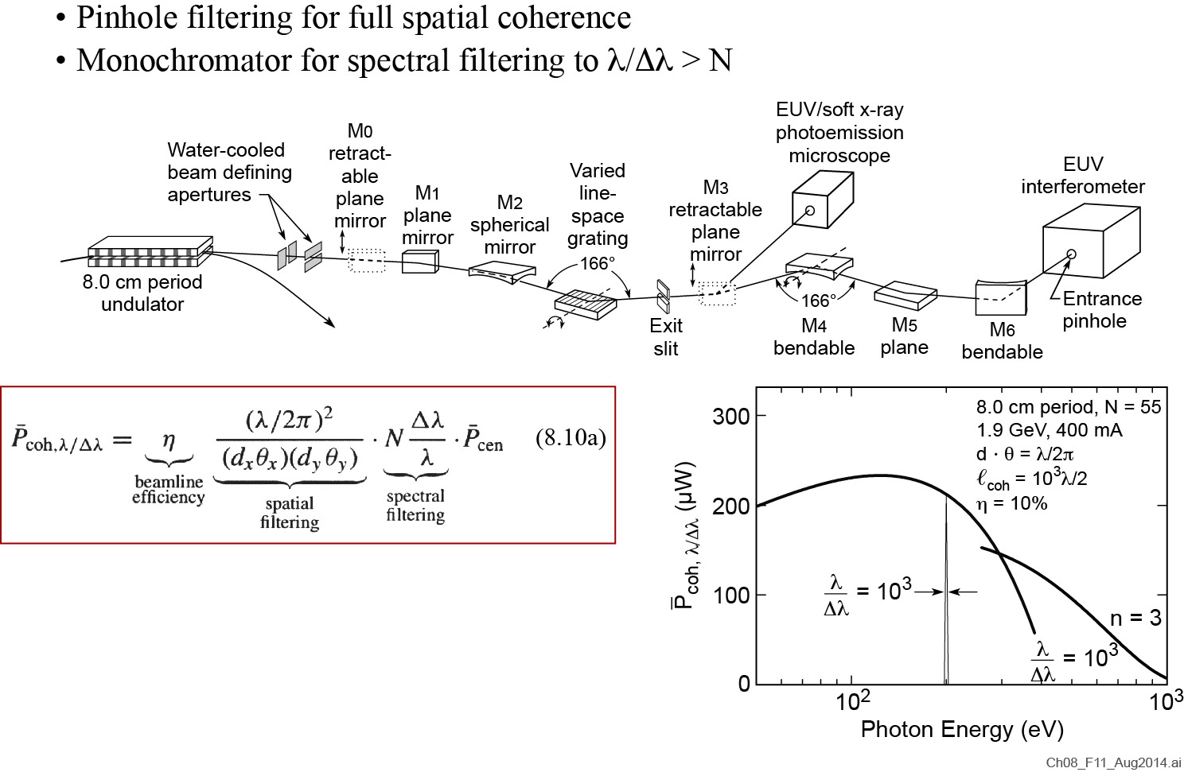
Spatial and spectral filtering each reduce available flux/power

Slide 21
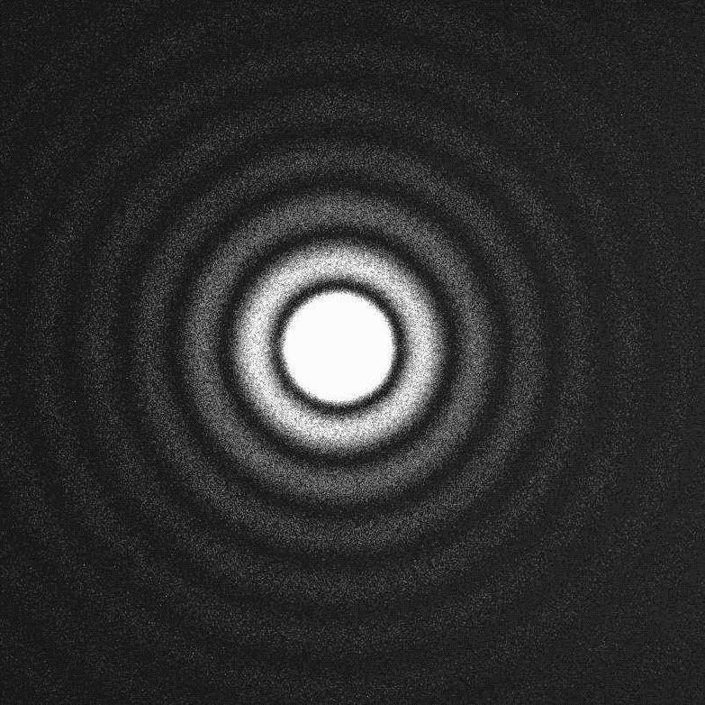
Spatially filtered soft x-ray undulator radiation
= 2.48 nm
(500 eV)
d = 2.6 µm
t = 40 msec
ALS beamline 12.0.2
Courtesy of Kris Rosfjord, EECS, and Y.W. Liu, AS&T, both UC Berkeley
K. Rosfjord et al., Coherent Soft X-Rays,
IEEE JSTQE 10, 1405 (Nov/Dec 2004)

Slide 22
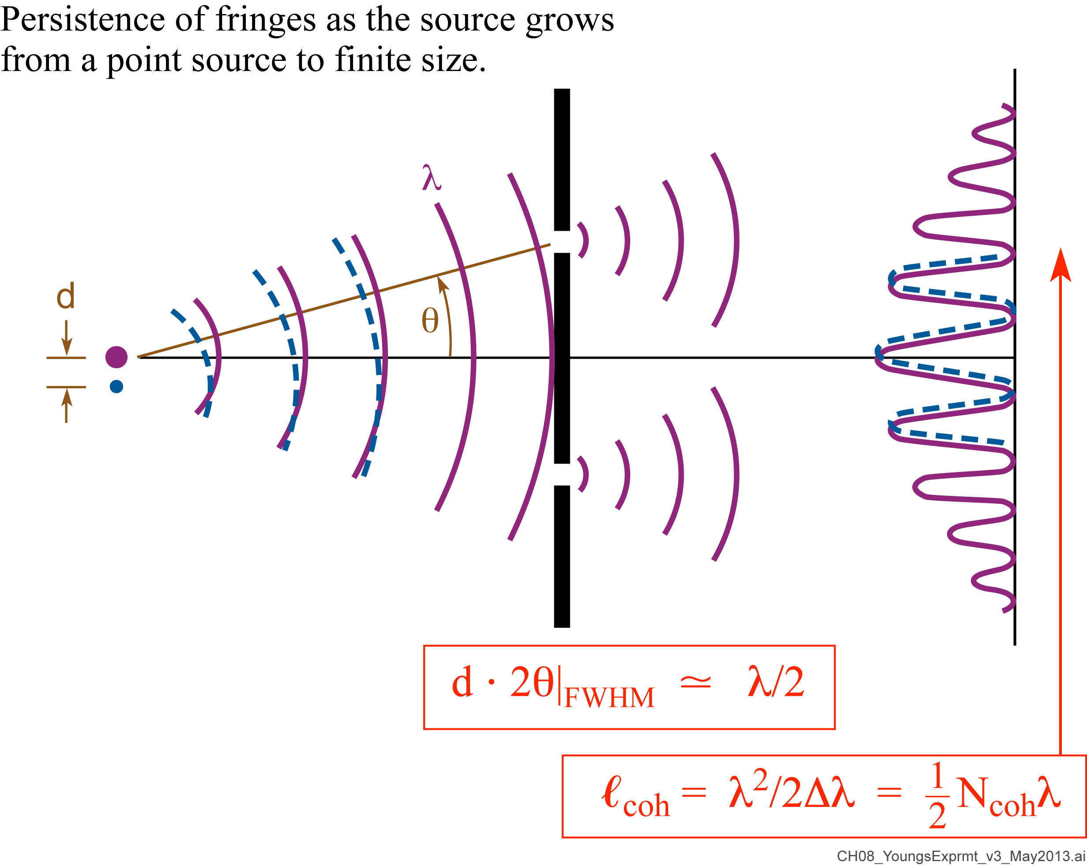
Young’s double slit experiment: spatial coherence and the persistence of fringes

Slide 23
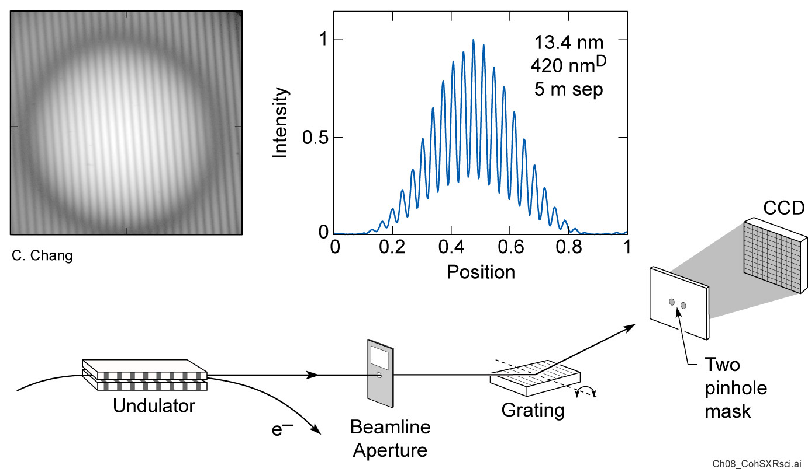
Undulator beamline for high spatial coherence measurements

Slide 24
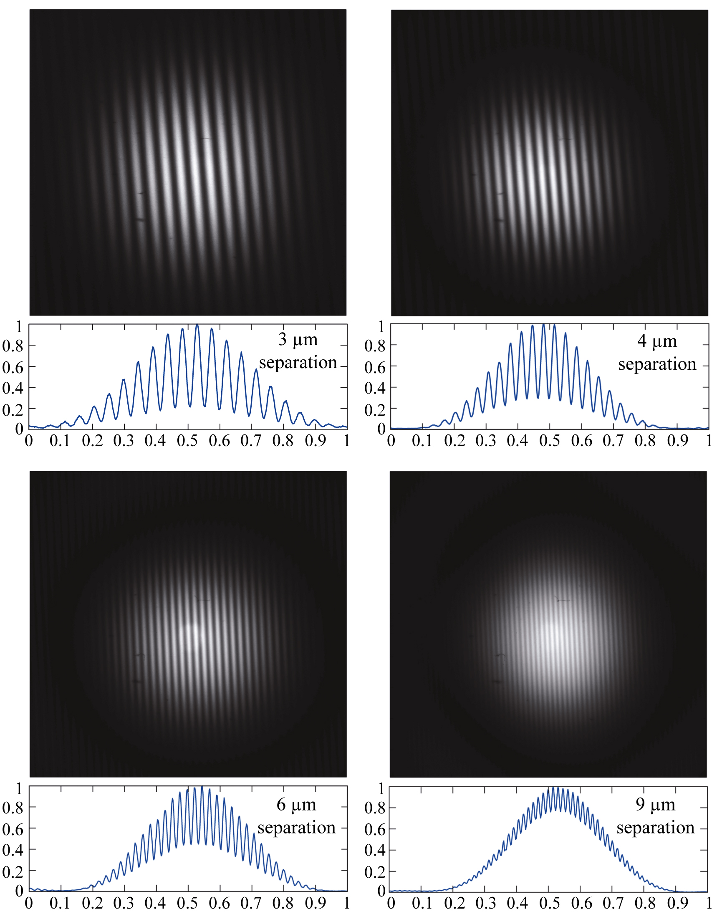
Young’s interference pattern for spatially filtered EUV undulator radiation
13.4 nm wavelength,
2 x 420 nm pinholes
Courtesy of C. Chang,
EECS/UC Berkeley

Slide 25
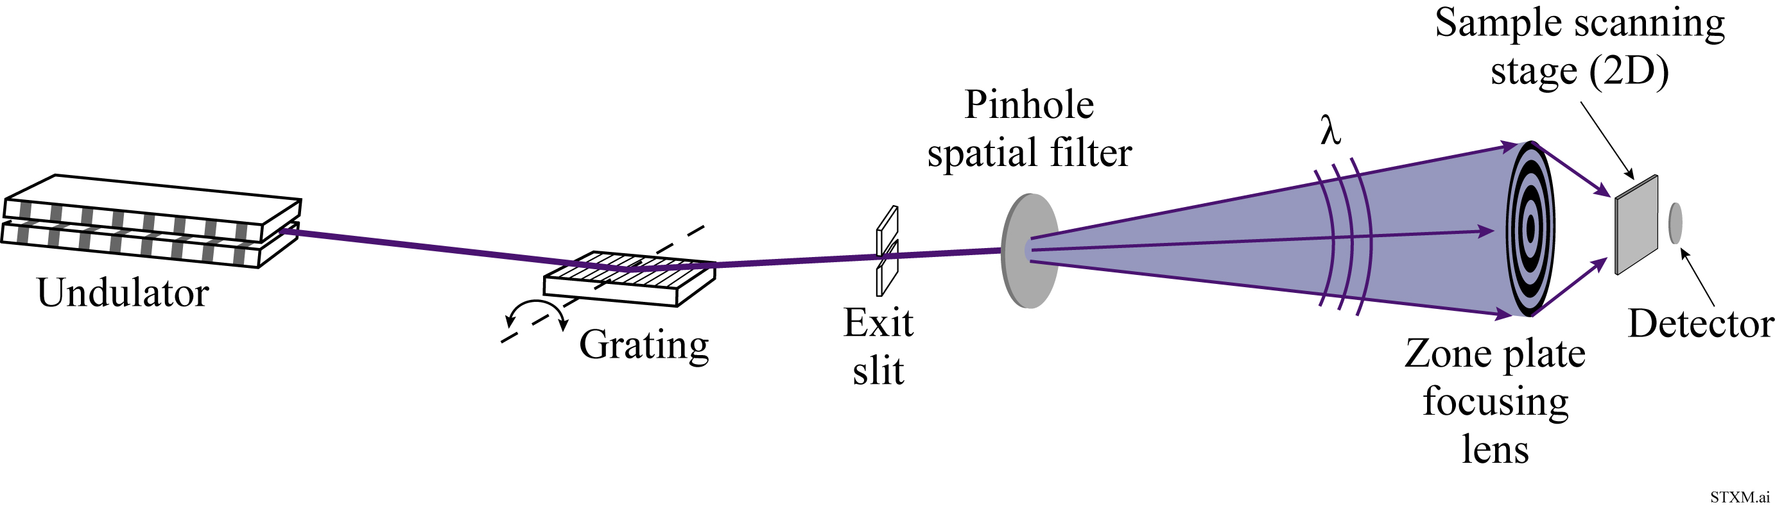
The scanning transmission x-ray microscope (STXM)
Requires spatially coherent illumination to achieve the smallest spot size and thus highest spatial resolution

Slide 26
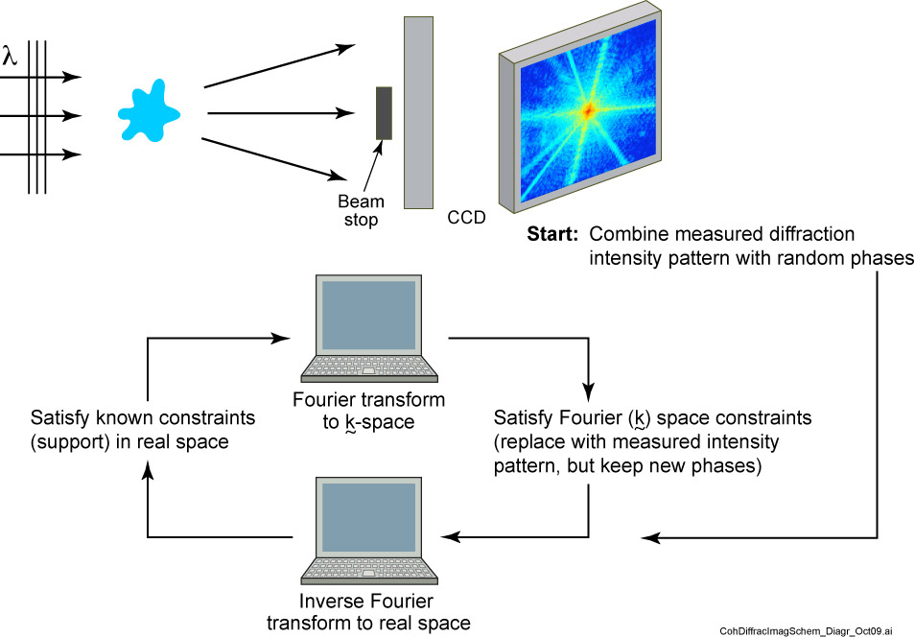
Coherent Diffractive Imaging (CDI)

Slide 27
Ptychography using a defocused STXM
Pinhole spatial filter
Zone plate is defocused to a larger size at the sample, no longer sets resolution.
Scanned 2D diffraction data is obtained in many overlapping areas.
Numerical techniques used to reconstruct image. Tomography possible, but with long data collection time. DLSRs will help.
Original figure S. Vogt(ANL), modified by J.Deng et al.,Sci.Rep. 7,445 (2017) .

Slide 28
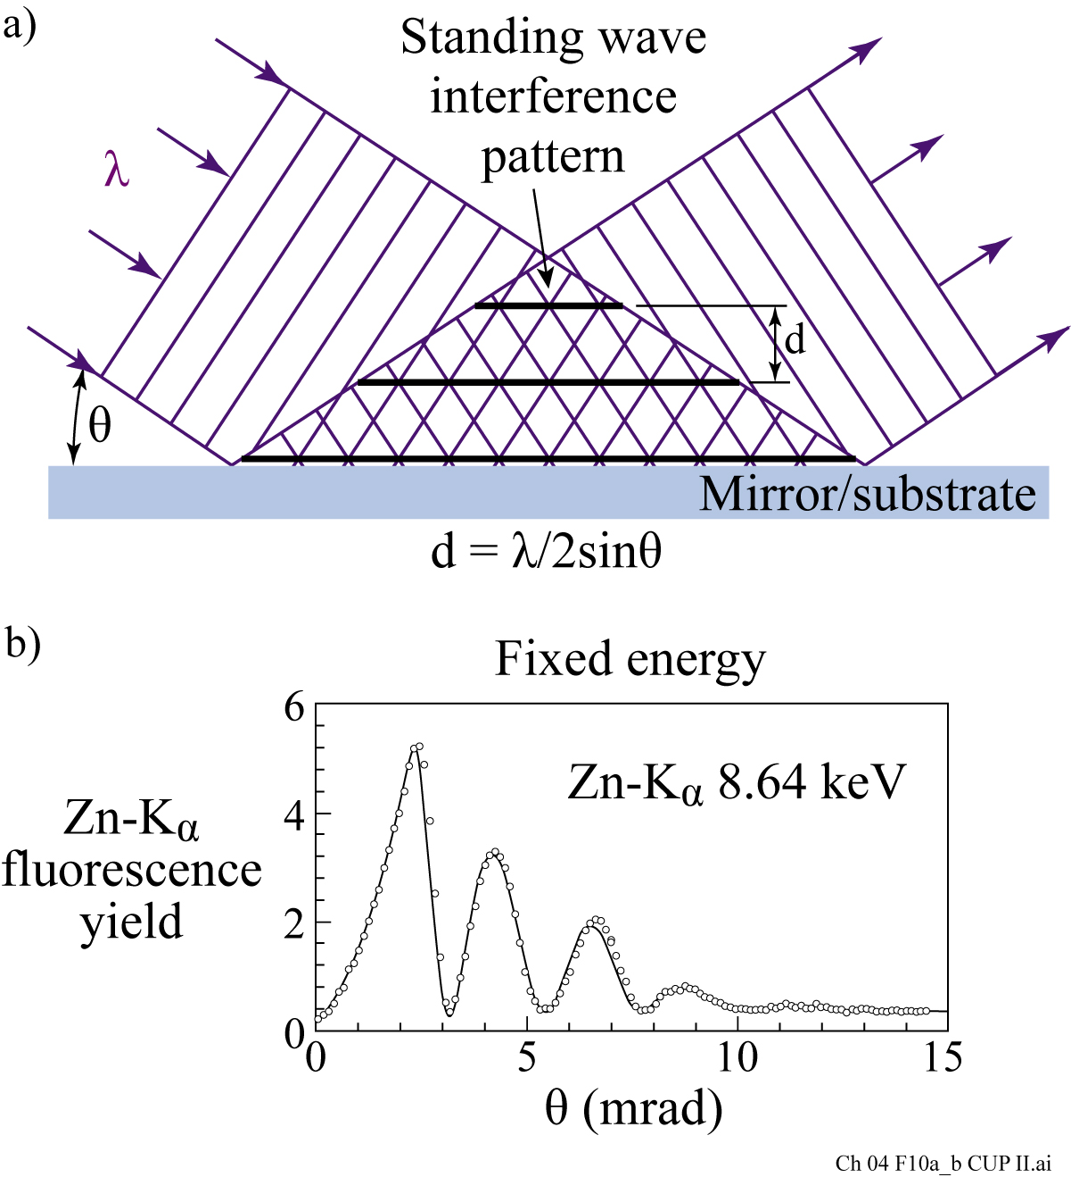
X-ray standing waves at a surface
Requires spatial and temporal coherence
Courtesy of M.J. Bedzyk, Cornell University, now at Northwestern University

Slide 29


X-ray holography with spatially filtered undulator radiation
Imaging magnetic nanostructures (Stanford & BESSY II)
S. Eisebitt, J. Lüning, W.F. Schlotter, M. Lörgren, O. Hellwig,
W. Eberhardt and J. Stöhr, Nature 432, 885 16December 2004)

Slide 30
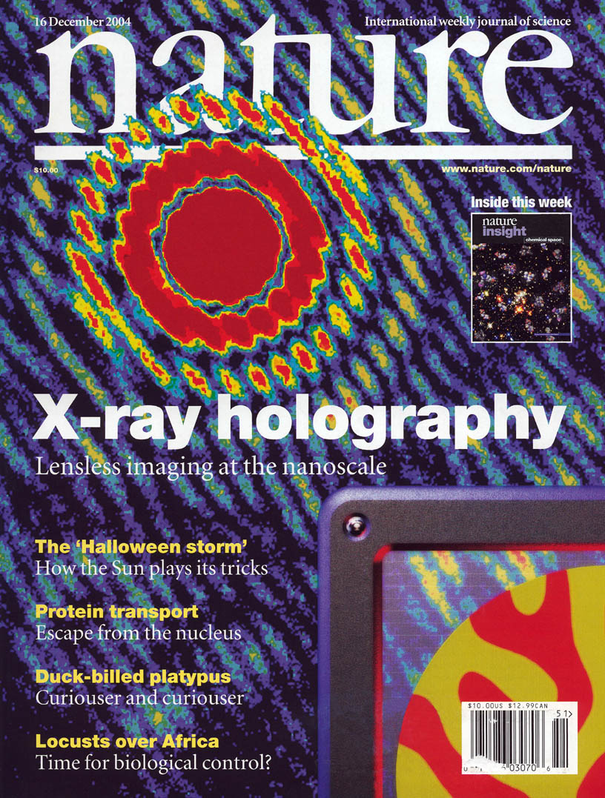

Slide 31
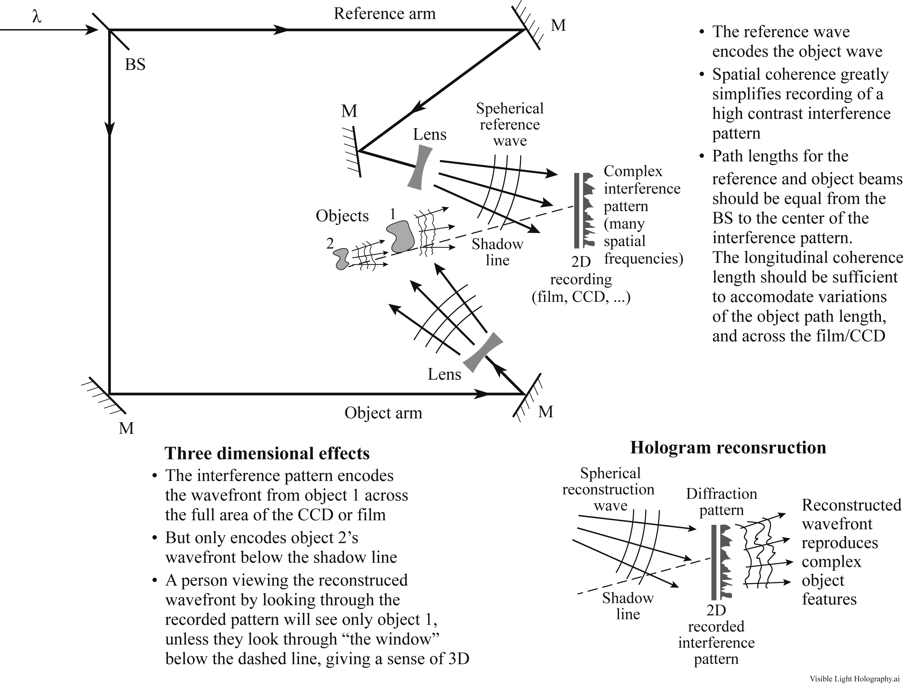
Holographic recording and reconstruction: Spatial coherence and path lengths matched within the coherence length

Slide 32
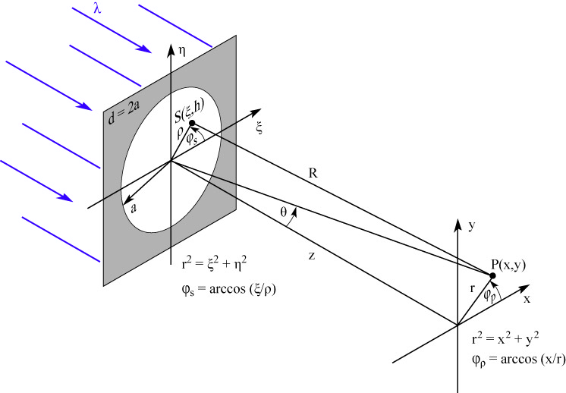
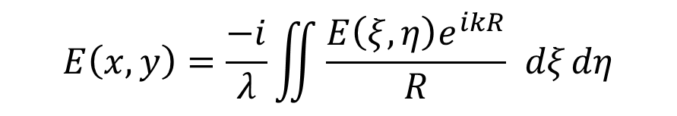
Diffraction of radiation by a coherently illuminated pinhole aperture
Fresnel–Kirchhoff diffraction formula
$$E\left(x,y\right)=\frac{−i}{λ}\iint{\frac{E\left(ξ,η\right)e^{ikR}}{R} }dξ dη$$

Slide 33
Diffraction pattern of a coherently illuminated pinhole
Bessel function dependence
84% of energy is
in the central lobe

Slide 34
van Cittert- Zernike theorem
Far-field spatial coherence is the Fourier transform of the source intensity of an incoherently illuminated aperture

Slide 35
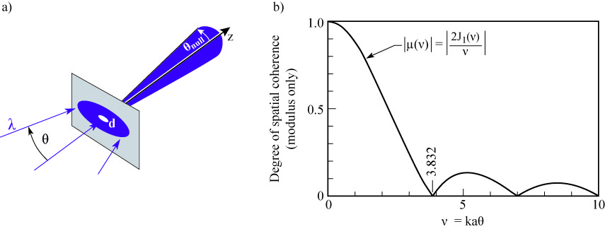

Spatial coherence of radiation transmitted by an incoherently illuminated pinhole
The van Cittert-Zernike theorem describes the degree of spatial coherence achievable as a function of pinhole size
For kaθ = 1, d·θ = λ/$π$, $μ$ = 0.88
i.e., 88% coherent @ θ = λ/$π$d.
For kaθ = 2.215, the mutual coherence function (spatial coherence) drops to μ = 0.5, but provides 4.9x more coherent photon flux.

Slide 36
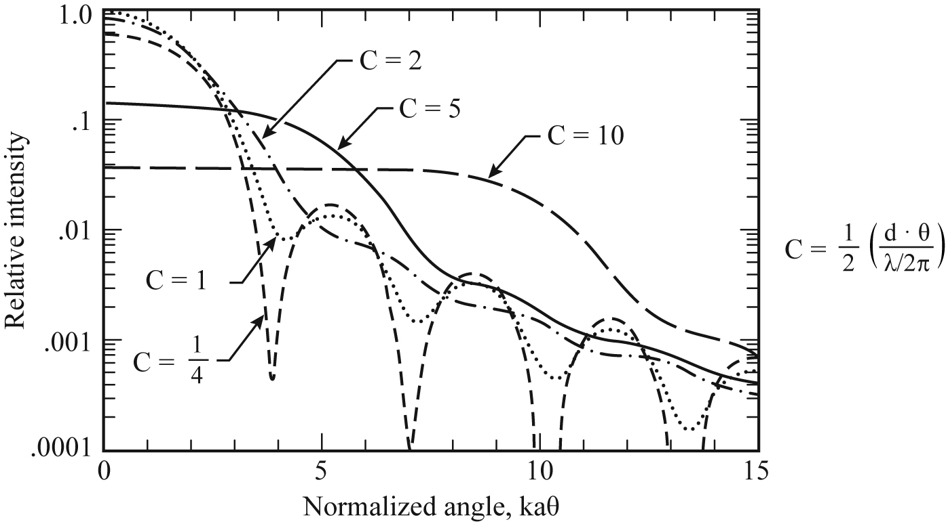
Diffraction from a circular aperture with varying degrees of partial coherence
Courtesy of B. Thompson, Univ. Rochester

Slide 37
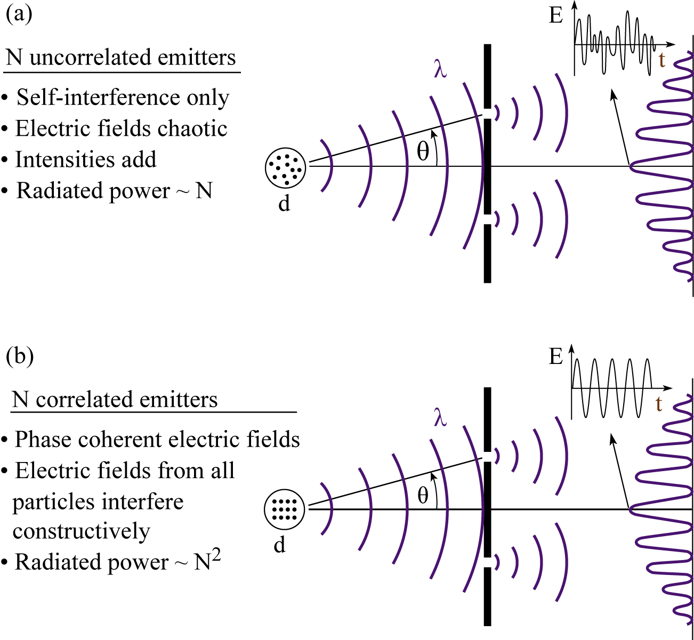
Young’s interference patterns for correlated and uncorrelated emitters

