Slide 1
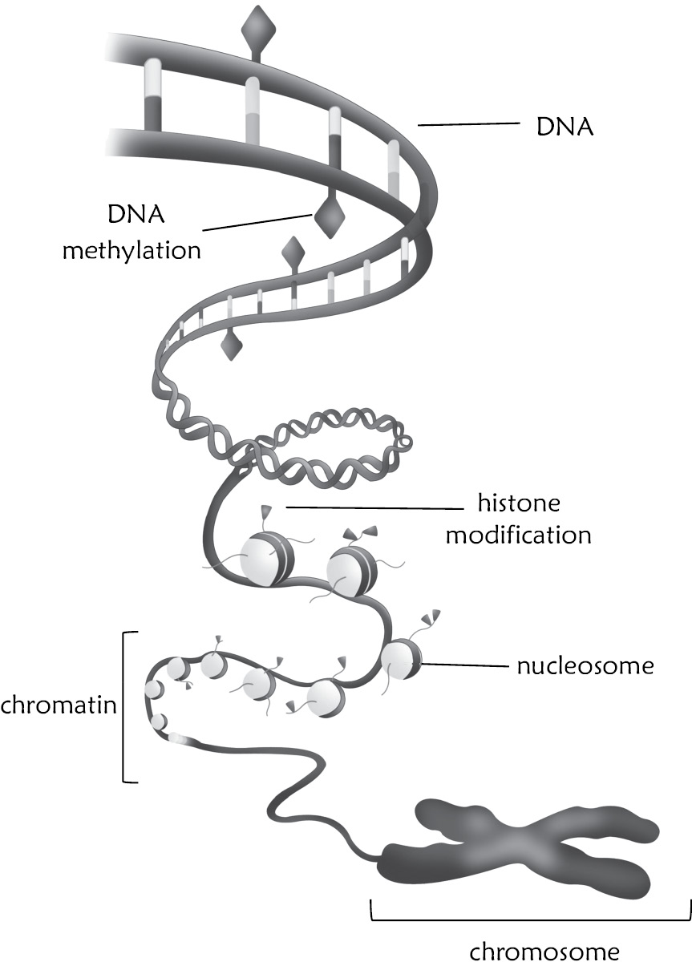
Figure 11.1

Slide 2
Figure 11.2
Due to copyright restrictions, this figure is not available online.

Slide 3
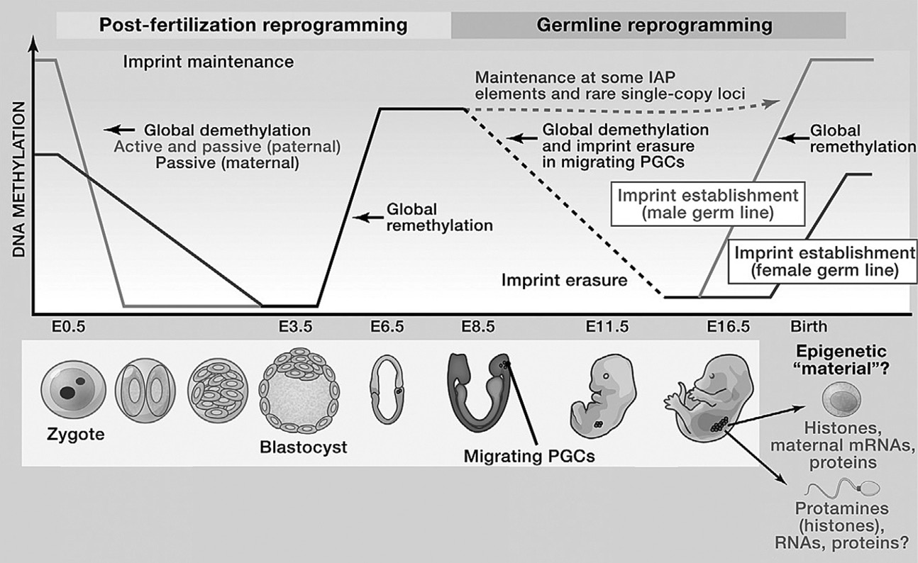
Figure 11.3

Slide 4
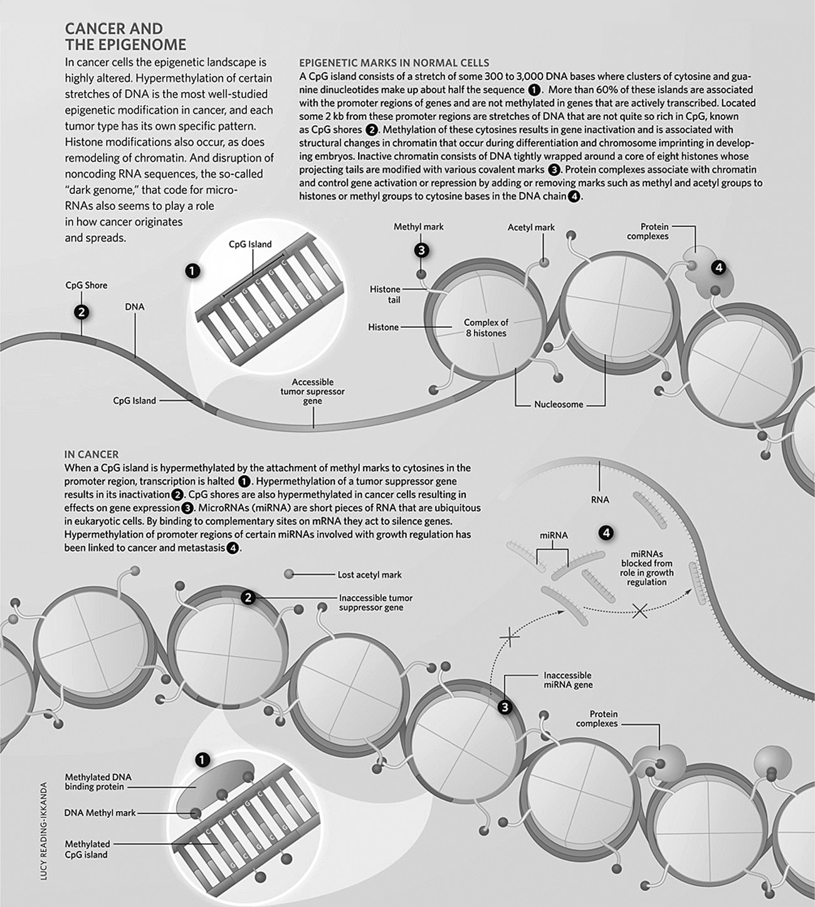
Figure 11.4

Slide 5
Figure 11.5

