Slide 1
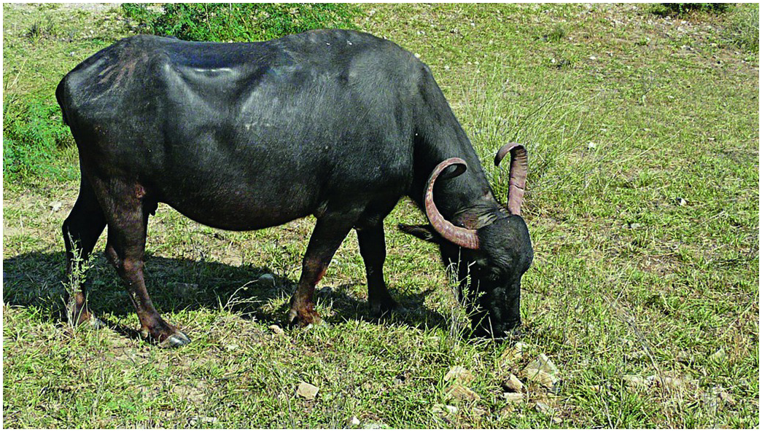
Figure 24.1
A River buffalo from Rajasthan.
(Photo by Anwaruddin Choudhury).

Slide 2
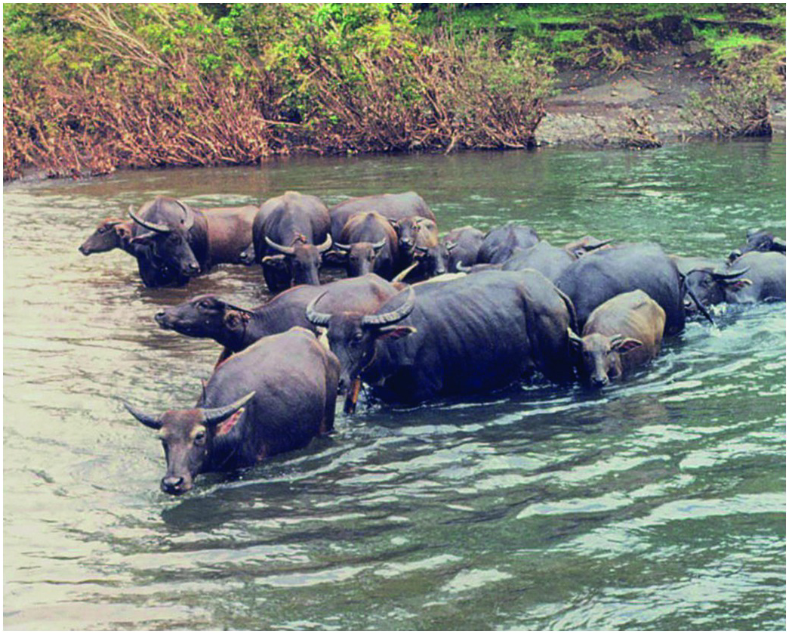
Figure 24.2
Swamp buffalo herd in Sulawesi, Indonesia.
(Photo by J. S. F. Barker)

Slide 3
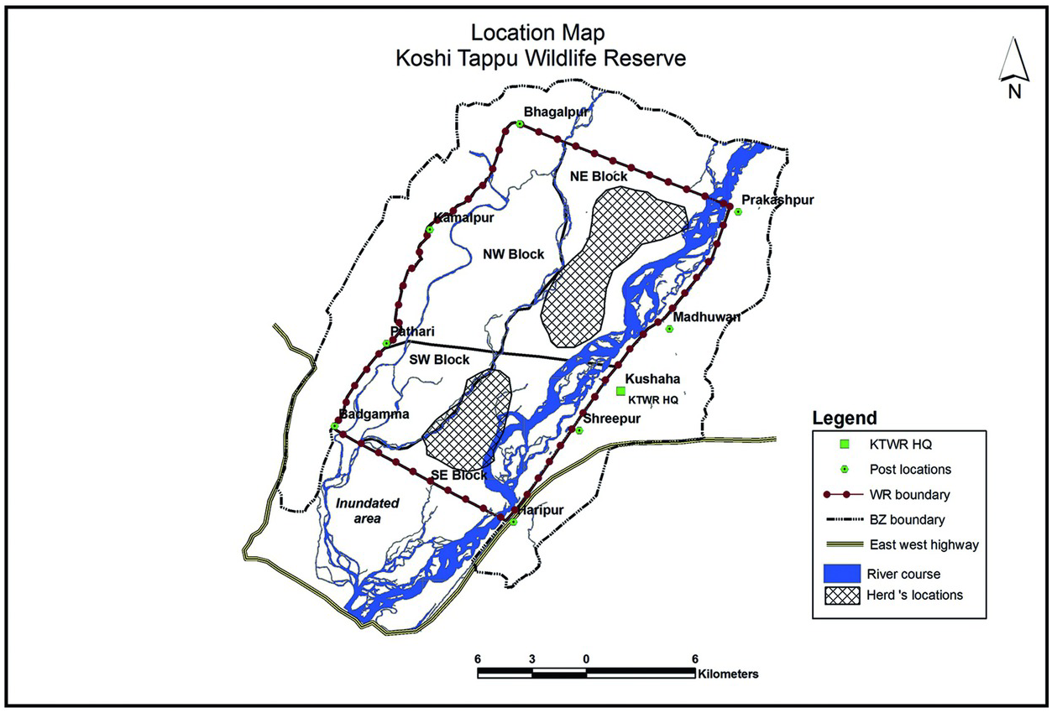
Figure 24.3
Map of Koshi Tappu Wildlife Reserve.

Slide 4
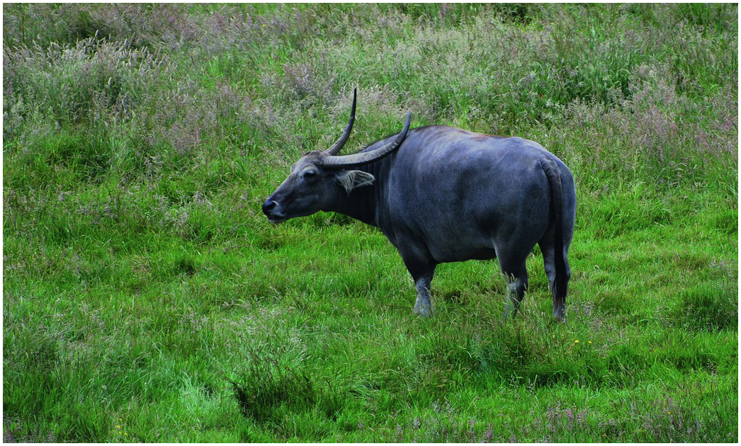
Figure 24.4
Putative Wild water buffalo (Bubalus arnee)
(Photo Courtesy of Port Lympne Wild Animal Park).

