Slide 1
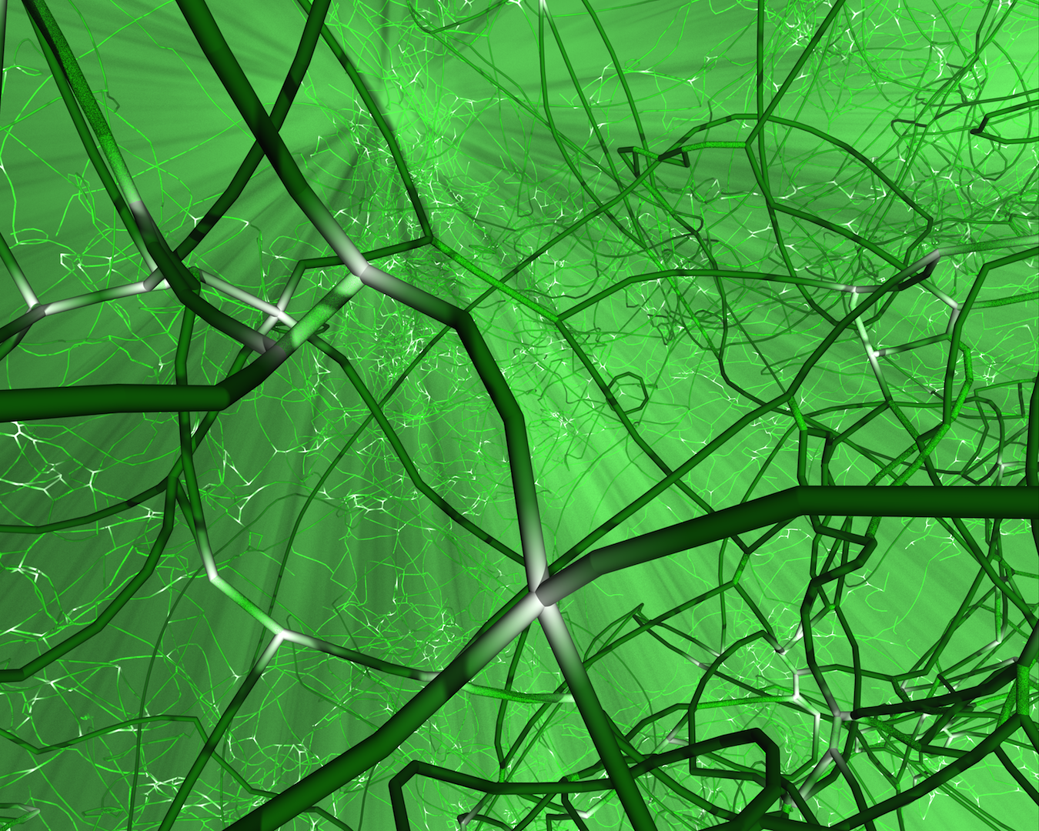

Slide 2
x
C₁
M
B₁
D₁
ξ₁
b₁
A₁
R
ξ₂
b₂
A₂
z
M
B₂
D₂
C₂
L
Notes:
3.68” x 3”, tiff.

Slide 3
b₁
a
C₁
dl₁
R
z
b₂
c
ϕ
C₂
dl₂
y
x
Notes:
3.92” x 3”, tiff.

Slide 4
Plane 2
(x₃ = 0)
e₍₂₎
y
disl. 2
ξ₂
Plane 1
(x₃ = z)
O
dl₂
θ
b₂
e₍₃₎
e₍₁₎
z
R = x_{α}e_{α}
O'
disl. 1
dl₁
b₁
x
ξ₁
Notes:
2.45” x 3”, tiff.

Slide 5
Plane 2
(x₃ = 0)
e₍₂₎
y
disl. 2
ξ₂
y₁
dl₂
y₂
b₂
Plane 1
(x₃ = z)
O
e₍₁₎
θ
z
e₍₃₎
R = x_{α}e_{α}
O'
disl. 1
dl₁
b₁
x
ξ₁
Notes:
3.49” x 5”, jpg.

Slide 6
y
x
y₂
dl₁
dl₂
R
(a)
y₁
h
z
e₃
ξ
d
e₂
e₂
ξ
y₁
dl₂
y₂
y
(b)
d
dl₁
x
Notes:
4.56” x 4”, tiff.

Slide 7
E
D
A
dl
C
B
Notes:
2.59” x 3”, tiff.

Slide 8
dl
A
h
B
dl'
Notes:
1.09” x 2”, tiff.

Slide 9
y₁
y
y₂
dl
−λ₁
λ₂
Notes:
1.02” x 2”, tiff.

Slide 10
x
(0, 0, z')
r'
z
r
R
dl₂
(x, y, z)
y
Notes:
2.45” x 3”, tiff.

Slide 11
x
p
m
b₁
ξ₁
θ
θ
b₂
ξ₂
z
Notes:
2.59” x 4”, tiff.

Slide 12
b_{e}
(2)
b_{s}
ξ
θ
λ
F₂/L
(1)
Notes:
2.01” x 3”, tiff.

Slide 13
x
(3)
b
Δx
(4)
(2)
(1)
(x₂, z₂)
Δz
z
Notes:
2.67” x 3”, tiff.

Slide 14
Y'
C'
(X', Y')
ξ'
R
θ
α
(x, y)
X'
Notes:
3.89” x 5”, tiff.

Slide 15
Y'
dl
R
−dθ
h
θ
α
(x, y)
X'
Notes:
2.5” x 4”, tiff.

Slide 16
r
A
O
R
R'
λ_{A}
h_{AB}
e_{AB}
ϕ_{AB}
ξ_{AB}
P
λ_{B}
B
Notes:
2.8” x 4”, tiff.

Slide 17
(a)
B
(b)
A
ξ
D
C
P_{I}
C
A
B
E
P_{II}
Notes:
2.36” x 5”, tiff.

Slide 18
surface
λ
ρ'
β
θ
b
dF
dl
Notes:
3.35” x 3”, tiff.

Slide 19
y
(2)
(1)
r₂
r₁
C
r
A
B
γb
O
b
βb
x
a
Notes:
2.28” x 3”, tiff.

Slide 20
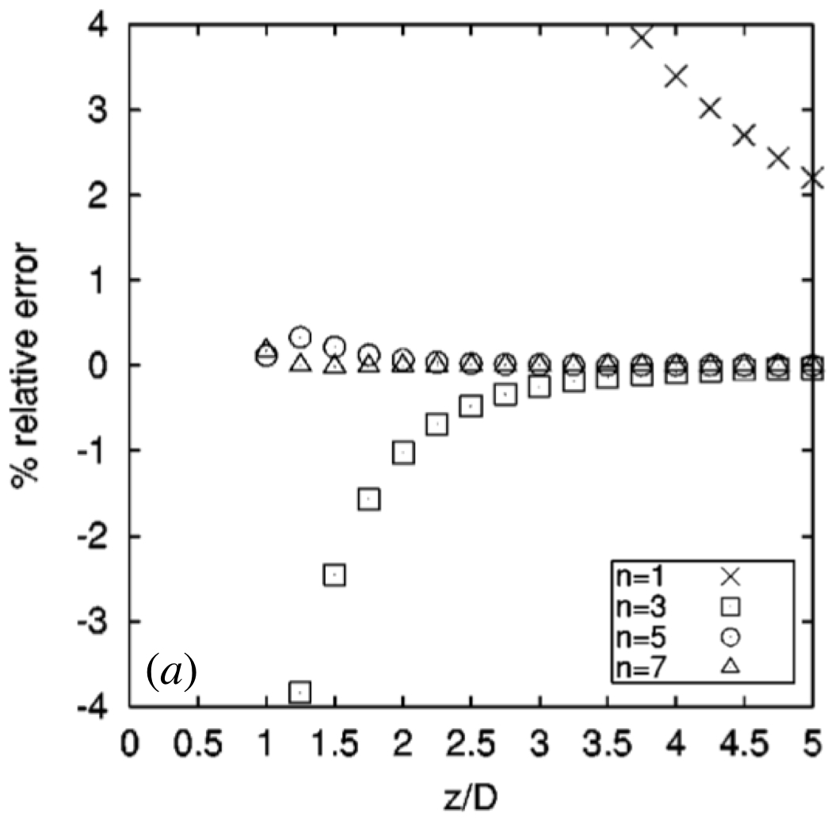
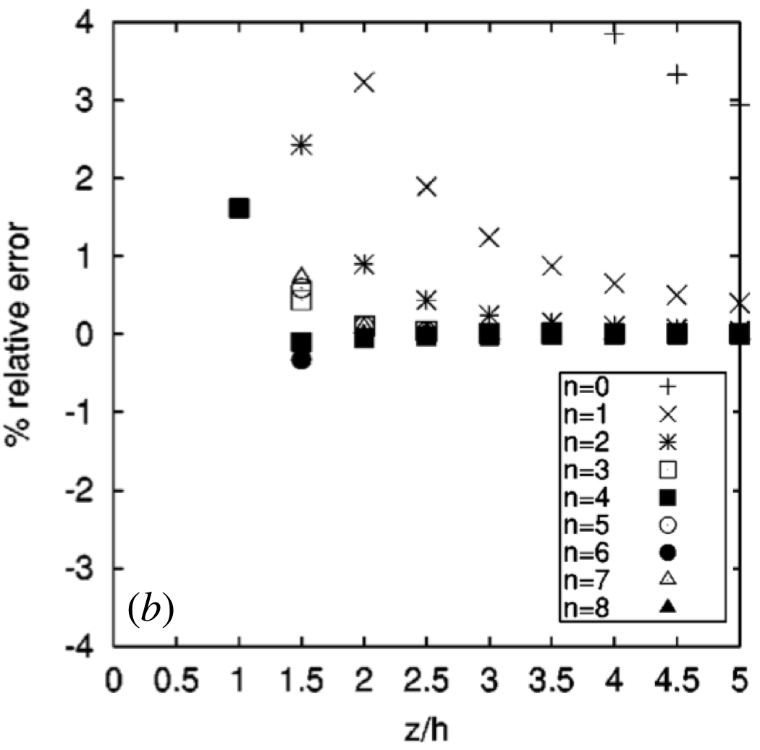
n=1
n=1
n=0
n=2
n=5
n=4
% relative error
% relative error
n=7
n=3
(a)
z/D
(b)
z/h
Notes:
2.48” x 2.5”, jpg
2.48” x 2.5”, jpg

