Slide 1

University of California, Berkeley
X-rays and Extreme Ultraviolet Radiation
AST210/EECS213
Fall 2019

Slide 2
X-ray and EUV Free Electron Lasers
David Attwood
University of California, Berkeley

Slide 3
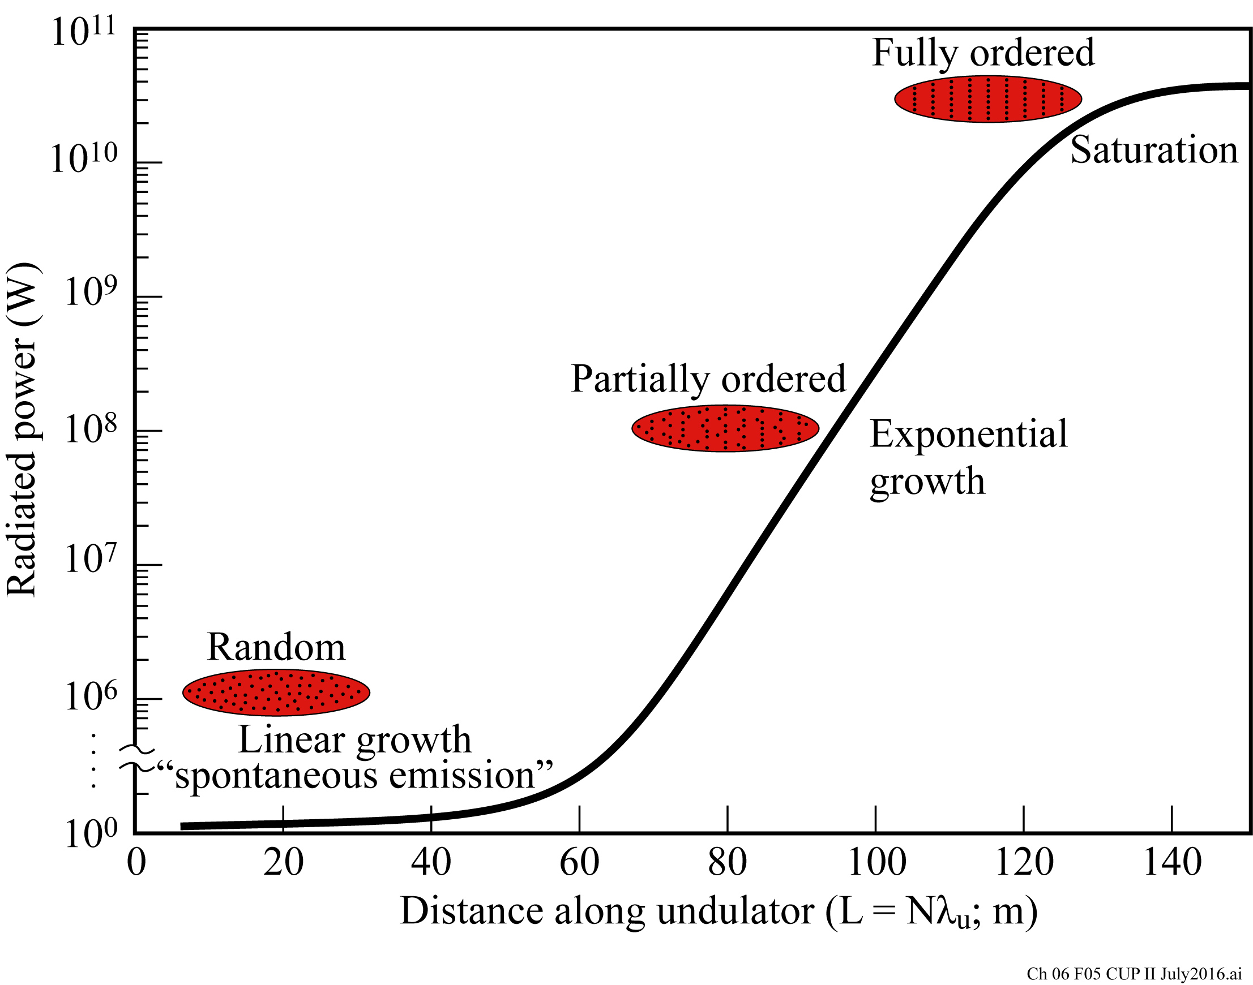
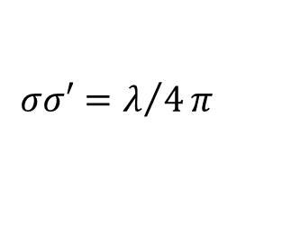
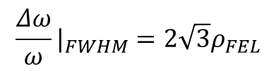
The evolution from undulator radiation to x-ray FEL
FELs offer fsec pulses, full spatial coherence, and GW peak power
(6.9)
(6.12)
(6.13)
$${\frac{Δω}{ω}|}_{FWHM}=2\sqrt{3}ρ_{FEL}$$
$$σσ′=λ/4π$$
(6.2)

Slide 4
Desirable qualities of short wavelength FELS
Photon energy (hard or soft x-rays, EUV)
High photon flux (photons/pulse; peak power)
Short pulses (few to 100 fsec, asec in future)
True phase control (N², fields add)
Broad photon energy tunability
Polarization control (final ‘radiator’ sets polarization)
Repetition rate
Synchronization (pump probe, two-color)

Slide 5
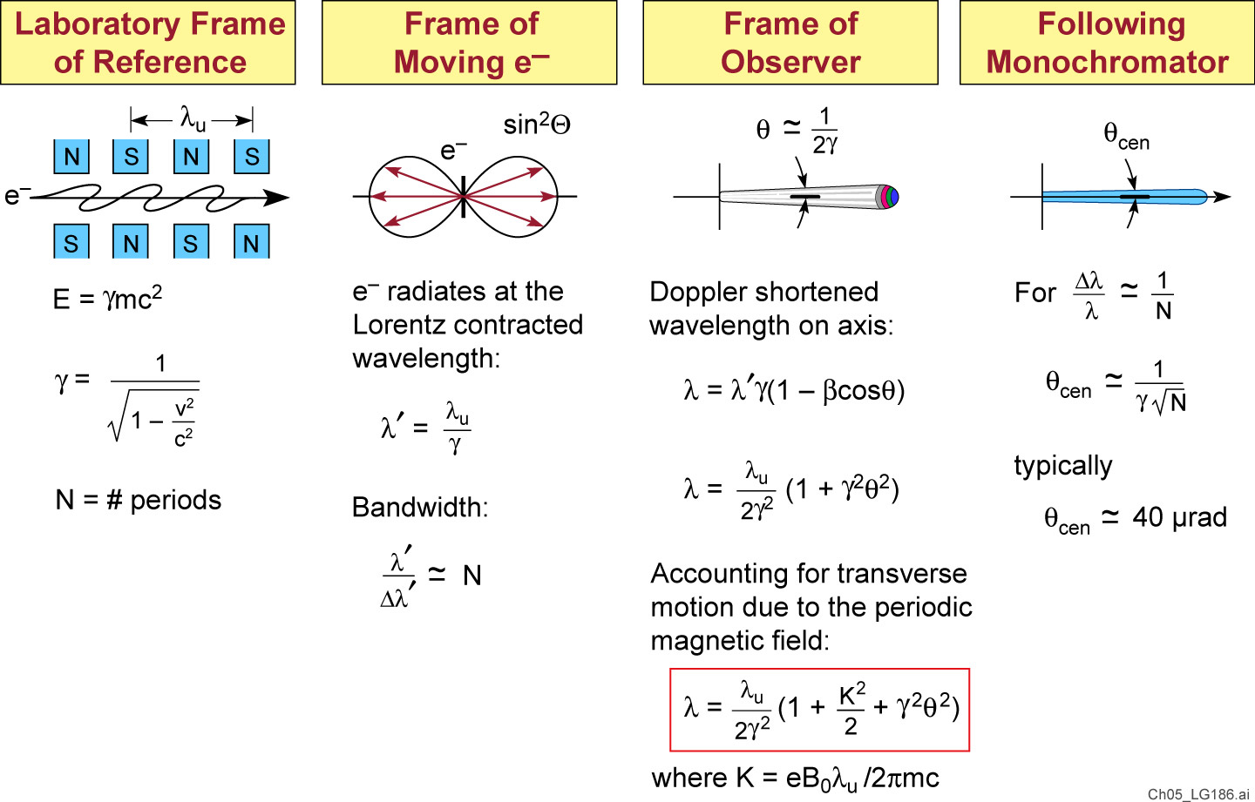
Recalling Undulator radiation
Following A. Hoffmann (SLAC)

Slide 6
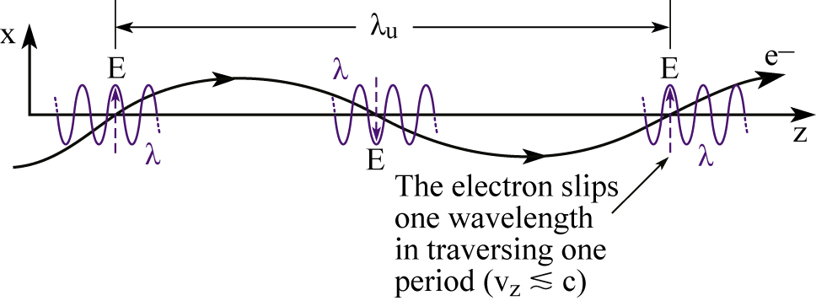
The “slip condition” by which radiation falls behind one wavelength as the electron traverses the magnet structure

Slide 7
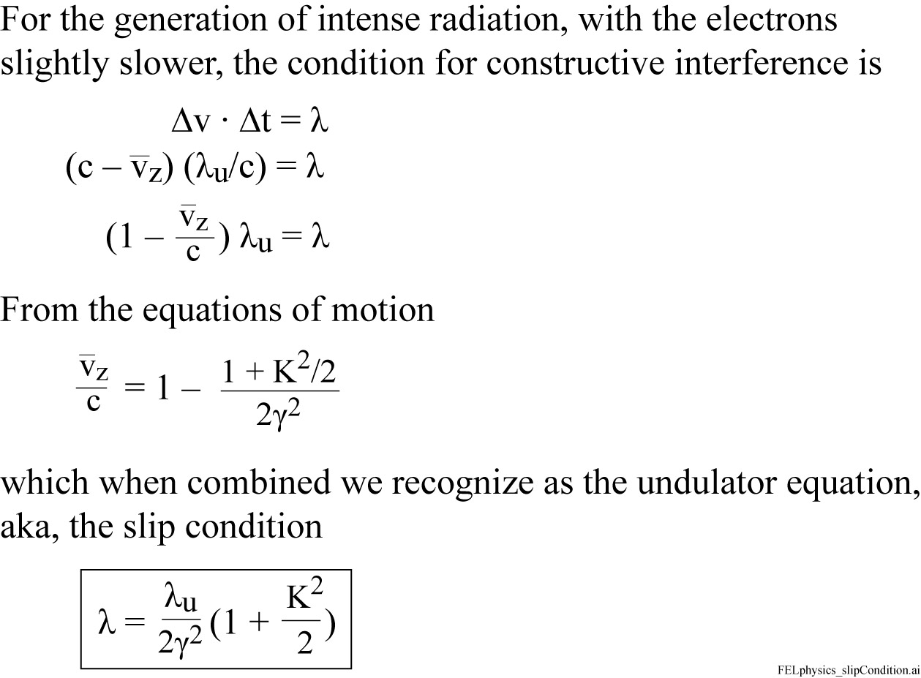
FEL Physics: the “slip condition”

Slide 8
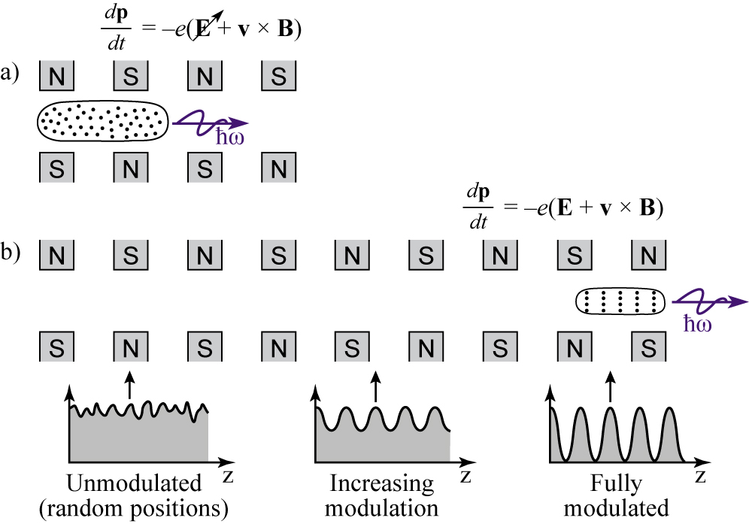
Evolution from undulator radiation to FEL
The “SASE” process
Longer undulator
High peak current
Smaller electron beam (better coherence)

Slide 9
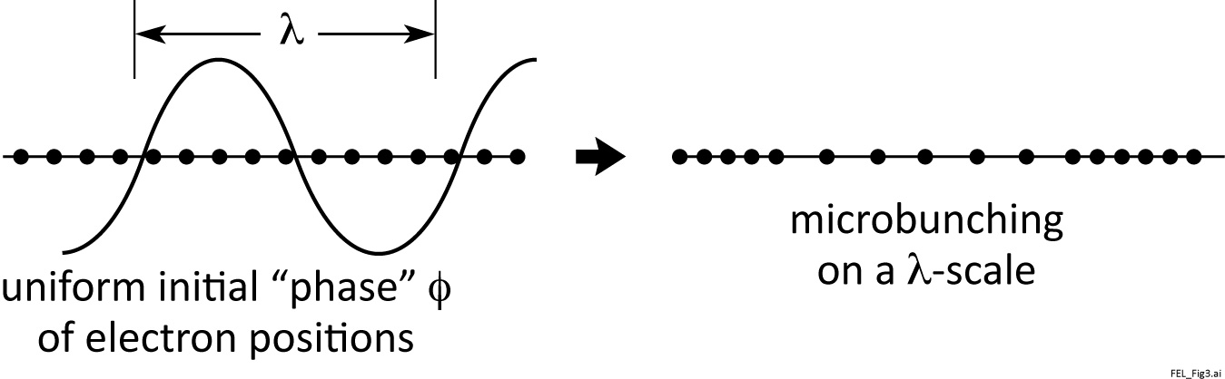
Electron axial positions can be affected by interaction with the electromagnetic wave, resulting in microbunching on a wavelength scale
Discuss both seeded and SASE processes

Slide 10
FEL power grows exponentially with microbunching

Slide 11
The bunching advantage of FELs
In an undulator with random, uncorrelated electron positions within the bunch, only the radiated self-fields E add constructively.
Coherence is limited
Power radiated is proportional to N_{e} (total # electrons)
For FEL lasing the radiated fields are strong enough to form “microbunches” within which the electron positions are well correlated. Radiated fields from these correlated electrons are in phase. The net electric field scales with N_{ej}, the # of electrons in the microbunch, and power scales with N_{ej}² times the number of microbunches, n_{j}.
Essentially full spatial coherence is achieved
Power radiated is proportional to Σn_{j}N_{ej}²; Gain ~ 3 × 10⁶

Slide 12
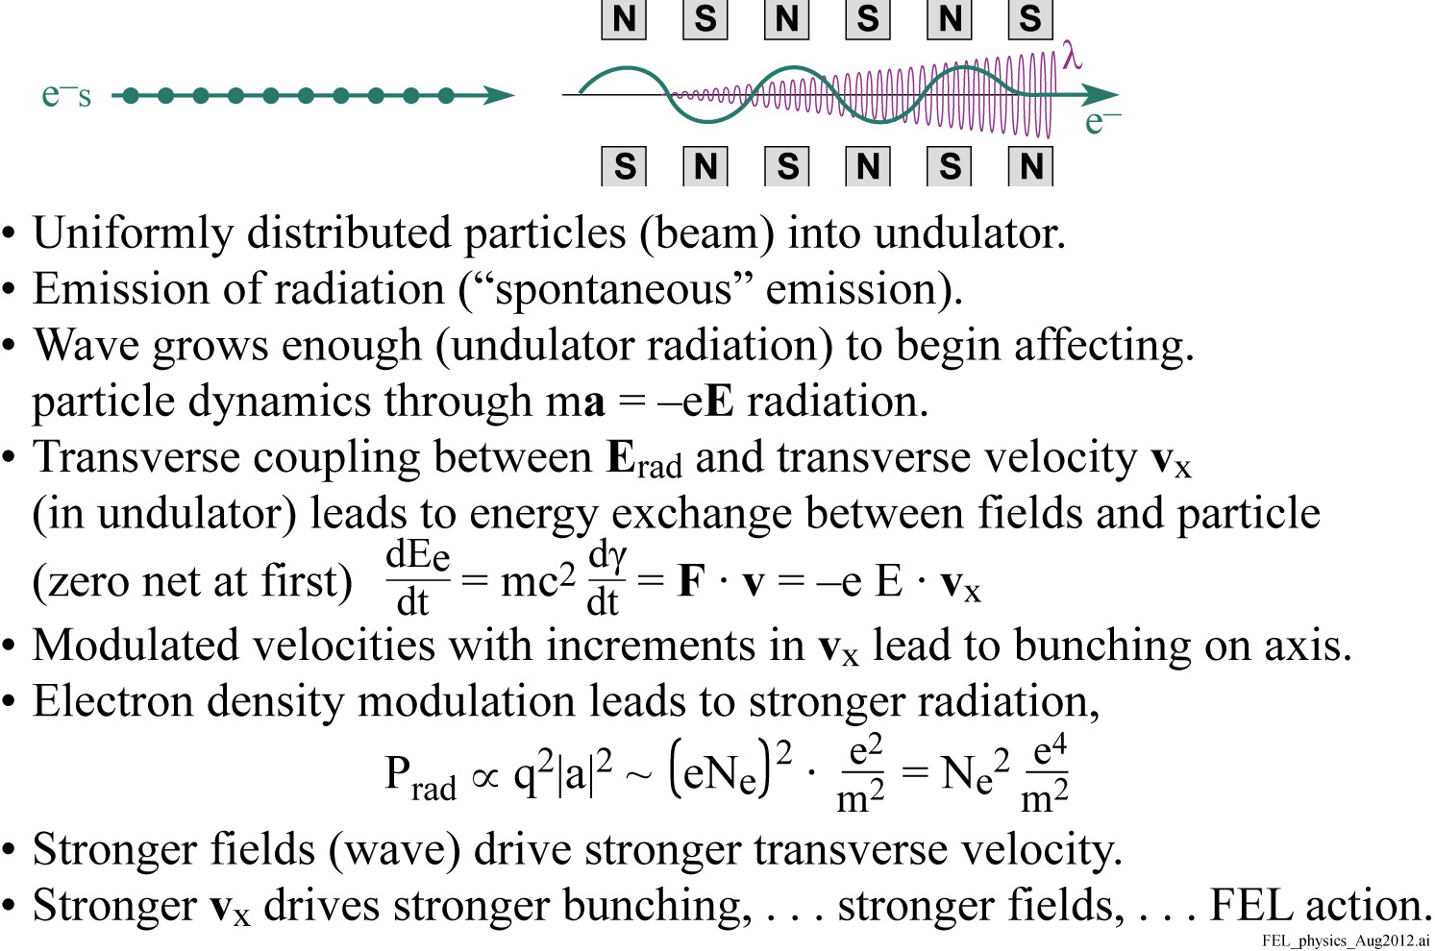
FEL Physics

Slide 13
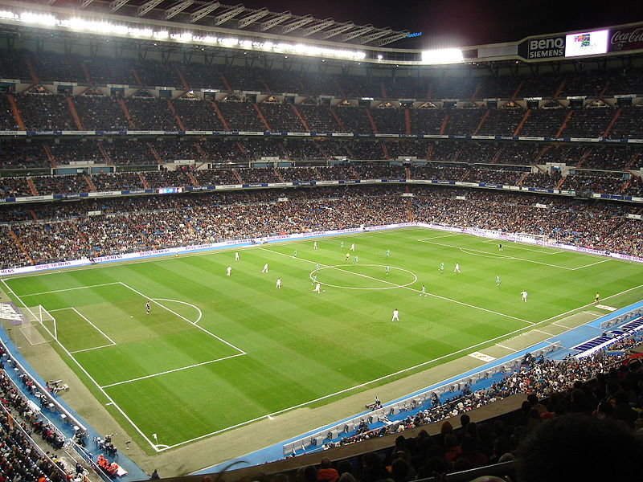
The evolution of incoherent clapping to coherent clapping
Suggested by Hideo Kitamura,
(RIKEN)

Slide 14
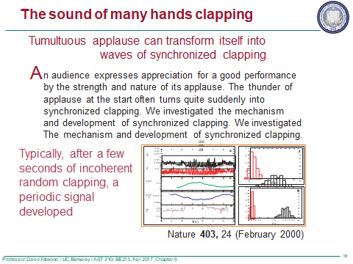
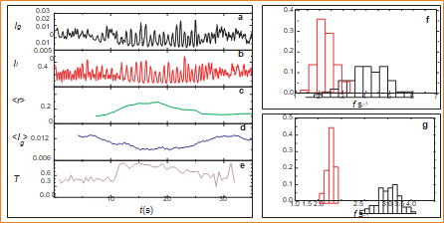
Z. Néda et al.,

Slide 15
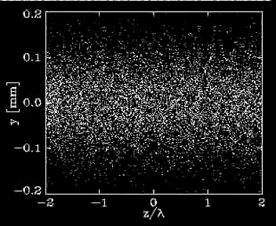
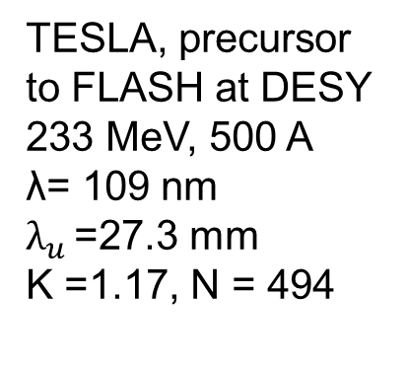
FEL Microbunching
TESLA, precursor
to FLASH at DESY 233 MeV, 500 A
λ= 109 nm
$λ_{u }$=27.3 mm
K =1.17, N = 494
Courtesy of Sven Reiche, U. Hamburg; UCLA; now SwissFEL

Slide 16
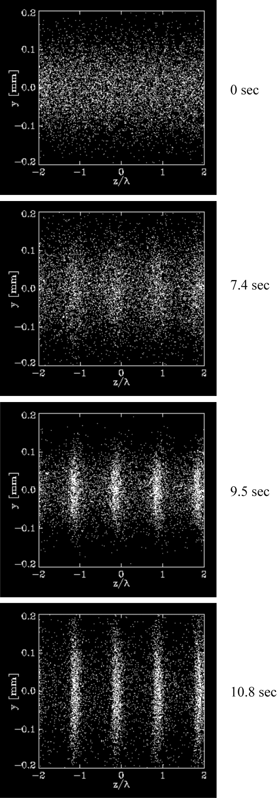
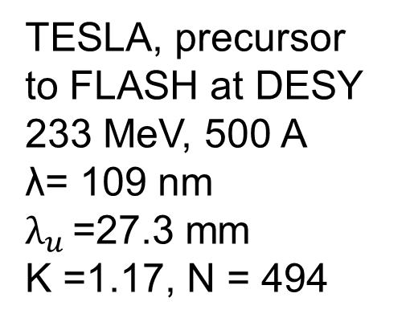
Four time steps from the movie
TESLA, precursor
to FLASH at DESY 233 MeV, 500 A
λ= 109 nm
$λ_{u }$=27.3 mm
K =1.17, N = 494
Courtesy of Sven Reiche, U. Hamburg; UCLA; now SwissFEL

Slide 17
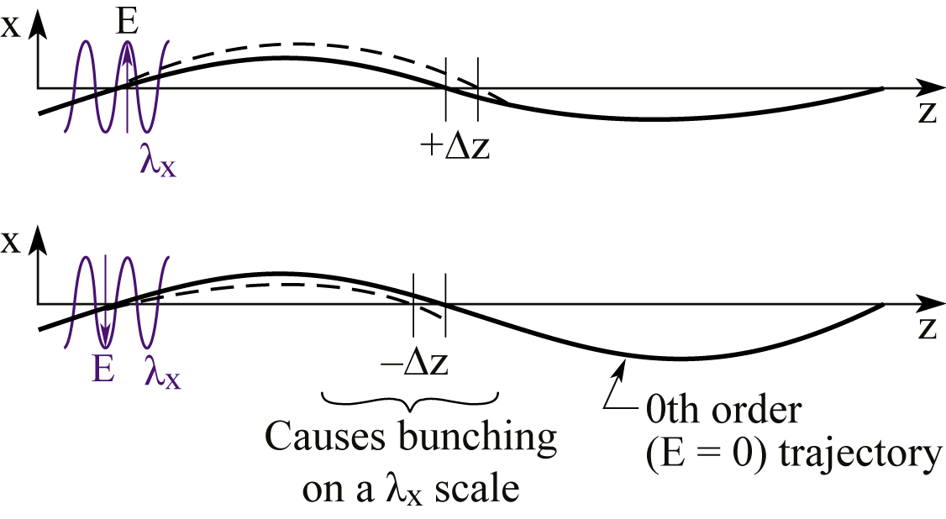
Energy is transferred between the electrons and the co-propagating wave, depending on local phase
Electron bunching occurs, which results in increased radiation,
stronger electric fields, and further bunching. This exponential
process leads to wave growth (lasing)
Depending on each electron’s position with respect to the
phase of the co-propagating
wave, its transverse velocity
will either be increased or decreased, affecting its time
of return to the z-axis, and
thus affecting local charge
density. This causes an electron density modulation on a wavelength scale, so-called “microbunching”.

Slide 18
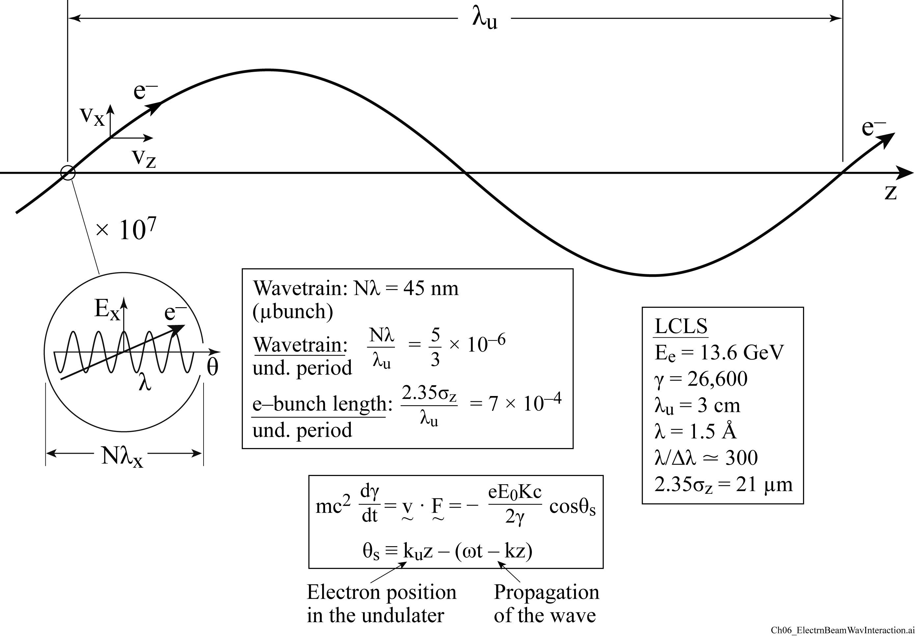

The scale of electron beam - wave interaction in an FEL undulator
$$\frac{e^{−}bunch.length}{wavetrain.length}=$$
$$\frac{21μm}{500x0.15nm}≃300$$

Slide 19
What is phase space?
“Phase Space” refers to a multi-dimensional space in which the spatial and velocity (or momentum) coordinates of particles are described. This could be a 6-dimentional space in which the coordinates of all N particles are plotted as a function of time, as in the microscopic Klimontovich distribution, Eq.(8.9)
There could also be a 6-dimensional phase space in which particles are grouped and described in terms of a “kinetic distribution function”, f(v, r; t), which is more slowly varying, and often described in terms of a Vlasov type equation, Sectin 8.4.2.

Slide 20
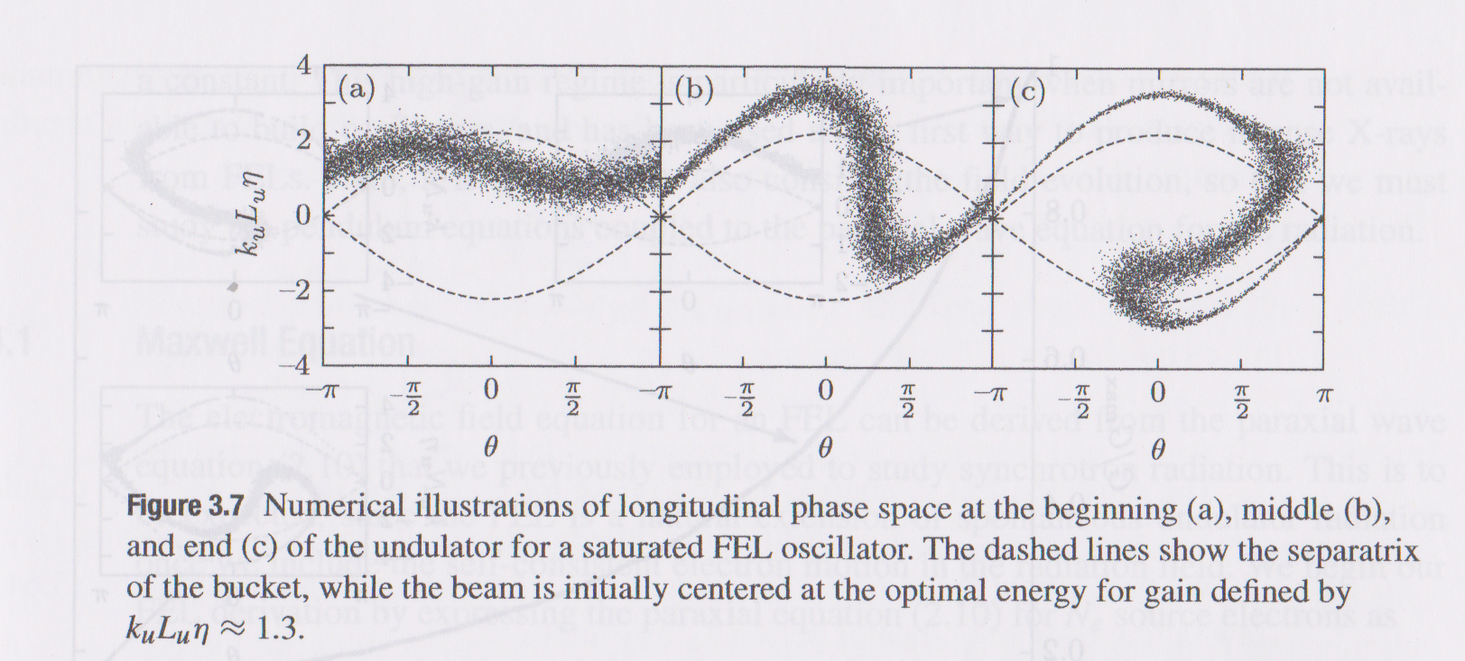
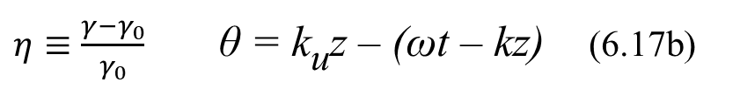
FEL longitudinal phase space: electron energy and z-position
$η≡\frac{γ−γ_{0}}{γ_{0}}$ θ = k_{u}z – (ωt – kz) (6.17b)
Kim, Huang, Lindberg, Synchrotron Radiation and
Free Electron Lasers (Cambridge, 2017), p.89.

Slide 21
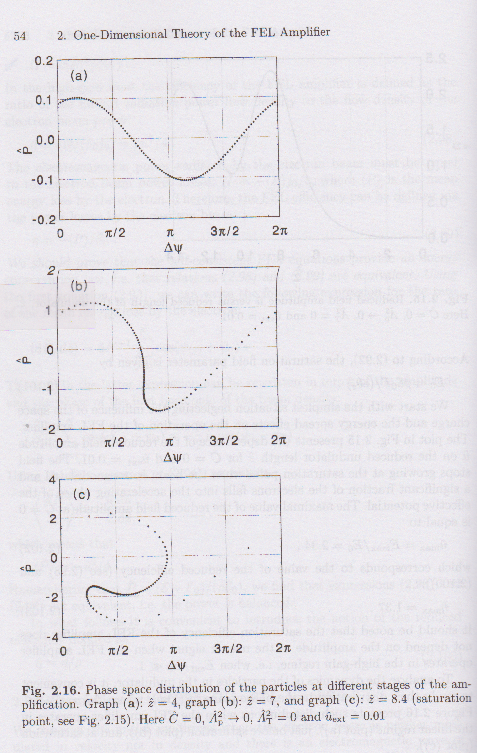
FEL longitudinal phase space: electron energy and z-position
Saldin, Schneidmiller, Yurkov, The
Physics of Free Electron Lasers
(Springer, 2000), p.70.

Slide 22
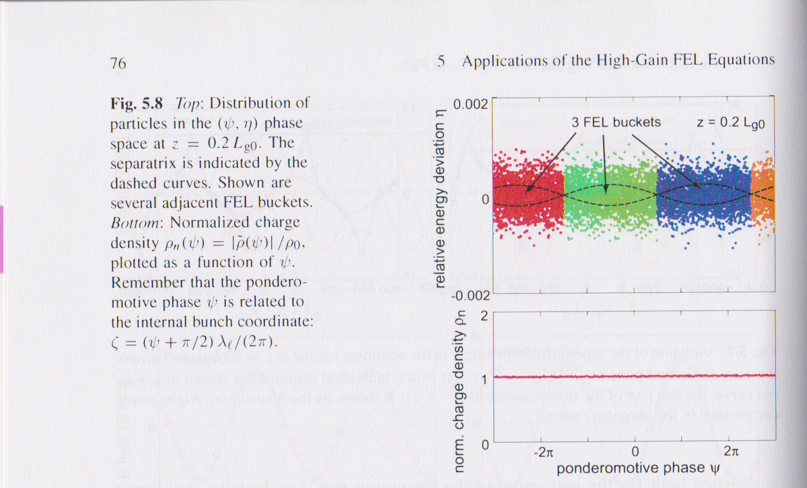
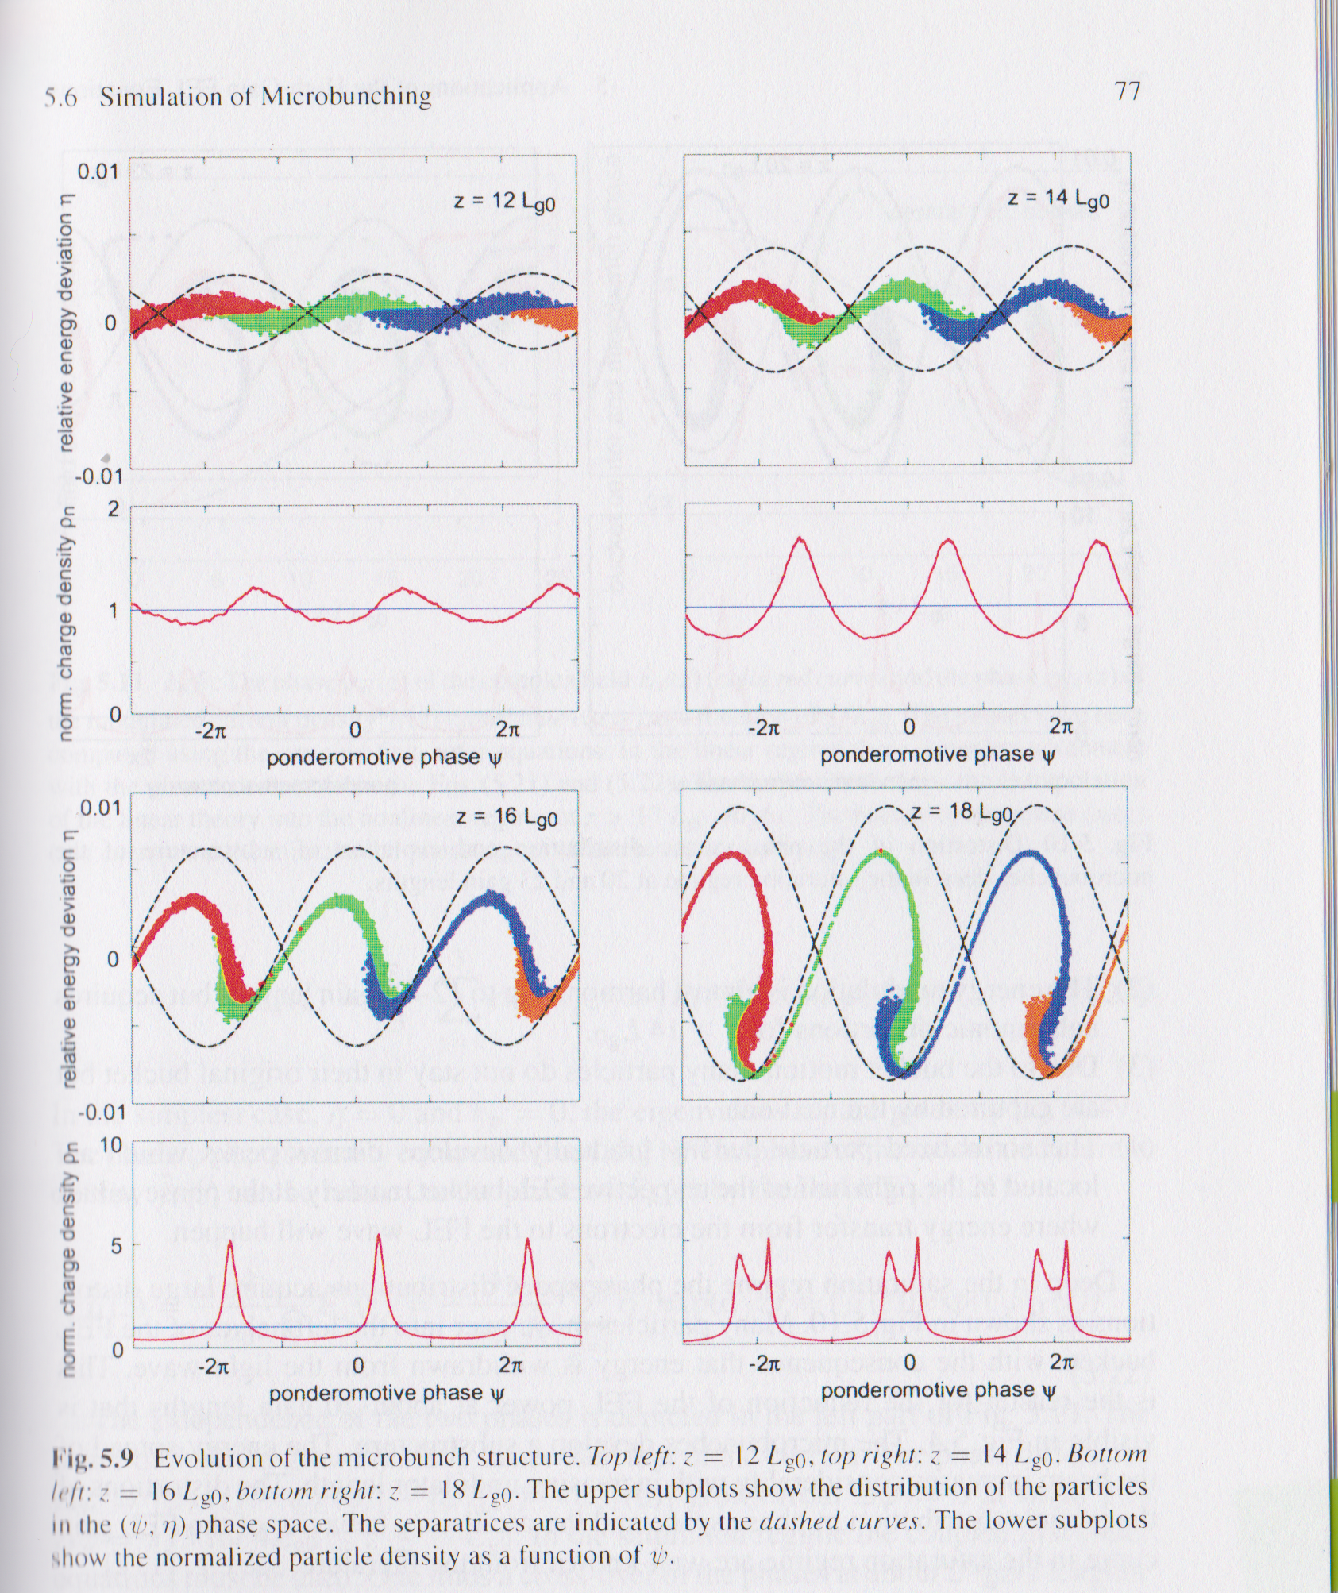
FEL longitudinal phase space: electron energy and z-position
Schmuser Dohlus Rossbach Behrens,
Free-Electron Lasers in the Ultraviolet
and X-Ray Regime (Springer, 2014),
pp.76,77.

Slide 23
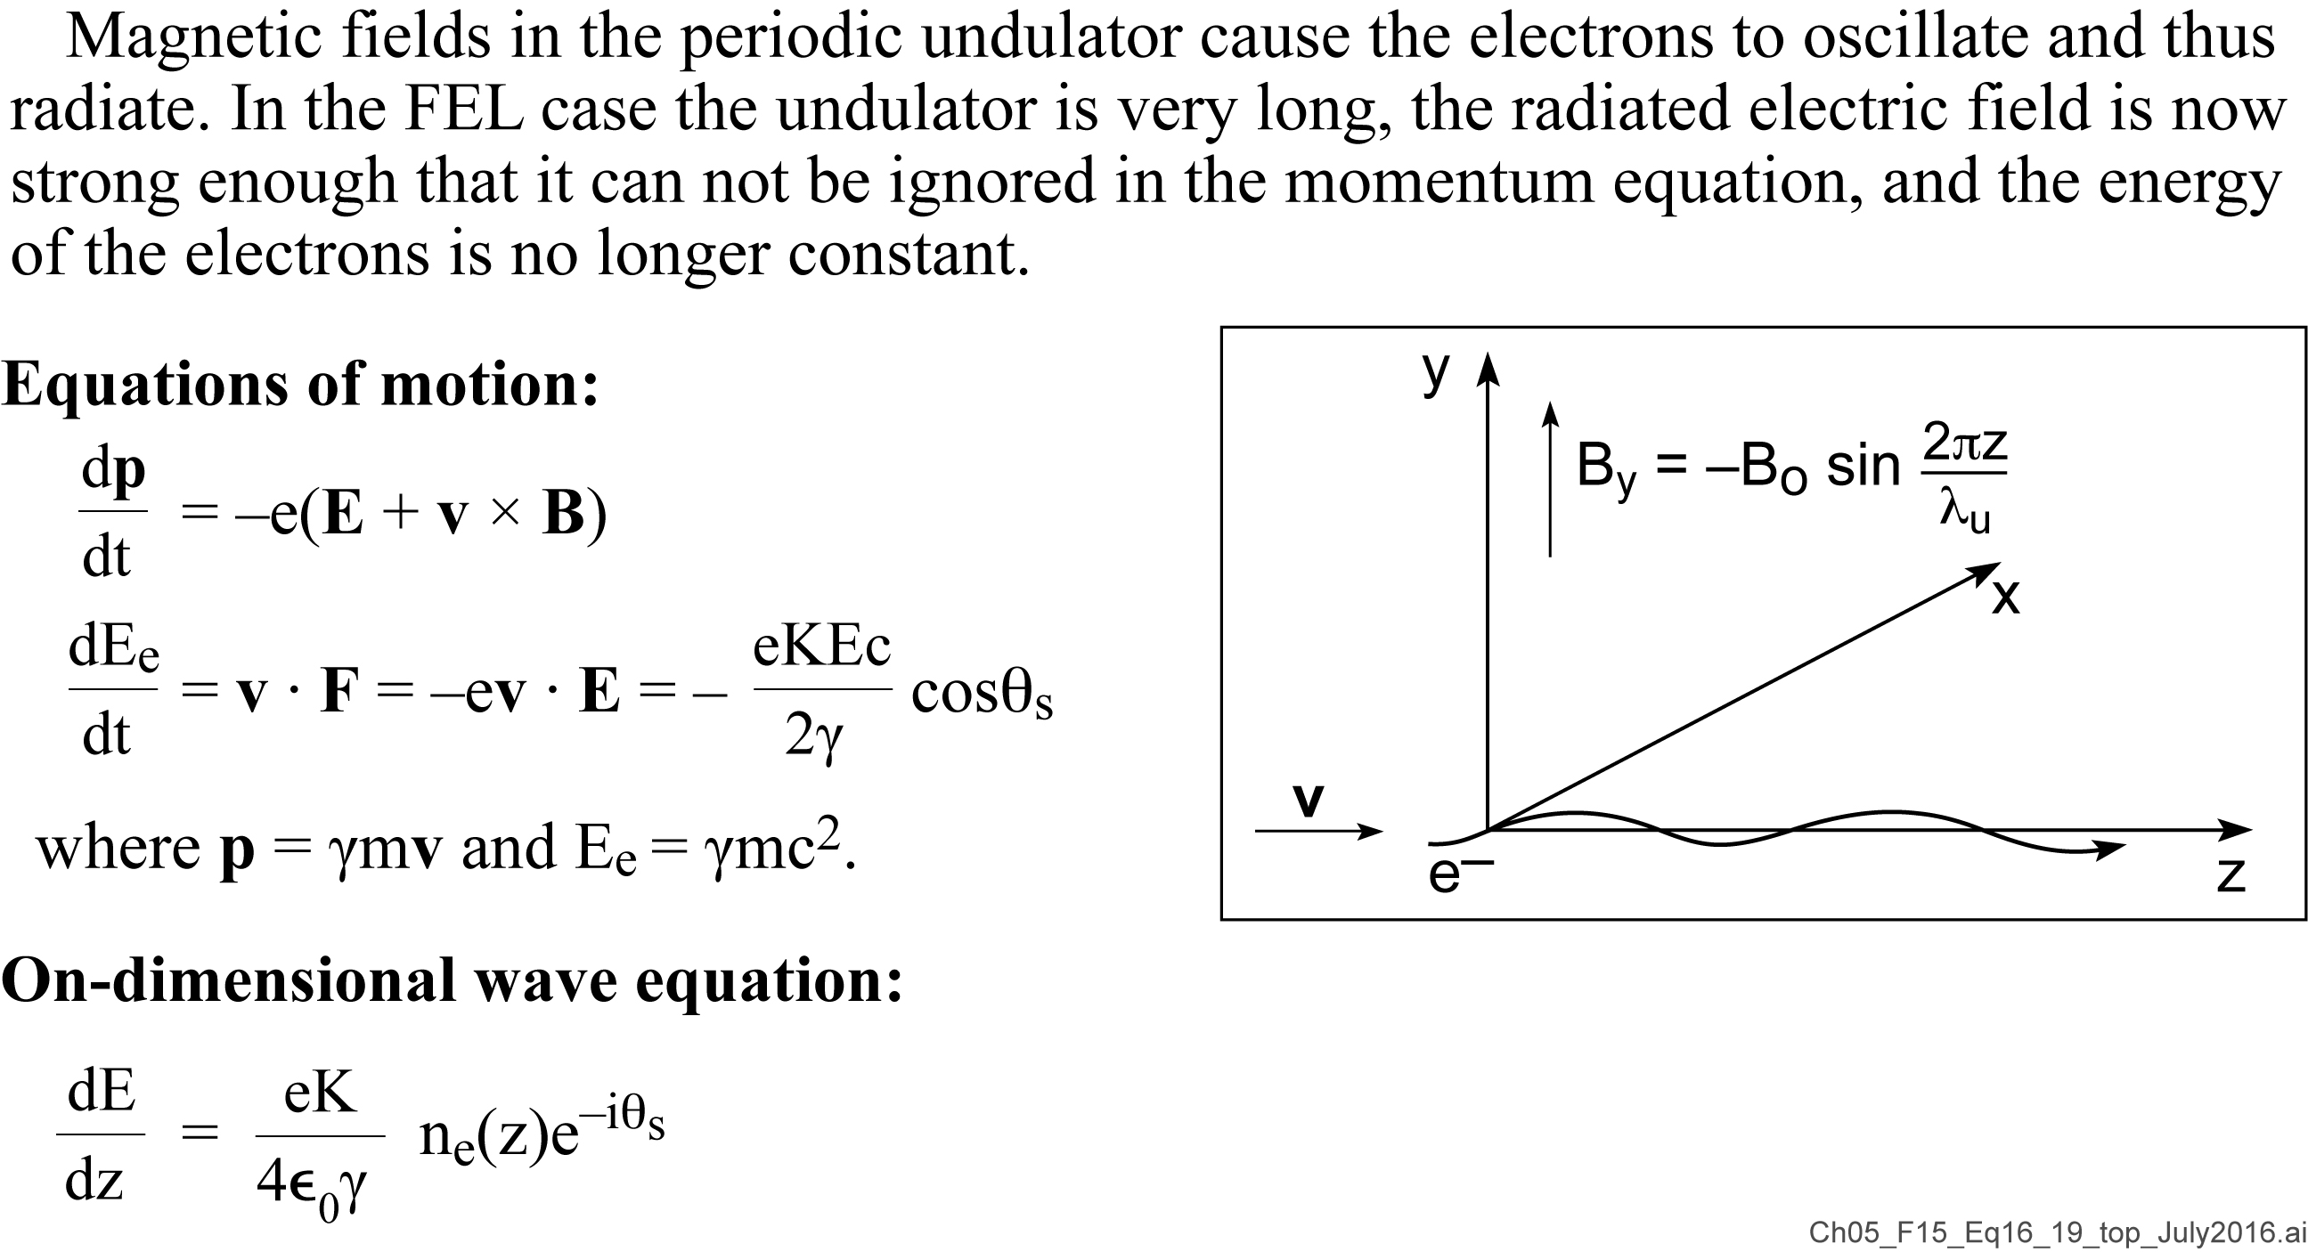
Equations of motion for the FEL

Slide 24

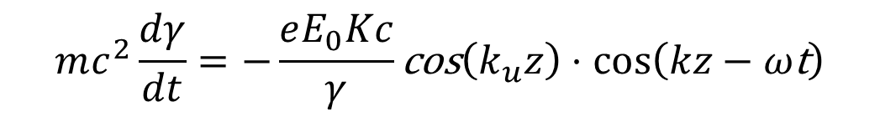
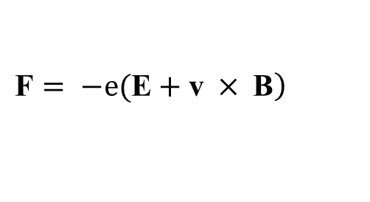
The equations of motion
$$\left.\text{F}= −e(\text{E}+\text{v} × \text{B}\right)$$
Combining the force equation and the energy equation
or
Introducing
$$mc^{2}\frac{dγ}{dt}=−\frac{eE_{0}Kc}{γ}\text{cos}\left(k_{u}z\right)⋅cos\left(kz−ω\text{t}\right)$$
$$η≡\frac{γ−γ_{0}}{γ_{0}}$$

Slide 25
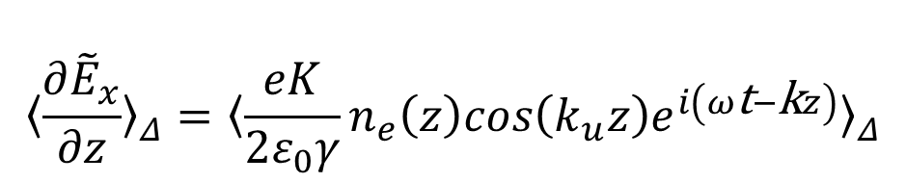
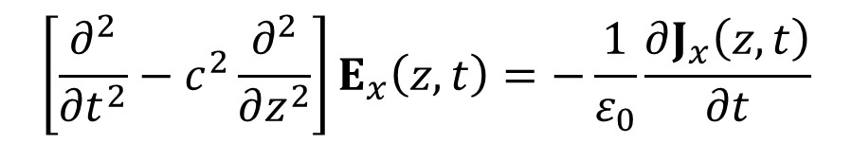
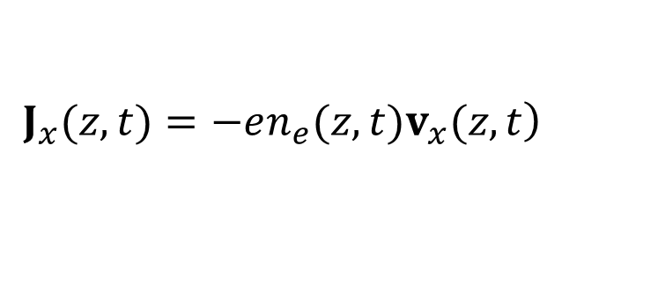
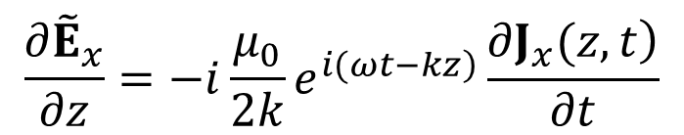
The one-dimensional wave equation for a growing wave
$$\left[\frac{∂^{2}}{∂t^{2}}−c^{2}\frac{∂^{2}}{∂z^{2}}\right]E_{x}\left(z,t\right)=−\frac{1}{ε_{0}}\frac{∂J_{x}\left(z,t\right)}{∂t}$$
$E_{x}\left(z,t\right)={\tilde{E}}_{x}\left(z\right)e^{\left.−i(ωt−kz\right) } ,i.e.,$ wave growth
$$\frac{∂{\tilde{E}}_{x}}{∂z}=−i\frac{μ_{0}}{2k}e^{\left.i(ωt−kz\right)}\frac{\left.∂J_{x}(z,t\right)}{∂t}$$
$$\left.J_{x}(z,t)=−en_{e}(z,t)v_{x}(z,t\right)$$
$${〈\frac{∂{\overset{}{\tilde{E}}}_{x}}{∂z}〉}_{Δ}={〈\frac{eK}{2ε_{0}γ}n_{e}\left(z\right)cos\left(k_{u}z\right)e^{i\left(ω\text{t}−\text{k}z\right)}〉}_{Δ}$$
$$\left(cosk_{u}z\right)e^{i\left(ωt−kz\right)}=\frac{1}{2}\left\{\left(cosθ_{s}+cosθ_{f}\right)−i\left(sinθ_{s}−sinθ_{f}\right)\right\}$$

Slide 26
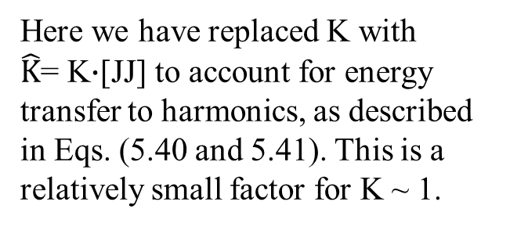
Three coupled first order equations for E, η and $θ_{s}$
…are non-linear
Here we have replaced K with
$\hat{K}$= K$∙$[JJ] to account for energy transfer to harmonics, as described in Eqs. (5.40 and 5.41). This is a relatively small factor for K ~ 1.

Slide 27
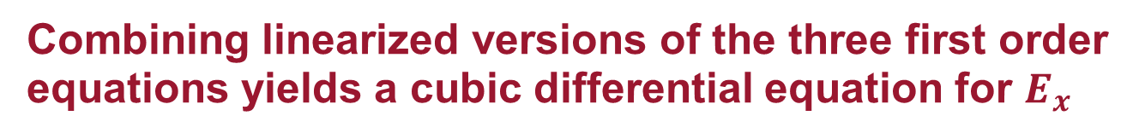
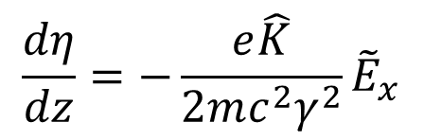
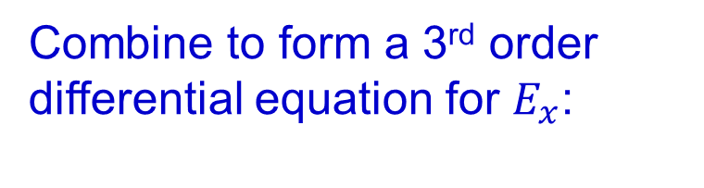
Combining linearized versions of the three first order equations yields a cubic differential equation for $E_{x}$
Linearization is appropriate for early FEL gain before amplitudes grow too large and nonlinearities begin to dominate
Combine to form a 3rd order differential equation for $E_{x}$:
$$\frac{dη}{dz}=−\frac{e\hat{K}}{2mc^{2}γ^{2}}{\tilde{E}}_{x}$$
where Γ is the “gain parameter”

Slide 28

Solving the 3rd order FEL differential equation
Assume a one-dimensional solution of the form
One obtains a third order dispersion relation
with three solutions:
$μ_{1}=−iΓ$ , $μ_{2}=\left(i−\sqrt{3}\right)Γ/2$ , $μ_{3}=\left(i+\sqrt{3}\right)Γ/2$
The third corresponds to a wave of exponentially growing amplitude
with a power growth
and power gain length
This result assumes small amplitude gain, no 2D or 3D effects, etc.

Slide 29

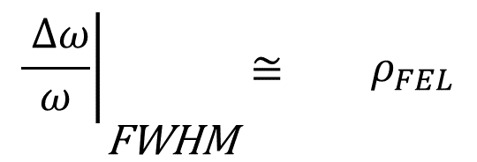
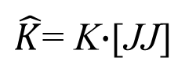

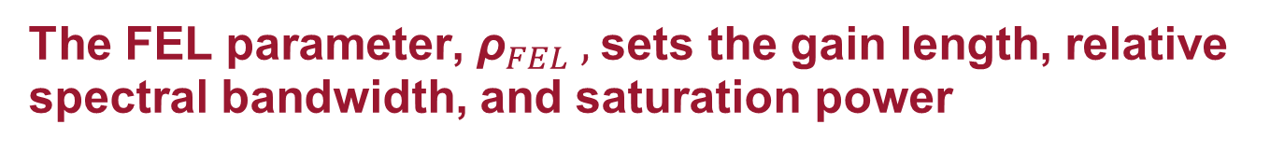

The FEL parameter, ${\text{ρ}}_{FEL} ,$sets the gain length, relative spectral bandwidth, and saturation power
$\hat{K}$= K$∙$[JJ]
$${\left.\frac{ Δω}{ω}\right|}_{\begin{matrix} \\ \text{FWHM}\end{matrix}}≅{ ρ}_{FEL}$$
$$2\sqrt{3}$$
$$≅$$
At LCLS, $ρ_{FEL}$ = 1/2300

Slide 30
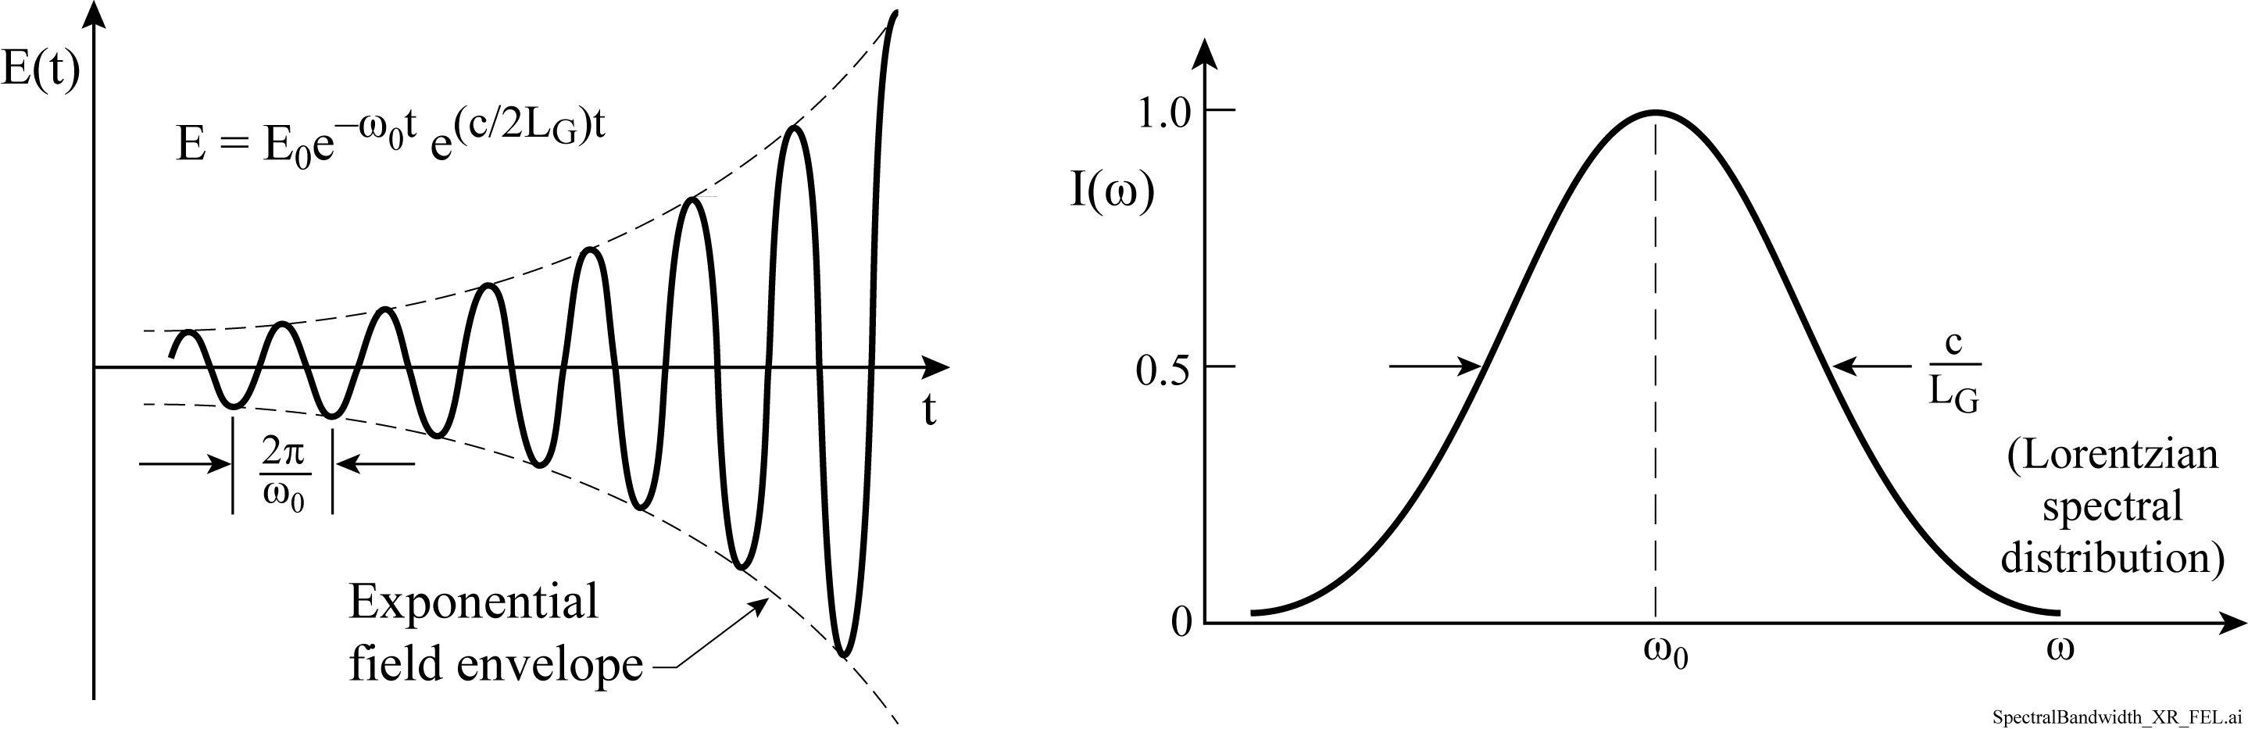

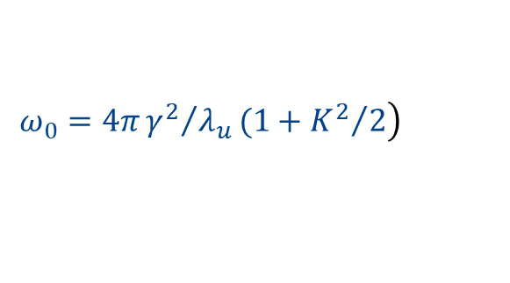


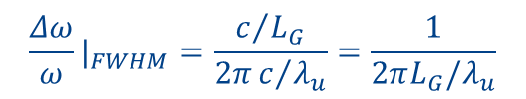
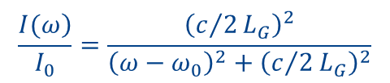
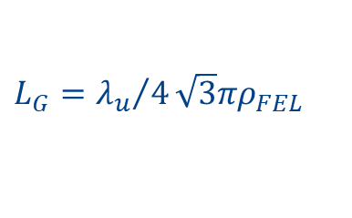
Spectral bandwidth of an x-ray FEL
As a first cut we model the spectrum of a one-dimensional FEL of constant gain length L_{G}, as an oscillating electric field of exponentially increasing amplitude.
2L_{G} is the e-folding distance for the
electric field and 2L_{G}/c is the time
for photons to traverse that distance. (~600 @ LCLS)
(1D, Δγ = 0)
Caveats: This assumes a 1D constant gain model, well below saturation,with Δγ = 0. Transverse variations will affect spectral bandwidth. Geloni et al. (NJP, 12, 035021, March 2010) point out that $L_{G}/λ_{u}$ is the number of cycles in one gain length. Also see ref.6.27, Schmüser et al.,p.69, Eq.(5.14) for z=8L_{G}, and ref 6.28, Kim et al., pp.116 and 142 for further discussions.
Fourier transform
$$\left.ω_{0}=4π{γ^{2}}/{λ_{u}}(1+{K^{2}}/2\right)$$
$$\frac{\left.I(ω\right)}{I_{0}}=\frac{{\left(c/2L_{G}\right)}^{2}}{{\left(ω−ω_{0}\right)}^{2}+{\left(c/2L_{G}\right)}^{2}}$$
$L_{G}={λ_{u}}/4\sqrt{3}πρ_{FEL}$
$${\frac{Δω}{ω}|}_{FWHM}=\frac{c/{L_{G}}}{2πc/{λ_{u}}}=\frac{1}{2πL_{G}/λ_{u}}$$
$=2\sqrt{3}ρ_{FEL}$
$${\frac{Δω}{ω}|}_{rms}=1.47ρ_{FEL}$$

Slide 31
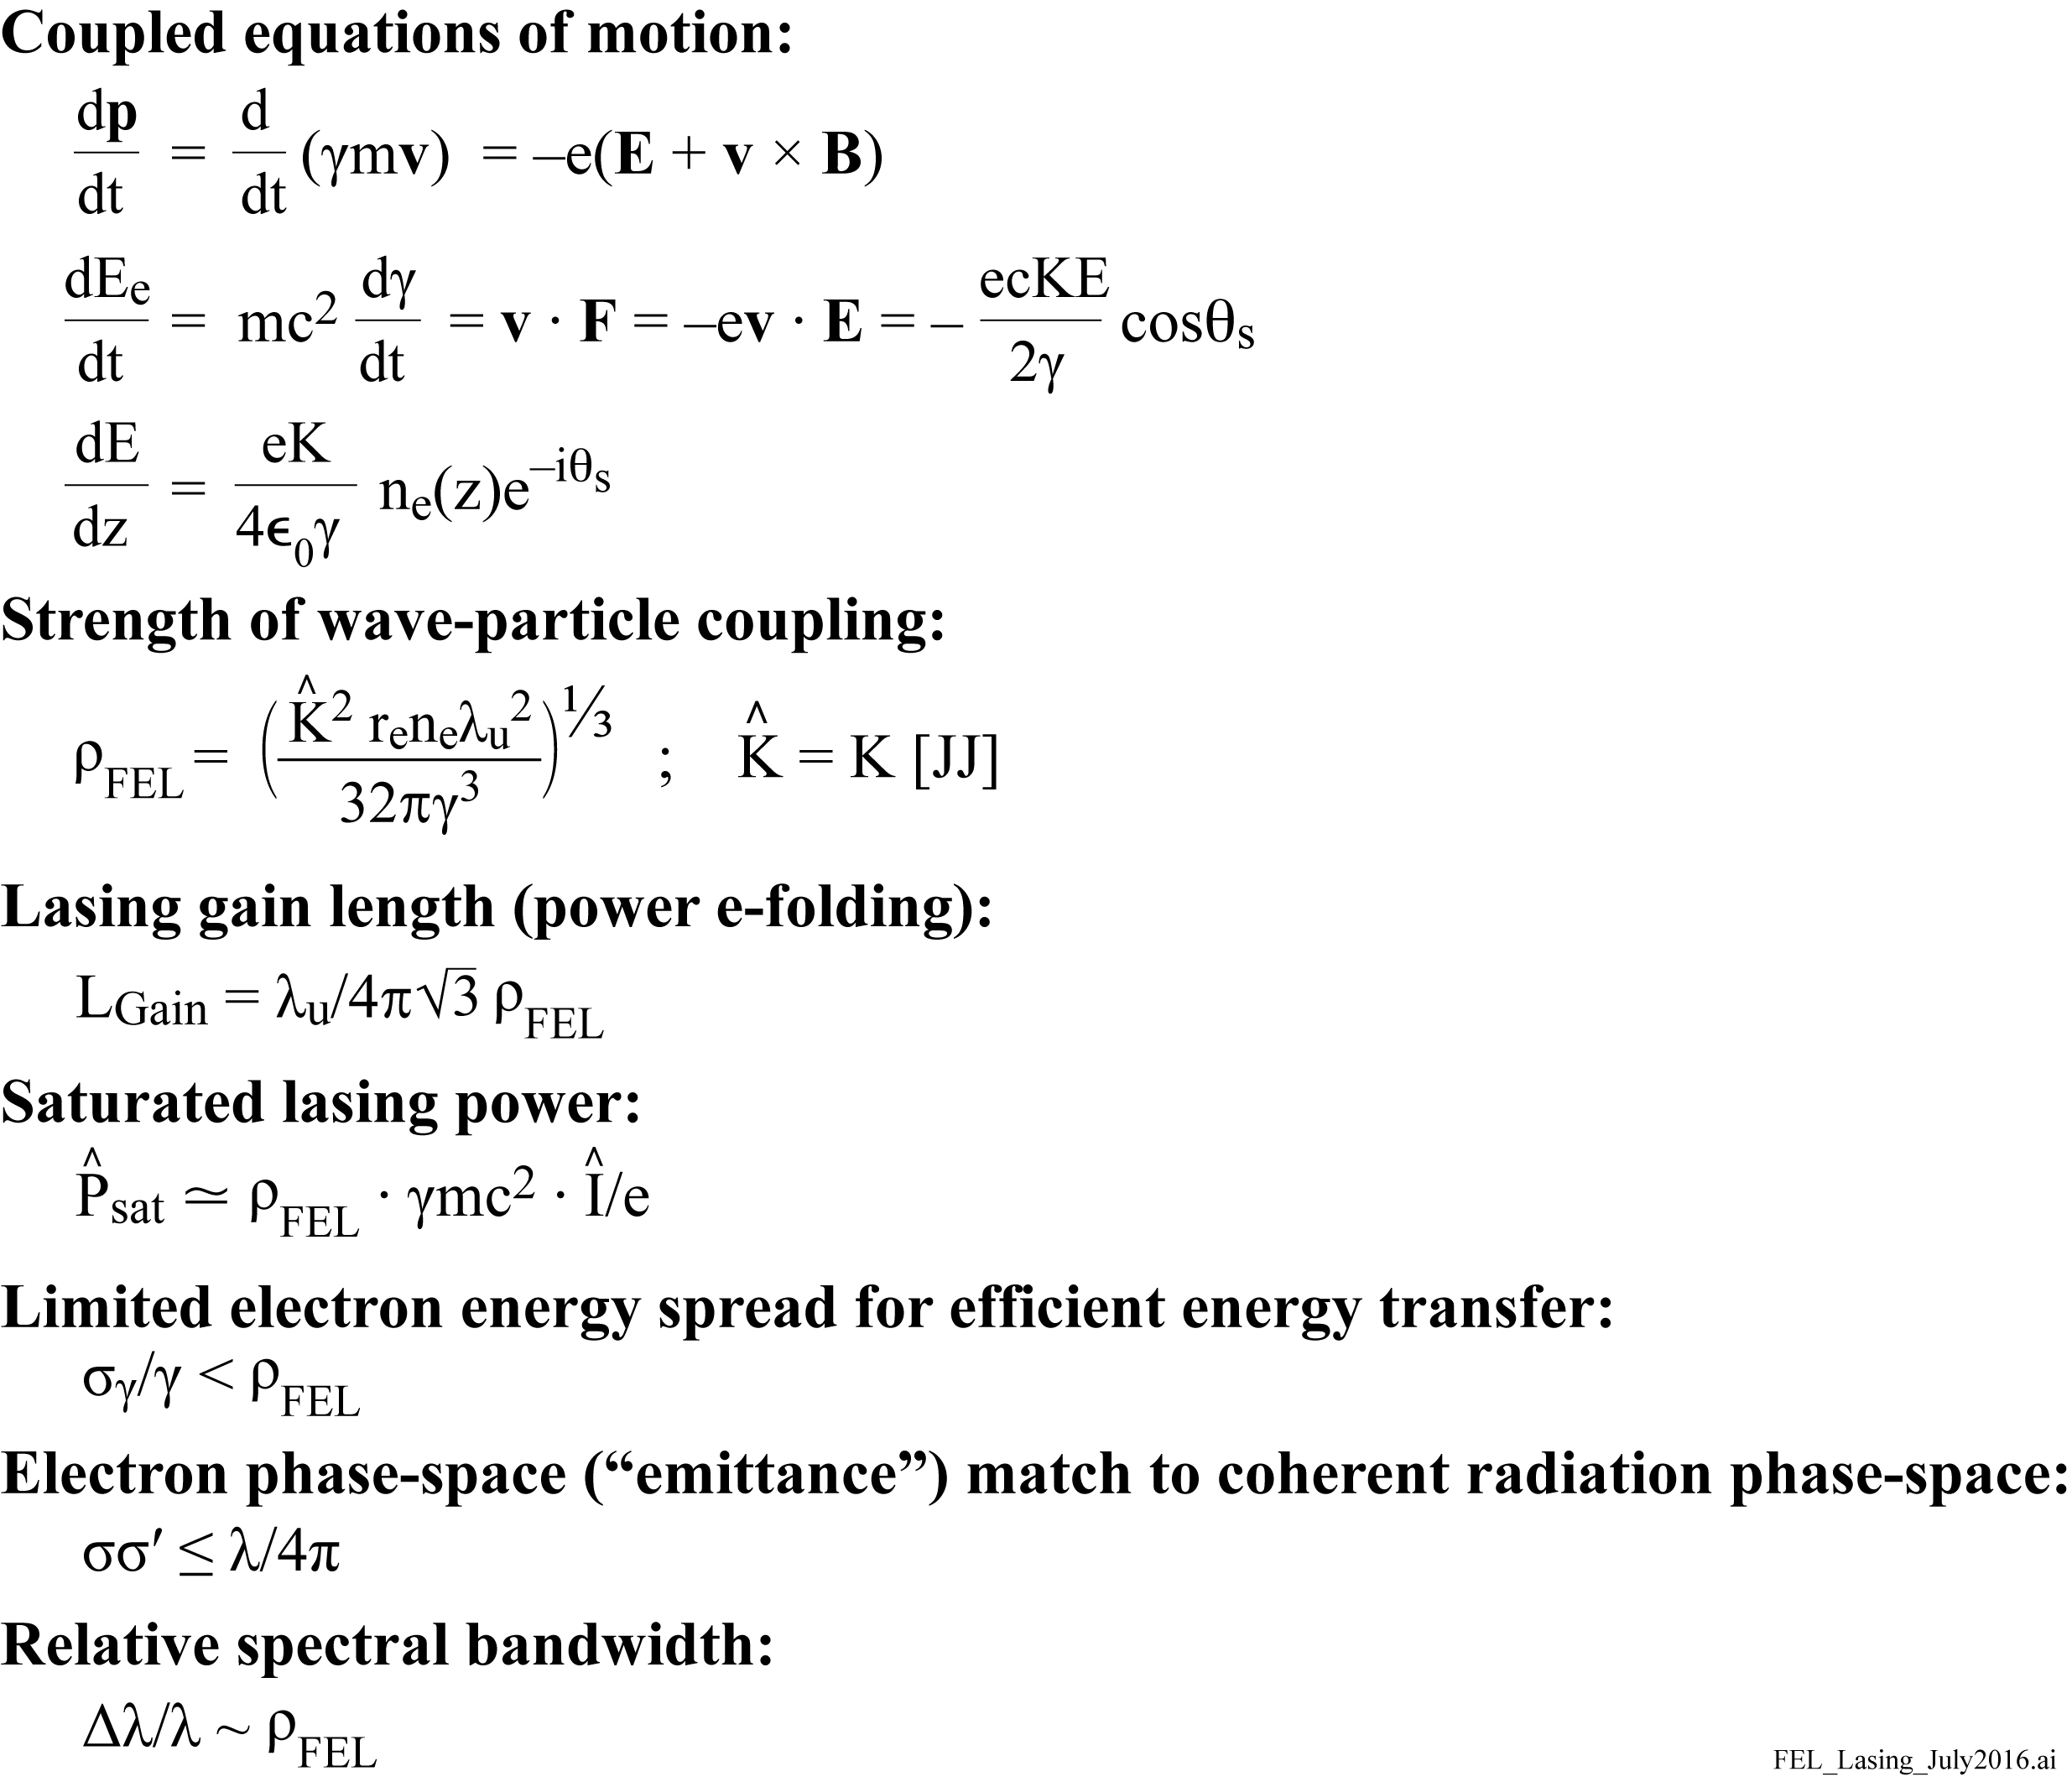
Summary of FEL lasing and the FEL parameter ρ_{FEL}

Slide 32
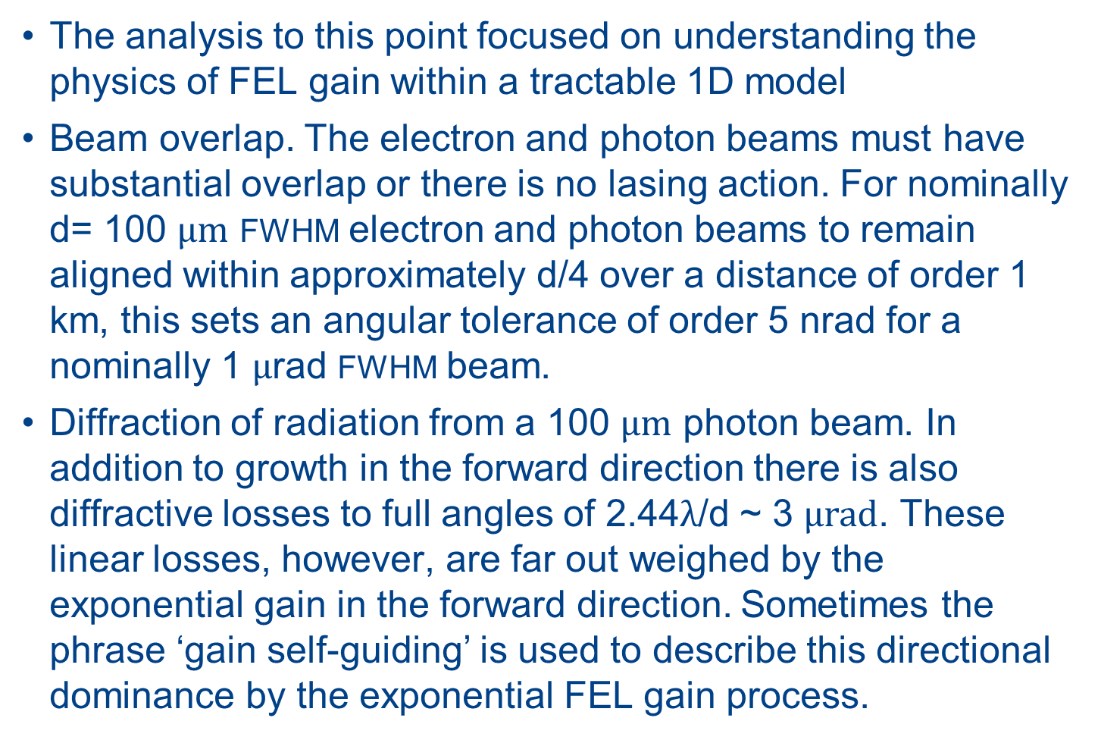
Some multi-dimensional effects which play an important role in FEL lasing
The analysis to this point focused on understanding the physics of FEL gain within a tractable 1D model
Beam overlap. The electron and photon beams must have substantial overlap or there is no lasing action. For nominally d= 100 $μm$ FWHM electron and photon beams to remain aligned within approximately d/4 over a distance of order 1 km, this sets an angular tolerance of order 5 nrad for a nominally 1 $μ$rad FWHM beam.
Diffraction of radiation from a 100 $μm$ photon beam. In addition to growth in the forward direction there is also diffractive losses to full angles of 2.44$λ$/d ~ 3 $μrad$. These linear losses, however, are far out weighed by the exponential gain in the forward direction. Sometimes the phrase ‘gain self-guiding’ is used to describe this directional dominance by the exponential FEL gain process.

Slide 33

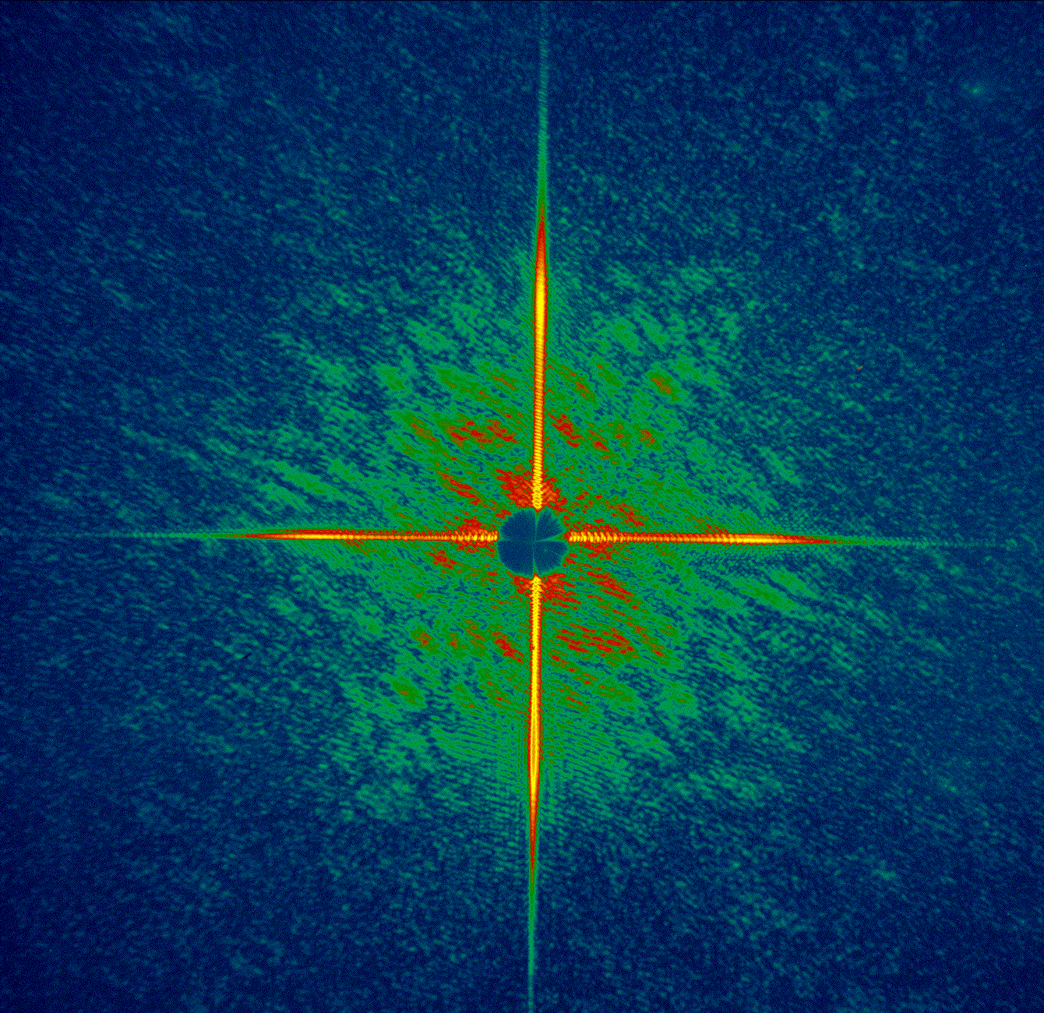
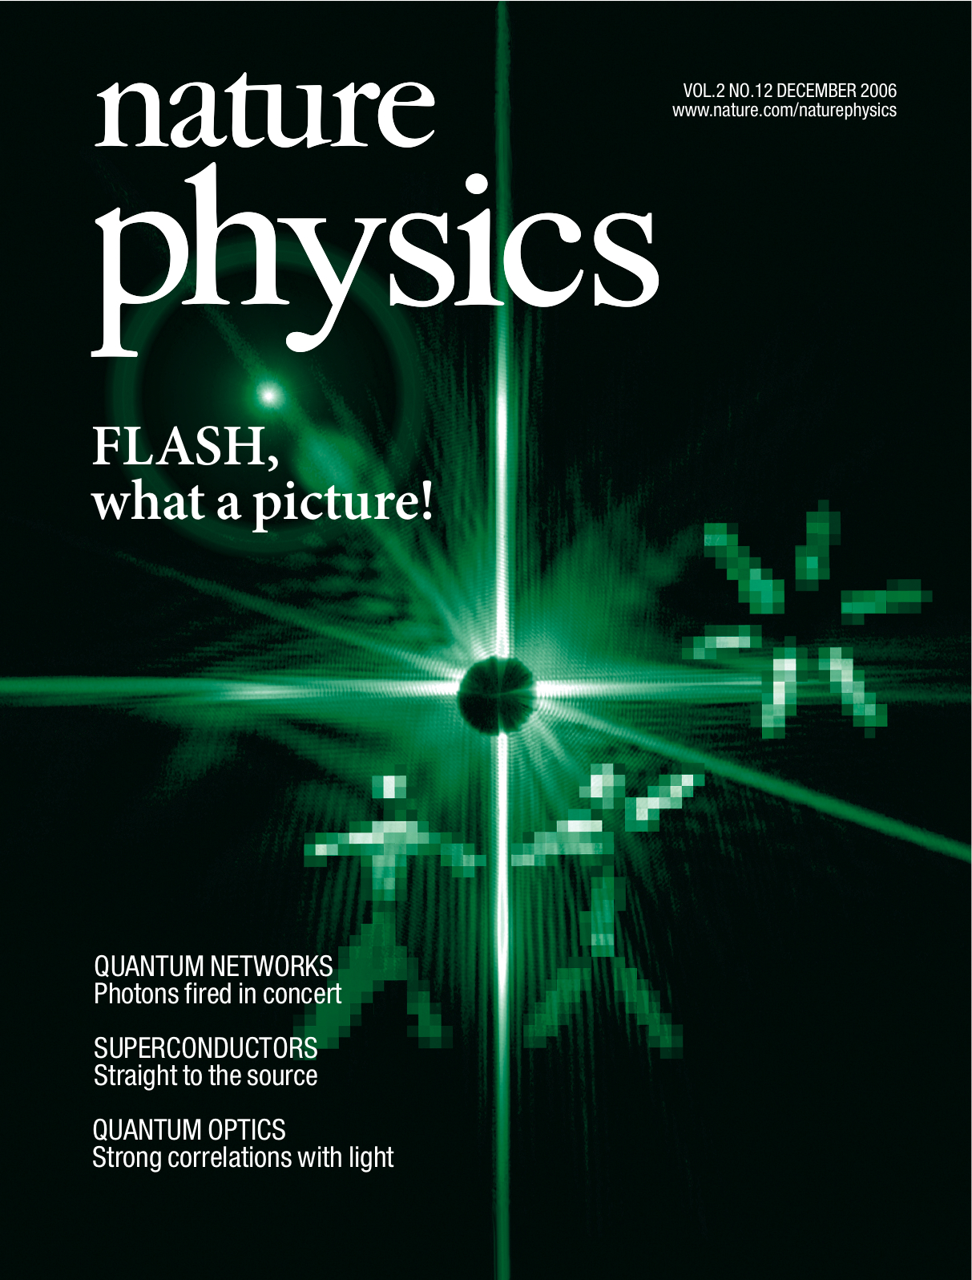

The FLASH free-electron laser (FEL) in Hamburg was the first major break through to short wavelength FELs
25 fs diffraction pattern
1 micron
Chapman et al, Nature Phys 2 839 (2006)

Slide 34

(LCLS, lasing April 2009, 1st day; saturated lasing 2009; publ. Sept. 2010)

Slide 35



The Linac Coherent Light Source (LCLS)
X-ray FEL at Stanford

Slide 36


Slide 37
The FEL parameter, ${\text{ρ}}_{FEL} ,$sets the gain length, relative spectral bandwidth, and saturation power
$\hat{K}$= K$∙$[JJ]
$${\left.\frac{ Δω}{ω}\right|}_{\begin{matrix} \\ \text{FWHM}\end{matrix}}≅{ ρ}_{FEL}$$
$$2\sqrt{3}$$
$$≅$$
At LCLS, $ρ_{FEL}$ = 1/2300

Slide 38


Stanford’s LCLS Free Electron Laser

Slide 39
The spatial and temporal coherence properties
of x-ray and EUV FEL pulses

Slide 40


The FEL electron bunch contains many microbunches
…with each lasing independently, at somewhat different wavelengths, complicating use for spectroscopic applications.
LCLS: 2.35 $σ_{z}$ = 21 μm FWHM bunch length.
Each e⁻ microbunch ≅ 500 waves x 1.5 Å = 75 nm length. (if λ/Δλ ~ 500)
∴ Bunch can can support of order 21 μm /75 nm = 300 microbunches ,
each radiating at slightly different wavelengths.
Solutions which would provide a narrower FEL spectral width include shorter electron bunches, ‘self-seeding’ (spectral filtering) to minimize spectral bandwidth, or the possible future use of a strong seed pulse.
.

Slide 41

… resulting in many spectral spikes
Courtesy of D. Zhu, J. Hastings and Y. Feng, SLAC.
D. Zhu et al., "A Single-Shot Transmissive Spectrometer for Hard X-Ray Free Electron Lasers," Appl. Phys. Lett. 101, 034103 (2012).

Slide 42

Self-seeding of an FEL to obtain a narrower spectrum

Slide 43
Self-seeding at LCLS
|Layout of the LCLS undulator with a self-seeding chicane, diamond (004) monochromator, gas detector and hard-X-ray spectrometer. The chicane is greatly exaggerated in scale.
The delay of both photons, by multiple reflections within the crystal, and electrons diverted through the chicane, is ~ 20 fsec.
The chicane washes out electron density microbunching, providing a clean electron beam entering the seeded section.
E_{e} = 8.3 keV, single pulse spectrum is narrow, λ/Δλ = 2000, but intensity variation is large (~50%).
J. Amann et al., “Demonstration of self-seeding in a hard x-ray free-electron laser”, Nature Photonics 6, 693 (2012)

Slide 44

Narrowed SASE FEL spectrum with “self-seeding”
8300 eV/30 eV ~ 280 spectral spikes

Slide 45

Spectral bandwidth of an x-ray FEL
As a first cut we model the spectrum of a one-dimensional FEL of constant gain length L_{G}, as an oscillating electric field of exponentially increasing amplitude.
2L_{G} is the e-folding distance for the
electric field and 2L_{G}/c is the time
for photons to traverse that distance. (~610 @ LCLS)
(1D, Δγ = 0)
Caveats: This assumes a 1D constant gain model, well below saturation,with Δγ = 0. Transverse variations will affect spectral bandwidth. Geloni et al. (NJP, 12, 035021, March 2010) point out that $L_{G}/λ_{u}$ is the number of cycles in one gain length. Also see ref.6.27, Schmüser et al.,p.69, Eq.(5.14) for z=8L_{G}, and ref 6.28, Kim et al., pp.116 and 142 for further discussions.
$$\left.ω_{0}=4π{γ^{2}}/{λ_{u}}(1+{K^{2}}/2\right)$$
$$\frac{\left.I(ω\right)}{I_{0}}=\frac{{\left(c/2L_{G}\right)}^{2}}{{\left(ω−ω_{0}\right)}^{2}+{\left(c/2L_{G}\right)}^{2}}$$
$L_{G}={λ_{u}}/4\sqrt{3}πρ_{FEL}$
$${\frac{Δω}{ω}|}_{FWHM}=\frac{c/{L_{G}}}{2πc/{λ_{u}}}=\frac{1}{2πL_{G}/λ_{u}}$$
$=2\sqrt{3}ρ_{FEL}$
$${\frac{Δω}{ω}|}_{rms}=1.47ρ_{FEL}$$

Slide 46
Young’s double slit to measure spatial coherence
Courtesy of Changyong Song (POSTECH)
송창용

Slide 47

Measuring spatial coherence with Young’s double slit interferometer

Slide 48

Young’s double slit experiment with phase coherent emitters (some lasers, or properly seeded FELs)

Slide 49

Spatial coherence of Stanford’s LCLS X-ray FEL

Slide 50

LCLS
780 eV (1.6 nm)
300 fsec
¼ nC
N = 13 × 113 = 1500
(of 33)
Δτ_{coh} = 0.55 fsec
(165 nm @ 300 nm/fsec)
λ/Δλ = 100
78% energy in a single TEM₀₀ mode
ϕ-space = 1.2 diffr. Ltd.

Slide 51

Spatially Coherent FEL X-rays
SLAC/LCLS
780 eV (1.59 nm)
I. A. Vartanyants, et al., "Coherence Properties of Individual Femtosecond Pulses of an X-Ray Free-Electron Laser," Phys. Rev. Lett. 107, 144801 (2011).

Slide 52






Nanostructures fabricated for characterizing beam properties of FELs and for imaging experiments
Coherence Measurements
URA Holography
FEL coherence characterization using Young’s double pinhole, double slit, triple slits, nonredundant arrays, etc. These structures were made using thick Au where great attention was paid to overall film stress.
Two dimensional uniformly redundant array used as the reference for holography experiments at FLASH and ALS. The right hand picture is a SEM of a newly fabricated URA pattern with features down to 20 nm.
Courtesy of A. Sakdinawat, BioE, UC Berkeley, now SLAC
with Stefano Marchesini

Slide 53

The pursuit of sub-femtosecond x-ray FEL pulses
There is presently much accelerator research into techniques that would lead to single, sub-femtosecond x-ray pulses. For example, a very short electron bunch capable of supporting only a single microbunch. Recently, Marinelli et al. demonstrated sub-fsec lasing at SLAC’s LCLS employing a transverse slit within a chicane of the electron optics. This spoils the electron beam quality (emittance) for all but a small portion of the beam, such that only that limited length of the beam is capable of lasing. The figure below shows (in blue) the spectrum of a single asec x-ray FEL pulse recorded at the LCLS. Based on the measured photon spectral width of 4.5 eV the pulse duration is estimated to be 420 asec FWHM at a 5.6 keV photon energy. Typical pulse energies varied from 5 to 10 μJ. The red curve shows the spectral envelope of many pulses.
Marinelli et al.,”Experimental Demonstration of a Single-Spike
Hard-X-ray Free-Electron Laser Starting from Noise”, Appl. Phys.
Lett. 111, 151101 (Oct. 2017).
In a second paper Huang et al. at LCLS demonstrated a non-linear bunch compression technique which also generated single electron spikes, radiating single 5.6 keV FEL pulses of 11 eV spectral bandwidth, corresponding to 162 asec FWHM. Huang et al.,“Generating Single-Spike Hard X-ray Pulses with Nonlinear Bunch Compression in Free-Electron Lasers”, Phys. Rev. Lett. 119, 154801 (Oct. 2017).
Spectral width (eV)

Slide 54

Spring-8 and the SACLA XFEL
Hyogo Pref.
Japan
Courtesy of Tetsuya Ishikawa, Director

Slide 55
First Hard X-ray Lasing at SACLA
Note the relative angular widths of the ‘sponataneous’ undulator radiation and that of the x-ray laser
Courtesy of Changyong Song (POSTECH)

Slide 56

Broadly tunable hard x-ray pump-probe experiments at SACLA/Spring-8
Nominally 7 fsec duration pulses
Courtesy of Hitoshi Tanaka and
Makina Yabashi, (SACLA/Spring-8)

Slide 57





Generating a Cu Kα atomic laser using the pump-‘probe’ capability at SACLA/Spring-8 Delay
Delay ~ 1 fsec
$$ℏω_{1}=8979eV$$
$$ℏω_{2}=8028eV$$
$$or$$
Courtesy of Makina Yabashi and Hitoshi Tanaka, (SACLA/Spring-8)
$$ℏω_{2}=8048eV$$
$$\left[Cu_{Kα1}...Cu_{Kα2}\right]$$

Slide 58


Hard x-ray Cu-Kα atomic laser at 8 keV
The first 8,979 eV pulse drills a small cylinder of Cu atoms, 120 nm x 20 µm, each with an n=1 core hole.
The second “seed” pulse, with random ASE spikes across a ~40 eV wide spectrum, can drive Cu Kα1 or Cu Kα2 lasing.
What does the 1.7 eV line width tell us about lifetime?
$$Δℏω⋅Δτ=1.825 eV⋅fsec$$
Courtesy of M. Yabashi, Y. Inubushi, H. Tanaka, T. Ishikawa (SACLA/Spring-8) and H. Yoned (U. Tokyo)

Slide 59

Pohang Light Source and PAL-XFEL
Pohang Accelerator Laboratory (PAL)
Courtesy of In-Soo Ko, Director

Slide 60
PAL XFEL and Pohang Light Source
Pohang Accelerator Laboratory, Korea
Courtesy of In-Soo Ko, Director

Slide 61

SwissFEL
Villigen, Switzerland
Courtesy of Hans-Heinrich Braun

Slide 62

The European X-ray Free Electron Laser (EU XFEL)
3.4 km
Courtesy of Massimo Altarelli, Director

Slide 63

ELLETRA and the FERMI EUV FEL
Trieste
Italy
Courtesy Of Alfonso Franciosi

Slide 64

Seeded Free Electron Lasing: Challenge, need an intense, coherent, short wavelength seed source
Skip the stochastic first step:
  Inject intense radiation with desired spatial and temporal coherence that will dominate the lasing process
SASE is always competing, so the seeded radiation electric field must be much stronger than that of the random fluctuations by some factor
High degrees of both spatial and temporal coherence will be obtained
Saturation will be achieved in a shorter length
Start Here!
+
Courtesy of E. Champanois, AS&T, UC Berkeley and LBNL, now at SLAC

Slide 65

A coherent seed pulse can enhance temporal coherence properties, especially for EUV FELs

Slide 66








HGHG scheme in FEL‐1
High Gain, High Harmonic technique
Modulator
Dispersive section
Radiator

Slide 67
FERMI at Elettra, Trieste
Two-stage FEL-2: Seeded FEL with two stages of high gain high harmonic techniques
E. Allaria et al.,”Two-stage seeded soft X-ray free- electron laser”, Nature Photonics 7, 913 (November 2013)

Slide 68

Seeded EUV/Soft x-ray FEL “FERMI” in Trieste
Frequency tripled 780 nm Ti:sapphire (3ω) to 260 nm, followed by two stages of high gain, high harmonic (HGHG)
Courtesy of Luca Giannessi, Michele Svandrlik, and Fulvio Parmigiani FERMI, Trieste

Slide 69

X-ray and EUV FEL Facilities

Slide 70

Comparing undulator radiation and FEL radiation

Slide 71
X-ray free electron laser references
J.M.J. Madey, “Stimulated Emission of Bremsstrahlung in a Periodic Magnetic Field”, J. Appl. Physics 42, 1906 (1971).
A.M. Kondratenko and E.L. Saldin, “Generation of Coherent Radiation by a Relativistic-Electron Beam in an Undulator”, Sov. Phys. Dokl. 24, 986 (1979).
R. Bonifacio, C. Pellegrini and L. Narducci, “Collective Instabilities and High-Gain Regime in a Free Electron Laser”, Optics Commun. 50, 373 (1984).
V. Avazyan et al., “Generation of GW Radiation Pulses from a VUV Free-Electron Laser Operating the Femtosecond Regime”, Phys. Rev. Lett. 88, 104802 (2002).
P. Emma et al., “First Lasing and Operation of an Ångstrom-Wavelength Free-Electron Laser”, Nature Photonics 4, 641 (2010).
E.L. Saldin, E.A. Schneidmiller, and M.V. Yukov, “The Physics of Free Electron Lasers” (Springer, 2000)
P. Schmüser, M. Dohlus, J. Rossbach and C. Behrens, Free-Electron Lasers in the Ultraviolet and X-Ray Regime (Springer, 2014). Second edition.
K.J. Kim, Z. Huang and R. Lindberg, Synchrotron Radiation and Free Electron Lasers: Principles of Coherent X-ray Generation (Cambridge, UK, 2017).
D. Attwood and A. Sakdinwat, X-rays and Extreme Ultraviolet Radiation (Cambridge, UK 2017), Chapter 6.

Slide 72
FEL books
K.-J. Kim, Z. Huang and R. Lindberg, Synchrotron Radiation and Free Electron Lasers: Principles of Coherent X-ray Generation (Cambridge, UK, 2017).
P. Schmüser, M. Dohlus, J. Rossbach and C. Behrens, Free-Electron Lasers in the Ultraviolet and X-ray Regime (Springer, Heidelberg, 2014).
E.L. Saldin, E.A. Schneidmiller, and M.V. Yukov, “The Physics of Free Electron Lasers” (Springer, 2000)
D. Attwood and A. Sakdinwat, X-rays and Extreme Ultraviolet Radiation (Cambridge, UK 2017), Chapter 6.
A. Chao, K. Mess, M. Tigner and F. Zimmermann, Handbook of Accelerator Physics and Engineering (World Scientific, Singapore, 2013).

