Slide 1
Digital Design: A Systems Approach
Lecture 11: Pipelining

Slide 2
Readings
L11: Chapter 23
L12: Chapter 15

Slide 3
System Design – a process
Specification
  Understand what you need to build
Divide and conquer
  Break it down into manageable pieces
Define interfaces
  Clearly specify every signal between pieces
  Hide implementation
  Choose representations
Timing and sequencing
  Overall timing – use a table
  Timing of each interface – use a simple convention (e.g., valid – ready)
Add parallelism as needed (pipeline or duplicate units)
Timing and sequencing (of parallel structures)
Design each module
Code
Verify
Iterate back to the top at any step as needed.

Slide 4
Two ways to make things faster: pipeline and parallel

Slide 5
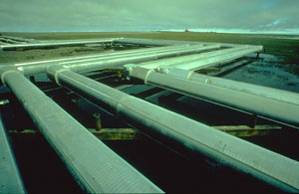
Pipelines

Slide 6
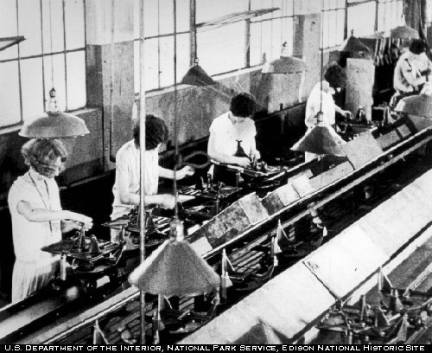
More Like an Assembly Line

Slide 7
Pipelines
Like an assembly line – each pipeline stage does part of the work and passes the ‘workpiece’ to the next stage
Example 1: Pipelined 32b Adder

Slide 8
Split into 4 8-bit adders

Slide 9
Split into stages
4 problems ‘in process’ at once

Slide 10
Pipeline Diagram
Illustrates pipeline timing

Slide 11
Movie

Slide 12
Cycle 1

Slide 13
Cycle 2

Slide 14
Cycle 3

Slide 15
Cycle 3

Slide 16
Latency and Throughput of a Pipeline
Suppose before pipelining the delay of our 32b adder is 3200ps (100ps per bit) and this adder can do one problem each 3200ps for a throughput of 1/3200ps = 312Mops
What is the delay (latency) and throughput of the adder with pipelining?
Suppose t_{dCQ} = 100ps, t_{s} = 50ps, t_{k} = 50ps (200ps Overhead)
t_{pipe} = n(t_{stage} + t_{dCQ} + t_{s} + t_{k}) 4(1000) = 4000
Θ = n/t_{pipe} = 1/(t_{stage} + t_{dCQ} + t_{s} + t_{k}) 4/4000 = 1Gops

Slide 17
Example 2: Processor Pipeline

Slide 18
Example 3: Graphics rendering pipeline

Slide 19
Example 4 – Packet Processing Pipeline
And each of these modules is internally pipelined
You get the idea. Lots of systems are organized this way.

Slide 20
Issues with pipelines
(all deal with time per stage)
Load balance (across stages)
  one stage takes longer to process each input than the others – becomes a ‘bottleneck’
  Example
    Rasterizing an ‘average’ triangle in a graphics pipeline takes more time than ‘lighting’ its vertices.
Variable load (across data)
  A given stage takes more time on some inputs than others
  Example
    The the time needed to rasterize a triangle is proportional to the number of fragments in the triangle. The average triangle may contain 20 fragments, but triangles range from 0 to over 1M
Long latency
  A stage may require a long latency operation (e.g., texture access)

Slide 21
Load Balancing Pipelines
Suppose transform takes 2 cycles and clip 4 cycles
Clip is a ‘bottleneck’ pipeline stage
Xform unit is busy only half the time

Slide 22
Load Balancing Solutions
1 – Parallel copies of slow unit

Slide 23
Load Balancing Solutions
2 – Split slow pipeline stage

Slide 24
When is it better to split? To copy?
Throughput and latency are the same

Slide 25
Variable load
Stage A always takes 10 cycles.
Stage B takes 5 or 15 cycles – averages 10 cycles
Pipeline averages ____ cycles per element

Slide 26
Stalling a rigid pipeline
A stall in any stage halts all stages upstream of the stall point instantly (on the next clock)
What if we stopped all stages, not just upstream stages?
How does the delay of this structure scale with the number of stages?

Slide 27
Double Buffer
Add an extra buffer to each stage that is filled during the first cycle of a stall.

Slide 28
What is the logic equation for “next_full”? “next_buf”? “mux_sel”?

Slide 29
Double Buffer Timing

Slide 30
Double Buffer Alternate Timing
(how do you make this happen?)

Slide 31
Elastic Pipelines
A FIFO between stages decouples timing
Allows stages to operate at their ‘average’ speed

Slide 32
Resource Sharing
Suppose two pipeline stages need to access the same memory
How would you set the priority on the arbiter?

Slide 33
Pipeline overview
Divide large problem into stages assembly-line style
Divide evenly or load imbalance will occur
  Fix by splitting or copying bottleneck stage
Rigid pipelines have no extra storage between stages
  A stall on any stage halts all upstream stages
  Hard to stop 100 stages at once
    Make this scalable with double-buffering
Variable load results in stalls and idle cycles on a rigid pipeline
  Make pipeline elastic by adding FIFOs between key stages

