Slide 1
Fig13_01

Slide 2
Fig13_02

Slide 3
Fig13_03

Slide 4
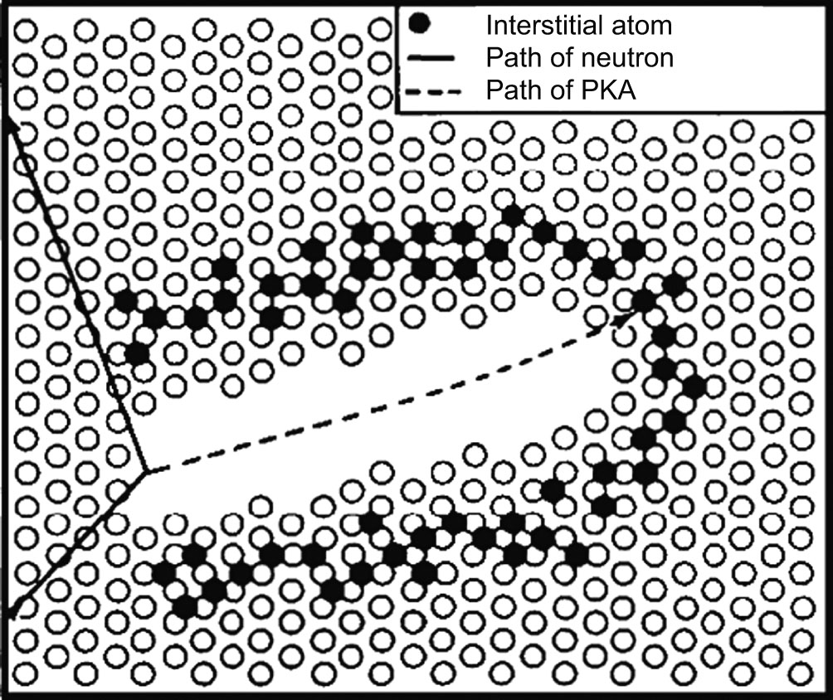
Fig13_04

Slide 5
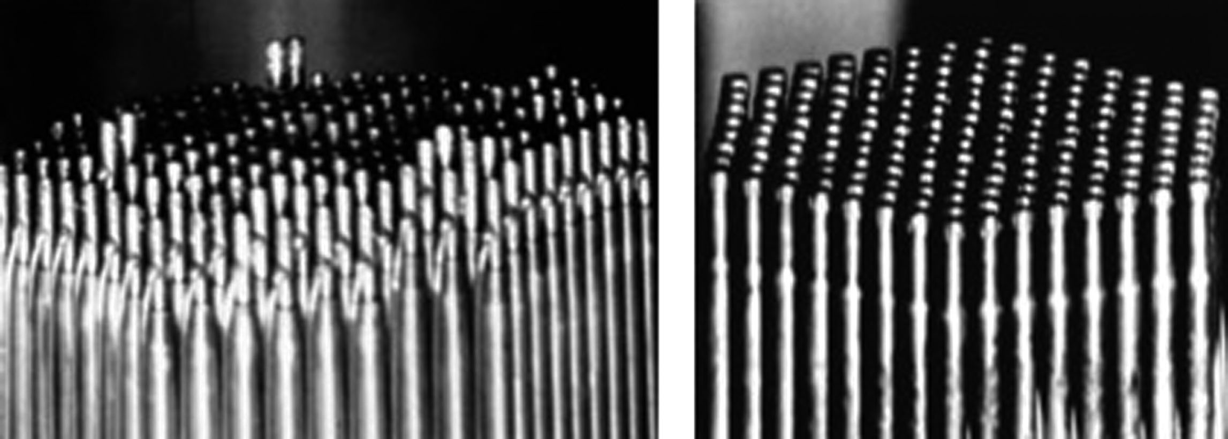
Fig13_05

Slide 6
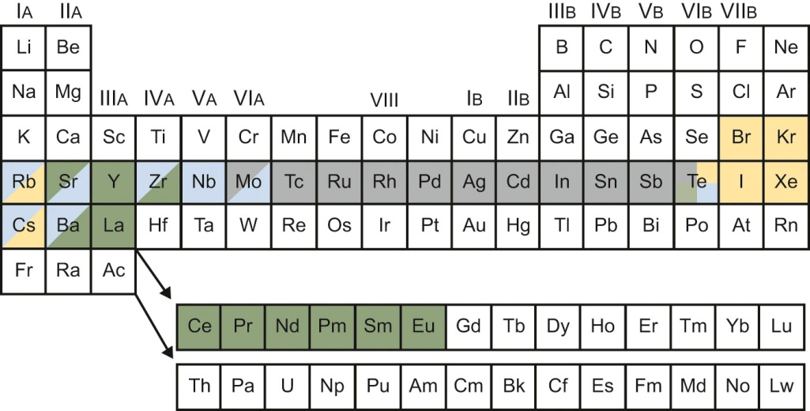
Fig13_06

Slide 7
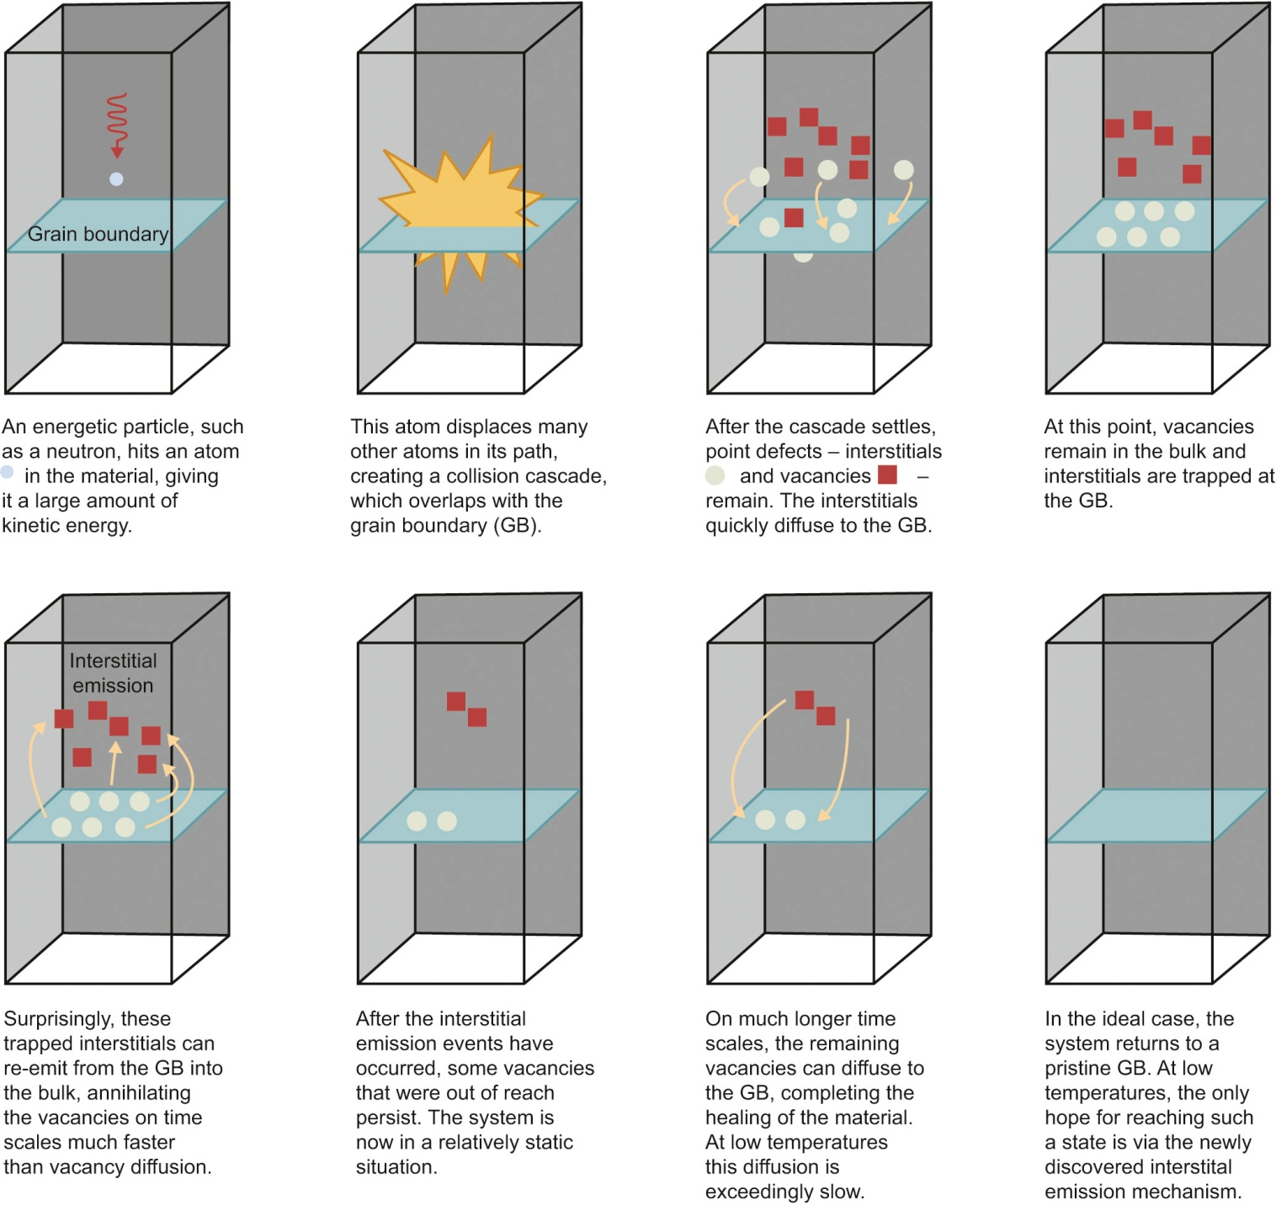
Fig13_07

Slide 8
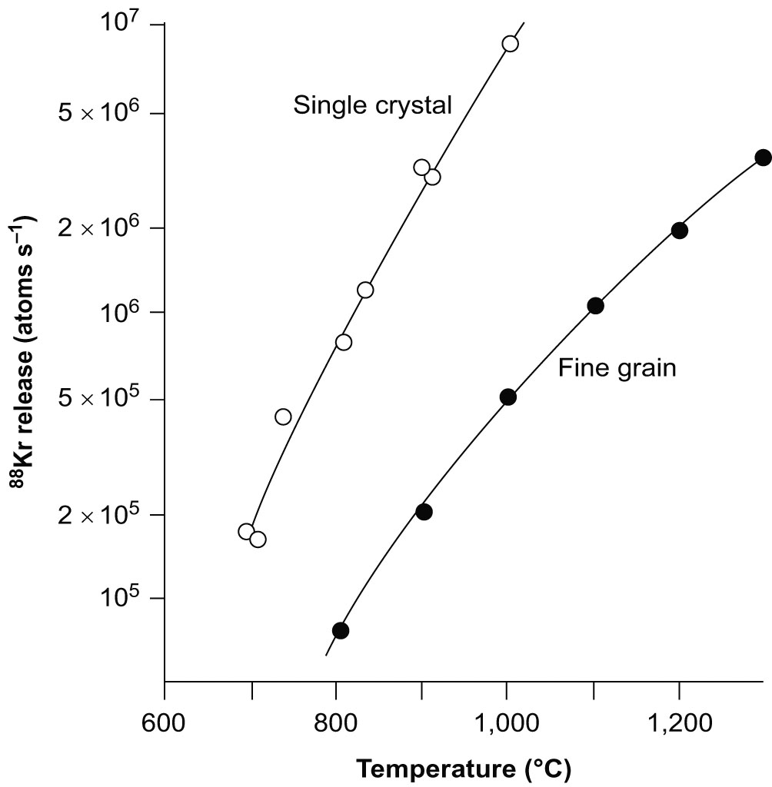
Fig13_08

Slide 9
Fig13_09

Slide 10
Fig13_10

