Slide 1
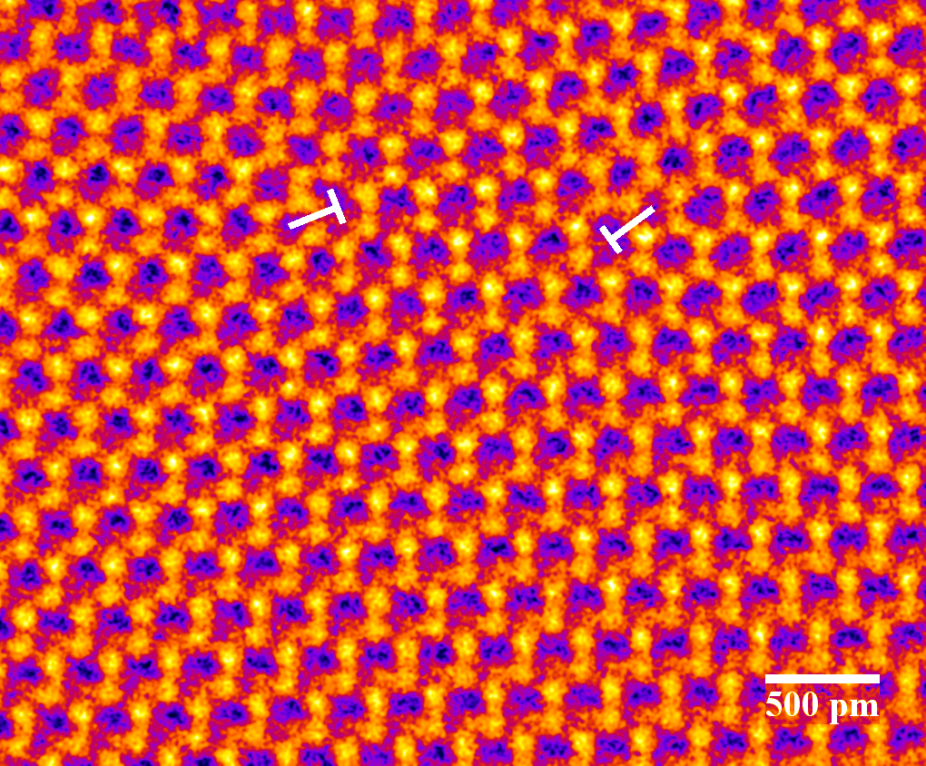
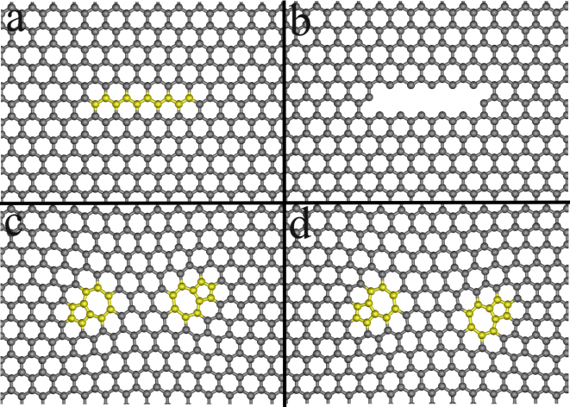
(a)
(b)
(c)
(d)
500 μm

Slide 2
A'
α
B'
β'
C'
D'
c
A₀
D'
α
A₀
α₀
B₀
A
B
β
β₀
a₁
a₃
D
C
C₀
D₀
(a)
a₂
(b)
Notes:
2.84” x 5”, tiff.

Slide 3
αB
Cβ
Aα
βB
(a)
(b)
A₀α₀
αB
Aα
α₀B₀
(c)
(d)
Aα + Cα₀ = αB
αB
α₀B
(e)
Aα + Cα = αB
αB
(f)
αB
Notes:
4.59” x 4”, tiff.

Slide 4
B
B
A
A
B
B
(a)
A
B
B
A
A
B
B
B
B
A
A
B
B
(b)
A
C
B
A
A
B
A
Notes:
3.17” x 4”, tiff.

Slide 5
A
C
B
A
A
C
B
A
(a)
A
B
B
A
A
B
B
A
A
A
C
B
A
A
C
(b)
B
A
A
C
B
A
A
B
Notes:
3.82” x 4”, tiff.

Slide 6
B
B
A
A
B
(a)
B
A
A
B
B
A
A
B
A
A
B
B
C
A
A
A
B
(b)
B
C
A
A
A
B
B
B
A
A
A
B
A
Notes:
4.18” x 4”, tiff.

Slide 7
B'C
Notes:
3.11” x 5”, tiff.

Slide 8
2
4
1
3
Notes:
2.91” x 5”, tiff.

Slide 9
2
4
1
1
3
Notes:
3.02” x 5”, tiff.

Slide 10
4
3
2
1
(a)
A
B
A
B
A
B
(b)
A
B
A
B
A
B
4
4
3
3
2
2
1
(c)
A
B
A
B
A
B
(d)
A
B
A
B
A
B
A
B
A
B
A
B
4
3
(e)
A
B
A
B
A
B
Notes:
4.64” x 5”, tiff.

Slide 11
Notes:
0.92” x 4”, tiff.

Slide 12
3
0
2
Aε
1
εC
A
B
A
B
A
B
c
A
a
Notes:
3.08” x 3”, tiff.

Slide 13
αC
εC
εα
αC
Aα
αε
Aε
Aα
Notes:
2.24” x 3”, tiff.

Slide 14
A
B
C
D
E
z
F
x
A
(110)
y
Notes:
2.1” x 3”, tiff.

Slide 15
F
D
B
F
A
E
C
A
B
F
D
B
C
A
E
C
D
B
F
D
E
E
E
E
F
F
A
A
B
B
(a)
I₃
(b)
I'₃
(c)
Notes:
4.35” x 5”, tiff.

Slide 16
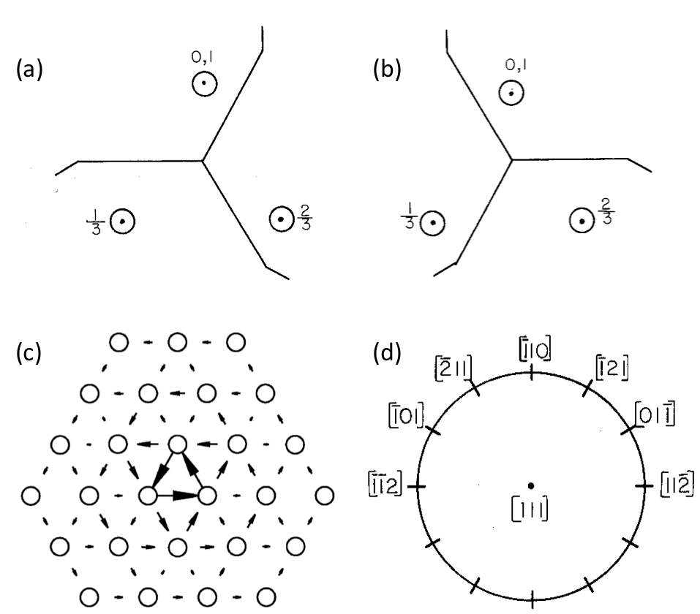
(a)
0,1
(b)
0,1
(c)
(d)
[111]
Notes:
4.39” x 5”, jpg.

Slide 17
(a)
C
(b)
C
(c)
C
B
B
B
A
D
D
A
A
D
(d)
(e)
C
C
B
D
B
D
A
A
Notes:
2.88” x 5”, tiff.

Slide 18
(a)
+
+
ξ
A
B
(b)
+
(c)
+
+
+
Notes:
1.66” x 3”, tiff.

Slide 19
Notes:
3.91” x 3”, tiff.

Slide 20
1
4
B
a
A
c
[111]
C
2
3
b
5
6
B
a
A
c
Notes:
3.08” x 4”, tiff.

Slide 21
C
C
B
A
A
E
C
I
B
B
A
C
(a)
(b)
Notes:
2.24” x 5”, tiff.

Slide 22
3
4
1
5
6
2
BC
Notes:
2.71” x 3”, tiff.

Slide 23
1
2
3
B'C'
Notes:
2.73” x 3”, tiff.

Slide 24
B
A
B'
A'
C
C
D
C'
D'
Notes:
3.72” x 3”, tiff.

Slide 25
δC
Bδ
Notes:
1.81” x 4”, tiff.

Slide 26
C
C
b
b
B
B
a
a
A
A
c
c
C
C
a
b
A
B
c
a
c
A
b
c
δC
Bδ
Notes:
2.25” x 5”, tiff.

Slide 27
4
5
3
6
7
2
δC
1
Bδ
Notes:
4.88” x 5”, tiff.

Slide 28
1
2
3
4
B'C' + δB
Notes:
2.82” x 3”, tiff.

Slide 29
Notes:
2.45” x 3”, tiff.

Slide 30
1
1
3
3
2
4
2
4
Notes:
0.77” x 3”, tiff.

Slide 31
[111]
(a)
(b)
(c)
(d)
Notes:
4.83” x 4”, tiff.

Slide 32
(a)
100 nm
(b)
Notes:
7” x 2.62”, tiff.

Slide 33
A
B
Notes:
1.78” x 2”, tiff.

Slide 34
z
y
x
(a)
(b)
Notes:
1.65” x 5”, tiff.

Slide 35
4
1
3
2
Notes:
4” x 3”, tiff.

Slide 36
z
B
A
y
x
Notes:
2.56” x 3”, tiff.

Slide 37
βC
βC
Dβ
Dβ
(b)
r₁
r
Notes:
1.38” x 3”, tiff.

Slide 38
c
s₁
b₁
A
β
α
α
k₁
c
k₂
b₂
β
k₁
β
c
s₂
α
α
k₂
α
A
k₂
D
c
c
k₁
β
β
β
I
C
B
II
α
α
(a)
(b)

Slide 39
z
y
b_{A}
(a)
x
b_{B}
z
y
b_{A}
(b)
x
b_{B}
Notes:
2.98” x 4”, tiff.

