Slide 1
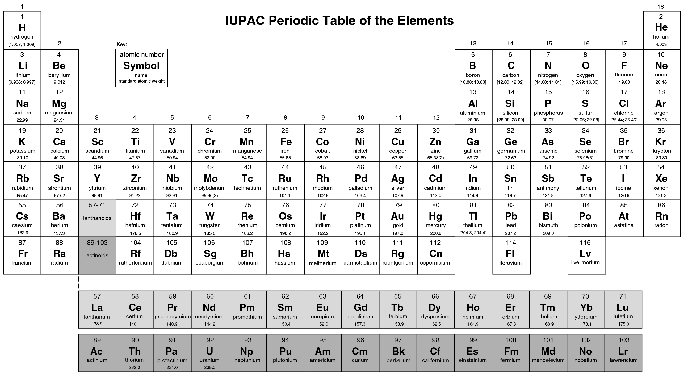
PILSON_Appendix-A_fig01
© Cambridge University Press 2012

Slide 2
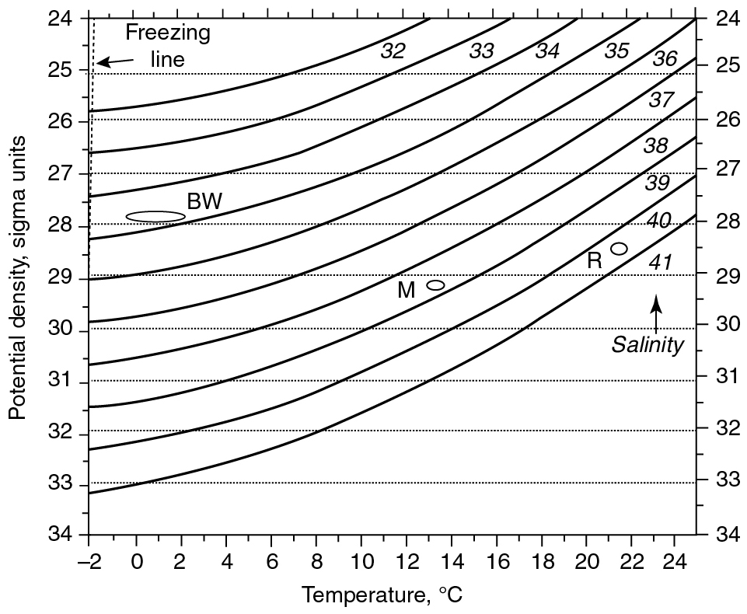
PILSON_Appendix-C_fig01
© Cambridge University Press 2012

Slide 3
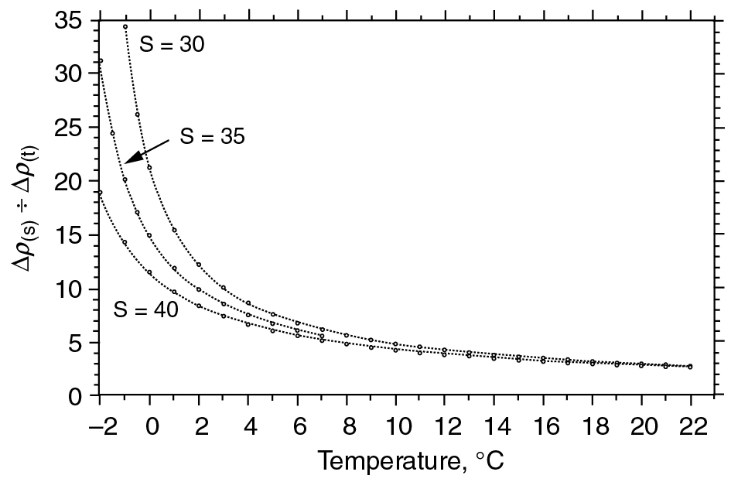
PILSON_Appendix-C_fig02
© Cambridge University Press 2012

Slide 4
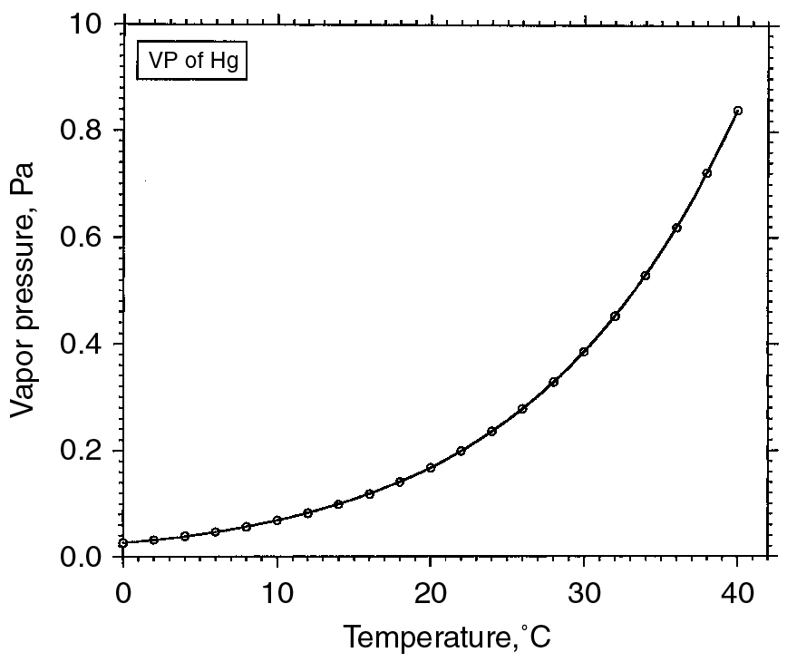
PILSON_Appendix-D_fig01
© Cambridge University Press 2012

Slide 5
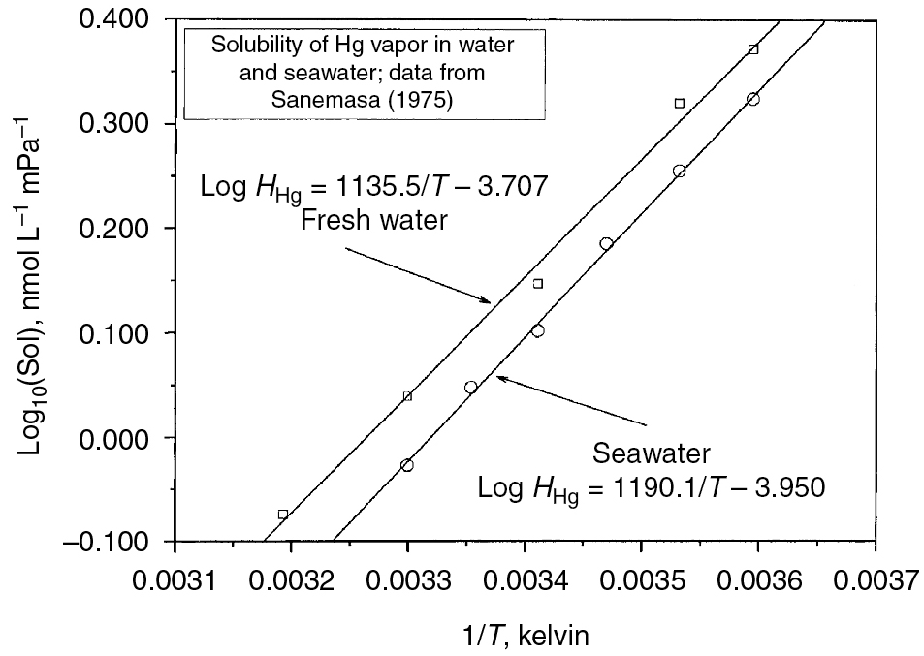
PILSON_Appendix-D_fig02
© Cambridge University Press 2012

Slide 6
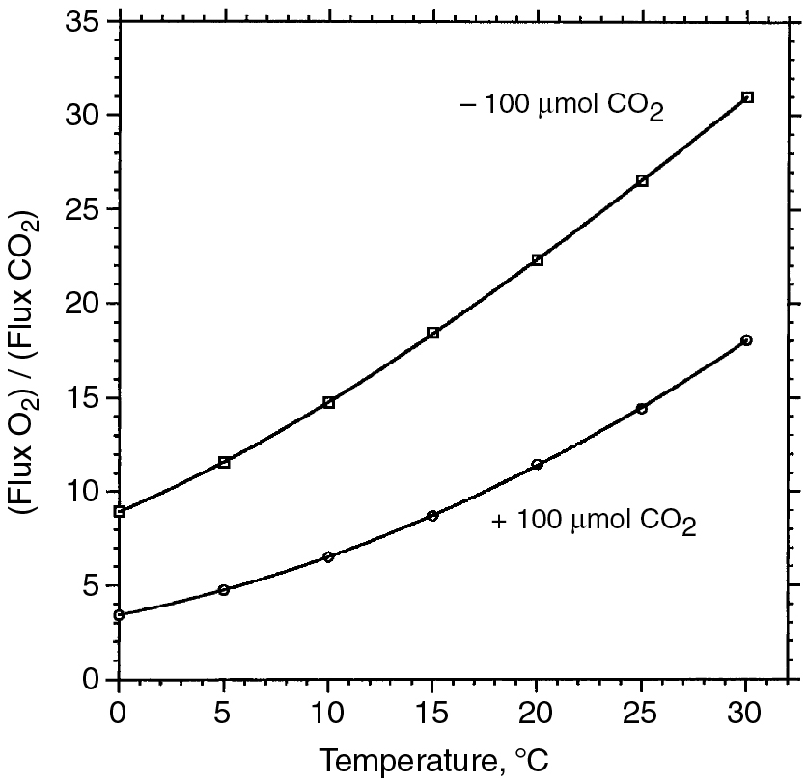
PILSON_Appendix-E_fig01
© Cambridge University Press 2012

Slide 7
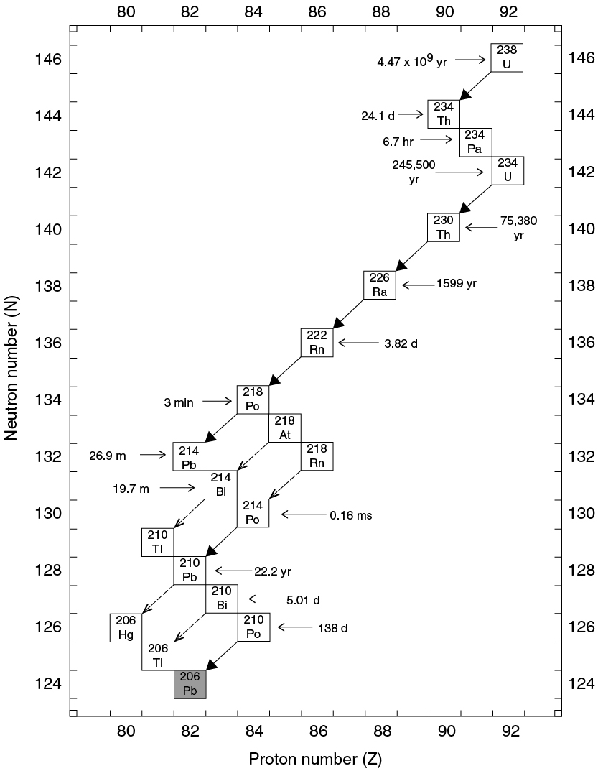
PILSON_Appendix-I_fig01
© Cambridge University Press 2012

Slide 8
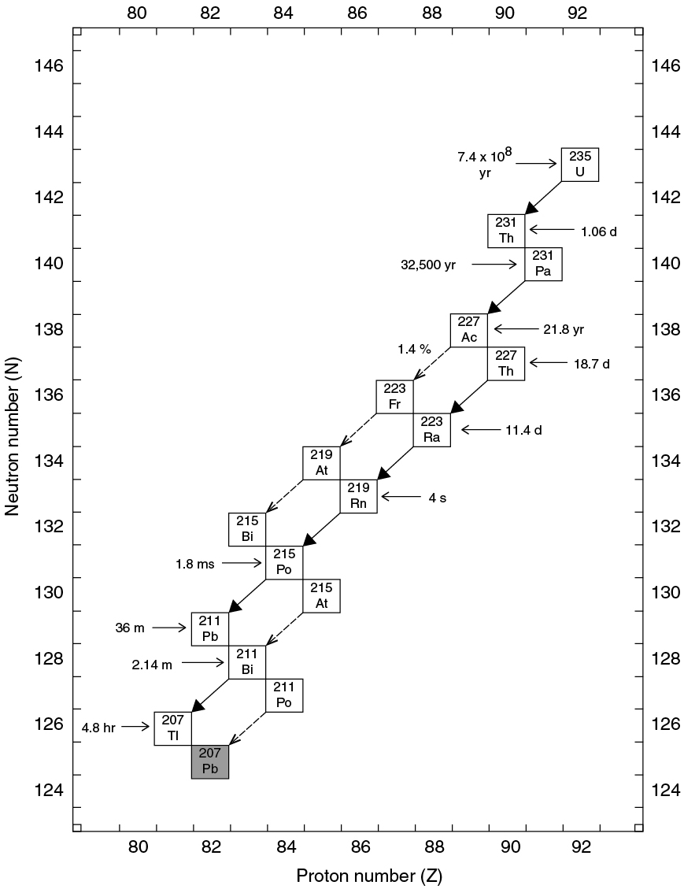
PILSON_Appendix-I_fig02
© Cambridge University Press 2012

Slide 9
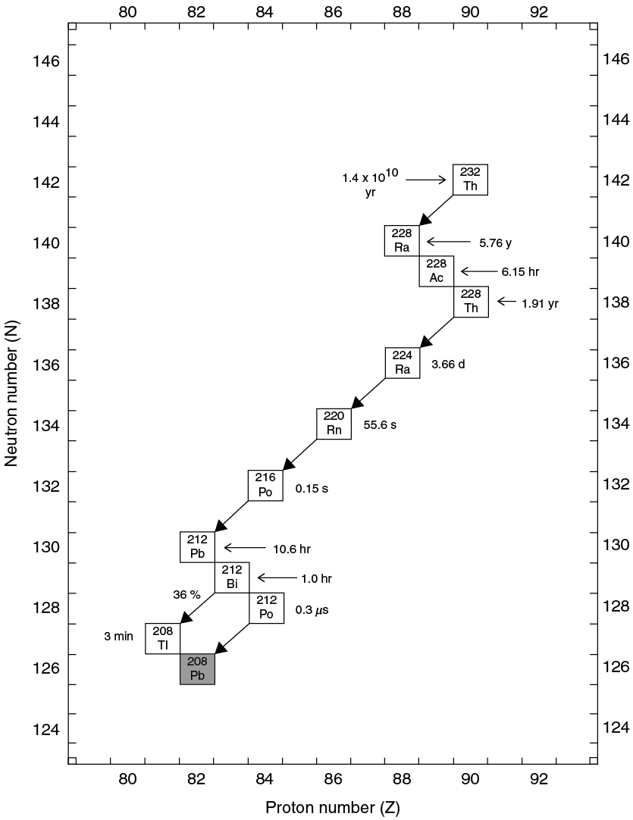
PILSON_Appendix-I_fig03
© Cambridge University Press 2012

Slide 10
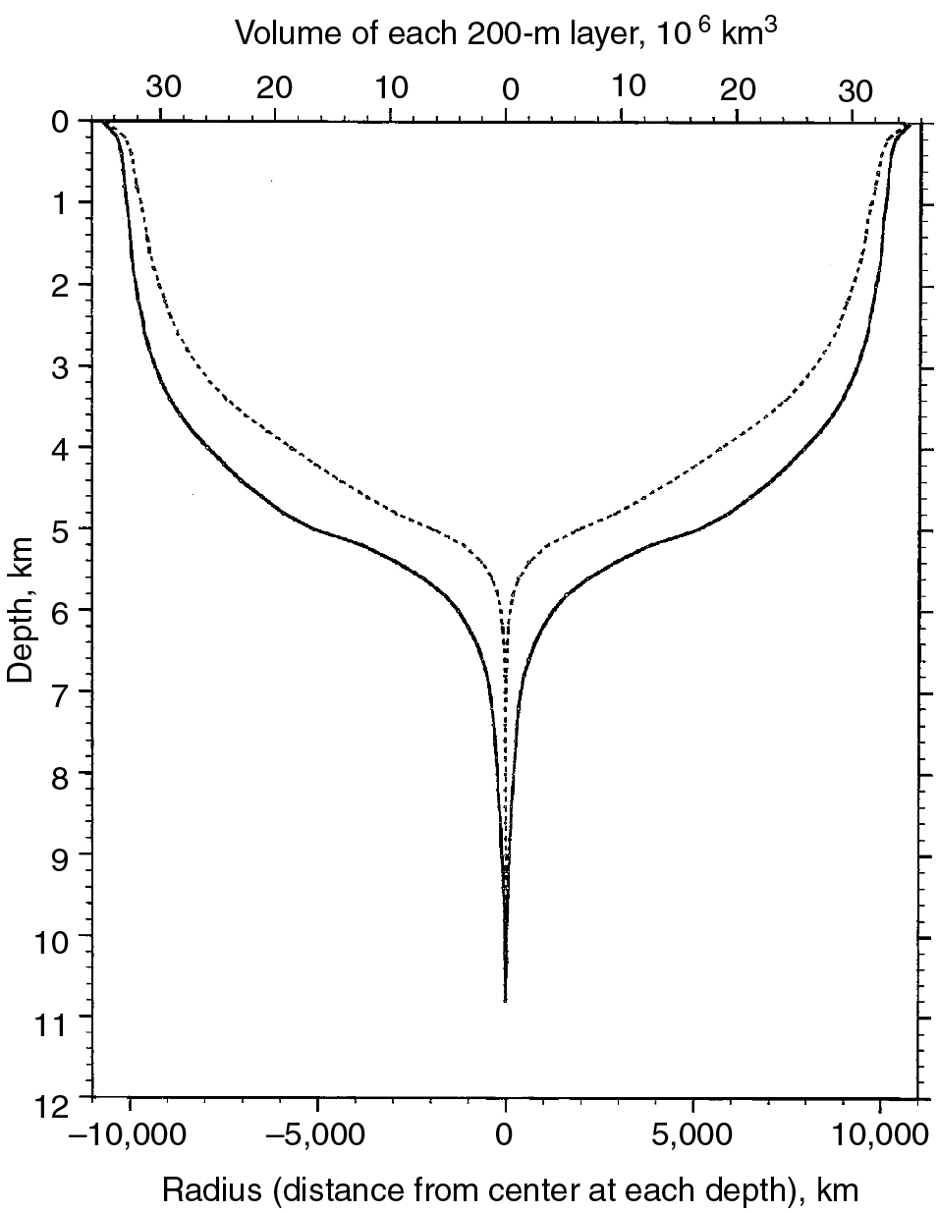
PILSON_Appendix-J_fig01
© Cambridge University Press 2012

