Slide 1
X-Ray Interaction with Matter: Refractive Index and Reflection
David Attwood University of California, Berkeley

Slide 2
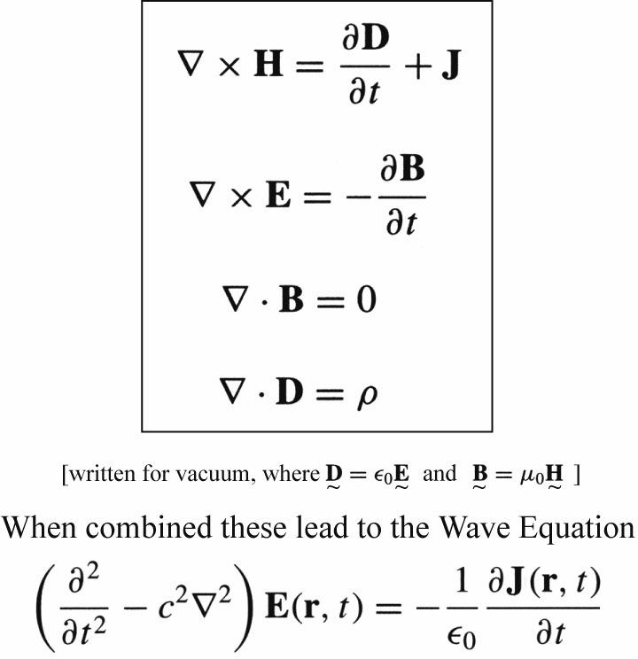
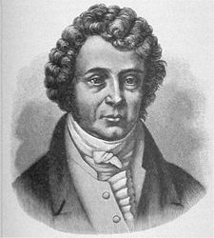
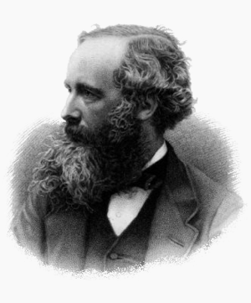
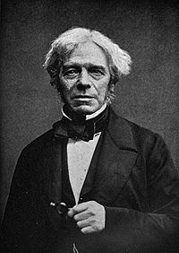
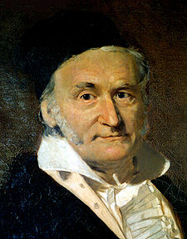
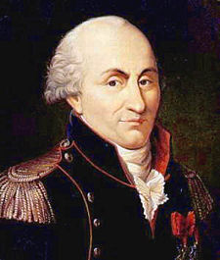
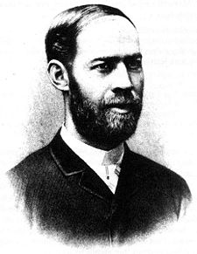
The Equations of Light
André-Marie Ampère
Maxwell’s Equations
Michael Faraday
James Clerk Maxwell
Carl Friedrich Gauss
Charles-Augustin de Coulomb
Heinrich Hertz
Courtesy of Andrew Aquila, AS&T, UC Berkeley, now SLAC/LCLS

Slide 3
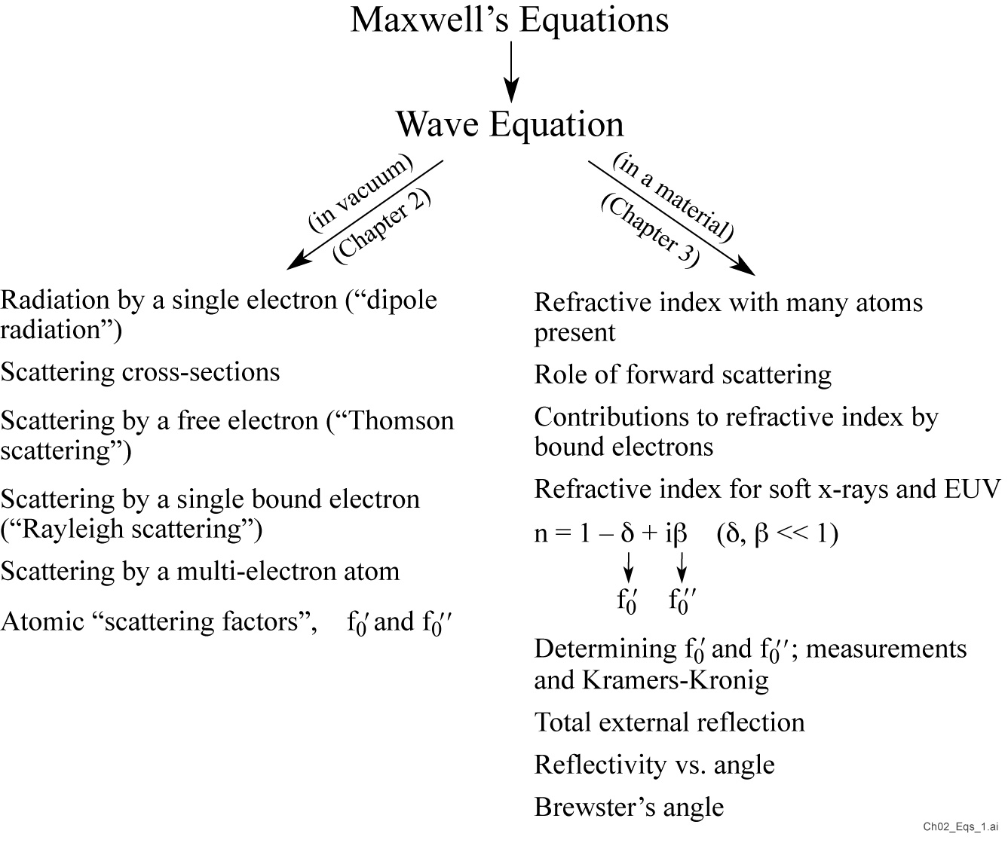

Slide 4
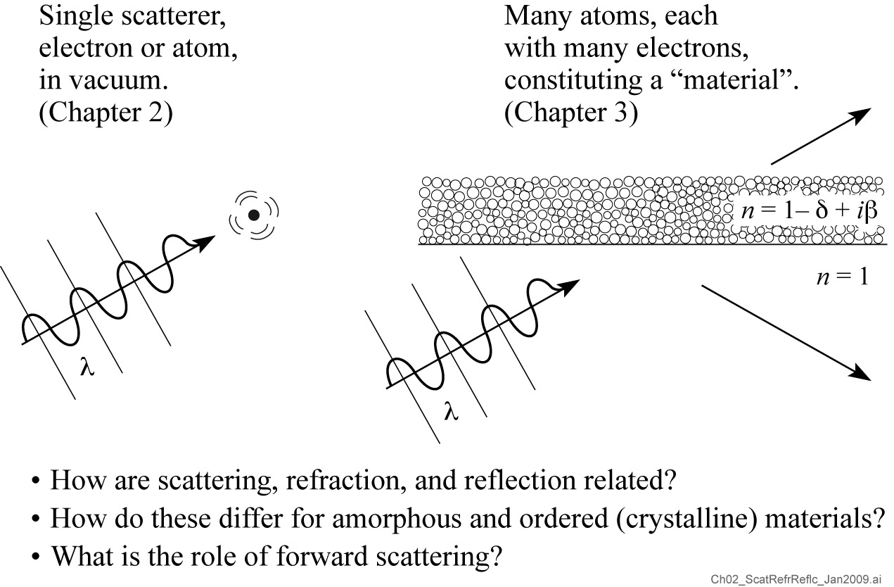
Scattering, refraction, and reflection

Slide 5
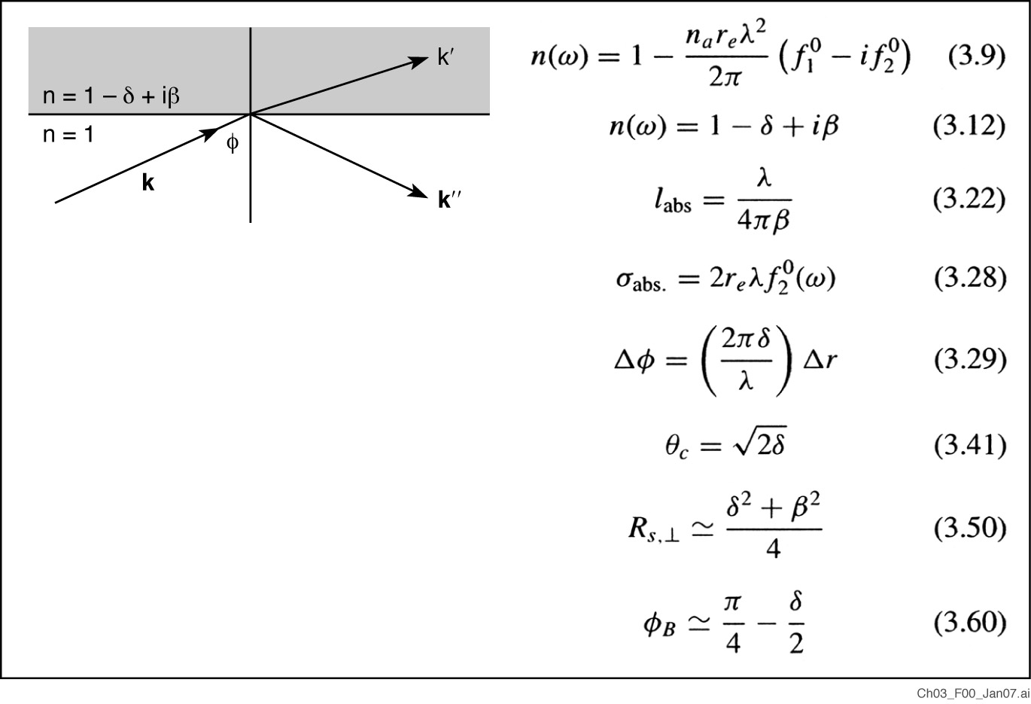
Wave propagation and refractive index at x-ray wavelengths

Slide 6
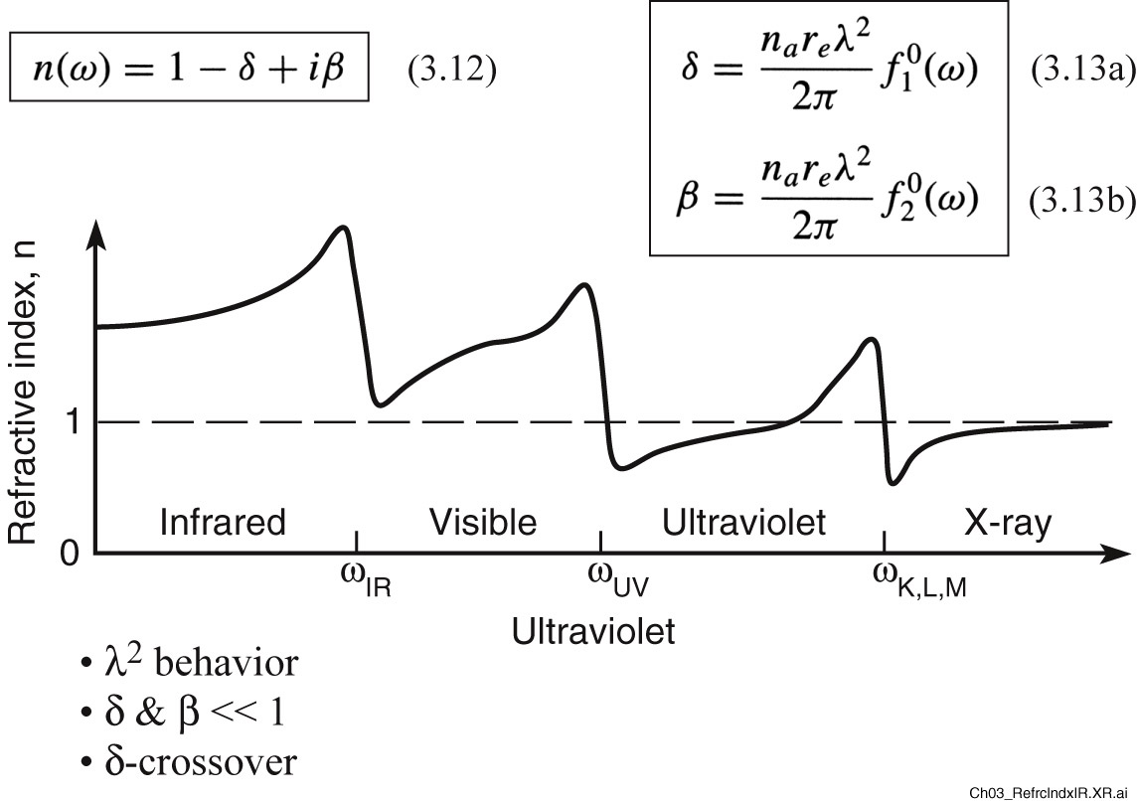
Refractive index from the IR to x-ray spectral region

Slide 7
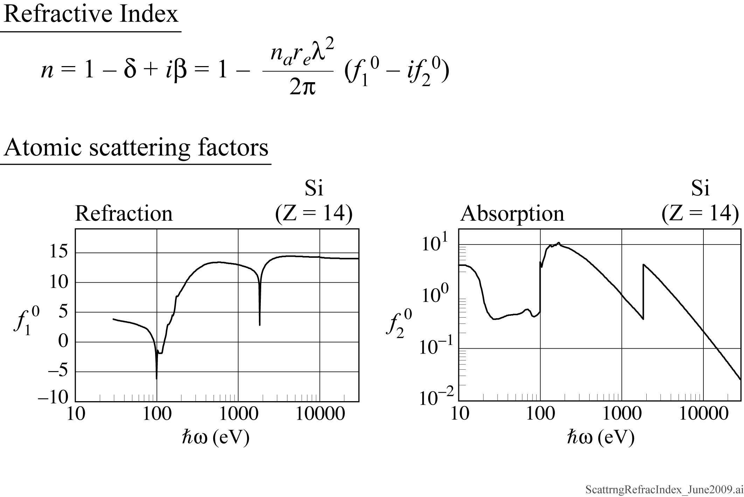
Refractive index at nanometer wavelengths
Scattering factors courtesy of E. Gullikson, LBL

Slide 8
Forward scattering and refractive index
Atomic positions and inter-atom electron positions are irrelevant to scattering in the forward direction, simplifying the total current J due to all electrons

Slide 9
Forward scattering and refractive index (continued)
Move common $E_{T}$(r,t) terms to the rhs of the equation
which can be rewritten in the standard form of the wave equation
where the frequency dependent refractive index n(ω) is identified as

Slide 10
Forward scattering and refractive index (continued)
The square root sign simplifies to
recognizing components of the forward scattering factor we have
which we can write simply as
(3.12)

Slide 11
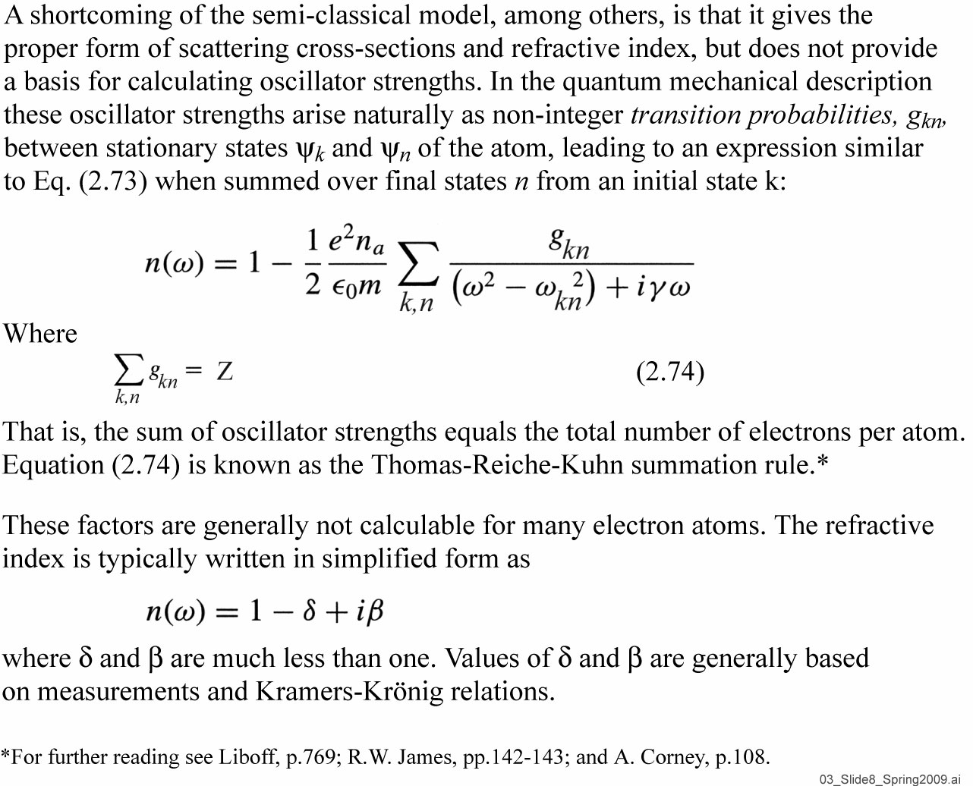
Quantum mechanical model of refractive index

Slide 12
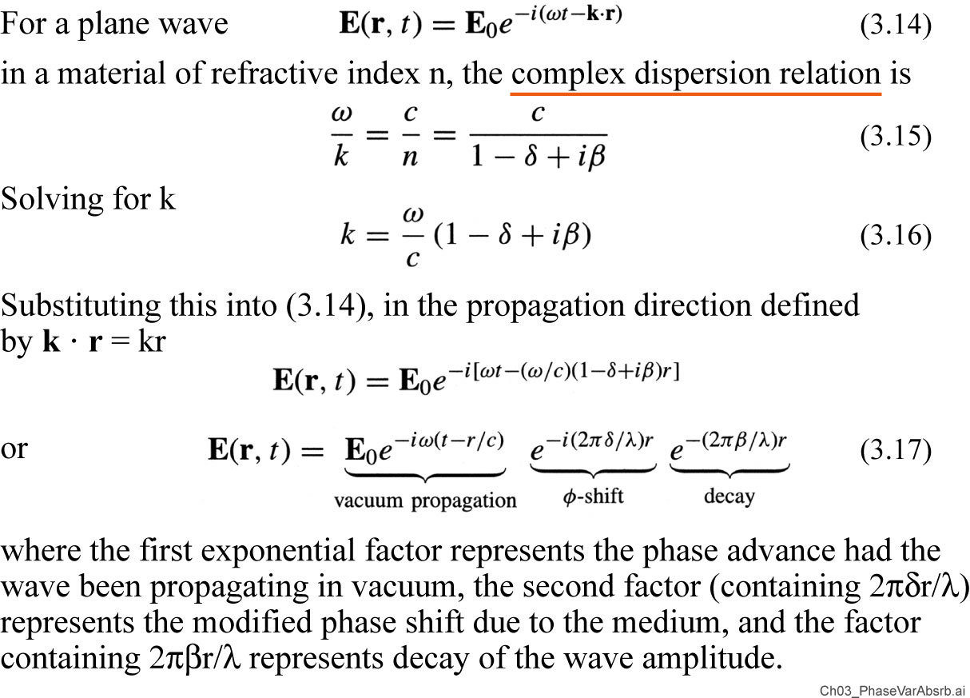
Phase variation and absorption of propagating waves

Slide 13
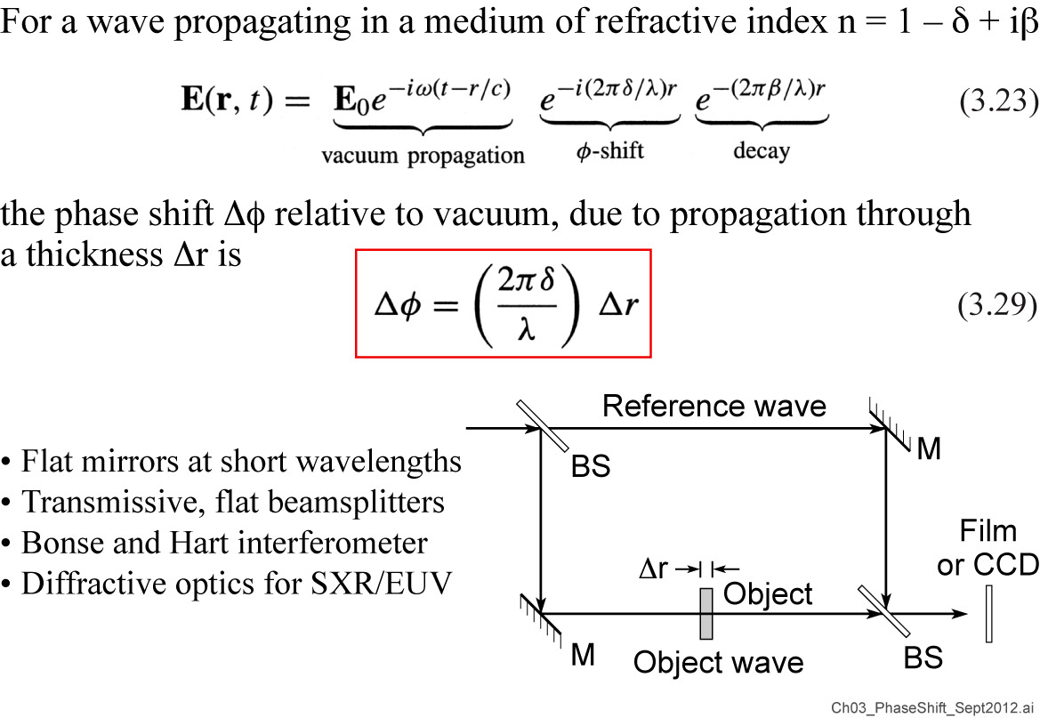
Phase shift relative to vacuum propagation

Slide 14
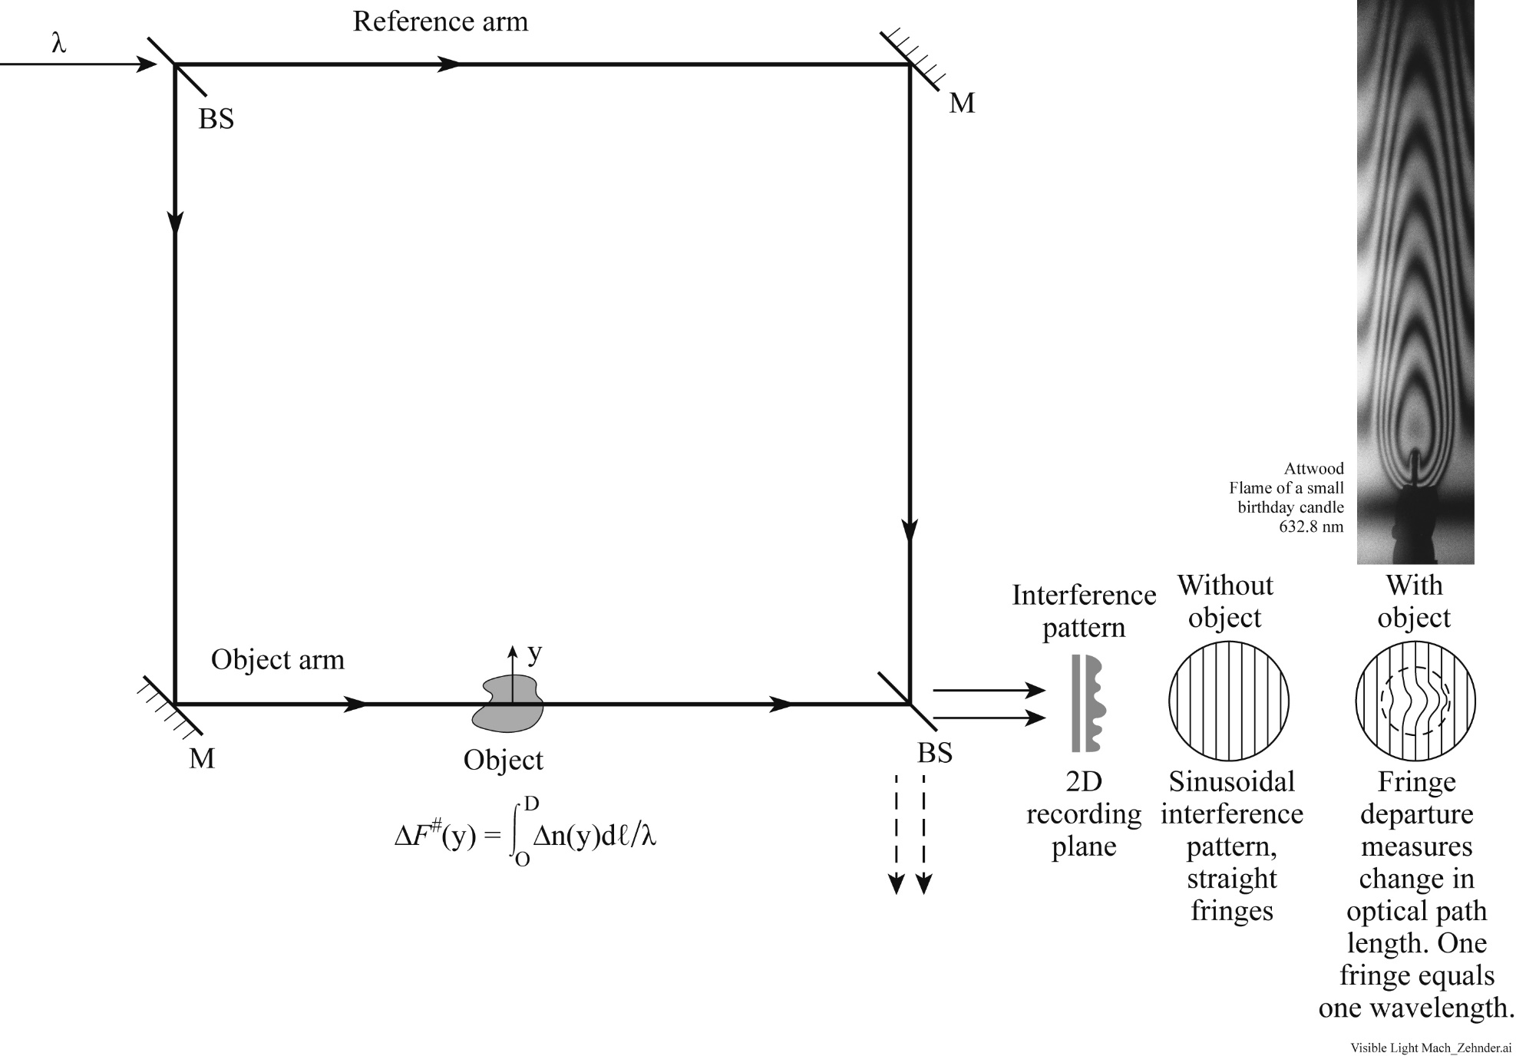
Mach-Zehnder visible light interferometer
Requires minimal spatial and temporal coherence

Slide 15
Interferometry with and without background fringes
Happy Holidays!
Flames of small
birthday candles
with and without background fringes
Attwood 632.8 nm
Attwood 632.8 nm
Attwood 632.8 nm

Slide 16
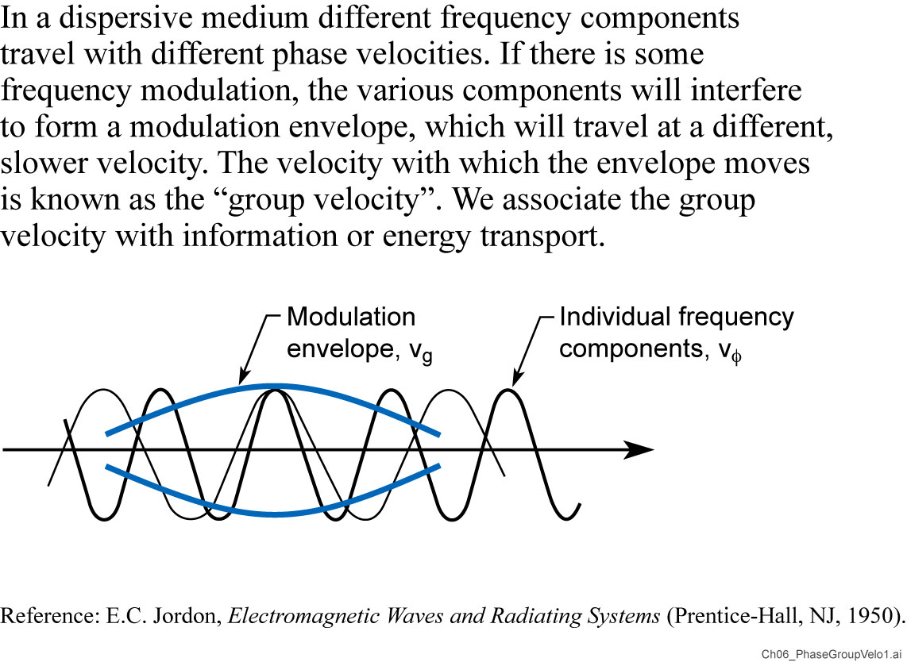
Phase velocity and group velocity

Slide 18
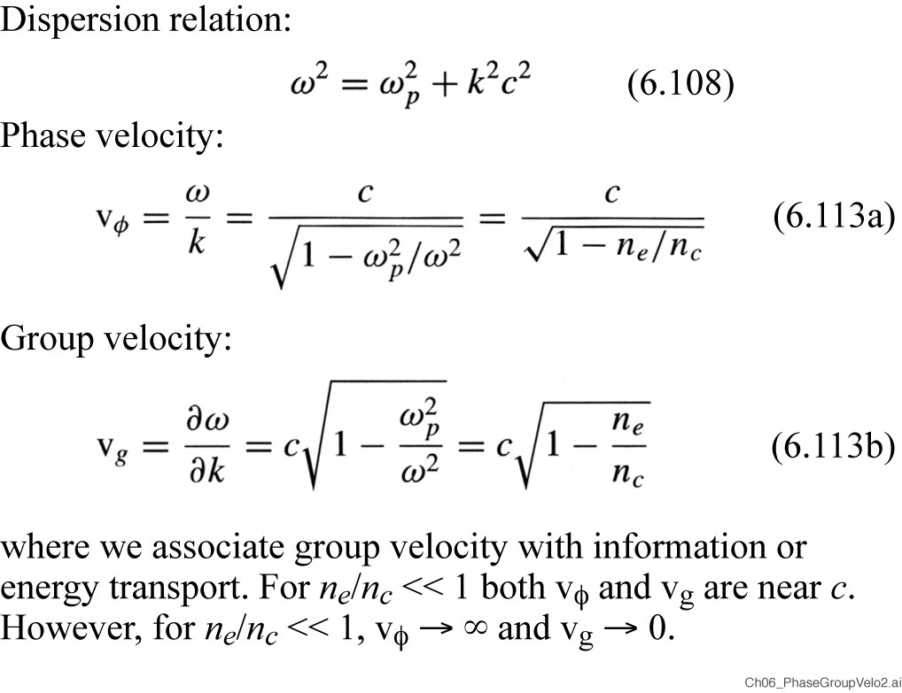
Phase velocity and group velocity for a plasma
See Chapter 8, Eqs. (8.113a,b)

Slide 19
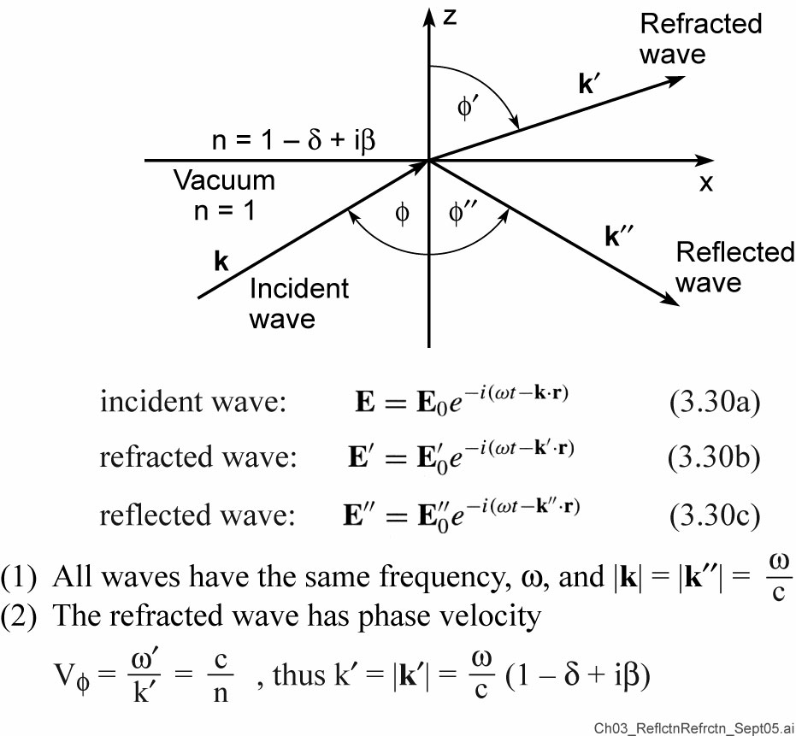
Reflection and refraction at an interface

Slide 20
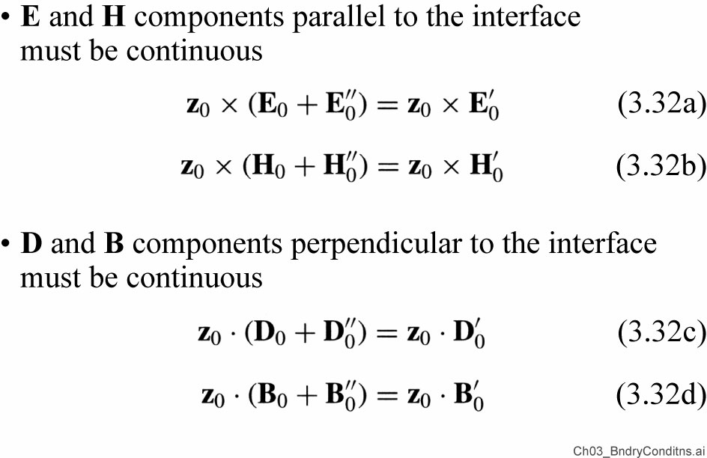
Boundary conditions at an interface

Slide 21
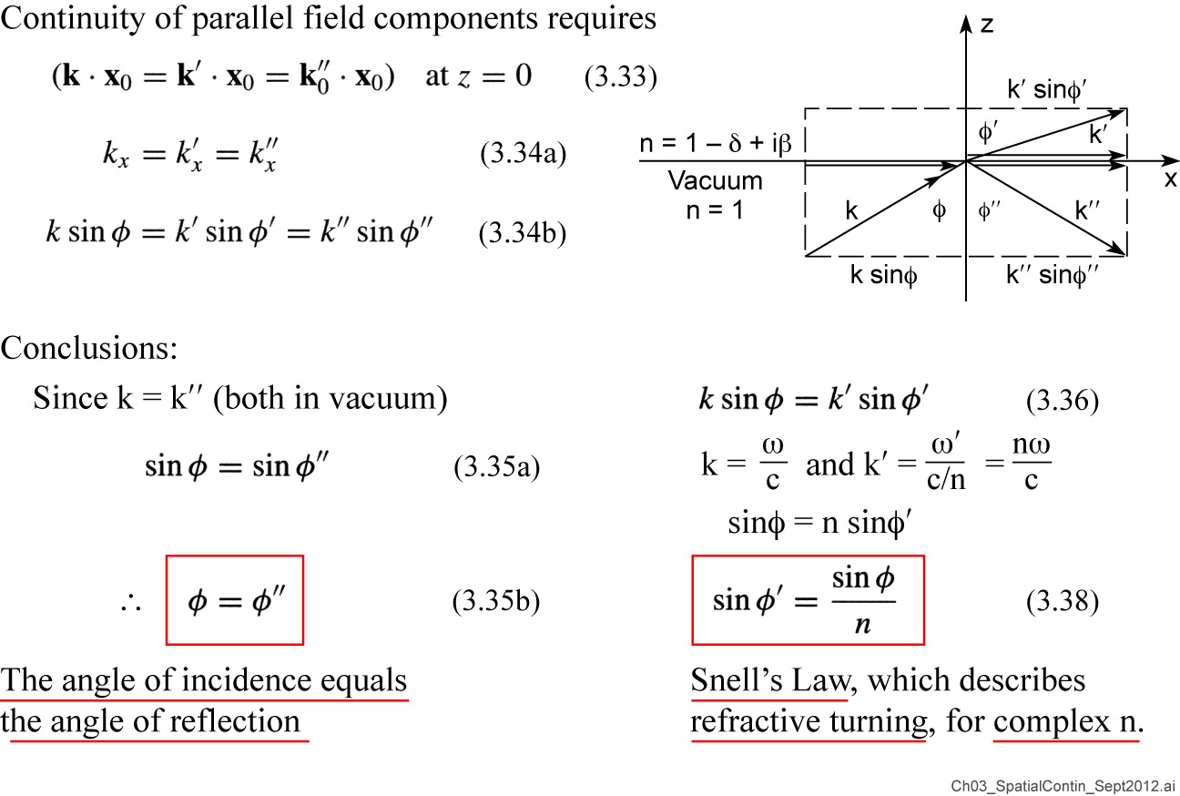
Spatial continuity along the interface

Slide 22
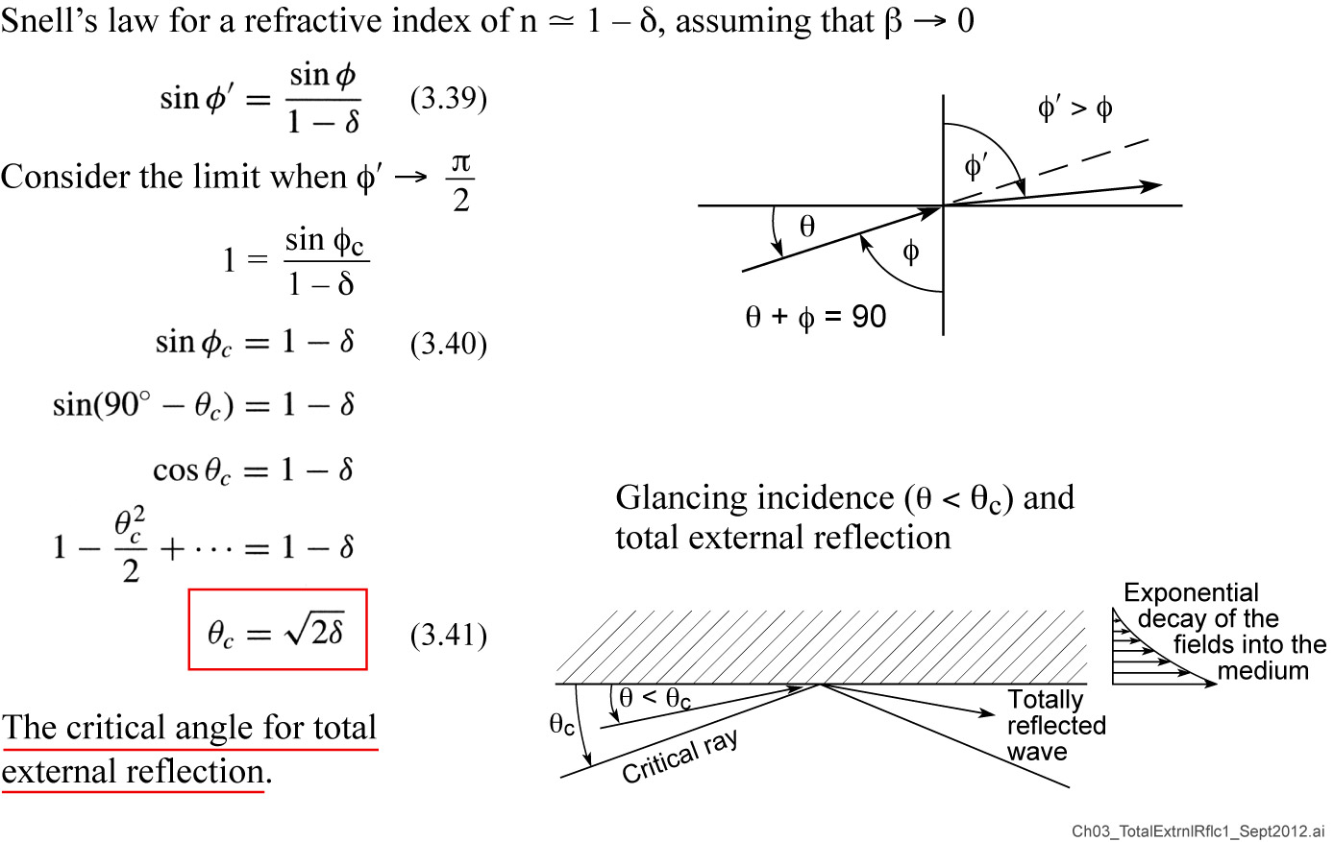
Total external reflection of x-rays and EUV radiation

Slide 23
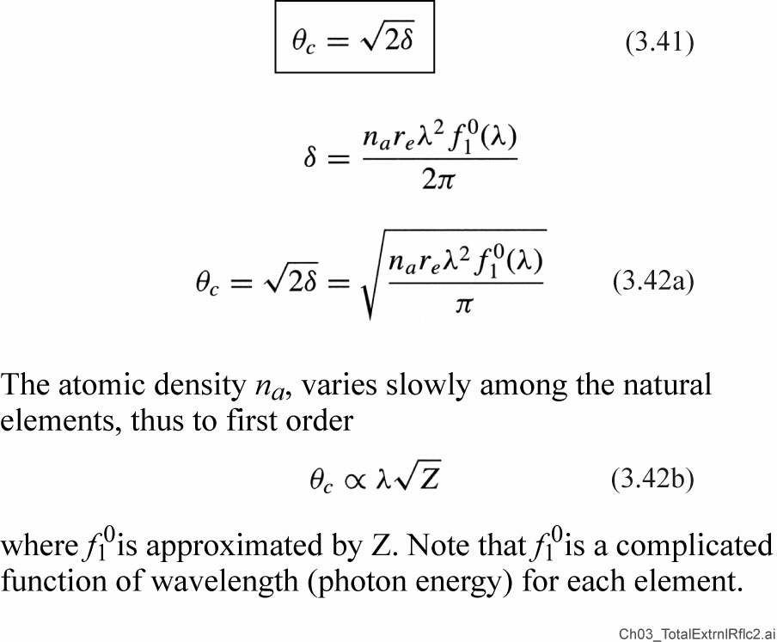
Total external reflection (continued)

Slide 24
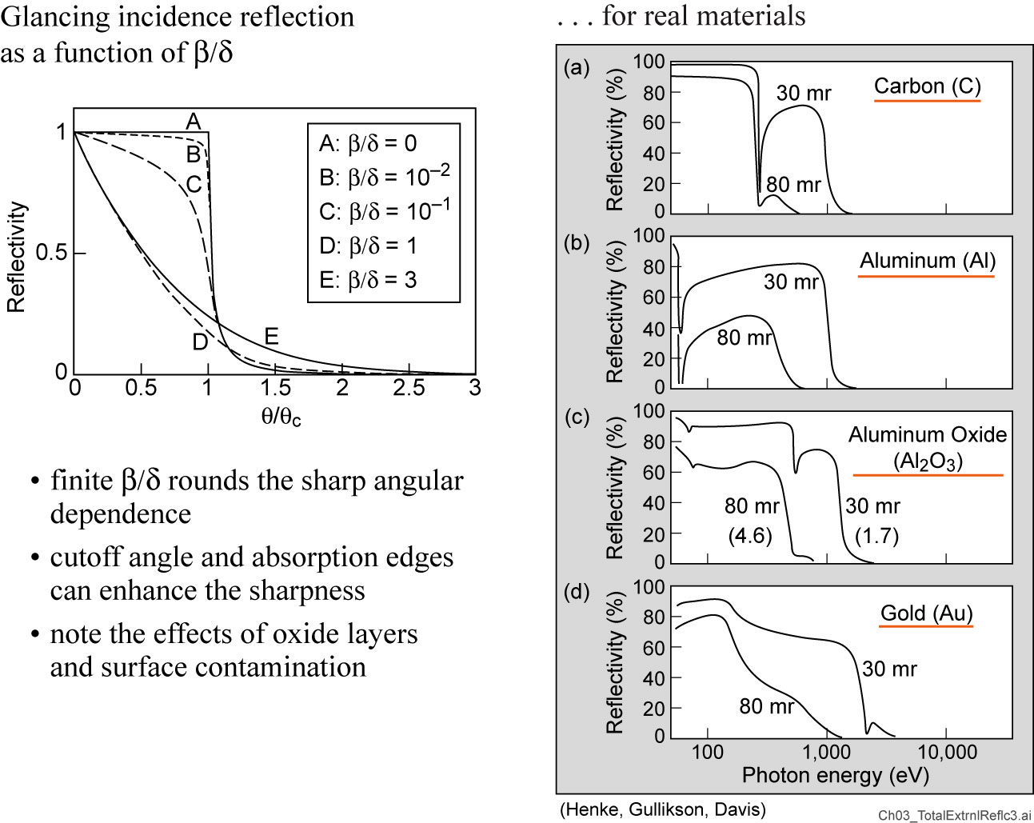
Total external reflection with finite β

Slide 25
Kirkpatrick-Baez Mirror Pair
Orthogonal mirrors cancel astigmatism
Elliptical surfaces for point to point imaging
Glancing incidence coatings for broad band applications, multilayer coatings for fixed bandpass
Commonly used in synchrotron and FEL beamlines, and in plasma diagnostics. More in Chapter10.
Courtesy of J. Underwood, LBNL

Slide 26
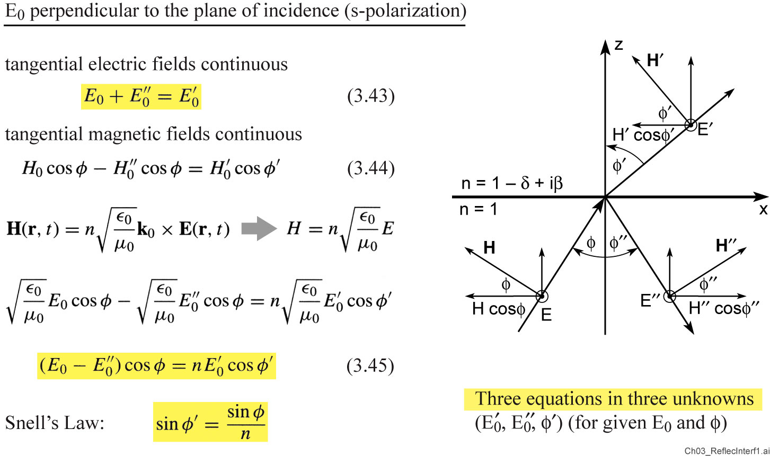
Reflection at an interface

Slide 27
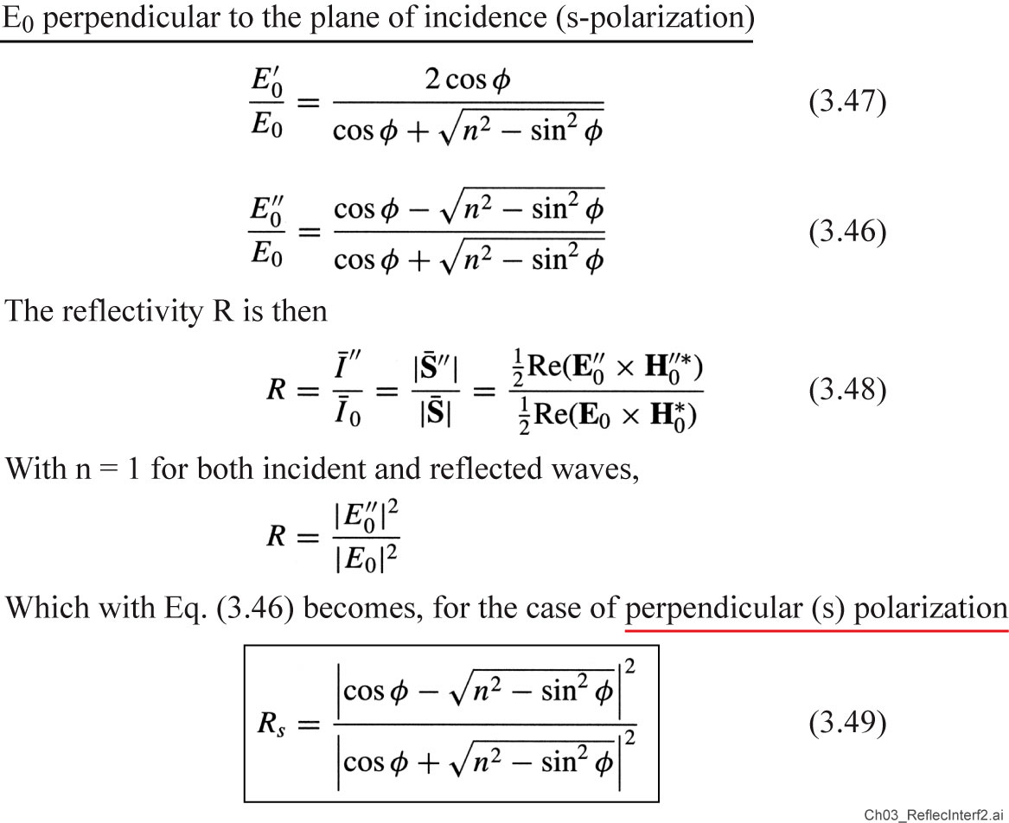
Reflection at an interface (continued)

Slide 28
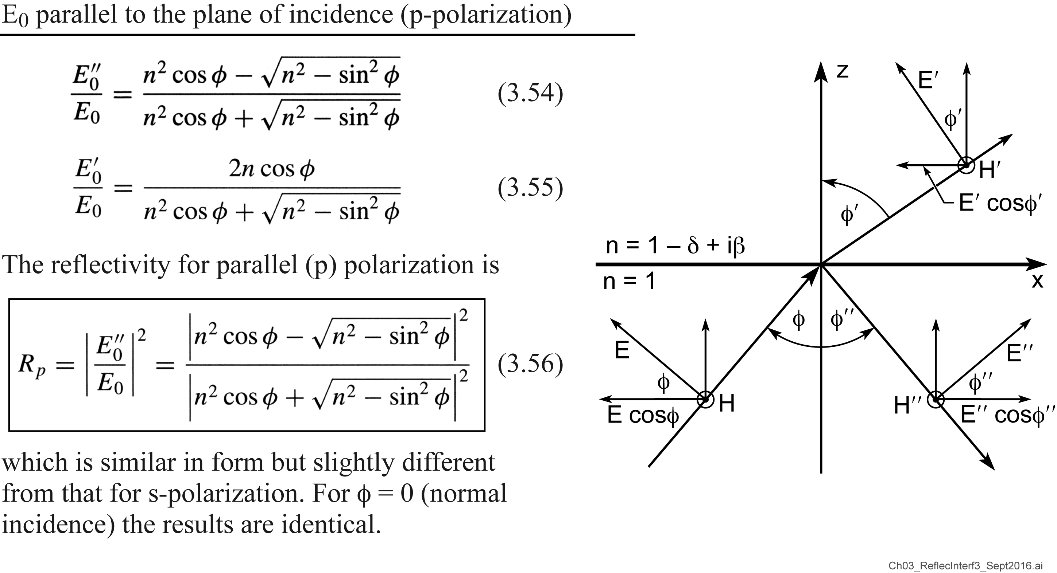
Reflection at an interface

Slide 29
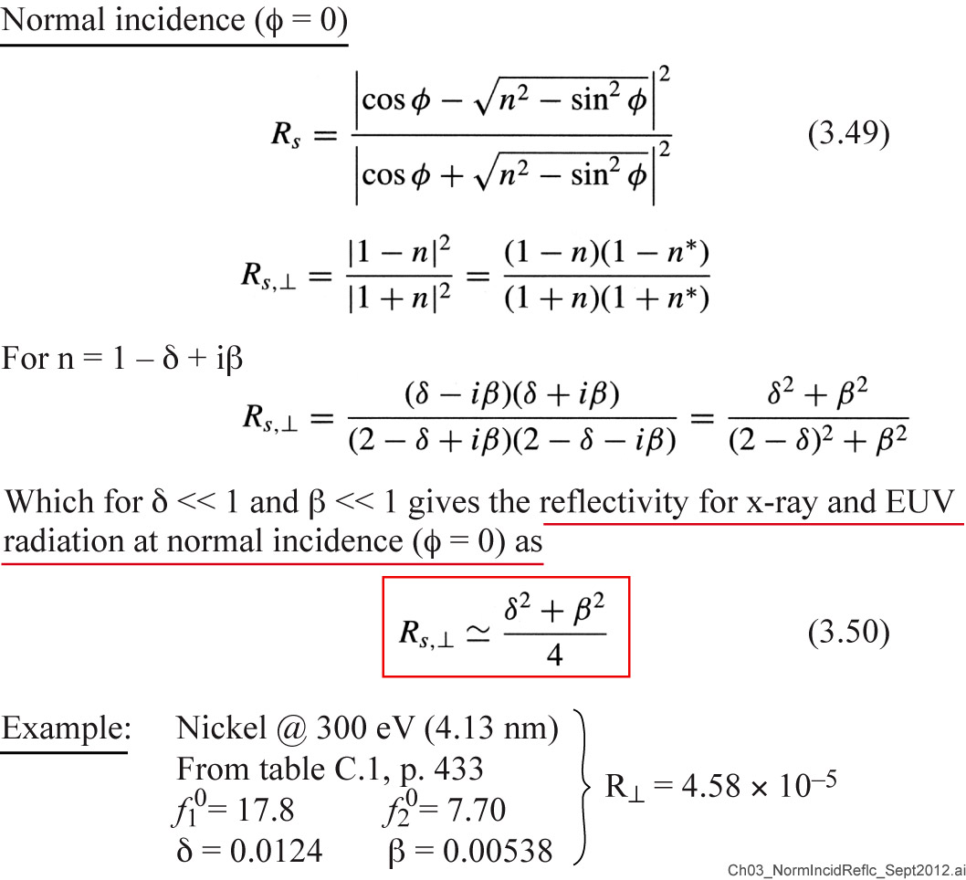
Normal incidence reflection at an interface

Slide 30
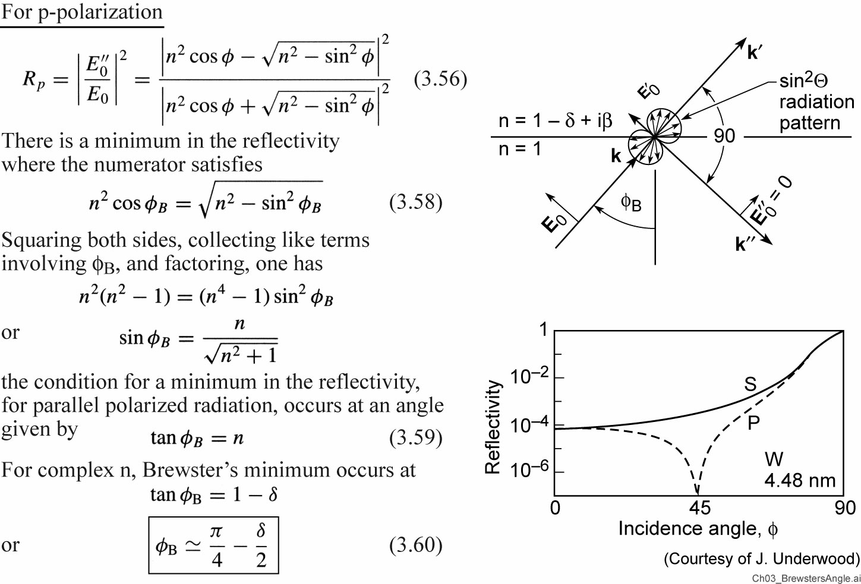
Brewster’s angle for x-rays and EUV

Slide 31
Determining f₁⁰ and f₂⁰

Slide 32
Multilayer interference coatings, aka ‘multilayer mirrors’
W/C, T. Nguyen, UC Berkeley, AS&T
W/C, T. Nguyen, AS&T, UC Berkeley, 1993
Recent SXR data courtesy of E. Gullikson, LBNL

Slide 33
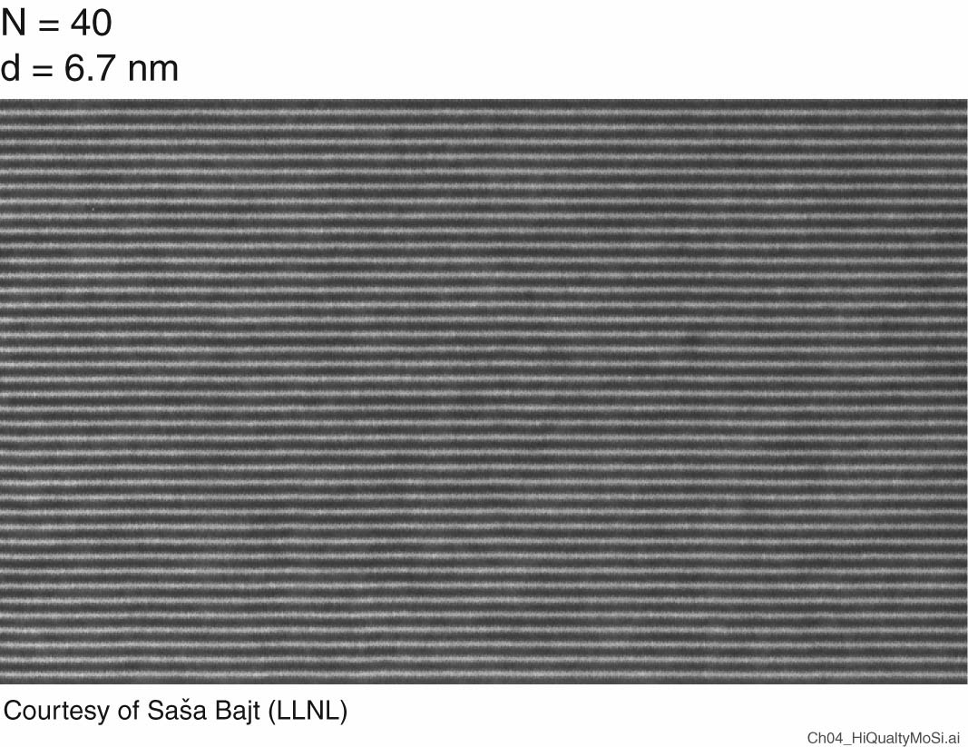
A high quality Mo/Si multilayer mirror

Slide 34
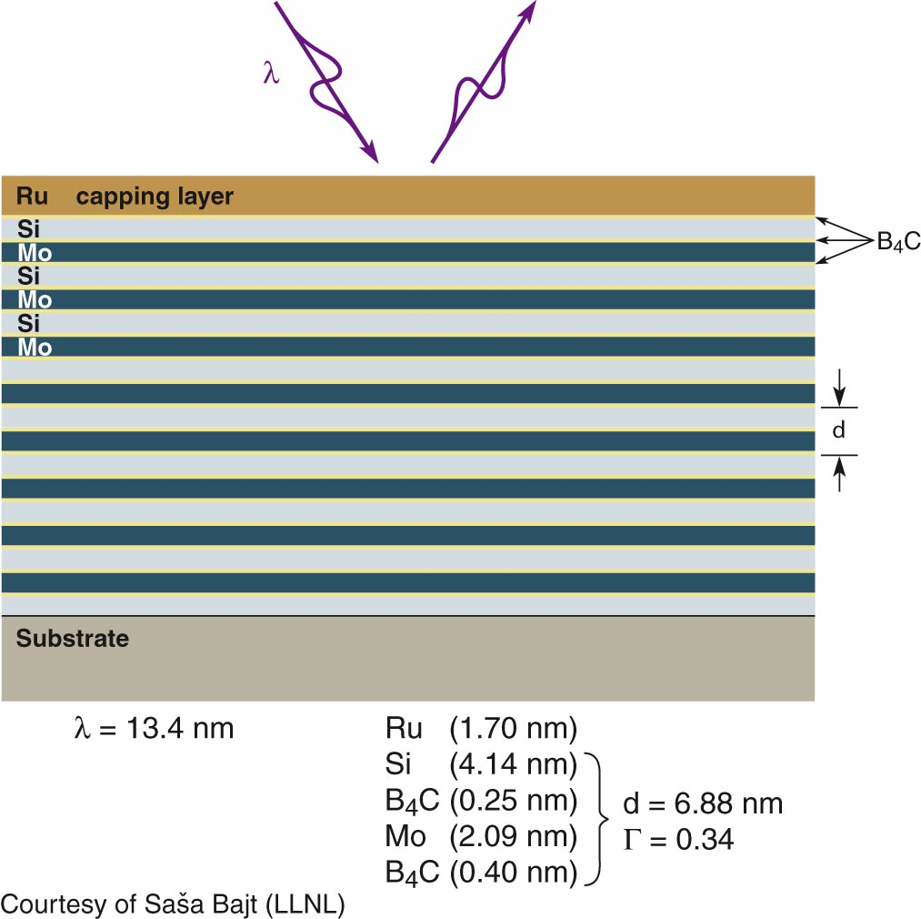
High reflectivity, thermally and environmentally robust multilayer coating for high throughput EUV lithography

Slide 35
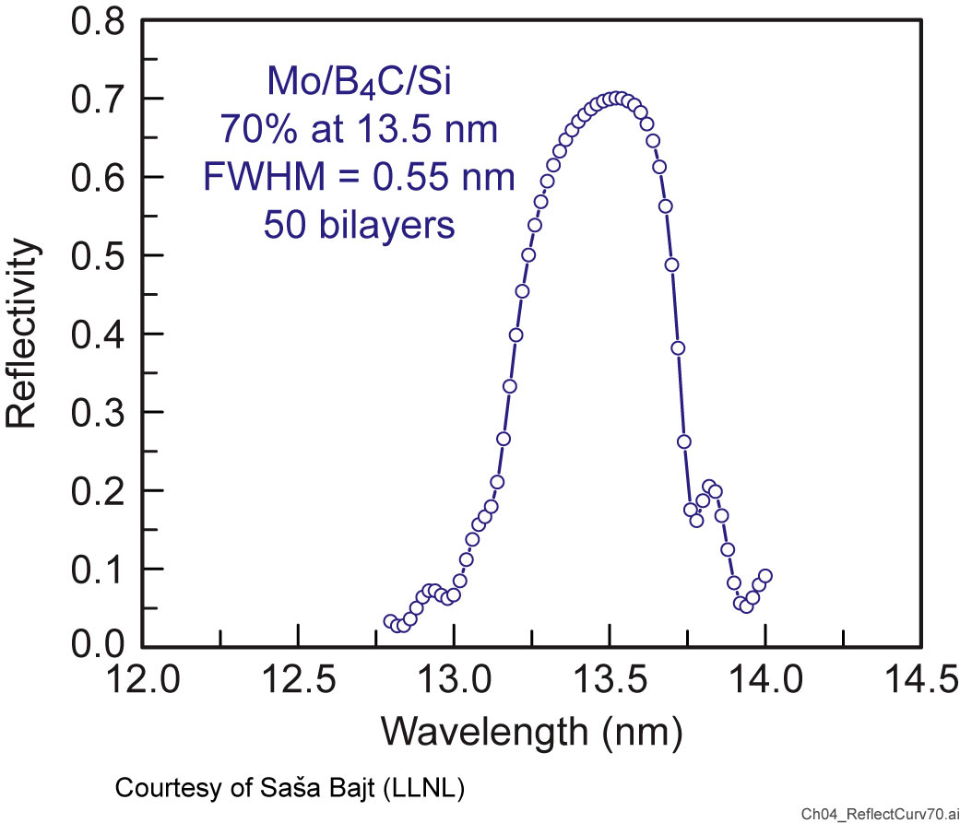
Multilayer mirrors have achieved a reflectivity of 70%

Slide 36
High reflectivity multilayer coatings require
Refractive index contrast at the interfaces
Minimal absorption in the low-Z material
Thin high-Z layer where possible Γ ; Δτ_{H} /(Δτ_{H} + Δτ_{L})
Interfaces which are chemically stable with time
Minimal interdiffusion at the interfaces
Minimal interfacial roughness (no crystallite formation within the layers, no shadowing in the coating process, surface mobility)
Thermal stability during illumination
Chemically stable vacuum interface(e.g., Si0₂ or capping layer)
Uniform coating thickness

Slide 37
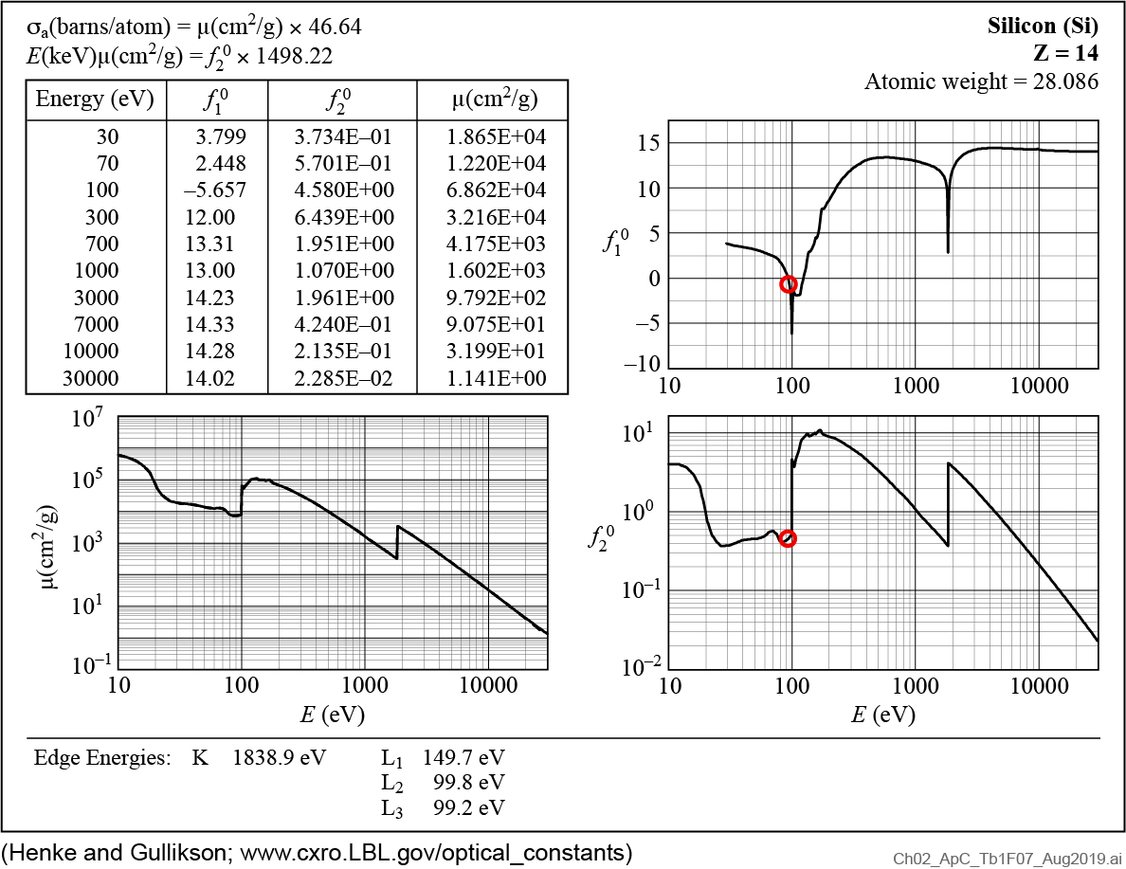
Atomic scattering factors for Silicon (Z = 14)

Slide 38
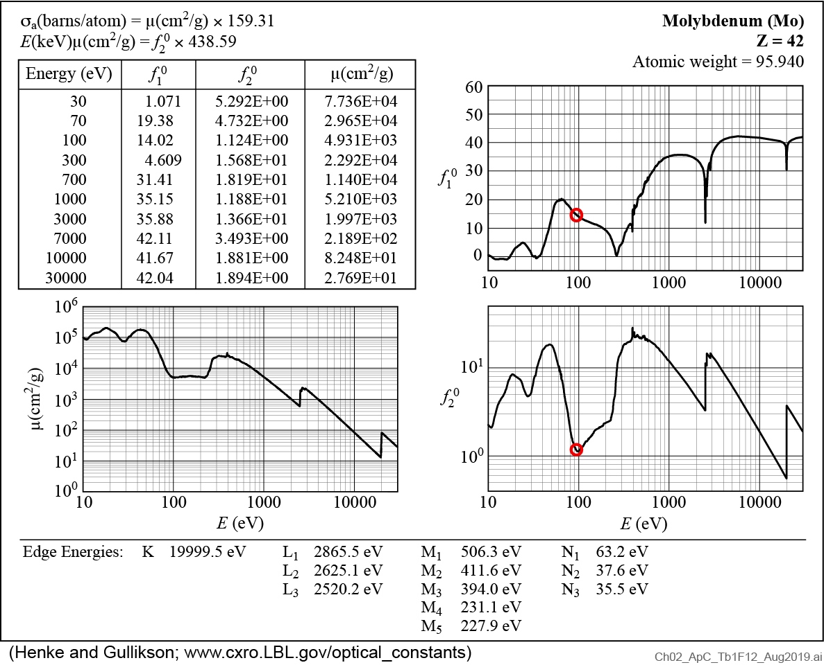
Atomic scattering factors for Molybdenum (Z = 42)

Slide 39
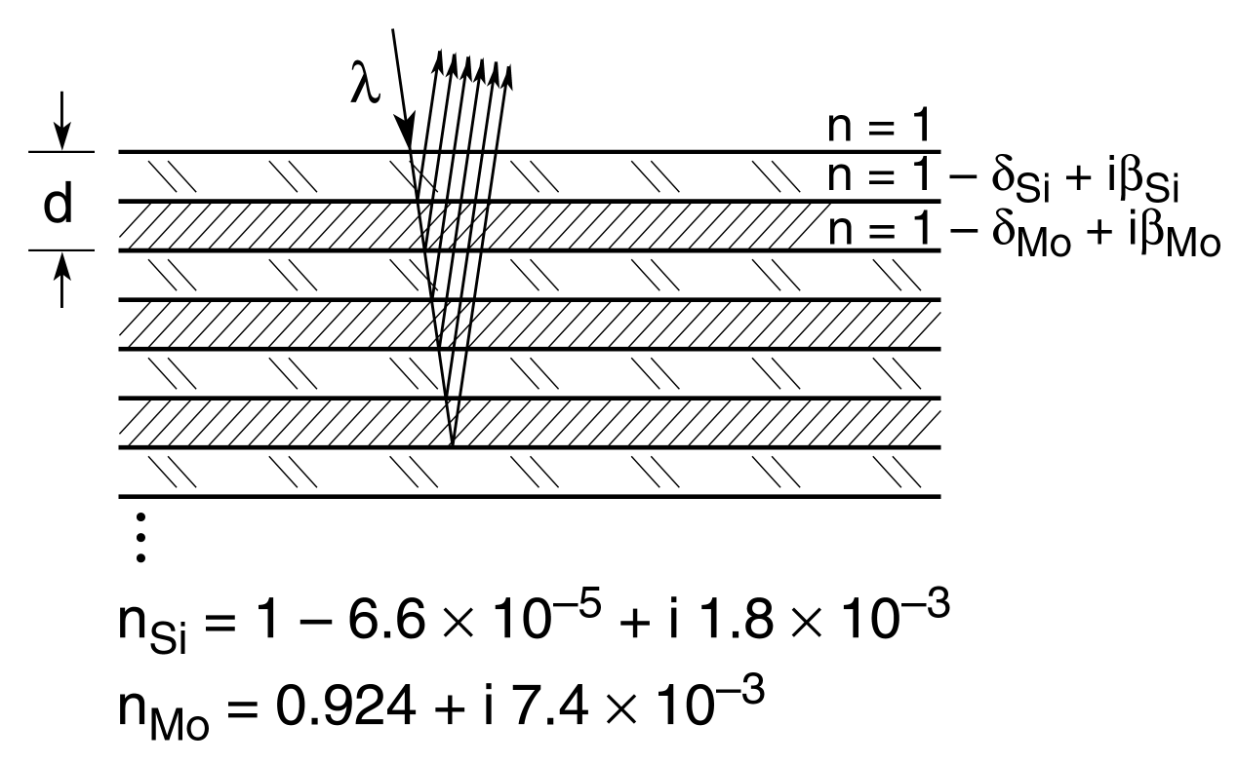
Mo/Si multilayer interference coating for EUV lithography
Molybdenum as the “scattering layer”
Silicon as the non-absorbing “spacing layer”
Actually an exaggeration, the complex refractive index of each material plays a role in the reflection process
The absorption edge Si-L₃ = 99.2 eV (12.5 nm)
Higher photon energies are absorbed in Si, lower photon energies (longer wavelengths) are not.
Typically λ = 13.5 nm for EUV lithography.
Molybdenum has relatively good scattering properties in this photon energy (wavelength) region, with limited absorption.

Slide 40
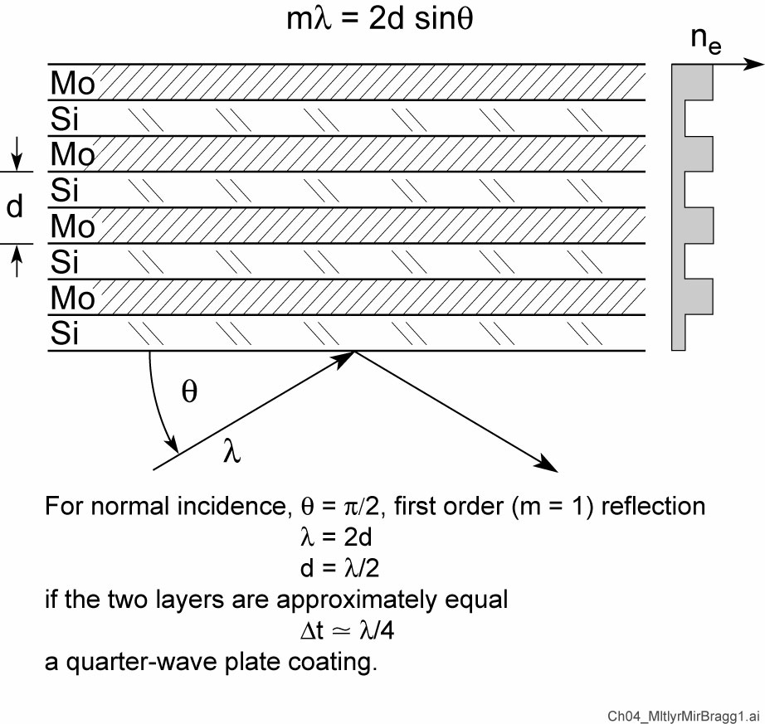
Multilayer mirrors satisfy the Bragg condition

Slide 41
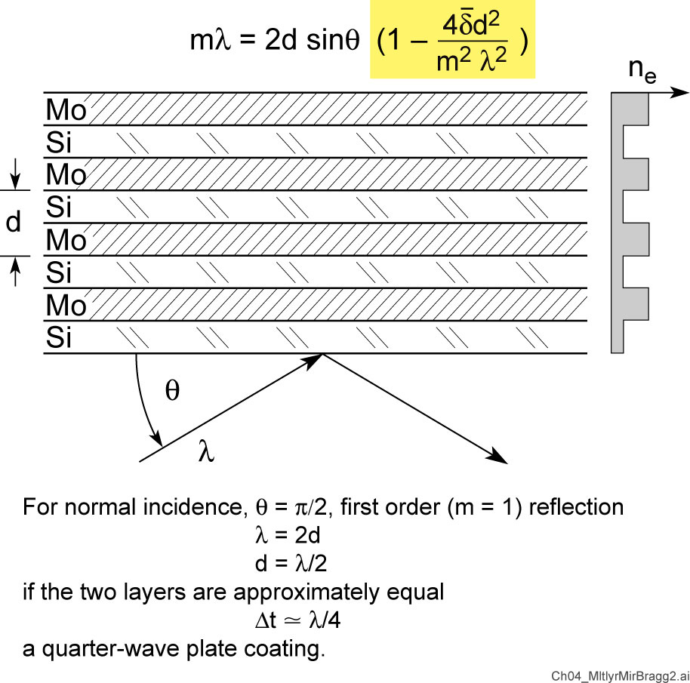
Multilayer mirrors satisfy the Bragg condition

Slide 42
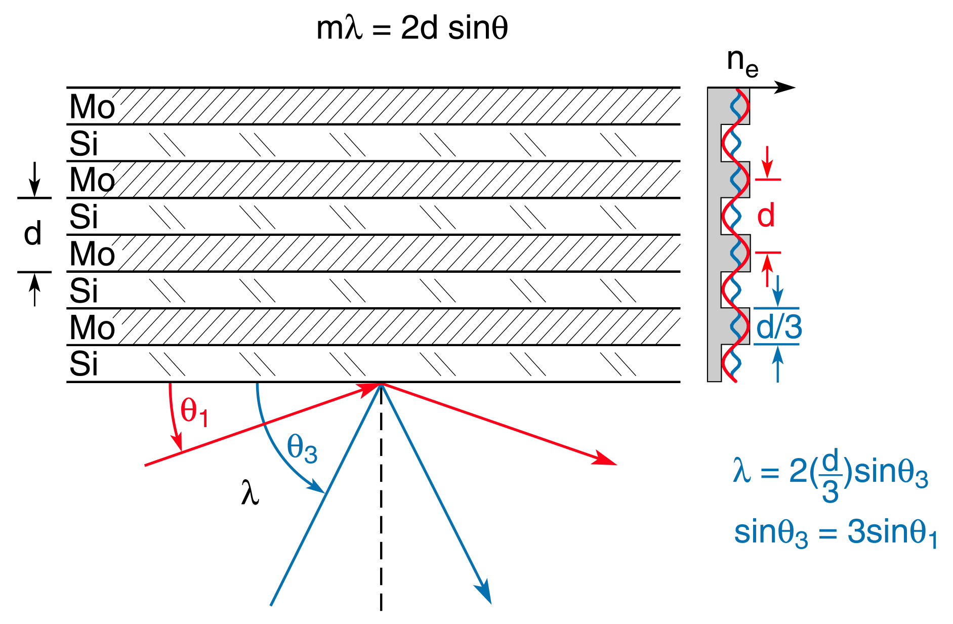
An angular scan of a multilayer mirror performs a Fourier-transform of the density profile

Slide 43
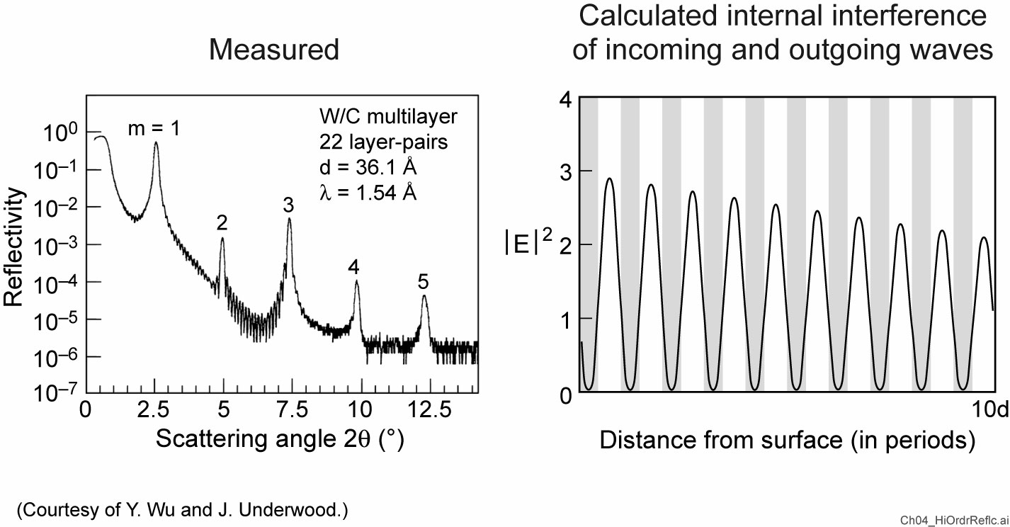
High order reflections from a multilayer coating

Slide 44
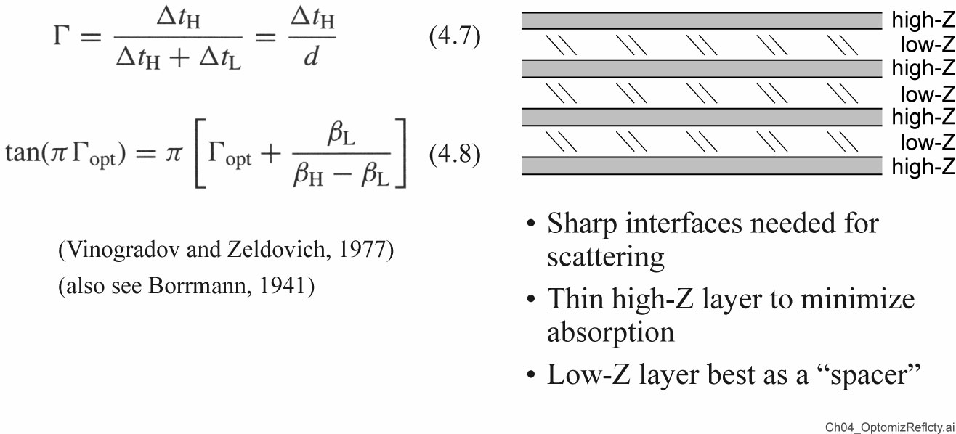
Optimized reflectivity with thin “high-Z” layers

Slide 45
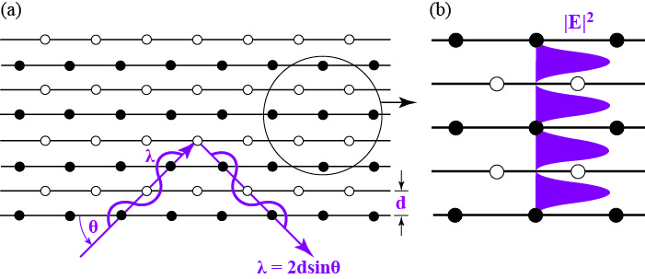
The Borrmann effect in crystals and multilayer mirrors

Slide 46
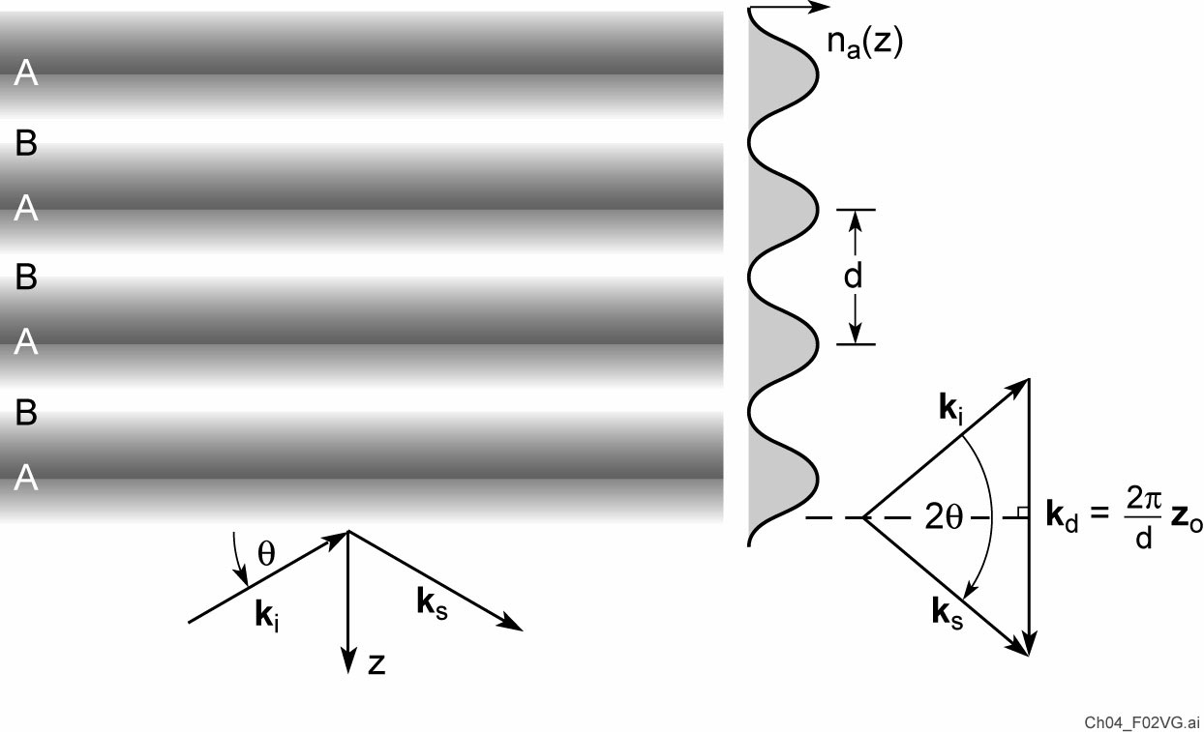
Scattering of radiation by a sinusoidal density distribution (atoms or electrons)

Slide 47
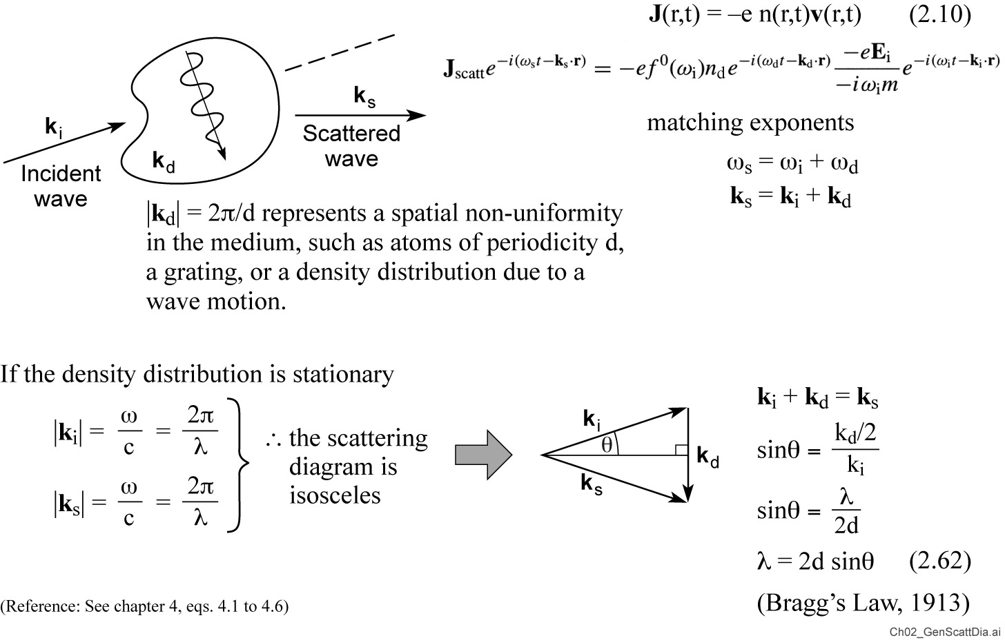
A general scattering diagram

Slide 48
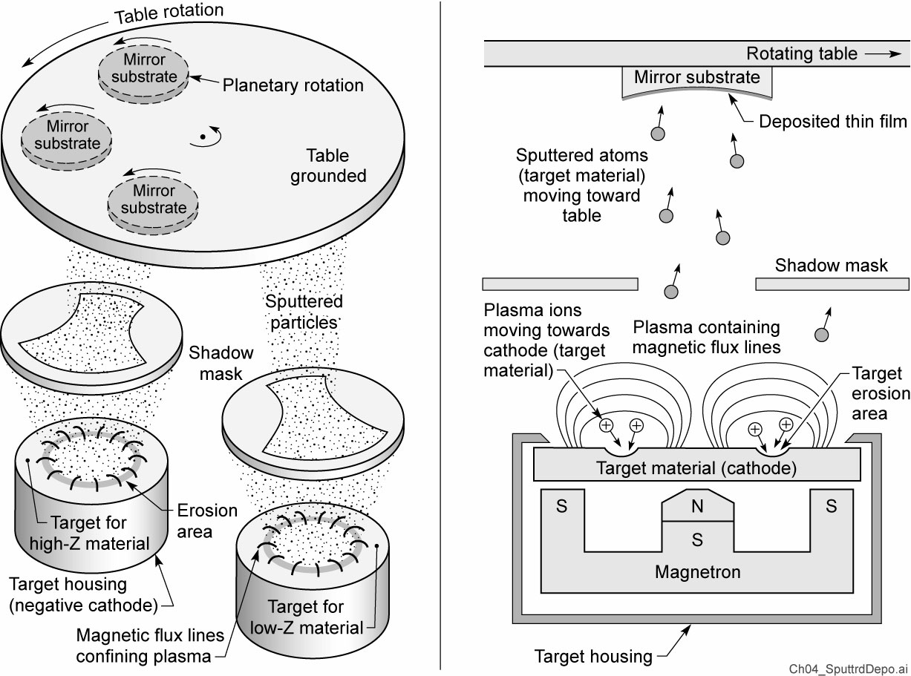
Sputtered deposition of a multilayer coating
Courtesy of J. Underwood, LBL

Slide 49
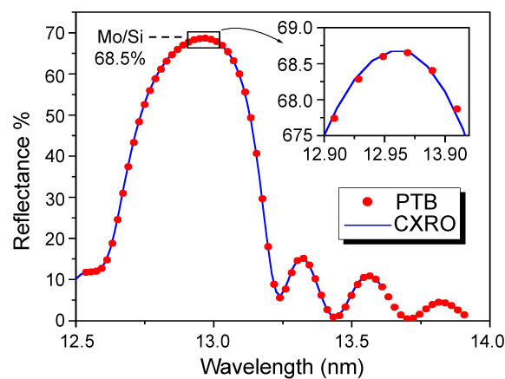
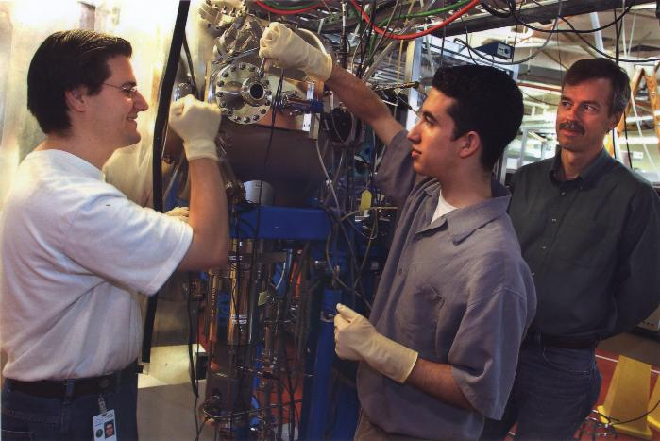
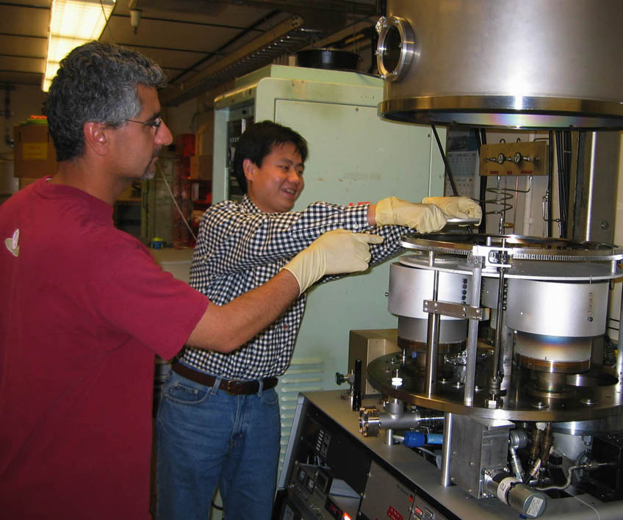
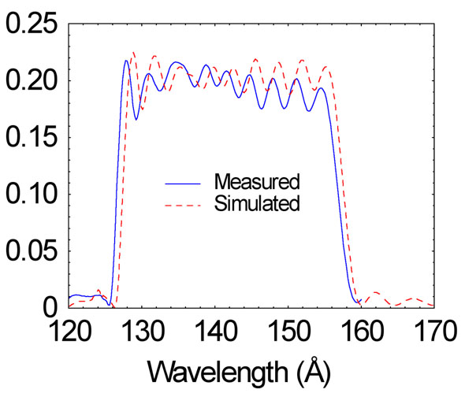
Multilayer coatings measurements at the ALS
Eric Gullikson, Farhad Salmassi, Yanwei Liu (AST, now SLAC), Andy Aquila (AST, now LCLS), Franklin Dollar (UCB EP, now UC Irvine)
World reference standard
Creating uniformity for λ/50 optics
World record in water window
Wide band, narrow band, and chirped mirrors for fsec applications
Reflectance

Slide 50
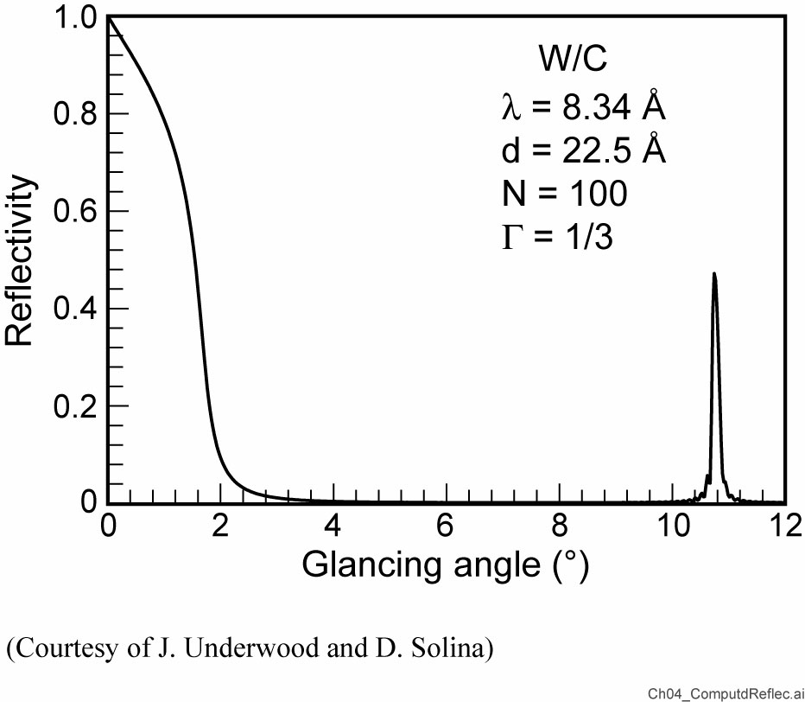
Computed reflectivity of a W/C x-ray multilayer mirror

Slide 51
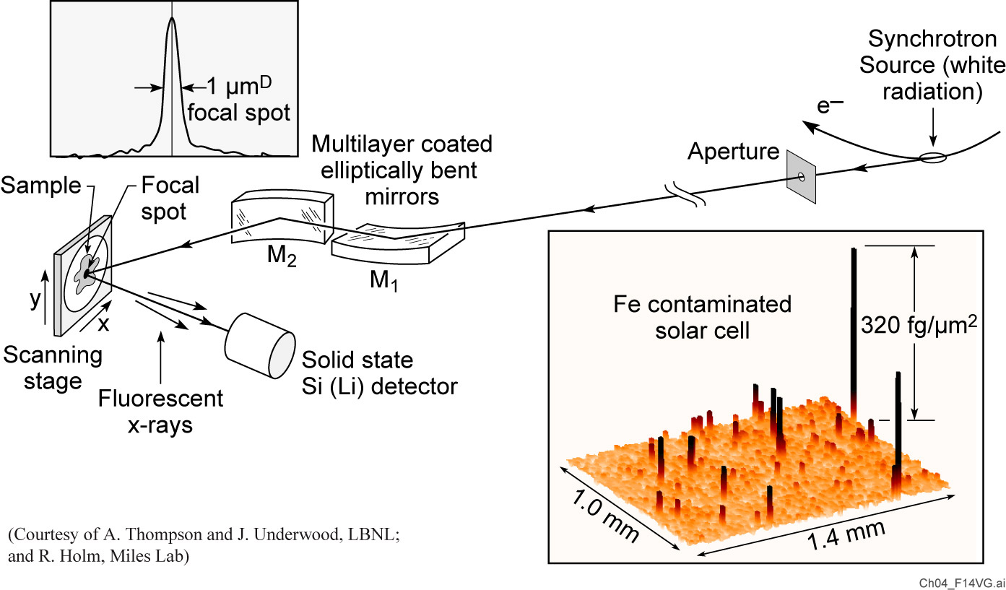
Buried, trace amounts of iron in a defective silicon solar cell

Slide 52
The Cassegrain telescope

Slide 53
Extreme ultraviolet astronomy

Slide 54
EUV image of the solar corona showing loops near the solar limb

Slide 55
Dynamics of the solar corona

Slide 56
Broad bandwidth mirrors needed for asec/fsec pulses
∆E(eV) ∙∆τ(fs) ≥ 1.8 fs∙eV (FWHM)
Multilayer mirrors depend on constructive interference from individual interfaces
Higher reflectivity needs more layers
Bandwidth gets narrower with more layers
Attosecond pulse
Broad bandwidth
Limited number of layers
N<10 layers required for
200 as pulse (@13nm)
Courtesy of Y.W. Liu, AS&T, UC Berkeley, now SLAC

Slide 57
More multilayer mirror slides in chapter 10

