Slide 1
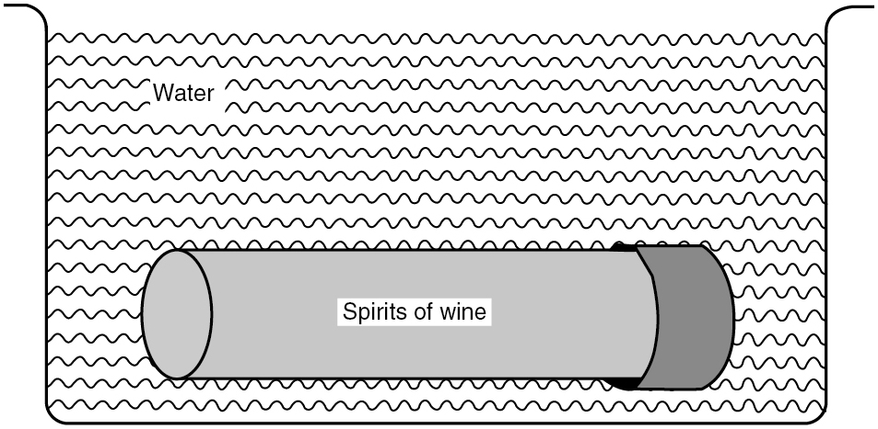
PILSON_Fig 06_01
© Cambridge University Press 2012

Slide 2
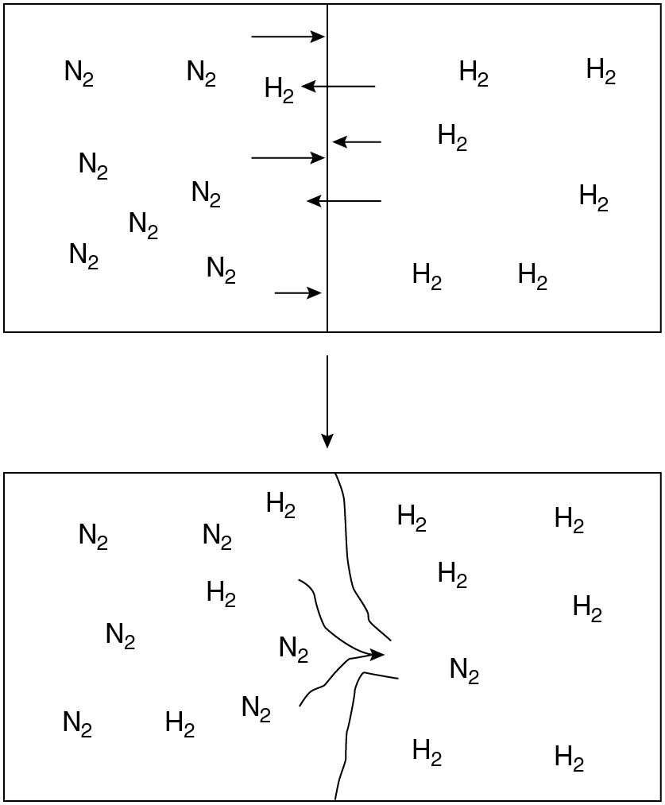
PILSON_Fig 06_02
© Cambridge University Press 2012

Slide 3
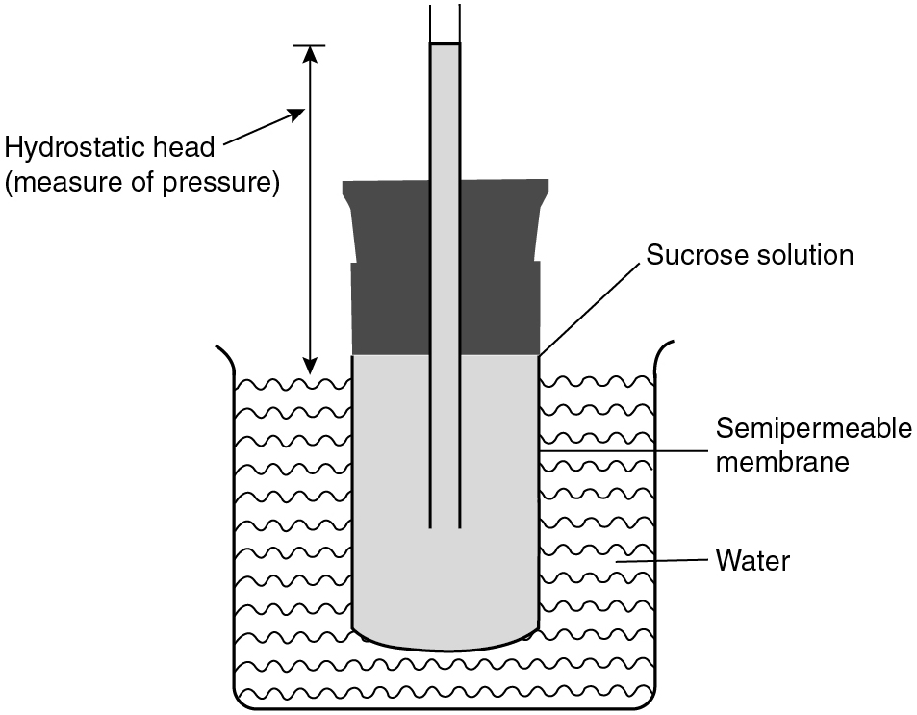
PILSON_Fig 06_03
© Cambridge University Press 2012

Slide 4
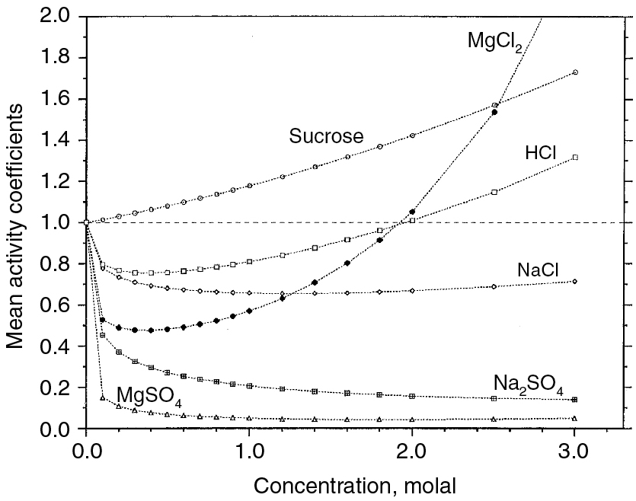
PILSON_Fig 06_04
© Cambridge University Press 2012

Slide 5
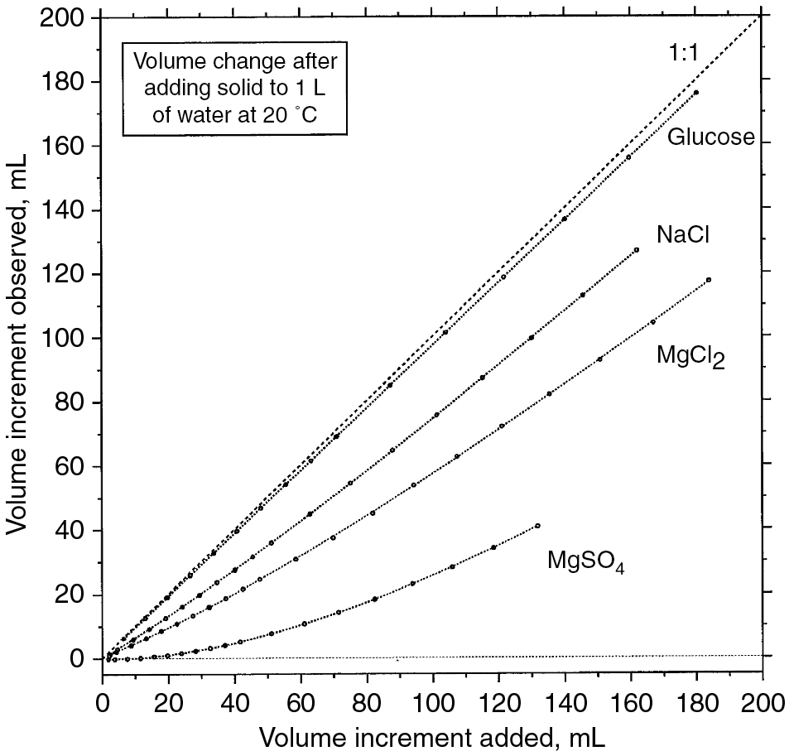
PILSON_Fig 06_05
© Cambridge University Press 2012

Slide 6
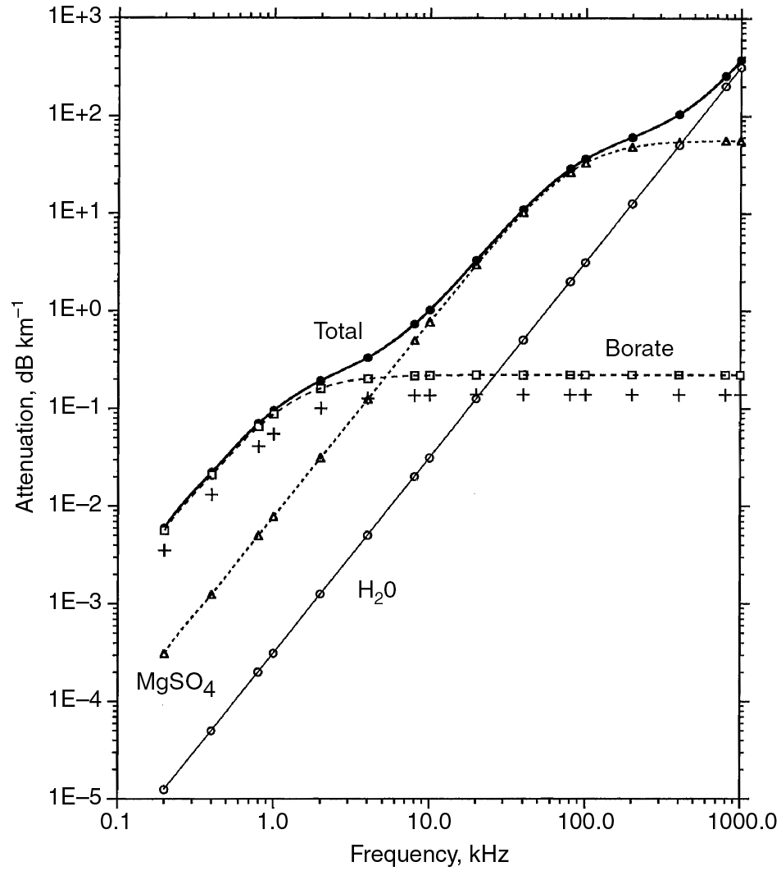
PILSON_Fig 06_06
© Cambridge University Press 2012

