Slide 1
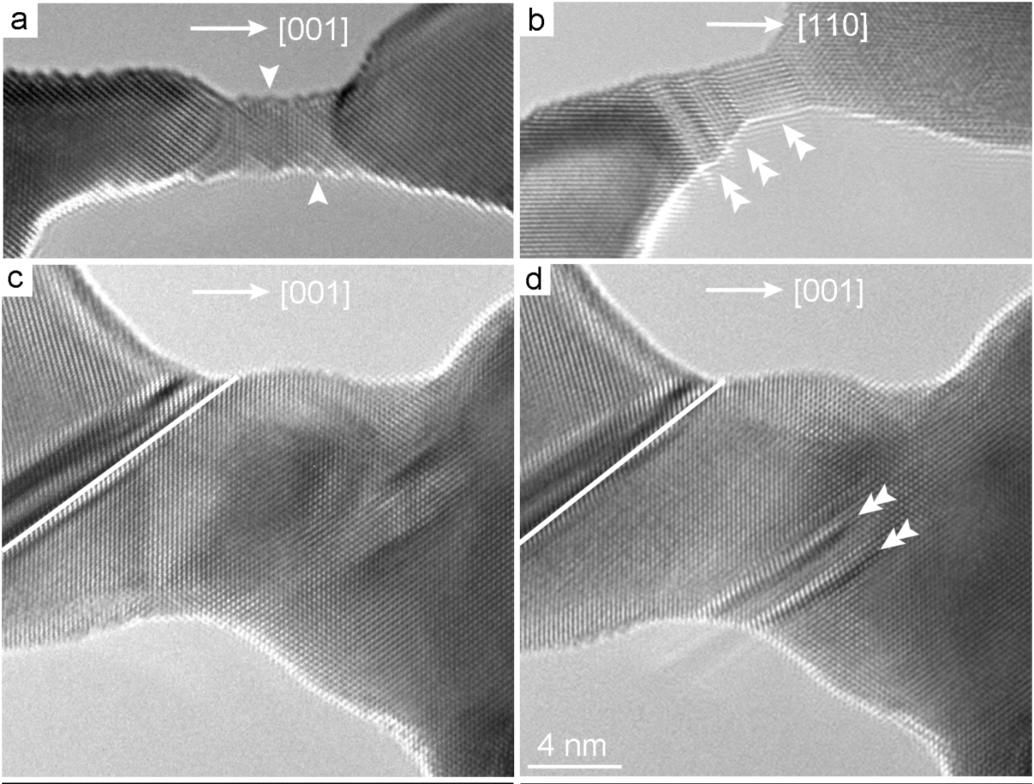
[001]
[110]
[001]
[001]
4 nm

Slide 2
C
B
A
(a)
(b)
(111)
(c)
(0001)
Notes:
3.99” X 5”, tiff.

Slide 3
ψ₄
ψ₂
A
B
C
A
B
C
B
A
C
B
A
ψ₃
Notes:
1.68” x 3”, tiff.

Slide 4
v
a
b₁
ξ
b
a
a
d
a
b
Notes:
1.53” x 2”, tiff.

Slide 5
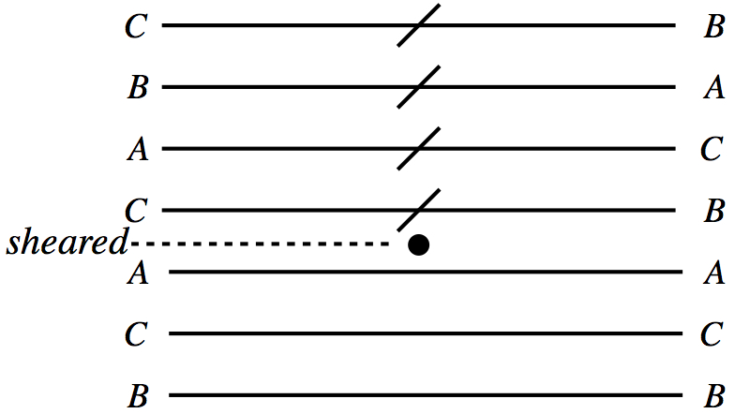
sheared
Notes:
1.13” x 2”, jpg.

Slide 6
Notes:
2.06” x 5”, tiff.

Slide 7
ξ₂
β
r_{e}
ξ₁
ξ₃
Notes:
1.08” x 2”, tiff.

Slide 8
1 μ
Notes:
4.85” x 5”, tiff.

Slide 9
ξ
ξ
ξ
(a)
(b)
Notes:
1.61” x 5”, tiff.

Slide 10
z
B
A
(d)
D
y
C
x
Notes:
2.41” x 3”, tiff.

Slide 11
D
<112]
<101]
γ
[011>
(c)
[211>
<121]
A
<110]
B
[121>
(d)
<211]
<112]
δ
(111)
<112]
[101>
<011]
[101>
<011]
β
α
(b)
[112>
(a)
[211>
<121]
[211>
<121]
D
<110]
C
[110>
D
Notes:
3.49” x 4”, tiff.

Slide 12
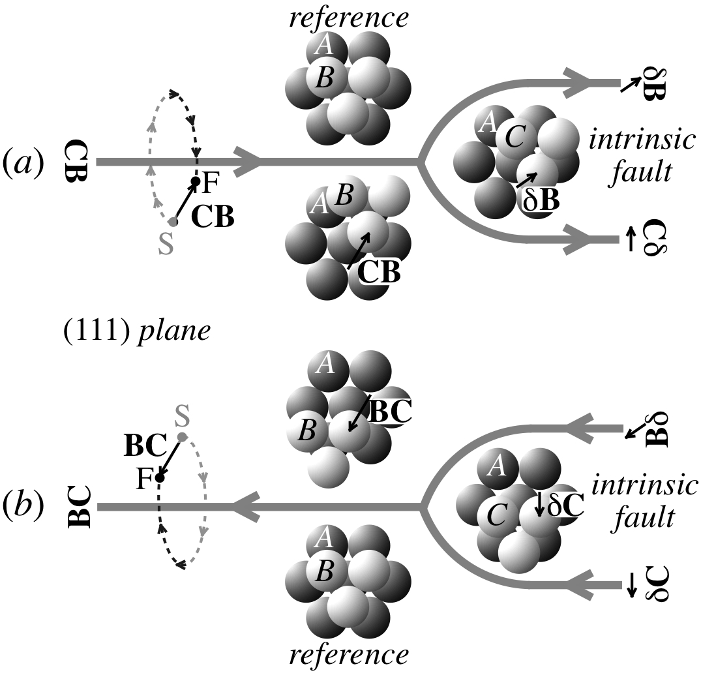
reference
intrinsic
fault
F
S
(111) plane
S
F
intrinsic
fault
reference
Notes:
2.9” x 3”, jpg.

Slide 13
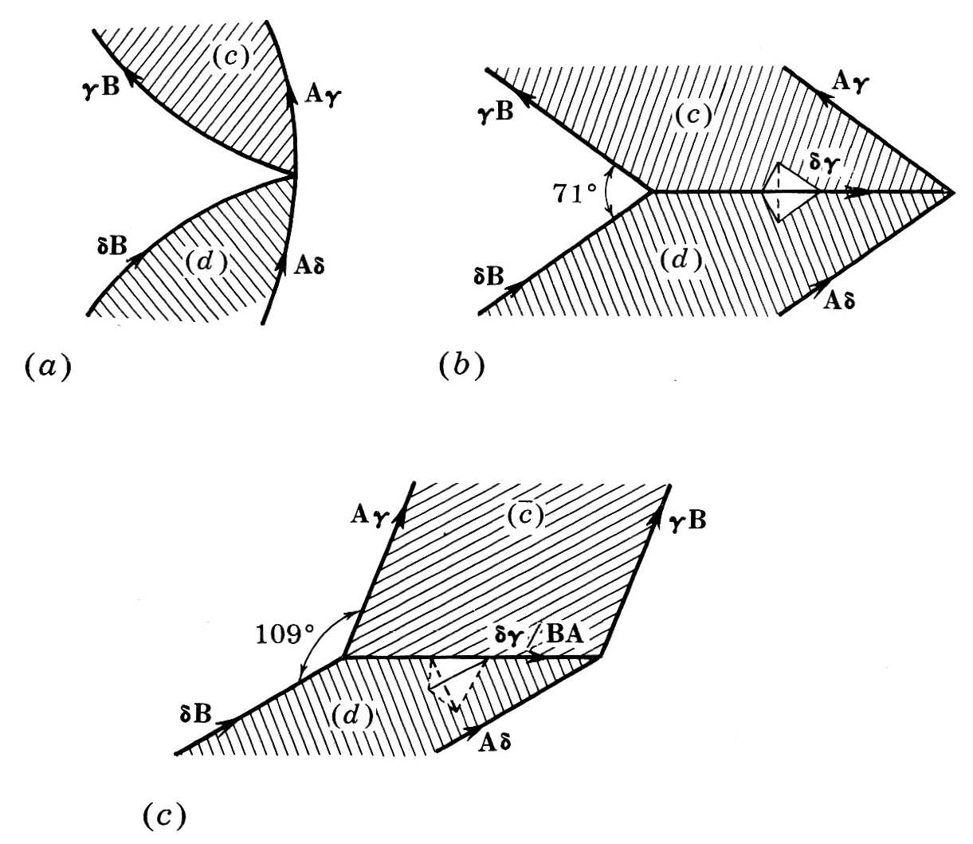
(c)
γB
Aγ
γB
(c)
Aγ
δγ
71º
δB
(d)
Aδ
(d)
δB
Aδ
(a)
(b)
Aγ
γB
109º
δγ/BA
δB
(d)
Aδ
(c)
Notes:
3.47” x 4”, jpg.

Slide 14
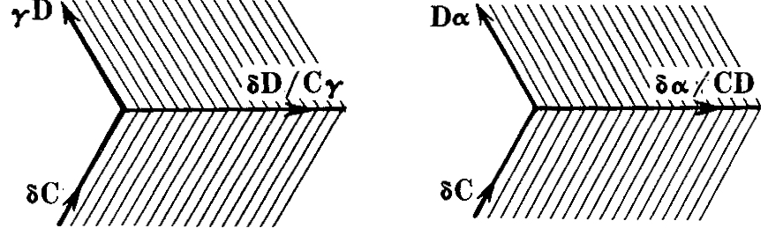
γD
(c)
Dα
δD/Cγ
δα/CD
δC
(d)
δC
(d)
Notes:
1.24” x 3”, jpg.

Slide 15
(a)
(b)
ξ
A
A
C
C
B
B
A
A
C
B
B
A
A
C
C
B
B
(c)
Notes:
2.89” x 4”, tiff.

Slide 16
Aδ
(a)
δD
(b)
δD
(c)
AD
Notes:
0.91” x 4”, tiff.

Slide 17
(d)
δβ
(d)
δD
(b)
(a)
(b)
βD
Notes:
1.04” x 4”, tiff.

Slide 18
δA
γA
γδ
δA
δγ
Bγ
Bδ
(a)
Bδ
δA
Bγ
δA
δγ/AB
(b)
γA
Bδ
AB/δγ
Bδ
Notes:
3.59” x 4”, tiff.

Slide 19
δA
δA
BA
Bδ
Bδ
Notes:
1.92” x 3”, tiff.

Slide 20
C
(down)
D
δA
Bδ
AB/δγ
B
A
(down)
(a)
Bγ
γA
(b)
Bγ
γA
δγ/AB
(up)
δA
(up)
Bδ
δA
δA
δB
(up)
Aδ
(c)
BA
(d)
δγ
(up)
Bγ
γA
Bδ
γδ
Bδ
δB
Aδ
(e)
(f)
δA
δA
βA
δA
Bδ
(up)
δA
βδ
δβ
BA
βδ
δβ
(up)
(up)
Bδ
Bδ
Bδ
Bδ
Bβ
Bδ
Bβ
Notes:
6.04” x 5”, jpg.

Slide 21
δA
δA
Bδ
αβ
δA
αA
(a)
δα
αδ
(up)
αβ
δβ
(b)
Bα
δα
δβ
Bδ
δA
αδ
δβ
Bδ
βA
C
Bδ
Bα
βA
δA
D
(up)
Bδ
Bβ
Bδ
B
A
δA
(up)
δβ
(up)
(c)
βδ
(d)
αA
δA
βA
δA
δA
Bδ
Bα
Bβ
δA
Bδ
(up)
(up)
AB/βδ
δβ
δA
Bδ
δA
Bδ
αβ
βA
δγ
(e)
βA
(f)
δα
γδ
Bγ
Bδ
γα
Bδ
(up)
δA
δA
Bδ
γδ/AB
Array
similar
to f
γA
(up)
γA
AB/γδ
(g)
γδ
Bγ
(h)
Bδ
δA
Notes:
6.23” x 5”, tiff.

Slide 22
c
or
f
a
c
or
f
b
or
c
f
a
or
b
ϕ
ξ
a
ϕ
h
(a)
BA
(b)
Notes:
1.77” x 4”, tiff.

Slide 23
h
l
Notes:
1.58” x 3”, tiff.

Slide 24
δγ
γδ
Notes:
1.74” x 2”, tiff.

Slide 25
(a)
(b)
Notes:
6.22” x 5”, tiff.

Slide 26
100 nm
(a)
(b)
Notes:
1.9” x 5”, tiff.

Slide 27
D
D
(a)
(b)
αD
βα
βD
γD
αγ
αD
γβ
δα
C
δα
B
C
B
βD
γD
δβ
δγ
δβ
δγ
A
A
D
D
(c)
(d)
βα
αγ
γβ
δα
δD
C
B
C
B
δβ
δγ
δD
δD
A
A
Notes:
4.7” x 5”, tiff.

Slide 28
Cβ
βD
αD
(a)
(a)
CD
(b)
Cγ
Cα
Cβ
Cβ
γD
βD
βD
Cγ
(c)
Cβ
βD
Notes:
3.7” x 5”, tiff.

Slide 29
Notes:
2.59” x 3”, tiff.

Slide 30
L'
L
Notes:
1.99” x 3”, tiff.

Slide 31
F(x)
G(x)
12
3
G
8
2
4
1
F
0
x
0
0
0.5
1.0
Notes:
2.98” x 3”, jpg.

Slide 32
w (x 10⁻³)
55
54
53
52
L_{T} = 580.0 nm
51
18
L_{E} = 26.5 nm
17
Q = 31 eV
16
15
L = 23 nm
14
Q = 8.8 eV
13
L = 21 nm, τ_{a} = 5 x 10⁻⁴μ
12
Q = 1.6 eV
11
L_{c} = 20 nm
10
L = 17 nm
9
8
0
0.2
0.4
0.6
0.8
1.0
Notes:
4.52” x 3”, jpg.

Slide 33
δA
Bδ
Cδ
Notes:
2.74” x 3”, tiff.

Slide 34
ϕ
b
r
z₀
d
λ
Notes:
2.97” x 4”, tiff.

Slide 35
δγ
Cδ
δA
Cδ
(d)
(d)
x
h
x
h
(c)
δC
Aδ
δC
(a)
γδ
(b)
Notes:
1.96” x 4”, tiff.

Slide 36
0.5 μm
Notes:
3.47” x 4”, tiff.

Slide 37
Cδ
Cδ
Cδ
(d)
(d)
Extrinsic
Intrinsic
δB
δA
200 nm
δB
Cδ
CB
(b)
CA
Notes:
3.4” x 5”, jpg.

Slide 38
δA
Aδ
δA
Aδ
δC
Bδ
δC
Bδ
αA/Dδ
DA/αδ
70º
αδ
BC/αδ
αD
αC
Bα
Bα
Dα
αC
(a)
αD
Dα
(b)
Notes:
1.73” x 5”, tiff.

Slide 39
r
y
b₁
b₂
x
b₃
z
D₁
D₂
D₃
v_{x}
A/r
A/r
v_{x}
E
γ
γ
B
C
(a)
(b)
Notes:
1.92” x 4”, tiff.

Slide 40
Pin
b₁
b₂
r_{e}
Pin
Notes:
3.63” x 2”, tiff.

Slide 41
γ
γ
a
r_{e}
Notes:
1.02” x 4”, tiff.

