Slide 1
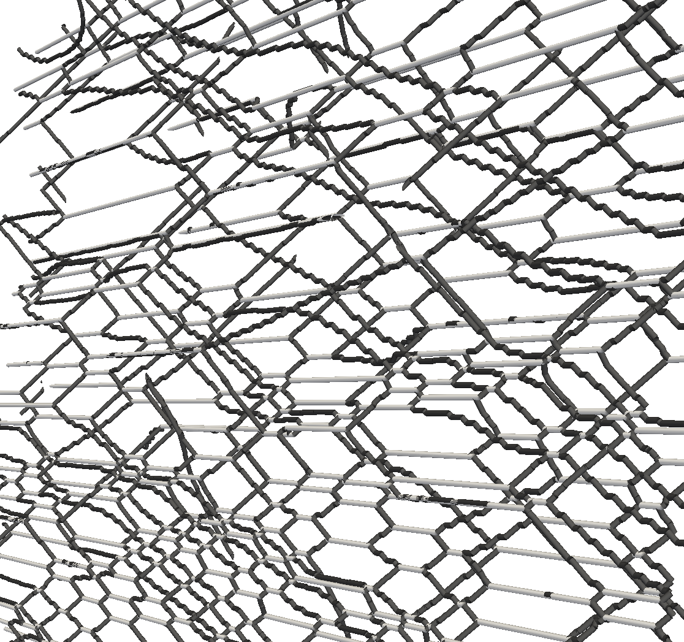
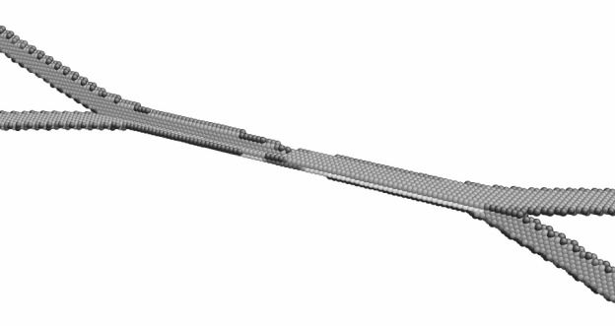
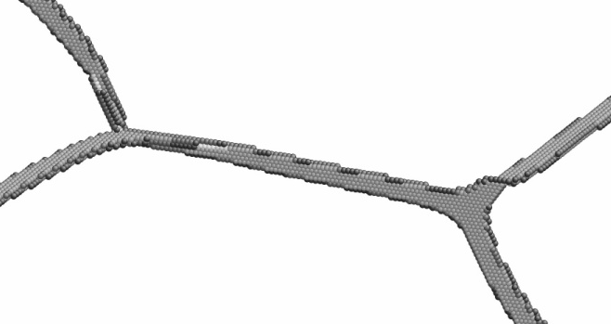
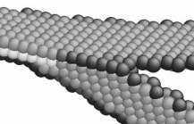
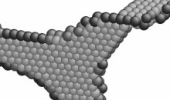
Hirth junction
Glissile junction

Slide 2
b₂
b₁
ξ₁
ξ₂
(a)
(b)
b₂
?
b₁
ξ₁
(c)
(d)
ξ₂
Notes:
3.25” x 4”, jpg.

Slide 3
y
b
ξ
h
b
x
ξ
z
Notes:
3.02” x 3”, tiff.

Slide 4
y
b
ξ
x
h
b
ξ
z
Notes:
2.79” x 3”, jpg.

Slide 5
ξ
b
ξ
b
ξ
b
b
ξ
(a)
(b)
b
b
(c)
(d)
Notes:
5.07” x 5”, jpg.

Slide 6
W
W*(σ, ε)
x
x*(σ, ε)
Notes:
4.03” x 5”, tiff.

Slide 7
(101)
ξ=[010]
A
B
b_{BA} = [100]
Notes:
2.26” x 3”, tiff.

Slide 8
W
x
Notes:
2.28” x 3”, tiff.

Slide 9
[001]
σ
(011)
C
b₁
A
B
D
G
F
b₂
E
H
σ
Notes:
2.82” x 3”, tiff.

Slide 10
η
A
1
B
0
10⁴
ρ, cm/cm³
10¹²
Notes:
2.4” x 3”, tiff.

Slide 11
αB
Dα
Bδ
(a)
δA
(d)
Lomer-Cottrell barrier
B
αδ
αδ
Dα
δA
Dα
δA
Bδ
v
v
C
αB
δA
reactant
dislocations
Dα
Bδ
αB
δA
Dα
BA(d)
reactant
dislocations
DB(a)
Notes:
2.95” x 3”, jpg. 1.83” x 3”, jpg.

Slide 12
D
J-K
(c)
J-K (6)
J-K (6)
(7)
J-K
A
B
J-J
K-J
BA(d)
K-J
J-J (1) or (4)
(d)
J-J
(b)
K-J
K-J
(a)
J-J
(1) or (4)
D
C
D
J-J
(2) or (5)
J-J
(3)
J-J
(2) or (5)
J-J
(3)
Notes:
2.49” x 3”, jpg.

Slide 13
αδ
δD/Aα
δA
Dα
Bδ
αC
(1)
(2)
BC/δα
αB
Bδ
αD
δA
δD/Aα
(3)
(4)
Notes:
2.12” x 3”, tiff.

Slide 14
αD
l
Cα
BC/δα
Bδ
δA
Notes:
1.92” x 3”, tiff.

Slide 15
(a)
δA
δA
(b)
Cβ
βA
αδ
δA
(b)
(d)
αδ
Dα
Dα
Bδ
δA
Bδ
δA
δA
Bδ
Dα
Bδ
(c)
Dα
αB
Dα
P
αB
Bδ
αδ
Bδ
δA
αδ
Q
R
δA
Bδ
Dα
δA
αB
Notes:
6.01” x 5”, tiff.

Slide 16
W
x
O
Notes:
2.18” x 3”, tiff.

Slide 17
αδ
αδ
αδ
γ₂
γ₂
δA
γ₁
γ₁
Dα
δA
Dα
δD/Aα
γ₁
γ₁
Notes:
1.54” x 5”, tiff.

Slide 18
Bγ
(a)
δA
δA
γA
Bδ
Bδ
βA
βA
δA
Bγ
γβ
(b)
δB
γβ
δA
γA
Bγ
γδ
Bδ
Bδ
Notes:
4.35” x 5”, tiff.

Slide 19
δA
Bγ
δA
Bδ
Bγ
γA
Bδ
δγ/AB
(a)
(b)
γB
γB
(c)
(c)
Cγ
δB
Cγ
(d)
surface
(d)
Cδ
(c)
Notes:
3.43” x 5”, tiff.

Slide 20
(a)
B
(c)
AB(c)
B
A
A
(c)
BA
(a)
DA
BC(a)
D
D
CA(d)
C
DB
C
BC
B
CA
DB(c)
B
A
(e)
BA
A
BA
BC(a)
BC(a)
D
CA(d)
D
C
CA(d)
(b)
(d)
C
Notes:
insert (a) into the figure caption.

Slide 21
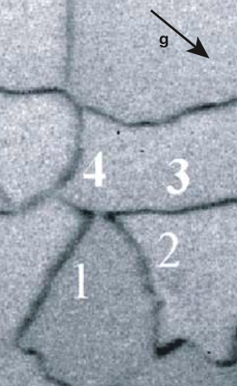
(a)
(b)
2
(c)
1
2
3
1
4
3
1
4
3
3
2
1
2
2
2
(d)
(e)
1
1
1
J
1
J
0.2 microns
2
2

Slide 22
F_{i}
ξ_{(ij)}
P
1'
l_{(ij)}
j
i
2'
+δ
R
−δ
O

Slide 23
(a) Al
z
(b) Ag
x
y
[111]
[111]
γδ
DC
γδ
δC
δC
Aδ
Aδ
γA
Dγ
γA
Dγ

