Slide 1
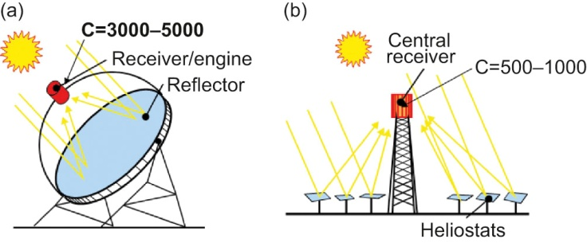
Fig48_01

Slide 2
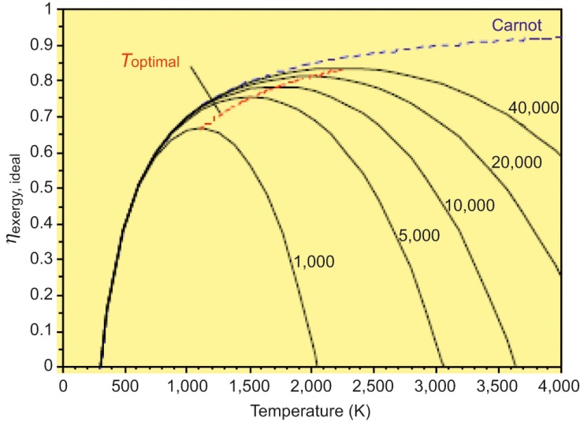
Fig48_02

Slide 3
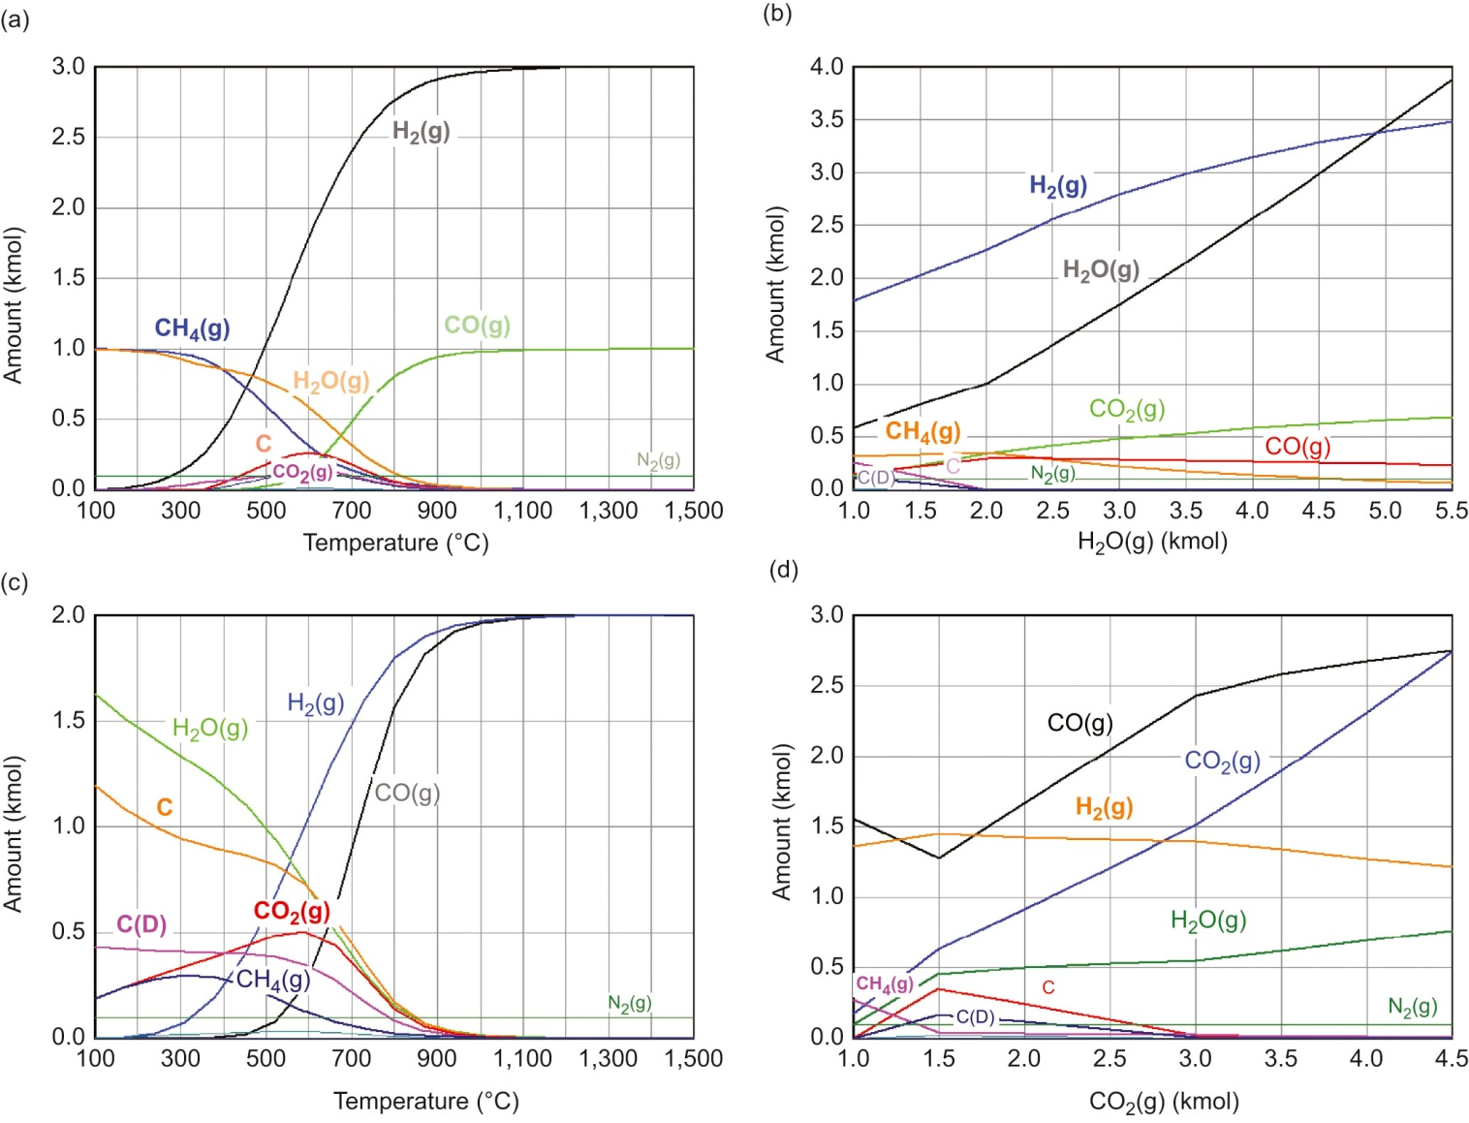
Fig48_03

Slide 4
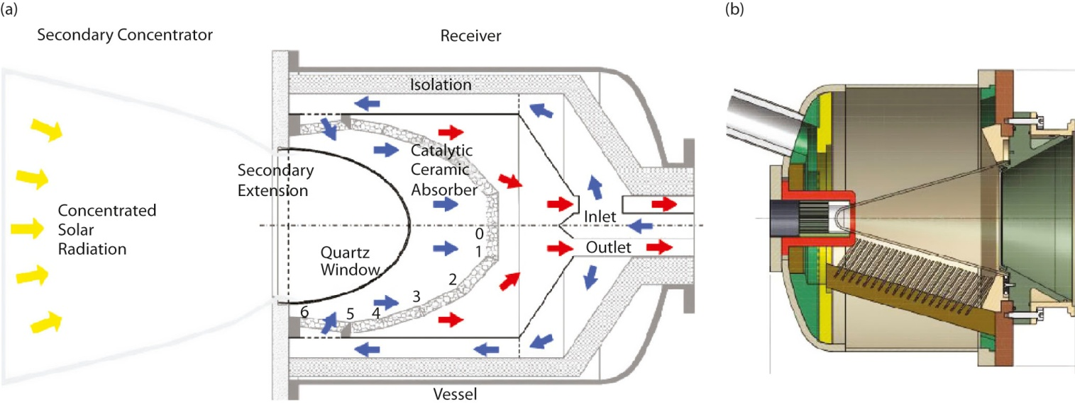
Fig48_04

Slide 5
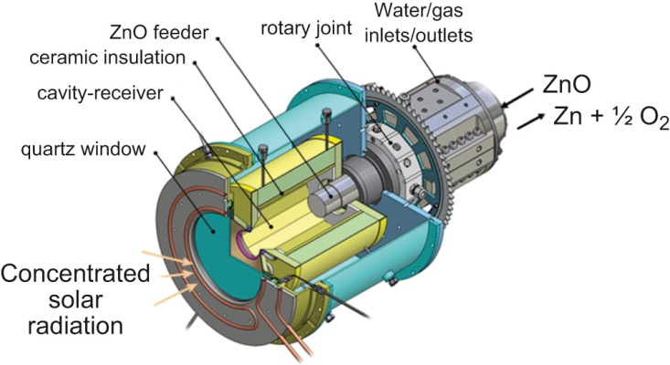
Fig48_05

Slide 6
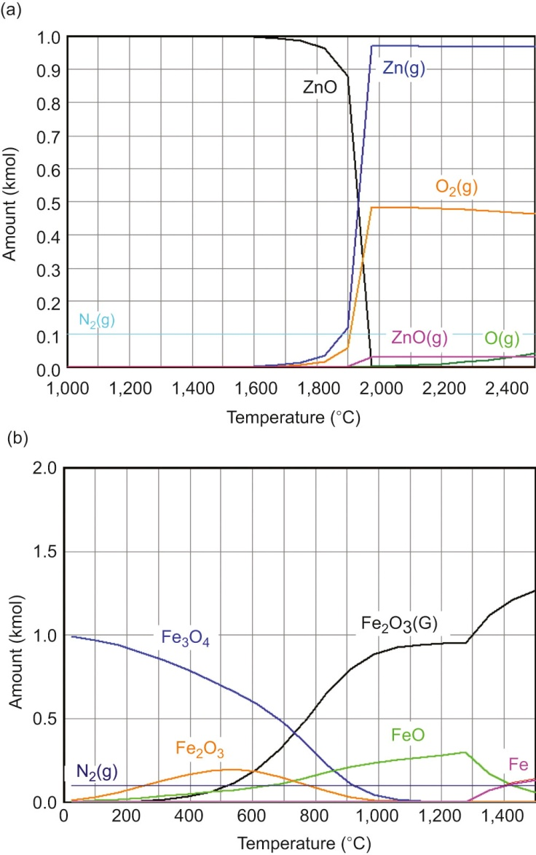
Fig48_06

Slide 7
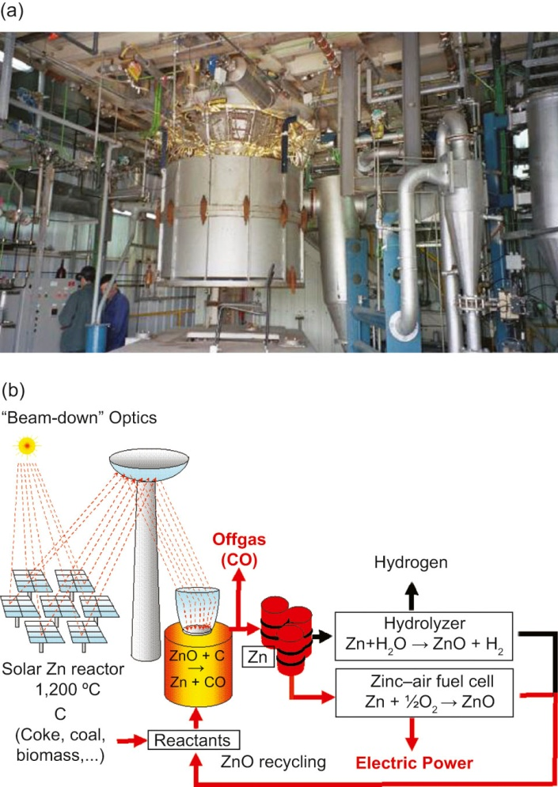
Fig48_07
© SOLZINC Project, Weizmann Institute of Science

Slide 8
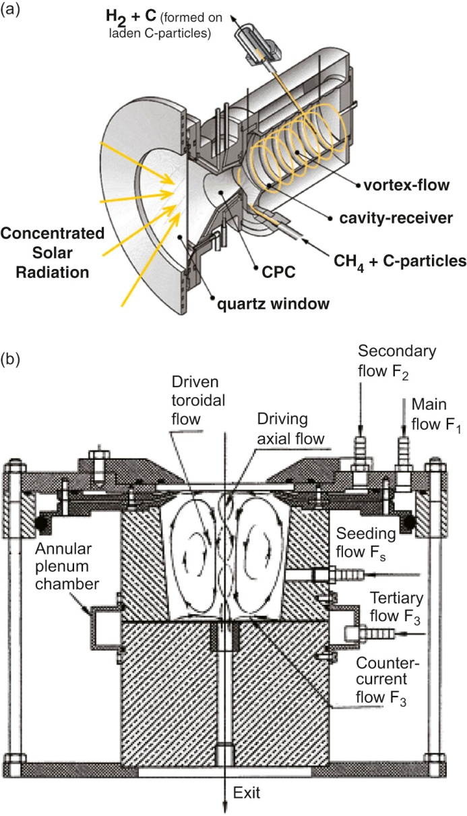
Fig48_08
© Weizmann Institute of Science

Slide 9
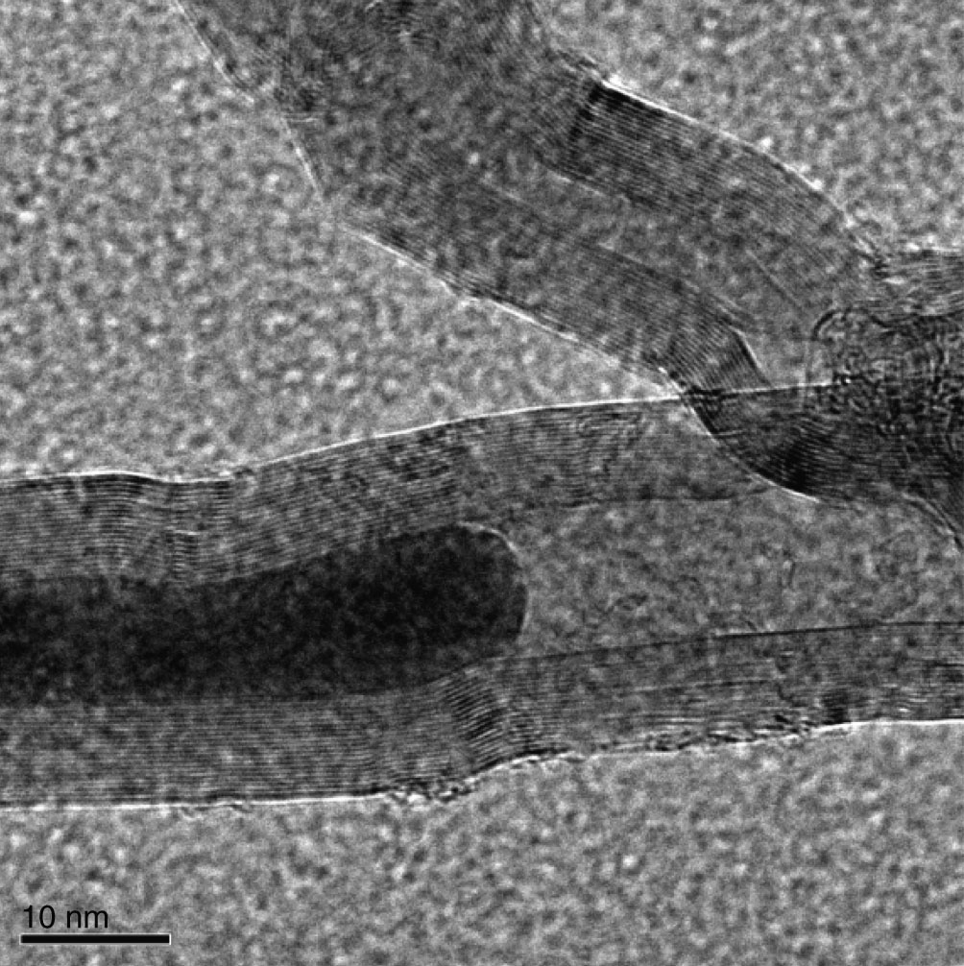
Fig48_09
© Weizmann Institute of Science

Slide 10
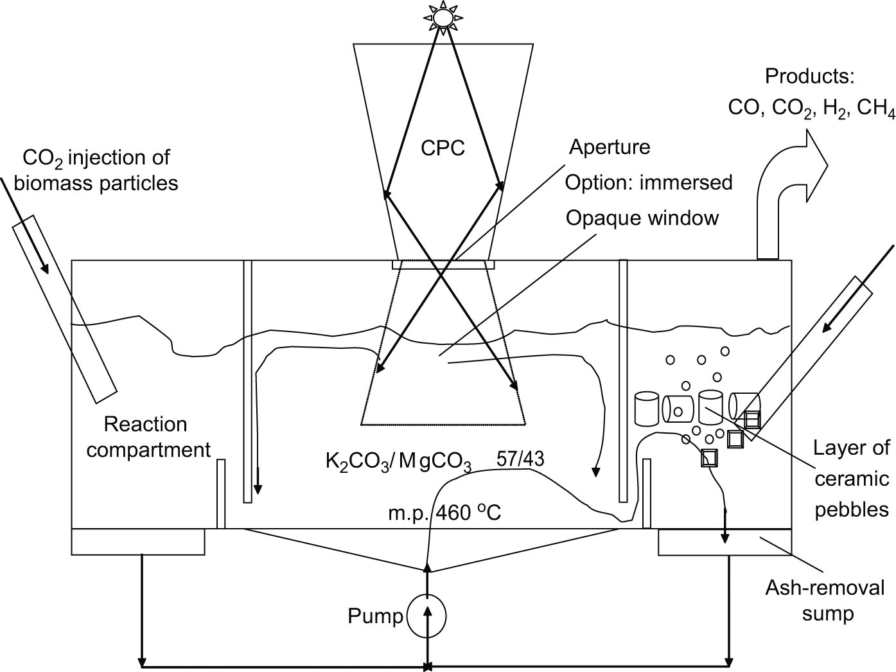
Fig48_10

