Slide 1
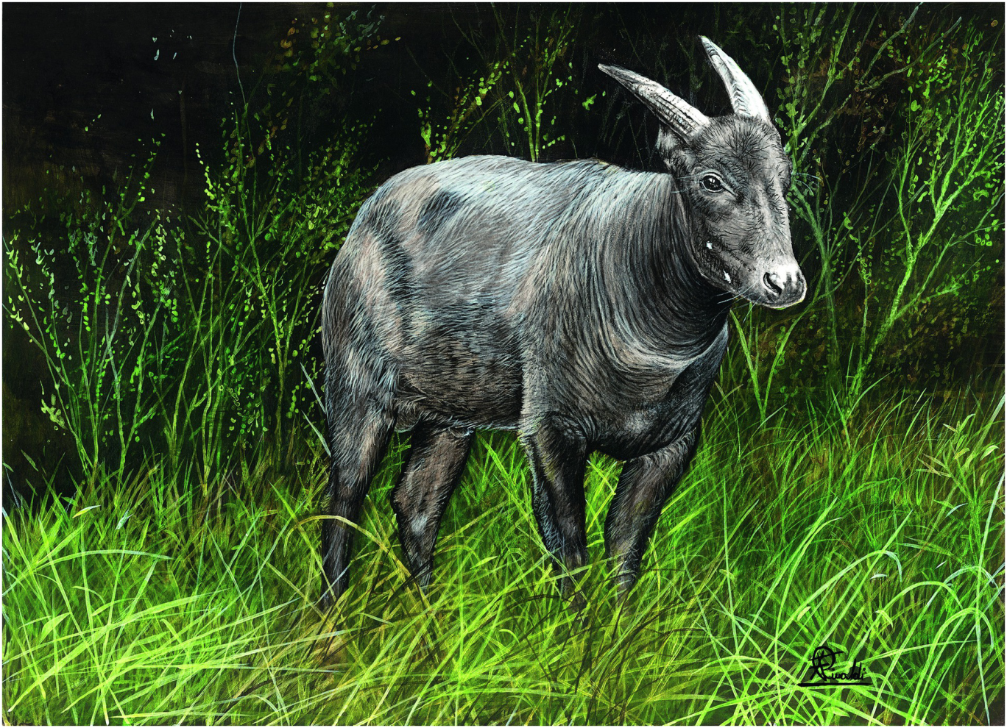
Plate 20
Anoa (illustration by Francesco Rinaldi)

Slide 2
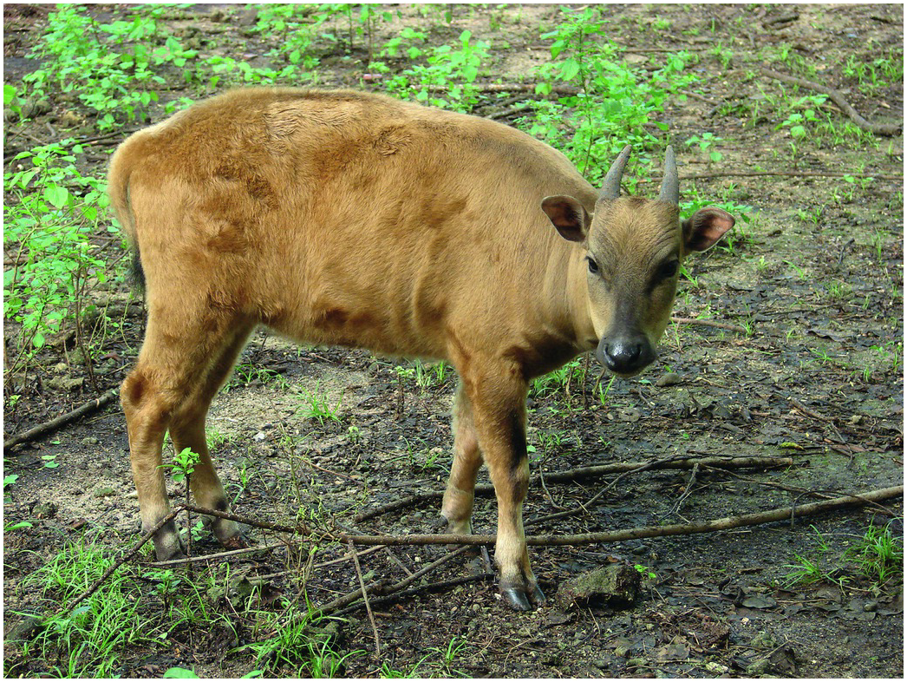
Figure 17.1
Anoa, female adult 7 years old from Central Sulawesi.
Photo by Abdul Haris Mustari

Slide 3
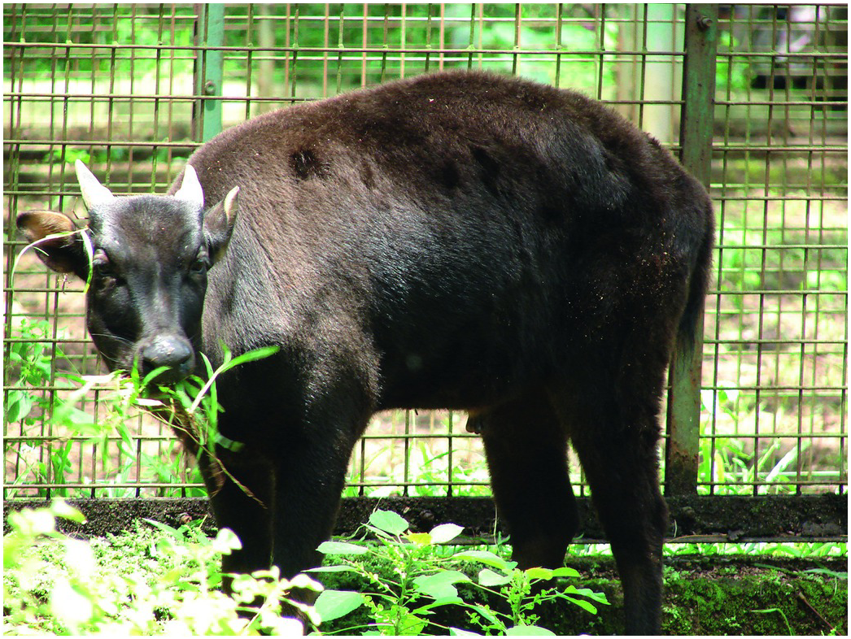
Figure 17.2
Anoa, male 19 years old, from Central Sulawesi.
Photo by Abdul Haris Mustari

Slide 4
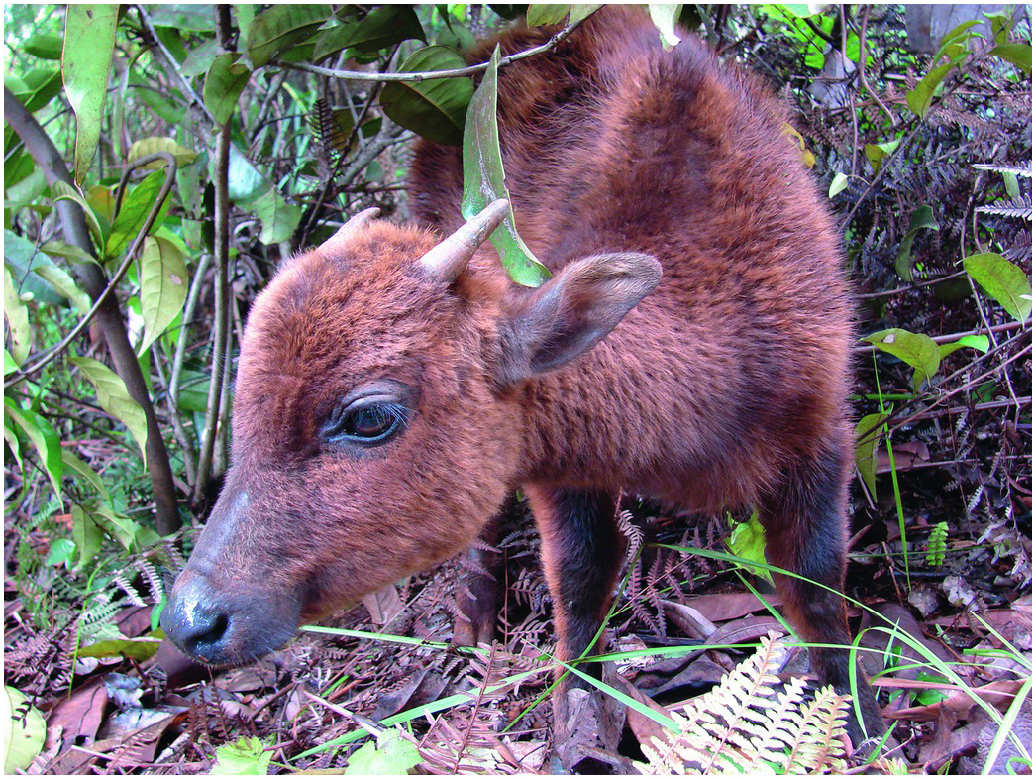
Figure 17.3
Male 1 year old, from southeast Sulawesi (Photo by Abdul Haris Mustari)

Slide 5
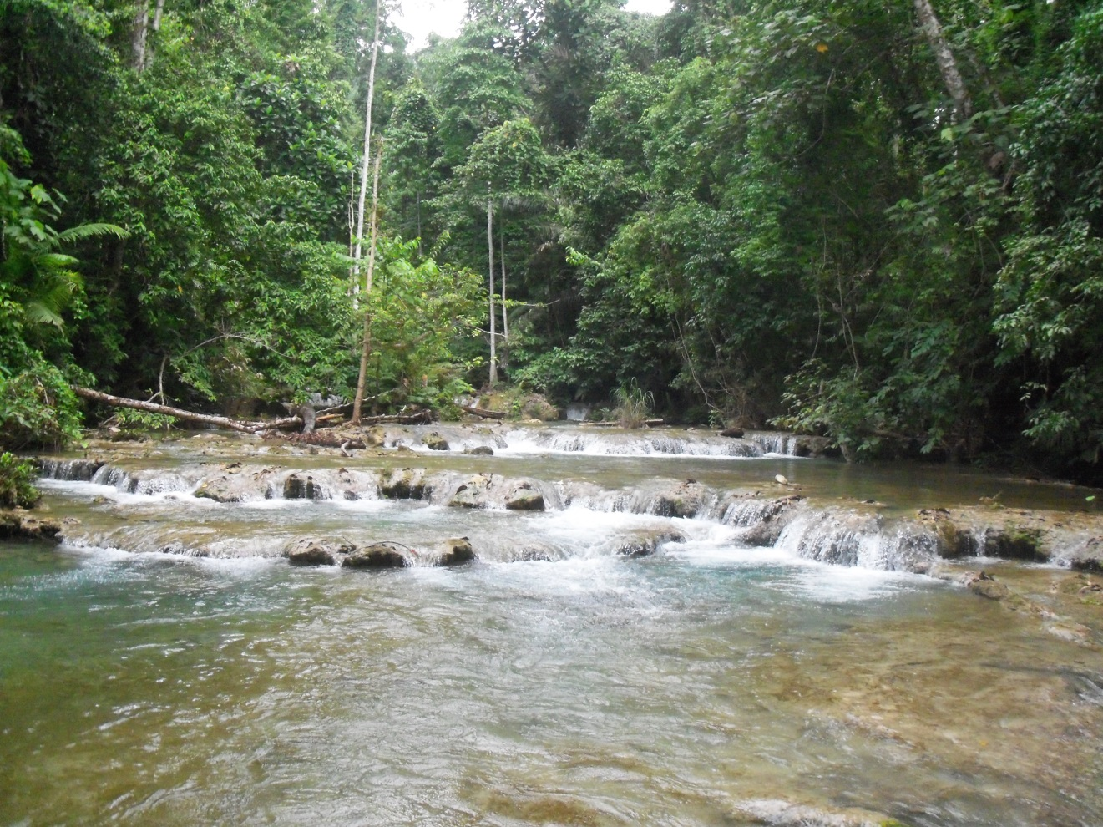
Figure 17.4
Riverine Forest, important habitat for anoa in Tanjung Peropa Wildlife Reserve, Southeast Sulawesi (Photo by Abdul Haris Mustari)

Slide 6
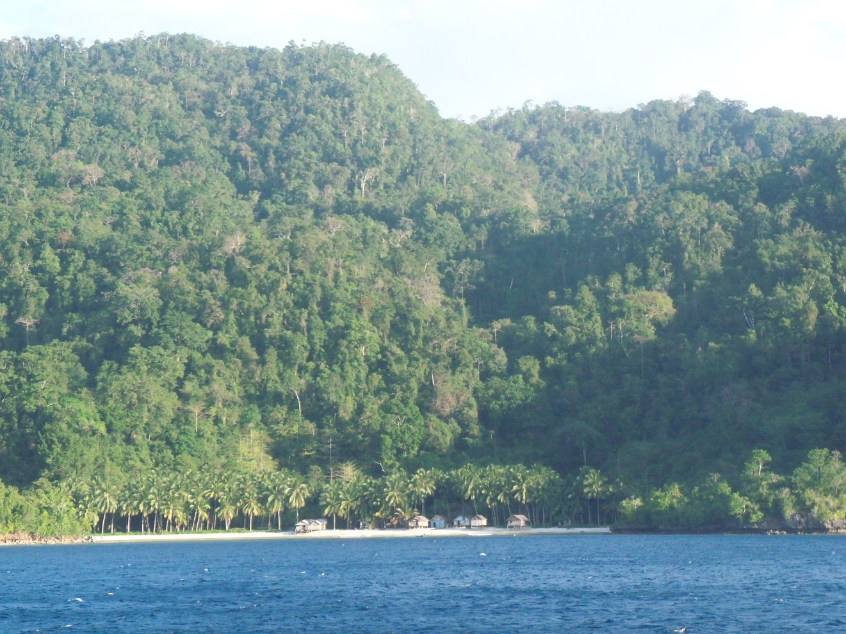
Figure 17.5
Tanjung peropa WR, habitat of anoa (Photo by Abdul Haris Mustari)

Slide 7
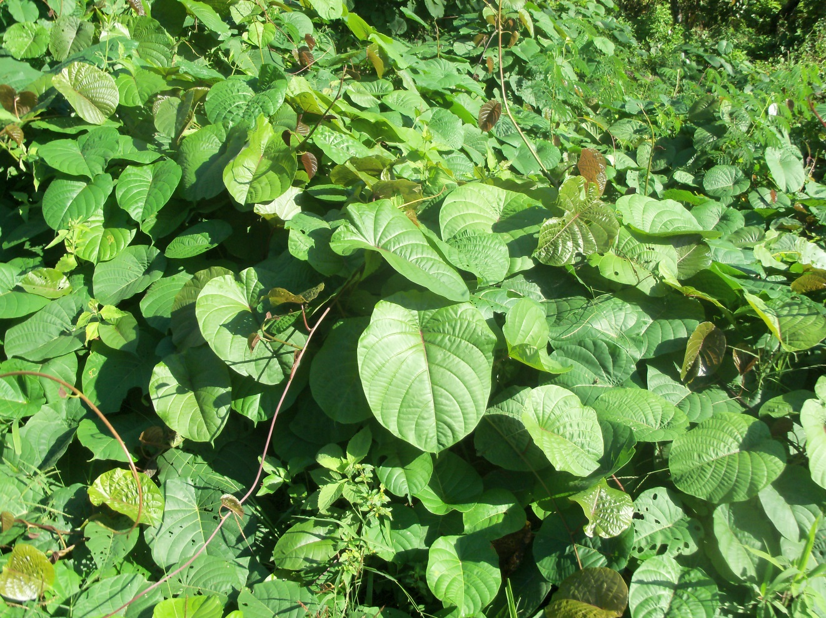
Figure 17.6
Merremia peltata, liana, amoang the frequently eaten by anoa in Sulawesi (Photo by Abdul Haris Mustari)

