Slide 1
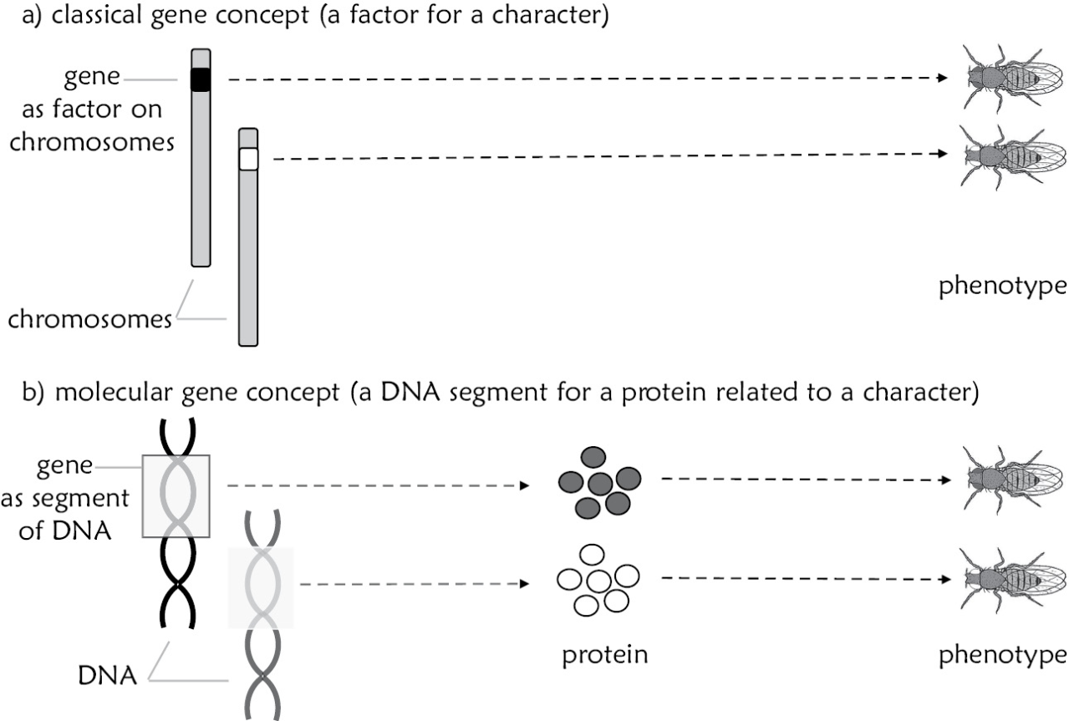
Figure 4.1

Slide 2
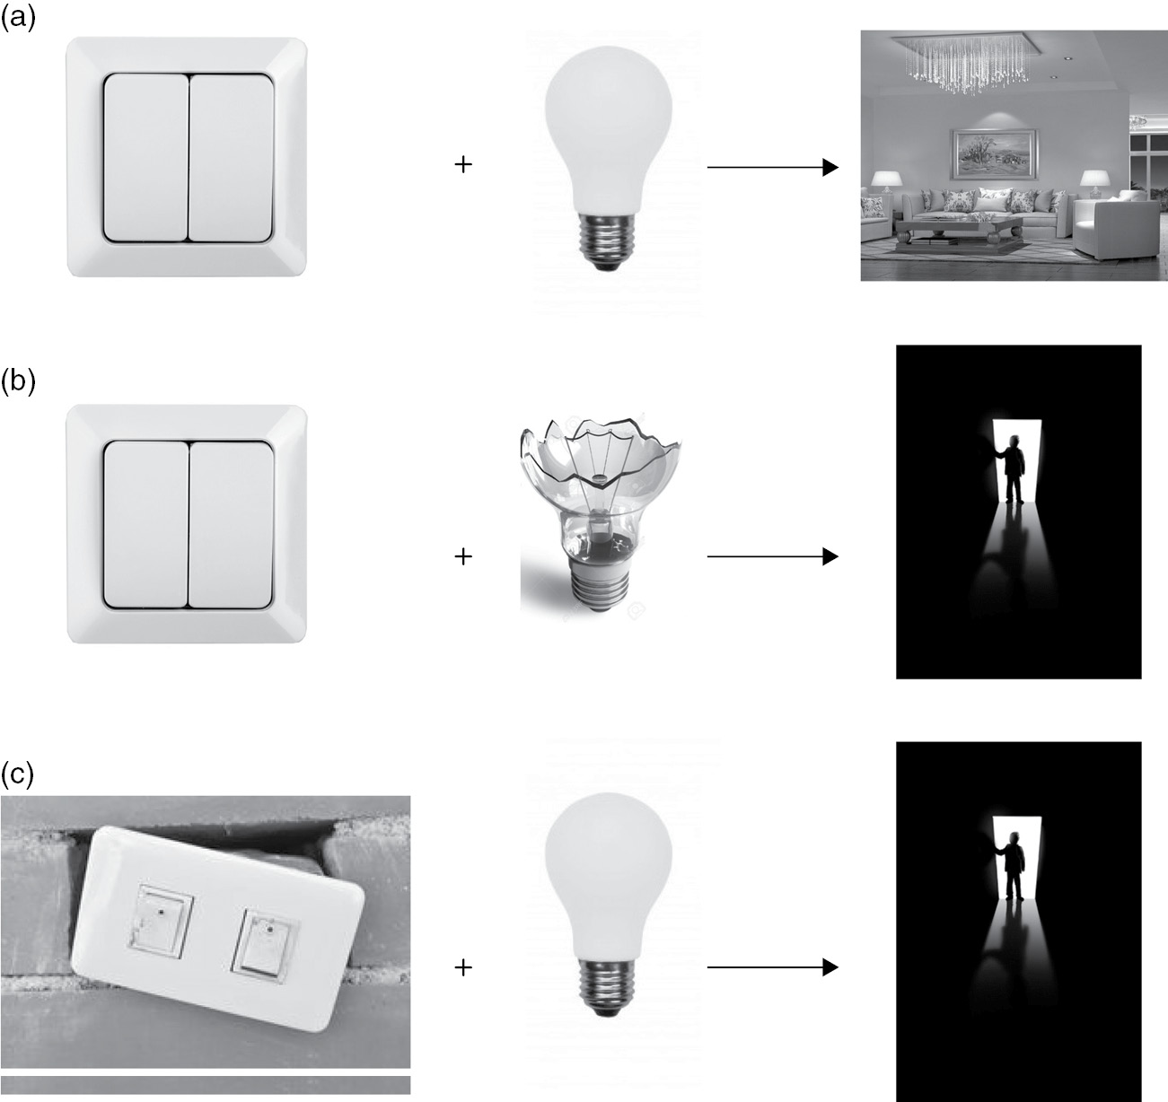
Figure 4.2

Slide 3
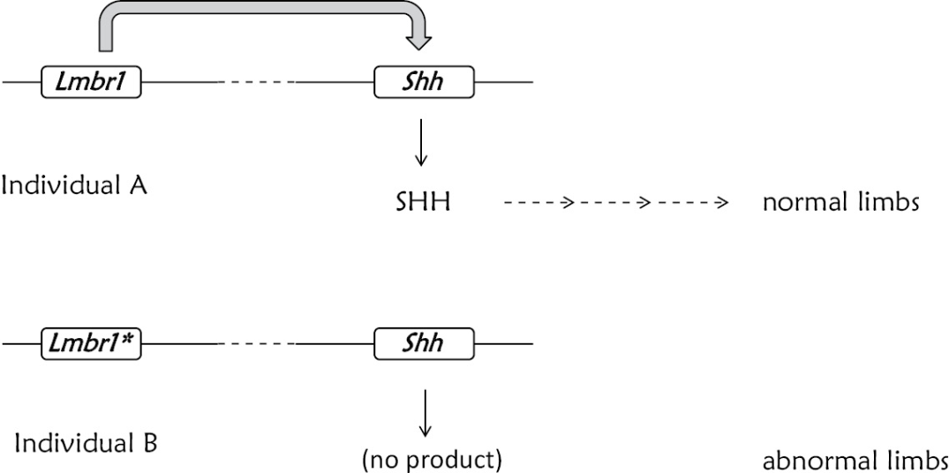
Figure 4.3

Slide 4
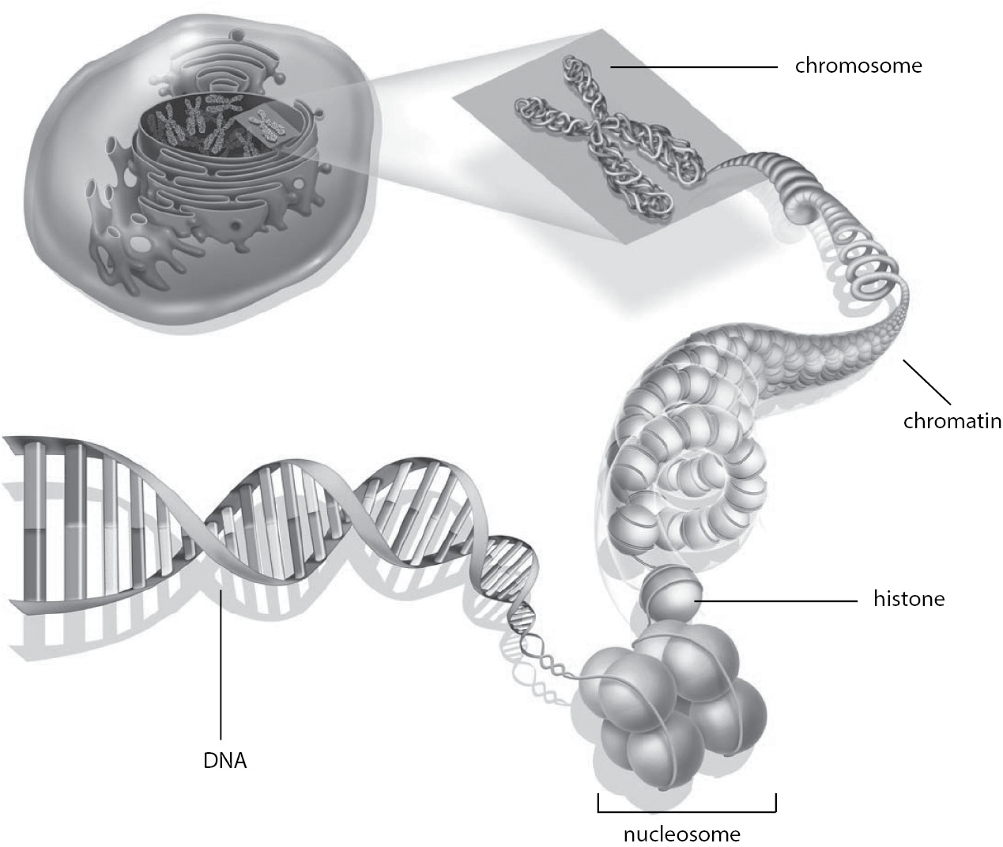
Figure 4.4

Slide 5
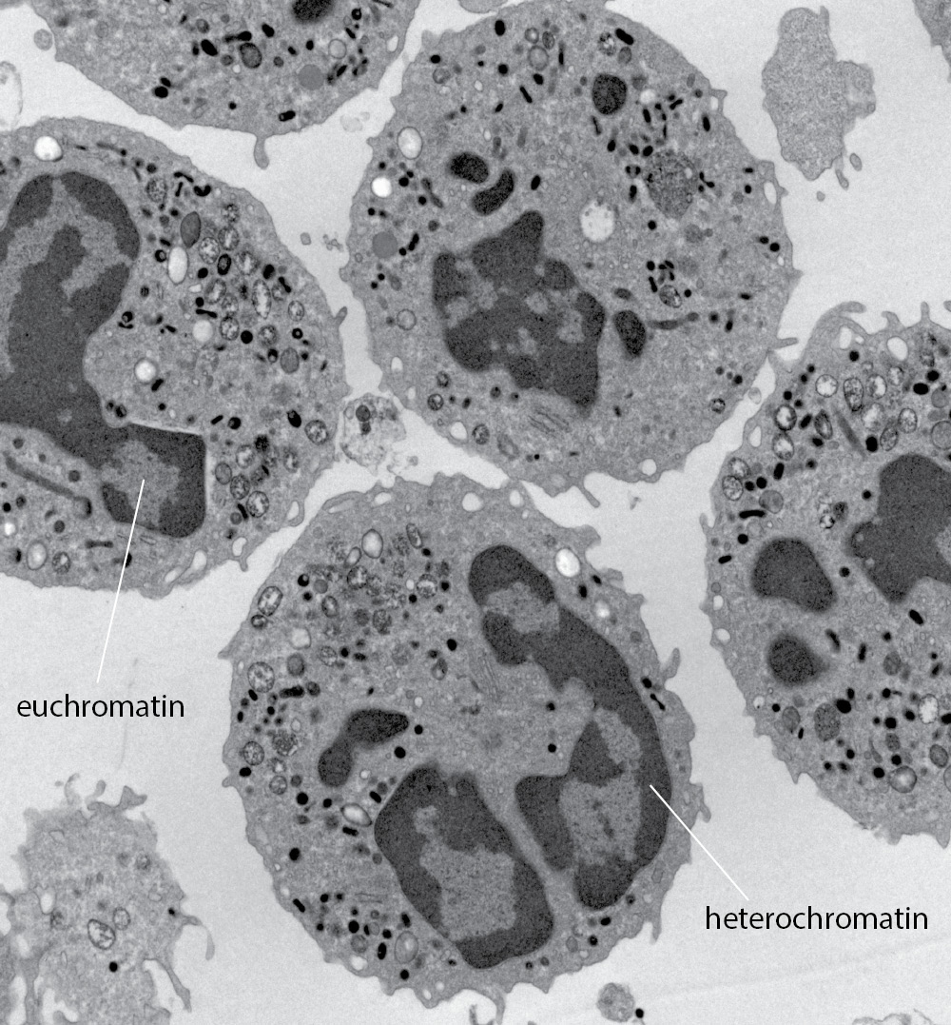
Figure 4.5

Slide 6
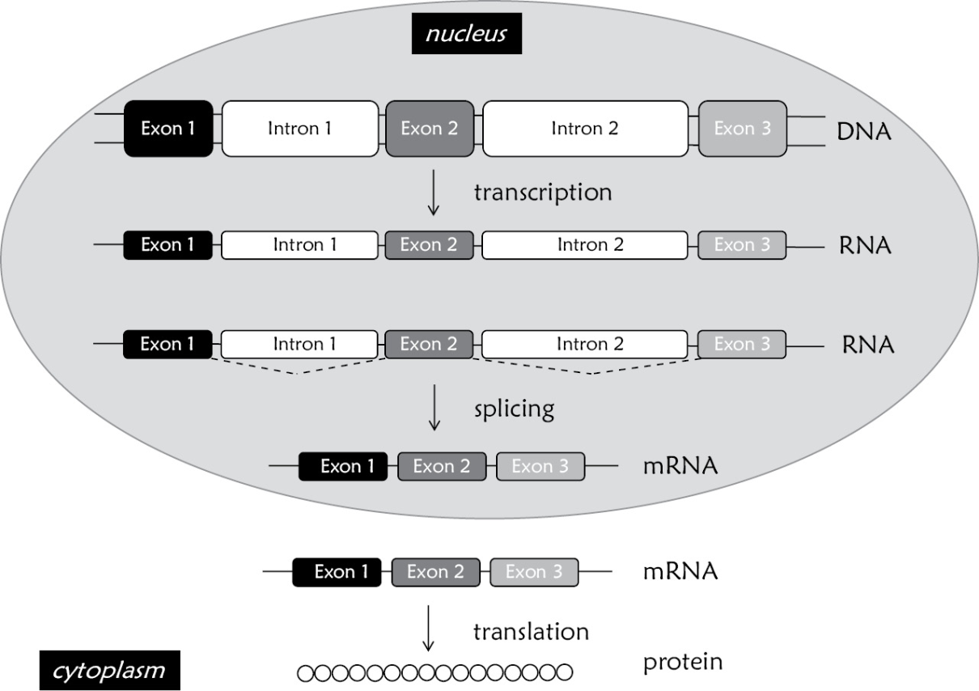
Figure 4.6

Slide 7
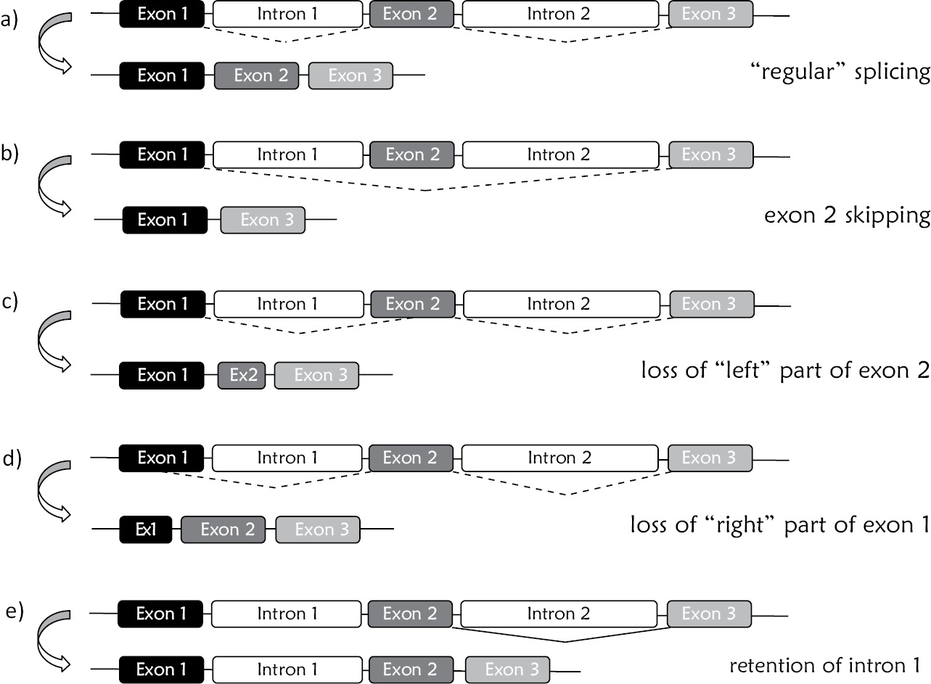
Figure 4.7

Slide 8
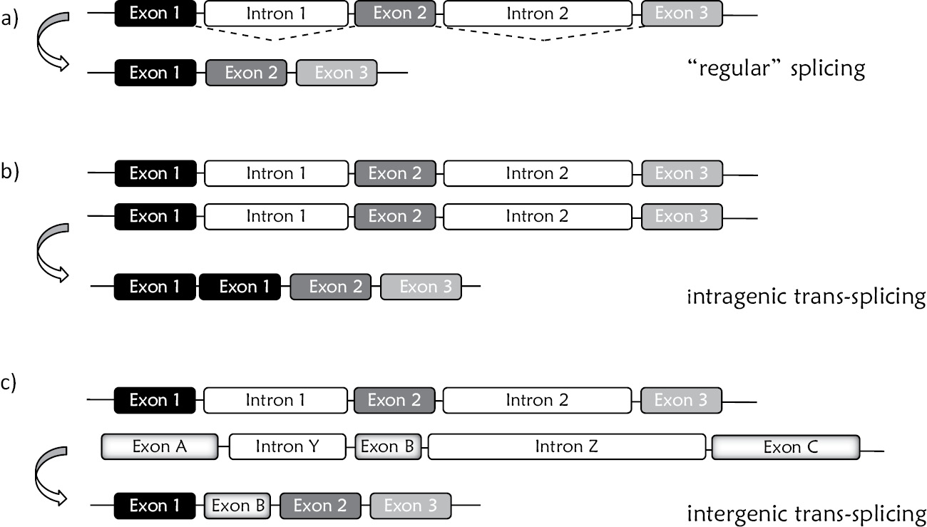
Figure 4.8

Slide 9
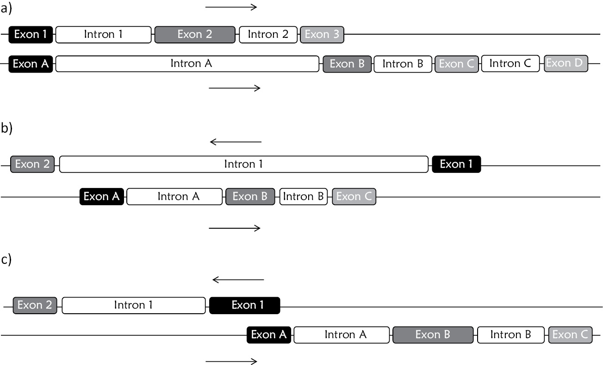
Figure 4.9

Slide 10
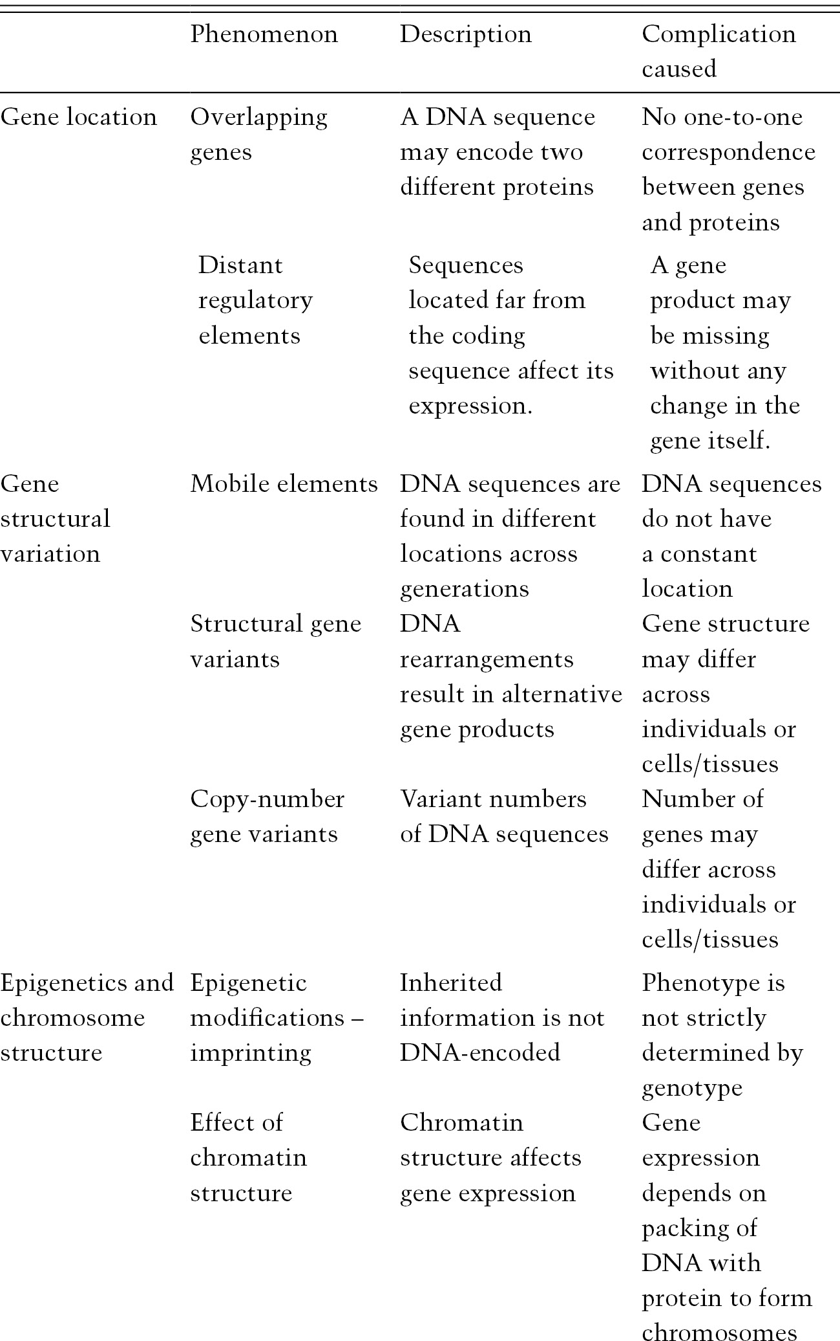
Table 4.1

Slide 11
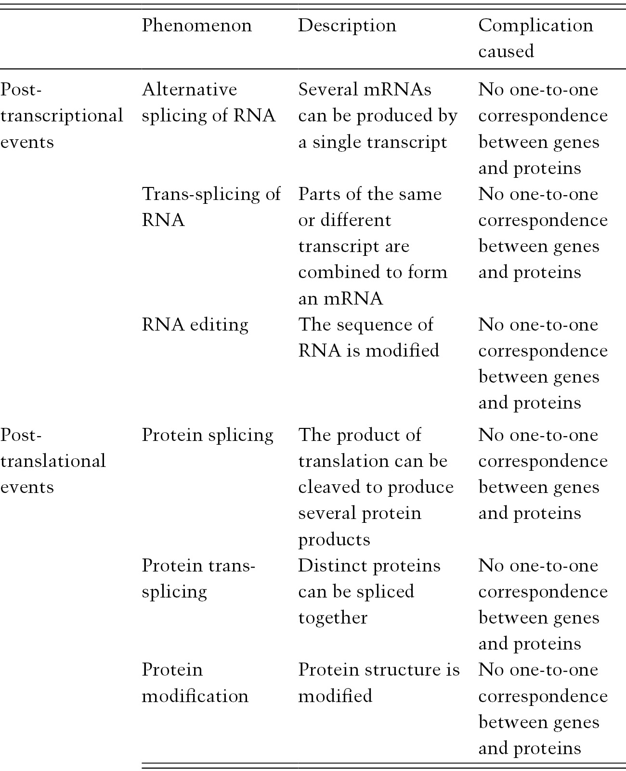
Table 4.1

Slide 12
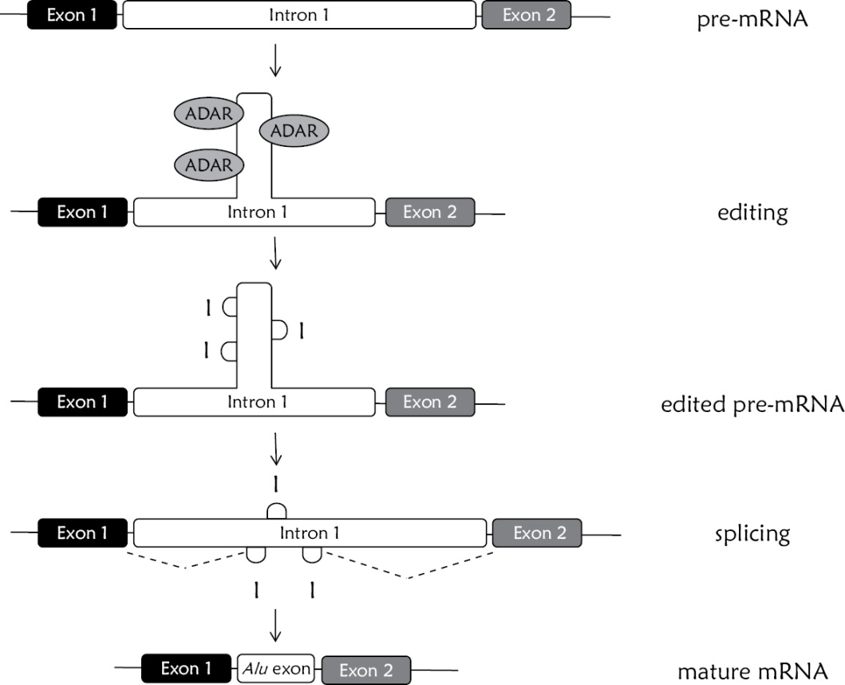
Figure 4.10

Slide 13
Figure 4.11
Due to copyright restrictions, this figure is not available online.

