Slide 1
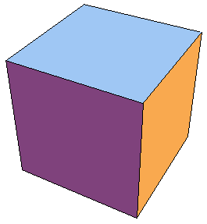
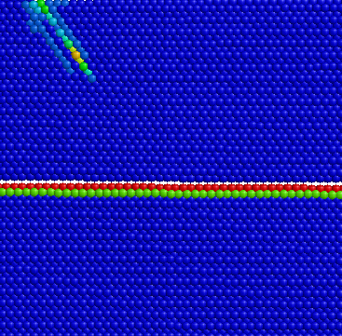
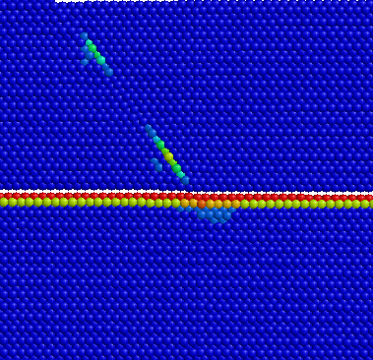
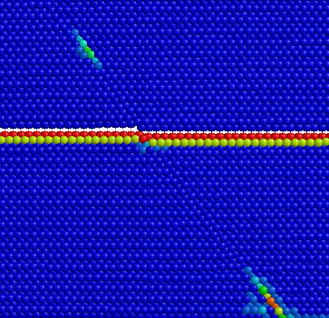
6
Ni
6
4
Ni
4
2
Cu
Uniaxial stress (GPa)
Biaxial stress (GPa)
0
2
-2
0
Cu
-4
-6
-2
Applied uniaxial strain (%)
Applied biaxial strain (%)
-8
-4
-4
-3
-2
-1
0
1
2
3
0
0.5
1
1.5
2
BD
γD
γD
Cu
Bγ
Ni
Bγ
Appl. biaxial strain: 0
Appl. biaxial strain: 1.4%
Appl. biaxial strain: 1.6%

Slide 2
3
3
σ₃₃₍₊₃₎
+3 face
+1 face
T
₁₃₍₊₃₎
₂₃₍₊₃₎
dx₃
∂∂
−1
₃₂₍₊₂₎
σ₂₂₍₋₂₎
₂₁
n
dx₃
₃₁₍₊₁₎
σ₂₂₍₊₂₎
−2
₁₂
σ₁₁₍₋₁₎
σ₁₁₍₊₁₎
O
₁₂₍₊₂₎
2
−1 face:
area dA₁
₂₁₍₊₁₎
₃₂
O
₃₁
1
∂∂
₁₃₍₋₃₎
−2 face:
area dA₂
dx₂
₂₃₍₋₃₎
dx₁
₂₃
₁₃
2
₃₃₍₋₃₎
dx₁
σ₃₃₍₋₃₎
dx₂
1
(a)
w
+2 face
(b)
−3 face:
area dA₃
−3
Notes:
2.33” x 5”, jpg.

Slide 3
2
u₁
ϕ₁
u₂
O
ϕ₂
1
Notes:
2” x 2.22”, jpg.

Slide 4
3
P
(x₁, x₂, x₃)
3'
θ
2'
O
1'
κ
2
1
ϕ
Notes:
2.13” x 3”, jpg.

Slide 5
3 = 3'
2'
45º
2
45º
1
1'
Notes:
2.91” x 2”, jpg.

Slide 6
u₂
2
(x₁, x₂, x₃)
u₁
f₂
k
h
−f₁
O
f₁
1
−f₂
Notes:
3.3” x 3”, jpg.

Slide 7
(010)
f₂ = βu₂
f₁ = βu₁
u₂
(100)
(000)
(100)
(001)
(000)
f₃ = βu₃
p
u₁
u₃
m
(a)
(b)

Slide 8
γ₁₂
σ₁₂
(a)
B
B
A
σ₁₂₍₀₎
γ₁₂
σ₁₂₍₀₎ + σ₁₂
(b)
B'
B'
A'
Notes:
4.11” x 5”, jpg.

Slide 9
Deformed
Deformed
σ_{i}
σ
σ
σ
S₁
S₂
σ
σ_{i}
S₃
Undeformed
(a)
(b)
Notes:
2.13” x 5”, tiff.

Slide 10
r
p₀
r₀
δv
R
P
Notes:
4.58” x 5”, tiff.

Slide 11
r
σ_{d}
Notes:
1.18” x 1.75”, tiff.

