Slide 1
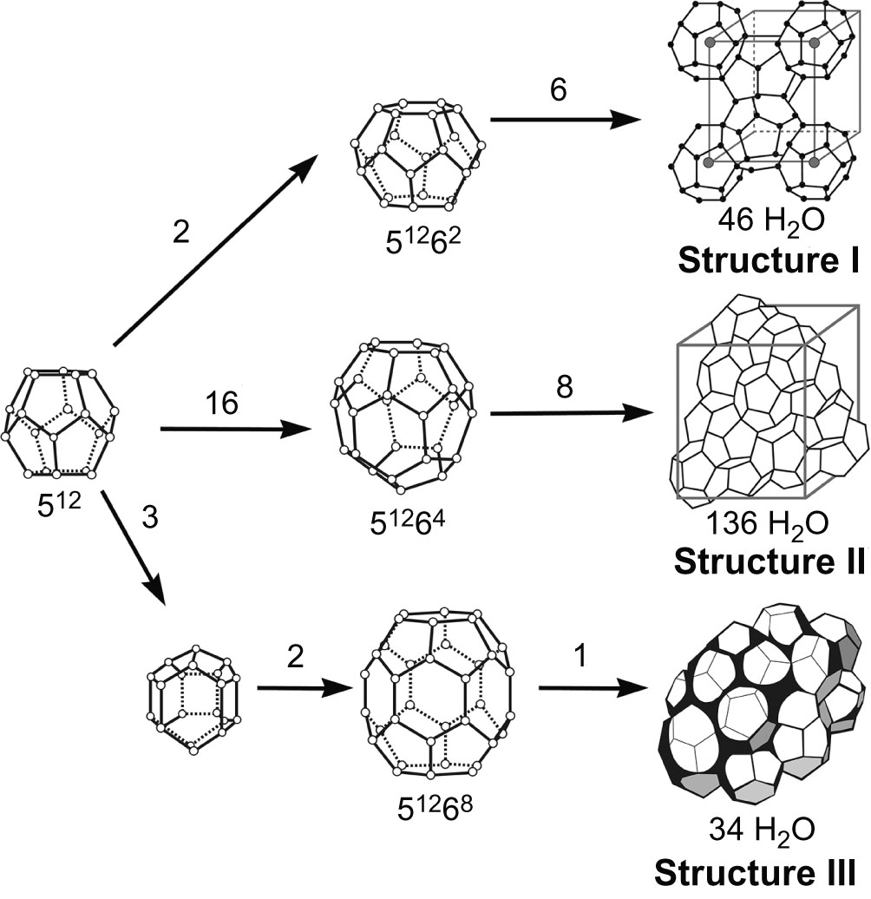
Fig12_01

Slide 2
Fig12_02

Slide 3
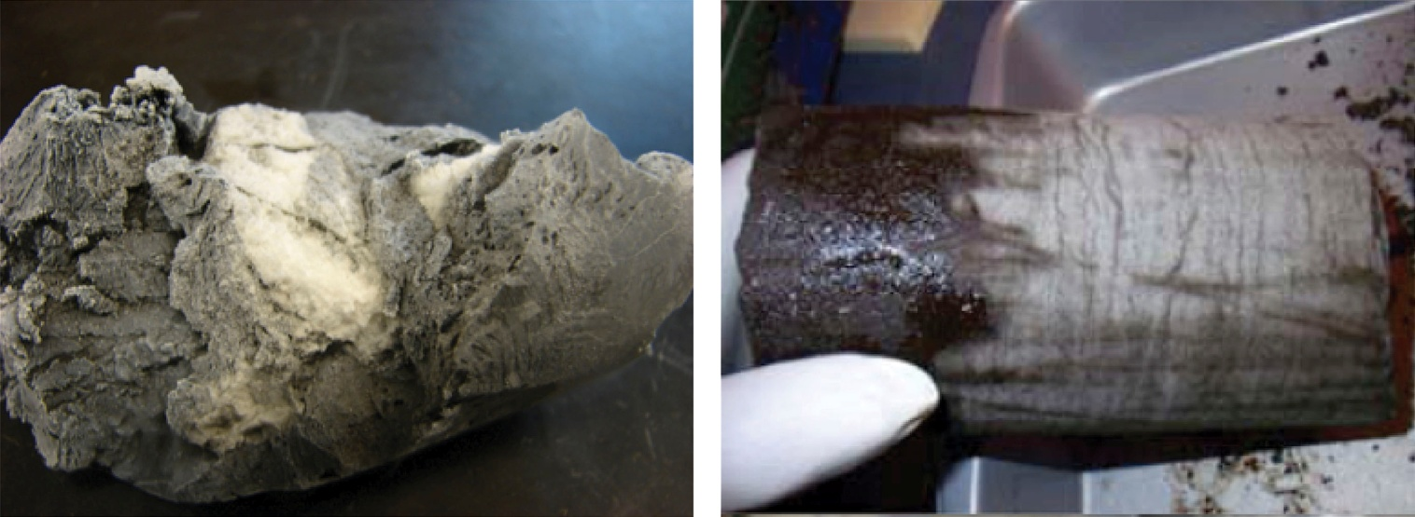
Fig12_03

Slide 4
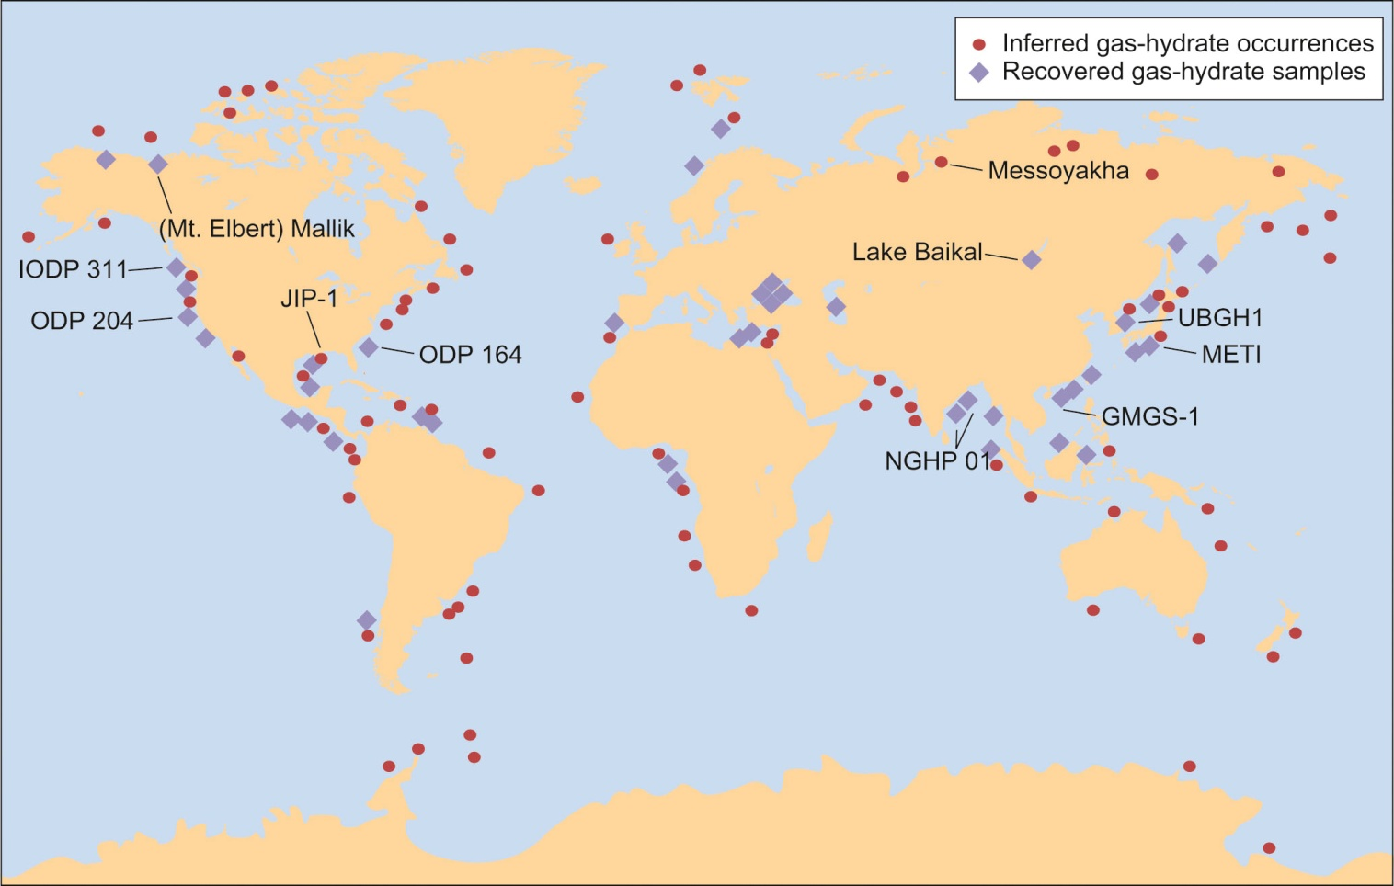
Fig12_04

Slide 5
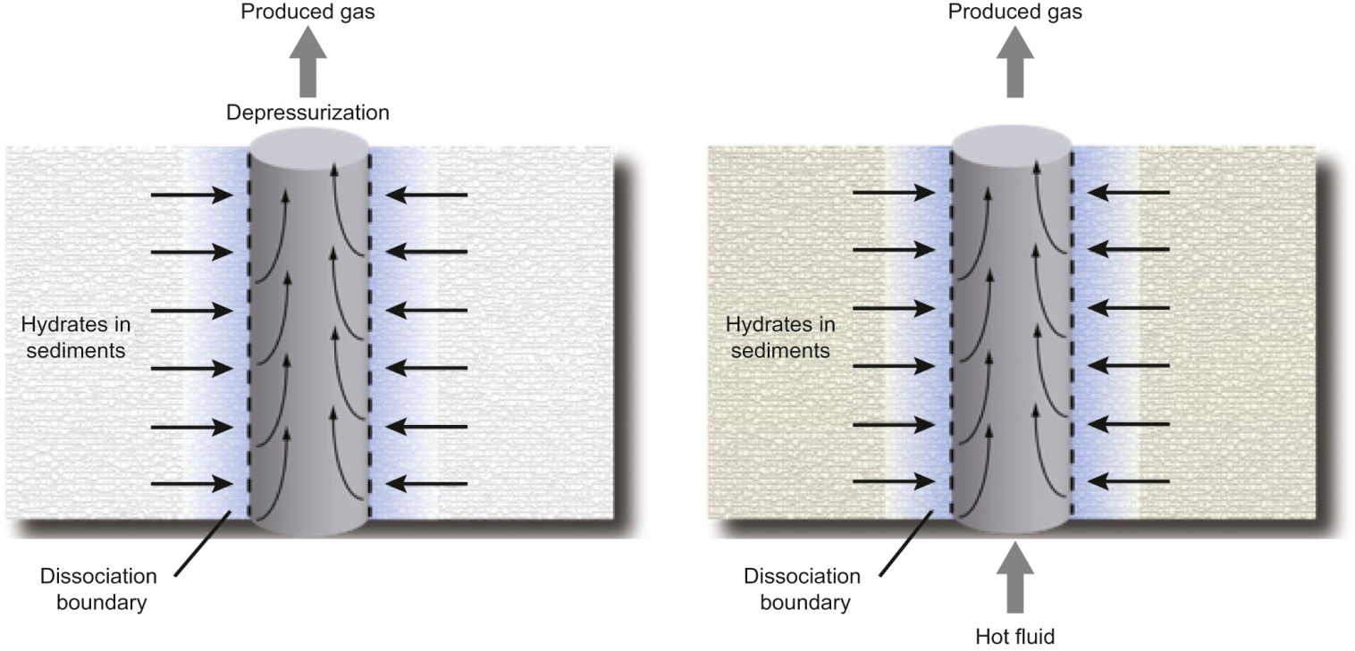
Fig12_05

