Slide 1
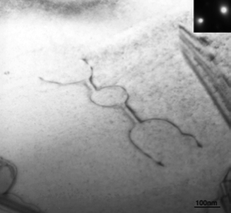
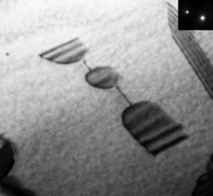
g = [002]
100 nm

Slide 2
Cl⁻
Na⁺
Na⁺
Cl⁻
Na⁺
Cl⁻
a
Cl⁻
Na⁺
Notes:
2.62” x 3”, tiff.

Slide 3
a
A
B
C
D
Notes:
1.37” x 4”, tiff.

Slide 4
a
∞
surface
c
A
B
∞
∞
Notes:
2.14” x 3”, tiff.

Slide 5
surface
surface
∞
∞
Notes:
2.03” x 3”, tiff.

Slide 6
(a)
(b)
Notes:
1.86” x 3”, tiff.

Slide 7
e/6
e/6
e/6
+e
e/6
e/6
e/6
Notes:
2.2” x 2”, tiff.

Slide 8
edge
face
corner
Notes:
2.56” x 3”, tiff.

Slide 9
A
B
(010)
Notes:
2.53” x 3”, tiff.

Slide 10
(a)
II
(b)
I
+
G
-
c
-
F
E
(010)
b
Notes:
3.15” x 5”, tiff.

Slide 11
-e/8
-e/8
q
-e/8
+e/8
Notes:
1.53” x 2”, tiff.

Slide 12
climb
projection
surface
Notes:
3.38” x 3”, tiff.

Slide 13
surface
jog
Notes:
1.43” x 3”, tiff.

Slide 14
surface
a
b
Notes:
1.3” x 3”, tiff.

Slide 15
C
D
[001]
B
E
a
(110)
Notes:
1.87” x 3”, tiff.

Slide 16
b
O
P
Q
Q
P
B
D
Notes:
2.23” x 3”, tiff.

Slide 17
H
F
D
E
G
I
J
C
K
A
B
L
(a)
(b)
M
N
[001]
R
O
P
Q
(c)
Notes:
4.26” x 4”, tiff.

Slide 18
neutral kink
(101)
ξ
b
Notes:
3.34” x 4”, tiff.

Slide 19
kink with (-) charge
jog pair created by anion vacancy
(101)
ξ
b
Notes:
2.81” x 4”, tiff.

Slide 20
q_{g}/2
(101)
q_{c}
b
q_{g}/2
Notes:
3.13” x 3”, tiff.

Slide 21
q_{c}
q_{g}
q_{c}
z
q_{g}
x
y
Notes:
2.98” x 3”, tiff.

Slide 22
b
-q_{g}/2
q_{g}/2
e/4
-e/4
Notes:
1.25” x 2”, tiff.

Slide 23
e/8
−e/4
A
e/4
−e/4
e/4
−e/8
b
O
O
O
B
e/4
Notes:
2.13” x 3”, tiff.

Slide 24
b
b
Neutral edge kinks
e/4
e/8
-e/8
-e/4
e/8
-e/4
e/4
e/8
Notes:
1.47” x 4”, tiff.

Slide 25
b₂
b₂
b₁
b₁
r
r'
(a)
(b)
Notes:
1.67” x 4”, tiff.

Slide 26
[001]
[110]
(110)
(100)
(a)
(b)
Notes:
2.04” x 4”, tiff.

Slide 27
y'
x'
y
z'
x
z
Notes:
3.13” x 3”, tiff.

Slide 28
b
surface
z
y
x
(a)
(b)
Notes:
2.07” x 4”, tiff.

