Slide 1
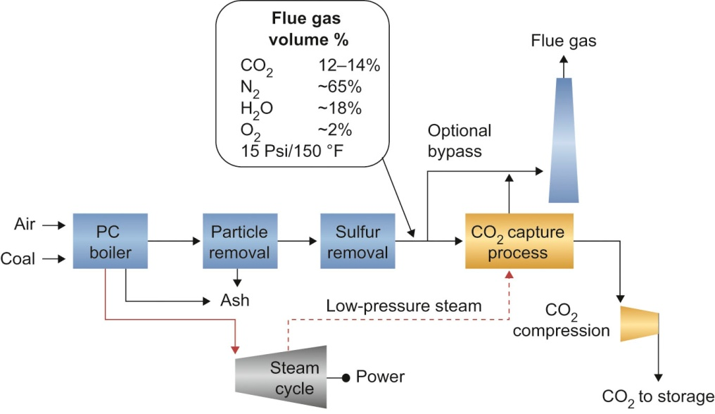
Fig10_01

Slide 2
Fig10_02

Slide 3
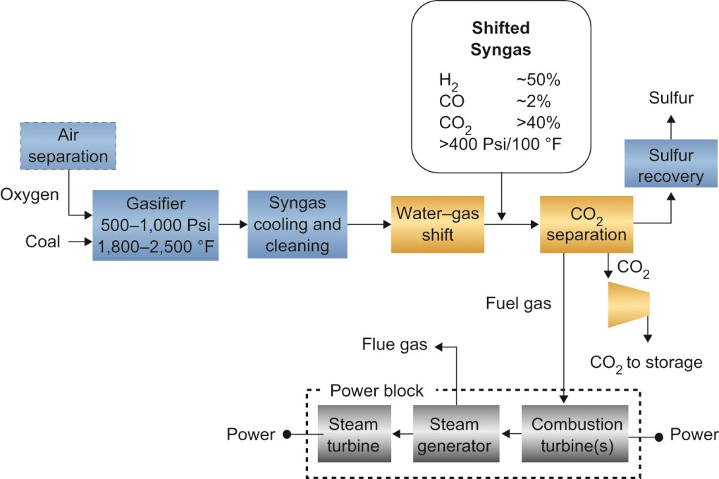
Fig10_03

Slide 4
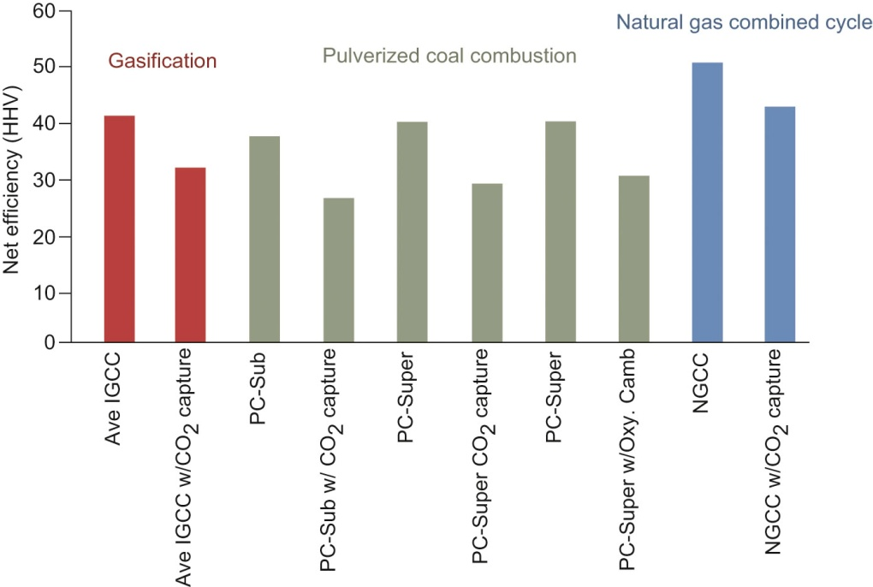
Fig10_04

